Slide 1
Lesson 11 databases
Textbook: Chapter 14

Slide 2
Objectives
LO11: Describe and explain operations within a relational database
Define a database and a database management system (DBMS) and describe the components of a DBMS.
Describe the architecture of a DBMS based on the ANSI/SPARC definition.
Define the three traditional database models: hierarchical, networking, and relational.
Describe the relational model and relations.
Understand operations on a relational database based on commands available in SQL.
Describe the steps in database design.
Define ERM and E-R diagrams and explain the entities and relationships in this model.
Define the hierarchical levels of normalization and understand the rationale for normalizing the relations.
List database types other than the relational model.

Slide 3
Contents
1. Introduction
2. Database architecture
3. Database model
4. Relational database model
5. Database design
6. Other database models

Slide 4
1- Introduction to Databases
Data storage traditionally used individual, unrelated files, sometimes called flat files. In the past, each application program in an organization used its own file.
Today, however, all of these flat files can be combined in a single entity, the database for the whole.
Although it is difficult to give a universally agreed definition of a database, we use the following common definition:
Database is a collection of related, logically coherent, data used by the application programs in an organization.

Slide 5
Introduction to Databases…
Storage of all related data is centralized in one location →
Advantage | Explanation
Less redundancy | (Ít dư thừa) Data are stored in fewer locations
Inconsistency avoidance | (nhất quán, không có mâu thuẫn) ability to be asserted together without contradiction
Efficiency | Data are stored in fewer locations
Data integrity | (toàn vẹn) the quality or state of being complete or undivided
Confidence | the storage of data is centralized in one location

Slide 6
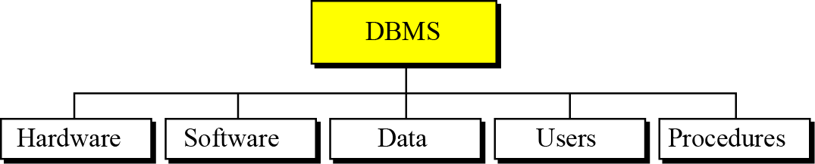
Introduction to Databases…
Database Management Systems (DBMS)
- A DBMS helps defining, creating, and maintaining a database.
DBMS also allows controlled access to data in the database.
A DBMS is a combination of five components: hardware, software, data, users, and procedures.
Figure 14.1 DBMS components

Slide 7
Introduction to Databases…
Database Management Systems (DBMS)
Component | Description
Hardware | The hardware is the physical computer system that allows access to data
Software | Actual program that allows users to access, maintain, and update data. In addition, the software controls which user can access which parts of the data in the database.
Data | Data in a database is stored physically on the storage devices. In a database, data is a separate entity from the software that accesses it. → Confident
User | We can divide users into two categories: end users and application programs.
Procedures | The last component of a DBMS is a set of procedures or rules that should be clearly defined and followed by the users of the database

Slide 8
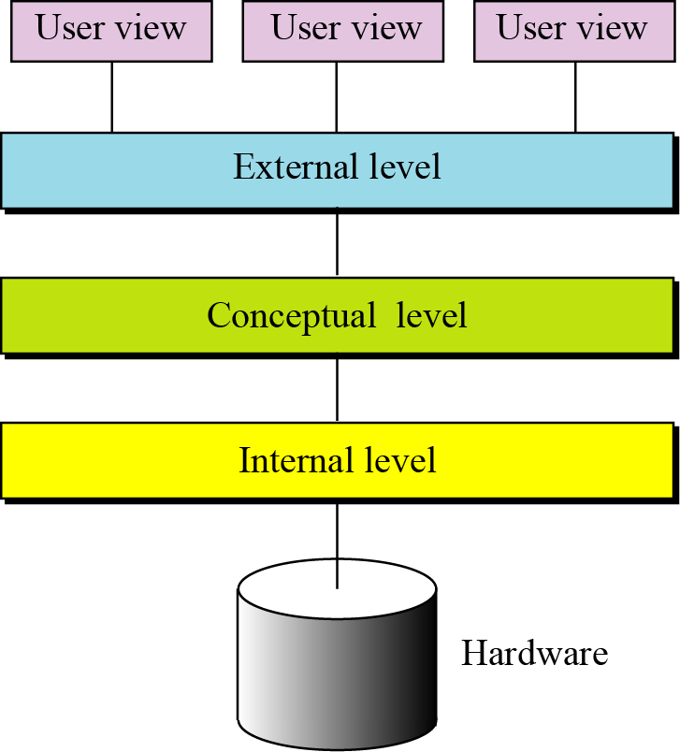
2- Database Architecture
The American National Standards Institute/Standards Planning and Requirements Committee (ANSI/SPARC) has established a three-level architecture for a DBMS: internal, conceptual, and external.
Figure 14.2 Database architecture
Application view
Conceptual view
Physical view

Slide 9
Database Architecture
Level | Description
Internal Level | determines where data is actually stored on the storage devices → This level deals with low-level access methods and how bytes are transferred to and from storage devices. In other words, the internal level interacts directly with the hardware.
Conceptual Level | The conceptual level defines the logical view of the data. The data model is defined on this level, and the main functions of the DBMS, such as queries, are also on this level. The DBMS changes the internal view of data to the external view that users need to see. The conceptual level is an intermediary and frees users from dealing with the internal level.
External Level | The external level interacts directly with the user (end users or application programs). It changes the data coming from the conceptual level to a format and view that is familiar to the users.

Slide 10
3- Database Model
A database model defines the logical design of data.
The model also describes the relationships between different parts of the data.
In the history of database design, three models have been in use: the hierarchical model, the network model, and the relational model.

Slide 11
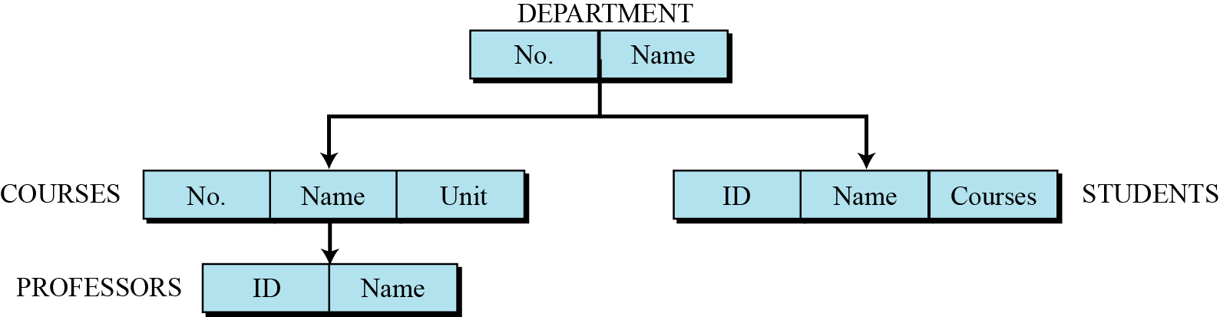
Database Model…
Hierarchical database model
In the hierarchical model, data is organized as an inverted tree (cây ngược). Each entity has only one parent but can have several children. At the top of the hierarchy, there is one entity, which is called the root.
Figure 14.3 An example of the hierarchical model

Slide 12
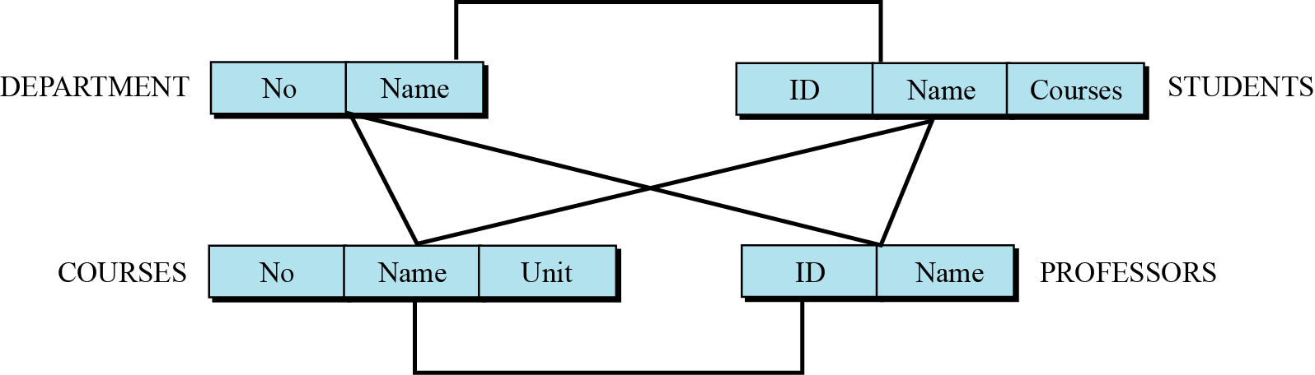
Database Model…
Network database model
In the network model, the entities are organized in a graph, in which some entities can be accessed through several paths.
Figure 14.4 An example of the network model representing a university

Slide 13
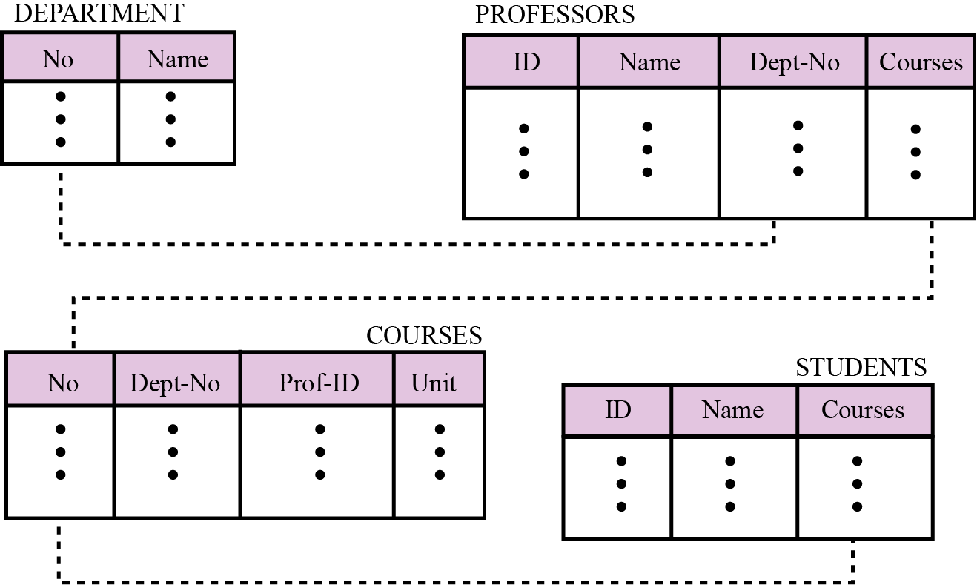
Database Model…
Relational database model
In the relational model, data is organized in two-dimensional tables called relations. The tables or relations are, however, related to each other.
Figure 14.5 An example of the relational model representing a university

Slide 14
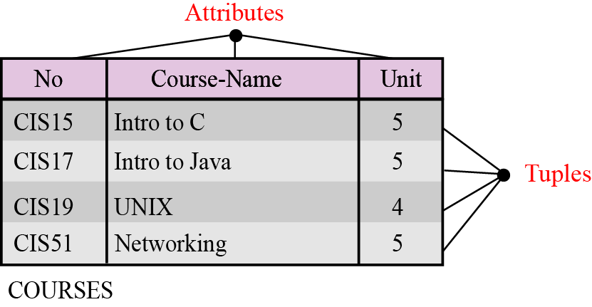
4- Relational Database Model
In the relational database management system (RDBMS), the data is represented as a set of relations.
Relations
Figure 14.6 An example of a relation
A relation, in appearance, is a two-dimensional table.
The RDBMS organizes the data so that its external view is a set of relations or tables.
The physical storage of the data is independent of the way in which the data is logically organized.

Slide 15
Relational Database Model
Relation’s features in an RDBMS:
Feature | Description
Name | A unique name
Attributes | Each column in a relation is called an attribute.
Tuples | Each row in a relation is called a tuple. A tuple defines a collection of attribute values. – Cardinality: number of tuple

Slide 16
Relational Database Model
Operations on Relations
9 operations are introduced:
(1) insert, ← thêm dòng
(2) delete, ← Xóa dòng
(3) update, ← Sửa dòng
(4) select, ← Lấy ra
(5) project, ← chiếu, che bớt
(6) join, ← Nối 2 bảng
(7) union, ← Hội 2 bảng
(8) intersection, ← Tìm phần giao của 2 bảng
(9) difference. ← Tìm phần hiệu của 2 bảng

Slide 17
Relational Database Model
Structured Query Language (SQL)
- SQL is the language standardized by the American National Standards Institute (ANSI) and the International Organization for Standardization (ISO) for use on relational databases.
It is a declarative rather than procedural language, which means that users declare what they want without having to write a step-by-step procedure.
The SQL language was first implemented by the Oracle Corporation in 1979, with various versions of SQL being released since then.

Slide 18
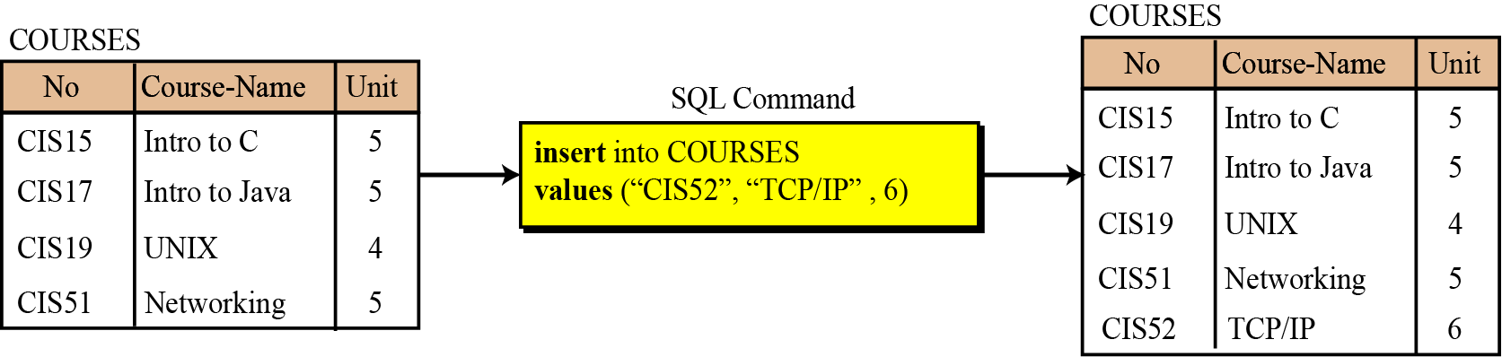
Relational Database Model
Operation: Insert
The insert operation is a unary operation
The operation inserts a new tuple into the relation.
Format: insert into relation_name values (…,…,)
Figure 14.7 An example of an insert operation

Slide 19
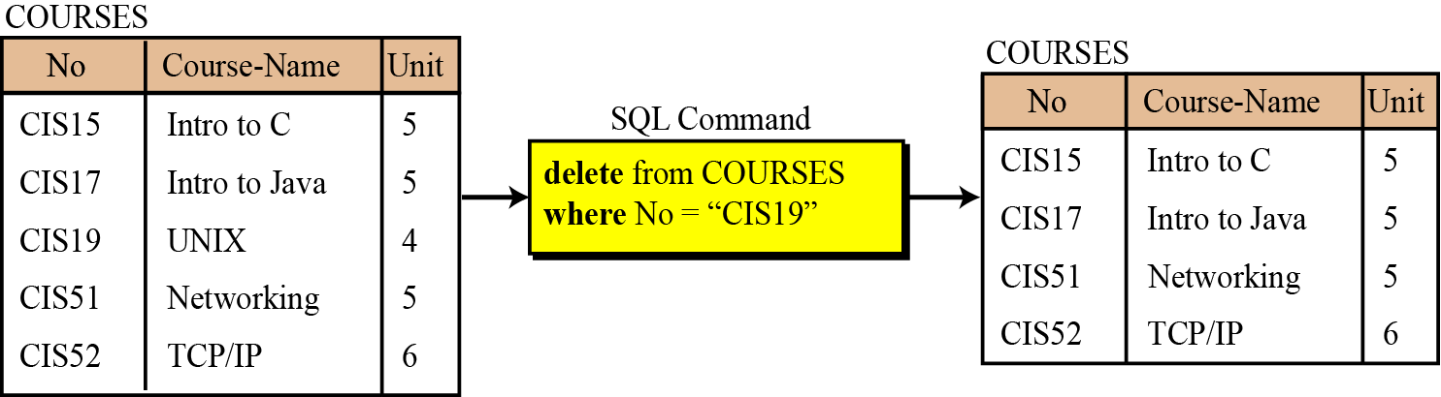
Relational Database Model
Operation: Delete
The delete operation is also a unary operation.
The operation deletes a tuple defined by a criterion from the relation.
Format: delete from relation_name
where criteria
Figure 14.8 An example of a delete operation

Slide 20
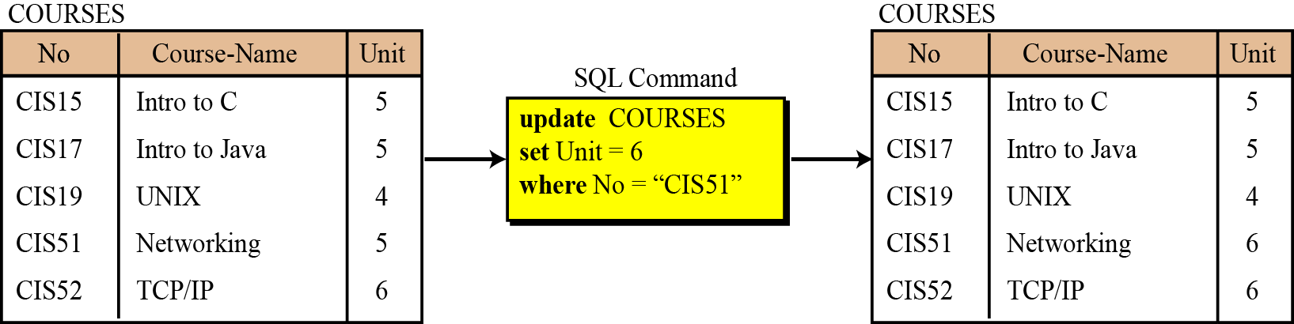
Relational Database Model
Operation: Update
A unary operation that is applied to a single relation.
The operation changes the value of some attributes of a tuple.
Format: Update relation_name
Set att1 = value1, att2 = value2, …
where criteria
Figure 14.9 An example of an update operation

Slide 21
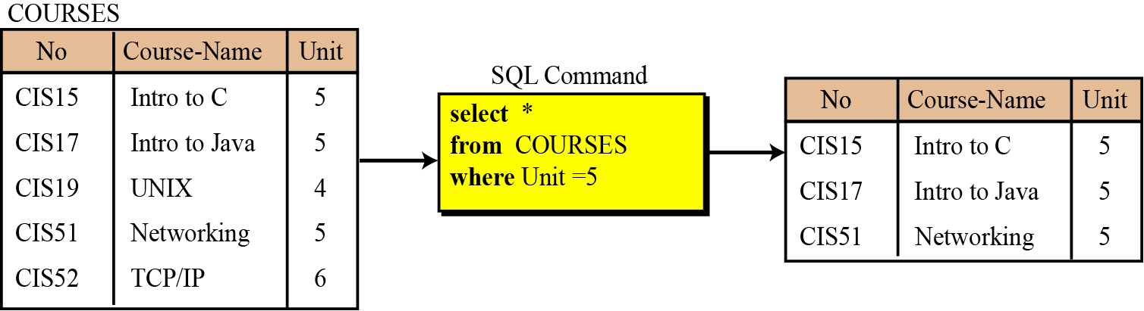
Relational Database Model
Operation: Select
-The select operation is a unary operation.
-The tuples (rows) in the resulting relation are a subset of the tuples in the original relation.
Format: select * from relation_name
where criteria
Figure 14.10 An example of a select operation

Slide 22
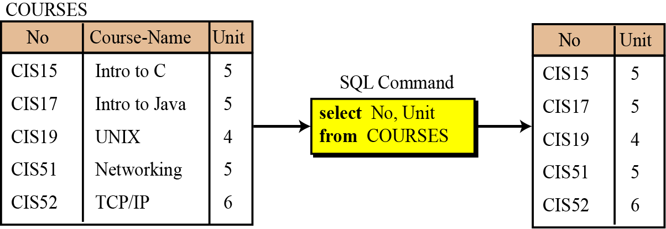
Relational Database Model
Operation: Project
- The project operation is also a unary operation,
Result: another relation having attributes is a subset of the attributes in the original relation.
Format: select att_list
from relation_name
Figure 14.11 An example of a project operation

Slide 23
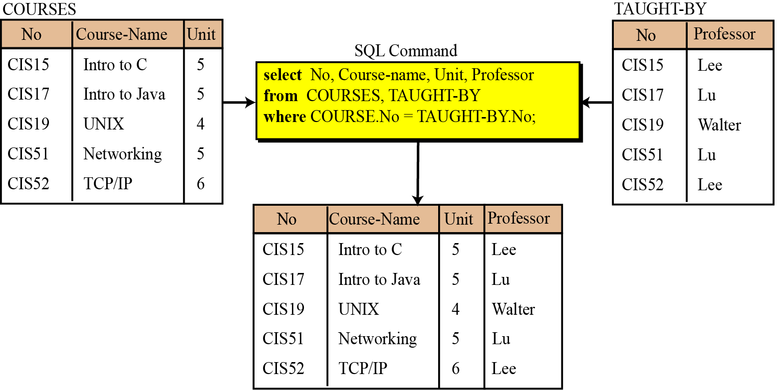
Relational Database Model
Operation: Join
The join operation is a binary operation that combines two relations on common attributes.
Figure 14.12 An example of a join operation

Slide 24
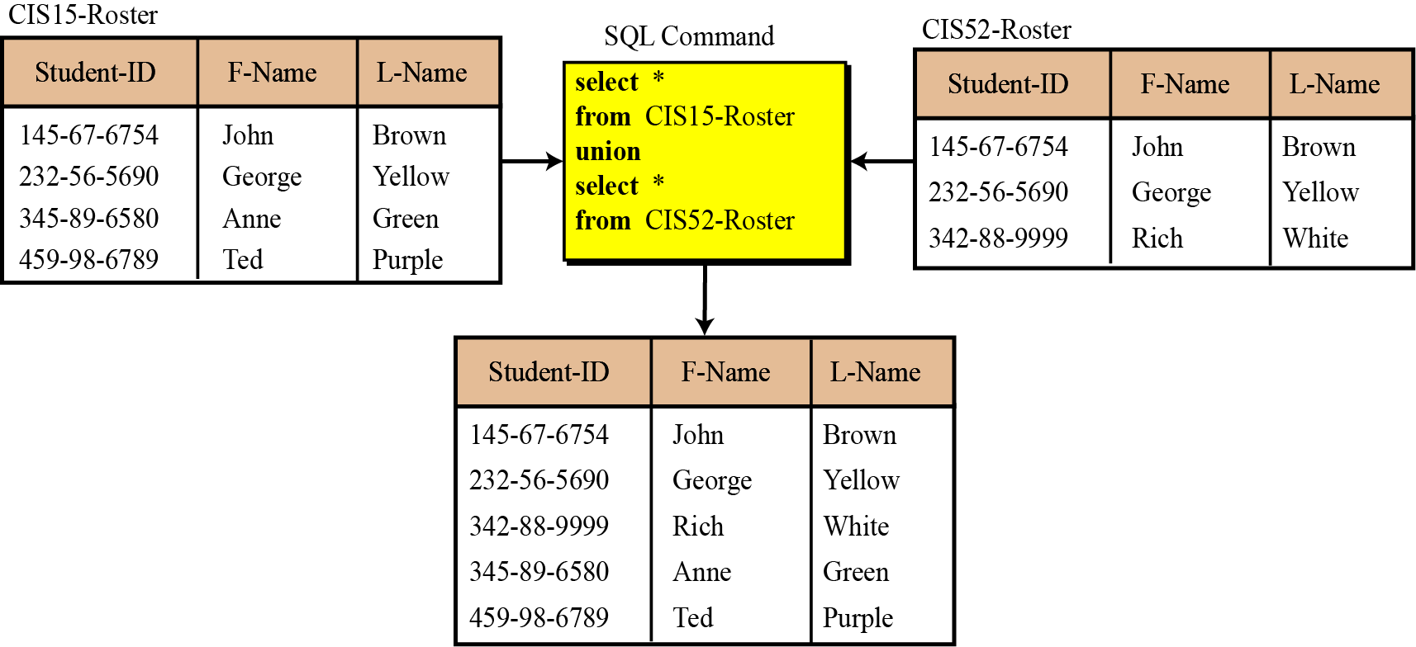
Relational Database Model
Operation: Union
The union operation takes two relations with the same set of attributes.
Figure 14.13 An example of a union operation

Slide 25
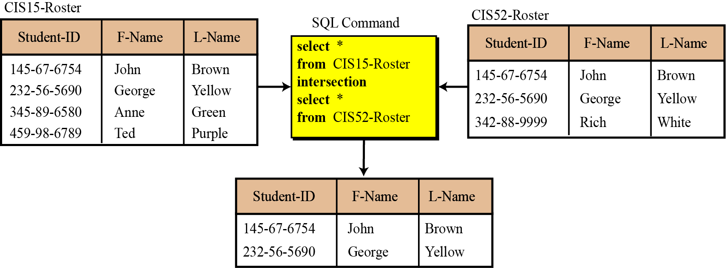
Relational Database Model
Operation: Intersection
The intersection operation takes two relations and creates a new relation, which is the intersection of the two.
Figure 14.14 An example of an intersection operation

Slide 26
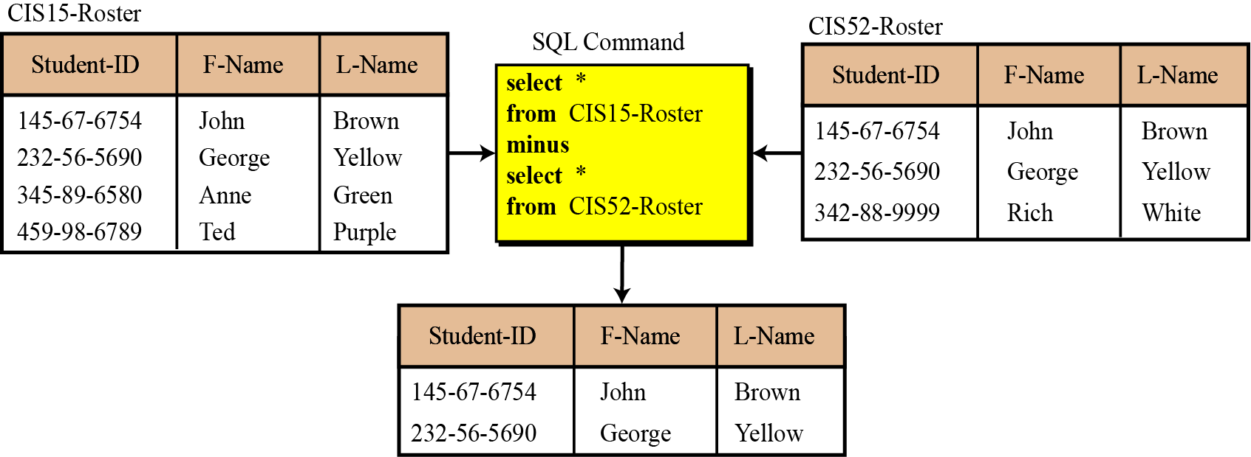
Relational Database Model
Operation: Difference
The difference operation is applied to two relations with the same attributes. The tuples in the resulting relation are those that are in the first relation but not the second.
Figure 14.15 An example of a difference operation
Select * from RELATION1
Minus
Select * from RELATION2

Slide 27
5- Database Design
The design of any database is a lengthy and involved task that can only be done through a step-by-step process.
The first step normally involves interviewing potential users of the database.
The second step is to build an entity-relationship model (ERM) that defines the entities, the attributes of those entities, and the relationship between those entities.

Slide 28
Database Design
Entity-relationship models (ERM)
In this step, the database designer creates an entity-relationship (E-R) diagram (ERD) to show the entities for which information needs to be stored and the relationship between those entities. E-R diagrams uses several geometric shapes, but we use only a few of them here:
Rectangles represent entity sets.
Ellipses represent attributes.
Diamonds represent relationship sets.
Lines link attributes to entity sets and link entity sets to relationships sets.

Slide 29
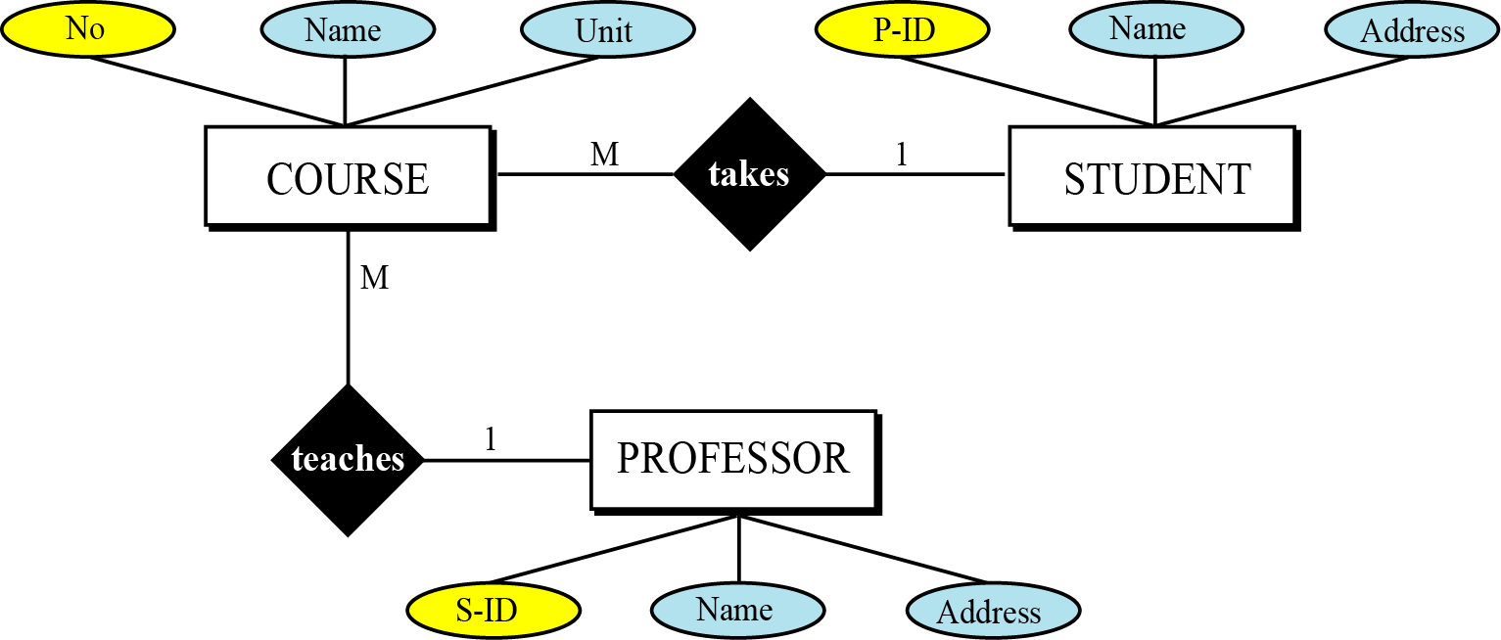
Database Design
Entity-relationship models (ERM) – ERD demo.
Figure 14.16 Entities, attributes, and relationships in an E-R diagram
entity
relationship
Key attribute
attribute
Key attribute: data for unique indentifying → A set is a group of different elements

Slide 30
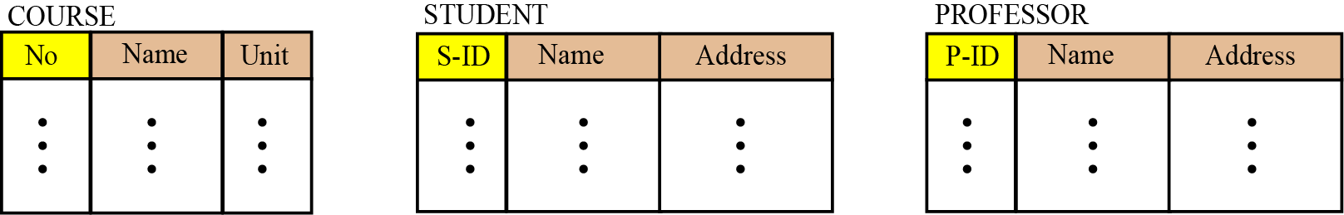
Database Design
From ER Diagrams to Relations
- After the E-R diagram has been finalized, relations (tables) in the relational database can be created in which there are n columns related to the n attributes defined for that set.
- Each entity set should have one column for the key.
Figure 14.17 Relations for entity set in Figure 14.16

Slide 31
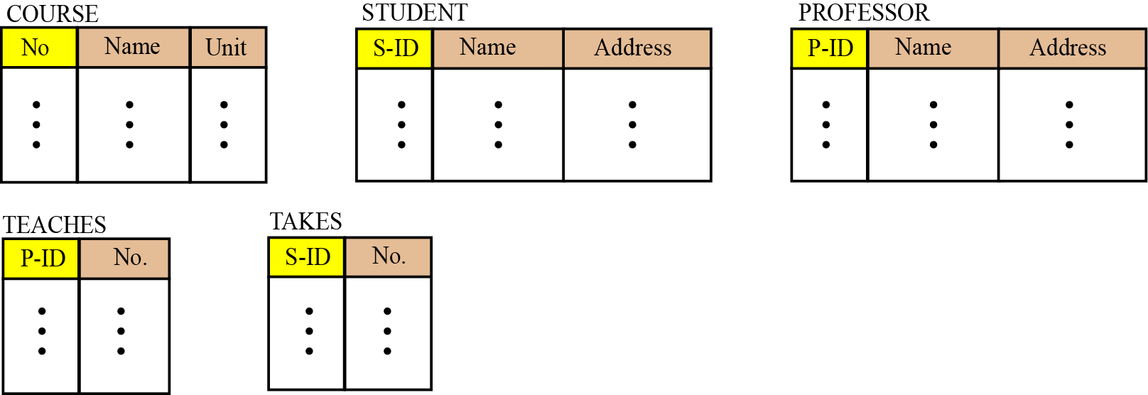
Database Design
From ER Diagrams to Relations
There are two relationship sets (teaches and takes) in Figure 14.16, teaches and takes, each connected to two entity sets. The relations for these relationship sets are added to the previous relations for the entity set and shown in Figure 14.18.
Figure 14.18 Relations for E-R diagram in Figure 14.16

Slide 32
Database Design
Normalization
What? Normalization is the process by which a given set of relations are transformed to a new set of relations with a more solid structure.
Why? Normalization is needed to allow any relation in the database to be represented, to allow a languages like SQL to use powerful retrieval operations composed of atomic operations, to remove anomalies in insertion, deletion, and updating, and reduce the need for restructuring the database as new data type are added.
How? The normalization process defines a set of hierarchical normal forms (NFs). Several normal forms have been proposed, including 1NF, 2NF, 3NF, BCNF (Boyce-Codd Normal Form), 4NF, PJNF (Projection/Joint Normal Form), 5NF, and so on. structure.

Slide 33
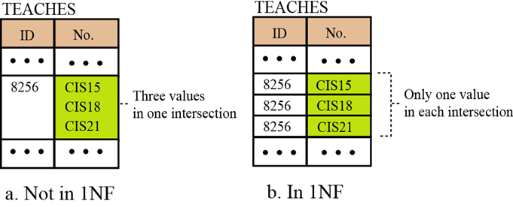
Database Design
Normalization: First normal form (1NF)
When we transform entities or relationships into tabular relations, there may be some relations in which there are more values in the intersection of a row or column.
Figure 14.19 An example of 1NF
1NF: There is no multi-values cell

Slide 34
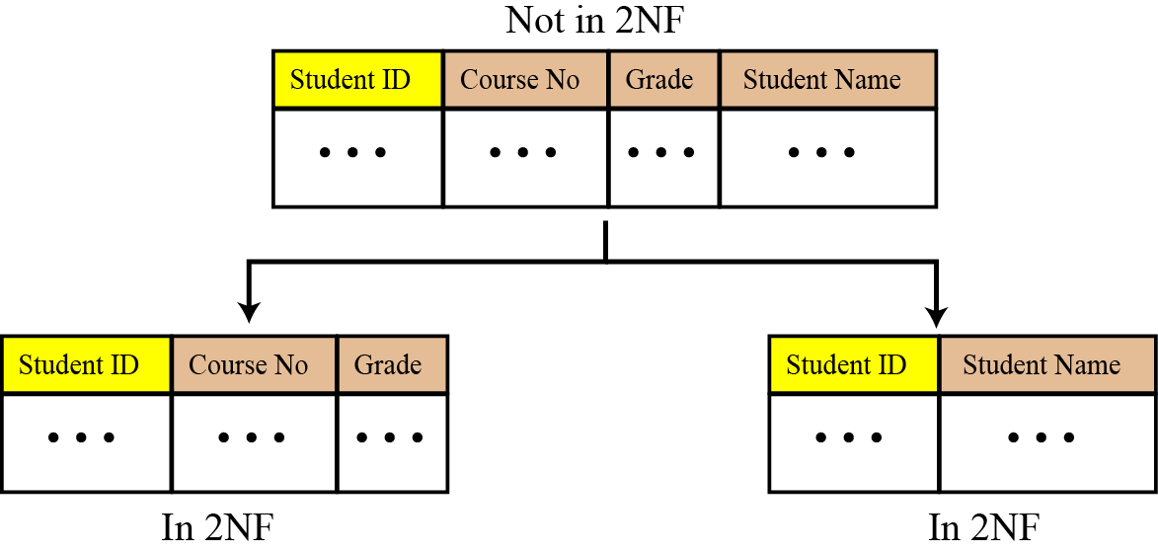
Database Design
Normalization: Second normal form (2NF)
In each relation we need to have a key (called a primary key) on which all other attributes (column values) needs to depend. For example, if the ID of a student is given, it should be possible to find the student’s name.
Figure 14.20 An example of 2NF
2NF: All non-key attributes depend on key attribute.

Slide 35
Database Design
Normalization: Other normal form
Other normal forms use more complicated dependencies among attributes. We leave these dependencies to books dedicated to the discussion of database topics ← The DBI subject

Slide 36
6- Other Database Models
The relational database is not the only database model in use today. Two other common models are introduced:
Distributed databases.
Object-oriented databases.

Slide 37
Other Database Models
Distributed databases
The distributed database model is based on the relational model.
The data is stored on several computers that communicate through the Internet or a private wide area network.
Each computer (or site) maintains either part of the database or the whole database.

Slide 38
Other Database Models
Distributed databases: Forms
Fragmented distributed databases:
Data is localized, access is mostly local, but occasionally global.
Replicated distributed databases:
Each site holds an exact replica of another site.
Any modification to data stored in one site is repeated exactly at every site.
The reason for having such a database is security and availability. If the system at one site fails, users at the site can access data at another site.

Slide 39
Other Database Models
Object-oriented databases (OOD)
An OOD tries to keep the advantages of the relational model and at the same time allows applications to access structured data.
In an OOD, objects and their relations are defined (attributes are fields).
The query language normally used for objected-oriented databases is XML (Extensible Markup Language). XML was originally designed to add markup information to text documents, but it has also found its application as a query language in databases. XML can represent data with nested structure.

Slide 40
Objectives- Revisited
LO11: Describe and explain operations within a relational database
Define a database and a database management system (DBMS) and describe the components of a DBMS.
Describe the architecture of a DBMS based on the ANSI/SPARC definition.
Define the three traditional database models: hierarchical, networking, and relational.
Describe the relational model and relations.
Understand operations on a relational database based on commands available in SQL.
Describe the steps in database design.
Define ERM and E-R diagrams and explain the entities and relationships in this model.
Define the hierarchical levels of normalization and understand the rationale for normalizing the relations.
List database types other than the relational model.

Slide 41
Exercises- Use your notebook
Write your reviews to your notebook.
More pages More Scores

Slide 42
Thanks for Following this lesson

