Slide 1
RELATIONAL DATA MODEL

Slide 2
Objectives
Understand concepts of:
Data model
Relational data model
Relational algebra
Constraints in relational data model

Slide 3
2.1 An Overview of Data Models
Data model, a notation for describing data or information
The description generally consists of three parts:
Structure of data
Operations on data
Constraints

Slide 4
Important Data Models
The relational model, including object-relational extensions
The semi-structured data model, including XML and related standards

Slide 5
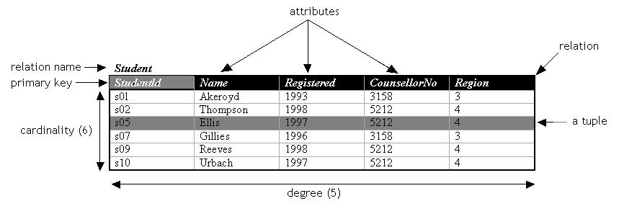
The Relational Model in Brief
The relational model is based on tables
Relation’s name
Attributes (column headers)
Tuples (rows)
The operations associated with the relational model form the relational algebra
The constraints on relational model define limitations on what the data can be on tables

Slide 6
The Semi-structured Model in Brief
Semi-structured data resembles trees or graphs rather than tables or arrays
XML, a way to represent data by hierarchically nested tagged elements
Operations involve following paths in tree from an element to one or more of its nested sub elements, and so on
Constraints involve the data type of values associated with a nested tag

Slide 7
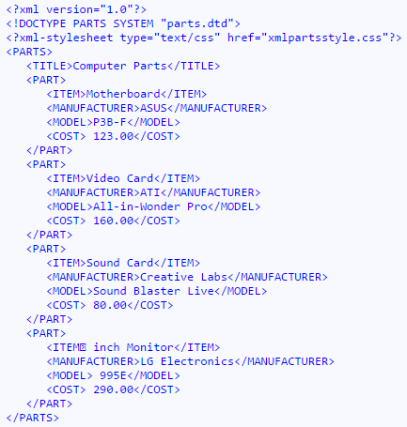
XML file example

Slide 8
2.2 Basics of the Relational Model
The relational model represents data as a 2-dimensional table called a relation
Suppose relation named as Movies
Each row represents a movie
Each column represents a property of movie
title | Year | length | genre
Gone With the Wind | 1939 | 231 | Drama
Star Wars | 1977 | 124 | Scifi
Wayne’s World | 1992 | 95 | Comedy
Figure 2.3: The relation Movies

Slide 9
2.2 Basics of Relational Model
Attributes
a columns of a relation
appears at the top of the columns
title | year | length | genre
Gone With the Wind | 1939 | 231 | Drama
Star Wars | 1977 | 124 | Scifi
Wayne’s World | 1992 | 95 | Comedy
Figure 2.3: The relation Movies

Slide 10
2.2 Basics of Relational Model
Relation schema
Relation’s name
Set of attributes for this relation
I.e. Movies (title, year, length, genre)
Database schema
Set of schemas for the relations of a database

Slide 11
2.2 Basics of Relational Model
Tuples
The rows of a relation, excepted the header row
A tuple has one component for each attribute of the relation
We shall use the order in which the attributes were listed in relation schema
Ex: (Gone With the Wind,1939,231,Drama)
title | year | length | genre
Gone With the Wind | 1939 | 231 | Drama
Star Wars | 1977 | 124 | Scifi
Wayne’s World | 1992 | 95 | Comedy

Slide 12
2.2 Basics of Relational Model
Domains
Each component of each tuple must be elementary type such as INTEGER or STRING
It is not permitted for a value to be a record structure, set, list, array, or any type that can have its values broken into smaller components
Domain is a particular elementary type of attribute
The components of any tuple must have a value that belongs to the domain of the corresponding column
Example in figure 2.3
Movies(title:string,year:integer,length:integer,genre:string)

Slide 13
2.2 Basics of Relational Model
Equivalent Representation of a Relation
Relations are sets of tuples, not lists of tuples
The order in which the tuples of a relation are presented is not important
Reorder the attributes ⇒ reorder the columns ⇒ reorder the components of tuples
year | genre | title | length
1939 | Drama | Star Wars | 124
1977 | Scifi | Wayne’s World | 95
1992 | Comedy | Gone With the Wind | 231
Figure 2.4: Another presentation of Movies

Slide 14
2.2 Basics of Relational Model
Relation Instances
A relation Movies is changing over time
Insert tuples for new movie as these appear
Edit existing tuples if there are some modifications
Delete a tuple from the database
Relation schema can be changed, but expensive and not often
Add new attributes to relation schema
Alter existing attributes of relation schema
Drop attributes of relation schema
A set of (current) tuples for a given relation is an (current) instance of that relation

Slide 15
2.2 Basics of Relational Model
Keys of Relations
A set of attributes forms a key for a relation if we don’t allow two tuples in all relation instance to have the same values in all attributes of the key
Example: in Figure 2.3, we consider that there could not ever be two movies that had both the same title and the same year. So, we choose a set of title, and year as a key
Movies(title, year, length, genre)
title | year | length | genre
Gone With the Wind | 1939 | 231 | Drama
Star Wars | 1977 | 124 | Scifi
Wayne’s World | 1992 | 95 | Comedy

Slide 16
2.2 Basics of Relational Model
An example of Database Schema
Movies(
title: string,
year: integer,
length: integer,
genre: string,
studioName: string,
producerC#: integer
)
StarsIn(
movieTitle: string,
movieYear: integer,
starName: string
)
Studio(
name: string,
address: string,
presC#: integer
)
MovieStar(
name: string,
address: string,
gender: char,
birthdate: date
)
MovieExec(
name: string,
address: string,
cert#: integer,
netWorth: integer
)

Slide 17
Summary 1: Relational Model
Relation schema: relation_name(<list of attributes>)
(relation name + attribute names + attribute types)
Relation instance: current set of rows for a relation schema. Each row is also called a tuple
Database schema: collection of relation schemas
Database instance: all relation instances for every relation in the database schema.

Slide 18
Summary 2: Why relations?
Very simple model
Often a good match for the way we think about our data
Abstract model that underlies SQL, the most important language in DBMS today

Slide 19
Exercises
Exercise 2.2.1 (page 28)
Exercise 2.2.3 (page 29)
Propose a suitable database schema to manage the information of supermarket invoice

Slide 20
2.3 Defining a Relation Schema in SQL
SQL is the principle language used to describe and manipulate relation databases
Data Definition Language: declare database schemas
Data Manipulation Language: query databases and modify the database

Slide 21
2.3 Defining a Relation Schema in SQL
Relations in SQL
Stored relations (called tables) – a relation that exists in the database and that can be modified by changing its tuples
Views – relations defined by a computation – these are not stored, but are constructed, in whole or in part
Temporary tables – these are constructed by SQL when it performs its job, and are thrown away and not stored
SQL command for creating tables
CREATE TABLE statement

Slide 22
2.3 Defining a Relation Schema in SQL
Data Types, supported by SQL systems
Character strings of fixed or varying length CHAR(n), VARCHAR(n)
Bit strings of fixed or varying length BIT(n), BIT VARYING(n)
Boolean type, BOOLEAN , the possible values are TRUE, FALSE, and UNKNOWN
INT or INTEGER
Floating point numbers FLOAT, REAL, DOUBLE, and DECIMAL(n,d)
DATE, TIME

Slide 23
2.3 Defining a Relation Schema in SQL
Simple Table Declarations
CREATE TABLE Movies (
title CHAR(100),
year INT,
length INT,
genre CHAR(10),
studioName CHAR(30),
producerC# INT
);
Figure 2.7: SQL declaration of Movies

Slide 24
2.3 Defining a Relation Schema in SQL
Modifying Relation Schemas
Delete a relation R
DROP TABLE R;
Modify a relation schema by keyword ALTER TABLE
ALTER TABLE MovieStar ADD phone CHAR(15);
ALTER TABLE MovieStar DROP phone;
ALTER TABLE MovieStar ALTER COLUMN name CHAR(50);

Slide 25
2.3 Defining a Relation Schema in SQL
Default Values
We can define default value when declare attribute and its data type by keyword DEFAULT and an appropriate value
Example
gender CHAR(1) DEFAULT ‘?’
birthdate DATE DEFAULT DATE ‘0000-00-00’
ALTER TABLE MovieStar ADD phone CHAR(16) DEFAULT ‘unlisted’;

Slide 26
2.3 Defining a Relation Schema in SQL
Declaring Keys
Two ways to declare keys in the CREATE TABLE statement
Declare one attribute to be a key when that attribute is listed in the relation schema
After finish a list of attributes, declare a set of attributes as a key
If the key consists of more than one attribute, we must use method (2)
If the key is a single attribute, either method may be used
Two declarations are used to indicate key
PRIMARY KEY
UNIQUE
NULL values are available for UNIQUE, but not for PRIMARY KEY

Slide 27
2.3 Defining a Relation Schema in SQL
Declaring keys
CREATE TABLE MovieStar (
name CHAR(30) PRIMARY KEY,
address VARCHAR(255),
gender CHAR(1),
birthdate DATETIME
)
CREATE TABLE Movies (
title CHAR(100),
year INT,
length INT,
genre CHAR(10),
studioName CHAR(30),
producerC# INT,
PRIMARY KEY (title,year)
)
CREATE TABLE MovieStar (
name CHAR(30),
address VARCHAR(255),
gender CHAR(1),
birthdate DATETIME,
PRIMARY KEY (name)
)

Slide 28
2.4 An Algebraic Query Language
Relational Algebra
An algebra consists of operators and atomic operands
Relational algebra is an example of an algebra, its atomic operands are
Variables that stand for relations
Constants, which are finite relations
Relational algebra is a set of operations on relations
Operations operate on one or more relations to create new relation

Slide 29
An Algebraic Query Language
Relational algebra fall into four classes
Set operations – union, intersection, difference
Selection and projection
Cartesian product and joins
Rename

Slide 30
Why we need …
… set operations on relations?

Slide 31
Set Operations on Relations
Union
R ∪ S = { t | t ∈ R ∨ t ∈ S}
Intersection
R ∩ S = { t | t ∈ R ∧ t ∈ S}
Difference
R \ S = { t | t ∈ R ∧ t ∉ S}
Intersection can be expressed in terms of set difference
R ∩ S = R \ (R \ S)

Slide 32
Set Operations on Relations
R and S must be ‘type compatible’
The same number of attributes
The domain of corresponding attributes must be compatible

Slide 33
Set Operations on Relations
Example
name | address | gender | birthdate
Carrie Fisher | 123 Maple St., Holywood | F | 9/9/99
Mark Hamill | 456 Oak Rd., Brentwood | M | 8/8/88
Relation R
name | address | gender | birthdate
Carrie Fisher | 123 Maple St., Holywood | F | 9/9/99
Harrison Ford | 789 Palm Dr., Beverly Hills | M | 8/8/88
Relation S

Slide 34
Set Operations on Relations
Example (cont.)
R ∪ S
name | address | gender | birthdate
Carrie Fisher | 123 Maple St., Holywood | F | 9/9/99
Mark Hamill | 456 Oak Rd., Brentwood | M | 8/8/88
Harrison Ford | 789 Palm Dr., Beverly Hills | M | 8/8/88
R ∩ S
name | address | gender | birthdate
Carrie Fisher | 123 Maple St., Holywood | F | 9/9/99
R \ S
name | address | gender | birthdate
Mark Hamill | 456 Oak Rd., Brentwood | M | 8/8/88

Slide 35
Why we need …
… selection?

Slide 36
Selection
R1 := σ_{C} (R2)
C is a condition (as in “if” statements) that refers to attributes of R2
R1 is all those tuples of R2 that satisfy C
R1 has the same schema as R2
The number of tuples of R1 is always less or equal to the number of tuples of R2

Slide 37
Selection
Example
Movies
title | year | length | genre
Gone With the Wind | 1939 | 231 | Drama
Star Wars | 1977 | 124 | Scifi
Wayne’s World | 1992 | 95 | Comedy
σ_{length≥100}(Movies)
title | year | length | genre
Gone With the Wind | 1939 | 231 | Drama
Star Wars | 1977 | 124 | Scifi

Slide 38
Selection
The Selection is commutative
σ _{<condition1>}(σ _{< condition2>} ( R)) = σ _{<condition2>} (σ _{< condition1>} ( R))
The cascaded Selection may be applied in any order
σ _{<condition1>}(σ _{< condition2>} (σ _{<condition3>} ( R))
= σ _{<condition2>} (σ _{< condition3>} (σ _{< condition1>} ( R)))
Selection may be replaced by a single selection with a conjunction of all the conditions
σ _{<condition1>}(σ _{< condition2>} (σ _{<condition3>} ( R)) )
= σ <condition1> AND < condition2> AND < condition3> ( R)

Slide 39
Why we need …
… projection?

Slide 40
Projection
The projection (π) is used to produce from a relation R a new relation S that has only some of R’s columns
S := π_{A1,A2,…,An} (R)
A1,A2,…,An are attributes of R
S relation schema S(A1,A2,…,An)
The projection eliminates duplicated tuples, if any

Slide 41
Projection
Example
Movies
title | year | length | genre
Star Wars | 1977 | 124 | Scifi
Galaxy Quest | 1999 | 104 | Comedy
Wayne’s World | 1992 | 95 | Comedy
π_{title,year,length}(Movies)
π_{genre}(Movies)
title | year | length
Star Wars | 1977 | 124
Galaxy Quest | 1999 | 104
Wayne’s World | 1992 | 95
genre
Scifi
Comedy

Slide 42
Projection
S := π_{A1,A2,…,An} (R) or π_{L} (R), with L is A₁,A₂,…,A_{n}
The number of tuples of S is always less or equal to the number of tuples of R
If the list of attributes L (A₁,A₂,…,A_{n}) includes the key of R, then the number of tuples of S is equal to the number of tuples of R
π _{<list1>} (π _{<list2>} (R) ) = π _{<list1>} (R) as long as <list2> contains the attributes in <list1>

Slide 43
Why we need …
… Cartesian product?

Slide 44
Cartesian Product
R3 := R1 Χ R2
Pair each tuple t1 of R1 with each tuple t2 of R2
Concatenation t1t2 is a tuple of R3
Schema of R3 is the attributes of R1 and then R2, in order
But beware attribute A of the same name in R1 and R2: use R1.A and R2.A
Suppose R1 has n1 attributes and tt1 tuples, R2 has n2 attributes and tt2 tuples, then R3 has (n1+n2) attributes, and (tt1*tt2) tuples

Slide 45
Cartesian Product
Example
Relation R
Relation S
Cartesian Product R X S
A | B
1 | 2
3 | 4
B | C | D
2 | 5 | 6
4 | 7 | 8
9 | 10 | 11
A | R.B | S.B | C | D
1 | 2 | 2 | 5 | 6
1 | 2 | 4 | 7 | 8
1 | 2 | 9 | 10 | 11
3 | 4 | 2 | 5 | 6
3 | 4 | 4 | 7 | 8
3 | 4 | 9 | 10 | 11

Slide 46
Why we need …
… theta joins?

Slide 47
Theta Join
R3 := R1 ⋈_{<join condition>} R2
Each tuple t1 of R1 connects with all those tuple t2 of R2 that satisfy <join condition>
<join condition> refers to attributes of R1 and R2
Schema of R3 is the attributes of R1 and then R2, in order
But beware attribute A of the same name in R1 and R2: use R1.A and R2.A
The result is constructed as follows
Take the product of R1 and R2
Select from the product only those tuples that satisfy the <join condition>
R1 ⋈_{<join condition>} R2 = σ _{<join condition>} (R1 x R2)

Slide 48
Theta Join
Example
A | B | C
1 | 2 | 3
6 | 7 | 8
9 | 7 | 8
B | C | D
2 | 3 | 4
2 | 3 | 5
7 | 8 | 10
A | U.B | U.C | V.B | V.C | D
1 | 2 | 3 | 2 | 3 | 4
1 | 2 | 3 | 2 | 3 | 5
1 | 2 | 3 | 7 | 8 | 10
6 | 7 | 8 | 7 | 8 | 10
9 | 7 | 8 | 7 | 8 | 10
Relation U
Relation V
Figure 2.17: Result of U ⋈ _{A<D} V
A | U.B | U.C | V.B | V.C | D
1 | 2 | 3 | 7 | 8 | 10
Result of U ⋈ _{A<D AND U.B≠V.B} V

Slide 49
Why we need …
… natural join?

Slide 50
Natural Join
R3 := R1 ⋈ R2
Pair only those tuples from R1 and R2 that agree in whatever attributes are common to the schema of R1 and R2
The result R3 keeps one component for each of the attributes in the union of the schemas of R1 and R2

Slide 51
Natural Join
Example
Relation R
Relation S
Natural Join R ⋈ S
A | B
1 | 2
3 | 4
B | C | D
2 | 5 | 6
4 | 7 | 8
9 | 10 | 11
A | B | C | D
1 | 2 | 5 | 6
3 | 4 | 7 | 8

Slide 52
How we need …
… relational expression?

Slide 53
Relational Expression
Relational algebra allows us to form expressions
Relational expression is constructed by applying operations to the result of other operations
Expressions can be presented as expression tree

Slide 54
Relational Expression
Example: What are the titles and years of movies made by Fox that are at least 100 minutes long?
(1) Select those Movies tuples that have length ≥ 100
(2) Select those Movies tuples that have studioName=‘Fox’
(3) Compute the intersection of (1) and (2)
(4) Project the relation from (3) onto attributes title and year

Slide 55
Relational Expression
Example (con.)
π_{title,year}
∩
σ_{length>=100}
σ_{studioName=‘Fox’}
Movies
Movies
Figure 2.18: Expression tree for a relational algebra expression
π_{title,year}(σ_{length≥100} (Movies) ∩ σ_{studioName=‘Fox’} (Movies))
π_{title,year}(σlength≥100 AND studioName=‘Fox’ (Movies))

Slide 56
Why we need …
… renaming?

Slide 57
Naming and Renaming
The ρ operation gives a new schema to a relation
ρ_{S(A1,…,An)}(R) makes S be a relation with attributes A1,…,An and the same tuples as R
Simplified notation: S:=R (A1,A2,…,An)

Slide 58
Naming and Renaming
Example
R X ρ_{S(X,C,D)} (S)
Relation R
Relation S
A | B
1 | 2
3 | 4
B | C | D
2 | 5 | 6
4 | 7 | 8
9 | 10 | 11
A | B | X | C | D
1 | 2 | 2 | 5 | 6
1 | 2 | 4 | 7 | 8
1 | 2 | 9 | 10 | 11
3 | 4 | 2 | 5 | 6
3 | 4 | 4 | 7 | 8
3 | 4 | 9 | 10 | 11

Slide 59
2.5 Constraints on Relations
There are many kinds of constraints can be expressed in relational algebra
Key constraints
Referential integrity constraints
Multi-columns one relation
Multi-columns multi-relations

Slide 60
Relational Algebra as a Constraint Language
Two ways we can use expressions of relational algebra to express constraints
If R is an expression of relational algebra, then R=∅ is a constraint – the value of R must be empty, there are no tuples in the result of R
If R and S are expressions of relational algebra, then R ⊆ S is a constraint → every tuple in the result of R must also be in the result of S

Slide 61
Why we need …
… a referential integrity constraint?

Slide 62
Referential Integrity Constraints
A value appearing in one context also appears in another, related context
Any value v as the component in attribute A of some tuples in relation R, v will appear in a component for attribute B of some tuples in relation S
We say, the attribute A of relation R refers to the attribute B of relation S
π_{A} (R) ⊆ π_{B}(S)
π_{A} (R) - π_{B}(S) = ∅

Slide 63
Referential Integrity Constraints
Example
Movies(title, year, length, genre, studioName, producerC#)
MovieExec(name, address, cert#, netWorth)
The producer of every movies must appear in the MovieExec relation
We say, producerC# of Movies refers to cert# of MovieExec, they make a referential integrity constraint
π_{producerC#}(Movies) ⊆π_{cert#}(MovieExec)

Slide 64
Why we need …
… key constraints?

Slide 65
Key constraints
No two tuples agree on the key component, and don’t agree on the non-key component,
A is a key component of R relation
B is a non-key component of R relation
R1,R2 is two instances of R relation
σ_{R1.A=R2.A AND R1.B≠R2.B}(R1xR2)=∅

Slide 66
Key constraints
Example
MovieStar(name, address, gender, birthdate)
Suppose that name is a key, and address is one non-key attributes, and MS1, MS2 are two instances of MovieStar, then
σMS1.name=MS2.name AND MS1.address≠MS2.address(MS1xMS2)=∅, where
ρMS1(name,address,gender,birthdate (MovieStar), and
ρMS2(name,address,gender,birthdate (MovieStar)

Slide 67
Additional Constraint Examples
Suppose that the only values for the gender attribute of MovieStar are ‘F’ and ‘M’, then
σ_{gender≠ ‘F’ AND gender ≠ ‘M’}(MovieStar) = ∅
Suppose that one must have a net worth of at least $10,000,000 to be the president of a movie studio
σ_{netWorth<10,000,000} (Studio ⋈_{pres#C=cert#} MovieExec )=∅
π_{presC#}(Studio) ⊆ π_{cert#}(σ_{netWorth≥10,000,000} (MovieExec))

Slide 68
Basics of Relational Model
An example of Database Schema
Movies(
title: string,
year: integer,
length: integer,
genre: string,
studioName: string,
producerC#: integer
)
StarsIn(
movieTitle: string,
movieYear: integer,
starName: string
)
Studio(
name: string,
address: string,
presC#: integer
)
MovieStar(
name: string,
address: string,
gender: char,
birthdate: date
)
MovieExec(
name: string,
address: string,
cert#: integer,
netWorth: integer
)

Slide 69
Summary of chapter 2
Relational Model
Semi-structured Data Model
Basic Concepts on Relational Model
Relational Algebra
Constraints in Relational Algebra

Slide 70
What are in the next chapter?
Functional dependencies
Rules for functional dependencies
Closure of attributes
Projecting functional dependencies
Normalization
BCNF
Decomposition
To BCNF relations

Slide 71
Exercises
Exercise 2.3.1 (a->f; page 36)
Exercise 2.4.1 (a->g; page 52)
Exercise 2.5.1 (a,b,c; page 62)

Slide 72
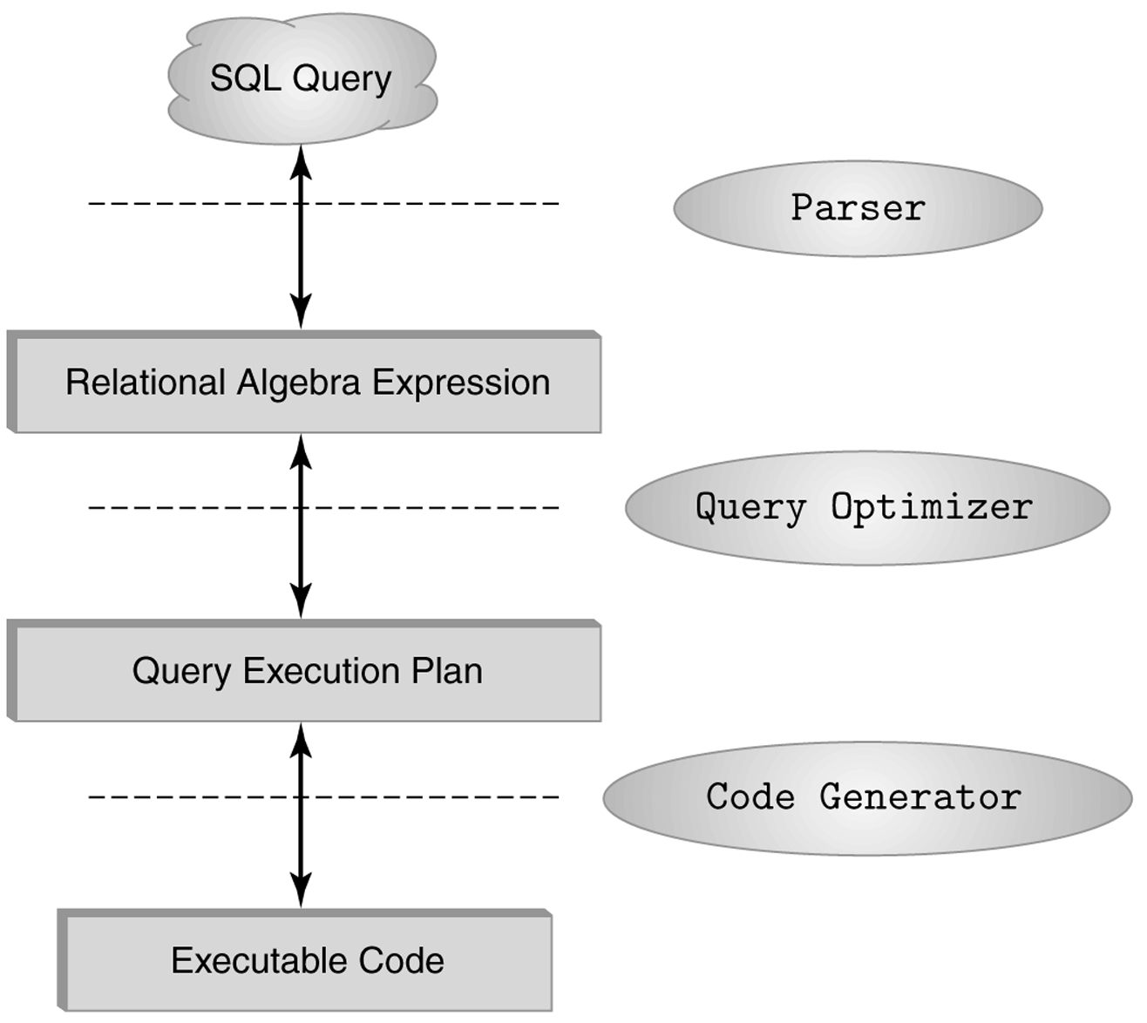
The Role of Relational Algebra in a DBMS

