Slide 1
The Roles of statistics
The Engineering Method and Statistical Thinking
Collecting Engineering Data
Mechanistic and Empirical Models
Probability and Probability Models
Notes:
Nhin lai qua khu

Slide 2
Objectives
The role that statistics
Making engineering decisions
Enumerative vs analytical studies
Methods of data collection
The advantages of designed experiments
Mechanistic models vs empirical models
Why probability models?

Slide 3
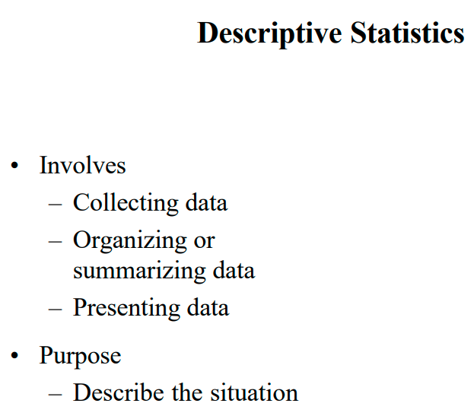


Slide 4
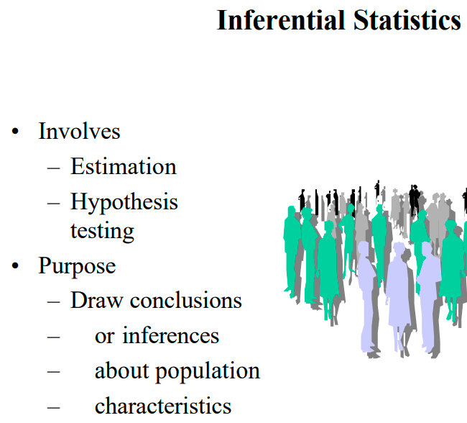

Slide 5
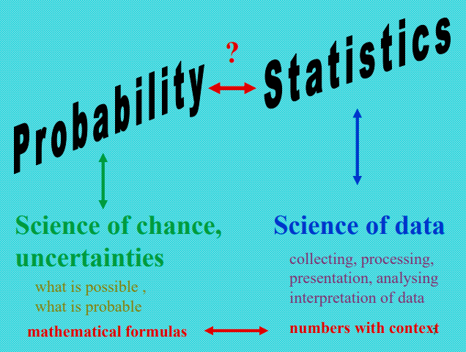

Slide 6
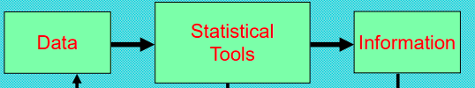

Slide 7
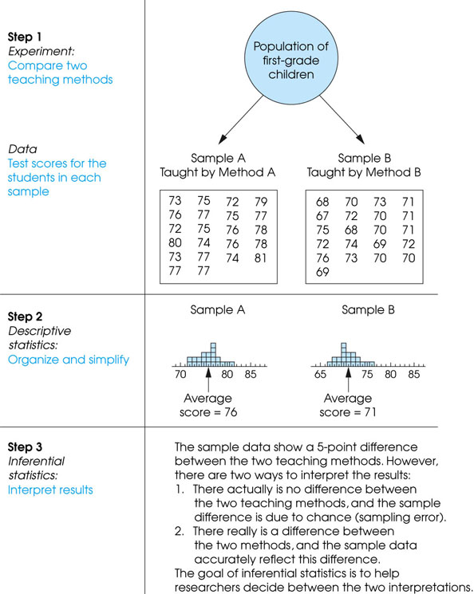
Notes:
Figure 1.3
The role of statistics in experimental research.

Slide 8
Statistics in Engineering
Problems of an engineer
  Refining existing products
  Designing new products or processes

Slide 9
Statistics in Engineering
The field of Statistics deals with the collection, presentation, analysis, and use of data to
  Make decisions
  Solve problems
  Design products and processes

Slide 10
1-1 Statistics in Engineering
Statistical techniques are useful for describing and understanding variability.
By variability, we mean successive observations of a system or phenomenon do not produce exactly the same result.
Statistics gives us a framework for describing this variability and for learning about potential sources of variability.
Notes:
Phenomenon: hiện tượng

Slide 11
1-1 Statistics in Engineering
Engineering Example
An engineer is designing a nylon connector to be used in an automotive engine application. The engineer is considering establishing the design specification on wall thickness at 3/32 inch but is somewhat uncertain about the effect of this decision on the connector pull-off force. If the pull-off force is too low, the connector may fail when it is installed in an engine. Eight prototype units are produced and their pull-off forces measured (in pounds): 12.6, 12.9, 13.4, 12.3, 13.6, 13.5, 12.6, 13.1.

Slide 12
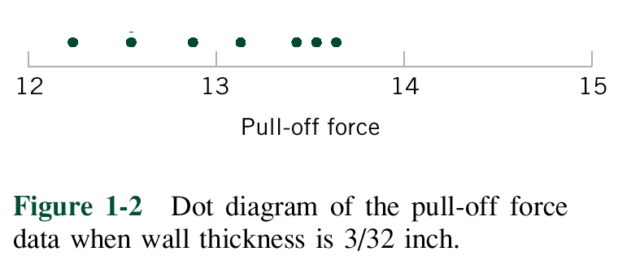
1-1 Statistics in Engineering
Engineering Example
The dot diagram is a very useful plot for displaying a small body of data - say up to about 20 observations.
This plot allows us to see easily two features of the data; the location, or the middle, and the scatter or variability.

Slide 13
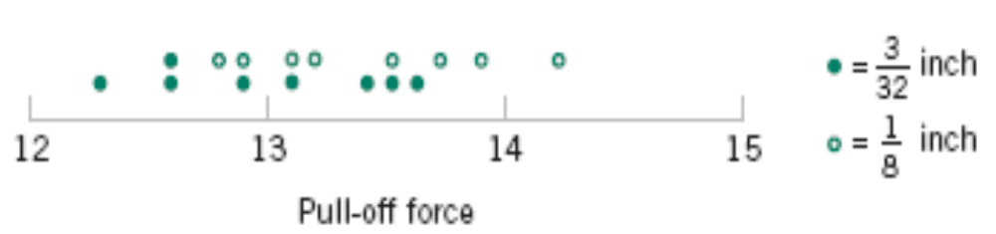
1-1 Statistics in Engineering
Engineering Example
The engineer considers an alternate design and eight prototypes are built and pull-off force measured.
The dot diagram can be used to compare two sets of data
Figure 1-3 Dot diagram of pull-off force for two wall thicknesses.

Slide 14
1-1 Statistics in Engineering
Engineering Example
Since pull-off force varies or exhibits variability, it is a random variable.
A random variable, X, can be model by
X = μ + ε
where μ is a constant and ε a random disturbance.

Slide 15
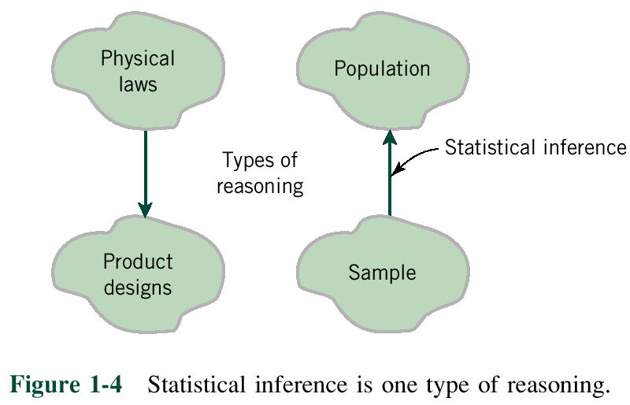
1-1 Statistics in Engineering
Notes:
Inference: su suy ra, ket luan
Reasoning: suy luan, lap luan

Slide 16
1-2 Collecting Engineering Data
Three basic methods for collecting data:
  A retrospective study using historical data
  An observational study
  A designed experiment

Slide 17
1-2 Collecting Engineering Data
  A retrospective study using historical data
  would use either all or a sample of the historical process data archived over some period of time.
  Propspective: past – present – future
  Cross-sectional: present

Slide 18
1-2 Collecting Engineering Data
  An observational study: the engineer observes the process or population, disturbing it
Notes:
Disturb: lam nhieu loan

Slide 19
1-2 Collecting Engineering Data
  A designed experiment: the engineer makes deliberate in the controlable variables of the system, observes the resulting system output data

Slide 20
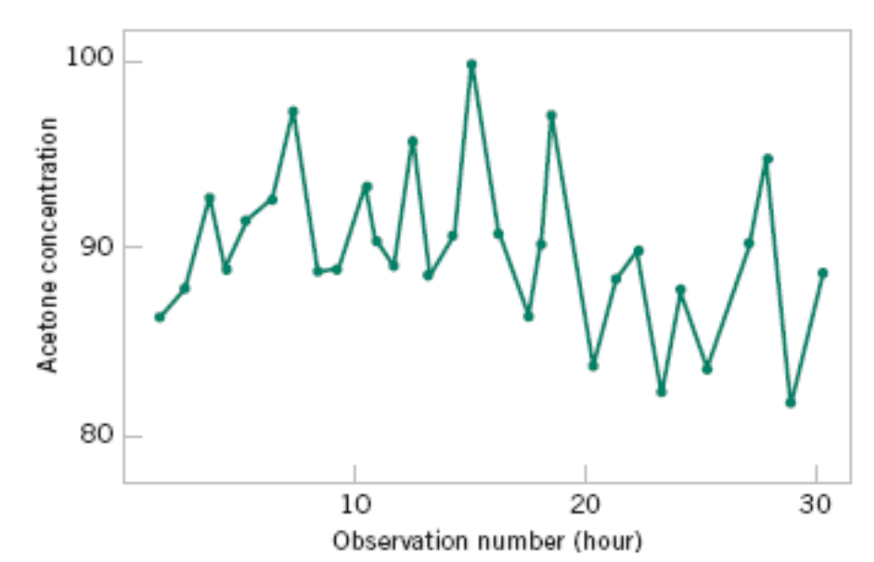
1-2.5 Observing Processes Over Time
Figure 1-9 A time series plot of concentration provides more information than a dot diagram.

Slide 21
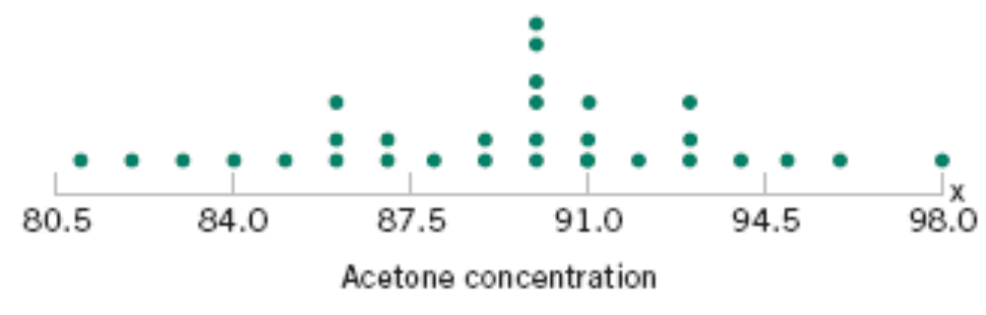
1-2 Observing Processes Over Time
Whenever data are collected over time it is important to plot the data over time. Phenomena that might affect the system or process often become more visible in a time-oriented plot
and the concept of stability can be better judged.
Figure 1-8 The dot diagram illustrates variation but does not identify the problem.

Slide 22
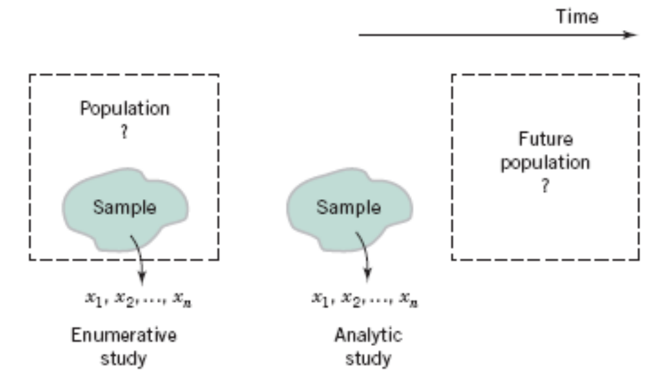
1-2 Observing Processes Over Time
Figure 1-14 Enumerative versus analytic study.

Slide 23
1-3 Mechanistic and Empirical Models
A mechanistic model is built from our underlying knowledge of the basic physical mechanism that relates several variables.
Example: Ohm’s Law
Current = voltage/resistance
I = E/R
I = E/R + ε

Slide 24
1-3 Mechanistic and Empirical Models
An empirical model is built from our engineering and scientific knowledge of the phenomenon, but is not directly developed from our theoretical or first-principles understanding of the underlying mechanism.

Slide 25
1-3 Mechanistic and Empirical Models
Example
Suppose we are interested in the number average molecular weight (M_{n}) of a polymer. Now we know that M_{n} is related to the viscosity of the material (V), and it also depends on the amount of catalyst (C) and the temperature (T ) in the polymerization reactor when the material is manufactured. The relationship between M_{n} and these variables is
M_{n} = f(V,C,T)
say, where the form of the function f is unknown.
where the β’s are unknown parameters.
Notes:
Viscosity: tính dẻo; catalyst: chất xúc tác.

Slide 26
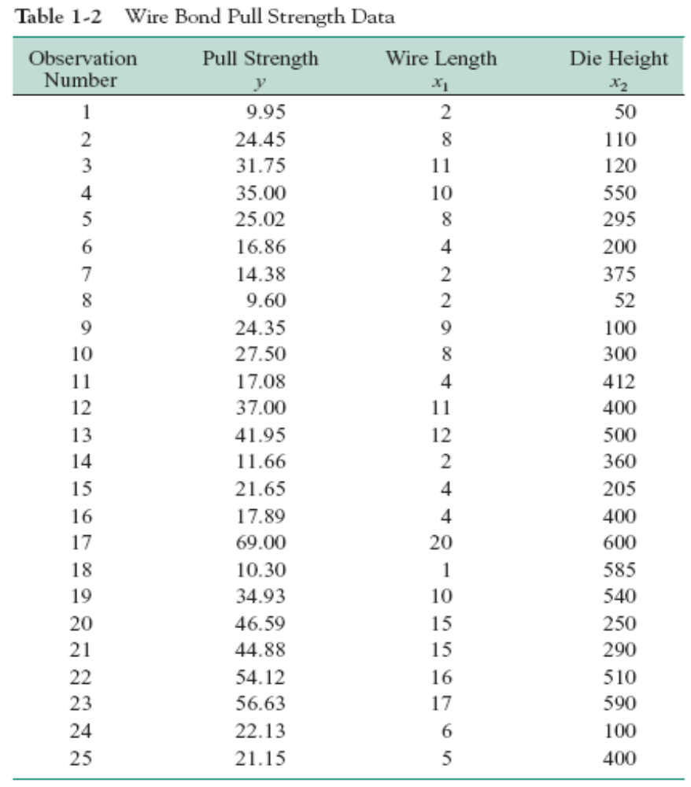

Slide 27
1-3 Mechanistic and Empirical Models
In general, this type of empirical model is called a regression model.
The estimated regression line is given by

Slide 28
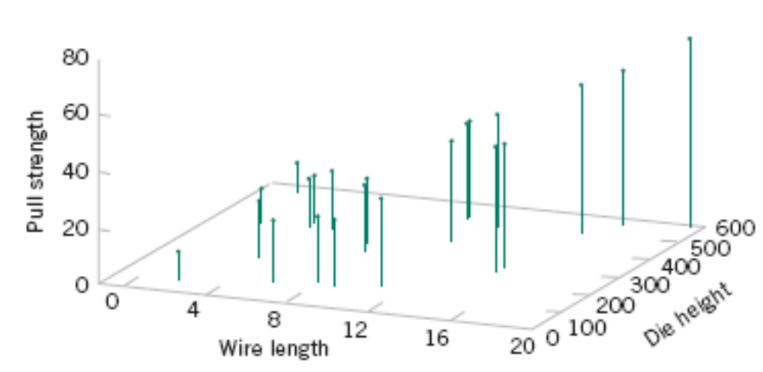
Figure 1-15 Three-dimensional plot of the wire and pull strength data.

Slide 29
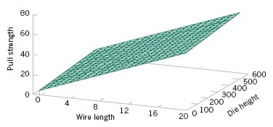
1-4 Probability and Probability Models
Figure 1-16 Plot of the predicted values of pull strength from the empirical model.

Slide 30
1-4 Probability and Probability Models
Probability models help quantify the risks involved in statistical inference, that is, risks involved in decisions made every day.
Probability provides the framework for the study and application of statistics.
Notes:
Quantify: định lượng

Slide 31
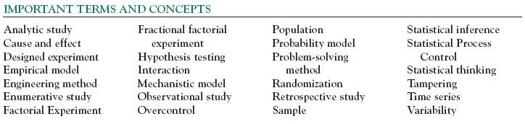

Slide 32

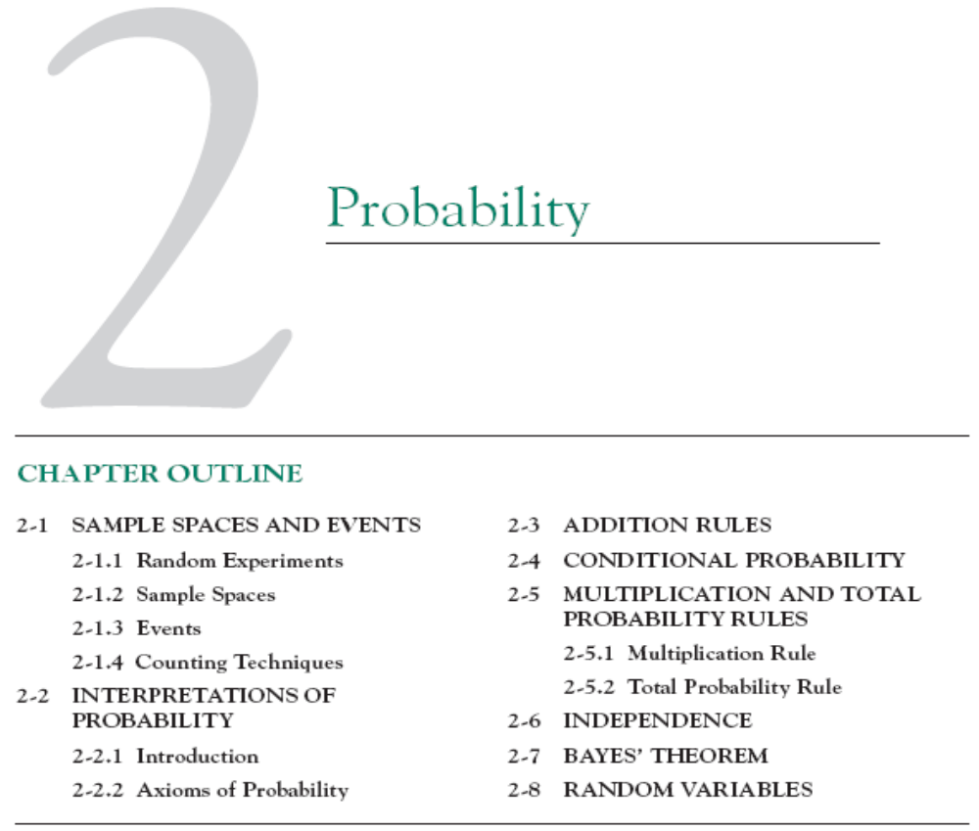

Slide 33
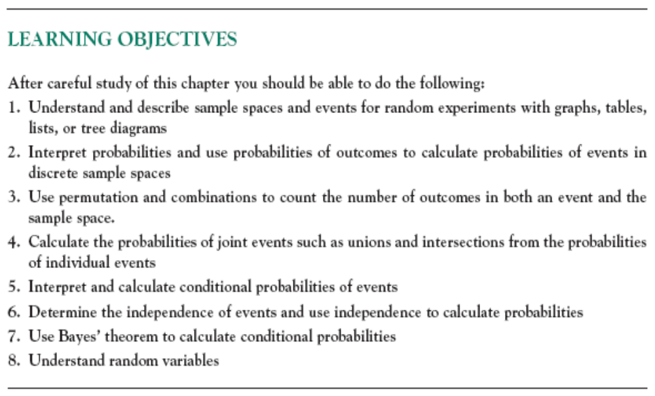

Slide 34
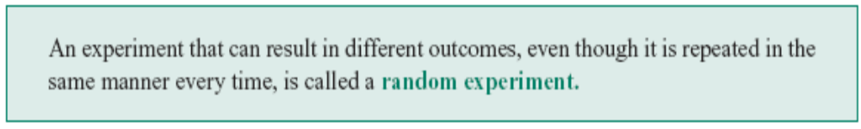
2-1 Sample Spaces and Events
2-1.1 Random Experiments
Definition

Slide 35
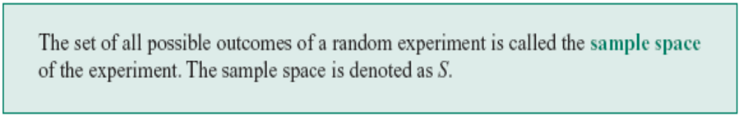
2-1 Sample Spaces and Events
2-1.2 Sample Spaces
Definition

Slide 36
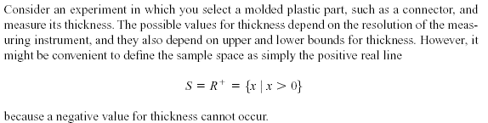
2-1 Sample Spaces and Events
2-1.2 Sample Spaces
Example 2-1

Slide 37
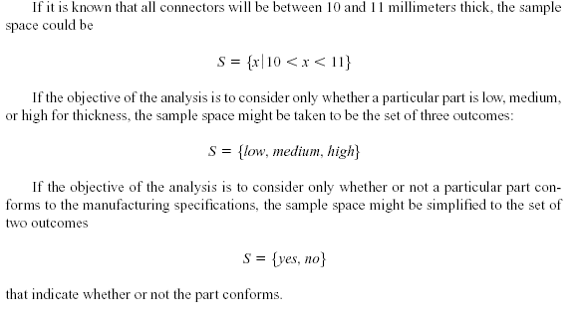
2-1 Sample Spaces and Events
Example 2-1 (continued)
Notes:
Conform: làm cho phù hợp với
Specification: đặc điểm kỹ thuật

Slide 38
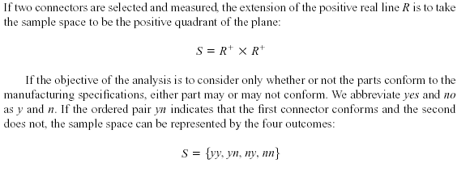
2-1 Sample Spaces and Events
Example 2-2
Notes:
Abbreviate: viết tắt

Slide 39
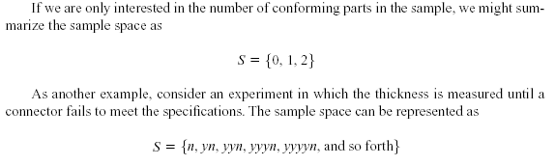
2-1 Sample Spaces and Events
Example 2-2 (continued)
Notes:
And so forth: và vân vân

Slide 40
2-1 Sample Spaces and Events
Tree Diagrams
Sample spaces can also be described graphically with tree diagrams.
  When a sample space can be constructed in several steps or stages, we can represent each of the n₁ ways of completing the first step as a branch of a tree.
  Each of the ways of completing the second step can be represented as n₂ branches starting from the ends of the original branches, and so forth.
Notes:
Stage: giai đoạn

Slide 41

2-1 Sample Spaces and Events
Example 2-3

Slide 42
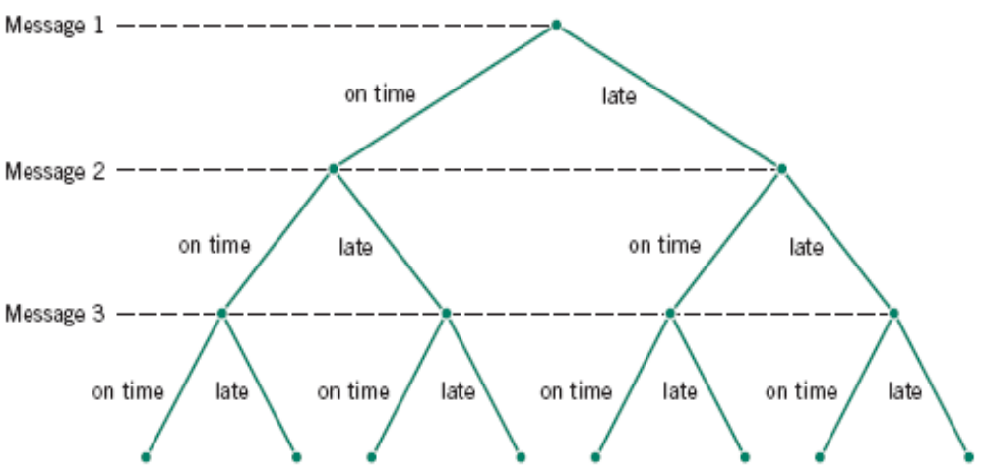
2-1 Sample Spaces and Events
Figure 2-5 Tree diagram for three messages.

Slide 43

2-1 Sample Spaces and Events
2-1.3 Events
Definition

Slide 44
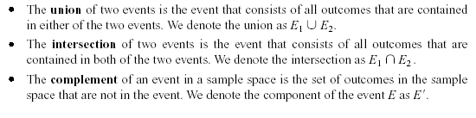
2-1 Sample Spaces and Events
2-1.3 Events
Basic Set Operations

Slide 45
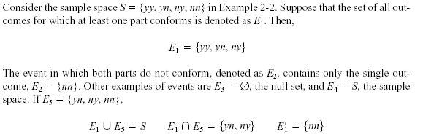
2-1 Sample Spaces and Events
2-1.3 Events
Example 2-6

Slide 46

2-1 Sample Spaces and Events
Definition
Notes:
Exclusive: xung khắc
Mutually: lẫn nhau

Slide 47
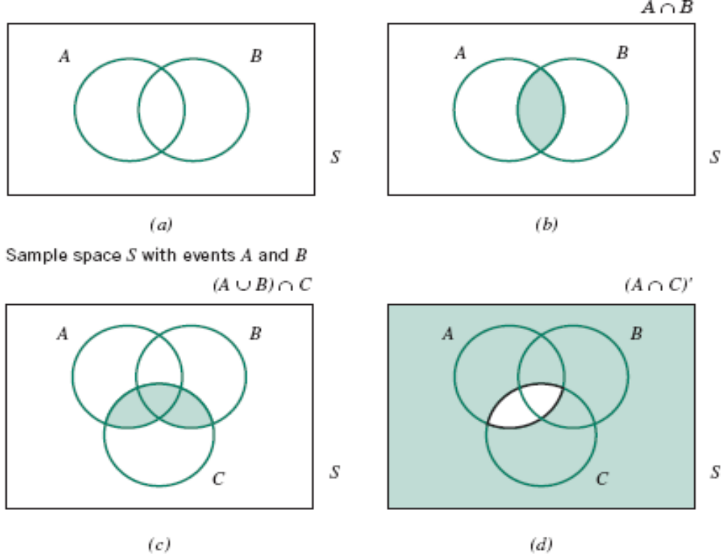
2-1 Sample Spaces and Events
Venn Diagrams
Figure 2-8 Venn diagrams.

Slide 48

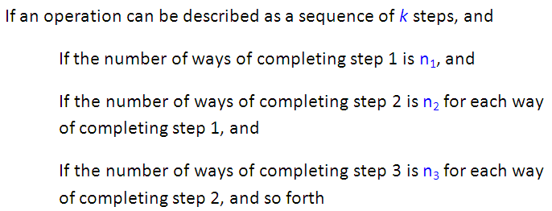

2.1.4 Counting Techniques

Slide 49

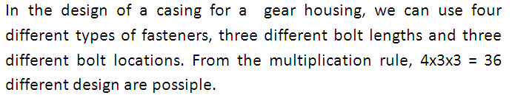

Slide 50

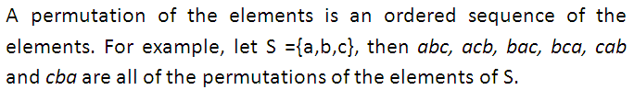

Slide 51




A printed circuit board has eight different locations in which a component can be placed. If four different components are to be placed on the board, how many different designs are possible?

Slide 52
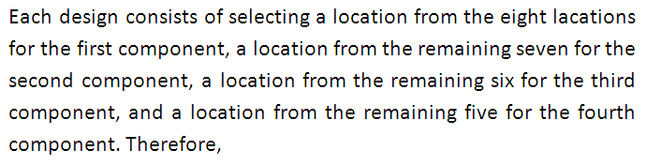


Slide 53

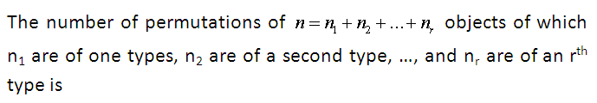


Slide 54

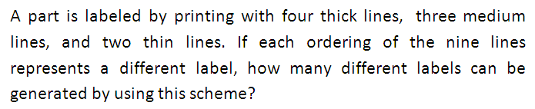


Slide 55

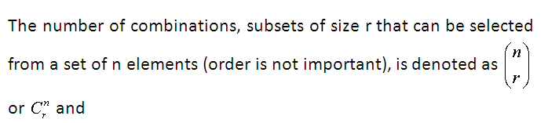


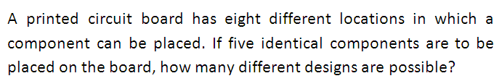

Slide 56



