Slide 1
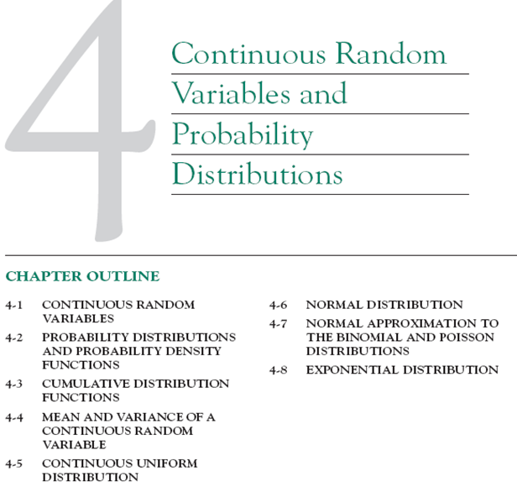

Slide 2
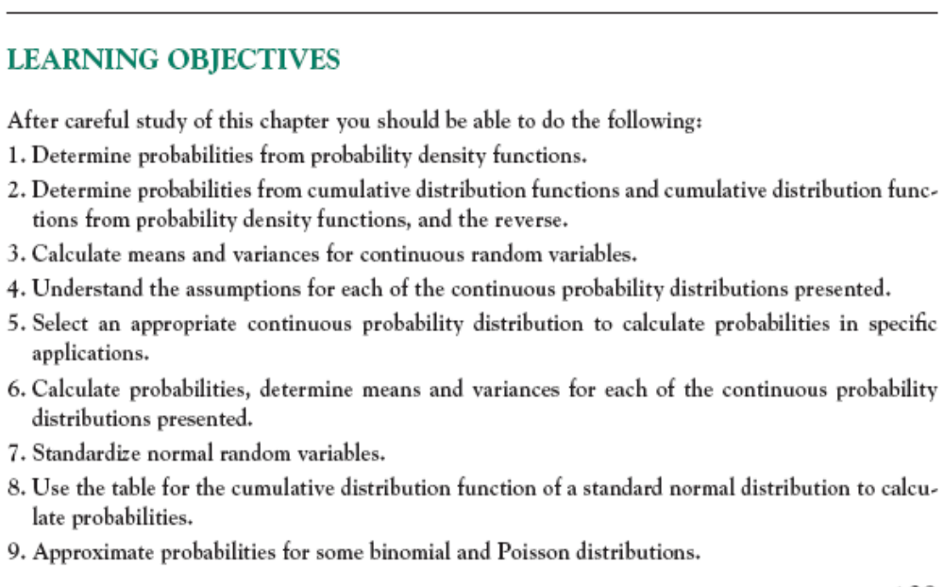

Slide 3
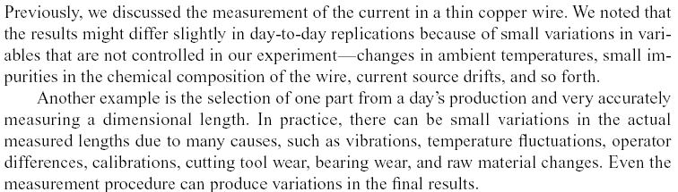
4-1 Continuous Random Variables

Slide 4
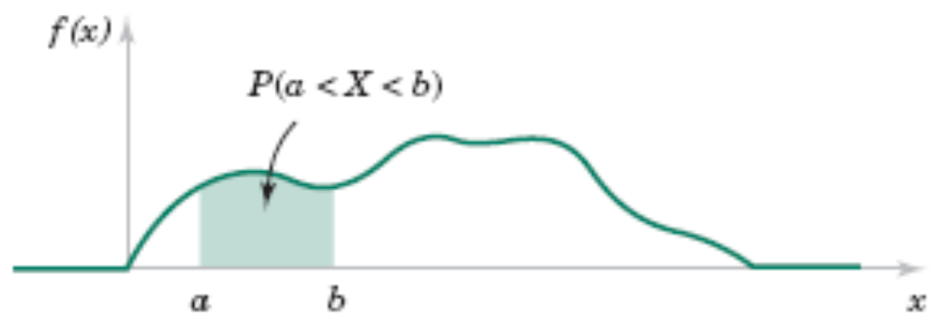
4-2 Probability Distributions and Probability Density Functions
Figure 4-2 Probability determined from the area under f(x).

Slide 5
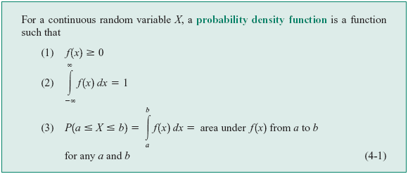
4-2 Probability Distributions and Probability Density Functions
Definition

Slide 6
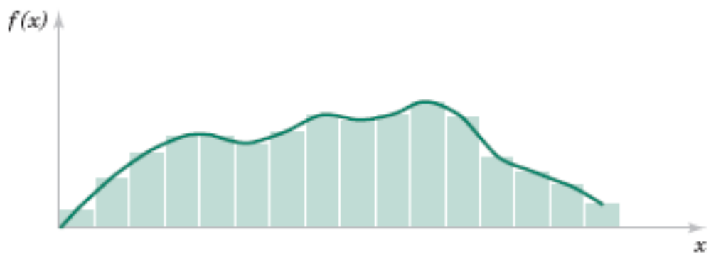
4-2 Probability Distributions and Probability Density Functions
Figure 4-3 Histogram approximates a probability density function.

Slide 7
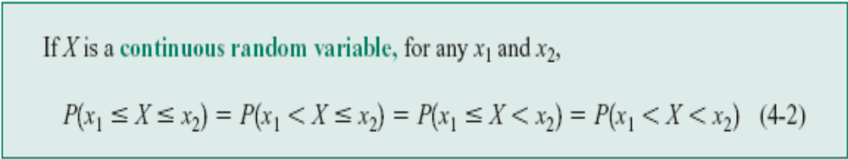
4-2 Probability Distributions and Probability Density Functions

Slide 8

4-2 Probability Distributions and Probability Density Functions
Example 4.1
Let the continuous random variable X denote the current measured in a thin copper wire in milliamperes. Assume that the range of X is [0,20 mA], and assume that the probability density function of X is f(x) = 0.05 for .
What is the probability that a current measurement is less than 10 milliamperes?
And the probability that a current measurement is more than 5 and less than 20?

Slide 9
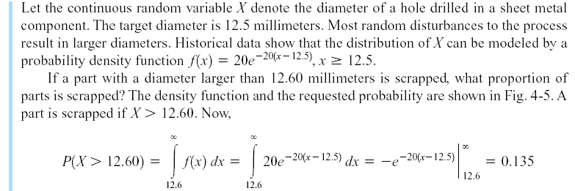
4-2 Probability Distributions and Probability Density Functions
Example 4-2

Slide 10
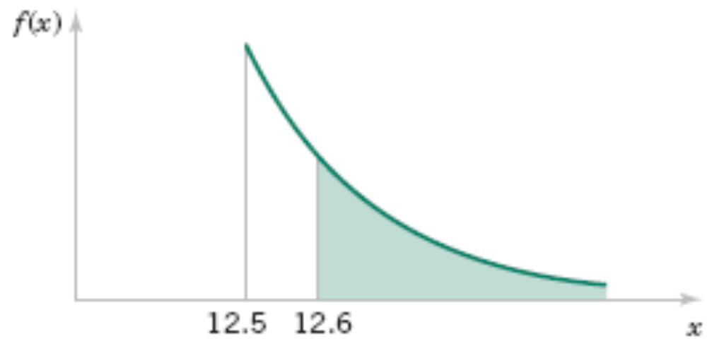
4-2 Probability Distributions and Probability Density Functions
Figure 4-5 Probability density function for Example 4-2.

Slide 11
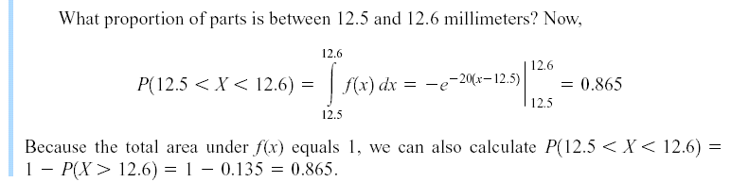
4-2 Probability Distributions and Probability Density Functions
Example 4-2 (continued)

Slide 12
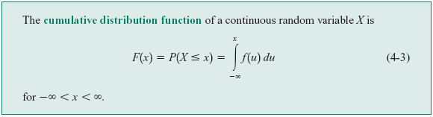
4-3 Cumulative Distribution Functions
Definition

Slide 13
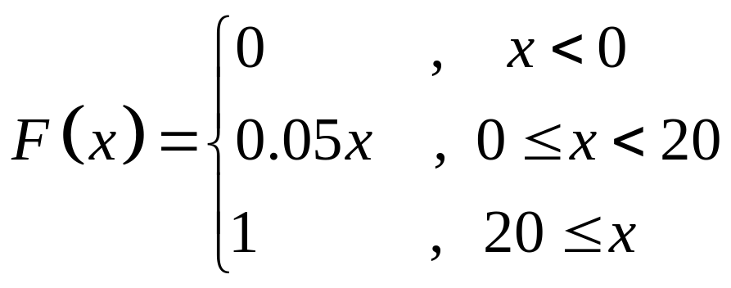
4-3 Cumulative Distribution Functions
Example 4.3
For the copper current measurement in Ex 4.1, the cumulative distribution function of the random variable X consists of three expressions. If x<0, f(x) = 0. Therefore,

Slide 14
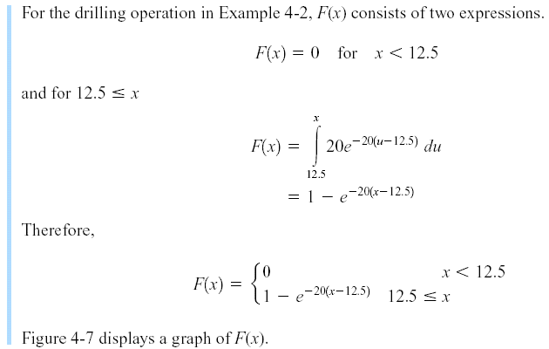
4-3 Cumulative Distribution Functions
Example 4-4

Slide 15
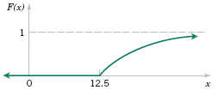
4-3 Cumulative Distribution Functions
Figure 4-7 Cumulative distribution function for Example 4-4.

Slide 16
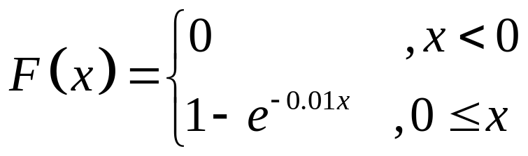
4-3 Cumulative Distribution Functions
Example 4.5
The time until a chemical reaction (in milliseconds) is approximated by the cumulative distribute function:
Find the probability density function of X. What proportion of reactions is complete within 200 milliseconds.
Notes:
Đến đây! IA1162

Slide 17
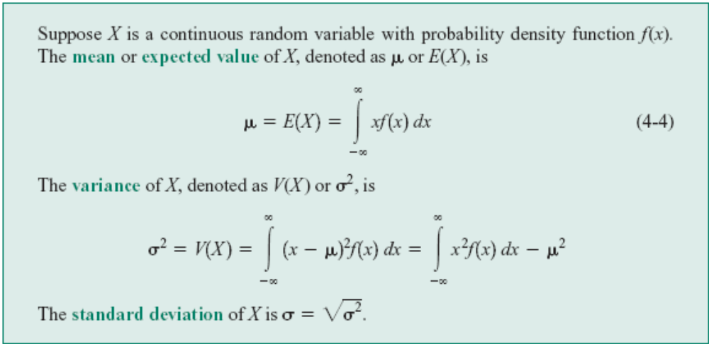
4-4 Mean and Variance of a Continuous Random Variable
Definition

Slide 18
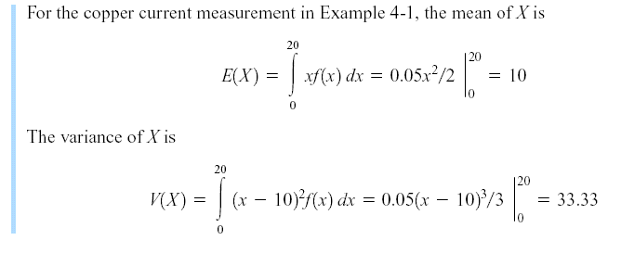
4-4 Mean and Variance of a Continuous Random Variable
Example 4-6

Slide 19
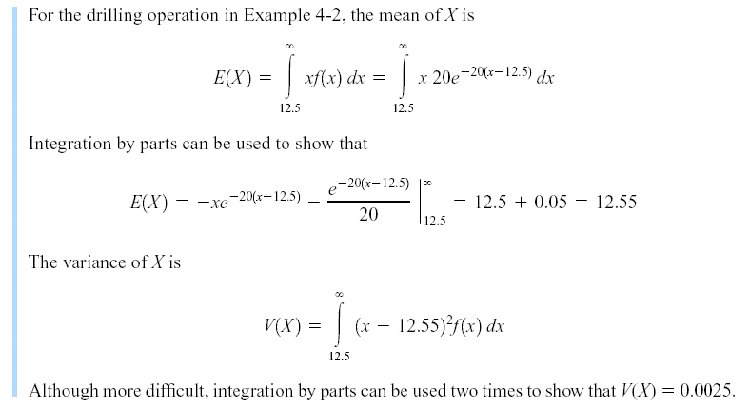
4-4 Mean and Variance of a Continuous Random Variable
Example 4-8

Slide 21
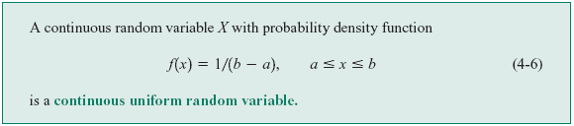
4-5 Continuous Uniform Random Variable
Definition

Slide 22
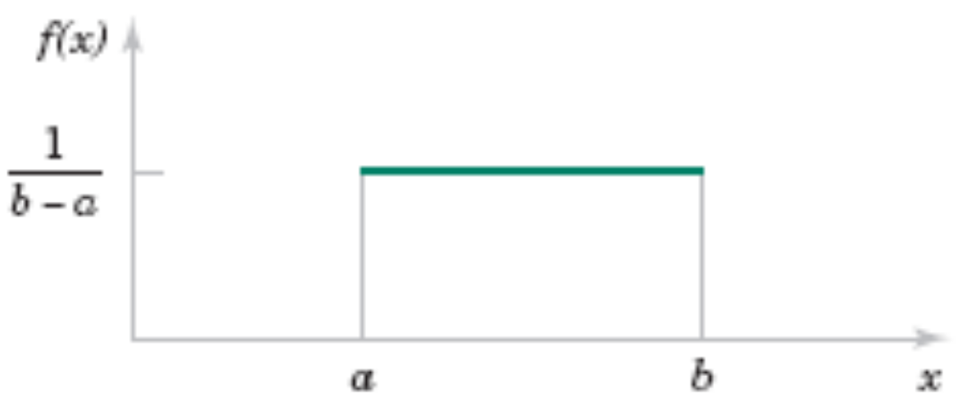
4-5 Continuous Uniform Random Variable
Figure 4-8 Continuous uniform probability density function.

Slide 23
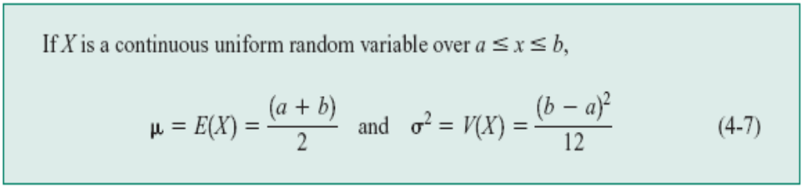
4-5 Continuous Uniform Random Variable
Mean and Variance

Slide 24
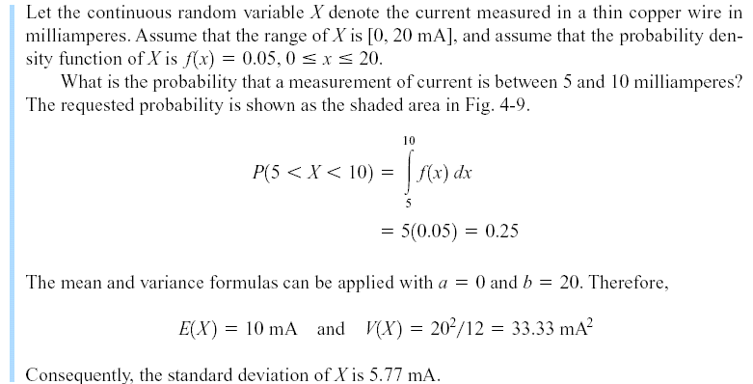
4-5 Continuous Uniform Random Variable
Example 4-9

Slide 25

4-5 Continuous Uniform Random Variable
Figure 4-9 Probability for Example 4-9.

Slide 26
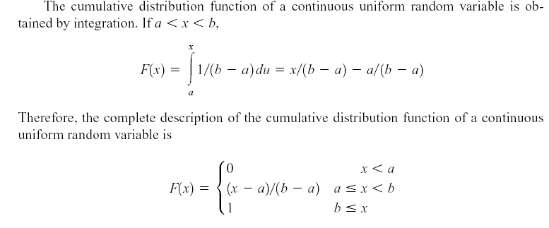
4-5 Continuous Uniform Random Variable

Slide 27
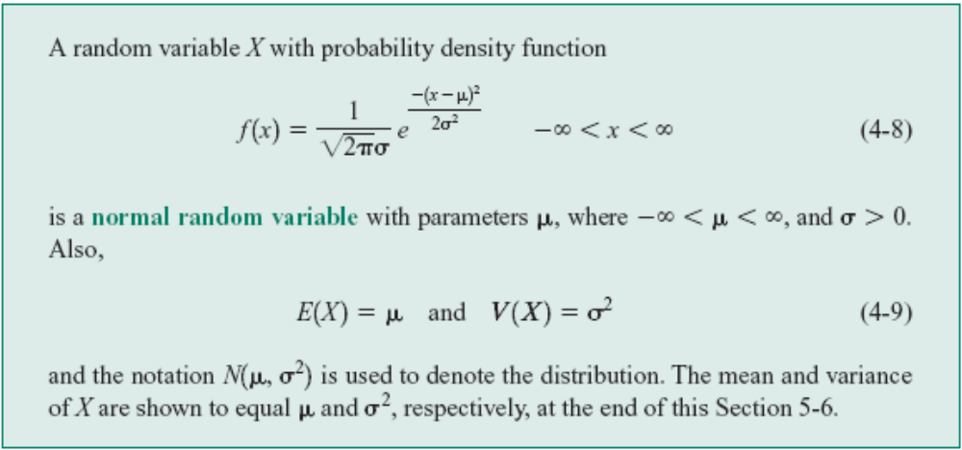
4-6 Normal Distribution
Definition

Slide 28
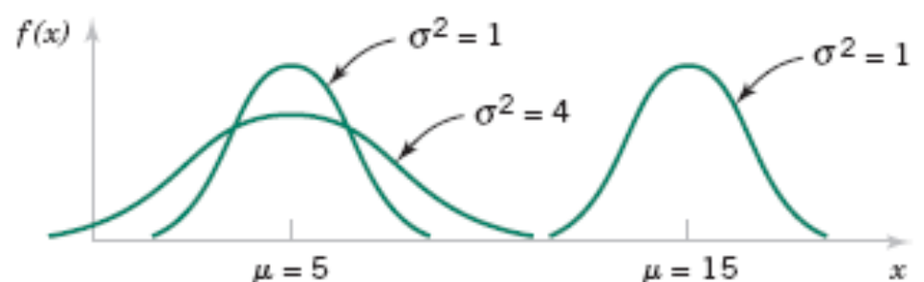
4-6 Normal Distribution
Figure 4-10 Normal probability density functions for selected values of the parameters μ and σ².

Slide 29

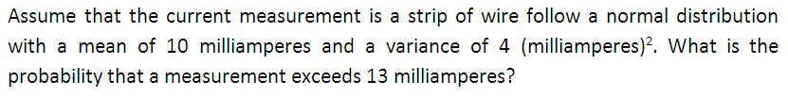
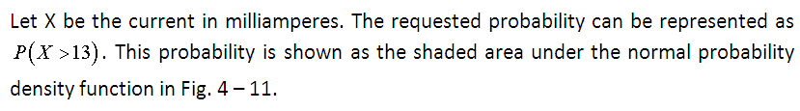
4-6 Normal Distribution

Slide 30
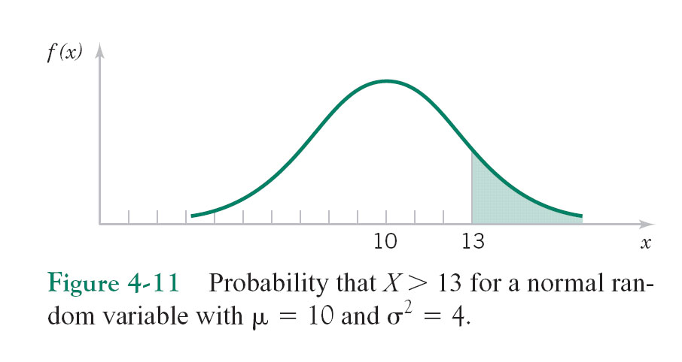
4-6 Normal Distribution

Slide 31
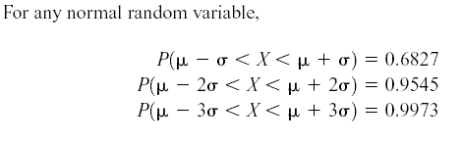
4-6 Normal Distribution
Some useful results concerning the normal distribution

Slide 32
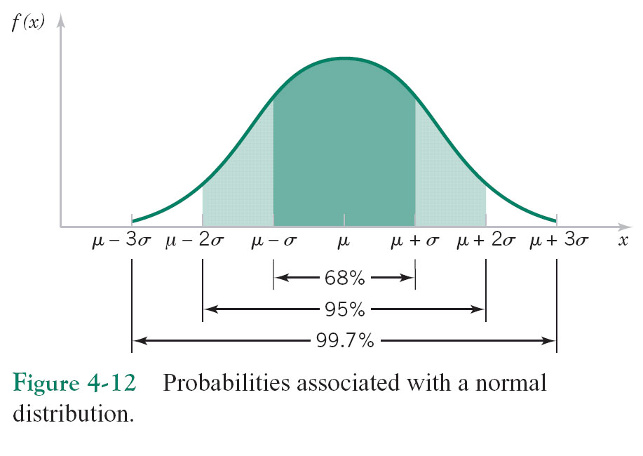
4-6 Normal Distribution

Slide 33
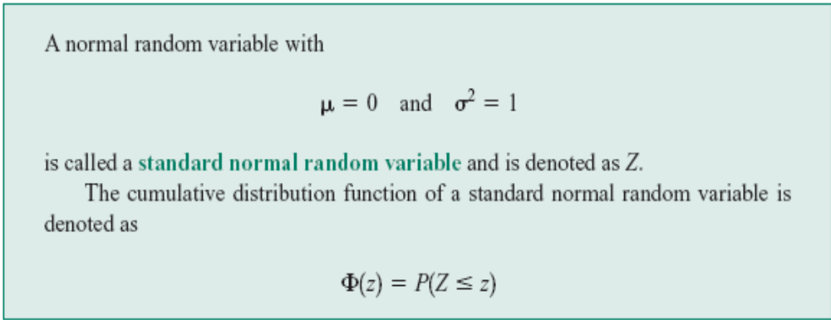
4-6 Normal Distribution
Definition : Standard Normal

Slide 34
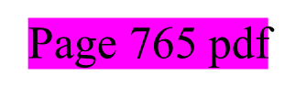
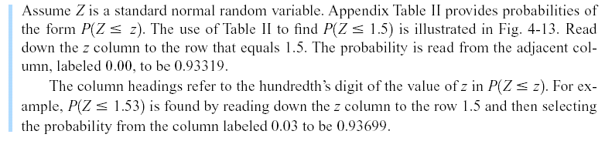
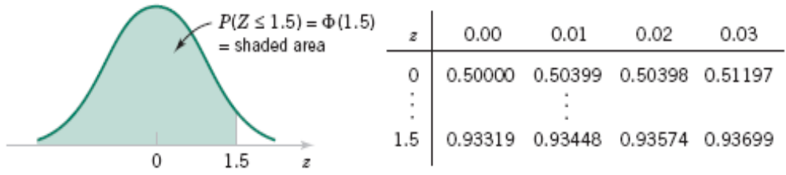
4-6 Normal Distribution
Example 4-11
Figure 4-13 Standard normal probability density function.

Slide 35


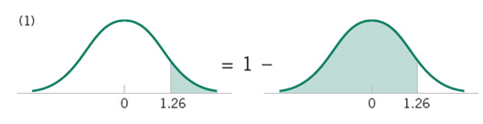

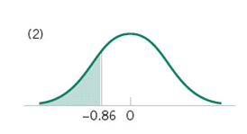
4-6 Normal Distribution

Slide 36
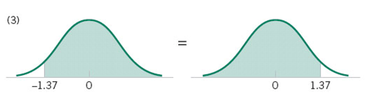


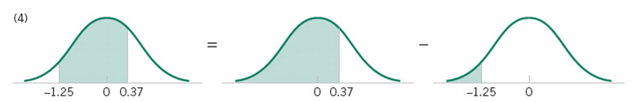

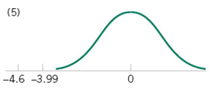
4-6 Normal Distribution

Slide 37
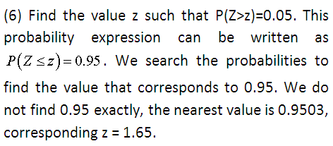
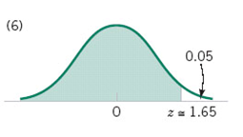
4-6 Normal Distribution

Slide 38
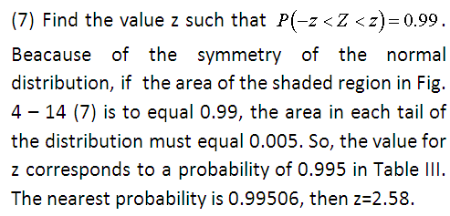
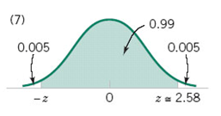
4-6 Normal Distribution

Slide 39
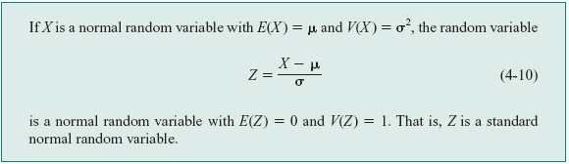
4-6 Normal Distribution
Standardizing

Slide 40
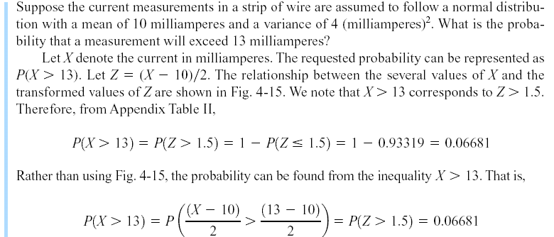
4-6 Normal Distribution
Example 4-13

Slide 41
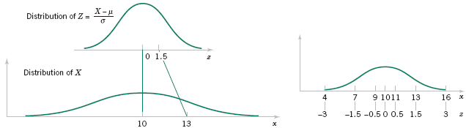
4-6 Normal Distribution
Figure 4-15 Standardizing a normal random variable.

Slide 42
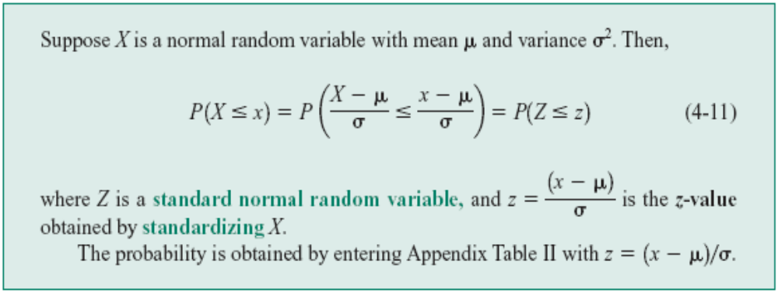
4-6 Normal Distribution
To Calculate Probability

Slide 43
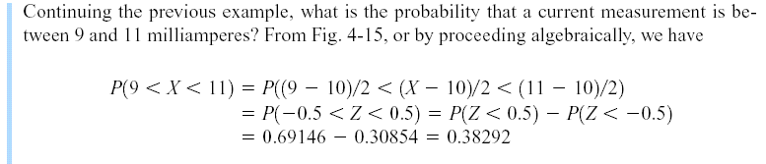
4-6 Normal Distribution
Example 4-14

Slide 44
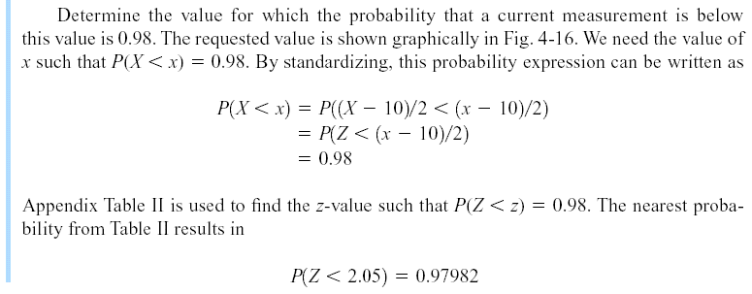

4-6 Normal Distribution
Example 4-14 (continued)

Slide 45
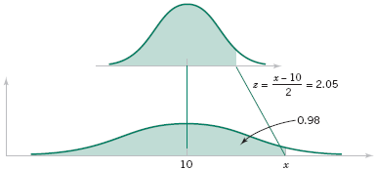
4-6 Normal Distribution
Example 4-14 (continued)
Figure 4-16 Determining the value of x to meet a specified probability.

Slide 46



4-6 Normal Distribution

Slide 47



4-6 Normal Distribution

Slide 48

4-6 Normal Distribution

Slide 49
4-7 Normal Approximation to the Binomial and Poisson Distributions
Under certain conditions, the normal distribution can be used to approximate the binomial distribution and the Poisson distribution.

Slide 50

4-7 Normal Approximation to the Binomial and Poisson Distributions
Figure 4-19 Normal approximation to the binomial.

Slide 51

4-7 Normal Approximation to the Binomial and Poisson Distributions
Example 4-17

Slide 52

4-7 Normal Approximation to the Binomial and Poisson Distributions
Normal Approximation to the Binomial Distribution

Slide 53

4-7 Normal Approximation to the Binomial and Poisson Distributions
Example 4-18

Slide 54


4-7 Normal Approximation to the Binomial and Poisson Distributions

Slide 55


4-7 Normal Approximation to the Binomial and Poisson Distributions

Slide 56

4-7 Normal Approximation to the Binomial and Poisson Distributions

Slide 57

4-7 Normal Approximation to the Binomial and Poisson Distributions

Slide 58

4-7 Normal Approximation to the Binomial and Poisson Distributions
Figure 4-21 Conditions for approximating hypergeometric and binomial probabilities.

Slide 59

4-7 Normal Approximation to the Binomial and Poisson Distributions
Normal Approximation to the Poisson Distribution

Slide 60



4-7 Normal Approximation to the Binomial and Poisson Distributions
Example 4-20

Slide 61

4-8 Exponential Distribution
Definition

Slide 62

4-8 Exponential Distribution
Mean and Variance

Slide 63

4-8 Exponential Distribution
Example 4-21

Slide 64

4-8 Exponential Distribution
Figure 4-23 Probability for the exponential distribution in Example 4-21.

Slide 65

4-8 Exponential Distribution
Example 4-21 (continued)

Slide 66

4-8 Exponential Distribution
Example 4-21 (continued)

Slide 67

4-8 Exponential Distribution
Example 4-21 (continued)

Slide 68


