Slide 1
2 Processes and Threads Part 1 (2 slots)
Chapter 2- part 1
Processes Threads InterProcess Communication (IPC)

Slide 2
Introduction
Nowaday, OSs allows:
Multiple processes running concurrently.
In a process, some codes can run concurrently.
Number of CPUs << number of processes. How does an OS manage them? ➔scheduling
Where are schedulers installed, kernel or shell?

Slide 3
Objectives
Processes
Definition
The process model
Process creation
Process hierarchies
Process Termination
Process States
Transition States
Implementation of Processes
Degree of multiprogramming

Slide 4
Objectives…
Threads
Overview
Models
Benefit
Implementing threads in User Space
Implementing threads in the Kernels
Hybrid Implementations
Pop-up Threads
Scheduler Activations
Making Single Threaded Code to Multithreaded

Slide 5
Objectives…
Interprocess communication
Overview
Race Conditions
Critical Regions
Mutual Exclusion with Busy Waiting:
(Disable Interrupts, Lock Variables, Strict Alternative, Peterson’s solution, TSL instructions)
Sleep and wakeup
Semaphores
Mutexes (Mutual Exclusive)
Monitors
Message Passing
Barriers

Slide 6
2.1- Processes
Definition
The process model
Process creation
Process hierarchies
Process Termination
Process States
Transition States
Implementation of Processes
Degree of multiprogramming

Slide 7
2.1.1- Processes: Definition
Process: A program in execution
Characteristics
A program loaded into its own memory and executing
Associated with each process is set of resources such as executable code, data, stack, CPU registers value, PC, and other information needing to run a program
Associated with each process is its address space (i.e., all memory locations that the process can read and write)
In some OSs, a process can create it’s sub-process.
Some OSs support the ability to have concurrent operations even when there is only one CPU available (pseudoparallelism) based on timesharing mechanism (introduced later).

Slide 8
2.1.2- The Process Model
Early computers allowed only one program to be executed at a time.
A process is an activity of some kind.
A process has a program, input, output, and a state.
There are two basic concepts:
When does a process run? → sequential execution: no concurrency inside a process; everything happens sequentially (There is only one CPU and one physical program counter)
How does OS manage a process → process state: everything that process interacts with (registers, memory, files, etc)

Slide 9
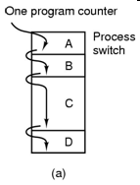
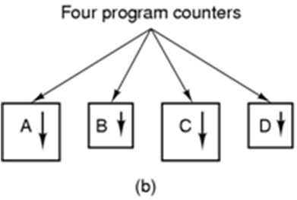
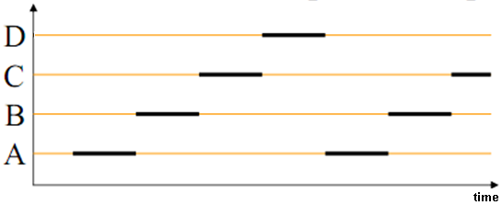
The Process Model: Program counters
Counter: a variable that maintains the instruction order that executes.
Tanenbaum, Fig. 2-1.
In a single-tasking system, such as DOS, only one counter is needed.
In a multi-tasking system with pseudo-parallel mode using time-sharing, each counter is maintained for a process.

Slide 10
The Process Model…
Single-processor systems: Pseudo-parallelism.
Multiprogramming:
Switching among processes (The CPU switches back and forth from process to process). A single processor may be shared among several processes → Scheduling algorithm, time-slicing.
Context switch time is pure overhead because the system does not useful work while switching. It‘s varies depending on the hardware machine.
It has become a performance bottle neck.
Context switch: Switching the CPU to another process
Tasks: (1) Save state of the current process
(2) Load the saved state for the new process.

Slide 11
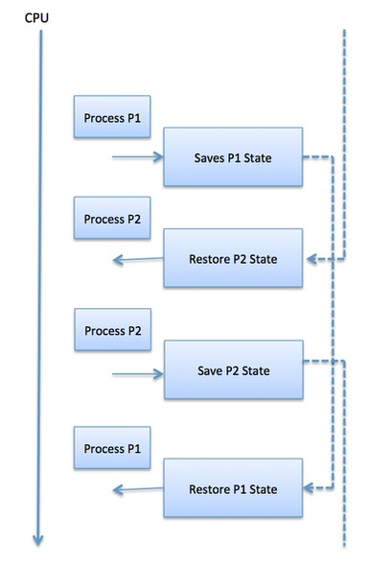

Slide 12
2.1.3- Process Creation
How is a new process is created?
Events that may cause process creation are:
System initialization: At system initialization, some processes are created that can be foreground (application) or background (services) processes.
Execution of a process creation system call by a running process: when a system call for process creation executes (fork() and exec() in UNIX, CreateProcess() in Win32)
(3) A user request to create a new process.
(4) Initiation of a batch job.

Slide 13
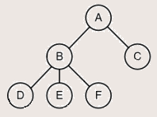
2.1.4- Process Hierarchies
Process hierarchy
Parent–Child relationship
The child can itself create new processes
Tree of processes
In UNIX OS
A process can creates another process, the parent process and child process continue to be associated in certain ways.
A process and all of its children and further descendants together form a process group.
In Windows OS
All processes are equal (has no concept of process hierarchy)
The parent is given a special token (called a handle, process ID) that it can use to control the child.

Slide 14
2.1.5- Process Termination
After a process has been created, it may terminate usually due to one of the following:
Normal exit (task accomplished,voluntary–tự nguyện)
Error exit (voluntary-tự nguyện)
Ex: inexistent files, insufficient or incorrect input
Fatal error (involuntary)
Ex: illegal instructions, division by zero etc.
Killed by another process (involuntary)
kill system call in Unix, or TerminateProcess in Win32.(in some systems, if the parent terminates)
Voluntary – using a special system call
Involuntary – receiving an interruption (exception)

Slide 15
2.1.6- Process State
New (optional): Waiting for same resources to be allocated (or the process is being created).
Ready: Runnable and waiting for it’s turn (waiting for CPU) because another process is running.
Running: Using the CPU at that instant, it’s instructions are being executed.
Blocked: Unable to run until some external events happen, such as waiting for data inputted from keyboard, network, data is written to disks,…
Terminated (optional): Keeping same information about the exit state (or the process has finished execution).
Optinal: Some OSs do not use some states (New, Terminated)

Slide 16
2.1.7-Transition States
New to Ready or Running
Ready to Running (dispatch)
its turn comes again.
selected by the scheduler.
Running to Ready (interrupt)
time slice expired
suspended by the scheduler
Running to Blocked (block)
wait for some event to occur
Blocked to Ready (ready)
the awaited event occurs
Running to Terminated (exit)
New
(optional)
Terminated
(optional)
Running
Blocked
Ready

Slide 17
2.1.8- Implementation of Processes
OS maintains a list of Process Control Blocks
Each PCB entry contains information about a process.
It is used as a repository (kho) when the process is suspended or blocked.
What is the structure of a PCB: → Next slide.
0
1
2
….
…
…
…
…
n-1
PCBs
Scheduler will use this table for
choosing a current process

Slide 18
Implement: PCB Structure
Figure 2-4: Some of the fields of a typical process table entry
Process Management | Memory Management | File Management
Registers Program counter Program status word Stack pointer Process state Priority Scheduling parameters ProcessID Parent process Process group Signals Time when process started CPU time used Children CPU’s time Time of next alarm | Pointer to text segment info Pointer to data segment info Pointer to stack segment info | Root directory Working directory File descriptors UserID GroupID

Slide 19
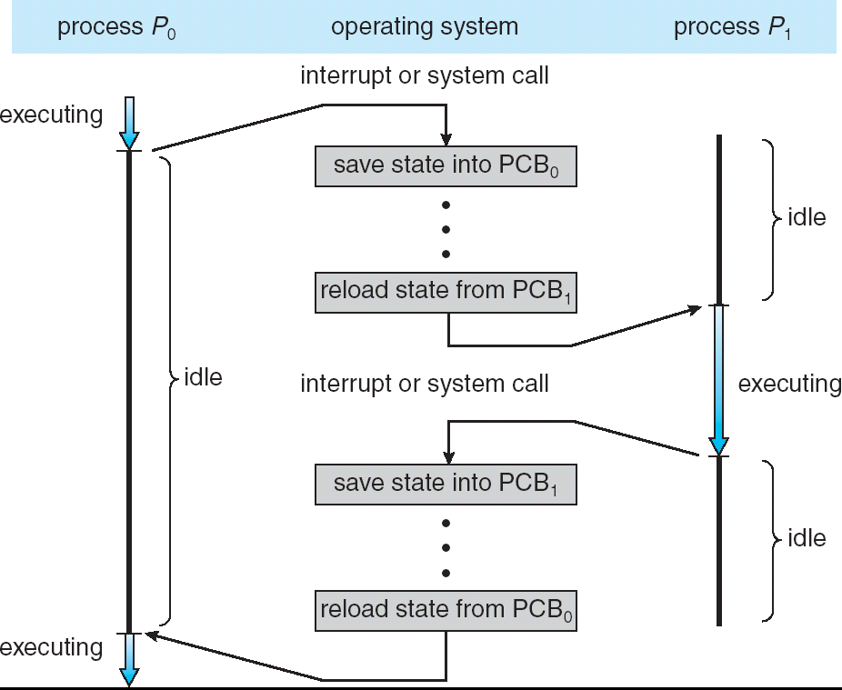
Implement: Swiching Between Processes

Slide 20
Implement: System Calls
P1
All standard IO mechanisms are stored in ROM. Each standard device is assigned an interrupt (a sub-routine) as a standard driver of this device, a subroutine can contain some functions.
Example: In x86 CPU architecture,
Interupt 0x10 for VGA managing:
A running process can be interrupted by an I/O operation,….
P2 (active)
….
Read HDD
…
Print out x
P3
OS services
Function | Function code
Set video mode | 00h
Set text-mode cursor shape | 01h
Set cursor position | 02h
Get cursor position and shape | 03h
Read light penposition (Does not work on VGAsystems) | 04h
Select active display page | 05h
Interrupt vector
(low and fixed location)
contains a list of routines for basic IO operations.
ROM
Interrupt 1
<code>
Interrupt 2
<code>
Interrupt 3
<code>
Memory image when a process is interrupted.

Slide 21
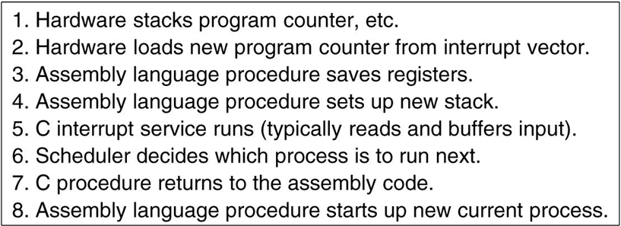
Implementation of Processes …
Interrupt handling and scheduling are summarized
Tanenbaum, Fig. 2-5.

Slide 22
2.1.9- Modeling Multiprogramming
With probability viewpoint, the CPU utilization is a function of the number of processes.
CPU utilization = 1 - p^{n}
p: time waiting for I/O to complete ( in which case, CPU will be idle)
n: number of processes
Number of processes (n) is called degree of multiprogramming
How to evaluate n ( the best number of processes) and CPU utilization of a specific system (next slide)

Slide 23
Modeling Multiprogramming…
Example for CPU Utilization evaluation
A computer has 512MB of memory, with OS taking 128 MB and each user program also taking up 128MB with an 80% average I/O wait
Memory for user-processes: 512-128
Number of processes: n= (512-128)/128 = 3
CPU utilization = 1 – 0.8³ = 1- 0.512 = 0.488 ~ 49%
When another 512MB of memory is added:
Memory for user-processes: 512+512-128
n =( (512 + 512 ) – 128) /128= 7
CPU utilization = 1 – 0.8⁷ ~ 79%

Slide 24
Processes: Summary
Definition
The process model
Process creation
Process hierarchies
Process Termination
Process States
Transition States
Implementation of Processes
Degree of multiprogramming

Slide 25
2.2- Threads
Overview
Definition
Properties
Models
Benefit
Implementing threads in User Space
Implementing threads in the Kernels
Hybrid Implementations
Pop-up Threads
Scheduler Activations
Pop-Up threads
Making Single Threaded Code Multithreaded

Slide 26
2.2.1- Threads: Overview
Each process has a different address space, the CPU is allocated to only one process at one time → Context switching.
There may be one process in which some tasks needs to carry out concurrently → Threads are needed.
If threads are not implemented…….
In Network Services
→The server can serve only one client at a time
In Word processor
The word processor needs to support some of features as automatically saving the entire file in every 5 minutes, reading the user typing on the keyboards, and display the graphics
→when the automatically saving is executed, the reading or display can be not progressed.

Slide 27
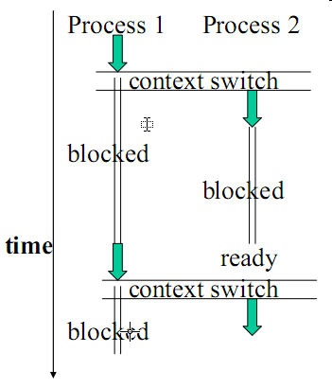
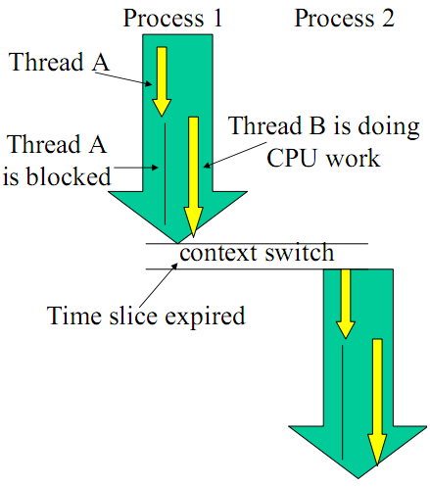
Threads: Overview…
It is desirable to have multiple threads of control in the same address space running in quasi-parallel (gần như song song), as though they were separate processes.
Having multiple threads running concurrently within a process is analogous to having multiple processes running in parallel in one computer (mutithreading technique).
Thread switching
Notes:
Quasi: y như thế

Slide 28
2.2.2-Threads: Definitions & Properties
Thread is a unit execution in a process (→ A function)
It is called mini-process, light-process also.
Thread properties:
Describe an sequential execution within a process.
Share the same address space and resources of the process.
Each thread has its own program counter (PC), registers and stack of execution.
There is no protection between threads in one process.
Lightweight processes (contains some properties of processes).
Have its own stack.

Slide 29
Threads: Multithreading
A support of OSs that allows multiple threads of execution within a single process.
MS-DOS supports a single-thread process.
UNIX supports multiple user processes but only supports one thread per process.
Windows 2000, Solaris, Linux, Mach, and OS/2 support multiple threads.
Multithread is really effective in multiprocessors because the thread can execute in concurrently.
…

Slide 30
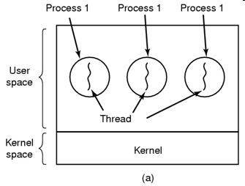
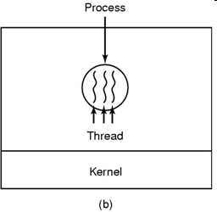
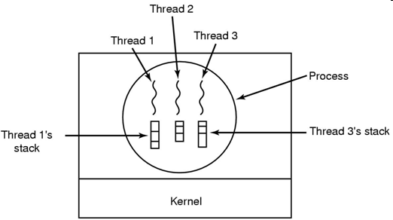
2.2.3- Threads: Models
Tanenbaum, Fig. 2-11, 2-13.
Three processes, each with one thread → Multiprogramming
One process with three threads → Multithreading
Each thread has it’s own stack

Slide 31
2.2.4- Threads: Benefits/Complications
Responsiveness and better resource sharing
A program may continue running even if part of it is blocked.
The application’s performance may improve since we can overlap I/O and CPU computation.
Economy:
Allocating memory and resources for process creation (faster, easier) is costly.
Thread creation may be up to 100 times faster than process sreation.
Useful on systems with multiple CPUs.
Less time to terminate a thread than a process.
Less time to switch between two threads within the same process (serve many task with the same purpose).
Since threads within the same process share memory and files, they can communicate with each other without invoking the kernel.
But, they introduce a number of complications:
E.g., since they share data, one thread may read and another may write the same location – care is needed!

Slide 32
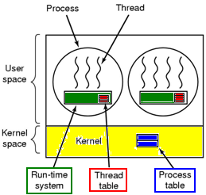
2.2.5- Implementing Threads in User Space
The kernel knows nothing about threads
The approach is suitable for OS that does not support threads
Threads are implemented by a user-level library (with code and data structure)
The threads run on top of a runtime system (which is a collection of procedures that manage threads)
Each process has its own thread table.
Tanenbaum, Fig. 2-16.

Slide 33
Implementing Threads in User Space…
Advantages
Faster: Thread switching and scheduling is faster (because it’s done at user mode) than to trapping the kernel mode.
Flexible, scale better: Each process can have its own customized scheduling algorithm. It can vary the table space and stack space in flexibility.
Disadvantages
The implementation of blocking system calls is complexity → instead of blocking thread, the process is blocked
The need that a thread voluntarily gives up the CPU → The OS doesn’t know this, so if any user-level thread is blocked, the entire process is blocked
Developers want threads precisely in applications → make system call constantly.

Slide 34
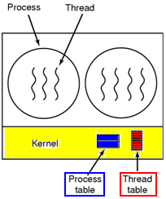
2.2.6- Implementing Threads in the Kernel
The kernel knows about the threads and manage the threads (no run-time system is needed).
The kernel schedules all the threads.
The kernel has a thread table (using kernel call to create or destroy thread).
Tanenbaum, Fig. 2-16.

Slide 35
Implementing Threads in the Kernel…
Advantages
The kernel can switch between threads belonging to different processes → No problem with blocking system calls.
Useful if multiprocessor support is available (multiple CPUs).
Disadvantages
Greater cost (time and resources to manage threads create and terminate).
Thread creation, saving is slow (needs system call).

Slide 36
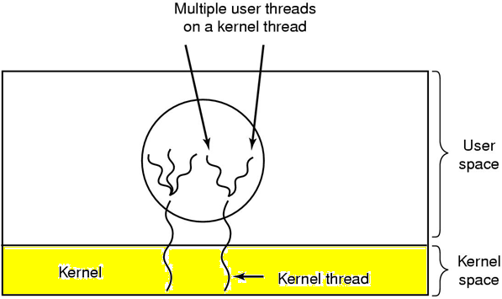
2.2.7- Hybrid Implementations
Combine the advantages of user-level threads with kernel-level threads.
Tanenbaum, Fig. 2-17.
Using kernel-level threads and then multiplex user-level threads onto some or all of the kernel threads (ultimate in flexibility)

Slide 37
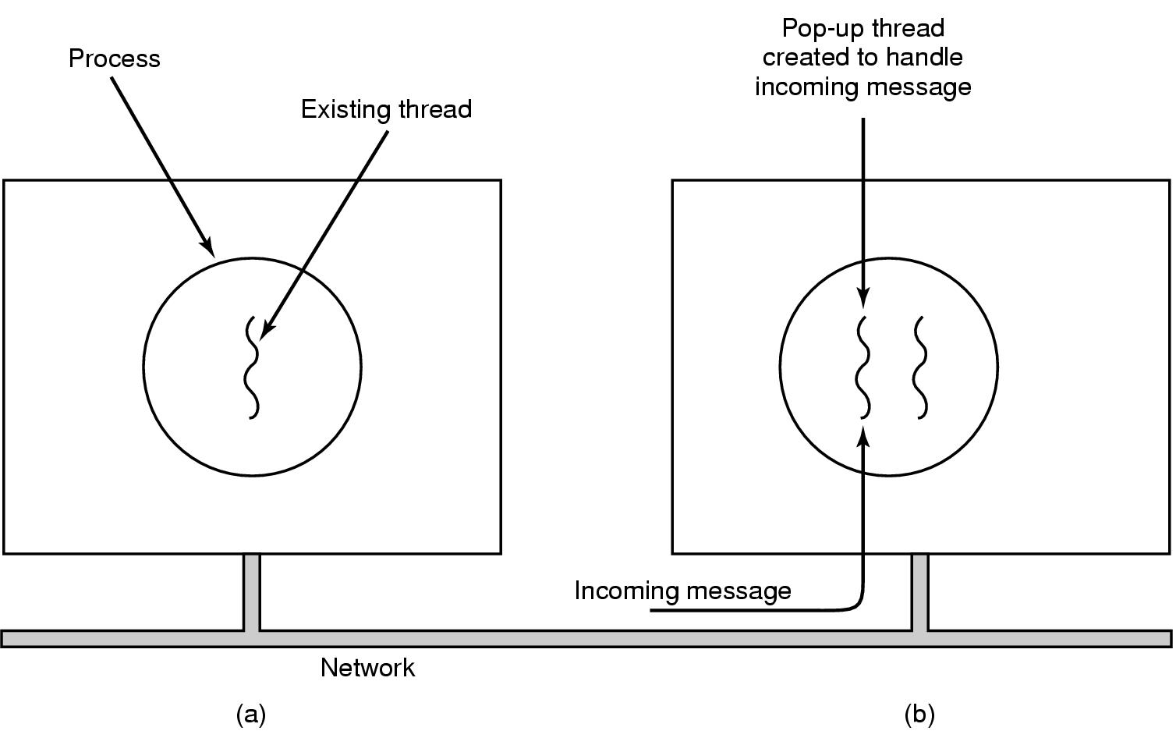
2.2.8- Pop-Up Threads
Tanenbaum, Fig. 2-18.
Problem in network:
When the receiver waits the incoming message from a client, it’s process or thread is blocked until the message arrives to process it → waste time to unblocked and reloaded thread information combining with unpacking the message, then parsing message’s content and processing it
Solution: using Pop-up threads
The incoming message is managed by the system. The system creates a new thread to process this message.
This thread is identical to all the others, but it do not have any history (registers, stack, …) that must be restored
It can be implemented in kernel or user mode
Advantages
Create quickly (Do not have any thread information that must be stored)
The latency (thời trễ) between message arrival and the start of processing can be made very short.

Slide 38
2.2.9- Three Primitive Thread Libraries
POSIX Pthreads (UNIX).
May be provided as either a user- or kernel-level library.
Win32 threads (Windows).
Kernel-level library, available on Windows systems.
Java threads (JAVA).
JVM is running on top of a host operating system, the implementation depends on the host system (Win32 API or Pthreads).

Slide 39
2.2.10- Scheduler Activations
Context: Threads are managed in kernel
Better: When a thread blocks, other threads within the same process can be run
Slower: OD must schedule all processes and threads in each process.
Context: Threads are managed in user-mode
Avoiding unnecessary transitions between user mode and kernel mode.
The user mode can block the thread and schedule a new one by itself → mimic ( bắt chước) the functionality of kernel threads and associate with threads packages implemented in user space
Upcall: The notified signal with information as thread’s ID and description is used to activate the runtime system.

Slide 40
Scheduler Activations…
The runtime system maintains a list of threads.
Scheduler Activation mechanism in Kernel
(OS maintains a list of threads in kernel)
When a thread has blocked, the kernel make the upcall to the process’s runtime system (in user mode) to inform this event.
Later, when the blocked thread, that has marked, is ready and can run again, the kernel make another upcall.
The runtime system can either restart the blocked thread immediately or put in on the ready list to be run later.
The user mode can re-schedule its threads by
(The runtime system maintains a list of threads)
Marking the current thread as blocked.
Taking another thread from ready list, loading and restarting it.
The scheduler is activated whenever a change occurs in the process table or in the thread table

Slide 41
Scheduler Activations…
Threads managed by kernel: The kernel assigns a certain number of virtual processors to each process and lets the (user-space) run-time system allocate threads to processors.
Schedulers in user-mode mimic the functionality of kernel threads, but with the better performance and greater flexibility usually associated with threads packages implemented in user space.
➔ It is efficiency in reducing transition: A thread is blocked due to waiting for another thread to do something → no reason to involve the kernel in transition.

Slide 42
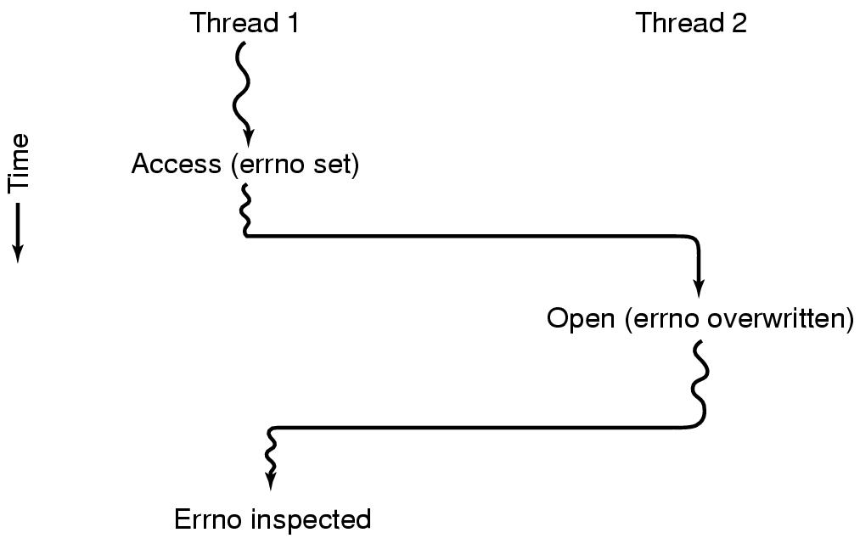
2.2.11- Single-Threaded → Multithreaded
Global variable:
Errno set
Problem: How to Convert programs, that were written for single-thread processes, to multithreading
The global variables using in entire process can be a problem when the thread is used.
Initial value
Changed value
Conflicts between threads over the use of a global variable errno
Tanenbaum, Fig. 2-19.

Slide 43
Single-Threaded → Multithreaded..
Solutions
Prohibit global variables altogether → conflicts with much existing software (modifying is impossible)
Assign each thread its own private global variables using private copy (parametered fuctions) → allocate a chunk of memory for global variables and pass it to each procedure in the thread as an extra parameter
Use the library procedures with some methods as create_global, set_global, read_global (serial accessing, synchronized methods in Java) → many libraries are not reentrant
Provide each procedure with a jacket that sets a bit to mark the library as in use → eliminates potential parallelism.
Consider signals → are difficult to enough to manage a single threaded environment.
→ Stack management with many stack that can be grown.

Slide 44
Threads Summary
Definitions: Thread, Multi-Threading
Properties
Models
Benefit
Implementing threads in User Space
Implementing threads in the Kernels
Hybrid Implementations
Pop-up Threads
Scheduler Activations
Pop-Up threads
Making Single Threaded Code Multithreaded

Slide 45
2.3- InterProcess Communication (IPC)
How data in this process can be passed to others?
Overview
Race Conditions
Critical Regions – vùng găng
Mutual Exclusion with Busy Waiting: (Truy xuất dạng loại trừ hỗ tương- bận thì đợi) Disable Interrupts, Lock Variables, Strict Alternative, Peterson’s solution, TSL instructions
Sleep and wakeup
Semaphores (cờ đánh dấu)
Mutexes (mutual exclusive) – Loại trừ hỗ tương
Monitors (cơ chế theo dõi)
Message Passing
Barriers (cơ chế chặn để cùng kết thúc)

Slide 46
2.3.1- IPC: Overview
How one process can pass information to another?
Waiting: Proper sequencing when dependencies are present: if process A produces data and process B prints them, B has to wait until A has produced some data before starting to print.
Context
Why does the C/ C++ compiler resist the back door pointer?
→A way to pass data from this process/thread to another.

Slide 47
2.3.2- Race Conditions
A situation where several threads (or processes) manipulate the same (shared) data (memory variables or files) concurrently and the outcome of the execution depends on the precise order of what is happening when, is called a race condition.
Race conditions on resources:
On data
On code
Data
V1
V2
V3
Process 2
File pointer
Write to file
Non-
Race
condition
Thread 1
Access V1
m();
Access V3
Process 1
File pointer
Write to file
Race
condition
OS
WriteFile
Thread 2
Access V2
m();
Access V3
f1.txt
?
?
m()
Critical region

Slide 48
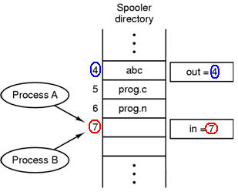
Race Conditions
Two or more threads concurrently access a shared resource:
The final state of a resource is unpredictable and could be inconsistent.
If the resource is code fragment then the result can not be predicted.
Two processes want to access shared memory at the same time.
Tanenbaum, Fig. 2-21.
Ex: A queue is used to manage a spooler directory. Shared variables for managing the queue: out: index for dequeuing, in: index for enqueuing . Two thread concurrently enqueue a string to the queue.

Slide 49
Race Conditions …
Other example in practically
The bank account has the balance as 800, and can withdraw with 2 ATM cards at different 2 locations at a time
First, the user1 pushes card to ATM machine and checking account’s balance. The process P1 is created simultaneously in server. Then the checking result is 800. The user choose withdrawing 400
Second, in the other location, the user2 also do same things as user1 and process P2 is created. The user choose withdrawing 500
In the case, if the P1 is out of time slice, the P2 is served first then user 2 gets 500. Later, does the user1 get 400 or get the error message?

Slide 50
2.3.3- Critical Regions – Vùng găng
The part of program where the shared memory is accessed (The code regions where race conditions appear)
The same code are executed by two or more threads.
Are the areas of code whose execution must be regulated to guarantee predictable results
To avoid races, we could arrange matters such that no two processes were ever in their critical regions
Conditions required to avoid race condition:
No two processes may be simultaneously inside their critical regions.
No assumptions may be made about speeds or the number of CPUs.
No process running outside its critical region may block other processes.
No process should have to wait forever to enter its critical region.

Slide 51
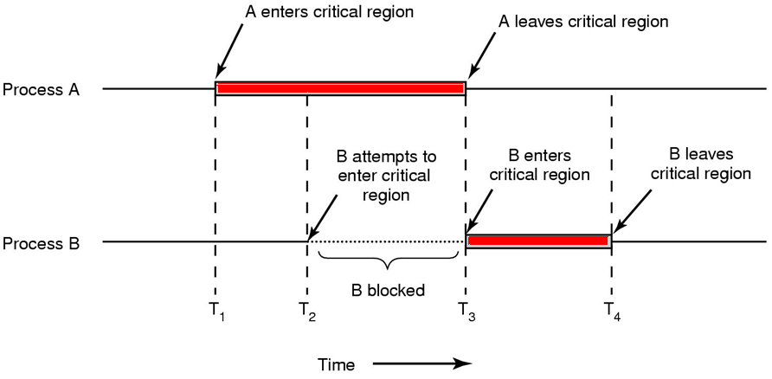
Critical Regions…
Tanenbaum, Fig. 2-22. Mutual exclusion using critical regions.

Slide 52
2.3.4- Mutual Exclusion with Busy Waiting
Mutual Exclusion – loại trừ hỗ tương
If one thread is executing in its critical section, no other threads can be executing in their critical sections (Only one process can use a shared resource at one moment)
Use an extra variable to lock common share resource (spin lock: khoá xoay vòng giúp các process/thread lần lượt truy xuất tài nguyên chung).
Proposals for achieving mutual exclusion:
Disabling interrupts
Lock variables
Strict alternation
Peterson's solution
The TSL instruction ( test and set lock)
A way to avoid race conditions is create one or more extra variables to make a serial accessing common resource. Before accesing common resources, all extra variables must be tested.

Slide 53
Busy Waiting: A Study Problem
Time
Person A
Person B
3:00
Look in fridge. Run out of milk.
3:05
Go to the store.
3:10
Arrive at store.
Look in fridge. Run out of milk.
3:15
Buy milk.
Go to the store.
3:20
Arrive home, put milk away.
Arrive at store.
3:25
Buy milk.
3:30
Arrive home, put milk away.
Not a good cooperation => Too much milk.
Correctness requirements:
Never more than one person buys milk .
Someone buys if needed.
This solution of this case (mutual exclusion) is called an synchronization.

Slide 54
Busy Waiting: Disabling Interrupts
Interrupt: A signal is sent to CPU from an IO device to announce that an IO operation terminated.
On a single-processor system, each process
Disable all interrupts just after entering its critical region → Scheduler must wait until all code in critical region terminate.
Re-enable them just before leaving it
→ A process can examine and updated shared memory without fear that any other process will intervene (xen vào)
Disadvantages: Give user processes the power to turn off interrupts (if a process dies while it is in its critical region → the system is indefinitely blocked)
On a multiprocessor: The disabling interrupts affects only the CPU that executed the disable instruction while the other ones will continue running and can access the shared memory.
→ Disabling interrupts is often a useful technique within the OS itself but is not appropriate for user processes.

Slide 55
Busy Waiting: Lock Variables
An extra variable (lock) is used as a flag to allow threads entering the critical region (CR).
// Code of a thread
while(TRUE) {
while (lock == 1); //waiting until lock is set to 0
lock = 1; // set the flag on to enter the CR
critical_region(); // enter the CR
lock = 0; // clear the flag just before going out the CR
nonCritical_region(); // going out the CR
}

Slide 56
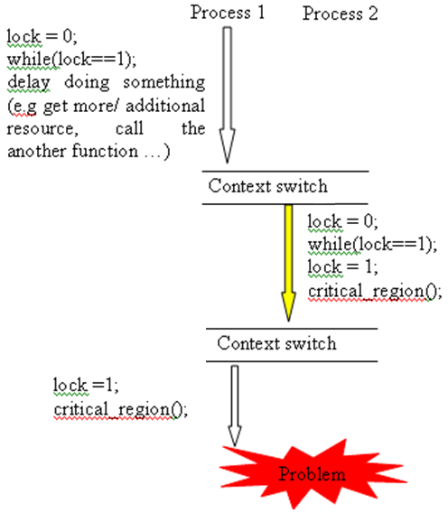
Busy Waiting: Lock Variables
The solution fails occasionally: both processes can be simultaneously in their own critical regions.
Process A reads the lock and sees that it is 0
Before it can set the lock to 1, Process B is scheduled, run, and set the clock to 1 (then Process A set the clock to 1)

Slide 57
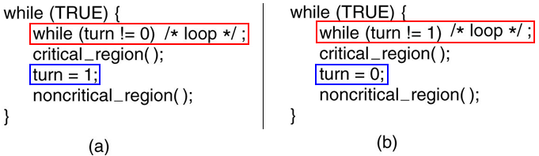
Busy Waiting : Strict Alternation
Code of the Process 0
Code of the Process 1
A proposed solution to the critical region problem. Tanenbaum, Fig. 2-23.
The two processes strictly alternate in entering their critical regions ( turn is as a lock ).
Problems
Testing a variable until some value appears is called busy waiting (wastes CPU time → disadvantage)
A process is being blocked by another process not in its critical region
One of process is much slower than the other.
When one process dies, the other ones are blocked forever.

Slide 58
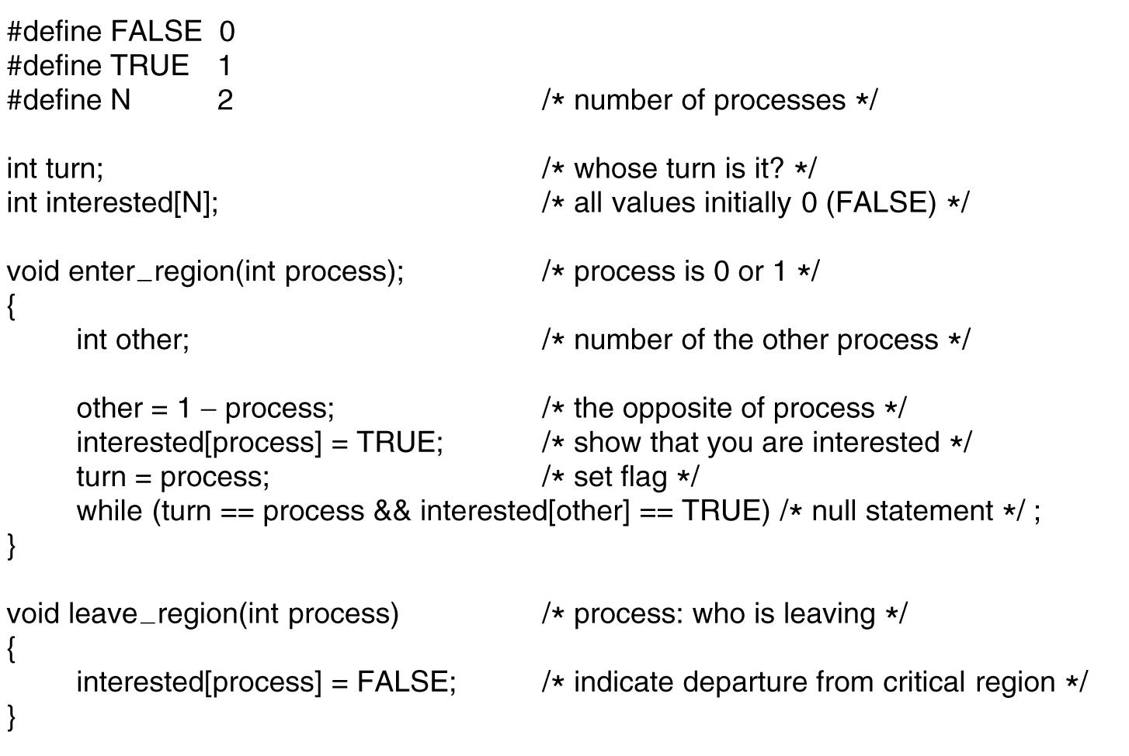
Busy Waiting : Peterson’s Solution
Combines the idea of taking turns with the idea of lock variables and strict alternation.
Use two locks: the turn and interested[i] variables for the process i.
Solution for process P_{i}
do {
enter_region(i);
critical_region();
leave_region(i);
nonCritical_region();
}
while (TRUE);
Tanenbaum, Fig. 2-24.

Slide 59
Busy Waiting : Peterson’s Solution…
Mutual exclusion is preserved
P_{i} enters its critical section only if either interested [j]=false or turn=j.
If both processes want to enter their critical sections at the same time, then interested [i] = interested [j] = true.
However, the value of turn can be either 0 or 1 but cannot be both. Hence, one of the processes must have successfully executed the while statement (to enter its critical section), and the other process has to wait, till the process leaves its critical section → mutual exclusion is preserved.

Slide 60
Busy Waiting : The TSL Instruction
TSL: Test and Set Lock, a pre-define assembly instruction → Hard lock
Instruction form: TSL RIGISTER, LOCK
This instruction will carry out 2 steps: Reads the content of the variable LOCK into a register then stores a nonzero value (1) at the memory address lock automatically.
Both 2 above steps are made atomically (indivisible – no processor can access memory word until the instruction is finished)‏
Different from Disabling interrupts: disabling interrupts then performing a read on a memory word followed by a write does not prevent a second processor on the bus from accessing the word between the read and the write
If LOCK is 0, a process will access the critical region. When it finishes, it set LOCK to 0.
enter_region:
TSL REGISTER, LOCK
CMP REGISTER, #0
JNE enter_region
RET
leave_region:
MOVE LOCK, #0
RET
Tanenbaum, Fig. 2-25.

Slide 61
Busy Waiting : The TSL Instruction
The XCHG instruction ( on Intel x86 CPU): an alternative to TSL:
Enter_region: MOVE REGISTER, #1 XCHG REGISTER, LOCK CMP REGISTER, $0 JNE Enter_region RET | Leave_region: MOVE LOCK, #0 RET

Slide 62
2.3.5- IPC: Sleep and Wakeup
Both Peterson and TSL have defect- nhược điểm- of requiring “busy waiting“ ➔ Waste CPU time, Priority inversion.
Solution: the pair sleep and wakeup is used to direct blocking instead of wasting CPU time when the processes are not allowed to enter their critical regions.
Sleep is a system call that causes the caller to block, that is, be suspended until the another process wakes it up.
Wakeup call has one parameter (the process to be awakened - ready).
Alternatively, both sleep and wakeup each have one parameter, a memory address used to match up sleeps and wakeups.

Slide 63
Sleep and Wakeup: Producer-Consumer Problem
Is known as the bounded-buffer problem
Two processes share comment, fixed-size buffer.
The producer puts information into the buffer.
The consumer takes it out.
Sleeping conditions
For producer, buffer full.
For consumer, buffer empty.
Wakeup conditions
For producer, there is space in buffer.
For consumer, there are messages in buffer.

Slide 64
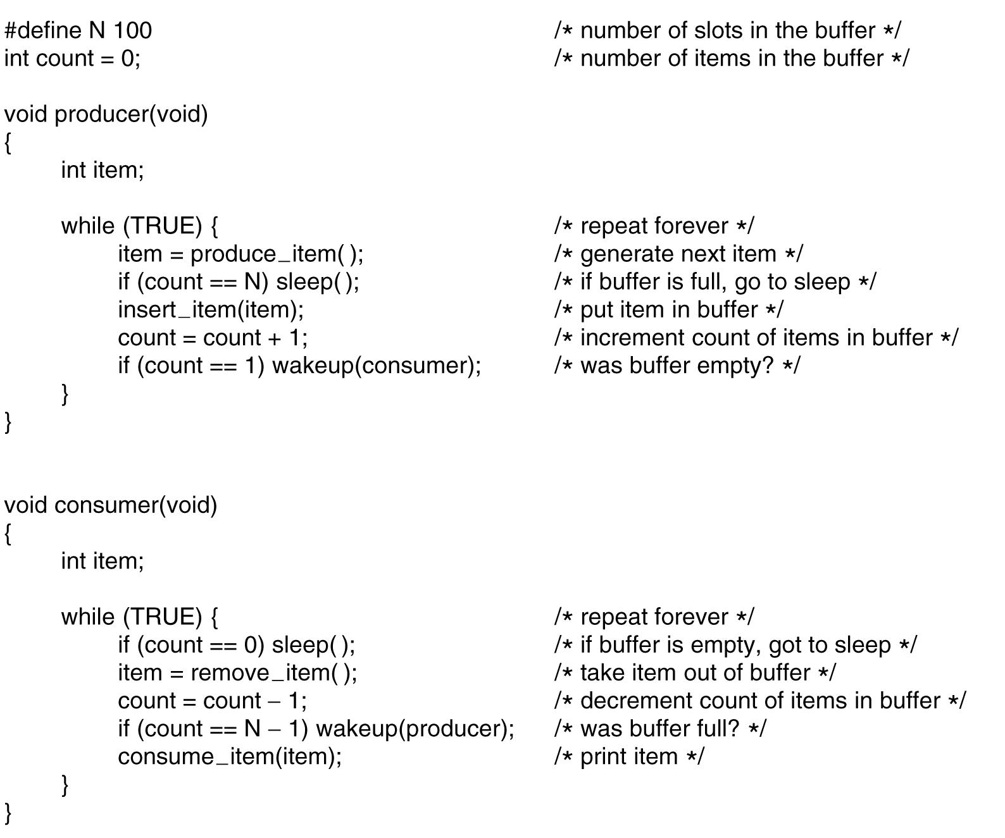
Sleep and Wakeup: Producer-Consumer Problem…
There are two problems:
Uncontrolled concurrent access to variable count
Wakeup signalization can be lost
Tanenbaum, Fig. 2-27.

Slide 65


Sleep and Wakeup: Producer-Consumer Problem…
Above functions are executed incorrectly at the statements “count = count + 1” of producer and “count = count – 1” of consumer if the functions run concurrently
Suppose that the value of the variable counter is 5.
Then the value of the variable of counter may be 4, 5, or 6!!
Two statements may be implemented in a machine language as

Slide 66
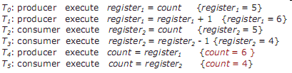
Sleep and Wakeup: Producer-Consumer Problem…
The first problem:
Uncontrolled concurrent access to variable count
The second problem
Wakeup signalization can be lost
Problems
The buffer is empty and the consumer has just read count = 0 -> consumer sleep, producer wakeup and insert data
Count =1, consumer is sleeping, thus the producer calls wakeup consumer
Consumer is not yet logically asleep, so the wakeup signal is lost

Slide 67
2.3.6- Semaphores
(E.W.Dijkstra, 1965):
A new variable type (semaphore) could have
The value 0: no wakeups were saved
The positive value: one or more wakeups were pending
Two operations
down (sleep)
Checking the semaphore value is greater than 0. If so, it decrements its value & continues, otherwise blocks the current process
checking the value, change it, and possibly going to sleep, are all done as single, indivisible atomic action
Once a semaphore operation has started, no other process can access the semaphore until the operation has completed or blocked
up (wakeup)
increments the semaphore’s value and wakes up a sleeping process (indivisible)
no process ever blocks doing an up, just as no process ever blocks doing a wakeup in the earlier model
Semaphores solve the lost-wakeup problem
Semaphore: a nonnegative integral counter.

Slide 68
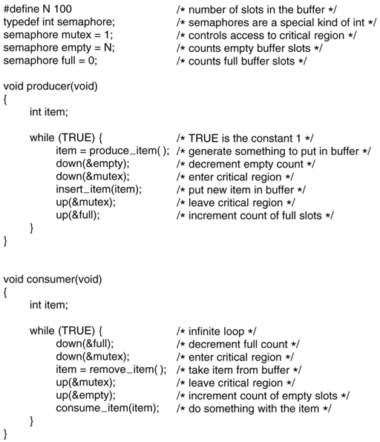
Semaphores: Solving Producer-Consumer Problem
Uses 3 semaphores
full: counting the full slots (0)
empty: counting the empty slots (n slots)
mutex: make sure the producer and consumer do not access the buffer (1)

Slide 69
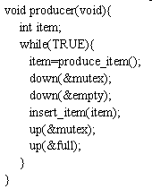
Semaphores: Solving Producer-Consumer Problem…
There are two ways of using semaphores:
Mutual exclusion – binary semaphores
Only one process can enters its critical region (reading or writing the buffer) at the same time
Synchronization – Condition checking
Ensure the producer stops running when the buffer full and the consumer stops running when it is empty
That leads to complicated and tricky solutions that can generate deadlocks
Two downs were reversed in order in the producer
So, mutex was decremented before empty
If buffer is full, mutex equals 0 before empty decrease → producer is blocked
In next time, the consumer tried to access the buffer, it would do down on mutex to 0 → consumer is also blocked, too
→ both producer and consumer are blocked forever
→ be carful to use semaphores

Slide 70
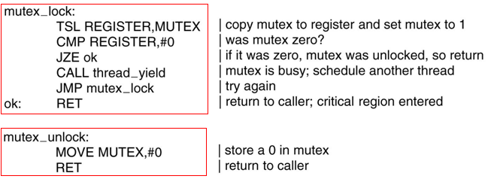
2.3.7- Mutexes
Mutex: Binary flag (binary semaphore. Good for managing mutual exclusion to some shared resource or piece of code (it is easy and efficient to implement using thread in user mode)
A mutex is a variable that can be in one of two states
unlocked (0): the calling threads is free to enter the critical region
locked (1): the calling thread is blocked until the thread in the critical region is finished (busy)
Two procedures are used
mutex_lock: is called when a thread needs access to a critical region
mutex_unlock: is called when a thread in the critical region is finished
Tanenbaum, Fig. 2-29.

Slide 71
2.3.8- Monitors
Is a proposal of Brinch Hansen (1973) and Hoare (1974)
Is a collection of procedures, variables, and data structures that are all grouped together in a special kind of module or package
Processes may call the procedures in a monitor whenever they want to, but they cannot directly access monitor‘s internal data structures from procedures declared outside the monitor (encapsulation)
Only one process can be active in a monitor at any moment (mutual exclusion)
Monitors are programming language constructs
When a process calls a monitor procedure, it must check to see if any other procedure in currently active within monitor. If so, the calling process is suspended until the other leaves. Otherwise, it enters the monitor
Monitor are implemented using
Mutual exclusion in monitor is ensured by the compiler
Condition variables: provide the possibility of waiting

Slide 72
Monitors: Condition Variables
Used to wait for a specific condition to be fulfilled
Two operations
wait(): current process sleep, waiting (block state)
signal(): a sleeping process is awaked
When a process calls wait, the other processes get access into the monitor
The wait must come before the signal and keep track the state of each process with variables to ensure the signal losing.

Slide 73
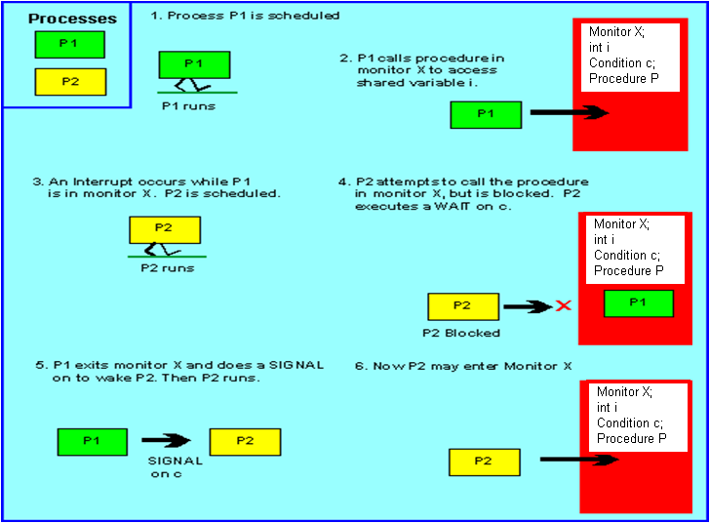
Monitor Functions

Slide 74
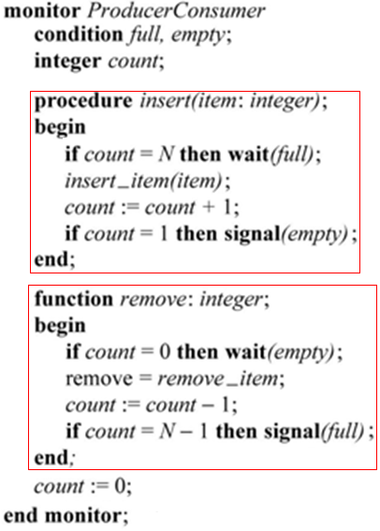
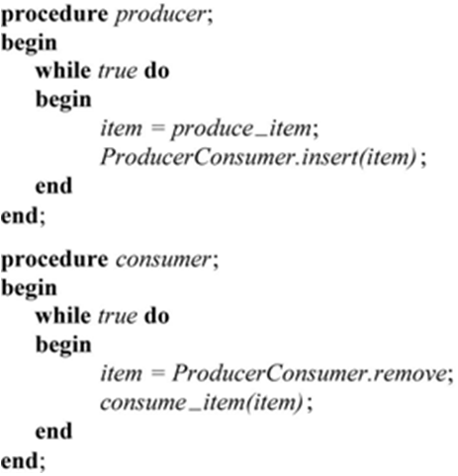
Monitor: Solving Producer-Consumer Problem
Encapsulation
Tanenbaum, Fig. 2-34.

Slide 75
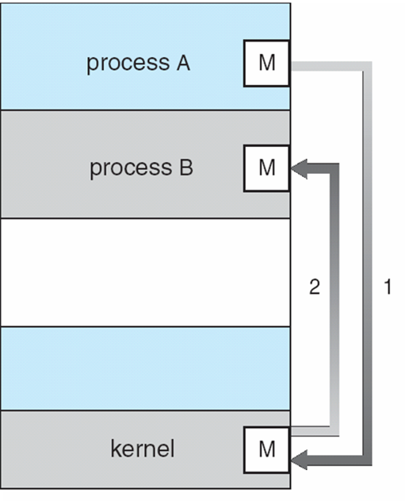
2.3.9- Message Passing
Using system calls (like semaphore) with 2 primitives
send (destination, &message): sends a message to given destination
receive (source, &message): receives a message from a given resource. If no message is available, the receiver can block until one arrives
Message-Passing System is used for the communicating processes are on different machines connected by a network
To guard against lost messages, sender and receiver can agree that as soon as a message has been received, the receiver will send back a special acknowledgement message (ensuring both process are blocked forever)

Slide 76
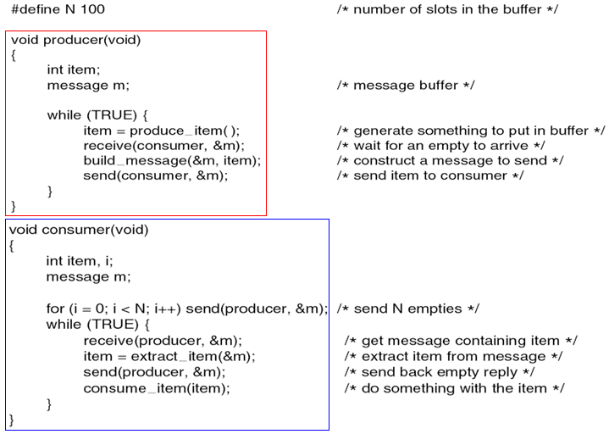
Message Passing: Solving Producer-Consumer Problem
Tanenbaum, Fig. 2-36.

Slide 77
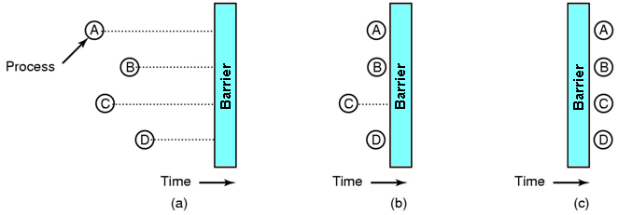
2.3.10- Barriers
Is intended for groups of processes rather than two process producer-consumer type situations
The applications are divided into phases and have the rule that no process may proceed into the next phase until all processes are ready to proceed to the next phase.
This behavior may be archived by placing a barrier at the end of each phase. When a process reaches the barrier, it is blocked until all processes have reached the barrier.
Tanenbaum, Fig. 2-37.

Slide 78
InterProcess Communication (IPC) Summary
Overview
Race Conditions
Critical Regions
Mutual Exclusion with Busy Waiting:
(Disable Interrupts, Lock Variables, Strict Alternative, Peterson’s solution, TSL instructions)
Sleep and wakeup
Semaphores
Mutexes
Monitors
Message Passing
Barriers

Slide 79
Summary
Processes
Threads
InterProcess Communication
Q&A

Slide 80
Keep in Your Mind
Process: a program in running
Process has it’s own resources (memory for code and data, CPU, files,…)
Information about each process is maintained by OS in Process Control Blocks
Ways to create a process: By system, by user, by other process, by batch file
Processes in UNIX are managed by a process hierarchy
In Windows, all processes are equal.
Ways which a process termnates: Normal exit, error exit (voluntary, non-voluntary, killed)
States of a process: New (optional), ready, running, blocked, terminated(optional)
Interupt vector: List of routines for processing IO devices
CPU utilization = 1 - p^{n}
Context switch: An overhead must be paid when a process (thread) used up it’s time slice. It’s information must be stored in it’s PCB and it is temporarily stoped and the scheduler will choose another process(thread) and makes it the current process.
Thread: unit of execution in a process

Slide 81
Keep in Your Mind
Threads can be managed in kernel or user mode
The main disadvantage when threads are managed in user mode (program runtime environmant) is if a thread is blocked, all process is blocked too.
When is the scheduler activated? → Whenever a change occurs in the PCBs or thread table.
Race condition: A situation in which some processes (threads) concurrently access common resources.
A way to avoid race conditions is making all accesses to common resources must be carried out sequentially through some extra variables. Before accessing common resources, values in extra variables must be tested.
To supports processes in comunicating with others and still all protection rules must be followed, OS allows processes communicate with others through a common OS’s buffer
Barrier: A technique allows a group of prosesses/threads must terminate together.

