Slide 1
3 Processes and Threads Part 2
Chapter 2- Part 2
Scheduling Classical InterProcess Communication Problem

Slide 2
Objectives
Scheduling
Introduction
Process Behavior
When to schedule?
Categories of Scheduling algorithms
Criteria/ Properties and Term
Scheduling in Batch Systems
Scheduling in Interactive Systems
Scheduling in Real-time Systems
Thread scheduling
Classical IPC Problems
The Dining Philosophers Problem
The Readers and Writers Problem

Slide 3
3.1- Introduction to Scheduling
Scheduler
It is an OS component that decides what process will be run and for how long based on some scheduling algorithms.
On OSs that support kernel-level threads, threads are scheduled also.
History
In the old days of batch system with input the form of card images on a magnetic tape: just run the next job on the tape.
In early computers, CPU time was a scarce (khan hiếm) resource: good scheduling was of paramount (tối cao) importance!
Nowadays, the CPU is not a scarce resource any more! Furthermore, in PCs there aren’t many users competing… However, scheduling algorithms have become more sophisticated!
Notes:
Scarce: khan hiếm
Paramount: tối cao

Slide 4
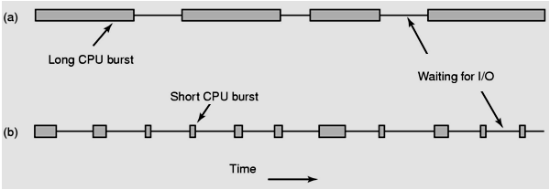
Introduction: Process Behavior
All process execution consists of a cycle of bursts of computing (CPU execution) and I/O request (I/O wait)
Based on CPU burst, processes are classified in to 2 types:
Compute-bound processes
Spend most of their time computing
Have long CPU bursts and thus infrequent I/O waits
I/O-bound processes
Spend most of their time waiting for I/O
Have short CPU bursts and thus frequent I/O waits
2 process
types
Tanenbaum, Fig. 2-38.
Notes:
Burst: háo hức

Slide 5
Introduction:When to schedule?
A key to scheduling: scheduling decisions
Situations in which scheduling is needed:
1) Process creation
A decision needs to be made whether run the parent or child process
2) Process termination
A decision must be made when a process exits. That process can no longer run, so some other process must be chosen from the set of ready processes. If no process is ready, a system-supplied idle process is normally run
3) Process blocking
When a process blocks, another process has to be selected to run
4) Interrupt occurrence due to IO device or hardware
→ Whenever there is a change in PCBs/thread table

Slide 6
Introduction:When to schedule…
Concepts: How does CPU know that an IO device completed it’s work?
Depending on the CPU architecture, one of two following apprroaches is used:
Use interrupt, a signal is sent to CPU from the device (Intel CPU)
CPU periodically scan register/buffer of each IO device → A clock tick (periodic pulse) is needed.
These things affect on selected algorithm for scheduling.
CPU
IO (Interrupt)Controller
Keyboard
Monitor
Others
CPU
IO Poller
Keyboard
Monitor
Others

Slide 7
Introduction:When to schedule…
Interrupt occurrence
If the interrupt came from an I/O device that has now completed its work, some processes that were blocked waiting for the I/O may now be ready to run.
If hardware clock provides periodic interrupt:
Preemptive (ưu tiên)/non-preemptive scheduling algorithms
CPU scheduling decisions may take place when a process:
Switches from running to blocked state (I/O or wait for child processes).
Switches from running to ready state (interrupted).
Switches from blocked to ready (completion of I/O).
Terminates.
→ The process executes following above steps in order, we can say it is scheduled in non-preemptive. Otherwise, it is scheduled in preemptive.

Slide 8
Introduction:When to schedule…
non-preemptive scheduling algorithms
Picks a process to run and then just lets it run until it blocks or until it voluntarily releases the CPU (will not be forceably suspended, no scheduling decisions)
Once a process is in the running state, it will continue until it terminates or blocks itself for I/O
Applying to the batch system
preemptive scheduling algorithms
The process can run (continuously) for a maximum of some fixed time. If it enters the suspended state, the scheduler will pick another process to run (→ A timer is needed).
Currently running process may be interrupted and moved to the ready state by the operating system
Allows for better service since any one process cannot monopolize (use) the processor for very long.
Applying to the time-sharing or real time.

Slide 9
Categories of Scheduling Algorithms
Base on the environment worth:
1) In Batch Systems: A system that processes data in discrete groups of previously scheduled operations rather than interactively or in real time.
Non-preemptive (không ưu tiên) algorithms
Preemptive algorithms with long time periods for each process
➔ Reduces processes switches and increase performance
2) In Interactive Systems
Preemptive algorithms are needed to prevent the situation that the preemptive keeps one process from hogging (lấn phần) the CPU and denying service to the others. Even if no process intentionally ran forever, one process might shut out all the others indefinitely due to a program bug.
3) In Real-Time Systems
Preemption normally used, but sometimes not needed because the processes know that they may not run for long periods of time and usually do their work and block quickly.

Slide 10
Criteria/Property and Terms
Fairness – equivalent processes get equivalent CPU times
Policy enforcement – if the local policy is that safety control processes get to run whenever they want to, even if it means the payroll is 30 sec late, the scheduler has to make sure this policy enforced
Policy vs. Mechanism
The policies is what is to be done
The mechanism specifies how it is to be done
The mechanism is a thing that implements the policy
Ex:
The timer constructed for ensuring CPU protection (mechanism)
The decision of how long the timer is set for a particular user (policy)

Slide 11
Terms
Throughput: (năng suất) the number of processes that complete their execution per time unit.
For example – for long processes, the rate may be one process per hour. For short processes, it may be 10 processes per second.
Turnaround time: (tổng thời gian thực thi) Amount of time to execute a particular process.
periods spent waiting in the ready queue + executing time on the CPU + time for I/O + …
Is the time from the process is submitted until it is completed (time of complete – arrival time)

Slide 12
Terms
CPU utilization: The utilization of CPU.
Can range from 0 to 100 percent. It should range from 40 percent (lightly loaded system) to 90 percent (heavily used system).
Response time: (Thời gian đáp ứng) This measure is the amount of time it takes from when a request was submitted until the first response is produced.
In an interactive system, turnaround time may not be the best criterion.
Often, a process can produce some output fairly early and can continue computing new results.
Proportionality – tính cân đối
When a request that is perceived (nhận thức) as complex takes a long time, users accept that, but when a request that is perceived as simple takes a long time, users get irritated (khó chịu, bực mình)

Slide 13
Scheduling Algorithm Goals
All systems
Fairness – giving each process a fair share of CPU
Policy enforcement – seeing that stated policy is carried out
Balance – keeping all parts of the system busy
Batch systems
Throughput – maximize jobs per hour
Turnaround time – minimize time between submission and termination
CPU utilization – keep the CPU busy all the time
Interactive systems
Response time – respond (react) to request quickly
Proportionality – meet, if possible, user’s expectations
Real-time systems
Meeting deadlines – avoid losing data
Predictability – avoid quality degradation in multimedia systems

Slide 14
3.2- Scheduling in Batch System
Batch System: A system that processes data in discrete groups of previously scheduled operations rather than interactively or in real time.
Algorithms
First Come First Served (FCFS)
Time-based:
Shortest Job First (SJF)
Shortest Remaining Time Next (SRT)
Evaluation
Average waiting time
Average turnaround time

Slide 15
3.2.1- The FCFS Algorithm
First-Come-First-Served
Processes are assigned the CPU in the order they request it.
It is
the simplest CPU scheduling algorithm .
non-preemptive (không ưu tiên) algorithm.
It requires a single queue of ready processes:
If a process enters the ready state, it is linked onto the tail of the ready queue.
If the CPU is free, the process at the head of the queue will be assigned to it.
If a running process is blocked, it is treated as new process and it is put back to the tail of the waiting list.
The time-slicing mechanism is not used.

Slide 16
The FCFS Algorithm…
Great strength: Simple to understand and implement.
Powerful disadvantage:
All the other processes wait for the one big process to get of the CPU → Result in lower CPU and device utilization.
The above situation is called a convoy effect (hiệu ứng hộ tống).

Slide 17
FCFS Algorithm Evaluation
Ex: 3 processes are ready in order and their process time: P1 (24 ms) , P2(3 ms), P3 ( 3 ms)
Process | Burst time | Waiting time | Turnaround time
P1 | 24 | 0 | 24
P2 | 3 | 24 | 27
P3 | 3 | 27 | 30
Sum | 30 | 51 | 81
+
=
Average waiting time = 51/3= 17
Average Turnaround time: = 81/3 = 27
Do yourself: 3 processes:
(Process:BurstTime) in order (P2:3), (P3:3), (P1:24)

Slide 18
FCFS Evaluataion: Do yourself
Process | Arrival Time | Service Time
A | 0 | 3
B | 2 | 6
C | 4 | 4
D | 6 | 5
E | 8 | 2
Avg waiting time = ?
Avg turnaround time = ?
0 | 1 | 2 | 3 | 4 | 5 | 6 | 7 | 8 | 9 | 10 | 11 | 12 | 13 | 14 | 15 | 16 | 17 | 18
A
 |  | B
 |  |  |  | C
 |  |  |  |  |  | D
 |  |  |  |  |  |  |  | E
Turn-around time = time of complete – arrival time

Slide 19
3.2.2- The Shortest Job First (SJF) Algorithm
Runtime is known in advance (nonpreemptive)
When several equally important jobs are sitting in the input queue waiting to be started, the scheduler picks the shorted job first
Another more appropriate term – shortest-next-CPU-burst scheduling algorithm
When the CPU is available, it is assigned to the process that has the smallest next CPU burst
→ Sort all processes based on CPU burst ascending
Is the optimal algorithm (only) when all the jobs are available simultaneously?

Slide 20
SJF Algorithm Evaluation
Ex: 4 simultanous incoming processes
(Process:BurstTime) (P1:6), (P2:8), (P3:7), (P4: 3)
Sorted list: P4(3), P1(6), P3(7), P2(8)
Process | Burst time | Waiting time | Turnaround time
P4 | 3 | 0 | 3
P1 | 6 | 3 | 9
P3 | 7 | 9 | 16
P2 | 8 | 16 | 24
Sum | 24 | 28 | 52
Avg |  | 28/4= 7 | 52/4= 13
+
=
Do yourself: 6 Simultanous incoming processes
(Process:BurstTime) (P1:5), (P2:8), (P3:6), (P4: 3), (P5:26), (P6: 6)

Slide 21
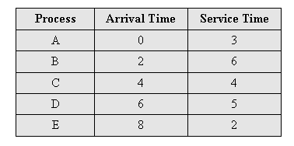
SJF Algorithm Evaluation
P | BT | WT | TT
A | 3 | 0 | 3-0=3
B | 6 | 3-2 =1 | 9-2=7
E | 2 | 9-8=1 | 11-8=3
C | 4 | 11-4=7 | 15-4=11
D | 5 | 15-6=9 | 20-6=14
Sum | 20 | 18 | 38
AVG |  | 3.6 | 7.6
0 | 1 | 2 | 3 | 4 | 5 | 6 | 7 | 8 | 9 | 10 | 11 | 12 | 13 | 14 | 15 | 16 | 17 | 18 | 19 | 20 | 21
A
 |  | B
 |  |  |  | C
 |  |  |  |  |  | D
 |  |  |  |  |  |  |  | E
(B,6)
Queue
(C,4)
(C,4)
(D,5)
(E,2)
(C,4)
(D,5)
(C,4)
(D,5)
(D,5)

Slide 22
SJF Algorithm Evaluation
Do yourself: 6 incoming processes
Average waiting time= ?
Average turnaround time = ?
Process | Arrival Time | Service Time
A | 0 | 5
B | 1 | 3
C | 2 | 2
D | 3 | 1
E | 4 | 7
F | 5 | 4

Slide 23
3.2.3- The SRT Algorithm
SRT: Shortest Remaining Next
Is a preemptive version of shortest job first
The scheduler always chooses the process whose remaining runtime is the shortest
Preempt the currently executing process, if the next CPU burst of the newly arrived process is shorter than “what is left” of the currently executing process
When a new job arrives, its total is compared to the current process’s remaining time.
If the new job needs less time to finish than the current process, the current process is suspended and the new job started

Slide 24
SRT Algorithm Evaluation
Ex: (Process:ArrivalTime:BurstTime):
(P1:0:9), (P2:2:4), (P3:4:1), (P4:5:4)
Process | Time | Execute | Process:remaining
P1:9 → | 0 | P1 | P1:9
 | 1 | P1 | P1:8
P2:4 → | 2 | P2 | P2:4, P1:7
 | 3 | P2 | P2:3, P1:7
P3:1 → | 4 | P3 | P3:1, P2:2, P1:7
P4:4 → | 5 | P2 | P2:2, P4:4, P1:7
 | 6 | P2 | P2:1, P4:4, P1:7
 | 7..10 | P4 | P4:4→0, P1:7
 | 11.. 17 | P1 | P1:7 → 0
 | 18 |  | finished
P | BT | WT | TT
P1 | 9 | 0+(11-2)=9 | 18
P2 | 4 | 0+1=1 | 5
P3 | 1 | 0 | 1
P4 | 4 | 2 | 6
Sum | 18 | 12 | 40
Avg |  | 12/4=3 | 30/4=7.5

Slide 25
SRT Algorithm Evaluation
Do yourself: 6 incoming processes
Average waiting time= ?
Average turnaround time = ?
Process | Arrival Time | Service Time
A | 0 | 5
B | 1 | 3
C | 2 | 2
D | 3 | 1
E | 4 | 7
F | 5 | 4

Slide 26
3.3- Scheduling in Interactive Systems
Interactive Program: A program that exchanges output and input with the user, who typically views a display of some sort and uses an input device, such as a keyboard, mouse, or joystick, to provide responses to the program.
Interactive System: The OS supports interactive processes.
Pattern for interactive processes:
Wait for command, execute command, and so on.
→ Command periods can be estimated.
Algorithms:
Round Robin scheduling, Priority scheduling
Multiple queues scheduling, Shortest Process Next
Guaranteed Scheduling, Lottery scheduling
Fair-Share Scheduling
Notes:
Period: chu kỳ

Slide 27
3.3.1- Round-Robin Scheduling (RR)
Oldest, simplest, fairest, most widely used.
Assumption: All processes are equally important.
Each process is assigned an equal time interval ( quantum/ time-slice).
When the process uses up its quantum or it blocks, it is move to the end of the queue and CPU is assigned to the process at the head of the queue → The queue is treated as circular queue)
It is similar to the First-Come-First-Served algorithm.
Quantum=3
P1
P2
P3
P4
P2
P3
P4
P1
Current process
Current process
t=0
t=3

Slide 28
Round-Robin Scheduling (RR)…
The length of the quantum
Too short → lower the CPU efficiency and causes too many process switches. Ex: Quantum = 4 ms, swiching overhead= 1ms
➔ CPU waste = 1/(1+4)=20%
Too long → poor response to short interactive requests (the same disadvantage as in FCFS). Ex: Quantum = 99ms, swiching overhead= 1ms ➔ CPU waste = 1%
20-50 msec is a reasonable compromise.

Slide 29

Round-Robin Scheduling (RR)…
Ex: With quantum=4, switching overhead=0,
3 processes come:
(Process:BurstTime) (P1:24), (P2:3), (P3:3)
Average waiting time = (6 + 7 + 4)/3 = 5.7
Average turnaround time = (30 + 7 + 10)/ 3 = 15.6
Ex: With quantum=4, switching overhead=1
- Average waiting time = ((13-4) + (5-0) + (9-0))/3 = 23/3 = 7.8
Average turnaround time = ((33-0) + (8-0) + (12-0))/ 3 = 53/3=17.8
0 | 4 | 5 | 8 | 9 | 12 | 13 | 33
P1 | Switch | P2 | Switch | P3 | Switch | P1 | Finished

Slide 30
Round-Robin Scheduling (RR)…
Do yourself:
With quantum=5, switching overhead=0, 6 processes come with burst time of each:
(P1:2), (P2:5), (P3:7), (P4:9), (P5:27), (P6:8)
Average waiting time =?
Average turnaround time = ?
The same problem but switching overhead = 1.

Slide 31
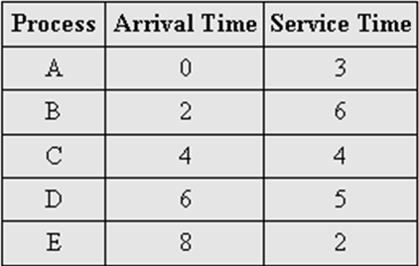
Round-Robin Scheduling (RR)…
0 | 1 | 2 | 3 | 4 | 5 | 6 | 7 | 8 | 9 | 10 | 11 | 12 | 13 | 14 | 15 | 16 | 17 | 18 | 19 | 20
A
 |  | B
 |  |  |  | C
 |  |  |  |  |  | D
 |  |  |  |  |  |  |  | E
Li st |  | B6 A1 | A1 B5 | B5 C4 | C4 B4 | B4 D5 C3 | D5 C3 B3 | C3 B3 E2 D4 | B3 E2 D4 C2 | E2 D4 C2 B2 | D4 C2 B2 E1 | C2 B2 E1 D3 | B2 E1 D3 C1 | E1 D3 C1 B1 | D3 C1 B1 | C1 B1 D2 | B1D2 | D2 | D1
Quantum=1
Avg waiting time = 6.8
Avg turnaround time = 10.8
Check these results.

Slide 32
3.3.2-Priority Scheduling
Each process has a priority assigned, an external factor.
The greatest priority (minimum value) runnable process is always run
Give a chance to other processes → change the priority of the running process or assign it a quantum
Priorities assignment
Statically: Static (or externally defined) priorities are predetermined for each process: E.g., the process of the boss; or the process of the guy who paid more than others to run on this machine
Dynamically: Dynamic (or internally defined) priorities are assigned by the system to achieve certain goals: E.g., boost the priority of I/O-bound processes

Slide 33

Priority Scheduling …
Priority classes (some processes are assigned the same priority)
Use priority scheduling between classes (4 class 1 – 4). Smaller number, the higher priority.
Use another scheduling algorithm with each class.
Ex: (Process:BurstTime:Priority)
(P1:10:3), (P2:1:1), (P3:2:4), (P4:1:2) → P2, P4, P1, P3
Average waiting time: (2 + 0 + 12 + 1)/ 4 = 3.75
Average turnaround time: (12 + 1 + 14 + 2)/ 4 = 7.25

Slide 34
Priority Scheduling… Example
Process | Arrival time | Service time | Priority
A | 0 | 3 | 4
B | 2 | 6 | 5
C | 3 | 4 | 3
D | 4 | 5 | 1
E | 6 | 2 | 2
Avg waiting time = 4.2
Avg turnaround time = 8.2
Check results!
0 | 1 | 2 | 3 | 4 | 5 | 6 | 7 | 8 | 9 | 10 | 11 | 12 | 13 | 14 | 15 | 16 | 17 | 18 | 19 | 20 | 21
A
 |  | B
 |  |  | C
 |  |  |  | D
Queue |  |  |  |  |  | E
A4 |  | B5 | C3 B5 | D1 B5 |  | D1 E2 B5 | E2 B5 | B5

Slide 35
Priority Scheduling…
Problem: Starvation
The low priority processes can be waited indefinitely (cannot be executed if the system occurred errors in runtime) for CPU by higher priority processes
Solution: Aging
Is a technique of gradually increasing the priority of processes that wait in the system for a long time (using the clock interrupt)
Ex: every 15 minutes, decreasing the priority of a waiting process from (1 → 127), means that the priority with 127 → 1 at least 32 hours
Notes:
Starvation: sự đói

Slide 36
3.3.3-Multiple Queues
One simple way of mapping priorities onto actual scheduling decisions would be to give to each process a time slice related to its priority (e.g., more time slice to higher-priority threads)
A more convenient approach is to view the ready state as not only one queue of processes, but multiple queues, each with its own priority!
Again, several options may exist:
Processes of queues of higher priority may have to complete before processes of queues of lower priority start running!
Higher priority queues may get more time than lower priority queues!
Processes may move between queues (dynamically adjusted priority)

Slide 37
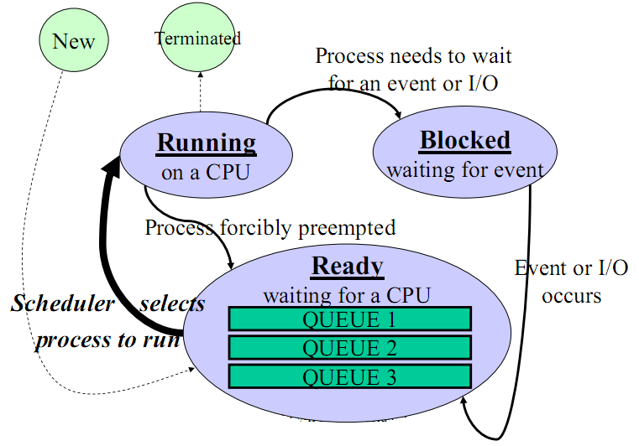
Multiple Queues…
Blocked processes are moved to the lowest priority queue
New process is put into the appropriate queue based on it’s priority

Slide 38
3.3.4- Shortest Process Next (SPT)
Non-preemptive policy (no external factor is used).
The shortest process will be choosen based on estimating.
How to update the estimate of each process? → The technique of estimating the next value in a series by taking the weighted average of the current measured value and the previous estimate is sometimes (the aging factor: 0≤a≤ 1). Its usual value is ½ due to the right-shift operation will be carried out very fast. Suppose that the estimated time per command for some terminal is T₀ . T₁ is real duaration of the next run. The new estimate will be: aT₀ + (1 – a)T₁ (general: T_{n+1} = aT_{n} + (1 – a)τ_{n+1}

Slide 39

Shortest Process Next (SPT)
Ex: a= ½, estimating time slice of a process:
10/2 + 6/2= 8

Slide 40
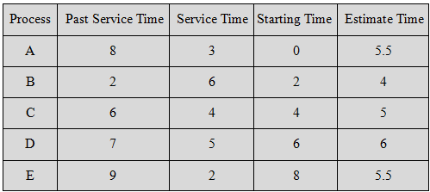
Shortest Process Next (SPT) Example
0 |  | 2 |  | 4 |  | 5.5 | 6 | 8 | 9 | 9.5 | 10 |  |  |  | 14.5 | 15 | 16 | 17 | 18 | 19 | 20 | 21 | 22 | 23 | 24 | 35 | 26
A
 |  | B (wait: 3.5)
 |  |  |  | C (wait: 5.5)
 |  |  |  |  |  |  | D (wait: 14)
 |  |  |  |  |  |  |  | E (wait: 6.5)
 |  | B | 4 | B C | 4 5 |  | C D | C E D | 5 5.5 6
a=0.5
Avg waiting time = 5.9
Avg turnaround time = 10.9

Slide 41
3.3.5- Guaranteed Scheduling
If a single-user system with n processes running, each one should get 1/n of the CPU cycles (fairness)
Mechanism
Initially, each process is allocated 1/n CPU time.
The system must keep track of how much CPU time each process has had since its creation.
Then, the system computes the amount of CPU time each one is entitled to (cho quyền), namely the time since creation divided by n ➔ t_{real}/ t_{entitled ,} the ratio represents the performance when a process is allocated CPU time.
The algorithm is then to run the process with the lowest ratio ( the process used CPU with the shortest time) until its ratio has move above its closet competitor (đối thủ)

Slide 42
3.3.6- Lottery Scheduling
Give processes lottery tickets
More important processes can be given extra tickets (to increase their odds of winning)
Whenever a scheduling decision has to made, a lottery ticket is chosen at random, and the process holding that ticket gets the resource
Lottery scheduling is highly responsive
Lottery scheduling can be used to solve problems that are difficult to handle with other methods.

Slide 43
3.3.7- Fair-Share Scheduling
The fairness is based on the number of users.
A situation: Each process is scheduled on its own, without regard to who its owner: if user 1 starts up 9 processes and user 2 starts up 1 process, with round robin or equal priorities, user 1 will get 90% of the CPU and user 2 will get only 10% of it
To prevent this situation, some systems take into account who owns a process before scheduling it. In this model, each user is allocated some fraction of the CPU and the scheduler picks processes in such a way to enforce it. Thus if two users have each been promised 50% of the CPU, they will each get that, no matter how many processes they have in existence.

Slide 44
3.4- Scheduling in Real-Time Systems
Context
A real-time system is one in which time plays an essential role
A real-time system has two kinds as hard real time and soft real time
A real-time system divides the program into a number of processes whose behavior is predictable and known in advance.
These processes are generally short lived and can run to completion in well under a second.
→ The scheduler schedules the processes in such a way that all deadlines are met.
Review
- Hard real-time system: System in which dealines must be met.
- Soft real-time system: System in which dealines may not be met.
Notes:
Known in advance: biết trước

Slide 45
Scheduling in Real-Time Systems
Static scheduling (applied to hard real-time)
Make their scheduling decisions before the system starts running
Only works when there is perfect information available in advance about the work to be done and the deadlines that have to be met
Dynamic scheduling (applied to soft real-time)
Make their scheduling decisions at runtime
Do not have static’s restrictions

Slide 46
3.5- Thread Scheduling
The kernel scheduler schedules the process.
The kernel scheduler may support scheduling threads.
The thread scheduler in each process decides which thread to run.
Applied algorithms are the same as in process scheduling.
In this section:
Schedule user-level threads
Schedule kernel-level threads

Slide 47
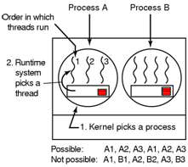
3.5- User-Level Thread Scheduling
If any thread have long CPU burst, this thread will consume all of process’s time (until it finishes) because the user mode is not supported clock interrupt.
Otherwise, each thread runs for a little, then it return the CPU back to the thread scheduler before the kernel allocate quantum to other process.
Tanenbaum, Fig. 2-43.
Round-robin and priority scheduling are usually applied.
Switching a thread takes a handful of machine instructions.
An application specific thread scheduler is used because it know what all the threads do to pick the needing thread to run.

Slide 48
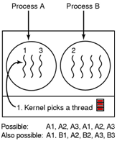
Kernel-Level Thread Scheduling
The kernel scheduler schedules threads → The kernel requires a full text switch (changing a memory map, invalidating caching … ), specially is the switching the thread in process to other thread in other process taking expensive costs. Moreover, the kernel would never know what each thread did.
Tanenbaum, Fig. 2-43.
→ User-level thread is more performance than kernel-level thread in scheduling

Slide 49
3.6- Policy vs. Mechanism
Policy: What is allowed to be done → It leaves the user processes
Mechanism: How it is done or implemented → It is put in the OS (kernel)
In scheduling, if kernel applies the priority scheduler with k priority levels
The mechanism
Building an sorted array of ready processes is indexed by priority level.
The scheduler searches the array for highest priority to lowest priority, selecting the first process it hits
The policy is setting the priorities corresponds with different users

Slide 50
3.7- Classical IPC Problems
Two classic problems in the interprocess communication are presented:
The Dining Philosophers Problem
The Readers and Writers Problem

Slide 51

3.7.1- The Dining Philosophers Problem
A circular table with 5 philosophers, 5 plates with spaghetti and 5 forks.
A philosopher needs two forks to eat. A philosopher eats (not thinks) and thinks (not eats)
When he/she gets hungry, she tries to pick up the two forks that are closer him/her. Obviously, he/she can not pick up forks that is already in the hand of a neighbour.
When he/she has finished eating, he/she puts down both forks and starting thinking again
Tanenbaum, Fig. 2-44 & 45.
Requirement: each philosopher does what it is supposed to do and never get stuck.
Notes:
Get stuck: hăng hái, vội vã

Slide 52
The Dining Philosophers Problem …
It represents the need to allocate several resources among several processes in
A deadlock (all of them take their left forks simultaneously. None will be able to take their rights fork)
Starvation (all of them could start the algorithm simultaneously, pick up their left forks, seeing that their right forks were not available, putting down their left forks, waiting, and picking up … forever)
5 philosophers are 5 processes(threads). They concurrently access common resources.

Slide 53
The Dining Philosophers Problem …
Solution 1: A random solution – only one person eats at a time → Low performance
The philosophers would just wait a random time instead of the same time after failing to acquire the right hand fork (that means all applications trying again later)
However, it is not adequate in the absolutely works
Solution 2: A adequate solution (applying binary semaphore) → Higher performance
Before starting to acquire forks, a philosopher would do a down on mutex
After replacing the forks, he/she would do an up on mutex
However, it has a performance bug (in practical), only one philosopher can be rating at any instant instead of two ones)
Solution: uses an array of state and semaphore combine with binary semaphore allowing the maximum parallelism for arbitrary number of philosophers by keeping track

Slide 54
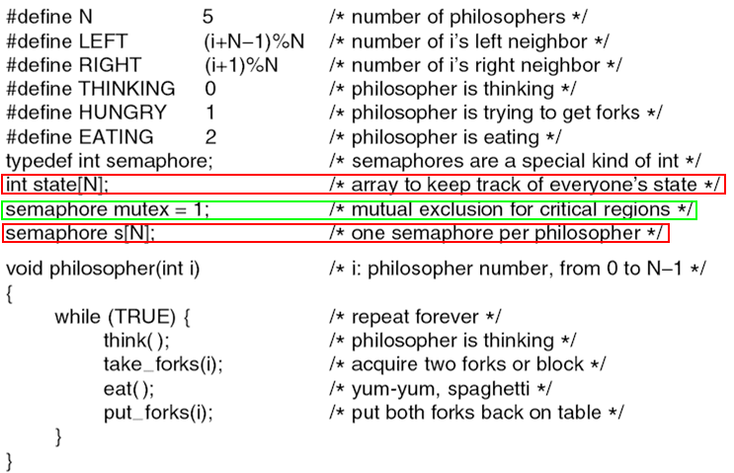
The Dining Philosophers Problem …
Tanenbaum, Fig. 2-46

Slide 55
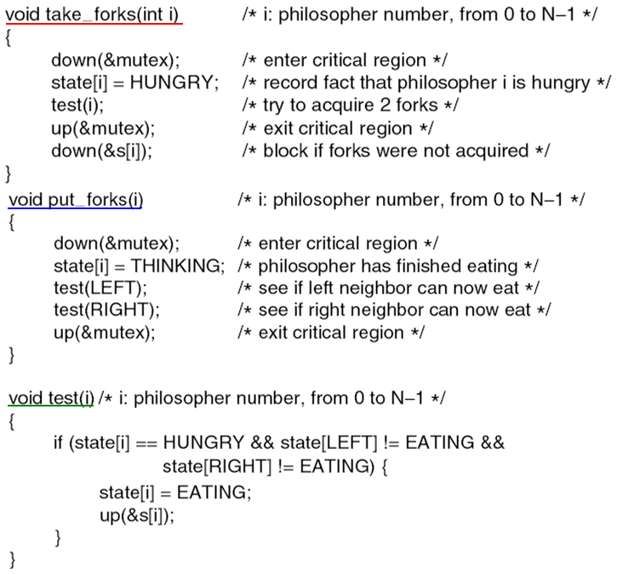
The Dining Philosophers Problem …
Tanenbaum, Fig. 2-46

Slide 56
3.7.2- The Readers and Writers Problem
Models access to a database (file)‏. Reader: process that read data: reader. Writer: process that modify data.
If two readers access the shared data simultaneously, no adverse affects will result
Multiple readers are allowed, but not in the same time with a writer. Only one writer is allowed to act on the database at one moment.
Solution: The readers-writers problem has several variations, all involving priorities.
The first readers-writers problem:
No reader will be kept waiting unless a writer has already obtained permission to use the shared object.
Or, no reader should wait for other readers to finish.
Or readers have higher priorities.
The second readers-writers problem:
Once a writer is ready, the writer performs its write as soon as possible.
Notes:
Adverse: bất lợi, có nguy hại

Slide 57
The Readers and Writers Problem…
Tanenbaum, Fig. 2-46.

Slide 58
The Readers and Writers Problem…
Tanenbaum, Fig. 2-46.

Slide 59
Keep in Your Mind
Scheduler: A part of the OS which will choose a process/thread and make it as the current process/thread whenever there is a change in the PCBs/thread table (creation, termination, blocking, interrupt occurs).
Based on process behaviors, processes are classified in to 2 types: Compute-bound and IO-bound processes
Depending on the CPU architecture, the CPU can know that an IO device completed it’s work as a result of polling mechanism or an interrupt is thrown by the IO device.
In non-preempty scheduling algorithms, the current process can prohibit interrupt in order to run until it releases the CPU.
In preemptive algorithms, each process is allocated a fixed duration for running (time slice, quantum).
Algorithm Evaluation:
Average waiting time
Average turnaround time
Waiting time: Sum of waiting time for running
Turnaround time = time of complete – arrival time

Slide 60
Keep in Your Mind
Scheduling algorithms for batch systems (1) First Come First Served (non-preemptive)
(2) Shortest Job First (non-preemptive, runtime is known in advance)
(3) Shortest Remaining Time First (a preemptive version of the SJF, runtime is known in advance)
Scheduling algorithms for interactive systems ( time slice can be pre-determined) (1) Round robin (time slice)
(2) Priority/ Multi queues (time slice)
(3) Shortest Process Next (non-preemptive, the runtime of each process is estimated)
(4) Guarranted scheduling (Each process uses 1/n CPU time)
(5) Lottery scheduling
(6) Fair-share scheduling: Processes of each user use 1/n CPU time (n=number of users)

Slide 61
Summary
Scheduling
Classical IPC Problem
Q&A

