Slide 1
4 Memory Management (4 slots)
Chapter 3-Part 1 No Memory Abstraction Address Space Virtual Memory Page Replacement Algorithms

Slide 2
Introduction
Some processes run concurrently and all of them access memory using physical address → 2 processes can access the same memory address .
How to assure that each memory address is unique and each process accesses its memory space? ➔ Logic memory space <base,offset> is needed.

Slide 3
Introduction
More process run, more physical memory is needed.
How to make a system that can run well even it’s memory size is not large?
paging, only active pages of a process are loaded to the memory and inactive pages can be swapped out to disks and when they are active, they are re-loaded from disks to memory (swap in).

Slide 4
Introduction
Some physical pages can increase dynamically , especial to data page → Memory can be overflowed.
Paging with an extra redundency.
Things in a process include code(text), static data, dynamic data → How to separate them? → segmentation.
Accessed address of a process is virtual and must be converted to physical address → How to increase the performance?

Slide 5
Objectives
Overview
No Memory Abstraction
Simplest
Multiple programming
A Memory Abstraction
Address Space
Base and Limit Registers
Swapping
Memory Management with Bitmaps
Memory Management with Linked Lists

Slide 6
Objectives…
Virtual Memory
Problems
Definitions
Terminologies
MMU ( Memory Management Unit)
Paging
Page Tables
Speeding up Paging
TLBs - Translation Lookaside Buffers
Multilevel page tables
Inverted Page tables

Slide 7
Objectives…
Page replacement algorithms
Optimal
NRU – Not Recently Used
FIFO – First In First Out
Second-Chance
Clock
LRU: Least Recently used
Working Set
WSClock-Working Set Clock

Slide 8
Overview
The need for a memory to be: infinitely large, infinitely fast, nonvolatile ➔ impossible
Types of memory hierarchy
A few MBs, very fast and expensive, volatile cache memory
A few GBs, medium-speed, medium-price, volatile main memory (RAM)
A few TBs of slow, cheap, nonvolatile disk storage
➔ Memory manager is needed in the OS
CPU
Disk
RAM
Cache 2
Cache 1
Cache 0
faster

Slide 9
Overview
Memory Manager
It is a part of OS that manages the memory hierarchy
Its jobs:
coordinates how the different types of memory are used.
keeps track of which part of memory are in use and which are not.
allocates and releases areas of main memory to processes.
manages swapping between main memory and disk, when main memory is too small to hold all the processes.

Slide 10
3.1- No Memory Abstractions
Is no abstraction at all → Physical addresses are used
It is the simplest way to manage memory and it is used in mainframe computers (before 1960), early minicomputers (before 1970), and early PC (before 1980).
No swapping or paging → Only one program can run at a time → OS will load a new process to the memory, overwriting the first one.
It permits accessing physical memory location.

Slide 11
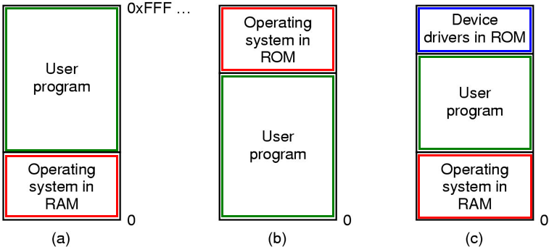
No Memory Abstractions…
Ways of memory organization:
Tanenbaum, Fig. 3-1.
BIOS
Locate at bottom in RAM
Mainframes, minicomputer
Locate at top in ROM
Handheld, embedded
Locate at bottom in RAM, device drives locate at top in ROM
PC

Slide 12
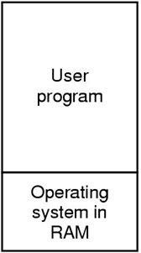
No Memory Abstractions…
How to ensure valid accessing (protection mechanism)?
Solution
Using the special register stores the highest address → An address is valid if it is smaller than the value stored in this register. → Slow down the performance
Otherwise, the interrupt occurs to intercept.
Disadvantages
The special register is created → High cost
Slow down the performance due to all accessed memory locations must be checked before doing each command.

Slide 13
No Abstractions: Mutiple Programs
What the OS has to do to permit multiple program running at the same time?
The OS saves the entire contents of memory to a disk file, the bring in and run the next program ( swapping mechanism)
How to protect one process against others?
➔Solution: Memory was divided into fixed size block and each one was assigned a fixed bit protection key held in special registers inside the CPU
Protect the code of OS against the processes
Protect one process against other processes

Slide 14
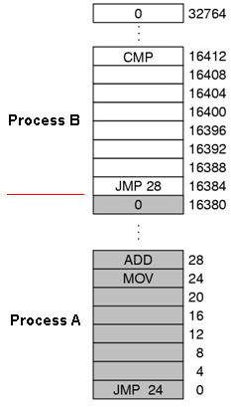
No Abstractions: Multiple Programs
Problem:
Internal fragmentation: There may be memory areas allocated but not used in the same process.
After the programs are loaded to run, the two programs both reference absolute physical memory → we want each program to reference a private set of addresses local to it. Number of programs are limited.
A drawback of direct accessing physical memory locations:
Process B refers to a location allocated to the process A

Slide 15
No Abstractions: Multiple Programs
Solution: Static relocation technique
At the compile time, the address of program is a relative addresses compared to the base.
At the time when the program is loaded into the memory at address b, the constant b was added to every program address during the load process
→ After loaded, the process cannot change its location in memory (static address)
→ Slow down loading due to addesses must be re-calculated
→ Not protection inside process
Process B: JMP 28→JMP 28+16384→JMP 16412 → CMP
Process A: JMP 24 → JMP 24+0= JMP 24 → MOV
Tanenbaum, Fig. 3-2.

Slide 16
3.2- A Memory Abstraction: Address Spaces
An address is a integral number
A mapping is created :
Physical addresses ←→ Abstract addresses
Addresses in a program is abstract addresses
→ Space of abstract addresses can be very large.
When the program is loaded into a specific memory area, physical base address is determined, an abstract address will be evaluated to physical address.
Address space is the set of addresses that a process can use to address memory

Slide 17
Abstraction: Base and Limit Registers
Problems:
In multiple process system, each process has a range of legal addresses, a process can access only these legal addresses, how to ensure correct operation in order to protect the operating system from access by user processes and to protect user processes from one another?
Solution
Give a two supplementary registers into the hardware
Base register: hold the physical address where the program begins in memory.
Limit register: specify the length of program
When the process is allocated in the memory
The base register is loaded the physical address where the program begins
The limit register is loaded the length of process
The address of process is relative (that is not compiled)

Slide 18
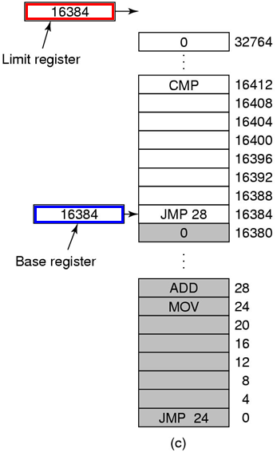
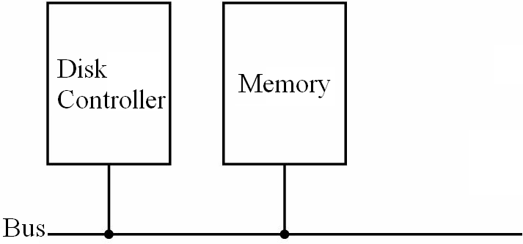
Abstraction: Base and Limit Registers
Limit Register
Base Register
True
Relative address
<
+
False
Real address
Address error; trap/ interrupt
Tanenbaum, Fig. 3-3.

Slide 19
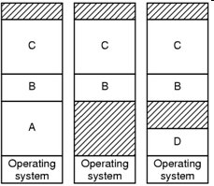
Abstraction: Evaluation
Advantages
An easy way to give each process its own private address space.
When the process can be moved to new location in the memory at runtime, only the base register’s value is reloaded.
Disadvantages
Need perform an addition and a comparison on every memory reference (update the registers’ value when the location of memory changes)
External Fragmentation ➔ compacting

Slide 20
Abstraction: Swapping
The reason
Users want to run more programs but no more space in memory to keep all the active processes.
Keeping all processes in memory all the time requires a huge amount of memory and cannot be done if there is insufficient memory
The simplest strategy is swapping
Bringing in each process in its entirely, running it for a while, then putting it back on the disk
swap out (memory → HDD) / swap in (memory ← HDD)
at one moment a process is entirely in the memory to be run or entirely on the HDD.

Slide 21
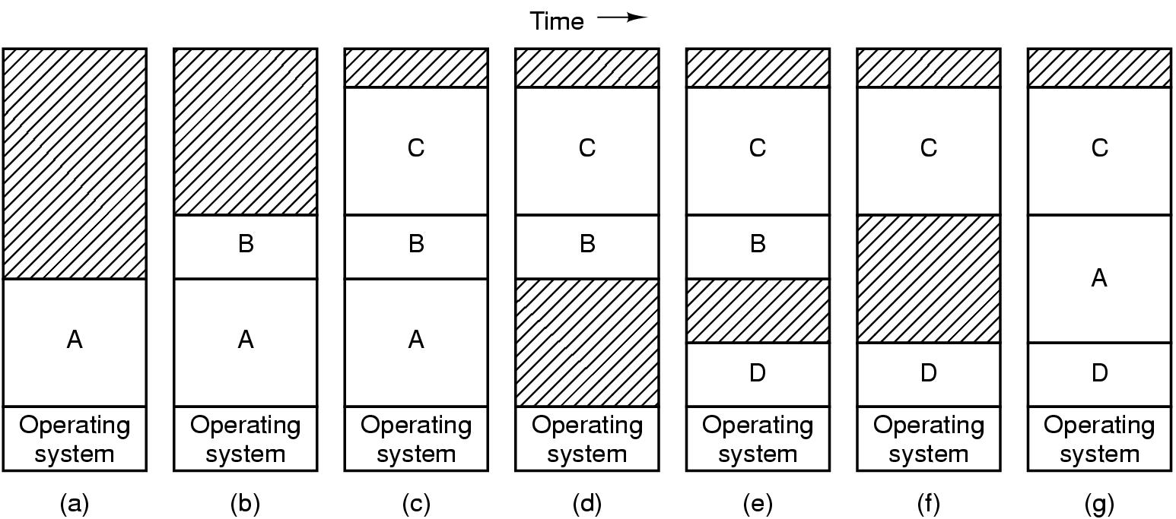
Abstraction: Swapping…
A, B, C are loaded.
Swap out: A
Load: D
Swap out: B
Swap in: A
Tanenbaum, Fig. 3-4.

Slide 22
Abstraction: Swapping…
Memory compaction technique (external defragment/ compaction)
Swapping can create multiple holes in memory → combine all into one big one by moving all the processes downward as far as possible,
Disadvantages: slow and complexity (the addresses are changed and updated)
If processes are created with fixed size that never changes, the OS allocates exactly what is needed.

Slide 23
Abstraction: Swapping…
Problem: the processes’ data segments can grow.
Solutions:
Move this process to a larger hole
Move the adjacent process to a hole
Choose a process to swap it
Allocate a little extra memory whenever a process is swapped in or moved.
Stack segement at the top grows downward, data segment grows upward. The memory between them can be used for either segment. If it runs out, the process will either have to be moved to a hole
If a process can not grow in memory and the swap area on the disk is full, the process will have to suspended until some space is freed up (or it can be killed).

Slide 24
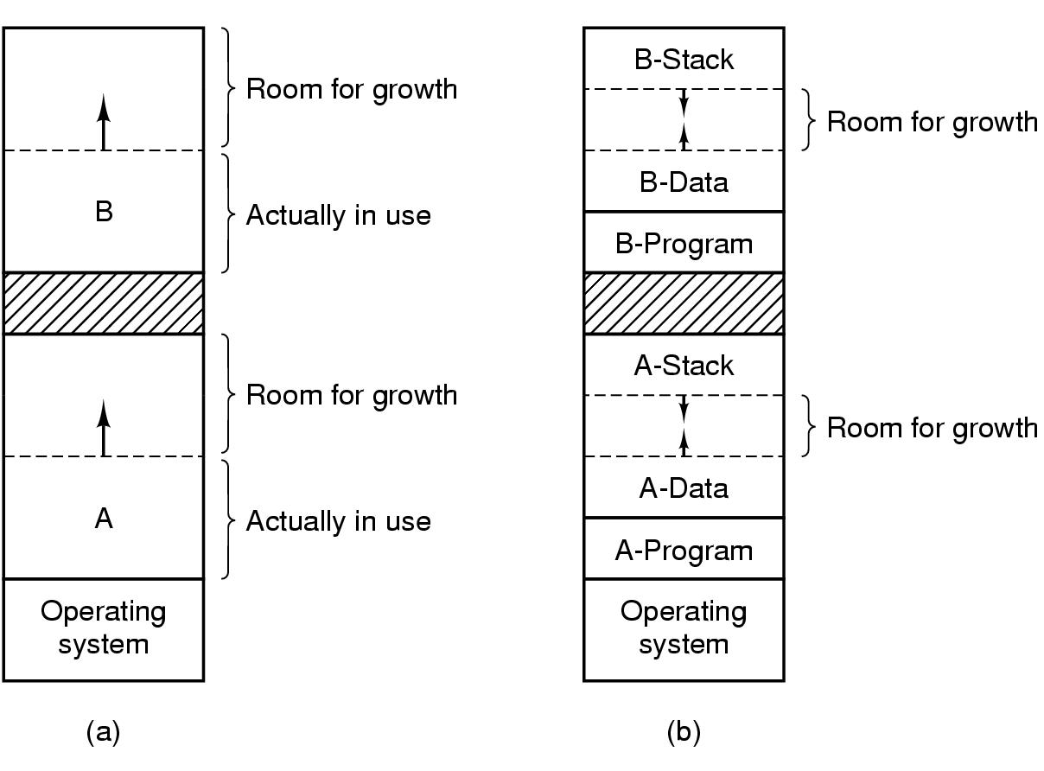
Abstraction : Swapping …
Allocate a little extra memory whenever a process is swapped in or moved.
In this context, Stack segment grows downward → underflowed, data segment grows upward→ overflowed
Tanenbaum, Fig. 3-5.

Slide 25
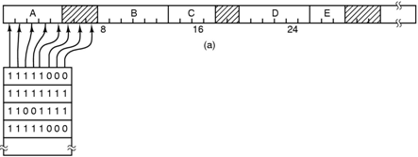
Abstraction : Memory Management with Bitmaps
Tanenbaum, Fig. 3-6.
- The memory is divided up into allocation units of the same size (a simple way to keep track memory words )
Each allocation unit has a bit corresponding bit in the bitmap: 0 (free), 1 ( occupied)
The size of the allocation unit is an important design issue: The smaller the size, the greater the bitmap, The greater the size, the smaller the bitmap, but results in waste of memory (internal fragmentation).
Problem: The memory manager must search the bitmap to find a run of k consecutive 0 bits in the map to load k-unit program → slow

Slide 26
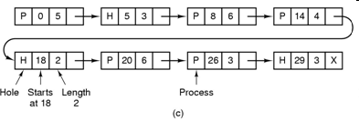
Abstraction : Memory Management with Linked Lists
Maintain a linked list of allocated and free memory segments, where a segment either contains a process or is an empty hole between two processes, to keep track of memory
Each entry in the list specifies
a hole (H) or process (P)
the address at which its starts
The length
The pointer to the next entry
Linear search → Slow
Improve: Sorted list based on addresses.
Tanenbaum, Fig. 3-6.

Slide 27
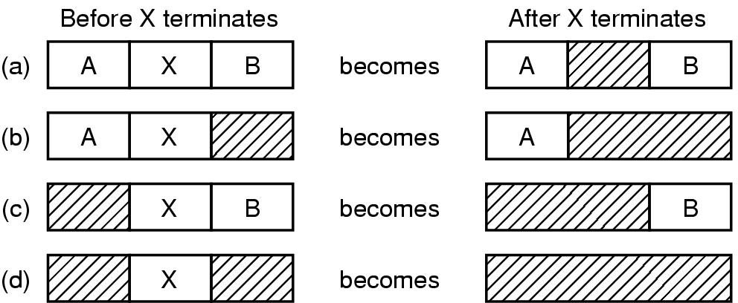
Abstraction : Memory Management with Linked Lists…
List sorted by the memory address
updating the list is simple and fast
4 cases in which the process X terminate and updates must be carried out .
Mix contiguous holes to create a lager hole
Tanenbaum, Fig. 3-7.

Slide 28
Abstraction : Memory Management with Linked Lists…
Approaches for Allocation of Memory
First fit – fast
The memory manager scans along the list of segments until it finds a hole that a big enough → It can cause redundant in memory use. If the hole is too big in comparison with the length of the process.
Next fit – slightly worse performance than first fit = first fit from last allocation
Works same as first fit except that it keep tracks of where it is whenever it finds a suitable hole
The next time it is called to find a hole, it starts searching the list from the place where it left off last time, instead of always at the beginning
Best fit – slower; tends to fill up memory with tiny, useless holes
Search the entire list, from beginning to end, and takes the smallest hole that is adequate
Rather than breaking up a big hole that might be needed later, best fit tries to find a hole that is close to the actual size needed, to best match the request and the available holes
Worst fit – is not a very good idea
Take a largest available hole, so that the new hole will be big enough to be useful

Slide 29
A Memory Abstraction Memory Management with Linked Lists…
8K
8K
12K
First Fit
12K
22K
Best Fit
6K
Last
allocated
block (14K)
18K
2K
Memory direct access
8K
8K
6K
6K
Allocated block
Free holes:
8, 12, 22, 18, 8, 6, 14, 36
Free block
14K
14K
Free holes:
8, 12, 22, 18, 8, 6, 14, 36
Worst Fit
Next Fit = First fit
from Last Allocation
36K
20K
Before
After
Allocate to block (16K) using First Fit, Best Fit, Next Fit, Worst fit

Slide 30
A Memory Abstraction Memory Management with Linked Lists…
Separate lists for processes and holes
Speed up searching for a hole at allocation
Complicates allocating and releasing of memory due to moving elements to-and-pro between two lists.
Improvements: Hole list can be sorted by the size
Quick fit
Finding a hole of the required size is extremely fast, but it has the same disadvantage as all schemes that sort by hole size, namely, when process terminates or is swapped out, finding its neighbors to see if a merge is possible expensive
If merging is not done, memory quickly fragment into a large number of small holes into which no processes fits

Slide 31
Virtual Memory: Problems
While memory sizes are increasing rapidly, software sizes are increasing much faster.
There is need to run simultaneously programs that are too large to fit in memory.
Swapping is not an attractive option because of hardware’s slow tranfer.
Solutions
Keep in memory only a part of each program (instructions and data) that are needed at any given time.
When other instructions are needed, they are loaded into space occupied previously by instructions that are no longer needed
The overlays and paging are proposed

Slide 32
Virtual Memory: Overlays
The developer must manually split programs into little pieces.
The overlays were kept on the disk and swapped in and out of memory by overlay manager.
When a program started,
First, the overlay manager (overlay 0) is loaded into the memory.
Then, the overlay 0 is informed to load the little pieces (overlay 1) into memory either above overlay 0 in memory (if there was space for it) or on top overlay 0 (if there was no space).
When the overlay 1 finished, the overlay 0 is informed to load the overlay 2 into memory either above overlay 1 in memory (if there was space for it) or on top overlay 0 (if there was no space), and so on.
The all code of overlays are kept on disk as absolute memory images, and are read by the overlay0 as needed. Special relocation and linking algorithms are needed to construct the overlays.
Advantages: Do not require any special support from the OS.
Disadvantages: The developers must burden the knowledge of the structure of program, its code, the size of pieces (overlays) that are split.
Notes:
To burden: gánh vác

Slide 33
Virtual Memory: Overlays
Example
The program is partition such as assembler into pass 1 code (70KB), pass 2 code (80KB), and the symbol table (20KB) and common routines (30KB) used by both pass 1 and pass 2.
The memory has only 150 KB. The overlay0 has its size as 10KB
→ It is impossible to load everything of program into memory because the required program size is 200KB
Therefore, the overlays is applied to overlay1 with 120KB (pass 1, symbol table, and common routines) and the overlay2 with 130KB (pass 2, symbol table, and common routines)
First, the overlay0 is loaded into memory. Then, overlay1 is also loaded above the overlay 0
When the overlay1 has finished, the control return the overlay0 that reads overlay2 into memory, overwriting overlay1, and transfer control to overlay2.

Slide 34
Virtual Memory: Definitions
Address space of a program is broken up into chunks called pages
Each page is a contiguous range of addresses
When a program executes, only some pages are loaded to the memory → Only some current pages are mapped to physical pages.
When a page is loaded to memory, this page is mapped onto physical memory.
When the program references a part of its address space that is in physical memory, the hardware performs the necessary mapping on the fly ( virtual address → physical address)
Page hit: Situation in which a referenced address is available in memory.
Page fault: Situation in which a referenced address is not available in memory. Solution: The page containing this address is loaded and a physical page can be swapped out.
Is a generalization of idea about the base and limit registers

Slide 35
Virtual Memory:Terminologies
Virtual Memory (VM)
Is the separation of user logical memory from physical memory
This separation allows an extremely large virtual memory to be provided for developers when only a smaller physical memory is available (→developer concentrates solving the problem domain)
Virtual (logical) addresses : Program memory addresses
Virtual address space
All the (virtual) addresses a program can generate
Is given by the number of bytes used to specify an address
Physical (real) addresses:
Addresses in main memory (on memory bus)
Memory Management Unit (MMU)
A mapping unit from virtual addresses into physical addresses

Slide 36
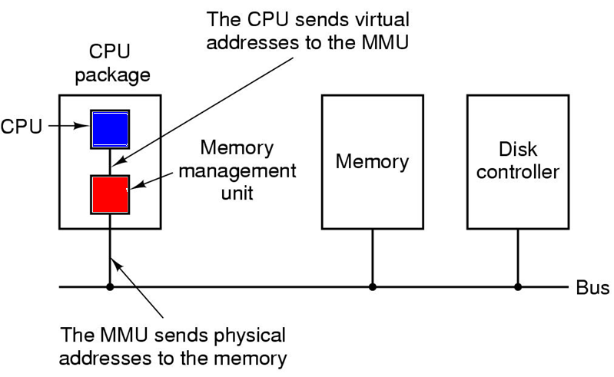
VM: Memory Management Unit (MMU)
Tanenbaum, Fig. 3-8.

Slide 37
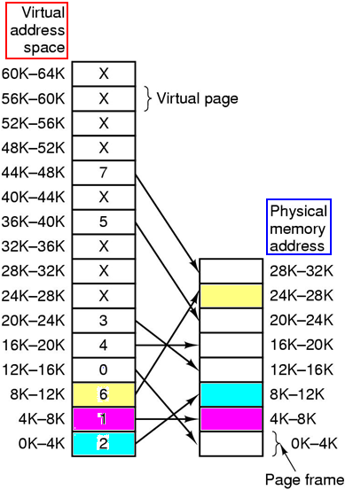
VM: Paging
Virtual address space
Is divided into fixed-size units called pages.
pages from 0 to AddressSpaceSize / PageSize – 1.
The physical memory
Is divided up into units of the same size corresponding in the physical memory called page frames.
page frames from 0 to PhysicalMemSize / PageFrames – 1.
Pages and frames are the same size
PageSize is typically be a value between 512 bytes and 64KB.
Transfer unit between RAM and disk is a page.
Page 0 of the program is loaded to frame 2 of RAM
Index in page frames
Tanenbaum, Fig. 3-9.

Slide 38
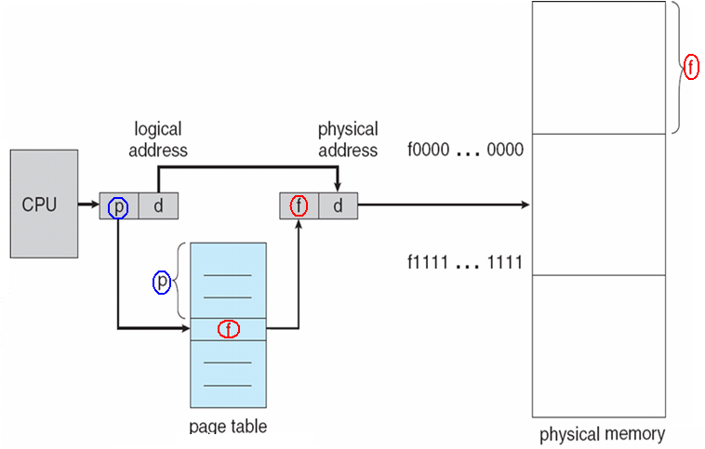
VM: Paging…
In traditional, the paging has been handled by hardware
The virtual (logical) address is divided into 2 parts: a virtual page (p) and a page offset (d) → <p,d>
The p is used indexed into the page table that maps the page frame (f) in memory
The f is combined with d to define the physical memory address

Slide 39
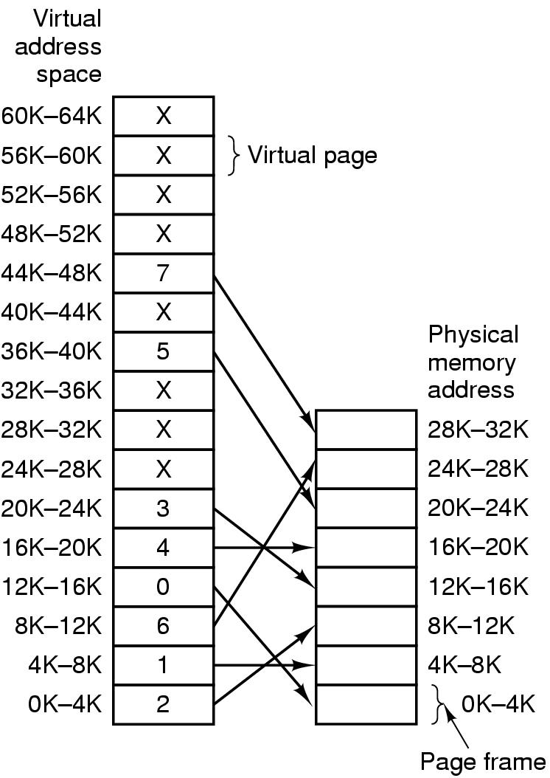
VM: Paging… – General formula
b: page size
How to determine a physical address?
(1) Full virtual address (va) was known
➔ Page index p = va/b
➔ Offset d = va – pb
Page table → Frame index f:
Entry (p, f) → f
Physical address= fb + d
(2) { p,d} were known
➔Page table p →Entry (p, f) → f
Physical addr = fb + d
Tanenbaum, Fig. 3-9.

Slide 40
VM: Paging… - Examples
move REG, 0 → move REG, 8192
→Address 0 → p=0, d=0
→ f= 2, d=0
physical address = 2*4*1024+0= 8192
move REG, 20500 → move REG, 12308
p= 20500/(4*1024) = 5 → f = 3
d = 20500 – 4*1024= 20
physical address = 3*4*1024+20
=12308
Page size= 4KB
Tanenbaum, Fig. 3-9.
Notes:
40

Slide 41
VM: Paging…
Problems
A process can use a large physical memory space → there exists some processes running concurrently in a system → Virtual address space is larger than the physical memory → How does OS check whether a page is loaded into memory?
Solution:
Only some virtual pages are mapped onto physical memory (e.g 16 pages maps 8 page frames)
→ Use a flag bit: Present/Absent bit to keep track of which pages are physically present in memory

Slide 42
VM: Paging…
F(){
……….
}
Page 4
Page fault
a trap into the OS because of a reference to an address located in a page not in memory
generated by the MMU
result in a swap between physical memory and disk
the referenced page is loaded from disk into memory
the trapped instruction is re-executed
……
Frame 3
……
Frame 2
……
Frame 1
F();
Trap instruction: OS temporary marks an instruction as waiting for execution.
Frame 0

Slide 43
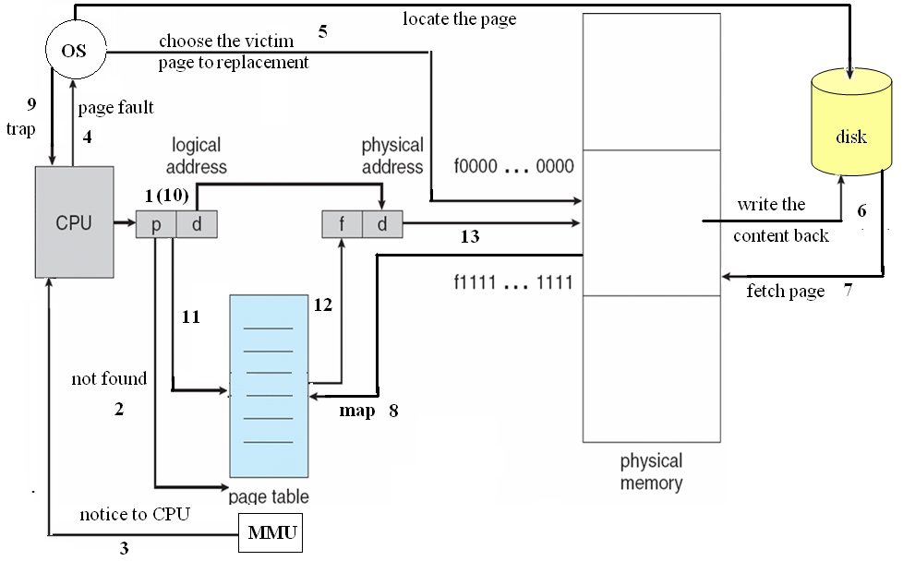
VM: Paging…
Paging mechanism

Slide 44
VM: Paging… Example
MOV REG, 32780
virtual address: p=8, offset=12
Page 8 is not loaded
Page fault
OS traps this instruction
OS choses a victim page (suppose frame 1)
OS loads page 8 to frame 1 and make to changes to the MMU map
MMU determines the physical address (f=1, d=12)
OS re-executed the instruction
page size=4KB
Tanenbaum, Fig. 3-9.

Slide 45
VM: Page Tables
The mapping of virtual addresses onto physical addresses can be summarized as following
The virtual address is split into a virtual page number (p, high-order bits) and offset (d, low-order bits)
Ex: 16 bit address and a 4KB page size, 4 bit for 16 pages and 12 bit offset (0 to 4095)
The virtual page number is used as an index into page table to find the entry for that virtual page
From the page table entry, the page frame number is found
The page frame number is attached to the high-order end of the offset, replacing the virtual page number, to form a physical address
Is the function with page number is argument and the page frame as result
Each process needs its own page table

Slide 46
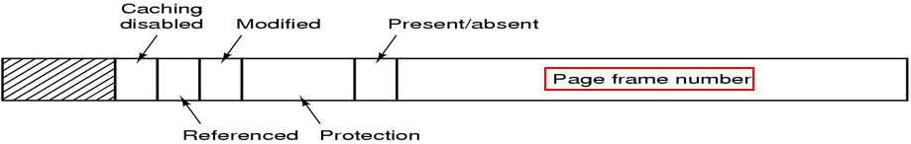
VM: Page Tables…
Tanenbaum, Fig. 3-11.
Structure of a Page table entry - 32 bits is a common size
Present/absent bit
1: the entry is valid and can be used
0: the entry belongs is not currently in memory
Protection bits (sophisticated with 3 bits: reading, writing, executing of page): 1: read only, 0: read/write
Modified and Referenced bits (keep track of page usage)
Modified: a page is written / Referenced: a page is referenced
Cached disable bit: allows caching to be disable for the page

Slide 47
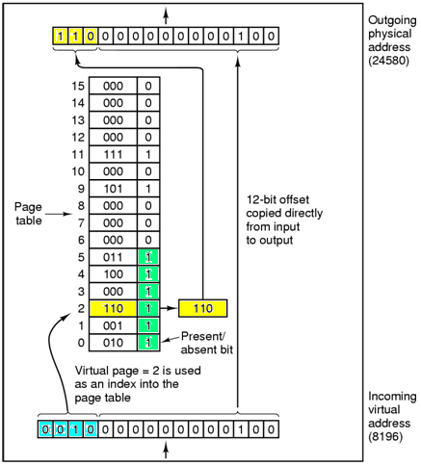
VM: Page Tables – Example
Physical address
using page size is a power of 2 (4KB→4096 bytes→12 bit offset)
16 bit virtual address
→ page number: 4 bit, offset 12 bits
MOV REG, 8196
8196 in binary 0010000000000100
0010 = page number (2)
000000000100 = offset (4)
Physical address 24580 (24K)
(page frame 6, offset 4)
Virtual address
Tanenbaum, Fig. 3-10.

Slide 48
VM: Page Tables – Example
Suppose a virtual address space of 2²⁸ words and the page size is 2¹² words. If the virtual address is 1234567 in Hexadecimal, what would be the page number in Hexadecimal?
0x1234567 = 19.088.743
2¹² = 4096
→ 19.088.743 / 4096 = 4660 = 0x1234
Virtual space: 2²⁸ → Virtual address 28 bits
Page size 2¹² → offset: 12 bits
→ Page number: 16 bits
1234567 ( hex)
Page, offset
You can be responsed results using decimal, binary or hexadecimal value

Slide 49
VM: Speeding up Paging
Paging issues
The mapping from virtual address to physical address must be fast
Avoid bottleneck
If an instruction execution takes 1 nsec, the page table lookup must be done in under 0.2 nsec ( 20%)
If the virtual address space is large, the page table will be large
32 bit virtual address, 4 KB page sizes → 1 million pages (entries)

Slide 50
VM: Speeding up Paging…
Simplest design
Have a single page table consisting of an array of fast registers, with one entry for each virtual page, indexed by virtual page number
Page table is loaded from memory into registers (at starting up)
No more memory references needed (when processing)
Advantages: no memory
Disadvantages:
Context switch is expensive (load entire table for each process).
It can apply to the small page table only.

Slide 51
VM: Speeding up Paging Calculate the length of a virtual address
If there are 64 pages and the page size is 2048 words, what is the length of logical address?
64 pages = 2⁶ → 6 bits is used to manage number of page
2048 words = 2¹¹ → 11 bits used to manage page size
→ 17 bits
If there are 128K pages and the page size is 32K words, what is the length of logical address?
128K pages = 2⁷ 2¹⁰ → 17 bits is used to manage number of pages
32K words = 2⁵ 2¹⁰= 2¹⁵ → 15 bits used to manage page size
→ 32 bits

Slide 52
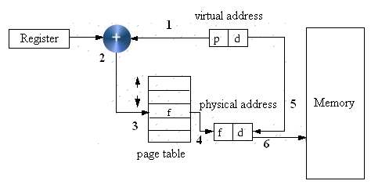
VM: Speeding up Paging…
Use a Single Register to point to the start of the page table
Page table can be entirely in memory
This register may be located in PCB
When the process start, this register must be reloaded
This allows the virtual to physical map to be changed at a context switch by reloading one register
Advantages: Context switch is fast (reloaded one register)
Disadvantages: still more references to the memory for reading page table entries (slow)

Slide 53
VM: Translation Lookaside Buffers (TLB)
Problem
The CPU makes a memory access using a virtual address. It requires an address translation to a real address
This needs accesses to the page table which is itself in memory i.e. every virtual memory access requires two (or more if 2 level table) real accesses
→Slow
Observations
Keeping the page tables in memory reduce drastically (mạnh mẽ) the performance
Make large number of references to a small number of pages

Slide 54
VM: TLB
Solution: Using TLB or associative memory
A small fast hardware for mapping virtual addresses to physical addresses without going through the page table
This device is usually inside in MMU and consists of a small number of entries (usually less than 64) → maps only a small number of virtual pages
A TLB entry contains information about one page (valid bit (that presents the page in use or not use), page number, modified bit, protection bit, page frame)
These fields have a one-to-one correspondence with the fields in page table, except for the page number, which is not need in the page table ( page number is the index of the page table)
A TLB can be also implemented in software ➔ but slow

Slide 55
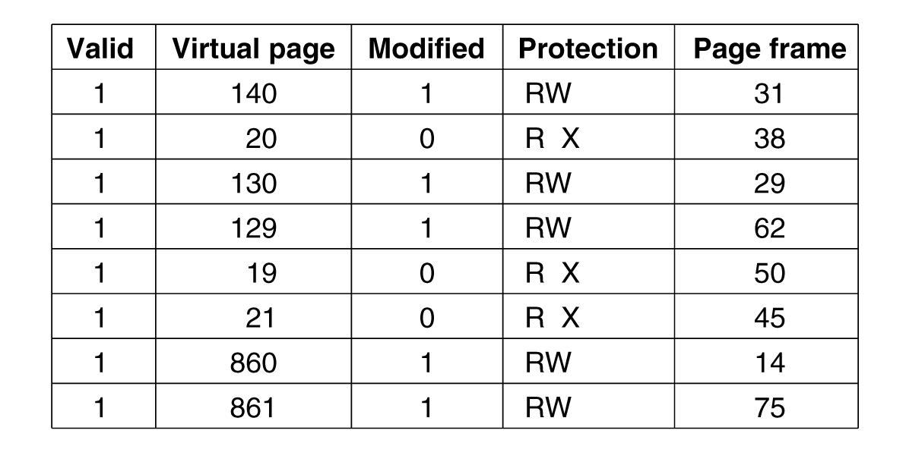
VM: TLB - An example
Tanenbaum, Fig. 3-12.

Slide 56
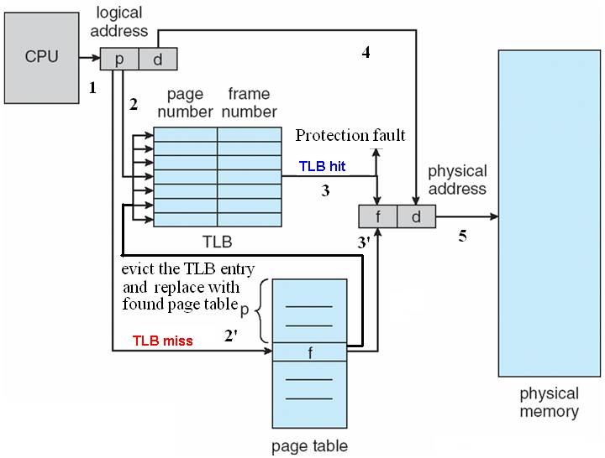
VM: How the TLB do?

Slide 57
VM: How the TLB do?...
When the virtual address is presented in MMU for translation
The hardware search entire TLB to find if the entry is matched
If so,
If the access does not violate the protection, the page frame is taken without going to the page table
Otherwise, the protection fault can occur
Otherwise,
The MMU detects the miss and does an ordinary page table lookup
The MMU evicts (đuổi) one of the entries from the TLB and replaces it with the page table just looked up
After the page frame is defined, the physical memory can be accessed

Slide 58
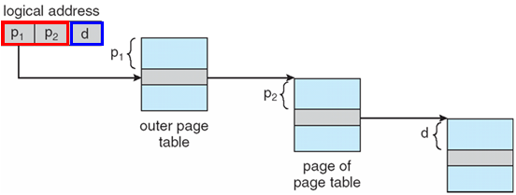
VM: Multilevel Page Tables
Physical Frame of a page table
Problem
Most modern computer support a large logical address (2³² to 2⁶⁴)
→ The page table become excessive large and the developer would not want to allocate it in memory at a/ all time
Physical frame of the page
Physical Mem.
Solution: Multilevel Page tables ← Hashing technique
Memory → some large blocks (LB)
A lager block is divided into some smaller pieces (SP).
Virtual address = Larger block index (PT1) , small piece index(PT2), offset
Virtual addr= PT1 * LB size + PT2* SP size + offset
To avoid keeping all the page tables in memory all the time.
The main idea is “Paging the page table”.

Slide 59
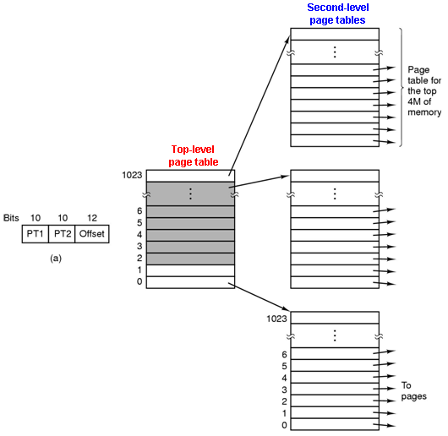
VM: Multilevel Page Tables
32 bit virtual addresses
PT1: 10 bits ➔ Top-level table contains 1024 entries ➔ 2¹⁰ large blocks
PT2: 10 bits ➔ Second level table contains 1024 entries ➔ 1 second level page table manages a physical small pieces of 1024x4KB = 4MB
Offset: 12 bits ➔ page size (small piece size) = 2¹² = 4KB
Tanenbaum, Fig. 3-13.

Slide 60
VM: Multilevel Page Tables: Example
Virtual address: 0x00403004 ( 4,206,596 in decimal)
0000 0000 0100 0000 0011 0000 0000 0100 in binary.
Offset 12 bit → Page size = 2¹² = 4KB
PT2 →10 bit → large block size = 2¹⁰ * 4KB = 4MB
PT1= 1, PT2= 3, offset=4
Virtual address= 1*4MB + 3* 4KB + 4 = 4* 2²⁰ + 3 * 2¹² + 4
= 2²² + 2¹³ + 2¹² + 4
= 0000 0000 0100 0000 0011 0000 0000 0100 in binary
= 0x00403004
Based on the mapping table → Physical address.
If the page is not in memory, causing a page fault
If the page is in memory, the page frame number taken from the second level page table combined with the offset to construct the physical address.

Slide 61
VM: Inverted Page Table
Problem
64 bit computer, with 4KB pages→ 2⁶⁴/2¹² = 2⁵² page table entries, with 8 bytes/entry → over 30 million GB per page table (too large).
Solution:
Using the inverted page table for handling large address spaces
Group pages based on processes and virtual page
Virtual address format: <process, page, offset>
Each one entry in table represents page frame in real memory (vs. each one entry per page of virtual address space in page table)
An entry contains the pair (process n, virtual page p) is located in page frame

Slide 62
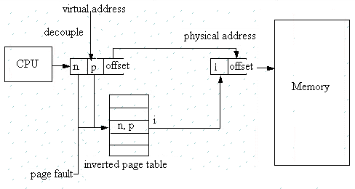
VM: Inverted Page Table…
When the process (n) references the virtual address: The virtual address is decoupled two parts (virtual page p, offset). The hardware searches entire the inverted page table for the entry (n, p). If the entry is found, the entry position is the page frame. Then, the physical memory is generated by adding the first address of detected page frame combined with the offset, otherwise, the page fault occurs

Slide 63
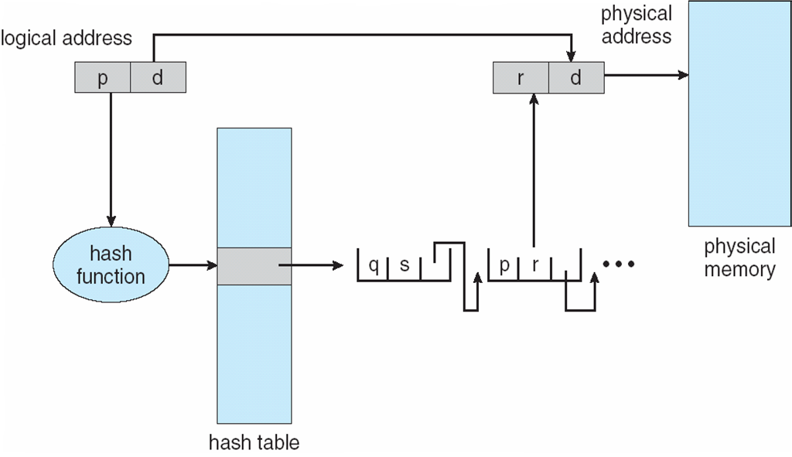
VM: Inverted Page Table…
Advantages
64bit virtual addresses, a 4KB page, 1GB RAM, an inverted table only required 262,144 entries (saving vast amount of space)
Disadvantages
The virtual-to-physical translation becomes much harder and slower
Searching the entire table at every memory reference
Practically: use of TLB and hash tables (searching in software)

Slide 64
Page replacement algorithms
Problems
At page fault and full physical memory
Space has to be made
A currently loaded virtual page has to be evicted from memory
Choosing the page to be evicted (removed)
Not a heavily used page → reduce the number of page faults
Page replacement
The old page has to be written on the disk if it was modified
The new virtual page overwrite the old virtual page into the page frame

Slide 65
Page replacement algorithms: Optimal
Each page can be labeled with the number of instructions that will be executed before that page is first reference
Choose the page that will be the latest one accessed in the future between all the pages actually in memory
Very simple and efficient (optimal)
Impossible to be implemented in practice
there is no way to know when each page will be referenced next
It can be simulated
At first run collect information about pages references
At second run use results of the first run (but with the same input)
It is used to evaluate the performance of other, practically used, algorithms

Slide 66

Page replacement algorithms: Optimal…
Ex: ( Suppose that no instruction executes when a process is loaded)
a memory with free three frames
The order, which pages are accessed, is:
7 0 1 2 0 3 0 4 2 3 0 3 2 1 2 0 1 0 7 0 1
Number of page faults: 9 times
The page 7 is overridden because it is the latest page acessed in the future

Slide 67
Page replacement algorithms Not Recently Used (NRU)
Each page has two status bits associated: Referenced bit (R), Modified bit (M)
updated by the hardware at each memory reference
once set to 1 remain so until they are reset by OS
can be also simulated in software when the mechanism is not supported by hardware
Algorithms
At process start the bits are set to 0
Periodically (on each clock interrupt) the R bit is cleared
For page replacement, pages are classified
Class 0: not referenced, not modified
Class 1: not referenced, modified
Class 2: referenced, not modified
Class 3: referenced, modified
The algorithm removes a page at random from the lowest numbered nonempty class
It is easy to understand, moderately efficient to implement, and gives an adequate performance

Slide 68

Page replacement algorithms First-In, First-Out (FIFO)
OS maintains a queue of all pages currently in memory, with the most recent arrival at the tail and the least recent arrival at the head. On a page fault, the page at the head is removed and the new page added to the tail of the list
It’s rarely used
Ex: a memory with free three frames
7 0 1 2 0 3 0 4 2 3 0 3 2 1 2 0 1 0 7 0 1

Slide 69
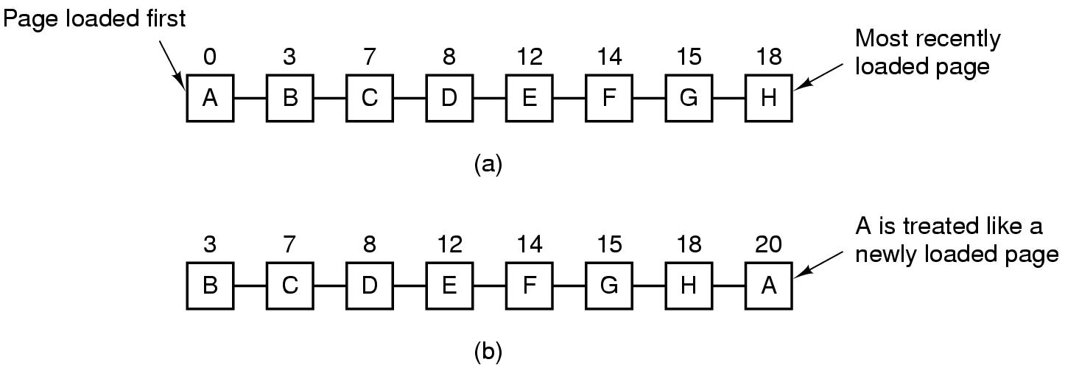
Page replacement algorithms Second-Chance
A modification of FIFO to avoid throwing out a heavily used page
Inspect the R bit of the oldest page
0 → page is old and unused → replaced
1 → page is old but used → its R bit = 0 and the page is moved at the end of the queue as a new arrived page
Look for an old page that has not been not referenced in the previous clock interval
If all the pages have been references → FIFO
Tanenbaum, Fig. 3-15.

Slide 70
Page replacement algorithms Clock
In a second chance algorithms, it is unnecessarily inefficiency because it is constantly moving pages around on its list
Keep all the page frames on a circular list in the form of a clock
The hand points to the oldest page
How to work
When a page fault occurs, the page being pointed to by the hand is inspected
If its R bit is 0, the page is evicted, the new page is inserted into the clock in its place, and the hand is advanced one position
If R is 1, it is cleared and the hand is advanced to the next page

Slide 71
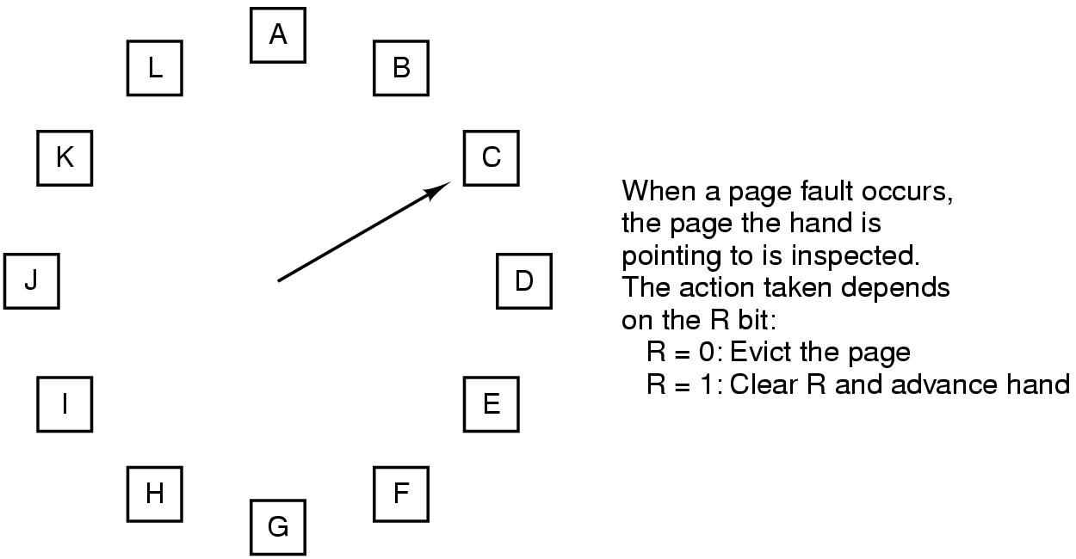
Page replacement algorithms Clock
Tanenbaum, Fig. 3-16.

Slide 72
Page replacement algorithms Least Recently Used (LRU)
Based on the observation that
pages that have been heavily used in the last few instructions will probably be heavily used again in the next few.
Throw out the page that has been unused for the longest time when a page fault occurs.
The algorithm keeps a linked list
the referenced page is moved at the front of the list
the page at the end of the list is replaced
the list must be updated at each memory reference → costly

Slide 73
Page replacement algorithms Least Recently Used (LRU)
Implementing LRU with a hardware counter
keep a 64-bit counter which is incremented after each instruction
each page table entry has a field large enough to store the counter
the counter is stored in the page table entry for the page just referenced
the page with the lowest value of its counter field is replaced
Implementing LRU with a hardware bits matrix
N page frames → N x N bits matrix
when virtual page k is referenced
bits of row k are set to 1
bits of column k are set to 0 ( demo ở slide sau)
the page with the lowest value is removed

Slide 74

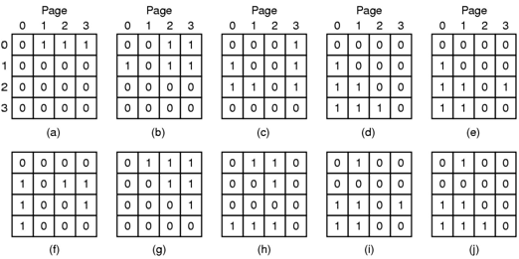
Page replacement algorithms Least Recently Used (LRU)
Ex:
a memory with free three frames
7 0 1 2 0 3 0 4 2 3 0 3 2 1 2 0 1 0 7 0 1
A memory with four page frames
0 1 2 3 2 1 0 3 2 3
Tanenbaum, Fig. 3-17.
Min value
The page 1 will be evicted if a new page is loaded.

Slide 75
Page replacement algorithms Not Frequently Used (NFU)
A software implementation of LRU
A software counter associated with each page (from 0)
At each clock tick the R bit (0/1) is added to the counter for all the pages in memory (counter = counter + R → each counter will increase or unchange) after that the R bits are reset to 0.
The page with the lowest counter is chosen when a page fault occurs. It is the not frequently used page in the list.
Problem:
The useful pages are evicted
The bit reference is useful to count the page to be reference, but it is not known the order of reference.
Notes:
Clock tick (CPU cycle): The time required for the CPU to perform the simplest instruction, such as fetching the contents of a register or performing a no-operation instruction (NOP).

Slide 76
Page replacement algorithms Aging
A software implementation of LRU
A modification of NFU
Shift right the counter one position
R bit is added to the leftmost bit
The page whose counter is the lowest is removed when a page fault occurs

Slide 77
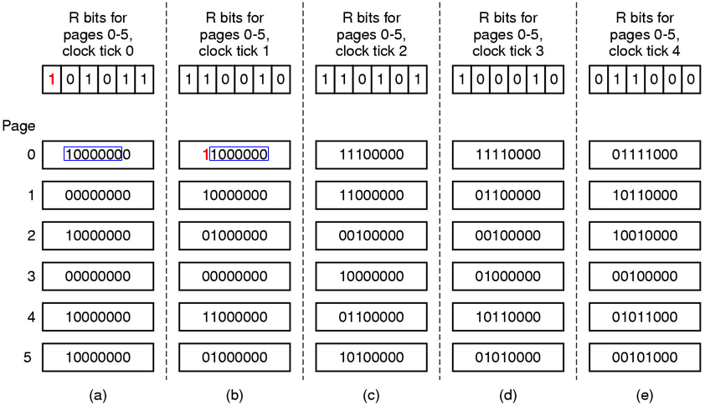
Page replacement algorithms Aging
Tanenbaum, Fig. 3-18.
counters
The R bit of each page will be shift to the left of each appropriate counter → counter which contains the smallest value is of the not-frequently-used page.

Slide 78
Page replacement algorithms Aging
Differences from LRU
We do not know which of them was referenced last in the interval between tick 1 and tick 2 - step (e)
The finite number of bits of counters ( ex: 8 bits) → does not differentiate between pages with the value 0 of their counters ( one page may be referenced 9 ticks ago, one page may be referenced 100 ticks ago)

Slide 79
Page replacement algorithms Thrashing – Khả năng thay trang liên tục
A program may cause page faults every few instructions
A process may not be allocated enough page frames as its requirements → Many processes are located in memory, thus, each process is allocated at least page frames → The page replacement takes more time (than execution) → The CPU utilization is decreased and some new process is loaded in the memory.
The impact (tác động) of thrashing on system
The system can be hanged
The process can not continually progress
Solution: Allocating enough page frame to the process
How to know the process need the number of page frame in progress?

Slide 80
Page replacement algorithms Locality of Reference
The process references only a relatively small fraction of its pages in execution
A small fraction is a set of pages that a process is currently using
The process moves from small fractions (that is needed in execution in time) to others
The process involves many small fractions that can intersected

Slide 81
Page replacement algorithms Demand paging vs. Prepaging
Demand paging: Pages are loaded only on demand
Processes are started up with none of their pages in memory
CPU tries to fetch the first instruction → page fault
Prepaging
Loading the pages before letting processes run
Loading the pages before resuming the process

Slide 82
Page replacement algorithms Working Set
The set of pages that a process is currently using
If the entire working set is in memory, the process will run without causing many faults until it moves into another execution phase
Working set can changes over time
Problems
If the available memory is too small to hold the entire working set, the process will cause many page faults and run slowly → thrashing .
The process will just cause page faults until its working set has been loaded → slow, waste considerable CPU time
Solutions
Using working set model

Slide 83
Page replacement algorithms Working Set Model
Keep track of each process’s working set and make sure that it is in memory before letting the process run (prepaging)
Reduce the page fault rate (avoid thrashing)

Slide 84
Page replacement algorithms Working Set Model
Is implemented as
OS keeps track of which pages are in the working set
When a page fault occurs, find a page not in the working set then this page is located in
The R bit is examined.
If R=1, the current virtual time is written into the Time of last use field
If R=0, the page may be a candidate to removal
The age (the current virtual time – its Time of last use) is computed and compared with τ (span multiple clock ticks).
If age > τ, the page is no longer in the working set, and the new page replaces it
Otherwise, the page is still in the working set
If the entire table is scanned without finding the candidate to evict and one or more pages with R = 0 is founds, the one with the greatest age is evicted. Otherwise, the chosen random is executed (R = 1)

Slide 85
Page replacement algorithms WSClock
Problem
Working set (WS) algorithm is cumbersome (nặng nề), since the entire page table has to be scanned at each page fault until a suitable candidate is located.
WSClock
Improved WS algorithm is based on the clock algorithm.
Simplicity of implementation and good performance.
A circular list of page frames is used.

Slide 86
Page replacement algorithms WSClock
How does it work?
This list is empty (initially)
The page is loaded, it is added to the list to form a ring (with Time of last use field and R bit)
As with the clock program, at each page fault the page pointed to by hand is examined first
If R is set to 1, the page has been used during the current tick, then R set to 0, the hand advanced to next page
If R equals 0,
if the age is greater than τ and the page is clean, it is not in working set and a valid copy exists on disk. The page frame is simply claimed and the new page put there
If the page dirty, it cannot claim immediately (clean page is define base on write to disk scheduled)

Slide 87
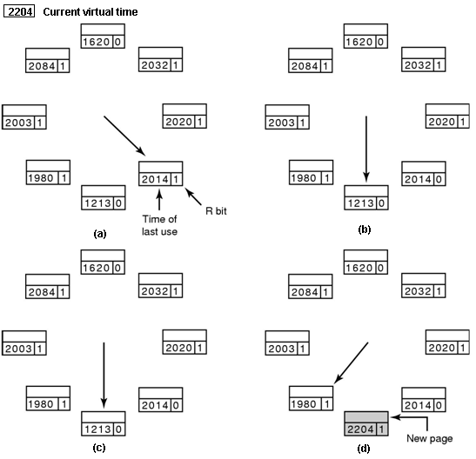
Page replacement algorithms WSClock
(a, b) Page fault occurs, the hand points to a page with R=1 (used) → Set R=0 then the hand moves to the next element.
(c,d) Page fault occurs, the hand points to a page with R=0 (not used) , this page will be swapped out, a new page is loaded , overriding this page , then the hand moves to the next element.
Tanenbaum, Fig. 3-21.

Slide 88
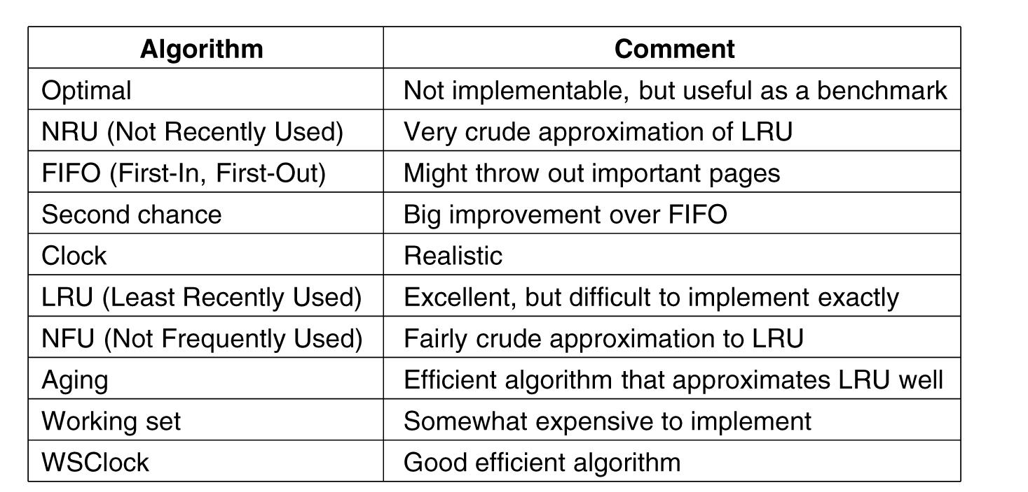
Page replacement algorithms Summary
Tanenbaum, Fig. 3-22.
Notes:
Crude: thô

Slide 89
Summary
No Memory Abstraction
A Memory Abstraction
Virtual Memory
Page replacement Algorithms
Q&A

Slide 90
Keep in Your Mind
Memory hierarchy: Disk → RAM → cache2 → cache1→ cache0
Memory manager: a part of OS that manages the memory hierarchy
No memory abstraction can cause the protection mechanism is violated because a process can access an address in another.
If no memory abstraction is used in a multiple program system, addresses in a program are relative addresses compared to the base address of each program and OS must determine the maximum address of each program.
Abstract address: An address in a program is presented by
<base, offset>
To ensure that the protection must be followed, base register and limit registers are allocated to each process.

Slide 91
Keep in Your Mind
External fragmentation: Situation in which there is some holes between processes.
External de-fragmenting: Move allocated memory blocks to make them contiguous, OS must update base registers of processes.
Memory swapping: A mechnism in which the OS will move the memory imange of a selected process out to disk and bring another from disk to memory.
Solution for growing data segment of a program is a little extra memory is allocated for it.
Memory management using bitmaps: System memory is divided into blocks, each block is mananged by one bit.
Memory management using linked list: A linked list is used, each element of the list contains data about a memory area is used or free.

Slide 92
Keep in Your Mind
Approaches for memory allocating: First fit, next fit, best fit, worst fit, quick fit.
Overlay mechanism: Developers manually split a program into some pieces and gives instruction for loading them explicitly into the memory.
Paging: A mechanism in which a program is divided into some pages having the same size. When a program executes, only some necessary pages are loaded into physical frames. OS bears responsibility for calculating the real physical address based on a mapping. Frame size = page size.
Virtual address: <page number, offset>
Physical address: <frame number, offset>
MMU: A hardware as a mapping unit.

Slide 93
Keep in Your Mind
Page table contains entries, each entry contains data of a page such as: cache disable, referenced bit, modified bit , present/absent bit, protection bits, frame number.
Page faults are generated by the MMU
Ways for speeding up paging:
A register is used to contain the start of the page table
A fast-TLB (Translation Lookaside Buffer) is used to store a part of the page table
A multi-level page table is used to page huge programs
An inverted page table helps to concentrate managing processes, each virtual address includes <processNumber, pageNumber, offset>

Slide 94
Keep in Your Mind
Page replacement algorithms:
The optimal algorithm: The evicted page is the latest one accessed in the future between all the pages actually in memory.
The Not Recently Used algorithm: Based on the referenced bit and modified bit, frames are classified into 4 classes. The best evicted frame is the frame which is not referenced and not modified.
The First In First Out algorithm: The evicted frame is the frame was loaded first.
The second chance algorithms: The solution of aging is used, a frame will be temporarily left and considering other frames. If there is no the most suitable frame for evicting then this frame will be evicted.

Slide 95
Keep in Your Mind
Aging algorithm: When a frame is referenced, a mechanism is used to increase it’s count. So, the evicted frame is the frame having the minimum count.
Least Recently Used / Not Frequently Used
Aging Using Clock algorithms: Frames are manages using a circle linked list. An evicted frame is choosen based on referenced bit
Thrashing: The situation in which the system becomes so slow due to so much page faults occur.
Working set of a process: Set of loaded frames. The lager working set the higher performance.
The Working Set Clock algorithm: The working set is organized as a circle linked list, the aging algorithm is used with association of the time factor.

