Slide 1
5 Memory Management – Part 2 (4 slots)
Chapter 3- Part 2
Design Issues for Paging Systems Implementation Issues Segmentation

Slide 2
Objectives
Design Issues for Paging Systems
Local vs. Global Page Allocation Policies
Load Control
Page Size
Shared Pages
Shared Libraries
Mapped Files
Cleaning Policy
Virtual Memory Interface

Slide 3
Objectives…
Implementation Issues
OS Involvement with Paging
Page Fault Handling
Instruction Backup
Locking Pages in Memory
Backing Store
Policy and Mechanism
Segmentation
Pure Segment
Read yourself
Segmentation with Paging: MULTICS
Segmentation with Paging: Intel Pentium

Slide 4
Review: Paging Algorithms
Algorithm | Fullname | Description
NRU | Not Recently Used : Pages are divided into 4 classes: Class 0: not referenced, not modified./ Class 1: not referenced, modified/ Class 2: referenced, not modified/ Class 3: referenced, modified. A page in the lowest class will be swapped out.
FIFO | First In First Out: The first page will be swapped out
Second chance | FIFO using a second change
Clock | A curcular list is used. At a time, a process is selected as a page that may be swapped out if R bit (referenced)=0
LRU | Least recently used: Quá trình được tham khảo cũ nhất sẽ bị loại ra
NFU | Not Frequently Used :Counter = counter + R. The process haring lowest count will be swapped out.
Aging | Right shift the counter of a process the add the R bit to theleft pf the counter The process haring lowest count will be swapped out.
WSClock | Working set clock: A circular list is used. The time when the process is referenced is stored along with the R bit.

Slide 5
5.1- Design Issues for Paging System
Local vs. Global Page Allocation Policies
Load Control
Page Size
Shared Pages
Shared Libraries
Mapped Files
Cleaning Policy
Virtual Memory Interface

Slide 6
Local vs. Global Allocation Policies
Design Issues for Paging System
Context: Page fault, Page replacement
Question: should the page replacement algorithms try to find LRU page consider only the page currently allocated to particular process, or should it consider all the pages in memory?
Local: pages of the current process are considered.
Global: pages of all processes are considered.
Answer: depends on the strategy used to allocate memory between the competing (cạnh tranh) runable processes
Local: Every process has a fixed fraction of memory allocated (advantages)
Global: page frames are dynamically allocated among runable processes

Slide 7
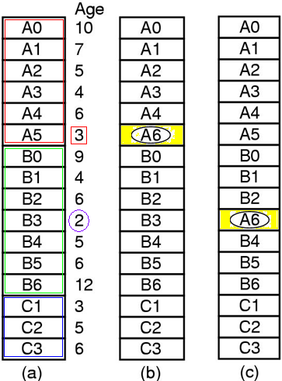
Design Issues for Paging System
Local vs. Global Allocation Policies
Local page replacement
(A5 has lowest age value)
Global page replacement
(B3 has lowest age value)
Tanenbaum, Fig. 3-23.
Original configuration

Slide 8
Design Issues for Paging System
Local vs. Global Allocation Policies
Local algorithms
The working set grows → thrashing
The working set shrinks → waste of memory
Global algorithms
Work better, especially when the working set size can vary over the lifetime of a process
The thrashing can occurs to other processes of which pages are chosen to replace → the other processes can not control the page fault rate
The working set size is smaller → waste of memory

Slide 9
Design Issues for Paging System
Local vs. Global Allocation Policies
Strategies for the system must continually decide how many page frames to assign to each process
Monitor the size of working set of all processes based on the aging bits of pages (It does not necessarily prevent thrashing)
Page frames allocation algorithm:
To periodically determine the number of running processes
Allocate pages proportionally with each process size
Give each process a minimum number of frames
The allocation is updated dynamically
The PFF (Page Fault Frequency) algorithm (Count the page number of faults per second)
Some page replacement algorithms
Can work with both policies (FIFO, LRU)
Can work only with the local policy (WSClock)
( First In First out/ Least Recently Used/ Working Set Clock)

Slide 10
Design Issues for Paging System
Load Control
Context
The system thrashes can occur even if the best page replacement algorithm and optimal global allocation of page frames is used
When the combined working sets of all processes exceed the capacity of memory → thrashing
PFF (Page Fault Frequency) algorithm indicates that some processes need more memory but no process need less memory
➔ no way to give more memory to those processes needing it without hurting some other processes

Slide 11
Design Issues for Paging System
Load Control
A good way to reduce the number of processing competing for memory is to swap out some processes and free up all the pages they are holding to divide those pages up to thrashing processes
Keep the page-fault rate acceptable (periodically, some processes are swapped in and other ones are swapped out)
Take into account the degree of multiprogramming
Considering not only process size and paging rate when deciding which process to swap out, but also its characteristics (CPU or I/O bound)

Slide 12
Design Issues for Paging System
Page Size
Is often a parameter that can be chosen by the OS
Determining the best page size requires balancing several competing factors (there is no overall optimum)
Arguments for small page size
Internal fragmentation- wastage: haft of the final page is empty → a process has text (code), data, stack segment (n = segments in memory, p = bytes of a page size → internal fragment is np/2 bytes
Need many pages → the page table is large and transferring takes more time
Review:
Internal fragmentation: Holes in memory allocated to a process
External fragmentation: Holes in memory allocated between processes

Slide 13
Design Issues for Paging System
Page Size
Argue for large size
Cause more unused program to be in memory than a small size
Transferring takes less time than small size
Analyzed mathematically
s = average process size in bytes,
p = page size in bytes
s/p = approximate number of pages needed per process
e = number of bytes per page table entry
➔overhead of memory for a process = se/p + p/2, due to page table size and internal fragmentation
➔optimum is found equating the first derivative to 0:
se/p² + ½ = 0 ➔

Slide 14
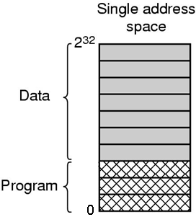
Design Issues for Paging System
Separate Instruction and Data Spaces
Problems
Most computers have a single address space that holds both programs and data
If this address space is often too small, forcing programmer to stand on their heads to fit everything into the address space
Tanenbaum, Fig. 3-25.

Slide 15
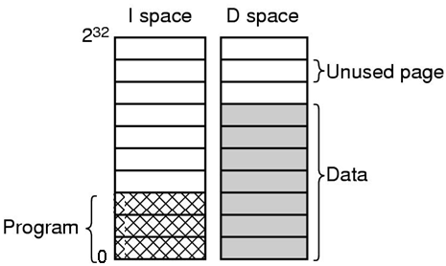
Design Issues for Paging System
Separate Instruction and Data Spaces
Solutions: Separate address spaces for
→ Instructions (I-space)
→ Data (D-space)
Each address space runs from 0 to maximum
Tanenbaum, Fig. 3-25.
The linker and the hardware must know when separate spaces are being used
Both address spaces can be paged, independently and have its own page table (mapping virtual pages to physical page frames)
Practically is double the available address space

Slide 16
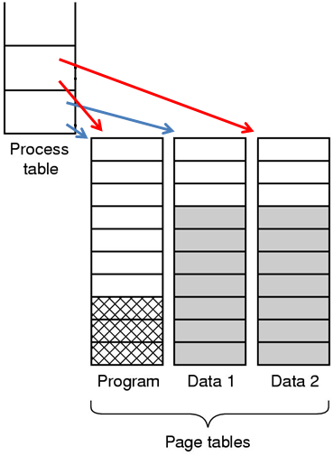
Design Issues for Paging System
Shared Pages
Problem
In large multiprogramming system, several users to be running the same program at the same time ➔ Having some copies of the same page in memory at the same time. How to manage them?
Solution
Share the read-only pages (code pages but data pages)
If separate spaces are supported, two or more processes use same their I-Space but different their D-Space. Implementing
Page tables are data structures independent of the process table
Each process has two pointers in process table: one to the I-space and one to the D-space
Tanenbaum, Fig. 3-26.

Slide 17
Design Issues for Paging System
Shared Pages
Problem:
Both A & B processes running the editor & sharing pages. When A terminates, some code pages are remove, how does OS ensure the process B is not affected?
Solution:
B generate a large number of page faults to bring them back in again. Similar, a data structure to keep track of shared pages is implemented to reduce the searching (since searching is expensive)

Slide 18
Design Issues for Paging System
Shared Pages
Sharing data (modifiable pages)
Context
Data can be shared and can be modified concurrently by many processes
Ex:
The child process attempt to modified a page containing portion of stack
The OS recognizes that the page may be shared and can be modified (by both processes), the OS will create a copy of this page and map it to the address space of the child process
The process will modify its copied page and not the page belonging to the parent process
Solution: Copy-on-write strategy is applied to modified-data pages (This solution is applied to the OS using the duplicating process strategies. Ex: Windows 2000, Linux, Solaris 2)

Slide 19
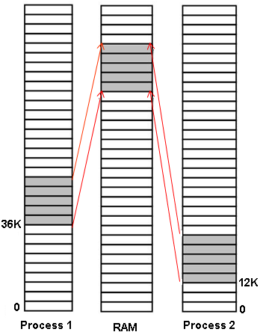
Design Issues for Paging System
Shared Libraries
Problems
In modern system, there are many libraries used by many process
Statically binding all these libraries to every executable program on the disk would make them even more bloated
Process 1
Process 2
Process 3
Process 4
Shared DLL
Solutions: Share libraries
(Ex: DLL – Dynamic Link Libraries)
Tanenbaum, Fig. 3-27.
Separate common routines to share libraries

Slide 20
Design Issues for Paging System
Shared Libraries
Share libraries
A program linked with a share libraries, instead of including the actual function called, the linker includes a small stub routine that binds to the called function at the run time
Shared libraries is only loaded either when the program is loaded or when functions in them are called for the first time
The entire libraries is not read into memory, it is paged in, page by page, as needed, so functions that are not called will not be brought into RAM
Advantages
Making executable file is smaller and saving space in memory.
If a function in a shared library is updated to remove a bug, it is not necessary to recompile the programs that call it. The old binaries continue to work.

Slide 21
Design Issues for Paging System
Shared Libraries
Problems
Two processes uses the shared library at a different address in each process
Each process and shared library are located at the different addresses
➔Therefore, some functions may be gone to the different absolute addresses in the shared library
➔The reference address will not be moved in exactly because the relocation on the fly will not work with using the shared libraries
➔The absolute address cannot be applied with using shared libraries

Slide 22
Design Issues for Paging System
Shared Libraries
Solution
First Approach: Using copy-on-write
This will create new pages and relocate them on the fly in correctly for each process in creating progress.
➔This is not the shared solution because this solution copies the non-modified pages.
Second Approach: using position-independent-code
The instruction in code should used only relative offsets then the absolute addresses.
This is word correctly with the shared libraries placing anywhere in virtual address space.

Slide 23
Design Issues for Paging System
Memory-Mapped Files
Context
Manipulating a file on disk must be invoked the system call open(), read() and write() and must access the disk ➔slow
Virtual memory needs to swap in/out memory pages from/to disk.
Solution: Use Memory Mapped File
Treat file I/O as routine memory access (device driver – ROM routines – read/write using binary format, data structure is not concerned).
Allowing a part of the virtual address space to be logically associated with the file
Map a disk block to a page(s) in memory and page used the file on disk as the backing store.
➔ faster and simplifier

Slide 24
Design Issues for Paging System
Memory-Mapped Files
How does it work?
Initial, when the file is accessed, the page fault is occurs
Then, the pages are allocated and are loaded the content from file system
Subsequent, the file manipulations are handled as routine memory accesses
It is not necessarily be immediate writes file to disk when the memory is modified. Instead of this, the OS updates the file on disk in periodically if any if the memory has been modified
When the process exits (e.g. file is closed), all the modified pages are written back to the file automatically.

Slide 25
Design Issues for Paging System
Memory-Mapped Files
In practical,
Some OS using this solution only through a specific system call (ex: mmap() in Solaris 2) and treat all other file I/O using the standard system calls
If two processes map onto the same file at the same time, they can communicated over shared memory
One process writing done to the share memory are immediately visible when the others one reads (sharing data and support to copy-on-write) ➔ Provide high bandwidth channel between process
Shared libraries can used this mechanism, if memory-mapped file is available

Slide 26
Design Issues for Paging System Cleaning Policy
All content of a page can be read from/write to file → The page must be clean.
Solution: Paging daemon is used.
A background process sleeps most of time but is awakened periodically to inspect the state of memory
Ensure a plentiful of free page frame to paging works best
If too few page frames are free, the paging daemon begins selecting pages to evict using some page replacement algorithm, then written them to disk (if it is modified)
Requirement:
The previous contents of page are remembered
→ All the free frames are clean, so the written to disk in a big hurry does not occur

Slide 27
Design Issues for Paging System Cleaning Policy
Cleaning policy
Using two-handed clock
Front hand (pointer for cleaning pages) is controlled by the paging daemon. When it points to a dirty page, that page is written back to disk and the front hand is advanced. Otherwise, it is just advanced
Back hand (pointer for choosing an evicted page) is used for page replacement algorithm as in the standard clock algorithm

Slide 28
Design Issues for Paging System Virtual Memory Interface
Context
Large virtual address space ←→ Smaller physical memory
Can programmers control over their memory map to allow many processes to share memory?
Solution: Share memory
Programmer can name regions of their memory then these names of memory regions can be shared to many processes.
➔ The page in memory can be shared to many processes
➔The shared memory region is used to write by one process and read from another(pipe mechanism, IPC – InterProcess Communication).
➔ High bandwidth, enhance the program’s progress

Slide 29
Design Issues for Paging System Virtual Memory Interface
In message passing system:
Problem: when messages are passed, the data are copied from one address space to another ➔ complexity and waste time
Solution: shared memory is applied by copying the named pages instead of all the data
The sender unmaps the pages containing the message when the message are passed
Then, the receiving maps the unmapped pages in (only page names have to be copied)
➔ High performance

Slide 30
Design Issues for Paging System Virtual Memory Interface
In distributed application,
When a process references a page that is not mapped in, the page fault occurs.
Solution:
(1)The page fault handler locates the machine holding the page and sends it a message asking it to unmap the page and send it over the network
(2) When the page arrives, it is mapped in and the fault instruction is restarted
➔Allow multiple process over a network to share a set of pages (high performance)

Slide 31
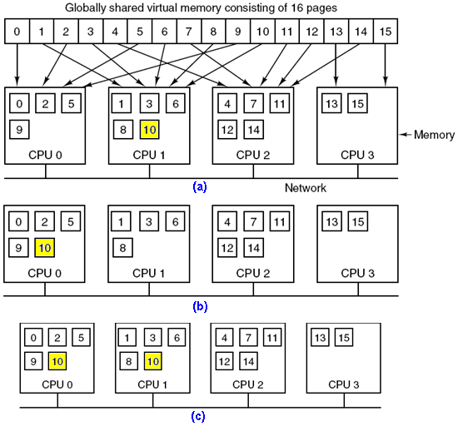
Design Issues for Paging System Virtual Memory Interface
CPU 0 references page 10, page 10 is moved to CPU 0
CPU 1 references page 10, page 10 is read –only and replication is used.
Tanenbaum, Fig. 8-22

Slide 32
5.2- Implementation Issues
OS Involvement with Paging
Page Fault Handling
Instruction Backup
Locking Pages in Memory
Backing Store
Policy and Mechanism

Slide 33
Impl. Issues: OS Involvement in Paging
There are four situations when OS has paging-related work to do
Process creation time
Process execution time
Page fault time
Process terminal time

Slide 34
Impl. Issues: OS Involvement in Paging…
At Process creation time
OS has to determine how large the program and data will be and create page table for it.
Space has to be allocated in memory for page table and it has to be initialized.
The page table need not be resident when the process is swapped out but has to be in memory when the process is running.
Space has to be allocated in the swap area (that has to be initialized with program text and data) on disk so that when a page is swapped out, it has somewhere to go.
Some systems page the program text(code) directly from the executable file, thus saving disk space and initialization time.
Information the page table and swap area on disk must be recorded in the process table.

Slide 35
Impl. Issues: OS Involvement in Paging…
At Process execution time
When a process is scheduled for execution, the MMU ( memory management unit) has to be reset for the new process and the TLB (translation lookaside buffer) flushed, to get rid (tống khứ) of traces of the previously executing process.
The new process’ page table has to be made current, usually by copying it or a pointer to it to some hardware registers.
Optionally, some or all of the process’ pages can be brought into memory to reduce the number of page faults initially.

Slide 36
Impl. Issues: OS Involvement in Paging…
At Page fault time
When a page fault occurs, the OS has to read out hardware registers to determine which virtual address causes the fault.
OS must compute which page is needed and locate that page on disk, then it must find an available page frame to put the new page, evicting some old page if need be.
OS reads the needed page into the page frame.
OS must back up PC (program counter, instruction of current instruction) to have it point to the faulting instruction and let that instruction execute again.

Slide 37
Impl. Issues: OS Involvement in Paging…
At Process terminal time
When a process exits, the OS must release its page table, its page, and disk space that the pages occupy when they are on disk
If some of the pages are shared with other processes, the pages in memory and on disk can only be released when the last process using them has terminated.

Slide 38
Impl. Issues: 10 steps for Page Fault Handling
1: The hardware trap to kernel; save PC on stack; save information about the state of current instruction into a special CPU registers.
2: An assembly code routine is started to save the general registers and other volatile information to keep the OS from destroying it.
3: The OS find the virtual page that is needed (page fault occurs).
The hardware registers contains this information.
If not, the OS must retrieve the PC, fetch the instruction, and parse it in software to figure out what it was doing when the fault hit

Slide 39
Impl. Issues: 10 steps for Page Fault Handling
4: Check if the address is valid and the protection consistent with the access.
If not, the process sent a signal or killed.
If the address is valid and no protection fault has occurred, the system checks to see if a page frame is free. If no frames are free, the page replacement algorithm is run to select a victim
5: If the “victim” page is dirty, the page is scheduled for transfer to the disk, and a context switch take place, suspending the faulting process and letting another one run until the disk transfer has completed. In any event, the frame is marked as busy to prevent it from being used for another purpose

Slide 40
Impl. Issues: 10 steps for Page Fault Handling
6: When the page frame is clean, the OS find on the disk address where the needed page is, and scheduled a disk operation to bring it in. While the page is being loaded, the faulting process is still suspended and another user process is run, if one is available.
7: When the disk interrupt indicates that the page has arrived, the OS updates the page table and mark as normal the page frame.
8: The faulting instruction is backed up to the state it had when it began and the PC is reset to point to that instruction
9: The faulting process is scheduled, and the OS returns to the routine that called it.
10: This routine reloads the registers and other state information and returns to user space to continue execution, as if no fault had occurred.

Slide 41
Impl. Issues: Instruction Backup
When the page fault occurs, the OS fetch the page needed, How is the instruction, causing the trap, restarted?
F()
{…..
}
Page
will be loaded
Counter
F();
nextInstruction
Method 1
frame
Method 2
PCB
Method 1: The instruction at the line causing the page fault is trapped → Counter+1 is the next instruction
Method 2: Counter = the instruction at the line right after the line which causing the page fault is trapped.

Slide 42
Impl. Issues: Instruction Backup…
Context
Where should the PC’s position be backed up when the progressed instructions occur errors?
Where should the PC’s position be loaded when the instruction is restarted?
The value of PC at the time of the trap depends on which operand faulted and how the CPU’s microcode has been implemented
In auto-incrementing mode
First approach
The increment may be done before the memory reference
Before restarting the instruction, the OS must decrease the register
Second approach
The auto-increment may be done after the memory reference
The OS do nothing to restart the instruction
In auto-decrementing mode, a similar problems also occur

Slide 43
Impl. Issues: Instruction Backup…
Problem
The page fault occurs when a instruction reference the memory, the instruction can occur at the operands
To restart the instruction, the OS must determine where the first byte of instruction is
The OS cannot know the command (operator) if the fault occurs at the operand
➔ How can the OS determine what happened and how to repair it?
Solution
A hidden internal register is used to store the PC before each instruction is executed.
A second register is used to store the value of the registers auto-incremented or auto-decremented.
➔ When the fault instruction is restarted, the OS can unambiguously undo all the effects of it

Slide 44
Impl. Issues:Locking Pages in Memory
Problems
Global paging is used. The process A is suspended due to IO. The process B is chosen to run and B causes a page pagefault. A page of A will recieve data from IO is evicted.
→ In the case of DMA (Direct Memory access, a way to tranfer data without controlling of CPU) used with I/O, the evicted page of A causes the problems → The transferring data will be written into either the buffer or this page?
Solution
First Approach: Lock pages engaged in I/O in memory so that they will not be removed. (pinning – ghim) → If the locking pages in memory always occurs with high ratio, the bottle neck or thrashing can be occurs.
Second Approach: Do all I/O to kernel buffers & copy the data to user pages later.

Slide 45
Impl. Issues: Backing Store
The simplest algorithm for allocating page space on disk
A special swap partition exits on the disk.
This partition uses block numbers relative to the start of the partition, instead of using a normal file system .
When the system is booted, the swap partition is empty and is represented in memory as a single entry giving its origin and size.
When the process is started, a chunk of the partition area the size of first process is reserved and the remaining area reduced by that amount.
As new processes are started, they are assigned chunks of the swap partition equal in size to their core images.
As they finished, their disk space is freed.
Requirements: swap area must be initialized to copy entire process image to the swap area before the process start.
→ associated with each process is the disk address of its swap area, that is where on the swap partition its image is kept (that also kept in process table).

Slide 46
Impl. Issues: Backing Store
Problem
Process can increase in size after starting due to the growing of data and stack.
Solution
First Approach: Reserve separate swap areas for text, data, stack and allow each of these areas to consist of more than one chunk on the disk.
Second Approach:
Allocate nothing in advance and allocate disk space for each page when it is swapped out and de-allocate it when it is swapped back in
➔ Processes in memory do not tie up any swap space
Disadvantage
A disk address is needed in memory to keep track of each page on disk
In each process, there must be a table stored the location of each page on disk

Slide 47
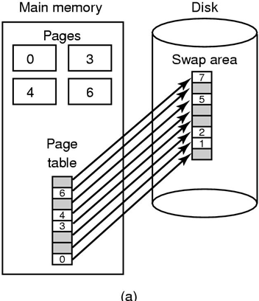
Impl. Issues: Backing Store
First approach in details:
-Paging to a static swap area
The swap area on disk is as large as the process virtual address space.
Each page has a fixed location on disk and store in contiguously in order of the page number.
A page is in memory always has a shadow copy on disk.
Disadvantages
The synchronization on disk must be progressed even the page in memory has not been modified
The page on disk may be out of date due to not update the modified page from memory (for a long time)
Ex: It is applied in Unix.
Paging to a static swap area
Tanenbaum, Fig. 3-29.

Slide 48
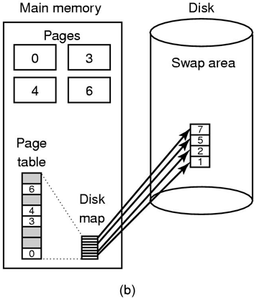
Impl. Issues: Backing Store
Second approach in details,
- Backing up pages dynamically
Disk map
Is a table mapping the disk address per virtual page is used
Its entries contain an invalid disk address or a bit marking them as not in used
Pages do not have fixed addresses on disk.
A page in memory has no copy on disk
When the page is swapped out, an empty disk space is chosen on the fly and the disk map is updated accordingly
Ex: Windows using swap file to apply this strategy
Backing up pages dynamically
Tanenbaum, Fig. 3-29.

Slide 49
Impl. Issues: Separation of Policy and Mechanism
Three parts of memory management system
A low-level MMU handler
All the details of how the MMU works are encapsulated in the MMU handler.
MMU handler is machine-dependent code and has to be rewritten for each new platform the OS is ported to.
A page fault handler that is part of the kernel
A page fault handler is machine-independent code and contains most of the mechanism for paging.
An external pager running in user space
The policy is largely determined by the external page, which runs as a user process.
When a process starts up, the external page is notified in order to set up the process page map and allocate backing store on the disk if need be.
As the process runs, it may map new objects into its address space, so the external pager is again notified.

Slide 50
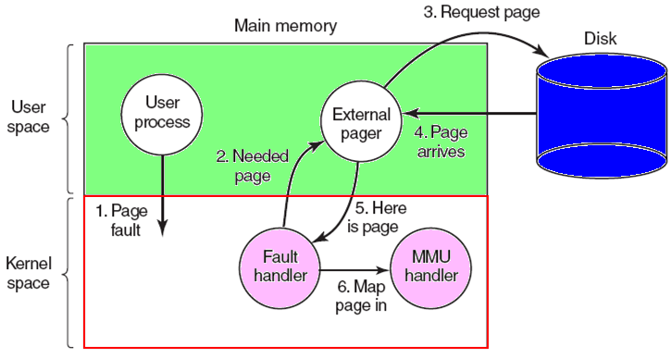
Impl. Issues: Separation of Policy and Mechanism
Tanenbaum, Fig. 3-30.
When the process starts running, it may get a page fault.
The fault hander figures out which virtual page is needed and send message to the external pager, telling it the problem.
The external pager then reads the needed page from the disk and copies it to a portion of its own address space, then tells the fault handler where the page is.

Slide 51
Impl. Issues: Separation of Policy and Mechanism
The fault handler then unmaps the page from the external pager’s address space and asks the MMU handler to put it into the user’s address space at the right place.
The user process can be restarted.
Problems
External pager does not have access to the Referenced bit and Modified bit of all the pages
Some mechanism is needed to pass this information to the external pager or the page replacement algorithm must go in the kernel
→the fault handler tells the external pager which page it has selected for eviction and provides the data, either by mapping it into the external pager’s address space or including it in a message. Either way, the external pager writes the data to disk
Advantages: is more modular code and greater flexibility
Disadvantages: the extra overhead of the various message being sent between the pieces of the system.

Slide 52
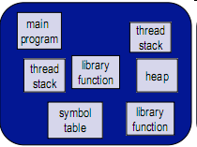
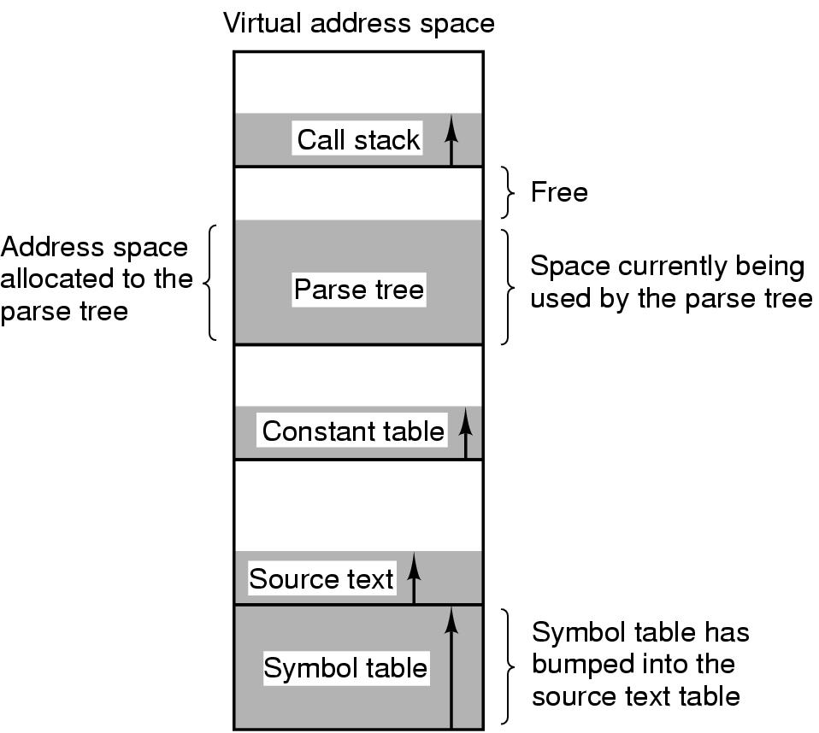
5.3- Segmentation
Context
Programmer’s view of memory is not usually as a single linear address space.
Programmer cannot predict how large these will be, or how they’ll grow, and doesn’t want to manage where they go in virtual memory.
The virtual memory is one-dimensional because the virtual address go from 0 to some maximum address, one address after one another.
The virtual memory gives a process a complete virtual address space to itself.
A compiler may create some tables for some objectives. These tables may grow in size.

Slide 53
Segmentation
Problem
The processes as compiler has many objects such as executed code, Static/ Heap Data, Stack, constant table … that are located in address space
One of them may grow and shrinks in dynamically or unpredictably
→ It is really needed a way of freeing manage the expanding and contracting space that virtual memory eliminates the worry of organizing the program into overlays
Solution: Using Segmentation
Segmentation provides the mechanism to management memory with many completely independent address spaces and are not fixed size as page
Segmentation maintains multiple separate virtual address spaces per process
The address space is a collection of segments
Segmentation can grow or shrink independently

Slide 54
Segmentation Example
A segmented memory allows each table to grow or shrink indepenedly of the other tables
Tanenbaum, Fig. 3-32.

Slide 55
Segmentation
Characteristics of a Segment
Is a logical entity.
Consists of a linear sequence addresses, from 0 to some maximum → length
Different segments may have different length and may change during execution (ex: the stack segment may be increased or decreased)
Has a separate address space, different segments can grow and shrink independently without effecting each other
Might contain a procedure, or a array, or a stack, or a collection of scalar variables, but usually it does not contain a mixture of different types (→ have different kinds of protection)
Facilities sharing procedures or data between several processes (e.g. share library)
The compiler automatically construct segments reflecting the input program
To specify an address in the segmented memory:
<segment-number, offset>

Slide 56
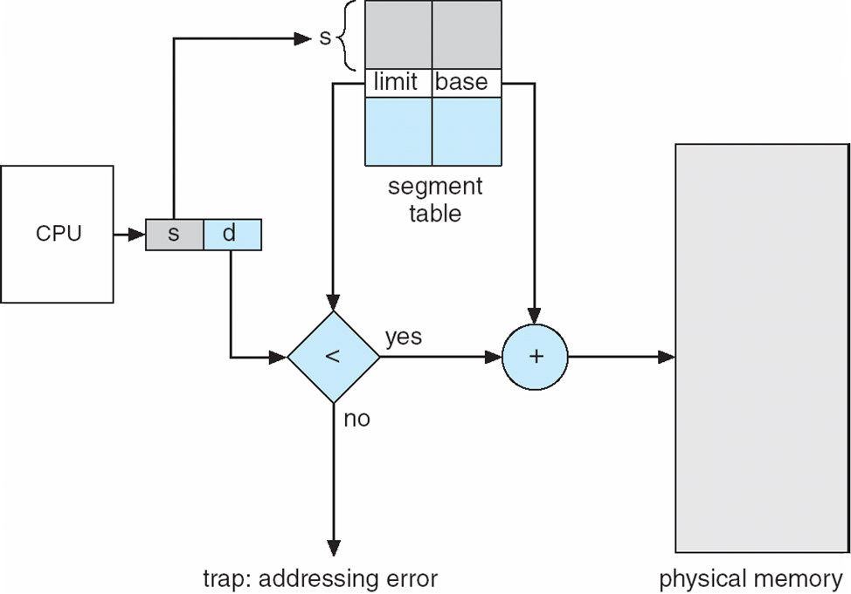
Segmentation Implementation using Hardware
Segment table
Each entry has segment base and segment limit.
Segment base contains the starting physical address where the segment resides in memory.
Segment limit specifies the length of segment.
Segment splits into <segment_number, offset> and using segment_number as index into the segment table
The real address is calculated by adding the offset to segment base

Slide 57
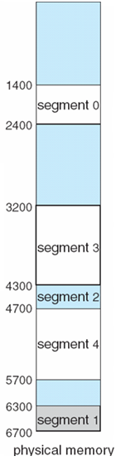
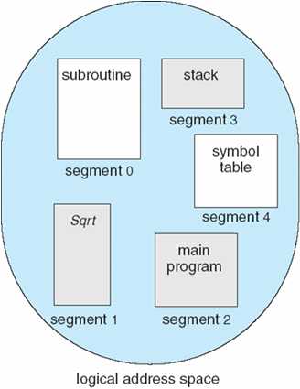
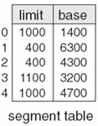
Segmentation Example
Segment 2 begins at 4300 and has 400 bytes size. If the 53rd byte of the segment 2 is referenced: ➔ the physical address is 4300 + 53 = 4353
If the 1222nd byte of the segment 0 is referenced (out of its space), the trap to the OS is occurs

Slide 58
Segmentation
Advantages
Can grow or shrink independently
Reduce costly because no starting addresses have been modified even if the new version is subsequently modified and recompiled creating the larger or the smaller size than the old one
Each procedure occupies a separate segment, with address 0 as its starting address
When a procedure call to the procedure locating at segment n as (n, 0), no procedures need be changed
Vs. the one dimensional memory, the procedures are packed tightly next to each other, with no address space between them → changing one procedure’s size requires modifying some procedures (that are moved) following the new starting address
Sharing
The entries in the segment table of two different processes point to the same physical location
→ Eliminating the need for many same code or data in every process’s address space
Protection is supported by memory management in modern OS (e.g the code is read only, the limit register on the hardware ….)
Disadvantages: internal fragmentation → compacting

Slide 59
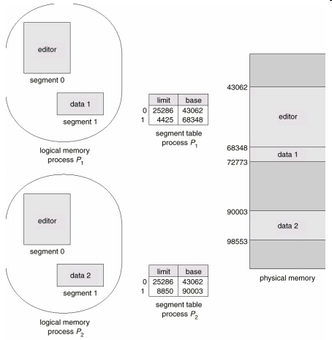
Segmentation Example
Two processes has the same segment address for their editor ( the same code, the code is read-only) but they have different data segments.

Slide 60
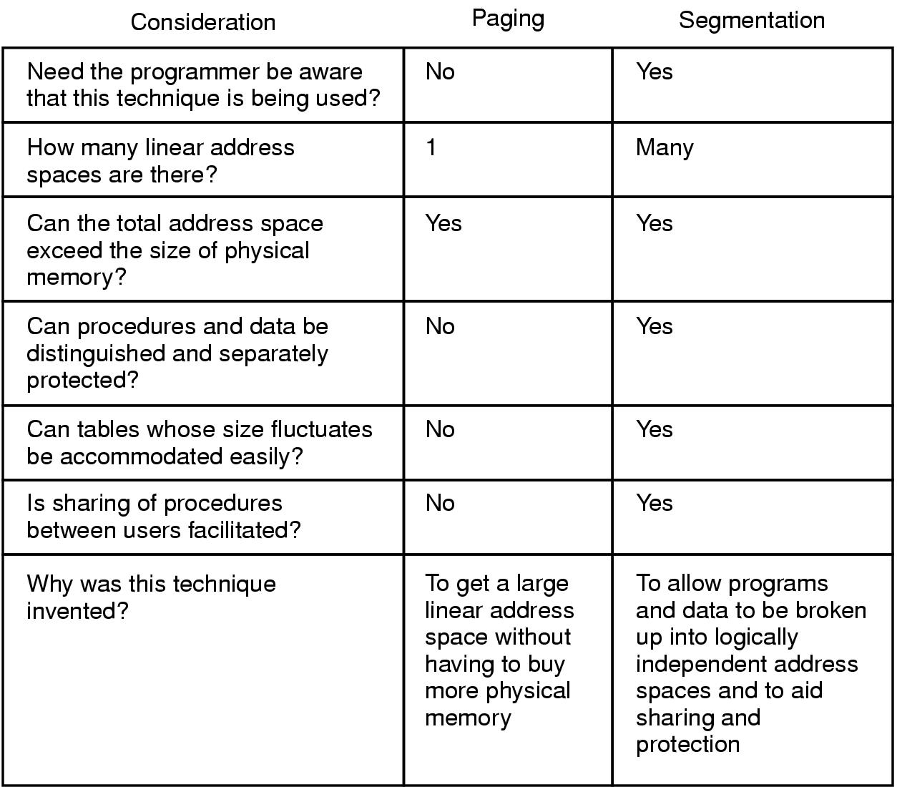
Segmentation Paging vs. Segmentation
Tanenbaum, Fig. 3-33.
Notes:
Fluctuate (v): thay đổi bất thường
Accommodate (v): cung cấp

Slide 61
Segmentation Implementation of Pure Segment
Checkerboarding and external fragmentation
Memory will be divided up into a number of chunks, some containing segments and some containing holes (after the system has been running for a while)
Wastes memory in the holes → compaction (means that external fragmentation)
(a)-(d): Development of checkerboarding.
(e) Removal of the checkerboarding by compaction.
Tanenbaum, Fig. 3-34.

Slide 62
Segmentation Segmentation with Paging
Context
Both paging and segmentation have advantages and disadvantages
Some system uses one of them to manage its memory.
However, if the segments are large, it may be inconvenient, or even impossible, to keep them in main memory in their entirety
Solution: using paging the segmentation
Treats each segment as a virtual memory and to page it, combining
The advantages of paging (uniform page size and not having to keep the whole segment in memory if only part of it is being used)
The advantages of segmentation (ease of programming, modularity, protection, sharing)
This strategy is applied on Intel Pentium and MULTICS
Notes:
Entirety: tính toàn vẹn

Slide 63
Summary
Design Issues for Paging Systems
Implementation Issues
Segmentation
Q&A

Slide 64
Keep in Your Mind
The global allocation policy is better than the local policy.
The system thrashes can occur even if the best page replacement algorithm and optimal global allocation of page frames is used.
Page size small → waste is small but the page table is large
Separate code and data using 2 address spaces make easier in managing data pages
Shared pages are pinned (ghim lại) until no process accesses it

Slide 65
Keep in Your Mind
Shared libraries:
Shared libraries (DDL) is a solution to minimize process’s size
Shared libraries is only loaded either when the program is loaded or when functions in them are called for the first time
The entire libraries is not read into memory, it is paged in, page by page, as needed, so functions that are not called will not be brought into RAM
If a function in a shared library is updated to remove a bug, it is not necessary to recompile the programs that call it. The old binaries continue to work.
Copy-on-write is a solution for common data pages
Memory-map file mechanism will periodically write modified pages to disk. This will make swapping a page faster and simplifier.

Slide 66
Keep in Your Mind
To clean frames: Use 2 pointer, Front hand pointer for cleaning pages, back hand pointer for choosing an evicted page.
Virtual memory interface: programmers can name regions of the program then make them as shared regions → Shared memory is applied by copying the named pages instead of all the data
In distributed systems, common pages are transfered from a machine to another machine.
Works must be done when a process is created:
(1) Determine the program size (code, data)
(2) Prepare memory space for load them
(3) Set up it’s page table
(4) Prepare it’s back up files for swapping
(5) Update it’s PCB

Slide 67
Keep in Your Mind
Works must be done when a process runs:
(1) Reset MMU
(2) Reset TLB
(3) Make it’s page table is current
Works must be done when a process causes a page fault:
(1) Read hardware to determine the virtual address causing the fault
(2) Determine the page which will be loaded
(3) Determne the evicted page if needed
(4) Backup the program counter

Slide 68
Keep in Your Mind
Instruction backup: When a page fault occcurs, besides referenced page must be determined, the position of the instruction which causes the page fault must be marked also. Hence, after the referenced code executed, the next instruction can continue.
2 approaches for backing store:
(1) Use static swap area: A rather large area on a disk partition is allocated for a process. This approach needs to synchronize frames in memory and pages on disk.
(2) Use dynamic swap area: Initially, no disk area is allocated. Only when a page is swapped out, a disk area is allocated. This approach needs a disk map which must be maintained and updated accordingly.

Slide 69
Keep in Your Mind
3 part of memory management system:
In kernel: MMU handler, page fault handler
In user space: External pager.
Memory Segmentation
A program is divided into some segments and they are managed separately.
An address is specified by
<segment-number, offset>
OS maintains a segment table for each process.
If segments are too large, a segment can be divided into some pages (an association of memory paging and segmentation)

Slide 70
Read yourself

Slide 71
Segmentation Segmentation with Paging: The Intel Pentium
The virtual memory is divided into two partition (8K segment)
Local Descriptor Table (LDT): describes segments local to each program including codes, data, stack …
Global Descriptor Table (GDT): describes system segments including the OS itself.
Each entry in the LDT and GDT consists 8 bytes and contains the segment base and segment limit.
Each program has its own LDT, but there is a single GDT, shared by all the programs on the computer.

Slide 72
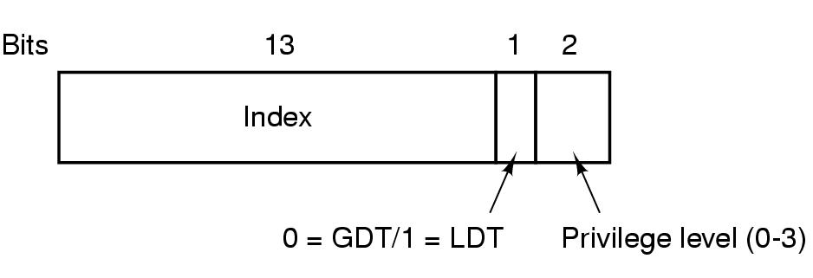
Segmentation Segmentation with Paging: The Intel Pentium
The virtual address is a pair of <selector,16 bits, offset,32 bits>.
The machine has 6 segment registers ➔ Allowing 6 segments to be addressed at any one time by a process.
The machine has also 6 microprogram registers (8 byte)
Holding the corresponding descriptors from the LDT or GDT.
Including the segment’s base address, size, and other information.
Tanenbaum, Fig. 3-39.
Structure of a Pentium Selector:
13 bits specify the LDT or GDT entry number
1 bit tells whether the segment is local or global
2 bits relate to protection with value

Slide 73
Segmentation Segmentation with Paging: The Intel Pentium
Not used
Pentium code segment descriptor. Data segments differ slightly.
Tanenbaum, Fig. 3-40.
Gbit ( granularity): 0: Limit (Li) field contains the exact segment size in bytes / 1: Limit field contains the segment size in pages. Pentium page size: 4KB → 20 bits are enough for segments up to 2³² bytes.
Dbit: describes type of segment size ( 16 or 32 bits)
Pbit (present bit), DPL ( Descriptor for Privilege Level), Sbit (system)

Slide 74
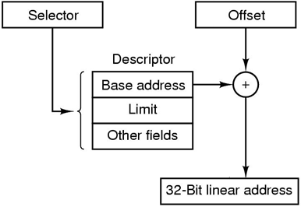
Segmentation Segmentation with Paging: The Intel Pentium
How to convert a (selector, offset) to physical address?
The microprogram finds descriptor corresponding to selector
The trap occurs if the currently page out or segment does not exist
Tanenbaum, Fig. 3-41.
Then, the hardware uses the Limit field to check if the offset is beyond the end of the segment.
If so, the trap occurs.
Otherwise, the Pentium adds the 32 bit Base field in descriptor to the offset to form what called a linear address .

Slide 75
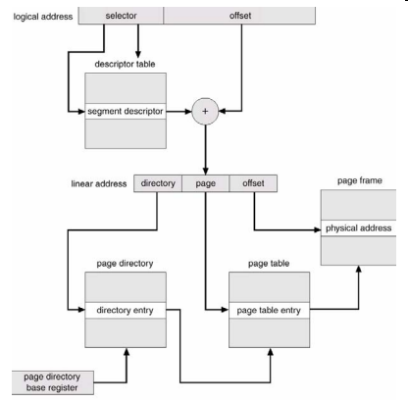
Segmentation Segmentation with Paging: The Intel Pentium
How to convert a (selector, offset) to physical address? …
If paging is disable
The linear address is interpreted as the physical address and sent to the memory for the read and write
If paging is enabled (following the multilevel page table)
The linear address is interpreted as a virtual address and mapped onto the physical address using page tables
The linear address divided into three fields <Dir, Page, Offset>.
Dir: index into the page directory to locate a pointer to the proper page table
Page: index into the page table to find the physical address of the page frame
Offset: is added to the address of the page frame to get the physical address of the byte or the word needed

Slide 76
Segmentation Segmentation with Paging: The Intel Pentium
The Pentium supports four protection levels (0 – 3)
0: kernel of OS handles I/O, memory management, and other critical matters
1: the system calls handler is present
2: contains library procedures, possibly shared among many running programs (call, read, or not modify)
3: user program
A program restrict itself to using segments at its own level
Attempts to access data at higher level are permitted
Attempts to access data at a lower level are illegal and cause traps
Attempts to call procedures at a different level are allowed, but in carefully controlled way
Tanenbaum, Fig. 3-43.

Slide 77
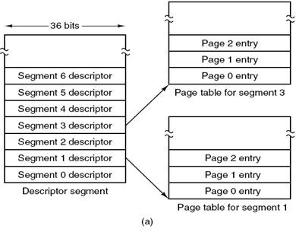
Segmentation Segmentation with Paging: MULTICS
MULTICS (Multiplexed Information and Computing Service) was an extra-ordinarily influential early time-sharing system.
Each program has a segment table, with one descriptor per segment.
The segment table is itself a segment and is paged.
The desciptor segment points to the page table
Tanenbaum, Fig. 3-35.

Slide 78
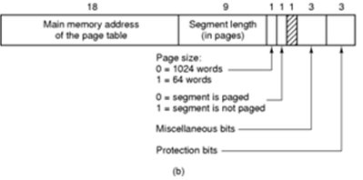
Segmentation Segmentation with Paging: MULTICS
A descriptor contains an indication of whether the segment is in main memory or not.
The descriptor (36 bits) contains an 18 bit pointer to its page table, 9 bit segment size, the protection bits, and few other items
A segment desciptor (numbers are field lengths)
Tanenbaum, Fig. 3-35.

Slide 79
Segmentation Segmentation with Paging: MULTICS
Each segment is an ordinary virtual address space and is paged
A vitual address (34 bits) consists of two parts
34-bit MULTICS virtual address
Tanenbaum, Fig. 3-36.
In implementation,
The descriptor segment is itself paged has been omitted
A base register is used to locate the descriptor segment’s table. This register points to the pages of descriptor segment

Slide 80

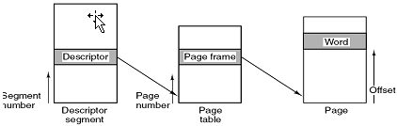
Segmentation Segmentation with Paging: MULTICS
Tanenbaum, Fig. 3-37.
How to convert the <segment, offset> to physical address
The segment number is used to checked if the segment’s table is in memory or not. If so, the segment table is located.
The page number is used to check if the virtual page is mapped (valid)
If so, the page frame is added to the offset to give the physical address
Otherwise, a page fault is triggered.
If not, segment fault occurs.
If there is a protection violation, a fault (trap) occurs.

Slide 81
Segmentation Segmentation with Paging: MULTICS
In reality implementation,
The TLB (Translation Lookaside Buffer) is used
When an address is presented to the computer, the addressing first checks to see if the virtual address is in the TLB
If so, it gets the page frame number directly from the TLB and forms the actual address of the referenced word without having to look in the descriptor segment or page table
Otherwise,
The descriptor and page tables are referenced to find the page frame address
Then, the TLB is updated to include this page using Aging page replacement

