Slide 1
6 File Systems (4 slots)
Chapter 4
Files Directories File System Implementation File System Management and Optimization Example File Systems

Slide 2
Introduction
How can OSs manage, access data in files?
How to ensure the consistence (correctness and exact) of data in files?
What are issues for OS to increase disk performance?

Slide 3
Objectives
Files
File Naming
File Structure
File Types
File Access
File Attributes
File Operations
An Example Program using File System Calls
Directories
Single-Level Directories Systems
Hierarchical Directory Systems
Path Names
Directory Operations

Slide 4
Objectives…
File System Implementation
File System Layout
Implementing Files
Implementing Directories
Shared Files
Log-Structured File Systems- – Hệ thống file dạng ghi sổ
Journaling File Systems – Hệ thống file nhật trình
Virtual File Systems
File System Management & Optimization
Disk Space Management
File System Backups
File System Consistency
File System Performance
Defragmenting Disks
Notes:
Journaling: ghi nhật trình

Slide 5
Objectives…
Example File Systems
CD-ROM File Systems
The MS-DOS File Systems
The UNIX V7 File Systems

Slide 6
Overview
Problems
Data in memory is lost when the process terminates
It is frequently necessary for multiple processes to access (parts of) the information at the same time.
How to preserve data> → Write them to file.
3 essential requirements for long-term information storage
It must be possible to store a very large amount of information
The information must survive the termination of process using it
Multiple processes must be able to access the information concurrently
Disk and its two operations (read, write) are used to solve the long-term storage problem.

Slide 7
1- Files: Definitions
Files:
are logical units of information (created by processes).
are the abstraction (objects and mechanism), that models in a convenient way the information stored and read it back on hardware devices and are managed by OS.
Processes can read existing files & create new ones if need be.
Information stored in files must be persistent (not be affected by process creation and termination).
File system
The OS’s component that manages the information stored on the storage devices and provides the users access to that information in a convenient way.
Hides the complexity of storage hardware devices.
Provides the users a uniform logical view of the information stored on these devices, based on the concept of file.
Maps files onto physical devices.

Slide 8
Files: Naming
When a process creates a file, it gives the file a name.
When the process terminates, the file continues to exist and can be accessed by other process using its name.
Rules for file naming vary somewhat from system to system. Some differences:
Distinction between upper and lower letters
Limit of name length
Extension (optional)
Provides some information about the file’s content structure
Is used to register with OS and specify for each program owns that extension
Ex: hello.c; hello.bat, hello.txt

Slide 9
Files: File Structure
There are 3 common way possibilities :
An unstructured sequence of bytes
Byte sequences (maximum flexibility).
Can put any thing they want and name file any way.
Record sequence
File contains sequence of fixed length records.
It provides 3 basic operations: read, write, append.
Tree
A file consists of a tree of records, not necessarily all the same length, each containing a key field in a fixed position in the record.
The tree is sorted on the key field to allow rapid searching for a key.
Provides the get operation to get the record with specifies key.
OS decides the new record’s position.

Slide 10
Files: File Structure Demo.
(a) Byte sequence, (b) Record sequence, (c) Tree
Tanenbaum, Fig. 4-2.

Slide 11
Files: File Types
OS supports several types of files
Regular files
Contain user data information (ASCII or binary)
Directories
System files for maintaining the structure of the file system
Character Special files
Are related of I/O ad used to model serial I/O devices
Ex: terminals, printer, networks
Block Special files
Disks Model

Slide 12
Files: File Access
Sequential access
Reads the bytes or records in order, starting at the beginning, but could not skip around and read them out of order
Could be rewind
Specific to magnetic tapes
Operation: read
Random access
Reads the bytes or records out of order, or to access records by key rather than by position ( key: unique data which helps distiguishing information)
Specific to disks
Operation: seek

Slide 13
Files: File Attributes
The extra information is associated to file by OS.
Is also called metadata.
Some attributes:
Type
Length
Time stamps: creation, last access, last modification time
Owner
Access rights: read (view), write (modify), execute, delete
Different flags: hidden, system, locked etc.
…..

Slide 14
Files: Operations
Create/ Delete / Rename/ Move
Open/ Close
Read/ Write/ Append/ Seek
Get attributes/ Set attributes

Slide 15
Files: Copy file – Demo.
System calls
Tanenbaum, Fig. 4-5.

Slide 16
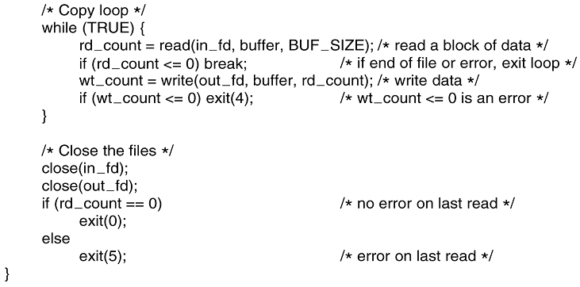
Files: Copy file- Demo…
System calls
Tanenbaum, Fig. 4-5.

Slide 17
2- Directories/ Folder: Definition
Directory:
Is a way of organizing files.
Imposes (quy định) a hierarchy of files.
Consists of a collection of files and subdirectories.
Can be viewed as a special file managed by the OS.

Slide 18
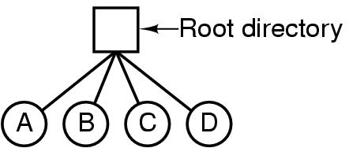
Directories: Single-Level Directory Systems
Is having one directory containing all files (root directory).
Applying on system that can be used by only one or many users.
Is adequate for simple dedicated applications.
Advantages: Simplicity, ability to locate file quickly.
Disadvantages: The file name can be duplicated in one/ many users.
files
Tanenbaum, Fig. 4-6.

Slide 19
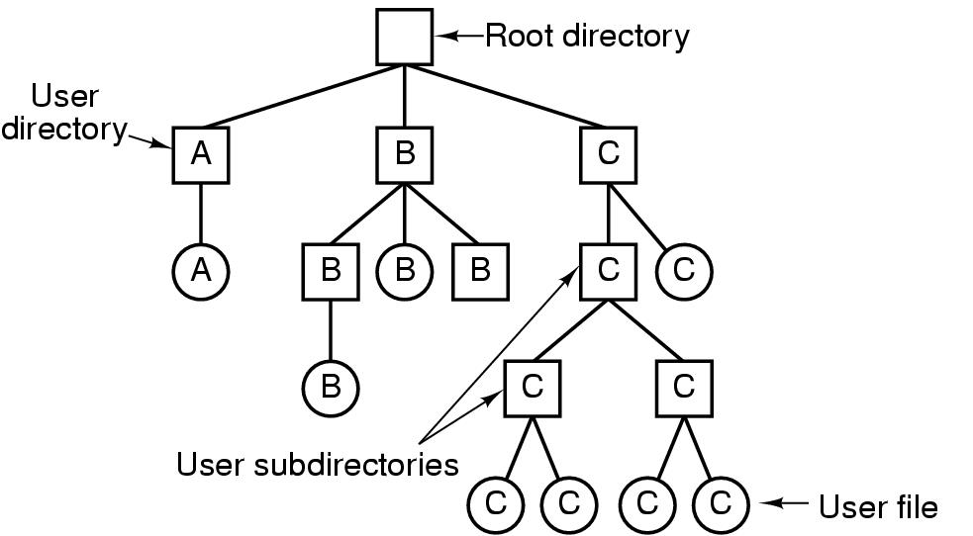
Directories: Hierarchical Directory Systems
It would be impossible to find anything if all files were in a single directory (slow) → group related files together.
There can be as many directories as are needed group the files in natural ways.
Tanenbaum, Fig. 4-7.
If multiple users share a common file server, as is the case many computer networks, each user can have a private root directory for his or her own hierarchy.
The ability for users to create an arbitrary number of subdirectories provides a powerful structuring tool for users to organize their work.

Slide 20
Directories: Path Names
Absolute path name
Starts from the root directory to the file
Examples
/home/students/john/program.c (in Linux)
C:\Program Files\Application\run.exe (in Windows)
Relative path name
Starts from the current (working) directory that can be owned to users ( each application has its own working directory)
Examples
john/program.c (in Linux)
application\run.exe (in Windows)
Special directories in relative paths
current directory: .
parent directory: ..

Slide 21
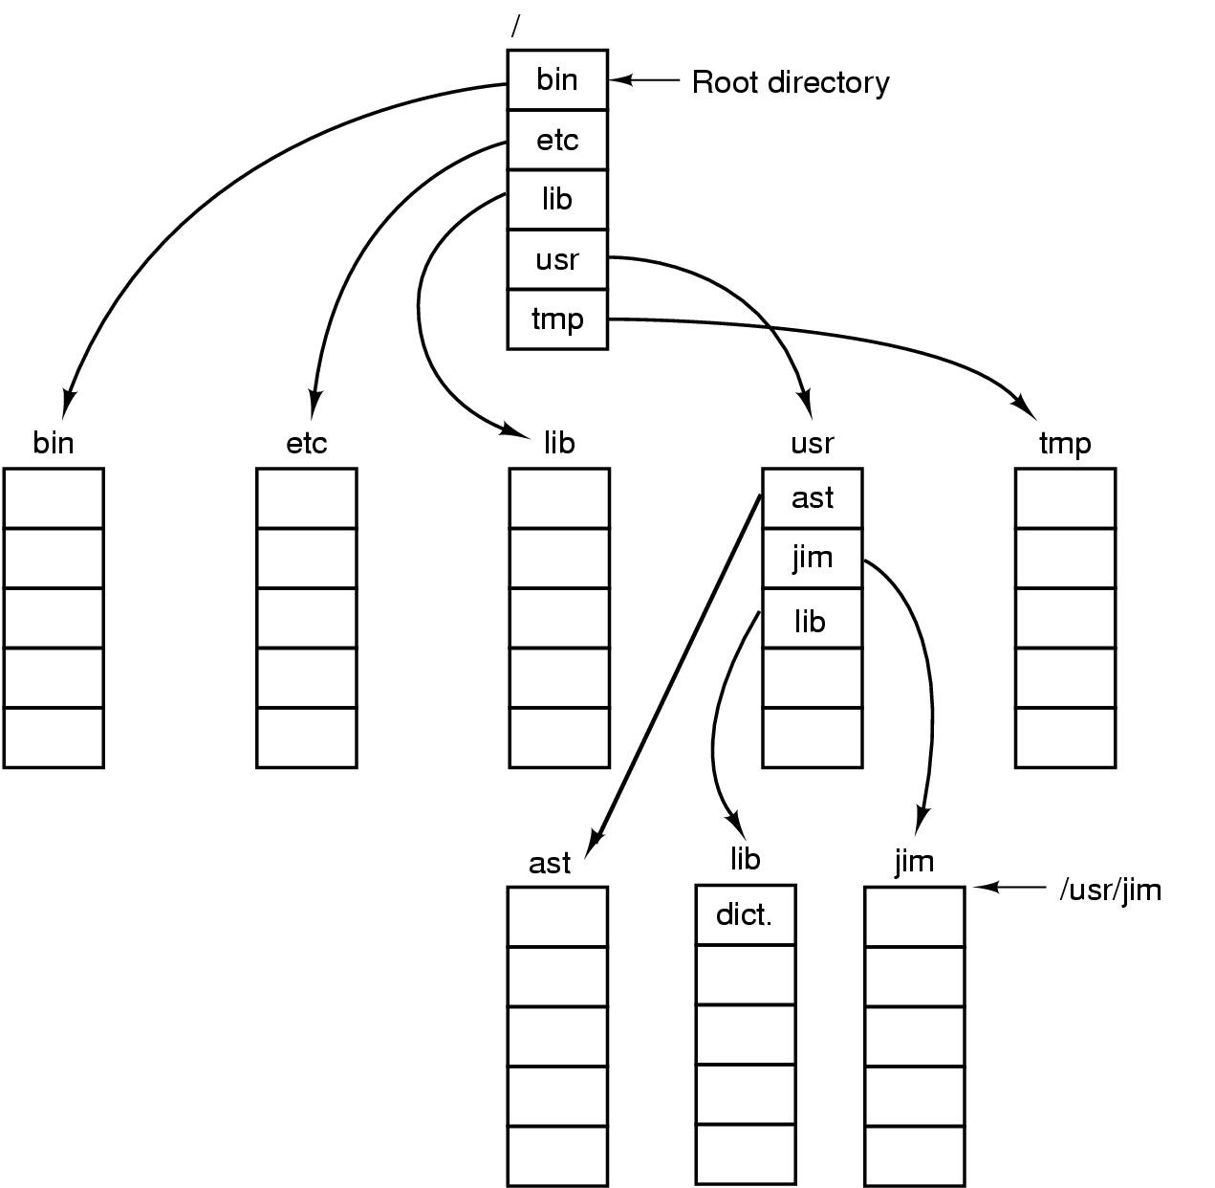
Directories/ Folders: Path Names, A demo.
Tanenbaum, Fig. 4-8.

Slide 22
Directories: Operations
Create
Delete
Opendir
Closedir
Readdir
Rename
Link: Allow a file to appear in more than one directory
Unlink

Slide 23
3- File System Implementation
How files and directories is stored?
How disk space is managed?
How to make everything work efficiently and reliably?

Slide 24
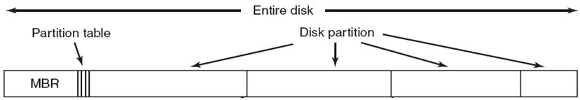
FS Impl.: File System Layout
File Systems
Are stored on disks
Disks can be divided up into one or more partitions, with independent file systems on each partition.
Tanenbaum, Fig. 4-9.:A possible file system layout
- Sector 0 of the disk is called the Master Boot Record (MBR) that is used to boot the computer.
- The end of the MBR contains the partition table.
Gives the starting and ending addresses of each partition.
One of the partitions in the table is marked as active.

Slide 25
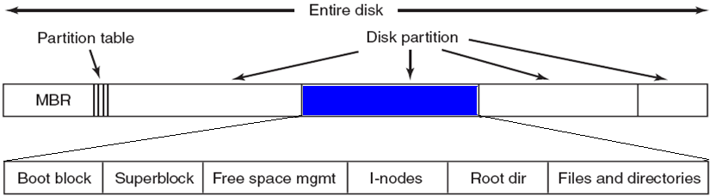
FS Impl.: File System Layout
Structure of a partition
The 1st block in each partition is called boot block that is existed even if the partition does not contain a bootable OS.

Slide 26
FS Impl.: File System Layout
The 2nd block is the super block contains the all key parameters about the file system including magic number (file system type), the number of blocks in the file system, and the other key administrative information. It will be read into memory when the computer is booted or the file system is first touched.
Next block is free blocks (ex: form of bitmap or a list of pointer)
The following block are i-nodes, an array data structures, one per file, telling all about the file (metadata of a file).
After that might come the root directory, which contains the top of the file system tree
Finally, the remainder contains all the other directories and files

Slide 27
FS Impl.: File System Layout
Mechanism of booted computer: A routine in the BIOS will:
After testing hardware is proceeded by the Power On Self Test program in ROM, the following steps will be carried out:
Read and execute the code in MBR
Locate the active partition ( data in MBR)
Read and execute the code in the boot block of the active partition.
Load the OS ( boot block contains the disk postion where the OS is stored).
A possible file system layout
Tanenbaum, Fig. 4-9.

Slide 28
FS Impl.: Implementing Files
Contiguous Allocation
Store each file as a contiguous run of disk blocks
Advantages
Simple to implement
Keeping track of files’ blocks needs :
<disk address of first block, number of allocated blocks>
High performance: get entire file from disk in one operation (only seek to first block)
Disadvantages
Fragmentation (internal and external)
Difficult to increase the file’s size

Slide 29
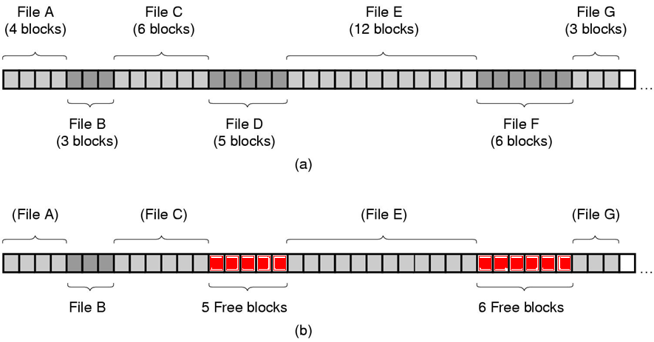
FS Impl.: Contiguous Allocation Demo.
(a) 7 files. (b) After files D and F are removed → Fragmentation
Tanenbaum, Fig. 4-10.

Slide 30
FS Impl.: Implementing Files
How does OS manage a file content stored in some separate location on a disk?
Linked List Allocation
Storing files is to keep each one as a linked list of disk blocks
First word of each block is used as pointer to the next one and the rest of the block is for data.
Advantages
No external fragmentation (still internal fragmentation)
It is sufficient for the directory entry to merely store the disk address of the first block
Disadvantages
Random access is extremely slow.
The amount of data storage in a block is not a power of two because the pointer takes up a few bytes

Slide 31
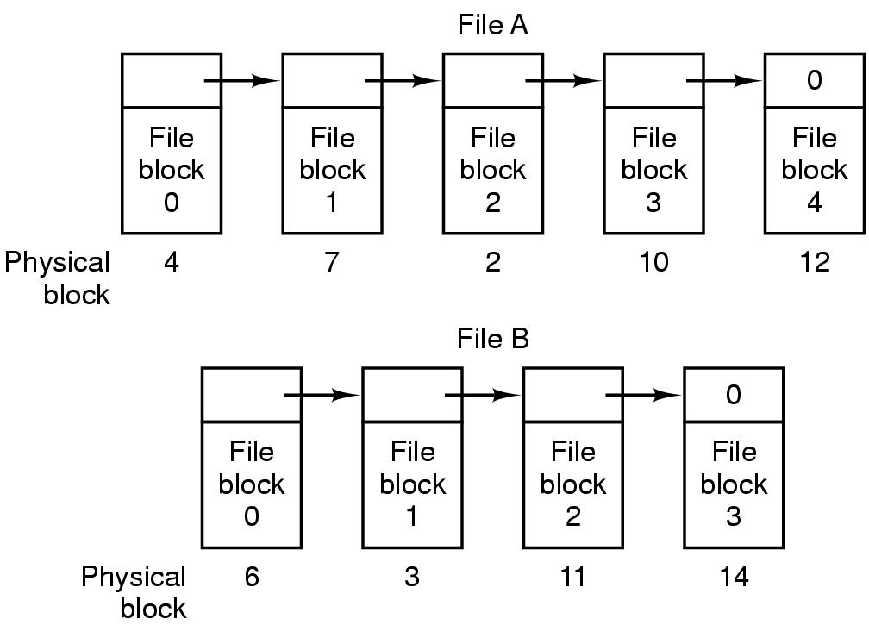
FS Impl.: Linked List Allocation Demo.
0: Last block
0 or -1 can be selected to mark the last disk block.
Tanenbaum, Fig. 4-11.

Slide 32
FS Impl.: Implementing Files
Linked List Allocation using a Table in Memory
Both the disadvantages of the linked list allocation can be eliminated by taking the pointer word from each disk block and putting it in a table in memory (File Allocation Table – FAT)
Tanenbaum, Fig. 4-12.

Slide 33
FS Impl.: Implementing Files…
Linked List Allocation using a Table in Memory
Advantages
The same advantages as linked list allocation
The entire block is available for data
Random access is relatively fast
Disadvantages
The entire table must be kept for efficiency in memory
Example: for a 200GB HDD, 1KB block-size, 4 bytes for a FAT entry => 200*2³⁰ / 2¹⁰ ~ 200*2²⁰ entries => 600MB – 800MB of memory for FAT.
Not wildly practical and does not scale well to large disks.

Slide 34
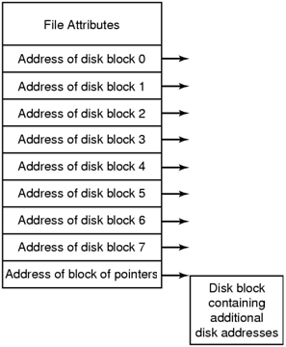
FS Impl.: i-nodes, Index-nodes
A data structure (involve 2 parts) associates with every file:
Part 1: Lists the attributes
Part 2: Disk addresses of the file’s block. It divides 2 sub parts
Sub part 1: contain the address of disk block i^{th} in directly
Sub part 2: contain the address of block of pointers that is used with large file (multilevel index)
Given the i-node, it is then possible to find all the blocks of the file
Tanenbaum, Fig. 4-13.

Slide 35
FS Impl.: i-nodes…
Advantages
The space is reserved because i-node need only be in memory when the corresponding file is open.
Allows the maximum number files that may be opened at once.
Is smaller than the space occupied by the file table.
Disadvantages
Each i-nodes has room for a fixed number of disk addresses (not flexibility) ➔ What happens when a file grows beyond this limit? ➔ Solution: reserve the last disk address not for data block, but it is used to contains more disk block addresses.

Slide 36
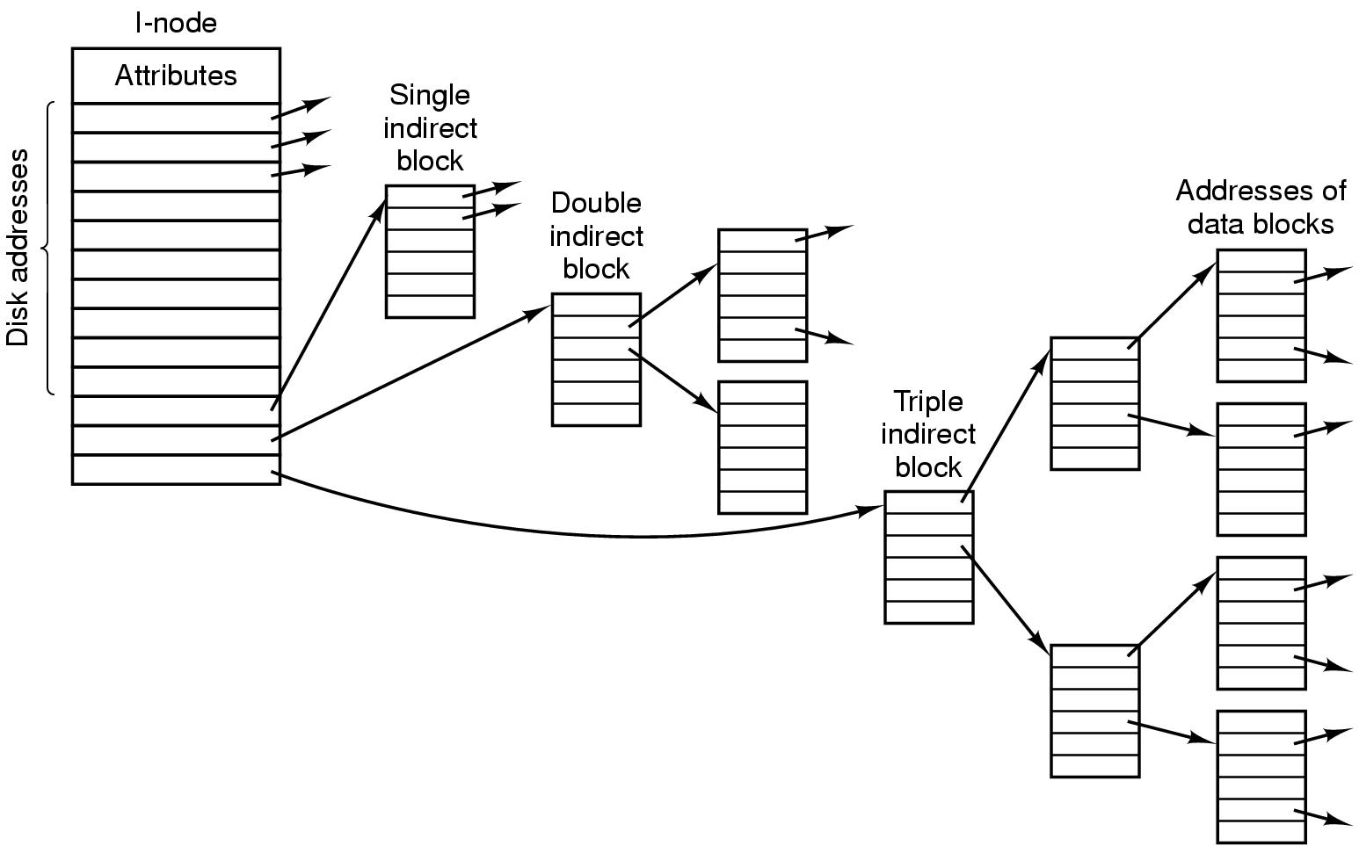
FS Impl.: i-nodes – Example
I-node can contain more indirect blocks such as: double indirect block, triple indirect block
➔ The file size can be very large.

Slide 37
FS Impl.: i-nodes…
Example:
An i-nodes has contain 10 direct addresses and 1 single indirected addresses of 4 bytes each and all disk blocks are 1KB. What is the largest possible file?
10 direct addresses with 1KB each block:
→ File size is managed by direct addresses: 10 * 1KB = 10KB
1 single indirected address points to a disk block (1KB)
→ Number of pointers can be managed by the indirect address:
1024/4 = 256
→ File size is managed by the indirect address:
256* 1KB= 256 KB
➔ The largest possible file is 10 + 256 = 266 KB

Slide 38
FS Impl.: Implementing Directories
The main function of the directory system is to map the ASCII name of a file onto the information needed to locate the data of that file: filename → first data block.
When a file is opened, the OS used the path name to locate the directory entry that contains:
The information needed to find the disk blocks such as disk address of entire file, or the number of the first block, or the number of the i-node.
Some file attributes.

Slide 39
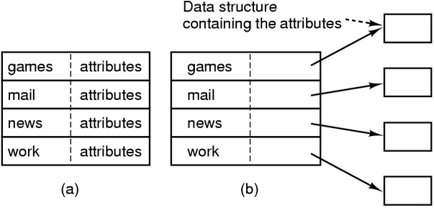
FS Impl.: Implementing Directories…
Tanenbaum, Fig. 4-14.
In simple design, a directory consists of
A list of fixed size entries, one per file, containing a (fixed-length) file name, structure of the file attributes, and one or more disk addresses
Or just a file name and i-node number

Slide 40
FS Impl.: Implementing Directories…
Long and variable-length file name
First approach (simplest)
Set a limit on file name length, typically 255 characters
Disadvantage: wastes a great deal of directory space

Slide 41
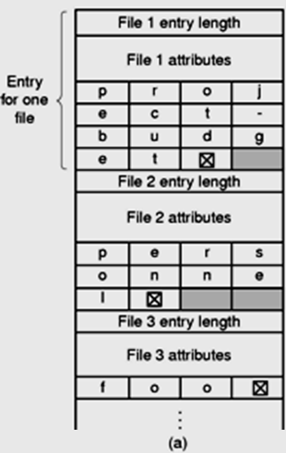
FS Impl.: Implementing Directories…
Long and variable-length file name
Second approach: All directories entries contains:
- Actual file name is terminated by special character.
To allow each directory entry begin on word boundary, each file name is filled out to an integral number of words
Disadvantages
Entry lengths can be various ➔ When a file is removed, a variable-sized gap is introduced into the directory into which the next file to be entered may not fit → fragmentation
A single directory entry may span multiple pages ➔ page fault occurs when reading a file name.
Tanenbaum, Fig. 4-15.

Slide 42
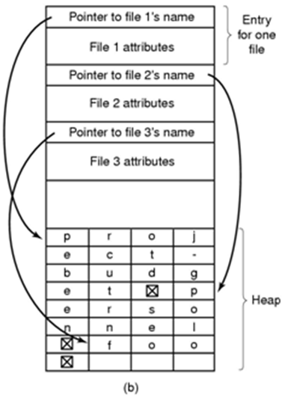
FS Impl.: Implementing Directories...
Long and variable-length file name
Third approach (Improvement)
Making the directory entries themselves all fixed length and keep the file names together in a heap at the end of the directory
Advantages
When an entry is removed, the next file entered will always fit there
No filler character after the file name
Tanenbaum, Fig. 4-15.

Slide 43
FS Impl.: Implementing Directories…
Searching Directories
Search linearly from beginning to end when a file name has to be looked up → slow with extreme long directories.
To speed up: the hash table is used.
Advantage: faster lookup.
Disadvantages: more complex administrator.
Applying to the large directories, the searching result is cached.
Before starting a search, a check is first made in the cache.
If so, it can be located immediately. Otherwise, the searching is started.

Slide 44
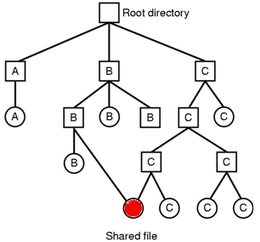
FS Impl.: Shared Files
Sharing file is useful in working together on a project.
A shared file appear simultaneously in different directories belonging to different users.
Problems: The changing of the shared file is listed in the directory of user doing the executing (not visible to other users) → Defeating the purpose of sharing.
File system with no shared files (tree)
Tanenbaum, Fig. 4-7.
File system with shared files – Using links
➔ Directed Acrylic Grapg - DAG
Tanenbaum, Fig. 4-16.
Notes:
Defeat: làm thất bại, hạ gục

Slide 45
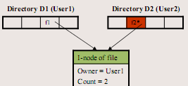
FS Impl.: Shared Files …
The first solution (traditional/ hard linking)
Disk blocks are not listed in directories, but in a little data structure (i-node) associated with the file itself. The directories would then point just to the little data structure.
Advantages
- One i-node
- No new blocks allocated
Disadvantages:
- A mechanism for removing file is needed. If not, a user can be billed (thông báo) for a “removed file”.

Slide 46
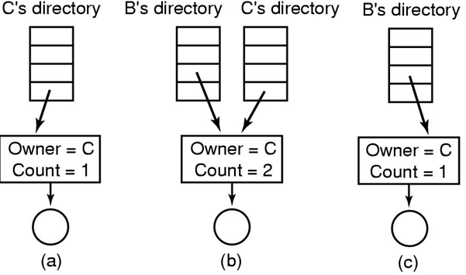
FS Impl.: Shared Files…
Traditional/ Hard Linking: (a): Situation prior to linking. (b) After the link is created. (c): After the original owner removes the file
Tanenbaum, Fig. 4-17.

Slide 47
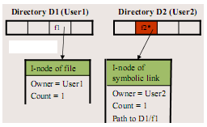
FS Impl.: Shared Files…
Second solution (symbolic linking)
By having the system create a new file (contains only path name), of type LINK, and entering that file in B’s directory.
When user2 reads from the linked file, the OS looks up name of the file, and read that file
Advantages:
No inconsistency (Only one actual file)
Can be used to link to files in a network (only using path name)
Disadvantages:
Extra overhead for getting the file i-node
Extra i-node needed for each symbolic link
Problems: When links are allowed, files can
have two or more paths .
➔execute one more actions

Slide 48
FS Impl.: Log-Structured File Systems (LFS)
Hệ thống file ghi sổ
Problem:
In most file system, writes are done is very small chunks (highly inefficient)
In UNIX
To write new file, the i-node for the directory, the directory block, the i-node for the file, and the file itself must all be written.
If a crash occurs before the write done, the file system exposes serious consistency problems. Thus, all the writing task can be delayed.
➔ How to make the file system always consistent?

Slide 49
FS Impl.: LFS…
Solutions: using LFS
Main idea: Structure the entire disk as a log.
All writes are initially buffered in memory, and periodically, all the buffered writes to the disk in a single segment at the end of the log.
A single segment
Contains i-nodes, directory blocks, and data blocks, all mixed together.
At the start of each segment is a segment summary telling what can be found .
i-nodes are scattered all over the log (the blocks are located in the usual way when an i-node is located).

Slide 50
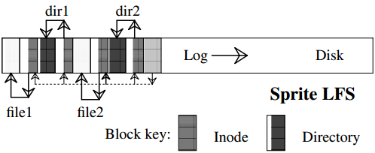
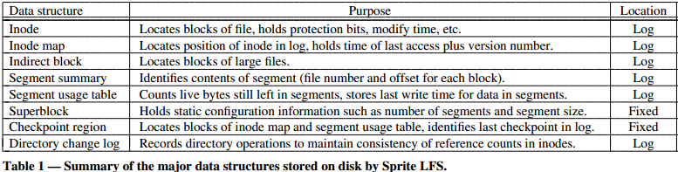
FS Impl.: LFS…
LFS introduced by Mendel Rosenblum and John K. Ousterhout
http://www.cs.berkeley.edu/~brewer/cs262/LFS.pdf

Slide 51
FS Impl.: LFS…
Solutions: using LFS…
Finding i-node is much harder, since its address cannot simply calculated from its i-number.
Thus, an i-node map, indexed by i-number is maintained.
Entry i in this map points to i-node i on the disk.
The map is kept on disk, but it is also cached ➔ the most heavily used parts will be in memory most of the time
Opening a file consists of using the map to locate the i-node for file. Once the i-node has been located, the addresses of the blocks can be found from it. All of the blocks will themselves be in segments somewhere in the log.
Filename → i-node map → position of i-node → addresses of data blocks
(on disk or cache)

Slide 52
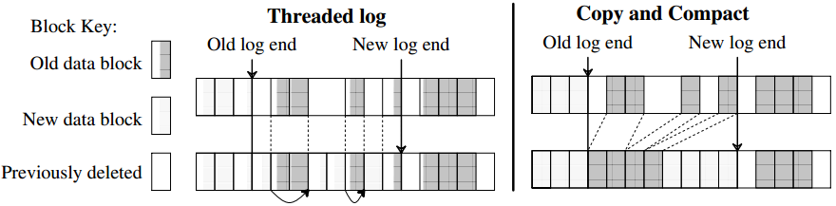
FS Impl.: LFS…
Problems
Disks are finitely large, thus when the log occupies the entire disk, no new segments can be written.
Many existing segments may have blocks that are no longer need but they still occupy space is previously written segments.
➔ Cleaner thread is used.
Possible free space management solutions for log-structured ﬁle systems
http://www.cs.berkeley.edu/~brewer/cs262/LFS.pdf

Slide 53
FS Impl.: LFS…
Solutions
Cleaner thread spends its time scanning the log circularly to compact it.
It starts out by reading the summary of first segment in the log to see which i-nodes and files are there
It then checks the current i-node map to see if the i-nodes are still current and file blocks are still in use → is written in the next segment. Otherwise, that information is discarded
Cleaner moves along the log, removing old segments from the back and putting any live data into memory for rewriting in the next segment
➔ the disk is a big circular buffer, with the writer thread adding new segment to the front and the cleaner thread removing old ones from the back.
➔complexity

Slide 54
FS Impl.: Journaling File System – JFS
Hệ thống file ghi nhật trình
Keep a log of what the file system is going to do before it does it.
If the system crashes before it can do its planned work
Upon rebooting the system can look in the log to see that was going on at the time of the crash and finish the job
NTFS and Linux ext3 file system applied
Operations required to remove a file in UNIX:
Remove the file from its directory.
Release the i-node to the pool of free i-nodes.
Return all the disk blocks to the pool of free disk blocks.

Slide 55
FS Impl.: JFS…
Problems
The first step is completed and the system crashes.
The i-node and file blocks will not be accessible from any file, but will also not be available for reassignment
The second step is completed and the system crashes.
Only blocks are lost
If the order of operation is changed
If the i-node is released first, then after rebooting, the i-node may be reassigned, but the old directory entry will continue to point to it, hence to the wrong file.
If the blocks are released first, then a crash before i-node is cleared (means the valid directory entry points to an i-node listing blocks now is the free storage pool).

Slide 56
FS Impl.: JFS mechanism
First, write a log entry listing the three actions to be completed
Then, the log entry is written to disk
Only after the log entry has been written, do the various operations begin.
After complete successfully, the log entry is erased.
Therefore, if the system now crashed, upon recovery the file system can check the log to see if any operation were pending ➔ all of them can be rerun until the file is correctly removed
Requirements
The logged operations must be idempotent (không đổi), they can be repeated as often as necessary without harm)
The crash recovery can be made and secure
Practically, JFS is applied to database concept with atomic transaction.

Slide 57
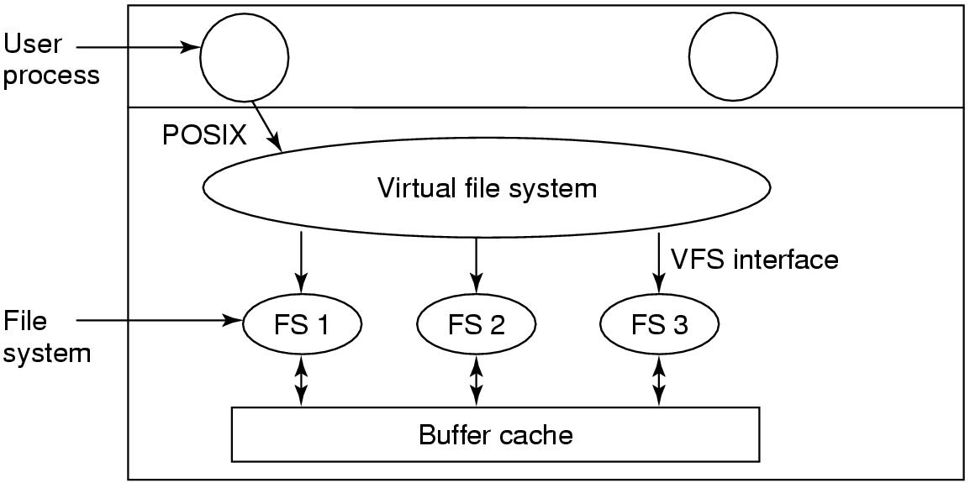
FS Impl.: Virtual File Systems
Problems: Many different file systems are used on the same computer, even same OS
Ex: Windows Vista, XP used NTFS, FAT32, FAT 16
Solution is Virtual File System (Kleiman, 1986 – Sun Microsystems): Try to integrate multiple file systems into an orderly structure
POSIX: Portable Operating System Interface for UNIX.
Position of the virtual file system
Tanenbaum, Fig. 4-19.

Slide 58
FS Impl.: Virtual File Systems…
Try to integrate multiple file systems into an orderly structure.
The key idea is to abstract out that :
Part of file system is common to all file systems.
Put that code in a separate layer that calls the underlying concrete file systems to actual manage the data.
The VFS is a upper interface to user processes and the lower interface to concrete file system.
All system calls (coming from user processes) relating to files are directed to the VFS for initial processing.
Does not know or care where the data are stored or what the underlying file system is like.
Is implemented essentially object oriented.
Supports key object types as super block, v-node, directory, mount table, an array of file descriptors (mount: to make a physical disk or tape accessible to a computer’s file system)

Slide 59
3- File System Management & Optimization Disk Space Management
Block size
Files are stored in fixed-size blocks of bytes, not necessarily adjacent
How large the block should be?
Large: Is efficiently read, but waste of HDD space
Small:
Is good use of HDD space
Span multiple blocks
Many disk accesses to read a file (reduce performance – waste time)
A good compromise should be chosen
Performance and space utilization are inherently in conflict
Median size better then mean size (~2KB)
Just read (1KB), just written (2.3 KB), and read and written (4.2KB)
Notes:
Compromise: thoả hiệp
Inherent: cố hữu, vốn đã thế

Slide 60
FSMO: Disk Space Management
Keep track of Free Blocks
How to keep track of free blocks?
The first method: Using a linked list of disk blocks. Each block holding as many free disk block numbers as will fit.
The second method: The bitmap requires less space than linked list model. However, the disk is full, the linked list require fewer blocks than the bitmap
If the free blocks tend to come in long runs of consecutive blocks, the free list system can be modified to keep track of runs of blocks than single blocks
A basic empty disk represented by two number: address of first free block, count of free block
If disk becomes fragmented, keeping track of runs is less efficient than keeping track of individual blocks

Slide 61
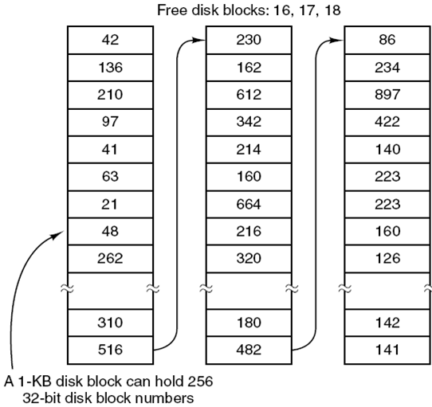
FSMO: Disk Space Management…
500GB disk ( 500x2³⁰)
Disk block size: 1KB ( 2¹⁰)
Number of blocks: 500x2²⁰
→Disk block number: 32 bits (4 bytes: 2 bytes: 0 … 65535, 4 byte: 0… 4 tỉ 2)
1 disk block can contain
2¹⁰/4= 2⁸= 256 entries
Number of blocks for managing disk block entries:
500x2²⁰ / 256 ~1.9x2²⁰
(~ 4% disk size)
Number of blocks for data:
500x2²⁰ – 1.9x2²⁰ ~ 488x2²⁰
A linked list for managing disk blocks
Tanenbaum, Fig. 4-22.

Slide 62
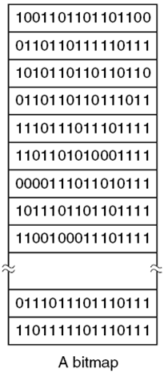
FSMO: Disk Space Management…
1: Free block
0: Allocated block
500GB disk ( 500x2³⁰)
Disk block size: 1KB ( 2¹⁰)
Number of blocks: 500x2²⁰
Number of bytes for the bitmap:
500x2²⁰/8 ~ 500 2¹⁷
percentage:
500x2¹⁷/ (500x2³⁰)= 1/(2¹³) ~ 0.012%
A bitmap for managing disk blocks
Tanenbaum, Fig. 4-22.

Slide 63
FSMO: Disk Space Management…
Disk Quotas
To prevent people from hogging too much disk space, multi-user OS often provide a mechanism for enforcing disk quotas
System administrator assigns each user a maximum allotment of files and blocks, and the OS makes sure that the users do not exceed their quotas
How to do
When a user opens a file, the attributes and disk addresses are located and put into an open file table in main memory. Among the attributes is an entry telling who the owner is. Any increases in the file’s size will be charged to the owner’s quota
A second table contains the quota record for every user with a currently open, even if the file was opened by someone else. It is an extract from a quota file on disk for users whose files are currently open
When all the file closed, the record is written back to the quota file
When a new entry is made in the open file table, a pointer to the owner’s quota record is entered into it, to make it easy to find the various limits
Every time a block is added to a file, the total number of blocks charged to the owner is incremented, and a check is made against both hard and soft limits
When a user attempt to login, the system examines the quota files to see if the user has exceeded the soft limit for either numbers of files or number of disks block
Notes:
Quota: chỉ tiêu, hạn ngạch
Hog: cắt xén
Allot: phân công

Slide 64
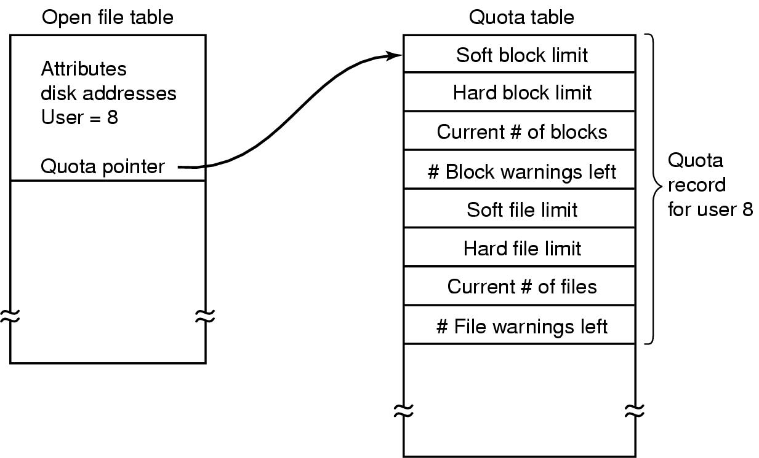
FSMO: Disk Space Management…
Quotas are kept track of on a per-user basis in a quota table
Tanenbaum, Fig. 4-24.

Slide 65
FSMO: Disk Space Management…
File System Backups
Recover data from disaster or from accidentally errors
Making a backup takes a long time and occupies a large mount of space, so doing efficiently and conveniently is important
backup only specific directories
incremental dumps
backup only what was modified from the last backup
can make recovery complicated
compression
Physical dump – backup every thing
Start at block 0 of disk, writes all the disk blocks onto the output tap in order, and stops when it has copied the last one
There is no value in backing up unused disk blocks
Dumping bad block
Advantages: simplicity, great speed
Disadvantages: inability to skip selected directories, make incremental dumps, and restore individual files upon request
Logical dump – backup selected paths only
Start at one or more specified directories and recursively dumps all files and directories found there that have changed since some given base date
Dumps all directories (even unmodified ones) in the selected paths.
Notes:
Disaster: bản sao
dump: kết xuất

Slide 66
FSMO: Disk Space Management…
File System Consistency
Problems
Many file system read blocks, modify them, and write them out later.
If the system crashes before all the modified blocks have been written out, the file system can be left in an inconsistent state.
It is especially critical if some of the blocks that have not been written out are i-node blocks, directory block, or block containing the free list.
Solutions
Using a utility program checks file system consistency in booting or after a crash (ex: scandisk, fsck – fix sick file system)
There are 2 kinds of consistency: blocks and files

Slide 67
FSMO: Disk Space Management…
File System Consistency
Solutions…: To check for block
Check disk blocks in the allocated list and the free list. A block in the allocated list must not appear in the free list.
The program builds two tables, each one containing a counter for each block (set 0).
The counter in 1st table keep track of how many time each block is present in a file
The counter in 2nd table record how often each block is present in the free list
The program then reads all the i-nodes using a raw device, which ignores the file structure and just returns all the disk blocks starting at 0
At each block is read, its counter in first table is incremented
The program then examines the free list to find all the block that are not used.
Each occurrence of a block in the free list results in its counter in the 2nd table increased

Slide 68
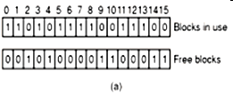

FSMO: Disk Space Management…
Block number
Consistence: the in-use block can not be in free block list.
Missing block: no real harm, waste space and reduce the capacity of disk. Solution: the file system checker adds the missing block to the free list
File system state
Tanenbaum, Fig. 4-24.

Slide 69


FSMO: Disk Space Management…
(c) Duplicate in free list
Solution: rebuild the free list
(c)
(d) Data block is present in two or more files → if the file is removed, both same block is free at the same time and the free is update to 2 as figure c
Solution: allocate the free block and copy one of file blocks to it
(d)
File system state
Tanenbaum, Fig. 4-24.

Slide 70
FSMO: Disk Space Management…
Directory Consistency
Is used to check for directory and its files in consistency.
A file may appear in some directories due to links.
Counting the number of directories containing this file then comparing this count to the values stored in its i-node.
It uses a table of counters, one per file: These counts start at 1 when a file is create and are incremented each time a link is made to the file
Traverse the directory tree: A counter is incremented when each every i-node in every directory
When the checker is all done, it has a list, indexed by i-node number, telling how many directories contain each file
It then compares these numbers with the link counts stored in the i-node themselves

Slide 71
FSMO: Disk Space Management…
Directory Consistency
Both counts will agree → consistency
The link count is higher: the file are removed, i-node will not be removed (is not serious errors and cause waste space) → fixed by setting the link count in the i-node to the correct value
The link count is lower: 2 directory entries are linked to a file, but the i-node present is only one (disaster and all blocks is release when the file is removed → the one of directories points to an unused i-node) → force the link count in i-node to the actual number of directory entries

Slide 72
FSMO: Disk Space Management…
File System Performance
Access to disk is much slower than access memory because OS must seek to track and then wait for desired sector to arrive under the read head.
Many file systems have been designed with various optimizations to improve performance.
Cache (Block cache or buffer cache)
A collection of blocks that logically belong on the disk are being kept in memory.
Check all read requests to see if the needed block is in the cache. If it is, accessing without disk access. Otherwise, reading from disk into the cache, then coping to wherever it is needed
To access quickly, the hash table and the linked list is used
When a block has to be loaded into a full cache, the usual page replacement algorithms is applied (LRU is best)

Slide 73
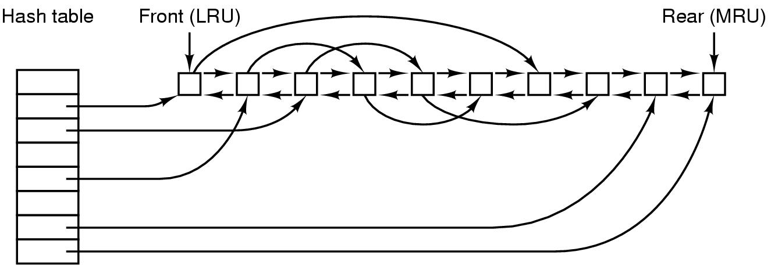
FSMO: Disk Space Management…
File System Performance
Cache (Block cache or buffer cache) (cont)
Problems:
Is the block likely to be needed again soon?
Is the block essential to the consistency of the file system?
Solutions: blocks can be divided into categories such as i-node blocks, indirect block, directory blocks, full data blocks, and partially full data blocks
Blocks that will probably not be needed again soon go on the front, rather than the rear of the LRU list, so their buffers will be reused quickly. Blocks that might be needed again soon, such as a partly full block that is being written, go to the end of the list, so they will stay around for a long time
If the block is essential to the file system consistency, and it has been modified, it should be written to disk immediately (reduce crash)
Tanenbaum, Fig. 4-28.

Slide 74
FSMO: Disk Space Management…
File System Performance
Block Read Ahead
Try to get blocks into the cache before they are needed to increase the hit rate.
Many files are read sequentially. When the file system is asked to produce block k in a file, it does that, but when it is finished, it makes a sneaky check in the cache to see if block k + 1 is already there. If it is not, it schedules a read for block k+1 in the hope that when it is needed, it will have already arrived in the cache.
The file system can keep track of the access patterns to each open file. Initially, the file is given the sequential access mode. Whenever a seek is done, the bit is cleared. If sequential reads start happening again, the bit is set once again.
Notes:
Sneaky: lén lút

Slide 75
FSMO: Disk Space Management…
File System Performance
Reducing Disk Arm Motion
Put blocks that are likely to be accessed in sequence close to each other, preferably in the same cylinder.
Keep track of disk storage not in blocks, but in groups of consecutive blocks.
When allocating blocks, the system attempts to place consecutive blocks in a file in the same cylinder (rotational positioning)
Put the i-nodes in the middle of the disk, rather than at the start, thus reducing the average seek between the i-node and the first block by a factor of two.
Divide the disk into cylinder groups, each with its own i-node, blocks, and free list. When creating a new file, any i-node can be chose, but an attempt is made to find a block in the same cylinder group as the i-node. If none is available, then a block in a near by cylinder group is used.
These algorithms will be presented in the next chapter.

Slide 76
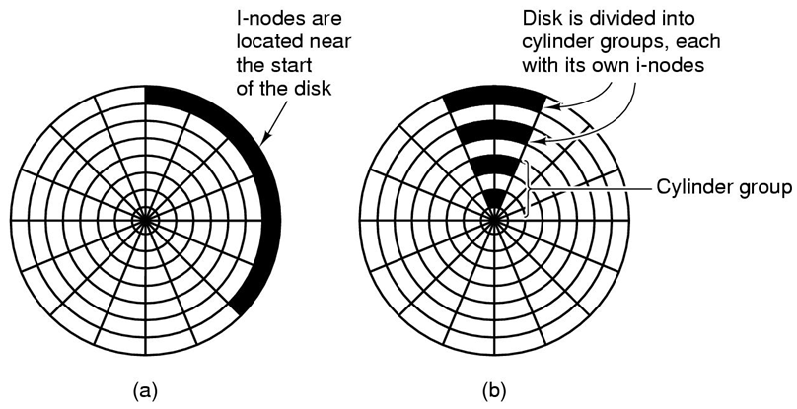
FSMO: Disk Space Management…
Tanenbaum, Fig. 4-29.

Slide 77
FSMO: Disk Space Management…
File System Performance
Defragmenting Disks
Disks become badly fragmented with files and holes all over the place → giving poor performance when new file is created
→ moving files around o make them contiguous and to put all of the free space in one or more large contiguous regions on the disk

Slide 78
4- Example File Systems: CD-ROM FS
Simple because they were designed for write once media
They have no provision for keeping tracking of free blocks
Do not have concentric cylinders instead of a single continuous spiral containing the bits in a linear sequence. The bits along the spiral are divided into logical blocks
CD-R
is possible to add files after the initial burning, but these are simply appended to the end of the CD-R
All the free space is in one contiguous chunk at the end of the CD
Files are never removed (although directory can be updated to hide existing files)
ISO 9960
An International Standard in 1998
Make every CD-ROM readable on every computer, independent of the byte ordering used and independent of the OS used

Slide 79
CD-ROM File Systems
Rock Ridge Extensions
In the UNIX community began working on an extension to make it possible to represent UNIX file systems on a CD-ROM
Use the System-use field in order to make Rock Ridge CD-ROMs readable on any computer
Any system not aware of the Rock Ridge extensions just ignores them and sees a normal CD-ROM
Rock Ridge extension fields:
PX - POSIX attributes.
PN - Major and minor device numbers.
SL - Symbolic link.
NM - Alternative name.
CL - Child location.
PL - Parent location.
RE - Relocation.
TF - Time stamps.

Slide 80
CD-ROM File Systems
Joliet Extensions
Is invented by Microsoft
Were designed to allow Windows file systems to be copied to CD-ROM and then restored, in precisely the same way that Rock Ridge was designed for UNIX
Joliet extension fields
Long file names.
Unicode character set.
Directory nesting deeper than eight levels.
Directory names with extensions

Slide 81
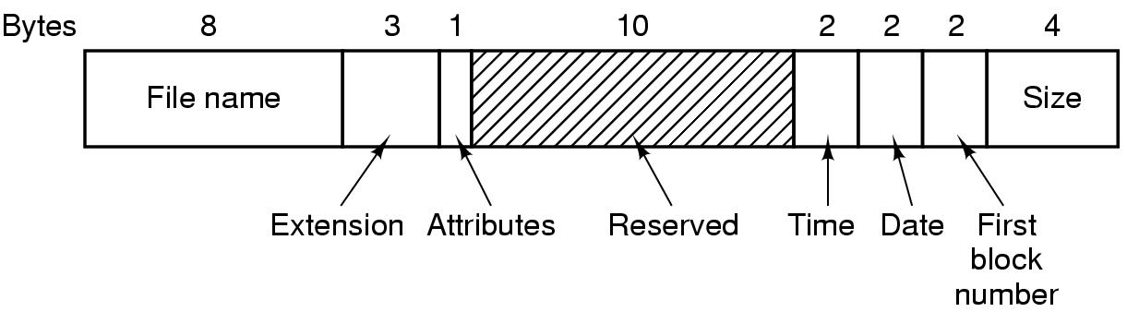
MS-DOS File System
To read a file, MS-DOS must first make an open system call to specifies a path that is looked up component to component until the final directory is located and read into memory. It is then searched for the file to be opened
Use a fixed-size 32 byte directory entry
File names (8 + 3) characters
Stores the file size as a 32 bit number (can be large as 2GB)
Keeps track of file blocks via a FAT in main memory
Tanenbaum, Fig. 4-31.

Slide 82
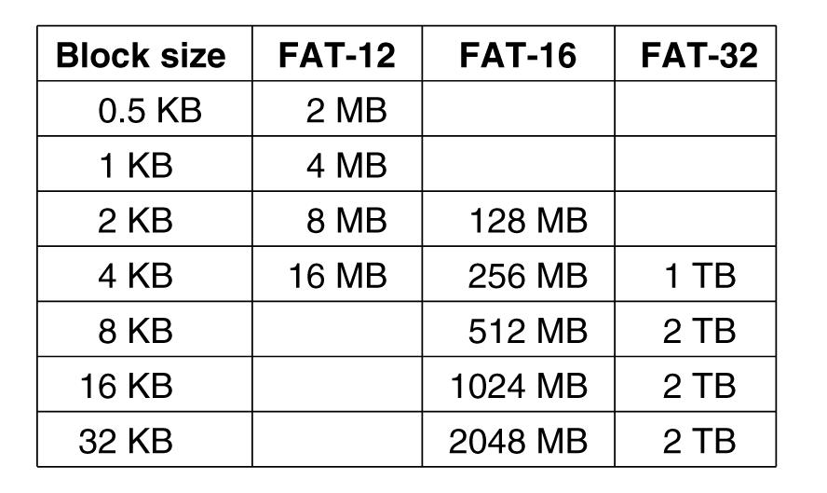
MS-DOS File System
Tanenbaum, Fig. 4-32.

Slide 83
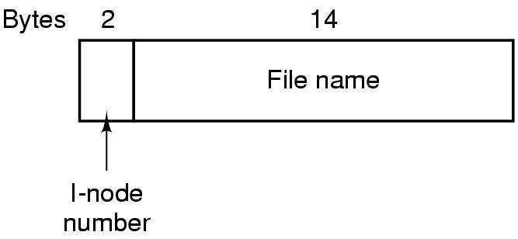
UNIX V7 File System
Form of a tree starting at the root directory, with the addition of links, forming a directed acyclic graph
File names are up to 14 characters and can contain any ASCII character except ‘/’ and NULL
A UNIX directory entry contains one entry for each file in that directory including file name (14 bytes) and the number of i-node (2 bytes).
Each entry is extremely simple because it uses the i-node that can contain some attributes
Tanenbaum, Fig. 4-33.

Slide 84
UNIX V7 File System
A Unix i-node
Tanenbaum, Fig. 4-34.

Slide 85
Summary
Operating System Concepts
Files
Directories
File System Implementation
File System Management and Optimization
Example File Systems
Q&A

Slide 86
Keep in Your Mind
Pick main concepts in the lecture and fill these slides.

