Slide 1
8 IO- Part 2 (2 slots)
Chapter 5
Clocks User Interfaces Thin Clients Power Management

Slide 2
Objectives
Clocks
Clock Hardware
Clock Software
Soft Timers
User Interfaces
Input Software
Output Software
Thin Clients
Power Management

Slide 3
Clocks: Overview
Is also call timers.
Are essential to the operation of any multi-programmed system.
Maintain the time of day and prevent one process from monopolizing (độc chiếm) the CPU, among other things.
The clock software take the form of a device driver, even though a clock is neither a block device nor a character device.

Slide 4
Clocks: Clock Hardware
How to create clocks in computers?
Two types of clocks are common used in computers:
(1) The simpler clocks are tied to the high volt power line (100-240v) and cause an interrupt on every voltage cycle at 50-60Hz
(2) It is built out of three components: a crystal oscillator, a counter, and a holding register
When a piece of quartz crystal is properly cut and mounted under tension, it can be made to generate a periodic signal of very great accuracy, typically in the range of several hundreds MHz.
Using electronics, this base signal can be multiplied by a small integer to get frequencies up to 1000MHz or even more.
At least one such circuit is usually found in any computer, providing a synchronizing signal to the computer’s various circuits.
This signal is fed into the counter to make it count down to zero. When the counter gets to zero, it causes a CPU interrupt.

Slide 5
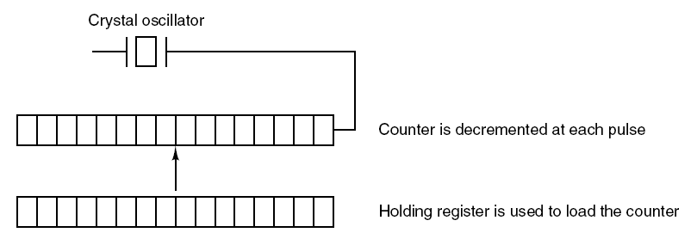
Clocks: Clock Hardware…
A programmable clock
Tanenbaum, Fig. 5-32.

Slide 6
Clocks: Clock Hardware …
Programmable clocks typically have several modes of operation
One-shot mode
Start: holding register → counter. Each pulse: counter value decrease 1.
If counter=0, it cause an interrupt and stops until it is explicitly started again by the software.
Square-wave mode
After getting to zero and causing the interrupt, the holding register is automatically copied into the counter, and the whole process is repeated again indefinitely.
These periodic interrupts are called clock ticks.
Advantages
Its interrupt frequency can be controlled by software
If a 500MHz crystal is used, then the counter is pulse every 2nsec. With unsigned 32 bit registers, interrupts can be programmed to occur at intervals from 2 – 8.6 nsec
It can contain two or three independently programmable clocks

Slide 7
Clocks: Clock Software
All the clock hardware does is generate interrupts at known intervals. Everything else involving time must be done by the software, the clock driver.
Typical duties of a clock driver
Maintaining the time of day (real time).
Preventing processes from running longer than they are allowed to.
Accounting for CPU usage.
Handling alarm system call made by user processes.
Providing watchdog timers (bộ định thời canh chừng) for parts of the system itself.
Doing profiling, monitoring, statistics gathering.

Slide 8
Clocks: Clock Software Typical duties of a clock driver
Maintaining the time of day (real time).
Just requires incrementing a counter at each clock ticks
Problem: With a clock rate of 60Hz, a 32 bit counter will overflow in just over 2 years → the system cannot store the real time as the number of tick since 1th, Jan, 1970.
→ How to maintain the time of day?

Slide 9
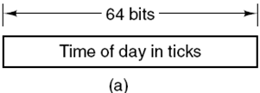
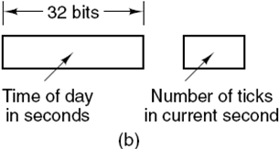
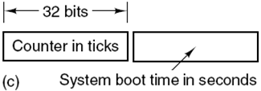
Clocks: Clock Software Typical duties of a clock driver…
Maintaining the time of day (real time)…
Three ways to maintain the time of day:
using 64 bit count → maintaining the counter more expensive since it has to be done many time in ticks.
(b) maintain the time of days in seconds, rather than in tick, using a subsidiary counter to count ticks until a whole second has accumulated → 136 years (2³² seconds)
(c) count in ticks, but to do that relative to the time the system was booted, rather than relative to a fixed external moment. In the system boot time, the current time of day value and store in memory. Later, when the time of day is requested, the stored time of day is added to the counter to get the current time of day
Tanenbaum, Fig. 5-33.

Slide 10
Clock: Clock Software Typical duties of a clock driver…
Preventing processes from running longer than they are allowed to
When a process is started, the scheduler initializes a counter to the value of that process’ quantum in clock ticks.
At every clock interrupt, the clock driver decrements the quantum counter by 1.
When it gets the zero, the clock driver call the scheduler to set up another process.

Slide 12
Clock: Clock Software Typical duties of a clock driver…
Accounting for CPU usage
First Approach: Using a second timer (distinct with system timer) to calculate how long the process has run from the process is started to be stopped.
Second Approach (too expensive and rarely done):
A less accurate, but simpler, way to do accounting is to maintain a pointer to the process table entry for currently running process in a global variable. At every clock tick, a field in the current process’ entry is incremented.
Problem: if many interrupts occur during a process’ run, it is still charged for a full tick, even though it did not get much work done.

Slide 13
Clocks:Clock Software Typical duties of a clock driver…
Handling alarm system call made by user processes.
A process can request that the OS give it warning after a certain interval, using a signal, interrupt, message, etc … (e.g acknowledged signal)
To implement, a table is used to kept the pending timers. A table is maintained as well as variable giving the time of the next times. Whenever the time of day is updated, the driver checks to see if the closest signal has occurred. If it has, the table searched for the next timer to occur

Slide 14
Clocks:Clock Software Typical duties of a clock driver…
Providing watchdog timers for parts of the system itself.
Watchdog: A hardware device (usually a timer or driver) used to monitor continuing system health and functionality through communications with the system software using a dedicated device driver.
OS also need to set timer to cause an interrupt after a sufficiently long time interval.
Doing profiling, monitoring, statistics gathering
Os provides a mechanism by which a user program can have the system build up a histogram of its program counter, so it can see where it is spends its time.
When profiling is a possibility, at every stick the driver can checks to see if the current process is being profiled, and if so, the bin number corresponding to the current PC. It then increments that bin by one .

Slide 15
Clock: Soft Timers
Avoid interrupts.
An OS facility that allows efficient scheduling of software events at microsecond granularity.
Whenever the kernel is running for some other reason, just before it return to user mode it checks the real time clock to see if a soft timer has expired.
If the timer is expired, the scheduled event is performed, with no need to switch into kernel mode since the system is already there.
As in the case when the system is already context-switched to the kernel… why not see if other work can be done “while you’re in there?”

Slide 16
Clock: Soft Timers
After performed, the soft timers is reset to go off again.
All that has to be done is copy the current clock value to the timer and add the timeout interval to it.
Soft timers stand or fall with the rate at which kernel entries are made for other reasons.
System calls.
TLB misses.
Page faults.
I/O interrupts.
The CPU going idle.

Slide 17
User Interfaces: Input Software
Keyboard Software
Mouse software

Slide 18
User Interfaces: Input Software Keyboard Software
Scan code: The number in the I/O port represented 7 bits (8th bit is used to represent key press (0) or release (1).
When any key struck, the scan code is put in an I/O register. It is up the driver to determine whether it is lower case, upper case, or the combination.
Although keyboard interfaces put the full burden on the software, it is extremely flexible.
Two possible philosophies can be adopted for the driver:
Raw mode/ character oriented/ noncanonical mode: the driver is just to accept input and pass it upward unmodified.
Cooked mode/ line oriented/ canonical mode: the driver handles all the intraline editing, and just delivers corrected lines to the user programs.

Slide 19
User Interfaces: Input Software Keyboard Software
Echoing
Many users have grown accustomed to seeing the characters they have just typed appear on the screen.
Is complicated because at the very least, the keyboard driver has to figure out where to put the new input without it being overwritten by program output.
Get complicated when more than 80 characters have to be displayed in a window with 80 character lines (wrapping around or throwing away).
Tab handling
The driver computes where the cursor is currently located, taking into account both output from programs and output from echoing,
and compute the proper number of spaces to be echoed.

Slide 20
User Interfaces: Input Software Keyboard Software
Device equivalence
Logically, at the end of a line of text, one wants a carriage return, to move the cursor back to column 1, and a linefeed, to advance to the next line.
The driver will convert whatever comes in to the format used by the OS.
If standard form is just to store a linefeed, then carriage returns should be turned into linefeeds (UNIX).
If the internal format is store both, then driver should generate a linefeed when it gets a carriage return and a carriage return when it gets a linefeed.
No matter what the internal convention, the monitor may require both a linefeed and a carriage return to be echoed in order to get the screen updated properly.

Slide 21
User Interfaces: Input Software Mouse Software
Whenever a mouse has moved a certain minimum distance in either direction or a button is depressed or released, a message is sent to the computer (picking up and put down is not).
The message usually occupies 3 bytes containing 3 items:
Δx: the change in x position since the last message.
Δy: the change in y position since the last message.
Buttons: the status of button.
Mickey is the unit representing minimum distance about 0.1mm.
Most mice report back a maximum of 40 times/sec.
Mouse only indicates changes in position, not absolute position itself.
The single or double click is distinguished by the software setting.

Slide 22
User Interfaces: Output Software
Text Windows
The program sends characters to current windows and they are display there. Usually, a block of characters is written in one system call.
Screen editors and many other sophisticated programs need to be able to update the screen in complex ways such as replacing one line in the middle of the screen (driver must support escape sequences to move the cursor, insert and delete character …).
Termcap (Berkeley UNIX) defines a number of basic actions that uses a generic escape sequence, the converted to the actual escape sequences.
How might the escape sequences be used by a text editor?
After the user types command, the editor might send the escape sequence over the serial line to the terminal.
The execution is done.

Slide 23
User Interfaces: Output Software
The X Window System
The user interface is used all UNIX System.
Is very portable and run entirely in user space.
Was intended for connecting a large number of remote user terminals with a central compute server, so it is logically split into client and host software.
Is not a complete GUI (must be more supported).
X server (local PC, just does what the X Client told)
The software collects input from keyboard and mouse and writes output to the screen → ( Inside the user’s computer, Displaying bits on the screen).
X clients (remote machine)
Running programs
Tells the server to do things, like display text or geometric figures …

Slide 24
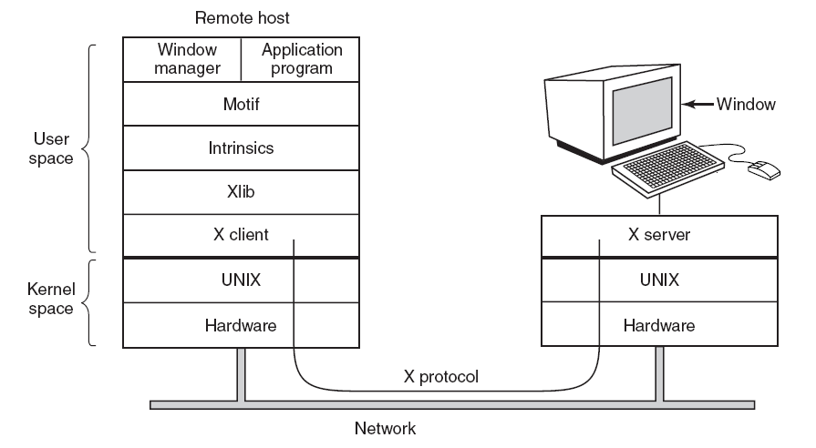
User Interfaces: Output Software
Client and servers in the M.I.T. X Window System
Tanenbaum, Fig. 5-537

Slide 25
User Interfaces: Output Software
Graphical User Interface – GUI
Has four essential elements WIMP (Windows, Icons, Menus, and Pointing device)
The GUI software can be implemented in either user-level code (UNIX) or in the OS itself (Windows).
Windows programs are message oriented.
Output almost always goes to a special hardware – graphics adapter
Containing video RAM that holds the image appear on the screen.
Support some number of screen sizes.
Window
Basic item on the screen is a rectangular area (that can be resized, scrolled)
Its position and size are uniquely determined by giving the coordinates (in pixel) of two diagonally opposite corners
Its coordinate system puts the origin in the upper lefthand corner and has y increase downward.

Slide 26
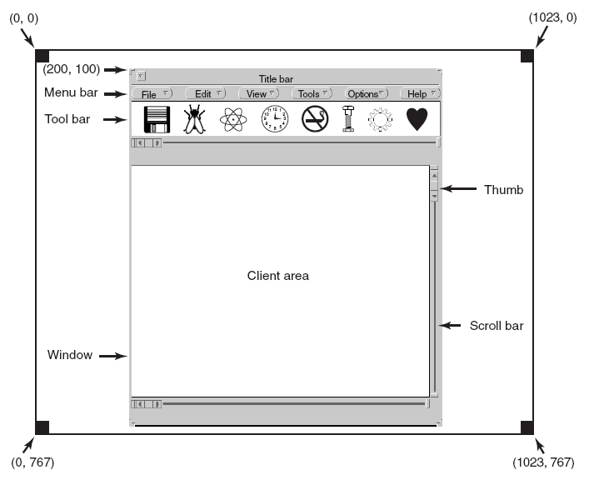
User Interfaces: Output Software
A sample window located at (200, 100) an an XGA display
Tanenbaum, Fig. 5-39.

Slide 27
User Interfaces: Output Software
Bitmaps
The average red, green, and blue values of each grid square are then sampled and saved as the value of one pixel
Use for text:
Represent a particular character in some font is as a small bitmap .
Adding text to the screen then becomes a matter of moving bitmaps.
Problems
They do not scale.
Copying between devices with different color properties or between monochrome and color does not work well.

Slide 28
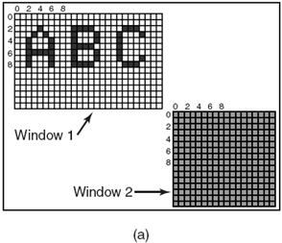
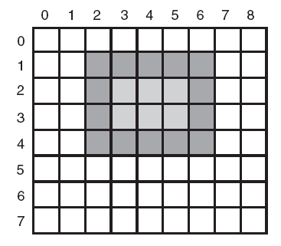
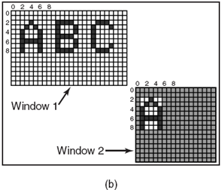
User Interfaces: Output Software
A rectangle is drawn
Tanenbaum, Fig. 5-41
Copying bitmaps: (a) Before. (b): After
Tanenbaum, Fig 5-42.

Slide 29
User Interfaces: Output Software
Fonts
Characters were represented as bitmaps and copied onto the screen or printer.
Problems
We just saw, is that a bitmap that makes sense on the screen is too small for the printer.
A different bitmap is needed for each character in each size.
Solutions
TrueType fonts is introduction which are not bitmaps but outlines the character.
Each TrueType character is defined by a sequence of points around its perimeter. All the points are relative to the (0, 0) origin.
It is easy to scale the characters up or down with any point size (even fraction).
All that has to be done is to multiply each coordinate by the same scale factor.

Slide 30
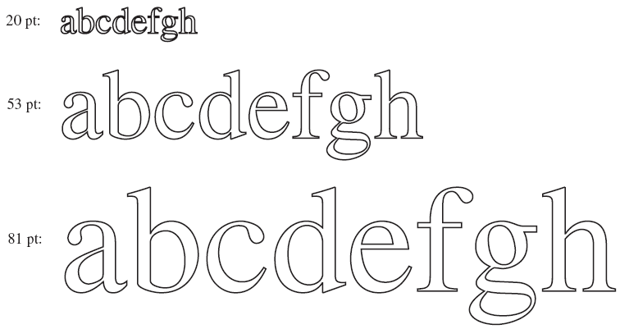
User Interfaces: Output Software
Some examples of character outlines at different point sizes.
Tanenbaum, Fig. 5-43.

Slide 31
Thin Clients
Is called THINC.
The most users want high performance interactive computing, do not really want to administer a computer.
The user machines had no software at all.
Strip the client machine of all it smarts and software and just use it as a display, with all the computing done on the server side.
The protocol between client and the server just tells the display how to update the video RAM, nothing more.
On the server side, graphical programs use high level command to paint the screen. These are intercepted (chặn) by THINC software and translated into commands that can be sent to the client. The commands may be reordered to improve efficiency.
Notes:
Intercept: chặn lại

Slide 32
Power Management: Overview
There are 2 general approaches to reduce energy consumption
The OS turns off parts of the computer when they are not in use because a device that is off uses little or no energy.
The application program uses less energy, possibly degrading the quality of the user experience, in order to stretch out battery time.

Slide 33
Power Management: Hardware Issues
Two general types of batteries
Disposable: like AAA, D cells, can be used to run handheld, but do not have enough energy to power notebook computers with large bright screens.
Rechargeable
Can store enough energy to power notebook for a few hours
Includes Nickel and Lithium ion
The OS manages the state transition at the right moments to reduces energy consumptions
On: the device can be used / Off: not consumptions
Sleeping: when the device will not be needed for a short time, the energy consumption is reduced
Hibernate: when the device is not expected to be needed for a longer interval, the energy consumption is reduced more, but this state will takes more time and energy than getting it out of sleep state.

Slide 34
Power Management: Hardware Issues
Power manage bring ups a number of questions that the OS deal with
Which devices can be controlled?
Are they on/off, or do they have intermediate states?
How much power is saved in the low-power states?
Is energy expended to restart the device?
Must some content be saved when going to a low-power state?
How long does it take to go back to full power?

Slide 35
Power Management: OS Issues
The OS controls all devices and must decide what to shut down and when to shut down.
If it shuts down a device and that device is needed again quickly, there may be an annoying delay while it is restarted.
If it waits too long to shut down a device, energy is wasted for nothing.
The trick(bí quyết) is to find algorithms and heuristics that let the OS make “good” decision about what to shut down and when.
Notes:
Trick: bí quyết

Slide 36
Power Management: OS Issues Display
The biggest item in energy budget
Many OSs attempt to save energy here by shutting down the display when there has been no activity for some number of minutes.
Turn off the display is a sleep state because it can be regenerated (from the video RAM) almost instantaneously when any key is struck or the pointing device is moved.
The user can often decide what the shutdown interval is.
Improvement
The display consist of some number of zones that can be independently powered up or down → The window manager has to understand power management or be capable of accepting instructions from some other piece of the system that does.

Slide 37
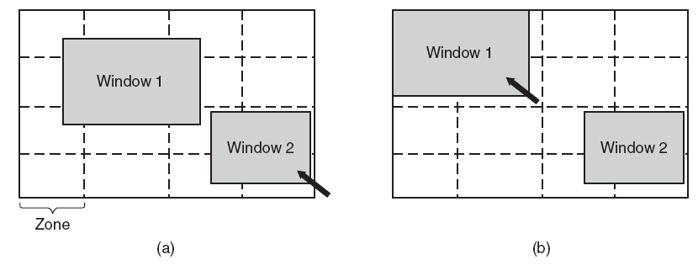
Power Management: OS Issues Display
Tanenbaum, Fig. 5-46.
The inactive zone (zone out of pointer) can be dark
The active zone must be fitted into the minimize zone by the window managers using the snap-to-zone in automatically
→ reducing of power ( about ¾)
More sophisticated, the window manager partial illuminate a window that was not completely full
Notes:
Illuminate (v): chiếu sáng

Slide 38
Power Management: OS Issues Hard Disk
Takes substantial energy to keep it spinning at high speed, even if there are no accesses.
Many computers spin the disk down after a certain number of seconds or minutes of inactivity. When it is next needed, it is spun up again.
A stop disk is hibernating because it takes quite a few seconds to spin it up again, it causes noticeable delays for the user.
Restarting the disk consumes considerable extra energy.
Notes:
Spin(v): quay tròn, spun, spun

Slide 39
Power Management: OS Issues Hard Disk
In practice, most systems are conservation and only stop the disk after a few minutes of inactivity.
Disk cache in RAM is used:
If a needed block is in the cache, an idle disk does not have to be restart to read
If a write to the disk can be buffered in the cache, a stopped disk does not have to restarted just to handle the write
The disk can remain off until the cache fills up or a read miss happens
OS keeps running programs informed about the disk state by sending it messages or signals.

Slide 40
Power Management- OS Issues CPU
A notebook CPU can be put to sleep software, reducing power usage to almost zero.
The only thing it can do in this state is wake up when an interrupt occurs
Whenever the CPU goes idle, either waiting for IO for no work to do, it goes to sleep
The CPU voltage can often be reduced in software, which save energy but also reduces the clock cycle (approximately linearly). Since power consumed is proportional to the square of the voltage, cutting the voltage in half makes the CPU about half as fast but at ¼ the power
Running slowly is more energy efficient than running quickly

Slide 41
Power Management: OS Issues Memory
There are 2 possible options:
The cache can be flushed and then switched off
It can always be reloaded from main memory with no loss of information.
The reload can be done dynamically and quickly, so turning off the cache is entering a sleep state.
Write the contents of main memory to the disk, then switch off the main memory itself.
It is hibernation since virtual all power can be cut to memory at the expense of a substantial reload time, especially if the disk is off too.
When the memory cut off, the CPU either has to be shut off as well or has to cause it to jump to code in a ROM. So, the memory can be reloaded before being used
Despite all the overhead, switching off the memory for long periods of time may be worth it if restarting in a few seconds is considered much more desirable than rebooting the OS from disk, which often takes a minute or more.

Slide 42
Power Management: OS Issues Wireless Communication
The radio transmitter and receiver required are often first-class power hogs (cắt xén).
Solutions:
The mobile computers communicate with fixed base stations that have large memories and disks and no power constraint.
Thus, this computer send a message to the base station when it is about to turn of the radio, then the base station buffers incoming messages on its disks.
When the mobile computer switches on the radio again, it tells the base station, then any accumulated messages can be sent to it.
Outgoing messages that are generated while the radio is off are buffered on the mobile computer. If the buffer threatens to fill up, the radio is turned on and the queue transmitted to the base station.
Notes:
Hog: thiến, cắt xén

Slide 43
Power Management: OS Issues Wireless Communication
When should the radio be switched off?
Let the user or the application program decide.
Turn it off after some number of seconds of idle time.
When should the radio be switched on?
Let the user or the application program decide.
Switched on periodically to check for inbound traffic and transmit any queued message, or the output buffer is close to full.

Slide 44
Power Management: OS Issues Thermal Management
Modern CPUs get extremely hot due to their high speed.
Desktop machines normally have an internal electric fan to blow the hot air out of chassis.
With notebooks, the OS has to monitor the temperature continuously. When it gets close to the maximum allowable temperature:
Switch on the fan → noise and consumes power
Reduce power consumption:
Reducing the backlighting of the screen
Slowing down the CPU
Being more aggressive about spinning down the disk
Notes:
Aggressive: xốc nổi, hung hăng, công kích

Slide 45
Power Management: OS Issues Battery Management
Smart batteries can also be instructed to change various operational parameters under control of the OS.
Some notebooks have multiple batteries
When the OS detects that one battery is about to go, it has to arrange for a graceful cutover to the next one, without causing any glitches (sự chạy không đều) during the transition.
When the final battery is on its last legs, OS warns the user and the cause an orderly shutdown making sure that file system is not corrupted.

Slide 46
Power Management: OS Issues Driver Interface
The Windows system has an elaborate mechanism for doing power management called Advanced Configuration and Power Interface – ACPI.
The OS can send any conformant driver commands asking it to report on the capabilities of its devices and their current states.
This feature is especially important when combined with plug and play because just after it is booted, the OS does not even know what devices are present, let alone their properties with respect to energy consumption or power manageability.
It can also send commands to driver instructing them to cut their power levels.
Notes:
Elaborate(v): thêm chi tiết, bổ xung

Slide 47
Power Management: OS Issues Application Program Issues
Tell the programs to use less energy, even if this means providing a poorer user experience.
This information is passed on when the battery charge is below some threshold (ngưỡng). Then the program decide between degrading performance to lengthen batteries life or to maintain performance and risk running out of energy.

Slide 48
Summary
Clocks
User Interfaces
Thin Clients
Power Management
Q&A

Slide 49
Your work
Write down main idea of this lesson.
If you do not, you will br considered as absent in the next class.

