Slide 1
Session 04 More on Classes and Nested Classes (http://docs.oracle.com/javase/tutorial/java/javaOO/more.html)

Slide 2
Objectives
In this lesson you will learn:
Controlling Access to Members of a Class using modifiers
Overriding methods in sub-classes
Nested Classes

Slide 3
Review: Access Level
Modifier | Class | Same Package | Subclass- Outside package | World
private | Y | N | N | N
No (default) | Y | Y | N | N
protected | Y | Y | Y | N
public | Y | Y | Y | Y

Slide 4
Tips on Choosing an Access Level
Use the most restrictive access level that makes sense for a particular member. Use private unless you have a good reason not to.
Avoid public fields except for constants. Public fields tend to link you to a particular implementation and limit your flexibility in changing your code.

Slide 5
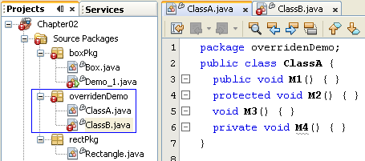
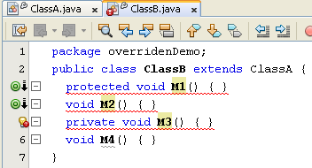
Access Modifier Overridden
Legal
private
default
protected
public
Illegal
public
protected
default
private
The sub-class must be more opened than it’s father
Notes:
Modifier: định tính, định lượng

Slide 6
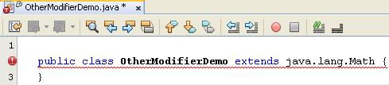
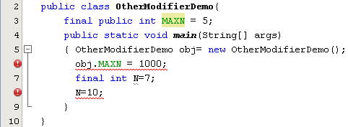
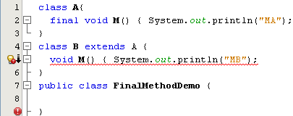
Modifier final
Final class: Class can not have sub-class
Final data is a constant.
Final method: a method can not be overridden.

Slide 7
Modifier static Class variable/ Object variable
Object variable: Variable of each object
Class Variable: A variable is shared in all objects of class. It is stored separately. It is declared with the modifier static
Class variable is stored separately. So, it can be accessed as:
object.staticVar
ClassName.staticVar
Notes:
Object variable:

Slide 8
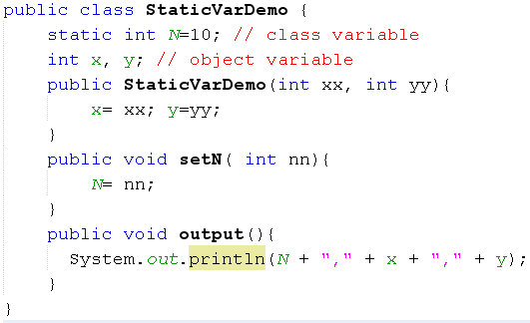
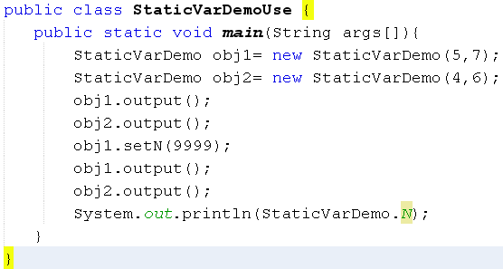
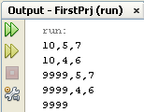
Modifier static:Class variable/ Object variable
y-=7
1000
x=5
y=6
800
x=4
obj1
1000
obj2
800
N
10 → 9999

Slide 9
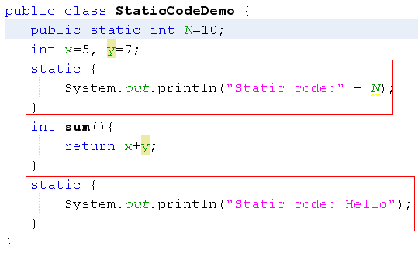
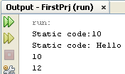
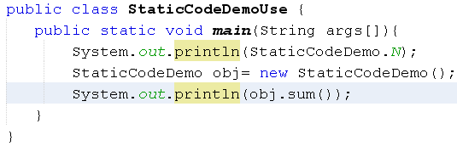
Modifier static: static code – Free Floating Block
All static codes run only one time when the first time the class containing them is accessed
The second access
Notes:
Static: chạy ngay khi class được truy cập
- Trình biên dịch gom code static thành một cục và chạy một lần

Slide 10
Modifier static: Static method
It is called as class method/global method and it is called although no object of this class is created.
Entry point of Java program is a static method
Syntax for calling it: ClassName.staticMethod(args)
Static methods:
can access class variables and class methods directly only.
cannot access instance variables or instance methods directly—they must use an object reference.
cannot use the this keyword as there is no instance for this to refer to.

Slide 11
Modifier static: Static code/ Free-floating block
What can free-floating block contain?
Initialize class (static) variable
Calling static methods with parameter

Slide 12
Modifier static: What should be static in a class?
Constants:
The static modifier, in combination with the final modifier, is also used to define constants. The final modifier indicates that the value of this field cannot change.
static final double PI = 3.141592653589793;
Notes:
By convention, the names of constant values are spelled in uppercase letters. If the name is composed of more than one word, the words are separated by an underscore (_).

Slide 13
Initializing Fields (3)
Initializing Instance Members
Will be copied initializer blocks into every constructor.
Can be used to share a block of code between multiple constructors.
Initializer blocks for instance variables look just like static initializer blocks, but without the static keyword:
{
// whatever code is needed for initialization goes here
}

Slide 14
Nested classes
Class is declared inside some other class or inside the body of other class’s method.
2 types of nested class: Static Nested classes, Inner classes ( non-static)
Static nested class ➔ All objects belong to the outer class share one nested object(cặp song sinh dính nhau, phần dính nhau nằm ở bên ngoài).
Inner class: Each outer object has it’s own inner object → Outer object must contain an instance of the inner object then accesses members of this nested instance (trái tim nằm bên trong thân người)
obj1
obj1
Inner obj
obj2
obj2
Inner obj
Static nested obj

Slide 15
Nested classes…
A nested class violates the recommendation “low coupling” in class design. Why are nested classes used?
It is a way of logically grouping classes that are only used in one place.
It increases encapsulation.
Nested classes can lead to more readable and maintainable code.

Slide 16
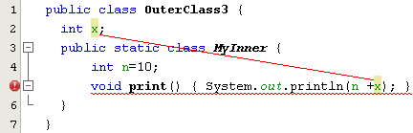
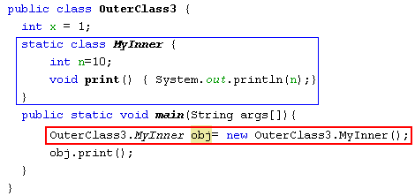

Static Nested Classes Demo…
Class-level nested class.
Because the static nested object is stored separately from enclosing instances, static nested object can be initiated without enclosing objects.
Methods of static nested class can not access data of enclosing instance because it can created even when enclosing objects do not exist.

Slide 17
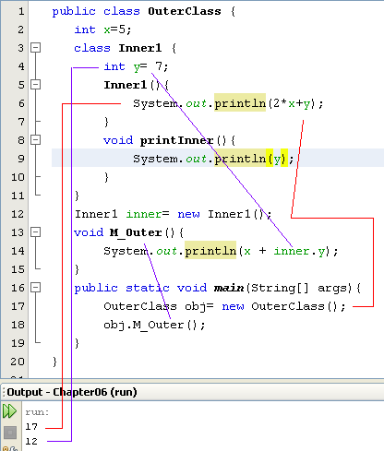
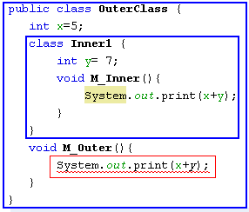
Inner classes demo…
outerObj
x=5
innerObj
y=7
y = 7
3000
A method of nested class can access all members of its enclosing class
obj
inner: 3000
x = 5
2000
obj: 2000
Error: inner obj do not created yet. Modified

Slide 18
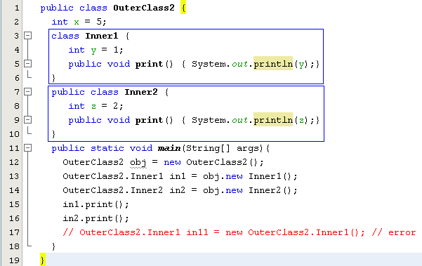
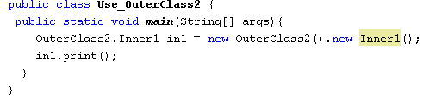

Creating Inner Class instance through enclosing instance
z = 2
3000
y = 1
2000
x = 5
1000
obj: 1000
in1: 2000
in2: 3000

Slide 19
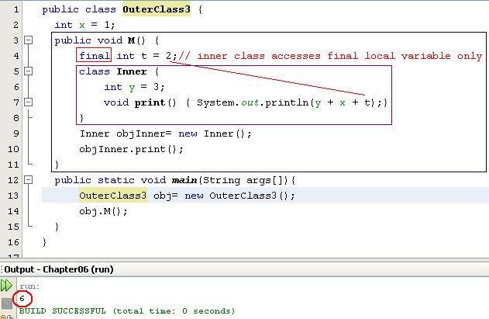
Inner Classes Defined Inside Methods
Local class
Inner-method class can not access normal local variables of the containing method.

Slide 20
How Compiler Treats Nested Class?
Nested class will be stored in a separate class file (file.class) but information about it’s enclosing class are stored in this class file also.

Slide 21
Shadowing (1)
Declaration of a type in a particular scope has the same name as another declaration in the enclosing scope, then the declaration shadows the declaration of the enclosing scope.

Slide 22

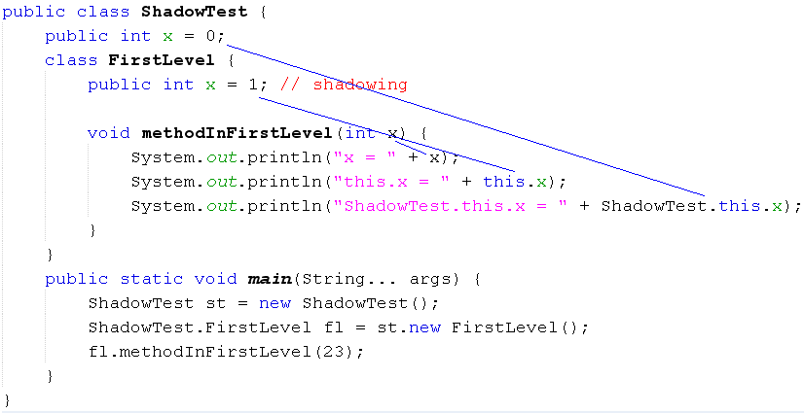
Shadowing Variable (2)
Mechanism: Local data is treated first

Slide 23
Summary
Overriding methods in sub-classes
Controlling Access to Members of a Class using modifiers
Nested Classes

