Slide 1
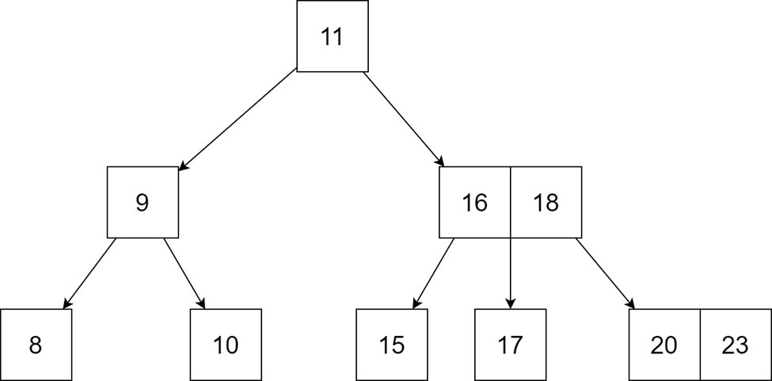
DATA STRUCTURE:
B-Tree
Group 4 - APCS2 - KPLT

Slide 2

Why are we using B-Tree?

Slide 3
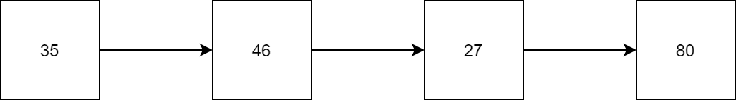
Review:
We have already learned about linked list - A very useful data structure for coding, but they are sequential lists.

Slide 4
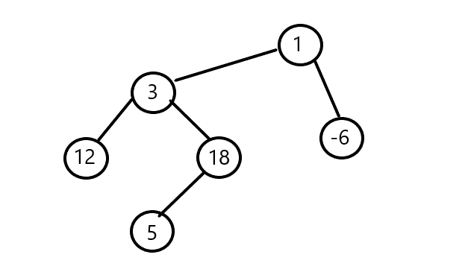

Learn more:
Therefore, we can consider trees or graphs as a data structure, using the methods of pointers and linked lists for their implementation.

Slide 5
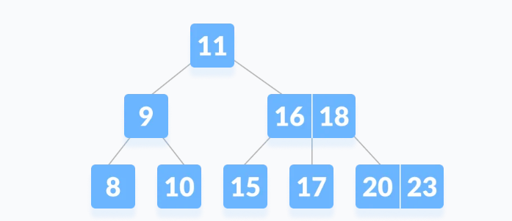
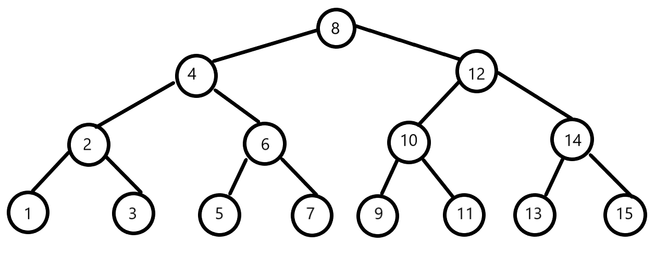
Therefore, In data structures for programming, we already learned about some data structures such as: binary tree and 2-3 tree, etc.; which are very useful for programming.

Slide 6
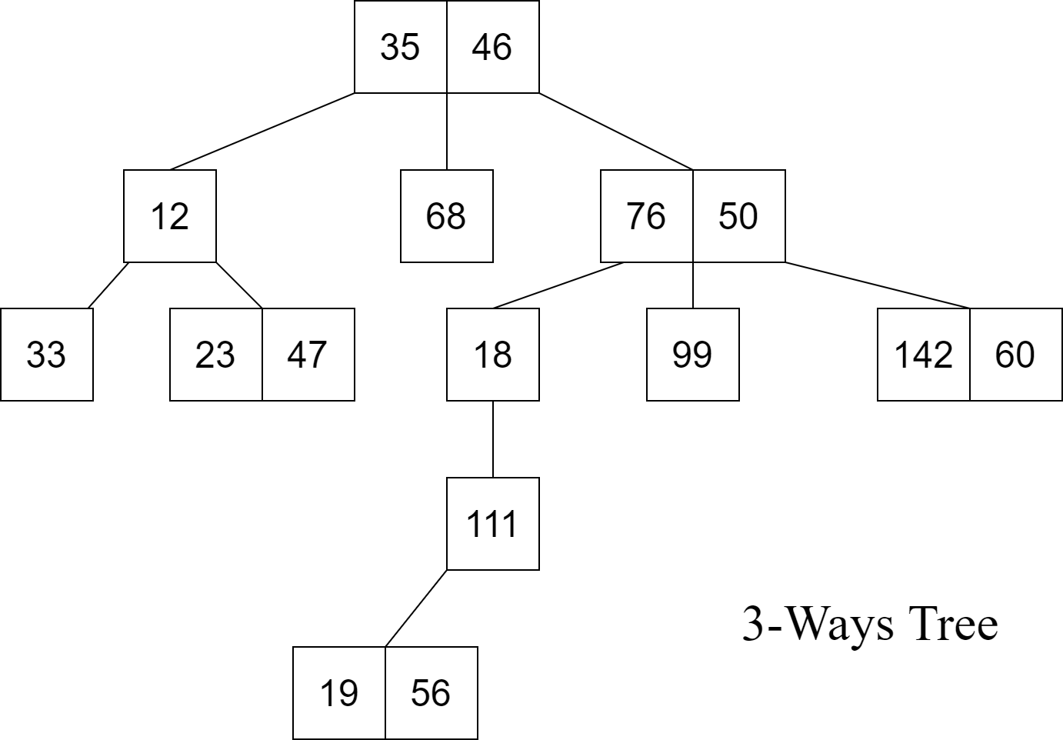
GENERALIZE
We can come to the generalized form of these data structures, which is called: M-Way tree.
Example: 3-Ways Tree

Slide 7
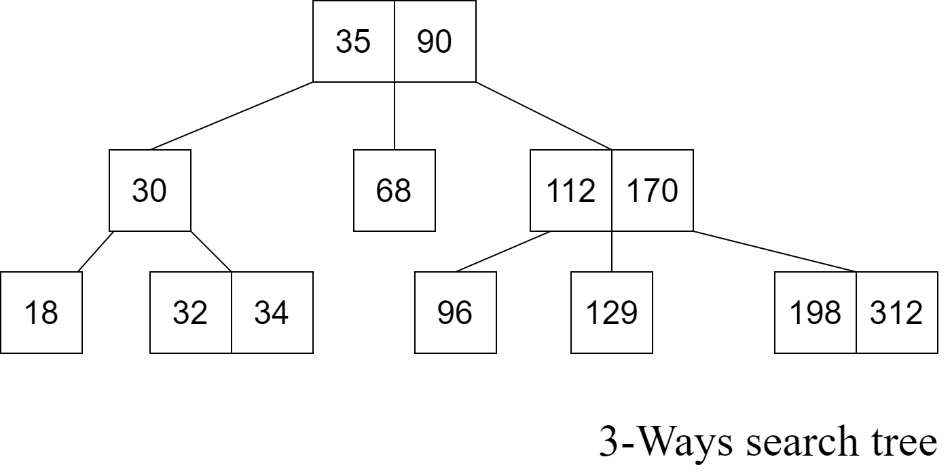
Learn more:
Go further on the M-Way tree, we will get a more special type of data structure: M-Way search tree.

Slide 8
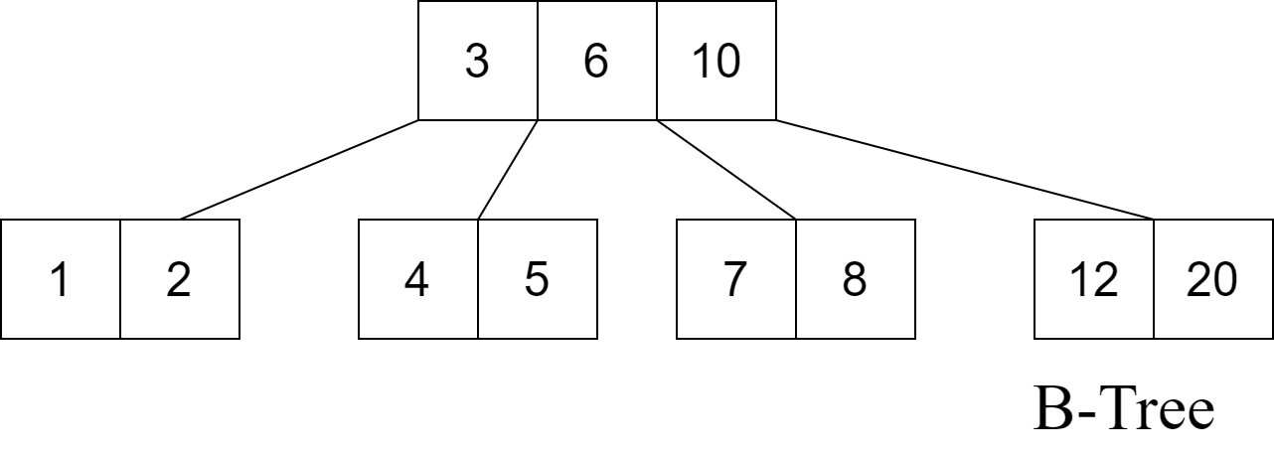
Going deeper on the M-way search tree we get a more specific type of data structure :
B-Tree.

Slide 9

History of B-Tree
Invented by Rudolf Bayer and Edward M. McCreight . While they are working at Boeing Research Labs, for the purpose of efficiently managing index pages for large random-access files.
Reason: The basic assumption was that indexes would be so voluminous that only small chunks of the tree could fit in main memory.
Bayer and McCreight's paper, Organization, and maintenance of large ordered indices, was first circulated in July 1970 and later published in Acta Informatica.

Slide 10

Fun Fact:
Bayer and McCreight never explained what, if anything, the B stands for: Boeing, balanced, broad, bushy, and Bayer have been suggested. McCreight has said that "the more you think about what the B in B-trees means, the better you understand B-trees."

Slide 11


1.Definition of B-Tree

Slide 12
a. M-Ways Tree – Definition:
An M-way(multi-way) tree is a tree that has the following properties:
Each node in the tree can have at most m children.
Nodes in the tree have at most (m-1) key fields and pointers(references) to the children.
The above image is a 3-way tree, where each node has at most (3-1) = 2 keys and 3 children.

Slide 13
b. M-Ways Search Tree:
An M-way search tree is a more constrained M-way tree, which has more property:
Each node in the tree can associate with m children and m-1 key fields.
The keys in any node of the tree are arranged in a sorted order (ascending).
The keys in the first K children are less than the K^{th} key of this node.
The keys in the last (m-K) children are higher than the K^{th} key.

Slide 14
Example for 3-Ways Search Tree

Slide 15
Now, It’s time for B-Tree
Definition:
§ Therefore, a B-tree is a special case of M-way search tree, and we got a new definition:
A B-tree is an expansion from the original M-way search tree. Besides having all the properties of an M-way search tree, it has some properties of its own, these mainly are:
All leaves of B-tree are at the same level.
Every node in B-tree of order m can have at most m-1 keys and m children.
Root node must have at least two nodes.
Every node except the root node and the leaf node contain at least m/2 children.

Slide 16
Example for B-Tree:
Check for B-tree property:
All leaves of B-tree are at the same level.
Root node must have at least two nodes.
Every node except the root node and the leaf node contain at least 2 children.
A B-tree of order 4 can have at most 3 keys and 4 children.

Slide 17
Note:
85
●2-3 trees and binary search trees that we learned before can be B-trees.
●If n ≥ 1, then for any n-key B-tree of height h and minimum degree t ≥ 2, h ≥ log_t (n+1)/2
37
100
12
46
89
101

Slide 18
Advantages:
The need for B-tree arose with the rise in the need for lesser time in accessing the physical storage media like a hard disk. The secondary storage devices are slower with a larger capacity. There was a need for such types of data structures that minimize the disk accesses.
Other data structures such as a binary search tree, AVL tree, red-black tree, e.t.c. can store only one key in one node. If you have to store a large number of keys, then the height of such trees becomes very large and the access time increases.
However, B-tree can store many keys in a single node and can have multiple child nodes. This decreases the height significantly allowing faster disk accesses.

Slide 19
Application:
Databases and file systems
to store blocks of data (secondary storage media)
multilevel indexing

Slide 20


2. Operation on B-Tree

Slide 21
Main Operation for B-Tree:
Insert a node in a B-Tree
Search for a node in a B-tree.
Delete a node in a B-Tree

Slide 22
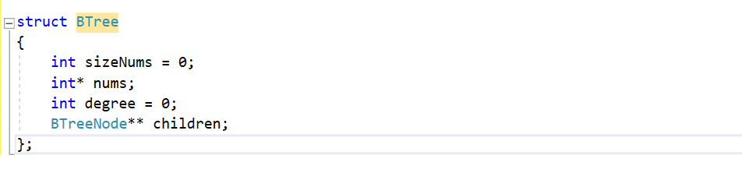
B-TREE CONSTRUCTOR
DEFINE B-TREE IN CODING
We define a new struct B-Tree according to the definition of B-Tree as below:

Slide 23
B-TREE CONSTRUCTOR
Number of children in a node
A list of pointers for children of a node
Number of keys in a node
An array to store keys

Slide 24
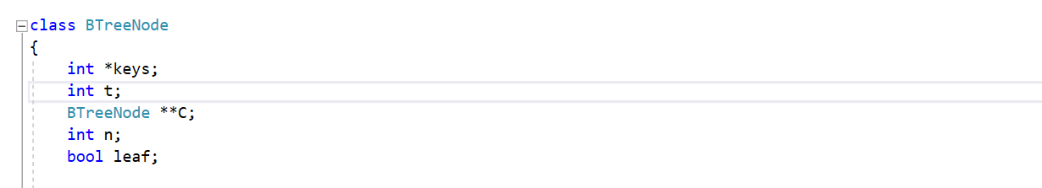
B-TREE CONSTRUCTOR
EFFICIENCY
However, this structure seem not efficiency when programming, since it’s looking a bit hard to maintain the property. So, we have a small update for this data structure:
We add 1 more Boolean variable to check if this node is a leaf or not!

Slide 25
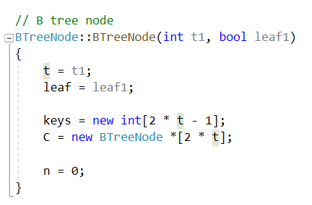
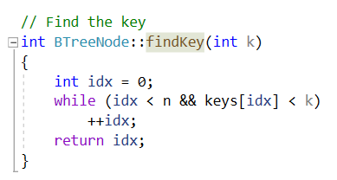
ADDITIONAL FUNCTION:
Creating a node for B-Tree
Find a valid key in a node

Slide 26
MAIN OPERATION:
1. INSERTION

Slide 27
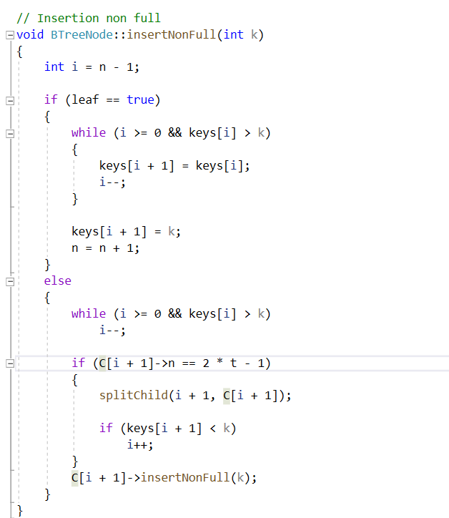
ADDITIONAL FUNCTION IN INSERTION
Insert a node which isn’t full : This function is used to insert a key into a non-full node (it might be already non-full or it had been split beforehand). Before inserting, we must choose the correct child to insert to in case of non-leaf node and we have to split that child if necessary.

Slide 28
DEMONSTRATION
Insert:
7
11
9
16
18
8
10
14
17
24
32

Slide 29
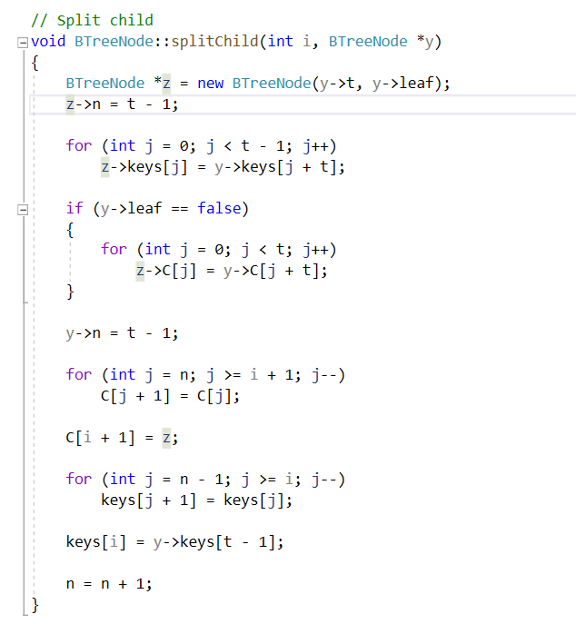
ADDITIONAL FUNCTION IN INSERTION
Split children

Slide 30
ADDITIONAL FUNCTION IN INSERTION
In this function, before inserting a key to a child node, should we know that a child named y is already full, we have to split it into two. During the process, the median key of the split child node will be pushed into the current parent node.
We also have i as the index of child node in array.

Slide 31
DEMONSTRATION
12
26
40
69
98

Slide 32
Operation for Insertion:
If the tree is empty, allocate a root node and insert the key.
Update the allowed number of keys in the node.
Initialize the tree with the newly added key
If the node is full, follow the steps below.
Insert the elements in increasing order.
Now, there are elements greater than its limit. So, split at the median.
Push the median key upwards and make the left keys as a left child and the right keys as a right child.
If the node is not full, follow the steps below.
Insert the node in increasing order.

Slide 33
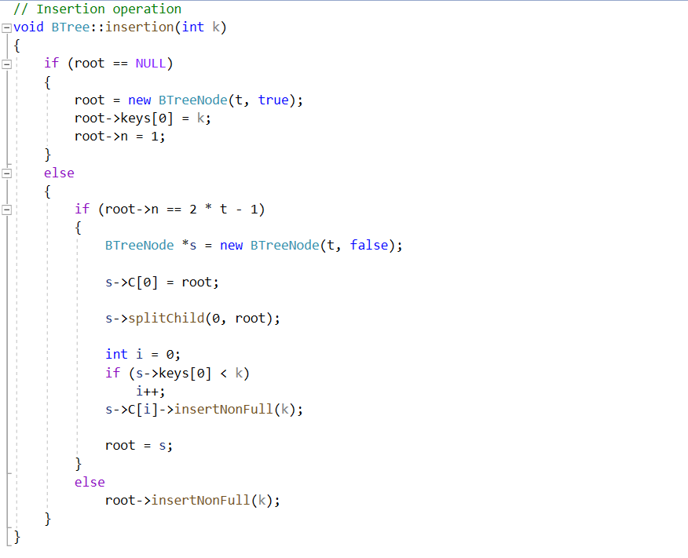
Implementation

Slide 34
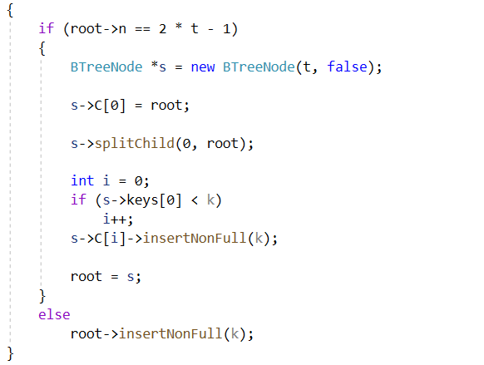
Understand the code:
Check root is a null ?If true:
Check root is a null ? If not: (B-Tree already existed)
Then, create a new tree by constructor for root, with t we already set as the order for the tree before, then, set the first key to k, then set number of key to 1.

Slide 35
Understand the code:
Check if the root is full or not by check if ( root->n == 2 * t -1).
If it is true (full), we have to split the root into two new nodes. These two nodes will become children of a new root node, which now contains the median of the previous root. Then we insert to the correct child node (split from the original root).
If it’s not full, simply insert the key to root node according to the rule (keys must be in the ascending order)

Slide 36
DEMONSTRATION
Insertion of b-tree has order 4 in this set of numbers: 37, 49, 80 ,19, 39, 60, 88, 100

Slide 37
DEMONSTRATION
37, 49, 80 ,19, 39, 60, 88, 100
39
37
49
19
80
19
37
49
80
80
39
49

Slide 38
DEMONSTRATION
100
60
37
49
88
39
49
80
100
19
60
80
88

Slide 39
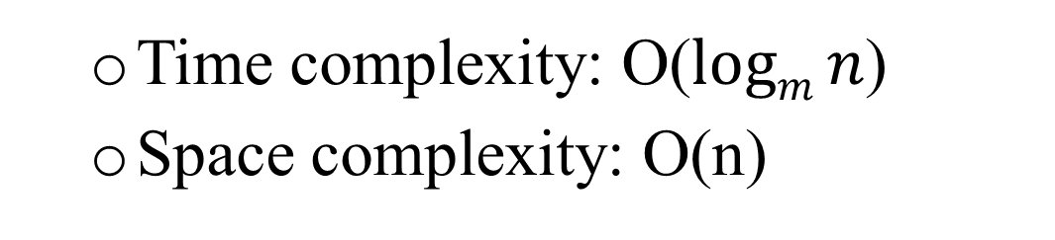
CALCULATE THE COMPLEXITY
Time complexity: O($\operatorname{logm}{n}$)
Space complexity: O(n)

Slide 40
MAIN OPERATION:
2. SEARCHING

Slide 41
Operation for Searching:
Starting from the root node, compare k with the first key of the node.
If k = the first key of the node, return the node and the index.
If k.leaf = true, return NULL (i.e. not found).
If k < the first key of the root node, search the left child of this key recursively.
If there is more than one key in the current node and k > the first key, compare k with the next key in the node.
If k < next key, search the left child of this key (ie. K lies in between the first and the second keys).
Else, search the right child of the key.
Repeat steps 1 to 4 until the leaf is reached.

Slide 42
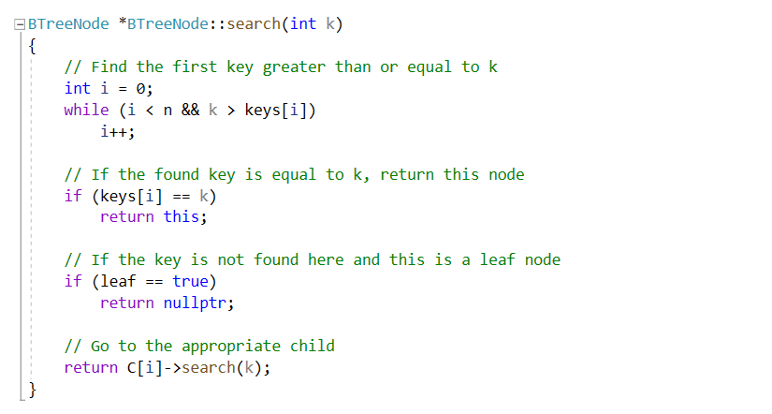
Implementation

Slide 43
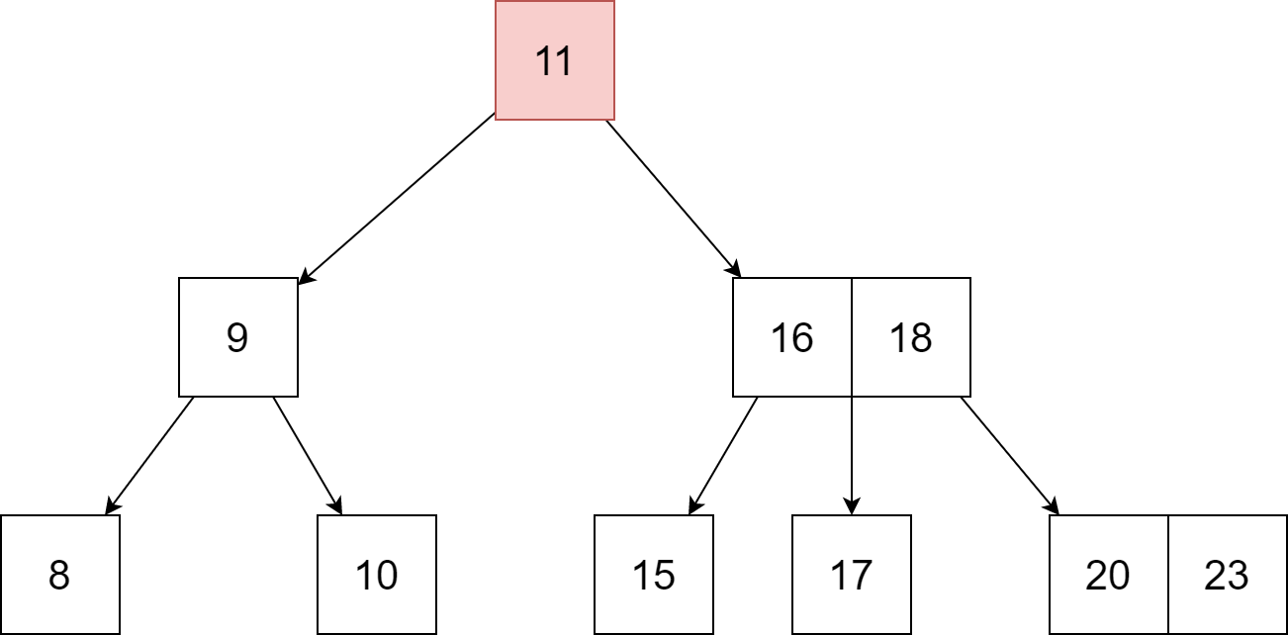
DEMONSTRATION
Search for 17 in this B-tree below.

Slide 44
DEMONSTRATION
11
Since 17>11, so we go to the right child
9
16
18
8
10
15
17
20
23
And we found out 17!!!
Since 16<17<18, so we go to the 2nd child

Slide 45
CALCULATE THE COMPLEXITY
Worst case Time complexity: O(log n)
Average case Time complexity: O(log n)
Best case Time complexity: O(log n)
Average case Space complexity: O(n)
Worst case Space complexity: O(n)

Slide 46
MAIN OPERATION:
3. DELETION

Slide 47
REMIND: PROPERTY
A node can have a maximum of m children.
A node can contain a maximum of m – 1 keys.
A node should have a minimum of ⌈m/2⌉ children.
A node (except root node) should contain a minimum of ⌈m/2⌉ - 1 keys.

Slide 48
ADDITIONAL TERMS:
Inorder Predecessor The largest key on the left child of a node is called its inorder predecessor.
Inorder Successor The smallest key on the right child of a node is called its inorder successor.

Slide 49
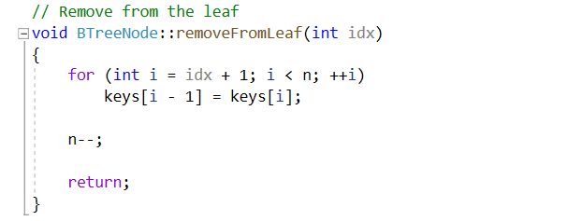
ADDITIONAL FUNCTION:
1. REMOVE A KEY IN LEAF NODE
This function will remove an idx^{th} key in a leaf node and arrange other numbers.

Slide 50
DEMONSTRATION
16
20
7
8
9
16
20

Slide 51
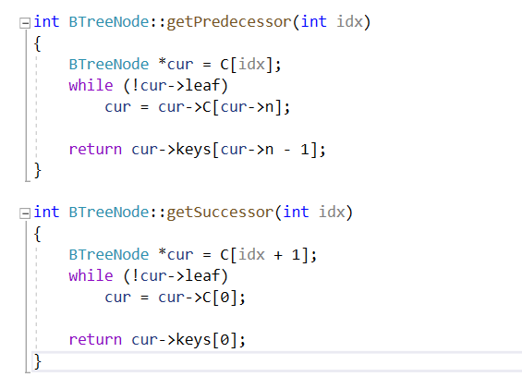
ADDITIONAL FUNCTION:
2. REPLACE A NODE
Case 1: By a predecessor node
Case 2: By a successor node

Slide 52
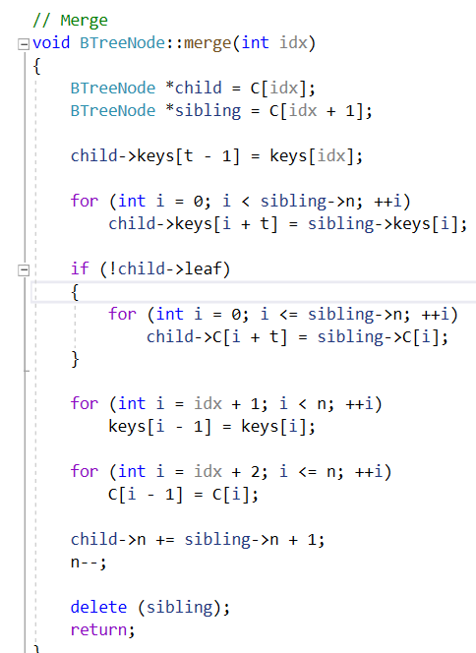
ADDITIONAL FUNCTION:
3. MERGE 2 CHILDREN
OF A NODE
This function will merge 2 idx^{th} and (idx+1)^{th} children of a node into 1 child. Then, merge their children also.

Slide 53
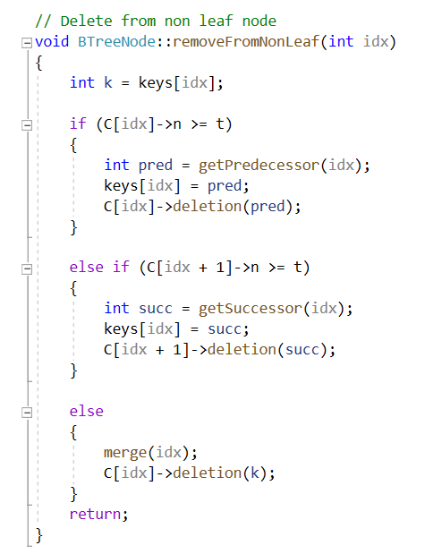
ADDITIONAL FUNCTION:
4. REMOVE A KEY IN AN INTERNAL NODE.
There are 3 main cases for this operation:
The internal node, which is deleted, is replaced by an inorder predecessor if the left child has more than the minimum number of keys.
The internal node, which is deleted, is replaced by an inorder successor if the right child has more than the minimum number of keys.
If either child has exactly a minimum number of keys then, merge the left and the right children.

Slide 54
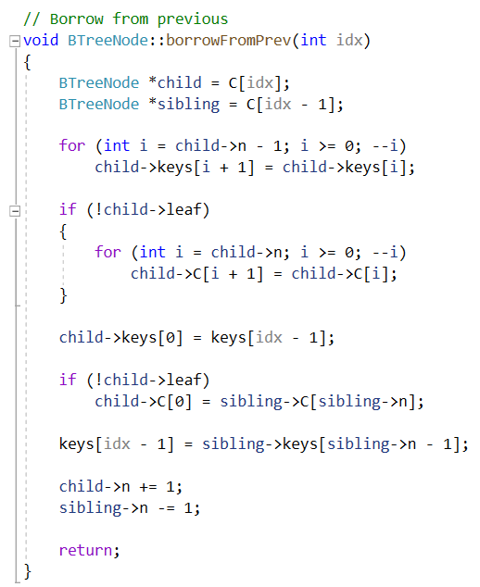
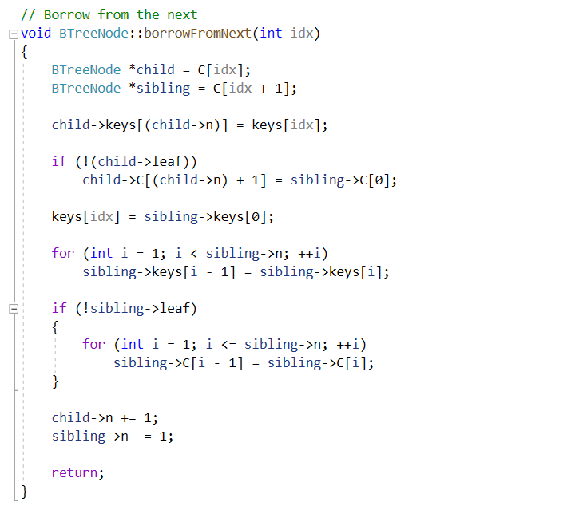
ADDITIONAL FUNCTION:
5.BORROW A NODE

Slide 55
ADDITIONAL FUNCTION:
5.BORROW A NODE FROM THE PREVIOUS AND NEXT
These 2 functions help us borrow the node from their children, the next children or the previous child of a key (for shorter, we can understand it as a left child or right child of a key) and keep the property of a B-tree after delete a node in a special case in the next part of the report.

Slide 56
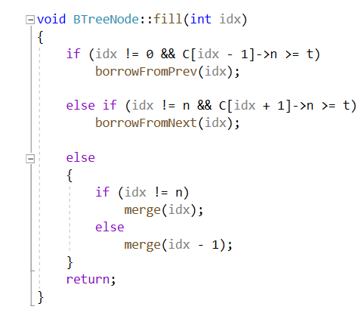
ADDITIONAL FUNCTION:
6. FILL A NODE AFTER DELETE:
After delete a node, there may be some empty space in tree, and we need to fill it to make the tree look “fully”. The main idea of this function is borrowing a spare key from the next or previous children or merge 2 children into 1.

Slide 57
OPERATION FOR DELETION:
So, after these supporting functions, now we go to the main algorithm and operation of delete a number in B-tree, along with example to illustrate:
Case 1: The key does not exist in the B-tree.
It’s easy, no work for that case.

Slide 58

Note: Let consider this B-tree for all of case in Case 2 and Case 3.

Slide 59
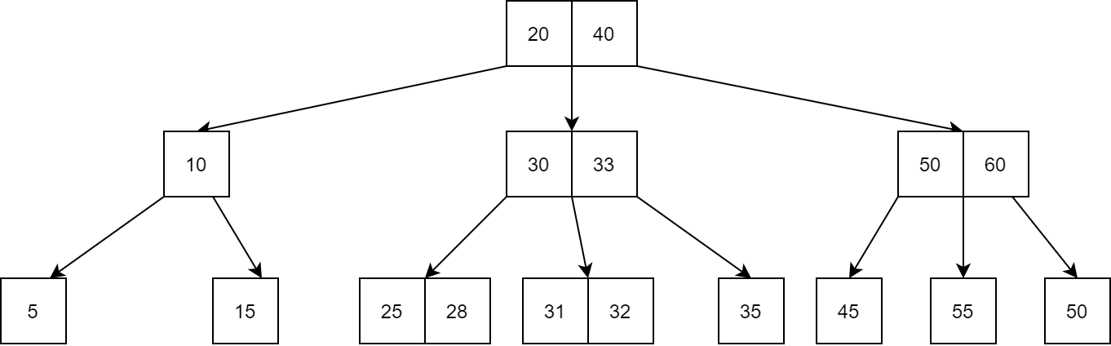
B-TREE – DEGREE: 3

Slide 60
OPERATION FOR DELETION:
Case 2: The key in the leaf node.
The deletion of the key does not violate the property of the minimum number of keys a node should hold. Then just remove it as normal.

Slide 61
IN EXAMPLE: DELETE 32
20
40
10
30
33
50
60
5
15
25
28
31
45
55
70
31
32
35

Slide 62
OPERATION FOR DELETION:
Case 2: The key in the leaf node.
The deletion of the key violates the property of the minimum number of keys a node should hold. In this case, we borrow a key from its immediate neighboring sibling node in the order of left to right .
First, visit the immediate left sibling. If the left sibling node has more than a minimum number of keys, then borrow a key from this node.
Else, check to borrow from the immediate right sibling node.

Slide 63
IN EXAMPLE: DELETE 35
20
40
10
30
33
50
60
5
15
25
28
31
32
35
45
55
70

Slide 64
OPERATION FOR DELETION:
Case 2: The key in the leaf node.
If both the immediate sibling nodes already have a minimum number of keys, then merge the node with either the left sibling node or the right sibling node. This merging is done through the parent node.

Slide 65
IN EXAMPLE: DELETE 55
20
40
10
30
33
50
60
45
5
45
50
15
25
28
31
32
35
55
70

Slide 66
OPERATION FOR DELETION:
Case 3: The key in the internal node.
The internal node, which is deleted, is replaced by an inorder predecessor or successor if the left child has more than the minimum number of keys.

Slide 67
IN EXAMPLE: DELETE 33
20
40
10
30
33
50
60
5
15
25
28
31
32
35
45
55
70

Slide 68
OPERATION FOR DELETION:
Case 3: The key in the internal node.
If either child has exactly a minimum number of keys then, merge the left and the right children.

Slide 69
IN EXAMPLE: DELETE 50
20
40
10
30
33
50
60
5
45
15
25
28
31
32
35
45
55
70

Slide 70
OPERATION FOR DELETION:
Case 4: Shrinking the tree.
In this case, the height of the tree shrinks. If the target key lies in an internal node, and the deletion of the key leads to a fewer number of keys in the node (i.e. less than the minimum required), then look for the inorder predecessor and the inorder successor. If both the children contain a minimum number of keys then, borrowing cannot take place. This leads to Case 3 i.e. merging the children.
Again, look for the sibling to borrow a key. But, if the sibling also has only a minimum number of keys then, merge the node with the sibling along with the parent. Arrange the children accordingly (increasing order).

Slide 71
IN EXAMPLE: DELETE 44
30
15
44
10
20
39
70

Slide 72
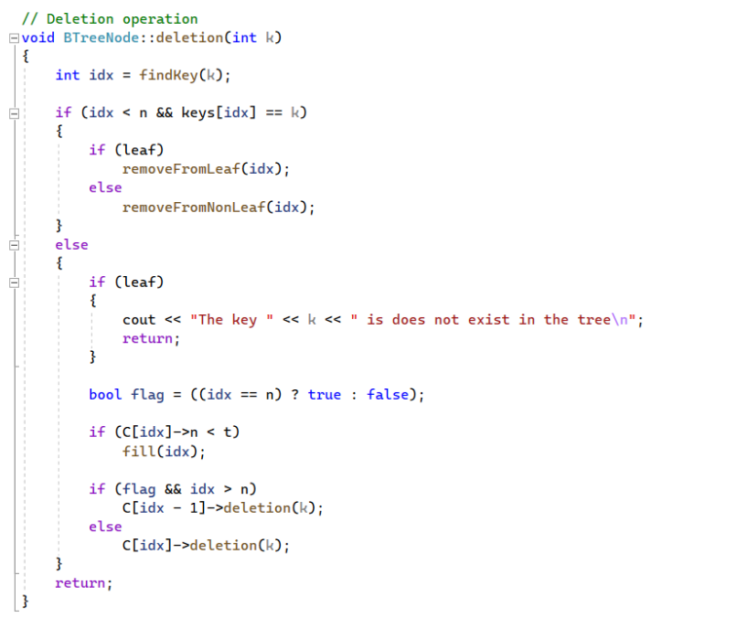
IMPLEMENTATION:

Slide 73
CALCULATE THE COMPLEXITY
Best case Time complexity: O(log n)
Average case Space complexity: O(n)
Worst case Space complexity: O(n)

Slide 74


QUESTION:
1. Calculate the maximum numbers of keys can have in a B-Tree of Order m and height h? Give the formula of the answer base on m and h and Explain.
$$Answer:K=3^{h}−1$$

Slide 75
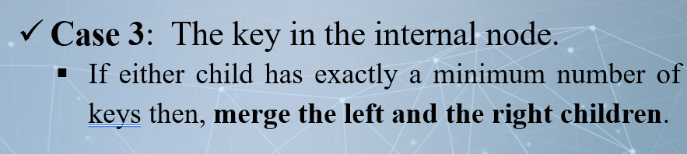
QUESTION:
2. When discussion about the operation on deletion, we have this case:
Then, why after this operation, the B-tree still maintain it’s property?

Slide 76
Answer:
We remind a little bit on the property of B-tree:
A node should have a minimum of m/2 children.
A node (except root node) should contain a minimum of m/2 - 1 keys.
Therefore , the number of keys and children in the node of a tree is acceptable in this B-tree after merging, beside that, we can check other property and hence the B-tree still maintain it’s property.

Slide 77

THANK YOU FOR LISTENING

