Slide 1
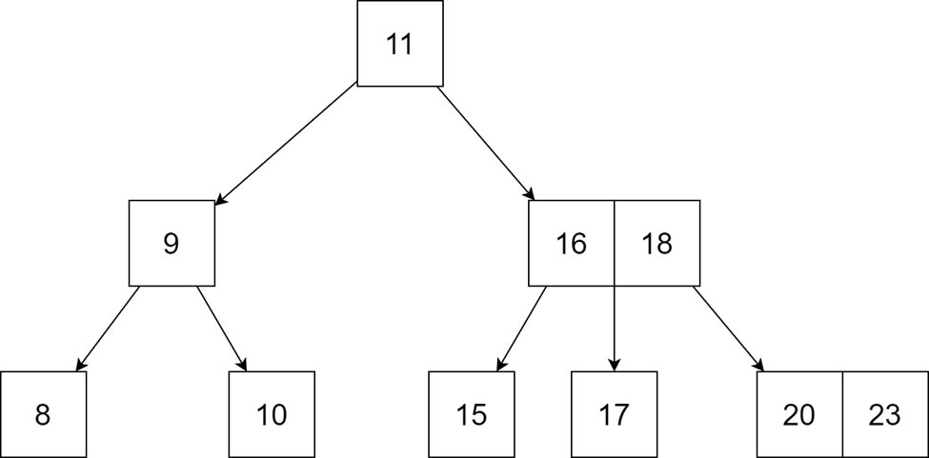
DATA STRUCTURE:
B-Tree
Group 4 - APCS2 - KLPT

Slide 2

Why are we using B-Tree?

Slide 3
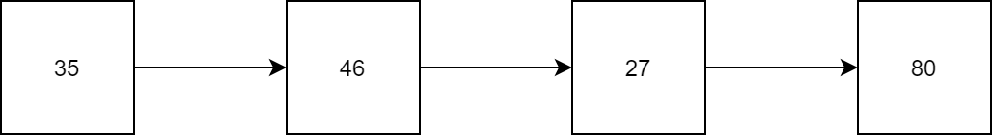
Revive:
We already learned about linked list - A very useful data structure for coding, but they are sequential lists.

Slide 5
Slide Title
Make Effective Presentations
Using Awesome Backgrounds
Engage your Audience
Capture Audience Attention

Slide 6
Slide Title
Product A
Product B
Feature 1
Feature 2
Feature 3
Feature 1
Feature 2
Feature 3

Slide 7


