Slide 1
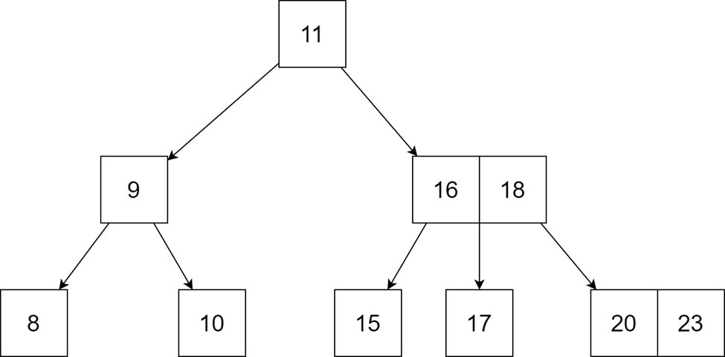
DATA STRUCTURE:
B-Tree
Group 4 - APCS2 - KLPT

Slide 2

Why are we using B-Tree?

Slide 3
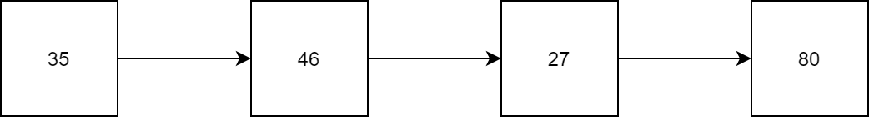
Review:
We have already learned about linked list - A very useful data structure for coding, but they are sequential lists.

Slide 4
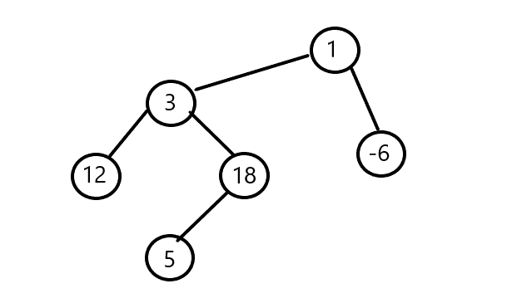

Learn more:
Therefore, we can consider trees or graphs as a data structure, using the methods of pointers and linked lists for their implementation.

Slide 5
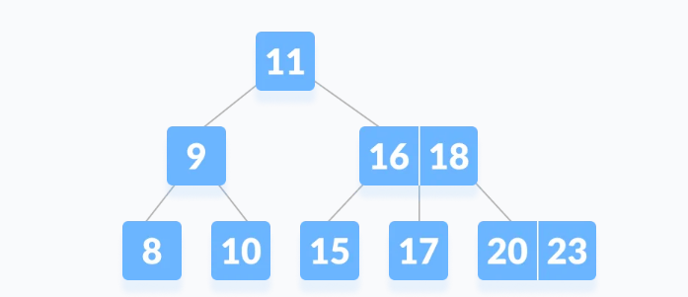
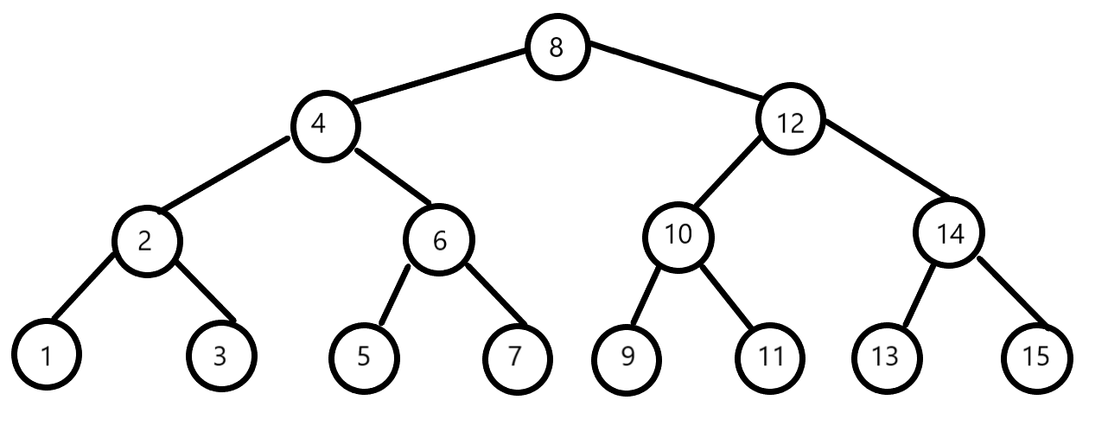
Therefore, In data structures for programming, we already learned about some data structures such as: binary tree and 2-3 tree, etc.; which are very useful for programming.

Slide 6
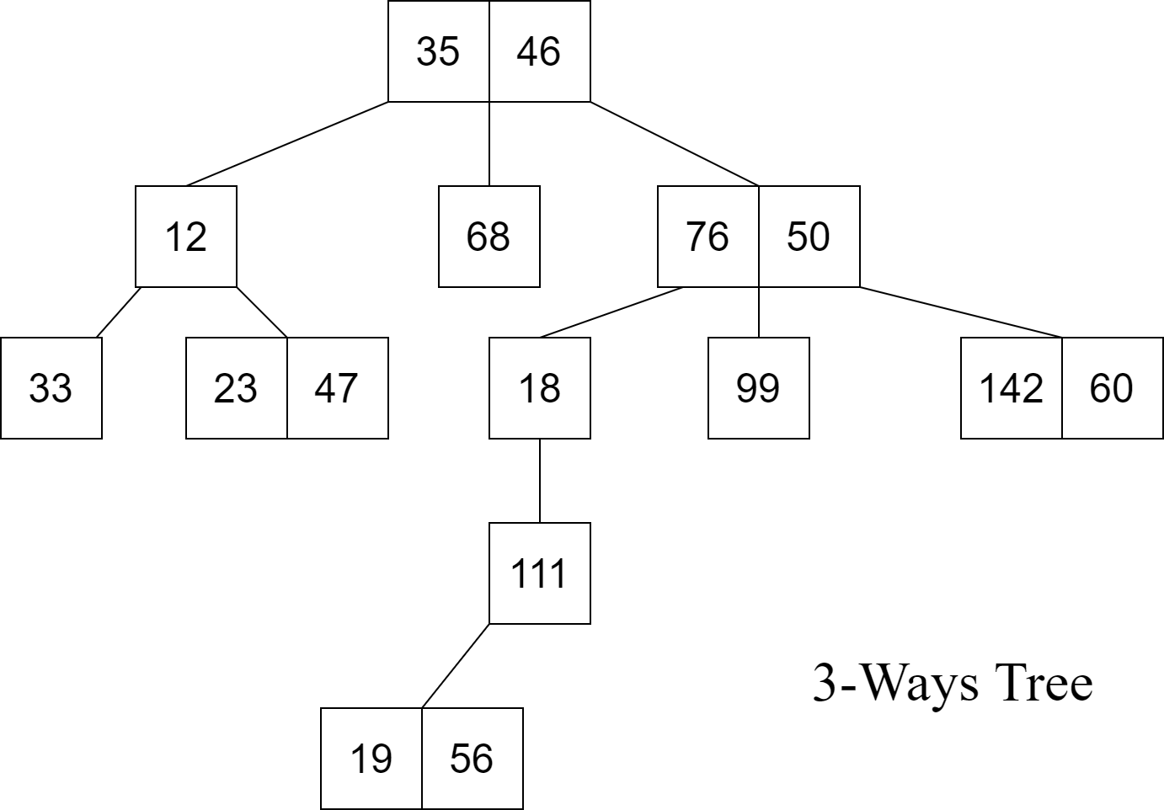
GENERALIZE
We can come to the generalized form of these data structures, which is called: M-Way tree.
Example: 3-Ways Tree

Slide 7
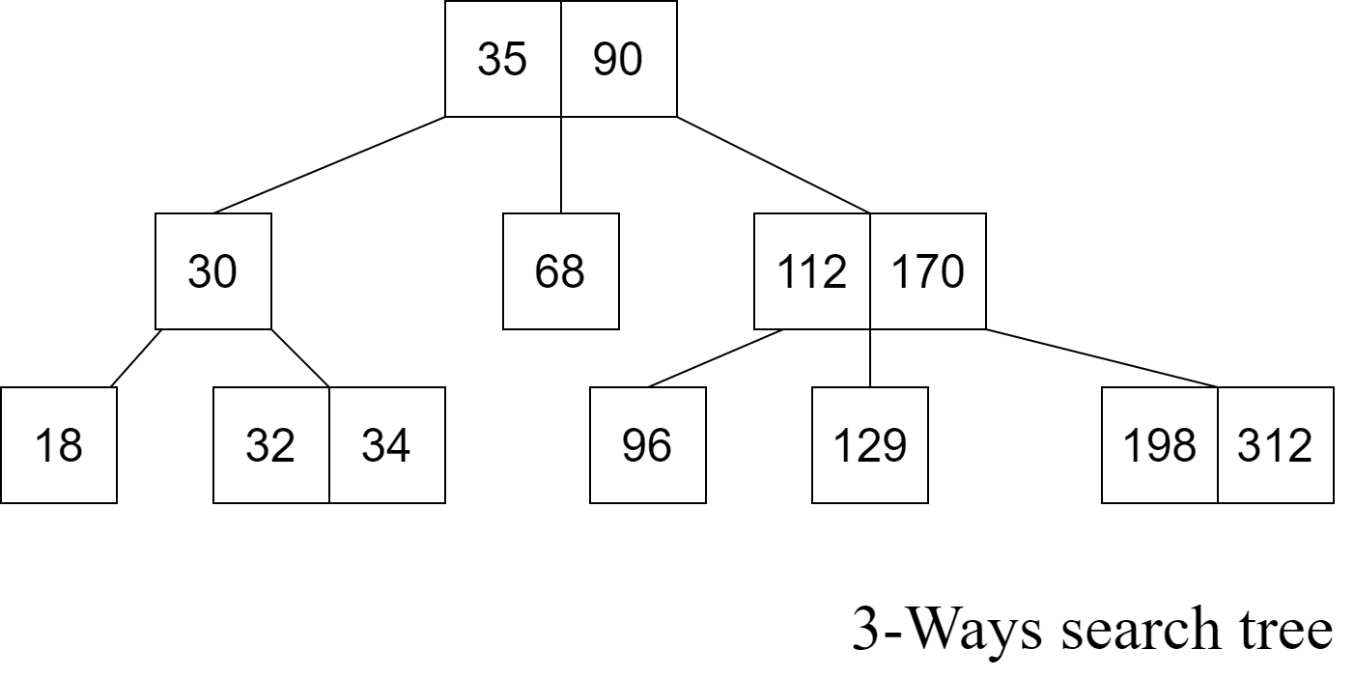
Learn more:
Go further on the M-Way tree, we will get a more special type of data structure: M-Way search tree.

Slide 8
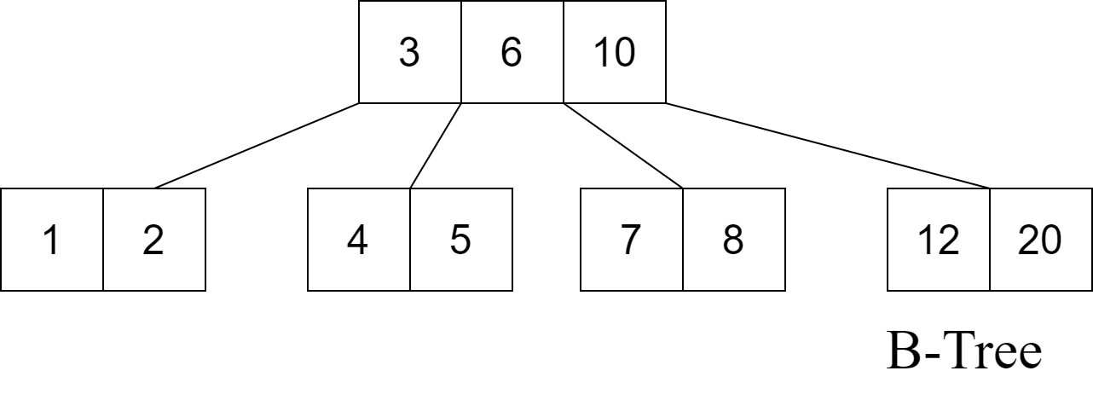
Going deeper on the M-way search tree we get a more specific type of data structure :
B-Tree.

Slide 9


1.Definition of B-Tree

Slide 10
a. M-Ways Tree – Definition:
An M-way(multi-way) tree is a tree that has the following properties:
Each node in the tree can have at most m children.
Nodes in the tree have at most (m-1) key fields and pointers(references) to the children.
The above image is a 3-way tree, where each node has at most (3-1) = 2 keys and 3 children.

Slide 11
b. M-Ways Search Tree:
An M-way search tree is a more constrained M-way tree, which has more property:
Each node in the tree can associate with m children and m-1 key fields.
The keys in any node of the tree are arranged in a sorted order (ascending).
The keys in the first K children are less than the K^{th} key of this node.
The keys in the last (m-K) children are higher than the K^{th} key.

Slide 12
Example for 3-Ways Search Tree

Slide 13
Now, It’s time for B-Tree
Definition:
§ Therefore, a B-tree is a special case of M-way search tree, and we got a new definition:
A B-tree is an expansion from the original M-way search tree. Besides having all the properties of an M-way search tree, it has some properties of its own, these mainly are:
All leaves of B-tree are at the same level.
A B-tree of order m can have at most m-1 keys and m children.
Every node in B-tree has at most m children.
Root node must have at least two nodes.
Every node except the root node and the leaf node contain at least m/2 children.

Slide 14
Example for B-Tree:
Check for B-tree property:
All leaves of B-tree are at the same level.
Root node must have at least two nodes.
Every node except the root node and the leaf node contain at least 2 children.
A B-tree of order 4 can have at most 3 keys and 4 children.

Slide 15
Note:
85
●2-3 trees and binary search trees that we learned before can be B-trees.
●If n ≥ 1, then for any n-key B-tree of height h and minimum degree t ≥ 2, h ≥ log_t (n+1)/2
37
100
12
46
89
101

Slide 16
Advantages:
The need for B-tree arose with the rise in the need for lesser time in accessing the physical storage media like a hard disk. The secondary storage devices are slower with a larger capacity. There was a need for such types of data structures that minimize the disk accesses.
Other data structures such as a binary search tree, AVL tree, red-black tree, e.t.c. can store only one key in one node. If you have to store a large number of keys, then the height of such trees becomes very large and the access time increases.
However, B-tree can store many keys in a single node and can have multiple child nodes. This decreases the height significantly allowing faster disk accesses.

Slide 17
Application:
Databases and file systems
to store blocks of data (secondary storage media)
multilevel indexing

Slide 18


2. Operation on B-Tree

Slide 19
Main Operation for B-Tree:
Insert a node in a B-Tree
Search for a node in a B-tree.
Delete a node in a B-Tree

Slide 20
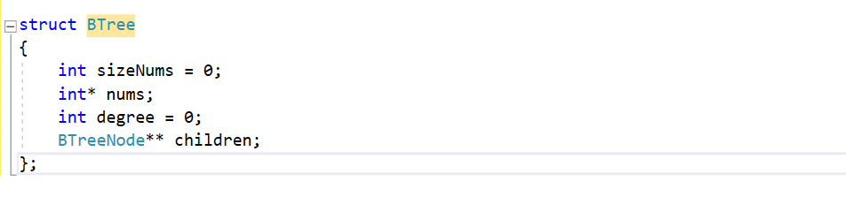
B-TREE CONSTRUCTOR
DEFINE B-TREE IN CODING
We define a new struct B-Tree according to the definition of B-Tree as below:

Slide 21
B-TREE CONSTRUCTOR
Number of children in a node
A list of pointers for children of a node
Number of keys in a node
An array to store keys

Slide 22
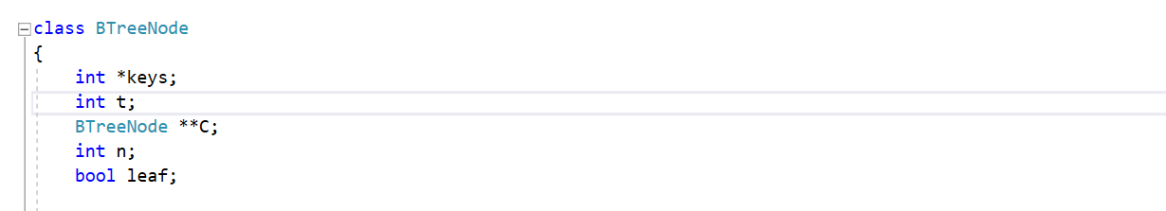
B-TREE CONSTRUCTOR
EFFICIENCY
However, this structure seem not efficiency when programming, since it’s looking a bit hard to maintain the property. So, we have a small update for this data structure:
We add 1 more Boolean variable to check if this node is a leaf or not!

Slide 23
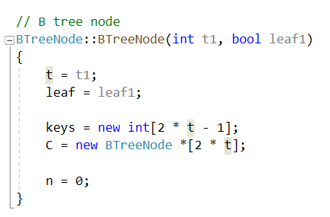
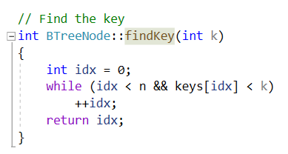
ADDITIONAL FUNCTION:
Creating a node for B-Tree
Find a valid key in a node

Slide 24
MAIN OPERATION:
1. INSERTION

Slide 25
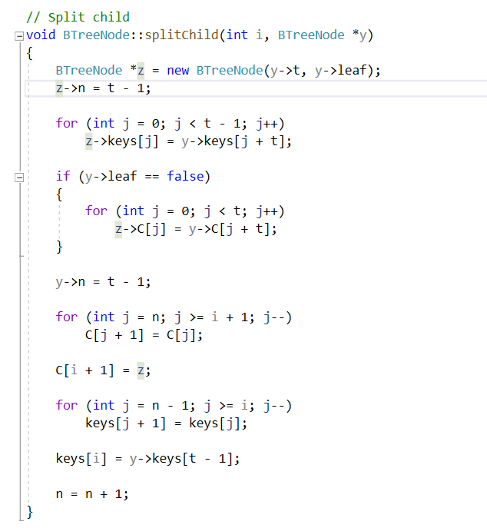
ADDITIONAL FUNCTION IN INSERTION
Split children

Slide 26
ADDITIONAL FUNCTION IN INSERTION
In this function, a child of a parent node name y will be split out to 2 children, the first child have the keys from the first key to i^{th} key of the previous child, and the remaining child will have the other keys, and them both connect to the parent of node y in the function .

Slide 27
DEMONSTRATION
12
26
40
69
98

Slide 28
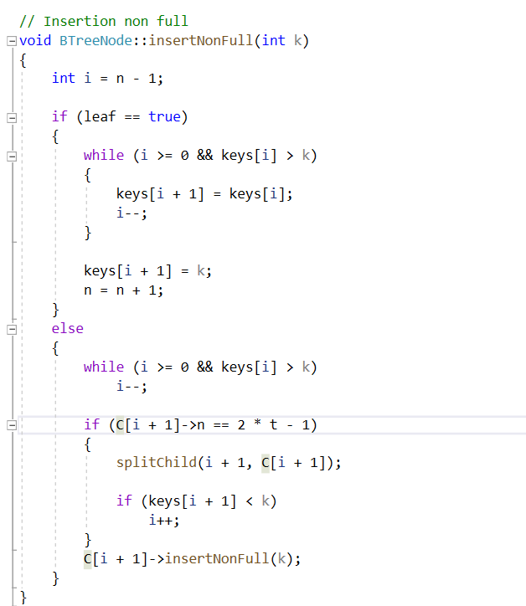
ADDITIONAL FUNCTION IN INSERTION
Insert a node whose root wasn’t full : This function helps us to insert another key to a Node whose root is not full and save the property of a tree such as: all the keys in the node are in increasing order, …

Slide 29
DEMONSTRATION
Insert:
7
11
9
16
18
8
10
14
17
24
32

Slide 30
Operation for Insertion:
If the tree is empty, allocate a root node and insert the key.
Update the allowed number of keys in the node.
Search the appropriate node for insertion.
If the node is full, follow the steps below.
Insert the elements in increasing order.
Now, there are elements greater than its limit. So, split at the median.
Push the median key upwards and make the left keys as a left child and the right keys as a right child.
If the node is not full, follow the steps below.
Insert the node in increasing order.

Slide 31
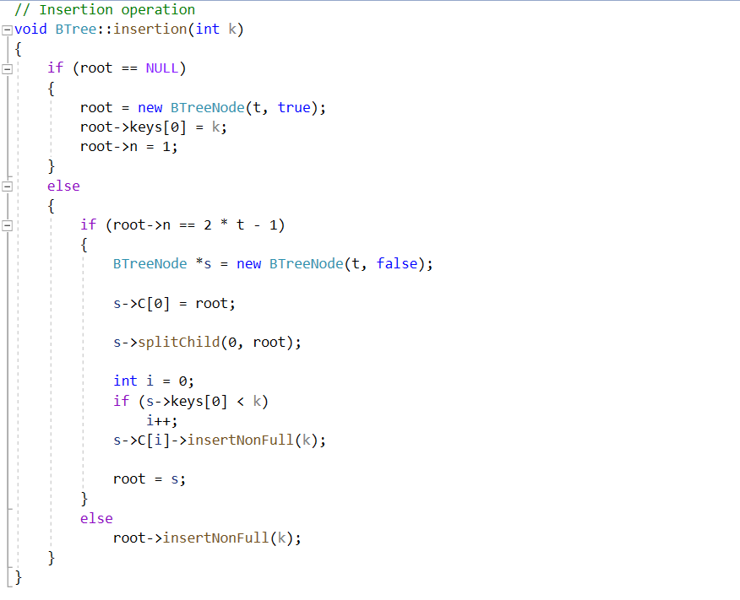
Implementation

Slide 32
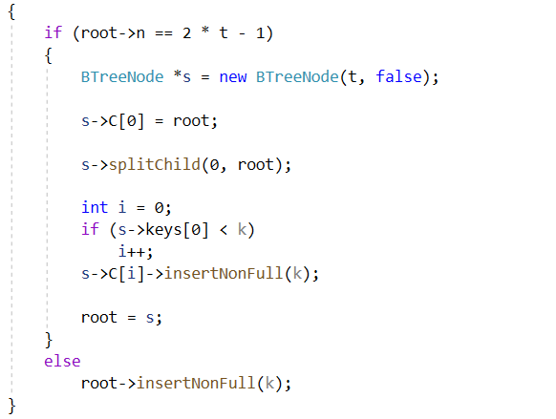
Understand the code:
Check root is a null ?If true:
Check root is a null ? If not: (B-Tree already existed)
Then, create a new tree by constructor for root, with t we already set as the order for the tree before, then, set the first key to k, then set number of key to 1.

Slide 33
Understand the code:
Check if the root is full or not by check if ( root->n == 2 * t -1).
If it is true (full), then we must create another new node for updating root, split the old root into two roots and make them become children of the new root, which is the root has 1 key of the old root so that it’s keep the same property of B-tree.
If it’s not full, then use the function of insert B-tree that its root isn’t full.

Slide 34
DEMONSTRATION
Insertion of b-tree has order 4 in this set of numbers: 37, 49, 80 ,19, 39, 60, 88, 100

Slide 35
DEMONSTRATION
37, 49, 80 ,19, 39, 60, 88, 100
37
49
19
80
19
37
49
80

Slide 36
Slide Title
Product A
Product B
Feature 1
Feature 2
Feature 3
Feature 1
Feature 2
Feature 3

Slide 37


