Slide 1
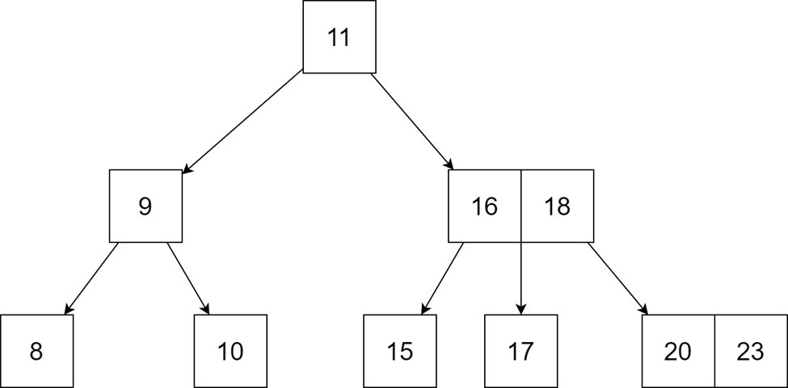
DATA STRUCTURE:
B-Tree
Group 4 - APCS2 - KLPT

Slide 2

Why are we using B-Tree?

Slide 3
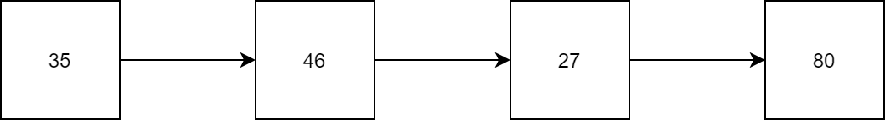
Review:
We already learned about linked list - A very useful data structure for coding, but they are sequential lists.

Slide 4
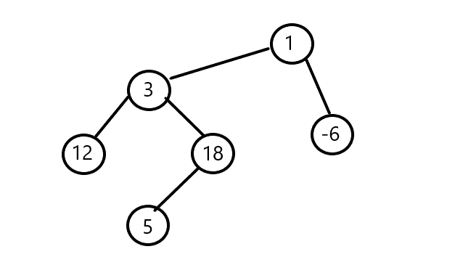

Extend:
Therefore, we can consider trees or graphs as a data structure, using the methods of pointers and linked lists for their implementation.

Slide 5
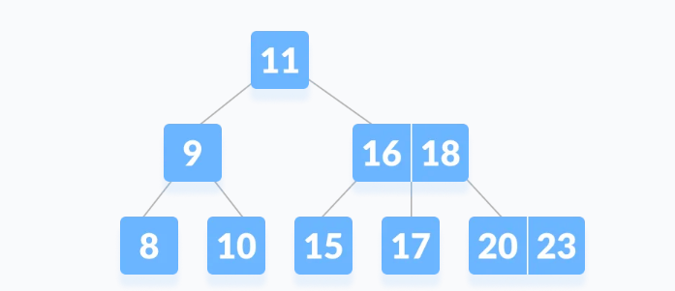
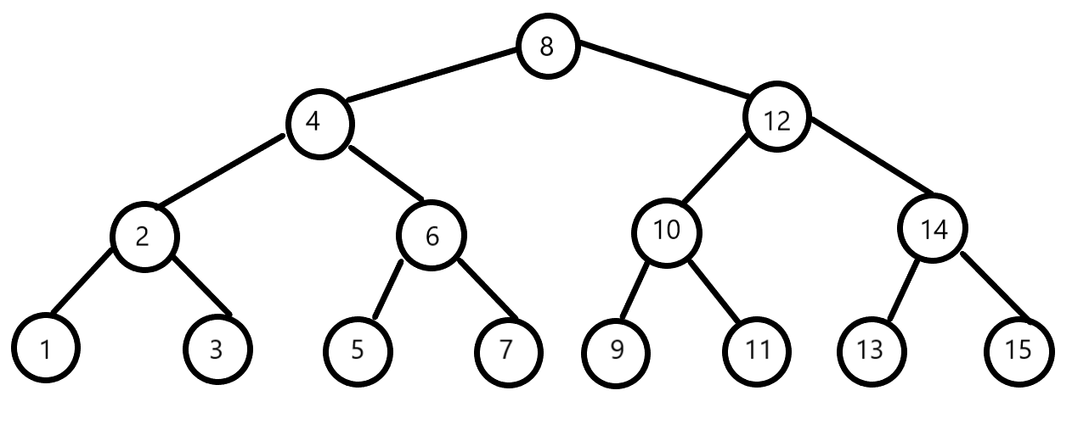
Therefore, In data structures for programming, we already learned about some data structures such as: binary tree and 2-3 tree, etc.; which are very useful for programming.

Slide 6
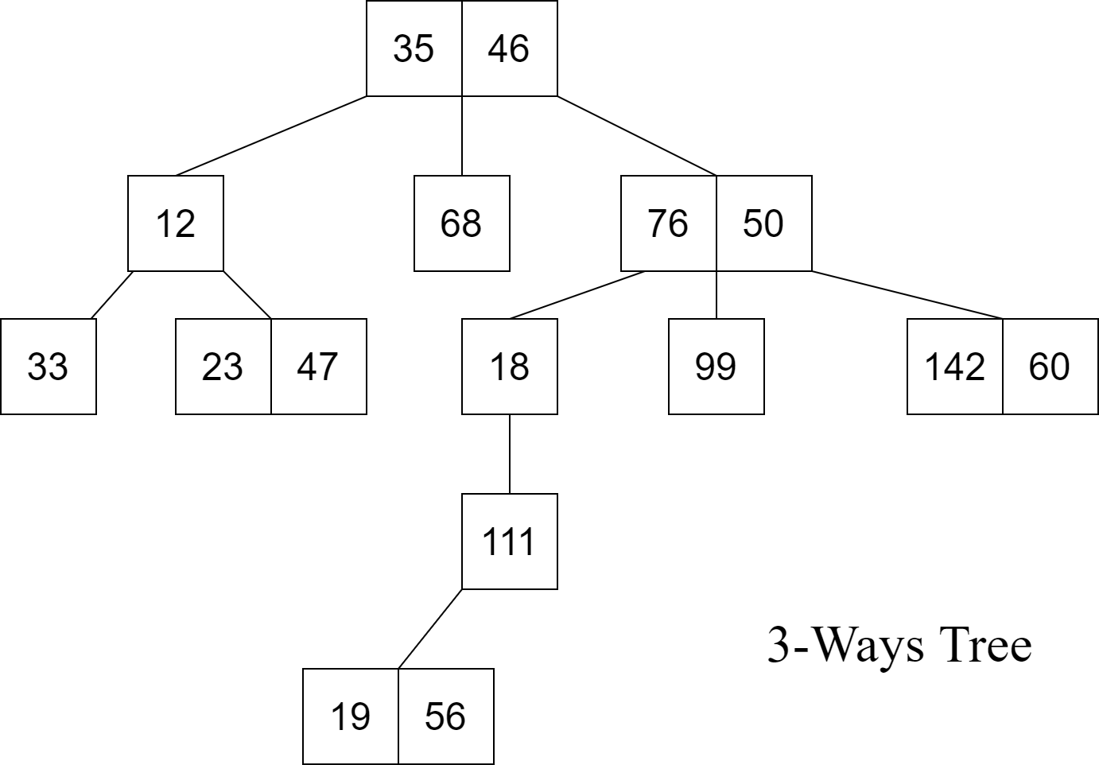
GENERALIZE
We can come to the generalized form of these data structures, which is called: M-Way tree.
Example: 3-Ways Tree

Slide 7
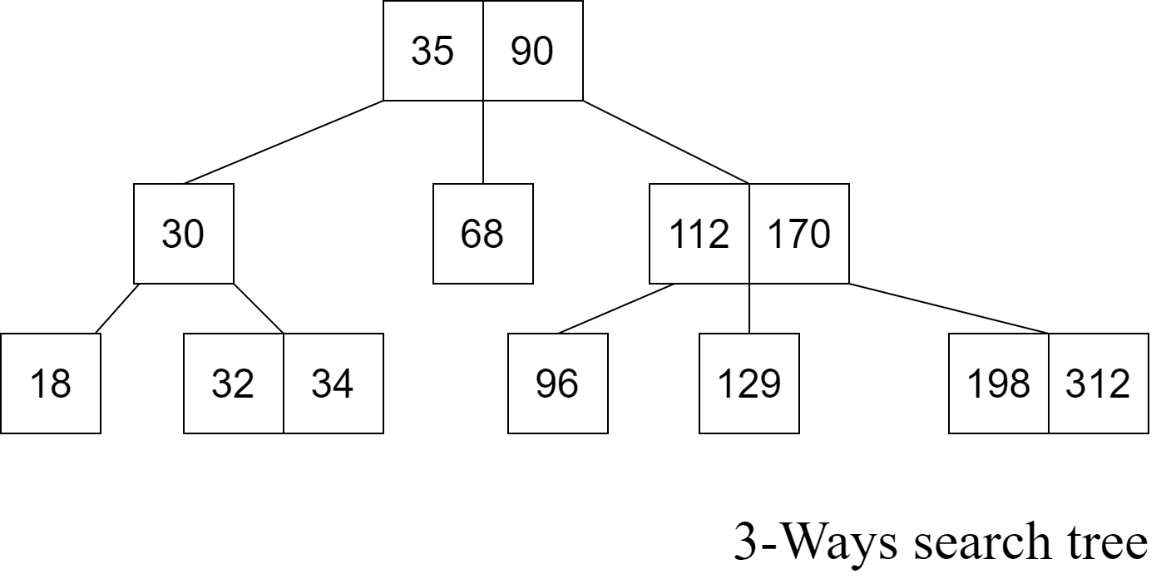
Another Extend:
Go further on the M-Way tree, we will get a more special type of data structure: M-Way search tree.

Slide 8
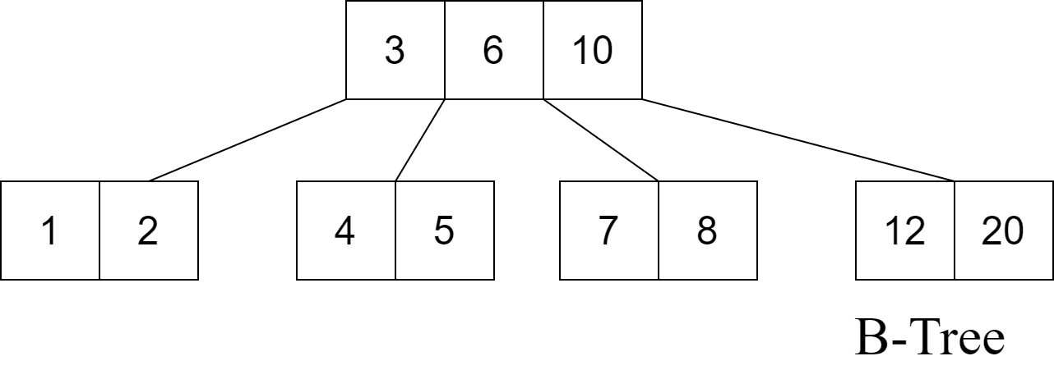
Going deeper on the M-way search tree we get a more specific type of data structure :
B-Tree.

Slide 9


1.Definition of B-Tree

Slide 10
a. M-Ways Tree – Definition:
An M-way(multi-way) tree is a tree that has the following properties:
Each node in the tree can have at most m children.
Nodes in the tree have at most (m-1) key fields and pointers(references) to the children.
The above image is a 3-way tree, where each node has at most (3-1) = 2 keys and 3 children.

Slide 11
b. M-Ways Search Tree:
An M-way search tree is a more constrained M-way tree, which has more property:
Each node in the tree can associate with m children and m-1 key fields.
The keys in any node of the tree are arranged in a sorted order (ascending).
The keys in the first K children are less than the K^{th} key of this node.
The keys in the last (m-K) children are higher than the K^{th} key.

Slide 12
Example for 3-Ways Search Tree

Slide 13
Now, It’s time for B-Tree
Definition:
§ Therefore, a B-tree is a special case of M-way search tree, and we got a new definition:
A B-tree is an extension of an M-way search tree. Besides having all the properties of an M-way search tree, it has some properties of its own, these mainly are:
All leaves of B-tree are at the same level.
A B-tree of order m can have at most m-1 keys and m children.
Every node in B-tree has at most m children.
Root node must have at least two nodes.
Every node except the root node and the leaf node contain at least m/2 children.

Slide 14
Example for B-Tree:
Check for B-tree property:
All leaves of B-tree are at the same level.
Root node must have at least two nodes.
Every node except the root node and the leaf node contain at least 2 children.
A B-tree of order 4 can have at most 3 keys and 4 children.

Slide 15
Note:
85
●2-3 trees and binary search trees that we learned before can be B-trees.
●If n ≥ 1, then for any n-key B-tree of height h and minimum degree t ≥ 2, h ≥ log_t (n+1)/2
37
100
12
46
89
101

Slide 16
Advantages:
The need for B-tree arose with the rise in the need for lesser time in accessing the physical storage media like a hard disk. The secondary storage devices are slower with a larger capacity. There was a need for such types of data structures that minimize the disk accesses.
Other data structures such as a binary search tree, AVL tree, red-black tree, e.t.c. can store only one key in one node. If you have to store a large number of keys, then the height of such trees becomes very large and the access time increases.
However, B-tree can store many keys in a single node and can have multiple child nodes. This decreases the height significantly allowing faster disk accesses.

Slide 17
Application:
Databases and file systems
to store blocks of data (secondary storage media)
multilevel indexing

Slide 18


2. Operation on B-Tree

Slide 19
Main Operation for B-Tree:
Insert a node in a B-Tree
Search for a node in a B-tree.
Delete a node in a B-Tree

Slide 20
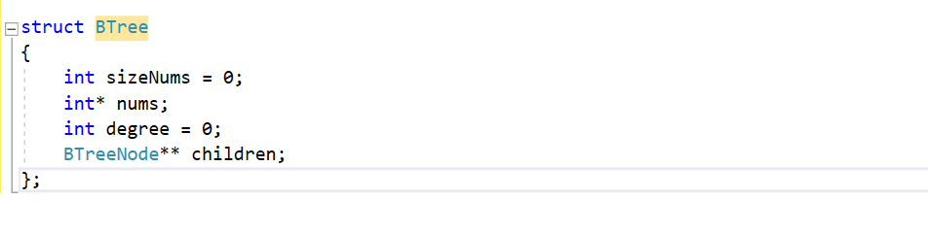
B-TREE CONSTRUCTOR
DEFINE B-TREE IN CODING
We define a new struct B-Tree according to the definition of B-Tree as below:

Slide 21
B-TREE CONSTRUCTOR
Number of children in a node
A list of pointers for children of a node
Number of keys in a node
An array to store keys

Slide 22
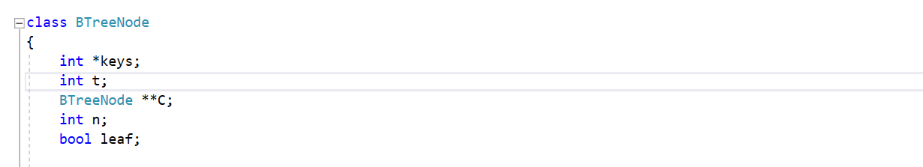
B-TREE CONSTRUCTOR
EFFICIENCY
However, this structure seem not efficiency when programming, since it’s looking a bit hard to maintain the property. So, we have a small update for this data structure:
We add 1 more Boolean variable to check if this node is a leaf or not!

Slide 23
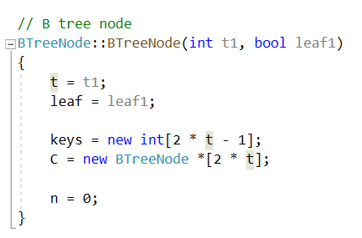
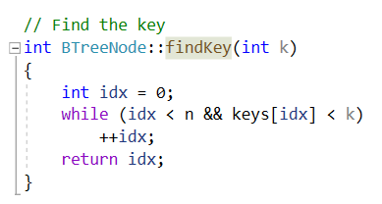
ADDITIONAL FUNCTION:
Creating a node for B-Tree
Find a valid key in a node

Slide 24
MAIN OPERATION:
1. INSERTION

Slide 25
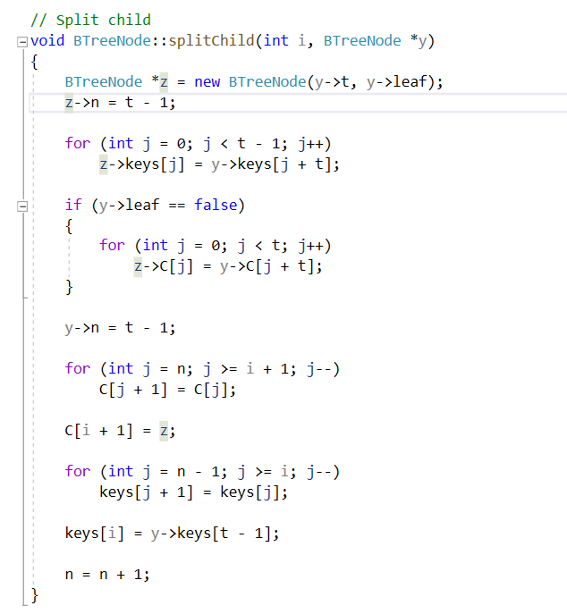
ADDITIONAL FUNCTION IN INSERTION
Split children

Slide 26
ADDITIONAL FUNCTION IN INSERTION
In this function, a child of a parent node name y will be split out to 2 children, the first child have the keys from the first key to i^{th} key of the previous child, and the remaining child will have the other keys, and them both connect to the parent of node y in the function .

Slide 27
DEMONSTRATION
12
26
40
69
98

Slide 28
Slide Title
Make Effective Presentations
Using Awesome Backgrounds
Engage your Audience
Capture Audience Attention

Slide 29
Slide Title
Product A
Product B
Feature 1
Feature 2
Feature 3
Feature 1
Feature 2
Feature 3

Slide 30


