Slide 1
Reactive Programming in Java
Specification, Libraries and Operators

Slide 2
Outline
Brief of Reactive Programming definition
Reactive Stream
Project Reactor
Reactive Objects
Reactive Operators
Hot and Cold Publisher
Threading and Schedulers
Unit Testing
Reactive Data Access

Slide 3
Brief of Reactive Programming definition
Repeat the previous presentation

Slide 5
Reactive Stream
Specification and Components

Slide 6
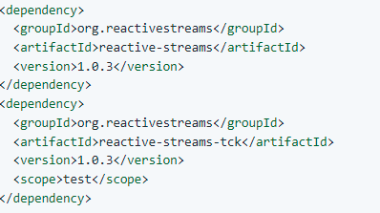
What is Reactive Stream?
Java Reactive Programming Specification
https://github.com/reactive-streams/reactive-streams-jvm
Handling stream of live data
whose volume is not predetermined
process data in asynchronous system
Ensuring data stream doesn’t overwhelm the stream destination
Stream destination’ buffer is limited
Has Backpressure mechanism to control receiving data flow
Reactive Stream provides a standard for asynchronous stream processing with non-blocking backpressure
(From https://www.reactive-streams.org/ )

Slide 7
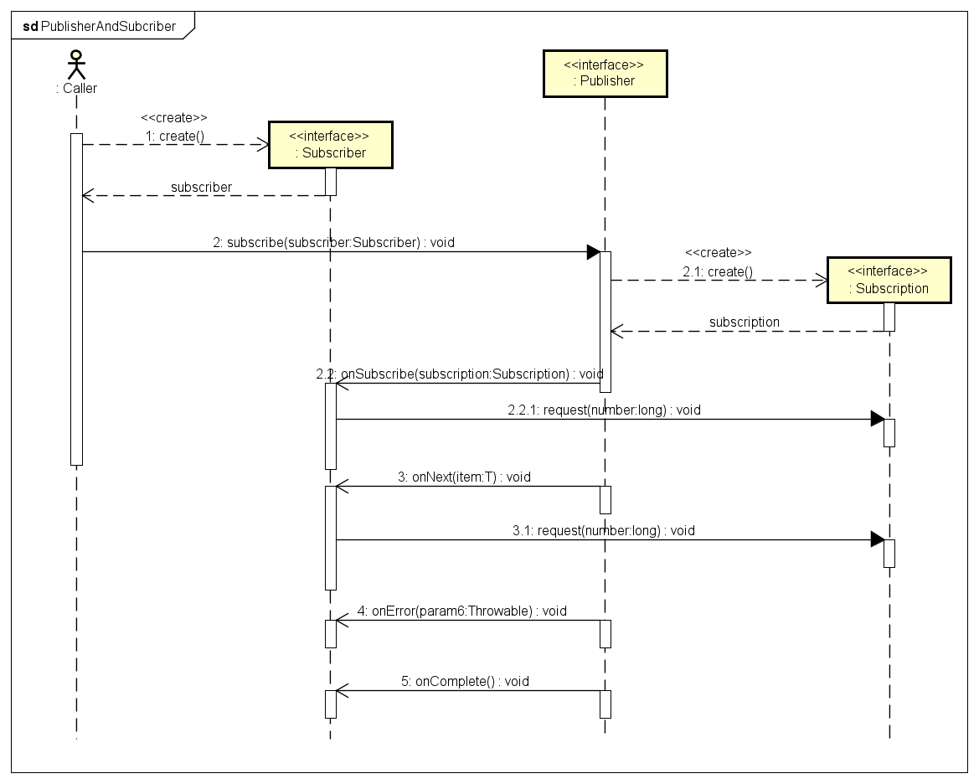
Reactive Stream Components
The Publisher
provide Data Stream elements by Subscriber’s demands
can serve multiple Subscribers
The Subscriber
subscribe to Publisher
request on demand to get Data Elements
The Subscription
represents a one-to-one lifecycle of a Subscriber subscribing to a Publisher.
The Processor
represents a processing stage—which is both a Subscriber and a Publisher and obeys the contracts of both.

Slide 8
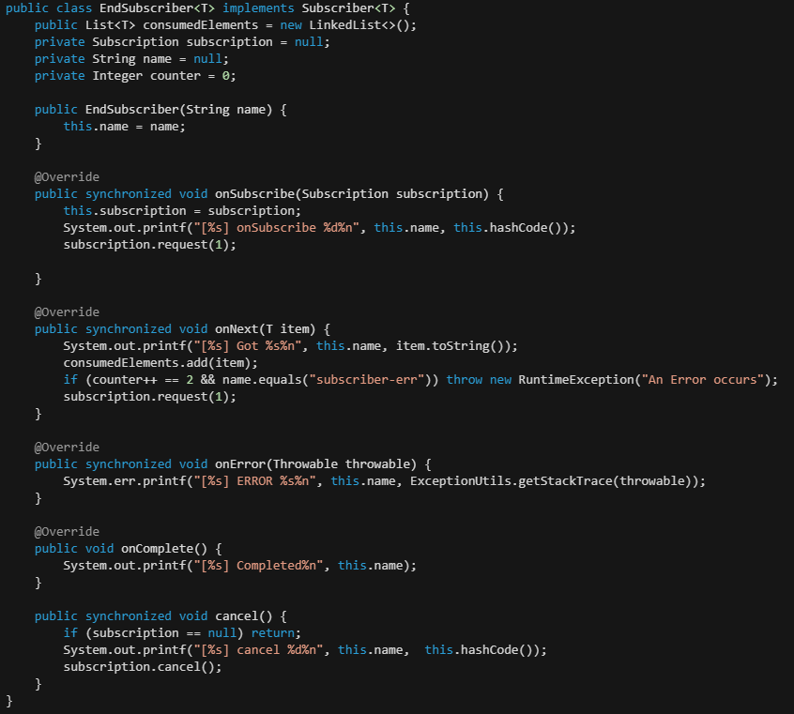
A demo of Reactor Stream
Using Java 9 Interface
which are 1:1 semantically equivalent to their respective Reactive Streams counterparts
EndSubcriber to handle data
Using Java 9 SubmissionPublisher to publish data

Slide 9
Reactor Project
Objects and Operators

Slide 10
Outline
Reactive Objects
Reactive Operators
Hot and Cold Publisher
Threading and Schedulers
Unit Testing

Slide 11
Reactive Objects
Introduction of Reactive Flux and Mono

Slide 12
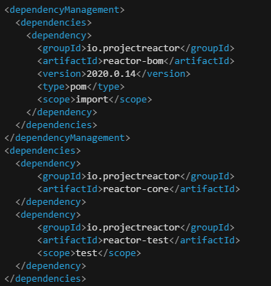
Introduce Reactor
Reactor is a fully non-blocking reactive programming foundation for the JVM
Implements the Reactive Streams specification.
Offers composable asynchronous sequence APIs - Flux (for [N] elements) and Mono (for [0|1] elements)

Slide 13
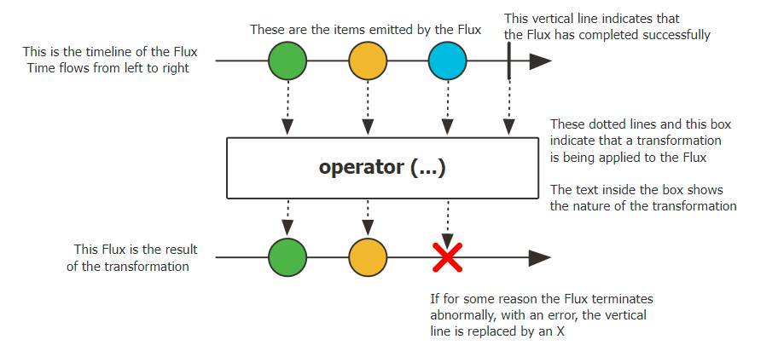
Flux
Flux is a Publisher
represents an asynchronous sequence of 0 to N emitted items
terminated by either a completion signal or an error
Emits signals to Subscriber by calling
onNext: to provide single data element
onError: represent an Error
onComplele: compete processing data-stream

Slide 14
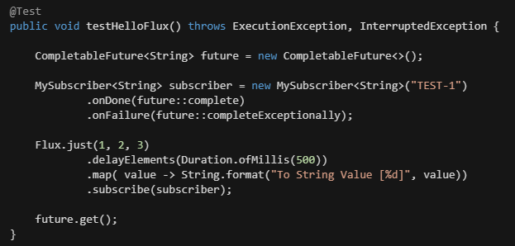
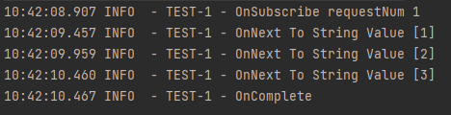
Subscribe to Flux
Using Subscriber to subscribe the Flux
Cold Stream Flux with values (1, 2, 3)
Delay before processing each item
Reformat Item value
Subscribe the Flux

Slide 15
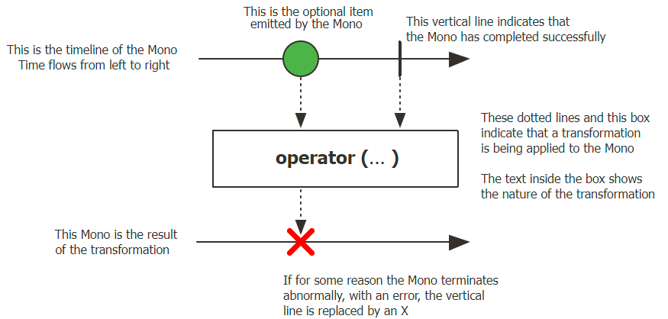
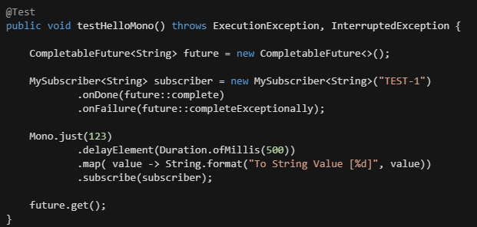

Mono
Mono is a Publisher
Emits at most ONE item to Subscriber by onNext event then terminates by onComplete
Or emit a single onError event
Subscribe to Mono
Single item will be published and processed

Slide 16
Reactive Operators
Process a Reactive Stream

Slide 17
Reactive Operators
Reactive Operators
Data stream items will be processed asynchronously
Data stream published by Flux and Mono.
Flux and Mono provide a ton of operators to process data

Slide 18
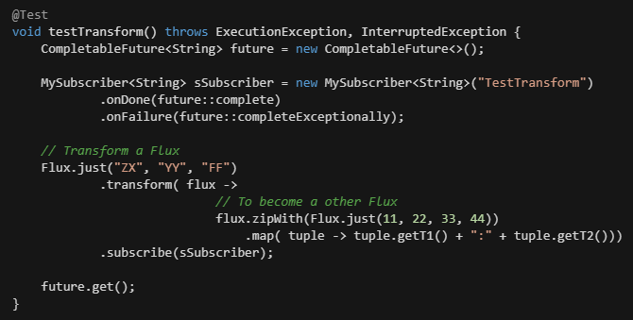
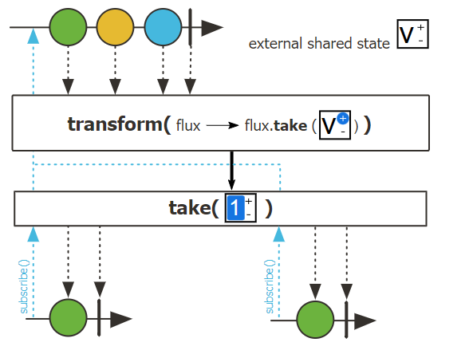
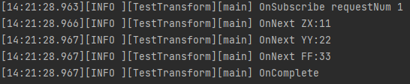
Reactor Operator : Transform
Transform a Flux in order to generate a target Flux

Slide 19
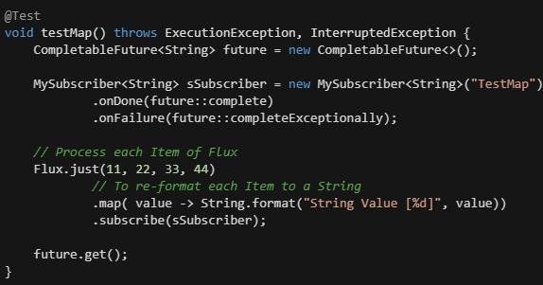
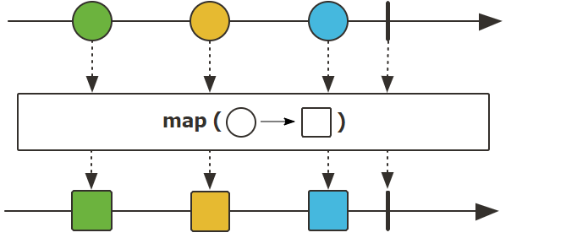
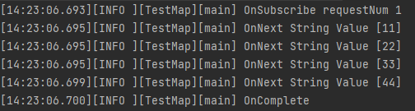
Reactor Operator : Map
Transform the items emitted by this Flux by applying a synchronous function to each item

Slide 20
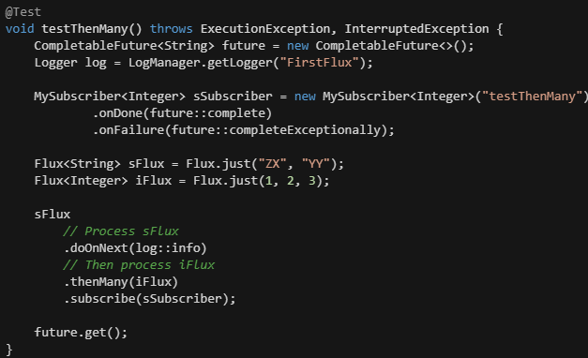
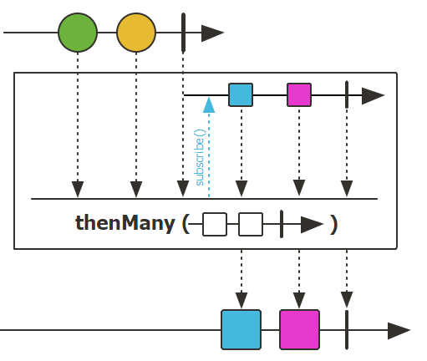
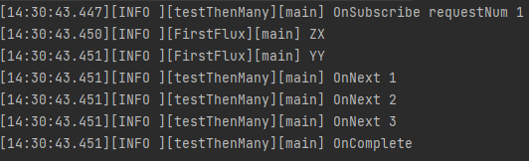
Reactor Operator: thenMany
Process a Flux after another completing
Process sFlux first
Then process iFlux

Slide 21
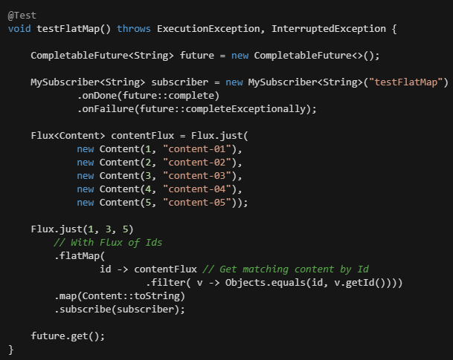
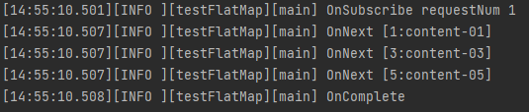
Reactor Operator: flatMap
Process each Item to Publisher and flat to Flux

Slide 22
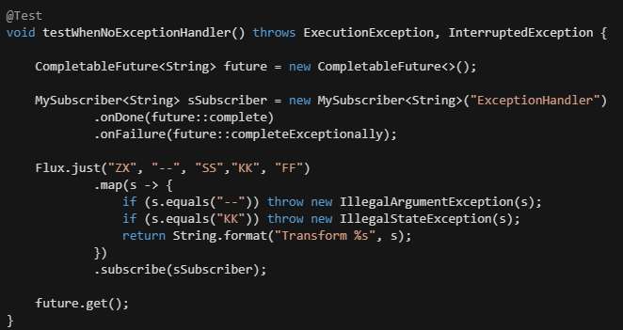
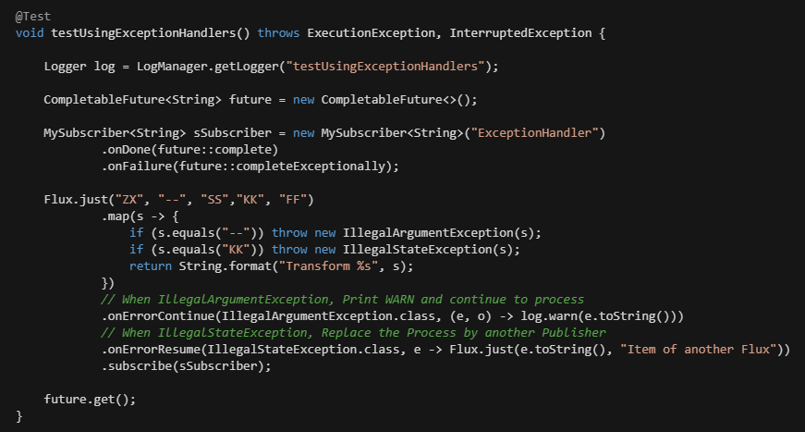
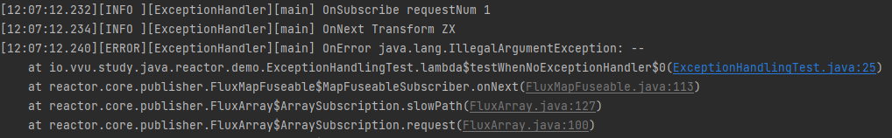
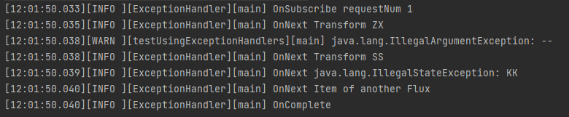
Exception Handling
When an error occurs:
Data Stream processing flow will be terminated
Or the error needs to be handled asynchronously
Error event handlers
onErrorContinue: ignore the error and continue
onErrorResume: replace current Publisher by another one

Slide 23
Hot and Cold Publisher
Two ways of publishing Stream data

Slide 24
Hot and Cold Publisher
Reactive Stream objects (Flux and Mono)
represent an asynchronous sequence of data
nothing happens before you subscribe.
Two broad families of publishers: Hot and Cold.
Cold Publisher
generate data anew for each subscription.
no subscription is created, data never gets generated.
Hot Publisher
start publishing data right away
continue doing so whenever a new Subscriber comes in
Note: maybe something does indeed happen before you subscribe

Slide 25
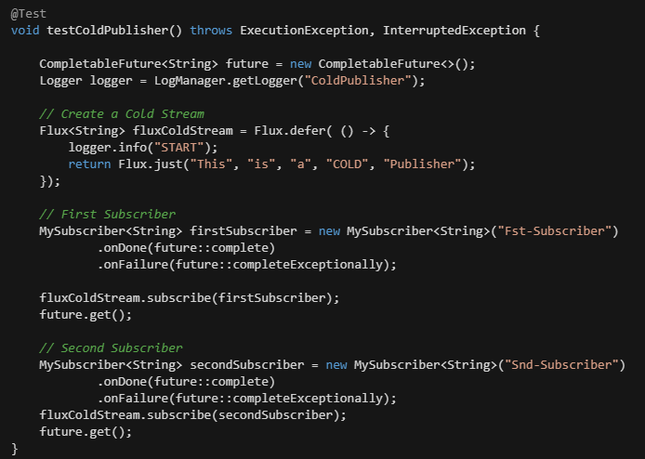
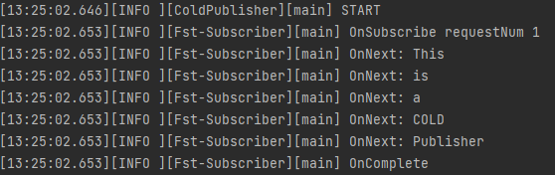
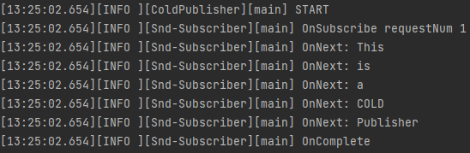
Cold Publisher
Generate data anew for each subscription.
No subscription is created, data never gets generated.
Generate data anew for each subscription
Same data Stream for 2 Subscribers

Slide 26
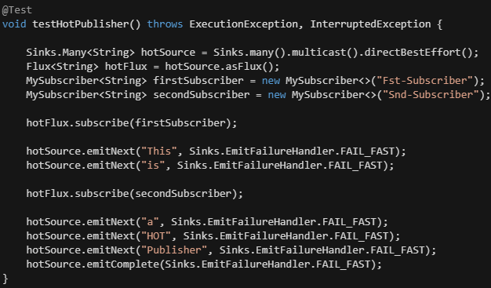
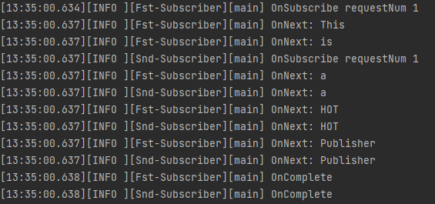
Hot Publisher
Start publishing data right away
Continue doing so whenever a new Subscriber comes in
Note: maybe something does indeed happen before you subscribe
Second Publisher misses 2 items that published before subscribing

Slide 27
Threading and Schedulers
Process stream on threads

Slide 28
Reactor Scheduler
The execution model and where the execution happens is determined by the Scheduler that is used.
By default, Reactor operators will be executed on thread of subscription.
Scheduler is like an ExecutorService to take responsibilities the execution of reactive chains
Reactor offers two means of switching the execution context in a reactive chain:
publishOn method: affects to assembly time, where reactive chains executed
subscribeOn method: affects the context of the source emission
Reactor Execution Contexts (Schedulers):
Using current Thread for execution context (Schedulers.immediate()).
A single, reusable thread (Schedulers.single())
A fixed pool of workers (Schedulers.parallel()).
A bounded elastic thread pool (Schedulers.boundedElastic())
creates new worker pools as needed and reuses idle ones.
worker pools that stay idle for too long (the default is 60s) are disposed

Slide 29
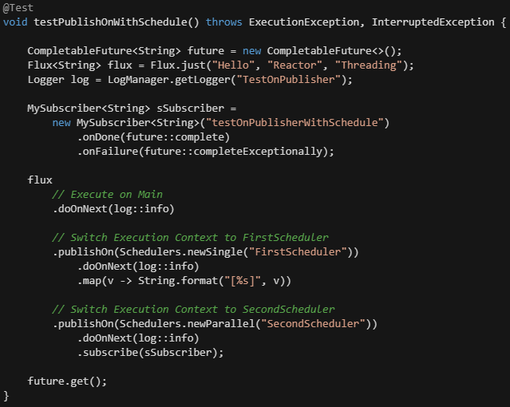
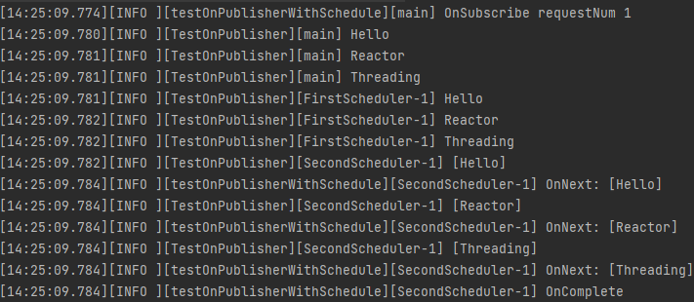
publishOn method
publishOn affects where the subsequent operators execute:
Changes the execution context to one Thread picked by the Scheduler
as per the specification, onNext calls happen in sequence, so this uses up a single thread
unless they work on a specific Scheduler, operators after publishOn continue execution on that same thread
same thread

Slide 30
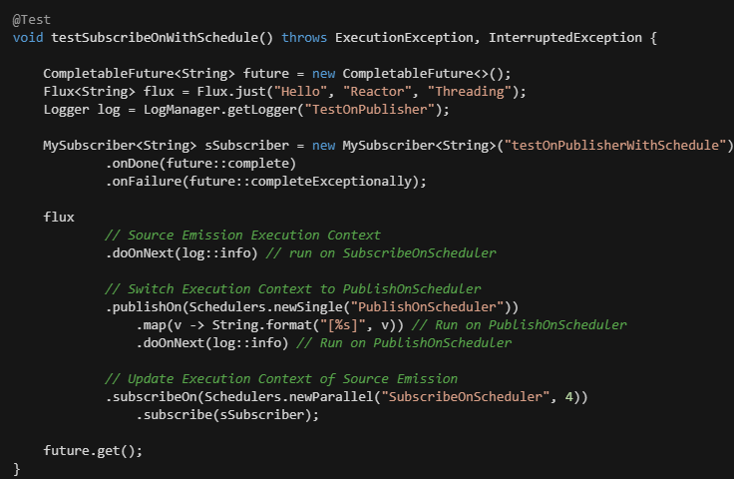
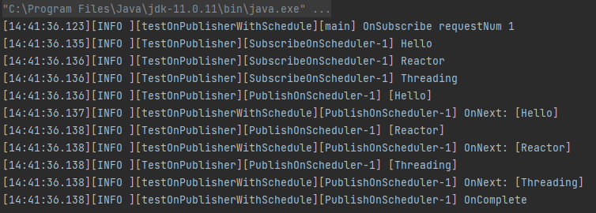
subscribeOn method
subscribeOn affects the context of the source emission:
Changes the Thread from which the whole chain of operators subscribes
Picks one thread from the Scheduler
Affects to Source Emission

Slide 31
Unit Testing
Verify the Stream flow

Slide 32
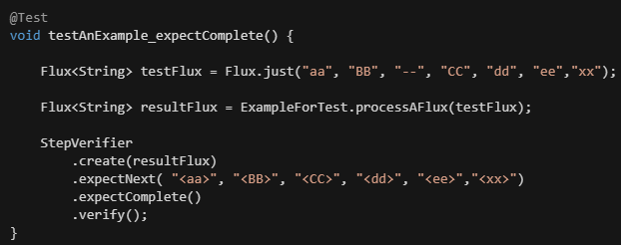
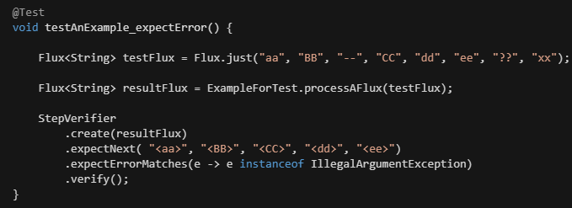
Unit Testing
Using StepVerifier to verify Scenario of stream processing
Verify the success processing flow
Verify the error processing flow

Slide 33
Reactive Data Access
R2DBC and Spring Data

