Slide 1
Kotlin programming concepts
..

Slide 2

Introduction
Kotlin
Modern, concise and safe programming language
Full compatibility and interoperability with Java
Support modern frameworks

Slide 3
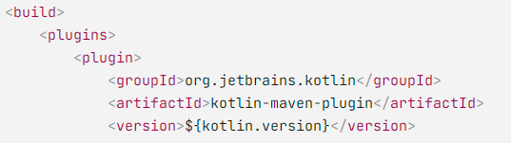
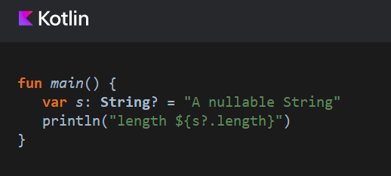


Kotlin Playground
Kotlin language:
https://kotlinlang.org/
Kotlin playground:
https://play.kotlinlang.org/
IDE: IntellJ Idea Community
https://www.jetbrains.com/idea/
Maven plugins
Gradle Plugins

Slide 4
Outline
Basic Concepts
Null Safety
Immutable and Mutable
Kotlin Functions
Unit Testing
Coroutine
Working with Spring Boot
R2DBC
Webflux

Slide 5
Basic Concepts
Play with Kotlin

Slide 6
Null-safety

Slide 7
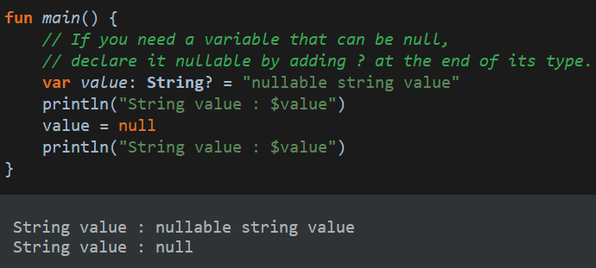
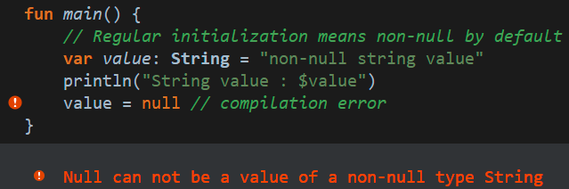
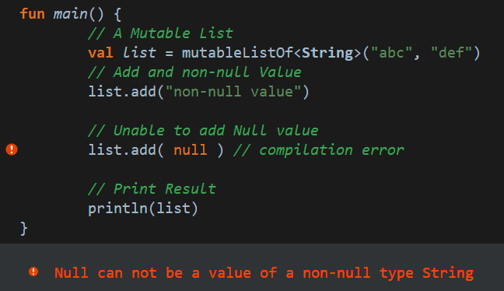
Null-safety
Regular initialization means non-null by default
Could not assign Null to Non-null variable
Reduce risk of Null Pointer Exception
If nullable variable is needed, add ? operator to the end of type

Slide 8
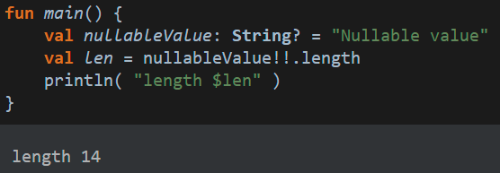
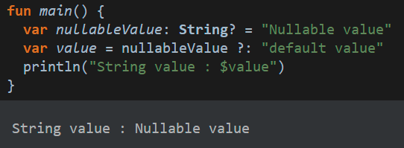
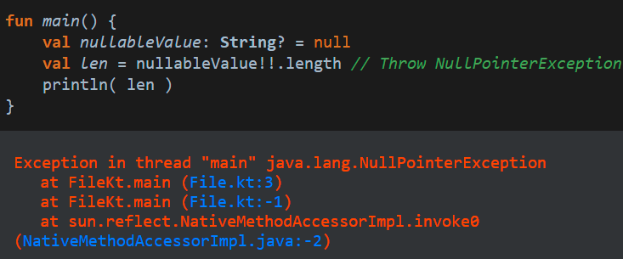
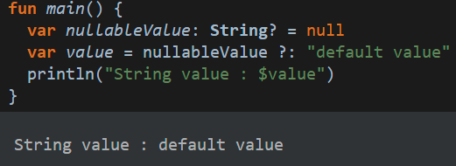
From nullable type to non-null type
Using !! Operator
When value not null
When value is null
Elvis Operator (?.)
When value not null
When value is null, use default value

Slide 9
Immutable concept

Slide 10
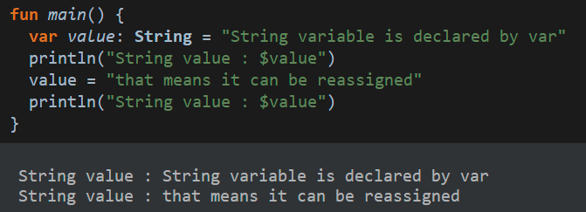
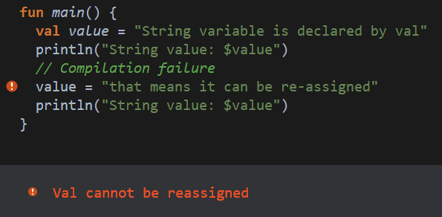
Keywords: var and val
var keyword for declare a re-assignable variable
val keyword for read-only variable, just initialize once, no change

Slide 11
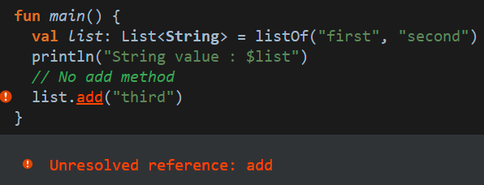
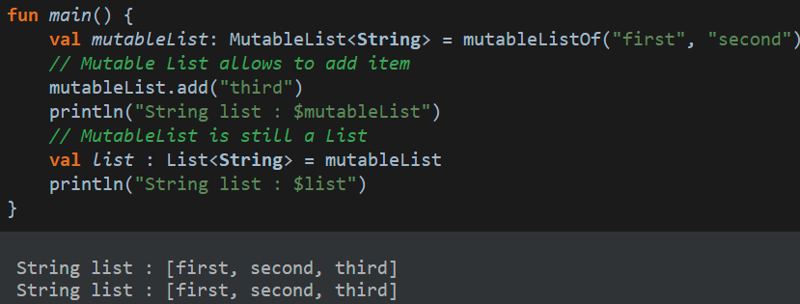
Immutable collection
Collection interface is Immutable by default
If need to change, use Mutable Collection

Slide 12
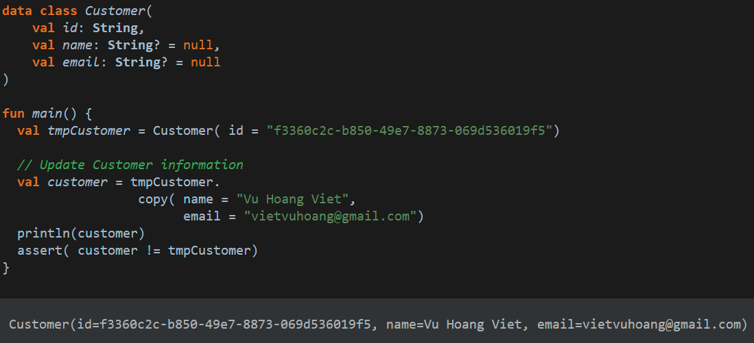
Working with DTOs – Data Class
Using Data class for DTOs
Using val keyword for immutable
Clone object to have new value instead of directly update
Named parameters is in-used
Notes:
## DTOs
```kotlin
data class Customer(
val id: String,
val name: String? = null,
val email: String? = null
)
fun main() {
val tmpCustomer = Customer( id = "bcc1f488-4be1-48c4-a3ee-5ad75b365aaa")
println(tmpCustomer)
// Update Customer information
val customer = tmpCustomer.copy( name = "Vu Hoang Viet", email = "vietvuhoang@gmail.com")
println(customer)
assert( customer !== tmpCustomer)
}
```

Slide 13
Kotlin Functions

Slide 14
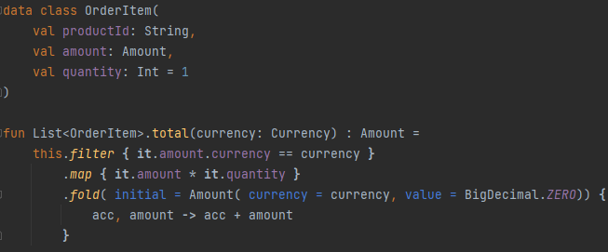
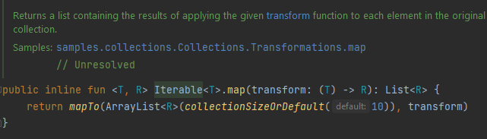
Lambda Function
Higher-order functions
A higher-order function is a function that takes functions as parameters or returns a function.﻿
Function as a parameter
Lambda Expression

Slide 15
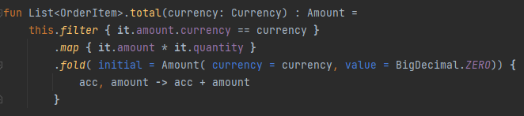
Extension function
Is the ability to extend a class with new functionality without having to inherit from the class
Able to add new functions for a class from a third-party library that can’t be modified
List can’t be modified
Add Extension function for List

Slide 16
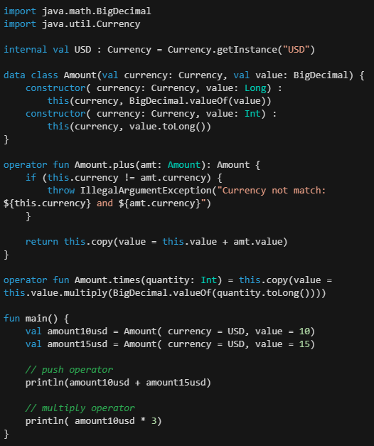
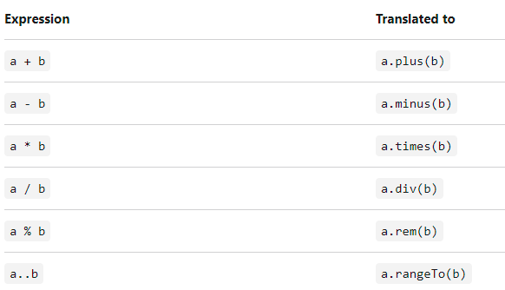
Operator overloading
The ability to provide custom implementations for the predefined set of operators on type

Slide 17
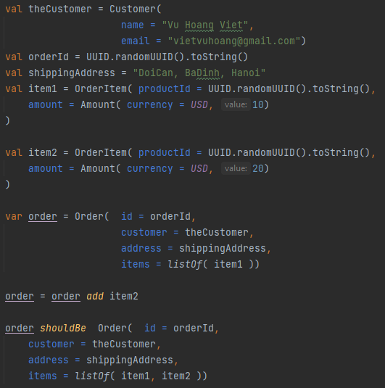
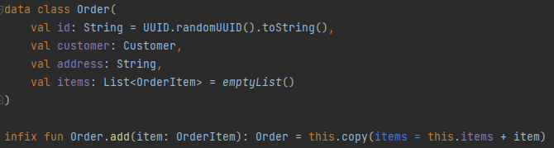
Infix notation﻿
Allows some functions to be called without using the period and brackets
Infix functions
must be member functions or extension functions.
must have a single parameter.
parameter must not accept variable number of arguments and must have no default value.

Slide 18
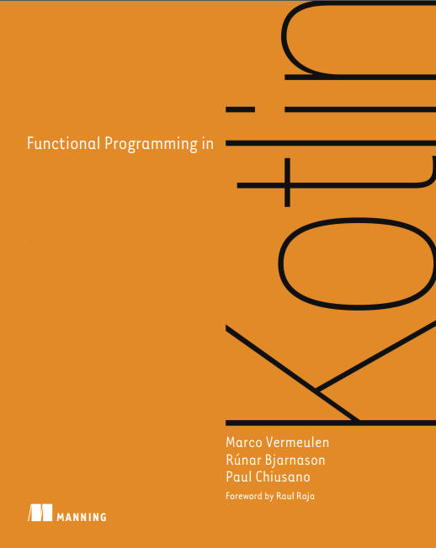
Functional Programming

Slide 19
Unit Testing

Slide 20
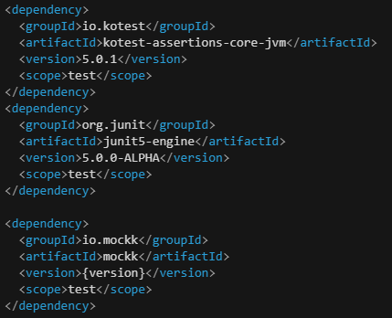
Unit Testing
Junit 5: Unit Testing Framework
Kotest: assertion library
https://kotest.io/
Mockk: mocking library
https://mockk.io/

Slide 21
Coroutine
Coroutine and suspend function

Slide 22
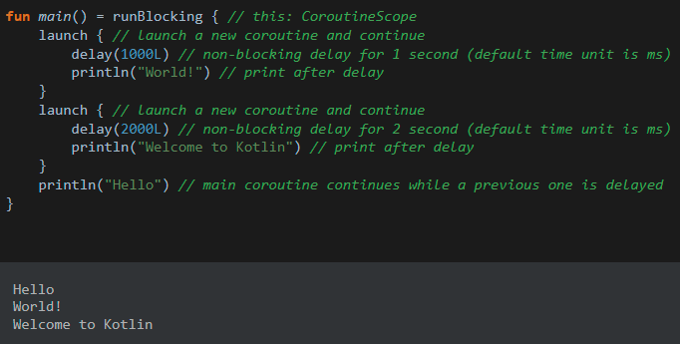
Getting Started
What is Coroutine?
A coroutine is an instance of suspend-able computation
Benefit of Coroutine:
Non-blocking and asynchronous programming
Provide suspend function as a safer and less error-prone solution for asynchronous operations

Slide 23
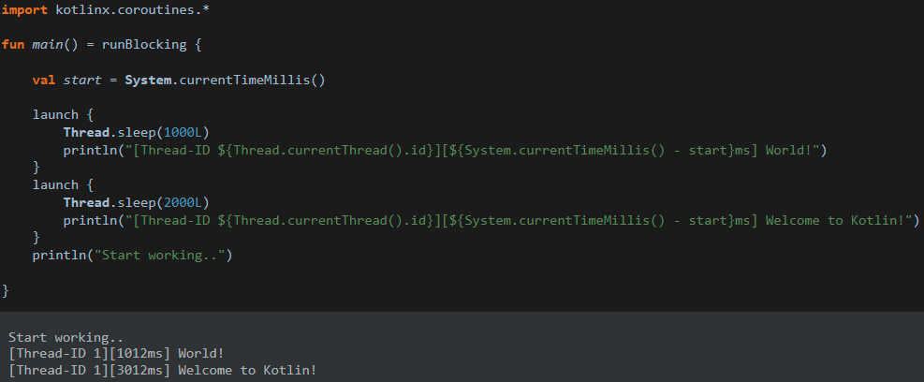
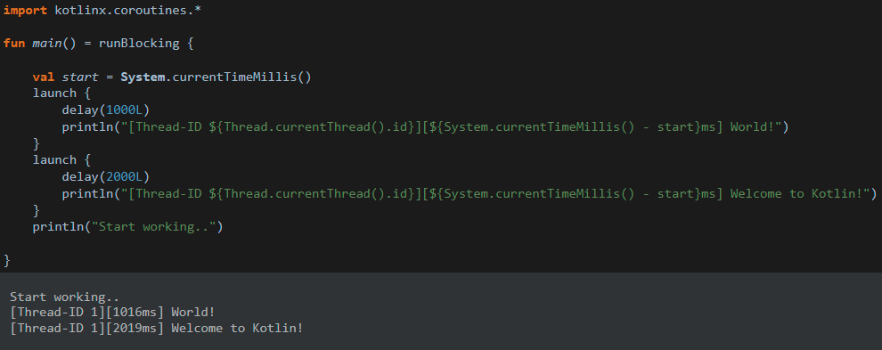
Blocking vs Non-blocking
Blocking with Thread sleep
Non-blocking delay
Thread Sleep will block the thread
Kotlin delay is a suspend function
Second task will finish after 3s
Second task will finish after 2s

Slide 24
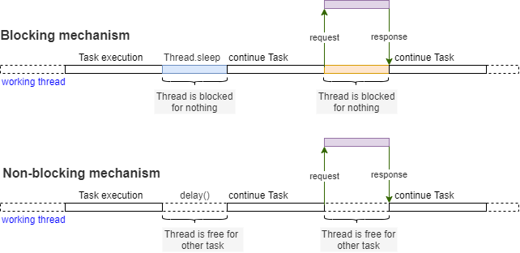
Blocking vs Non-blocking

Slide 25
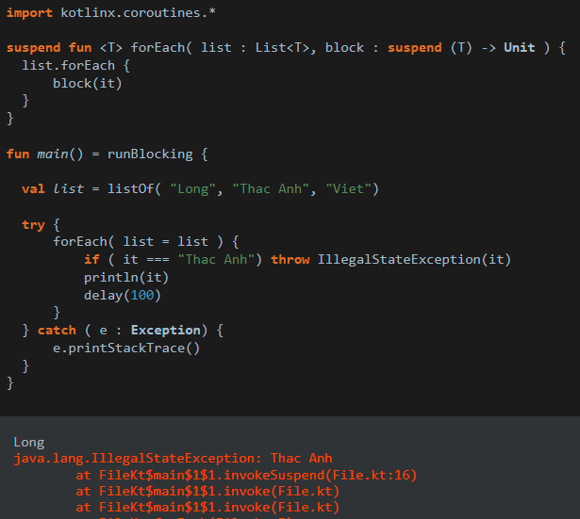
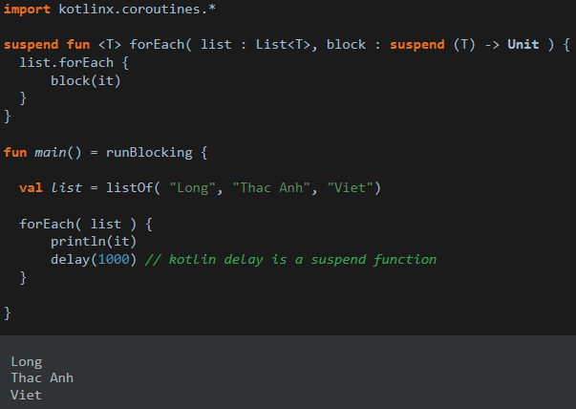
Suspend function
Working on Coroutine only
Only allowed to be called from a coroutine or another suspend function
Safer and less error-prone solution for asynchronous operations
Serial processing with suspend function
Safely Error handling

Slide 26
Coroutine Scope and Dispatcher

Slide 27
Working with Spring Boot
Reactor, Webflux and R2DBC

Slide 28
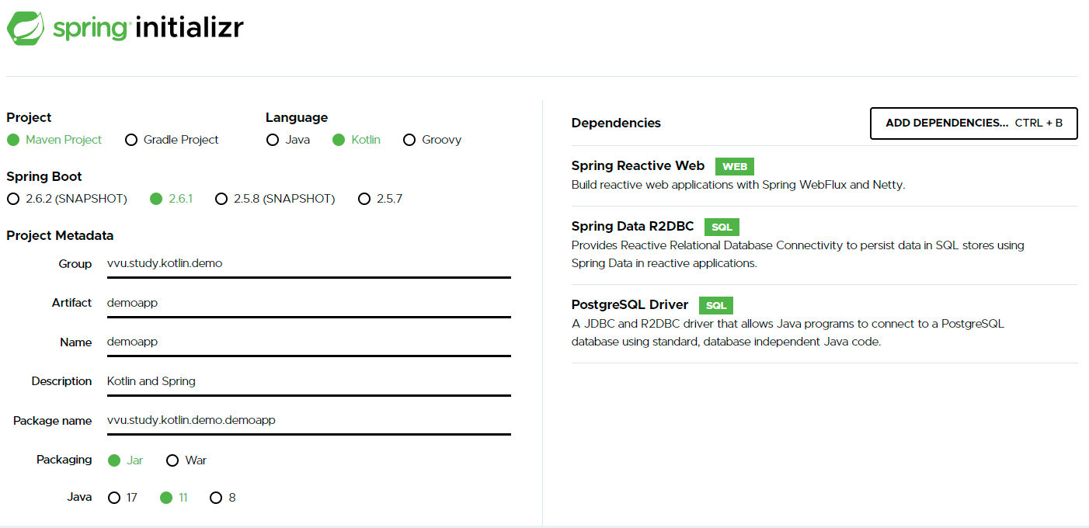
Kotlin and Spring
Start with Spring
https://start.spring.io/
Unit Testing
Mockk
SpringMockk

Slide 29
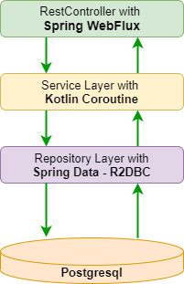
Demo Application
Spring Webflux with Kotlin
Reactive-stack web applications
Run on non-blocking servers
R2DBC with PostgreSQL
A fully-reactive non-blocking API
Work with SQL databases using a reactive API
Unit Testing with Mockk and SpringMockk

Slide 30
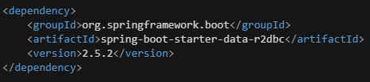
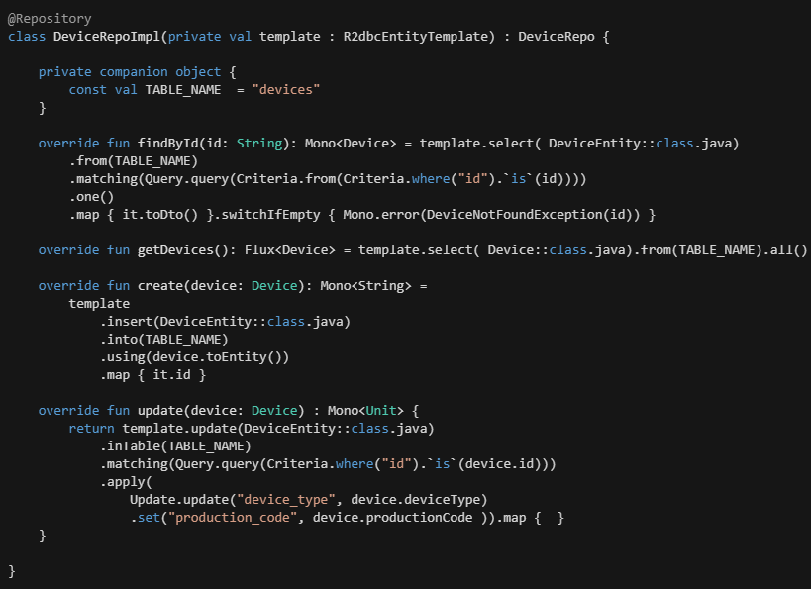
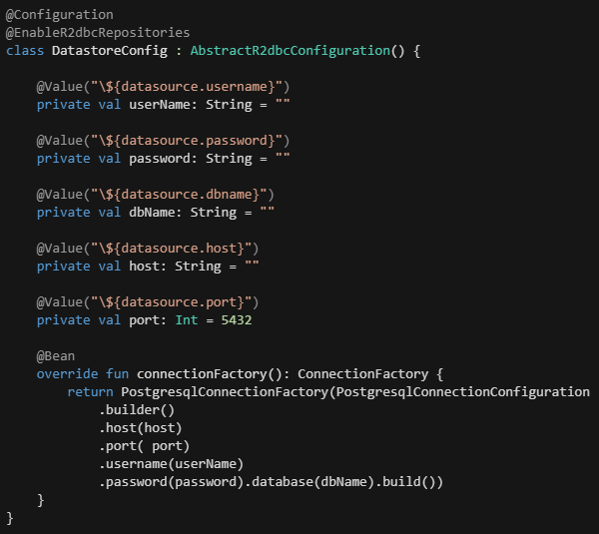
Spring Boot with R2DBC
Maven dependency
R2DBC Configuration
Repository Implementation

Slide 31
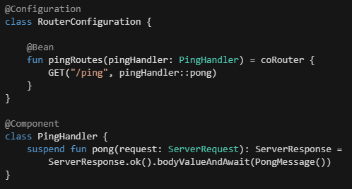
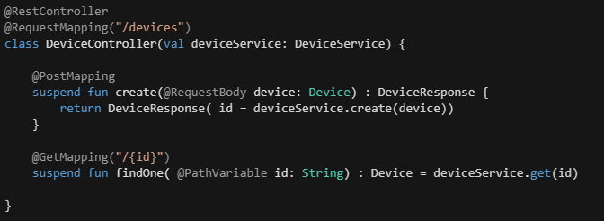
Spring Webfux
Functional Handler
RestController

Slide 32
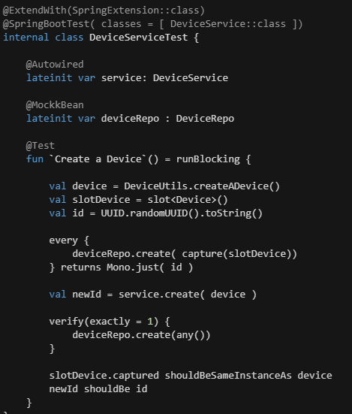
Unit Testing with Spring Mockk
Why SpringMockk
Mockito does not support Coroutine
@MockBean annotation uses Mockito
@MockkBean support Spring and Coroutines

Slide 33
R2DBC
Fully-reactive non-blocking API
Works with relational databases
R2DBC
https://r2dbc.io/
\a

