Slide 1
Working with Java
Java Core, UT and Practices

Slide 2
Outline
Getting Started with Java
OOP
Class and Objects
Abstract class and Interface
Build a Java Project
Maven Introduction
Working with Maven
Unit Testing
Chess - the mini project
Practices
The Developer Work
JUnit and Mockito

Slide 3
Getting Started with Java
Object Oriented Programming

Slide 4
Working with Java
Object Oriented Programming
Class and Objects
Abstract Class
Interface

Slide 5
Object Oriented Programming
Object-oriented programming (OOP) is a programming language model:
objects rather than actions
Object relationship rather than logic.
In Structured Programming
How many steps to resolve the task?
What exactly does each step do?
OOP
Determine Objects on the system
Relationship among Objects
Life-cycle of Objects
What does the object do and how does it live?

Slide 6


Class and Objects
Class is the type of Objects
And Object is an instance of the Class
Human is a Class
Cristiano Ronaldo is an instance of Human

Slide 7
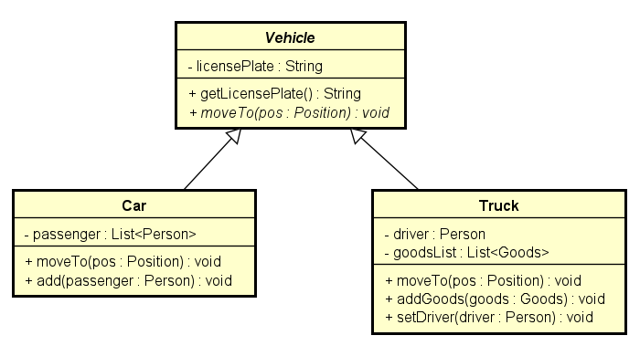
Abstract Class
Vehicle is the machine to transport people or goods
Abstract class is not completely defined
Abstract Class defines the Characteristic of a Family of Class
It leaves Sub-Classes fulfill the definition
moveTo is declared here, but not defined yet
Car is a Vehicle to transport People
Car is a Vehicle to transport Goods

Slide 8
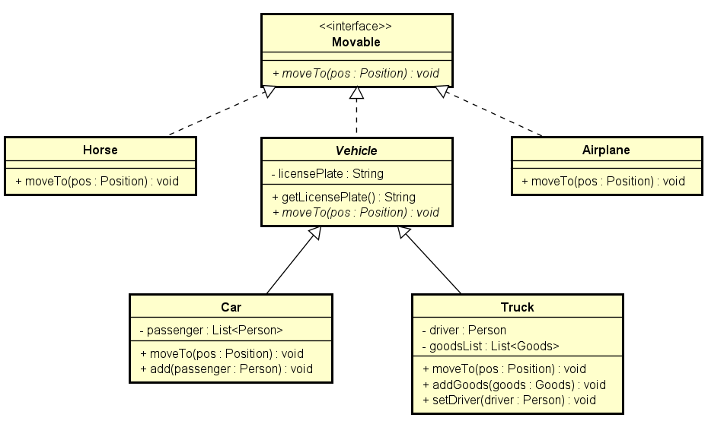
Interface
Interface is the simplest declaration for Client
It is the entry to allow Client access to the System
Interface defines what Component could do, not implement it

Slide 9
Build a Java Project
With Maven

Slide 10
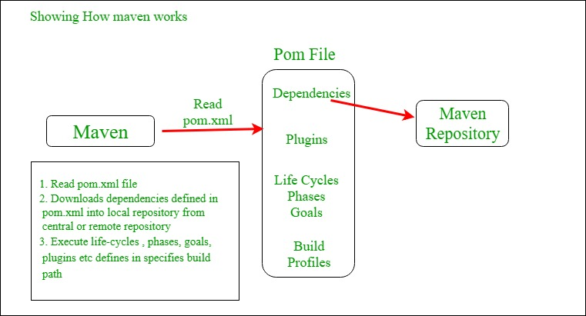
Maven Introduction
What is Maven?
Tool to build Java Project base on pom.xml file
Dependency Management
Dependency Center Repository
With millions Java JAR libraries

Slide 11
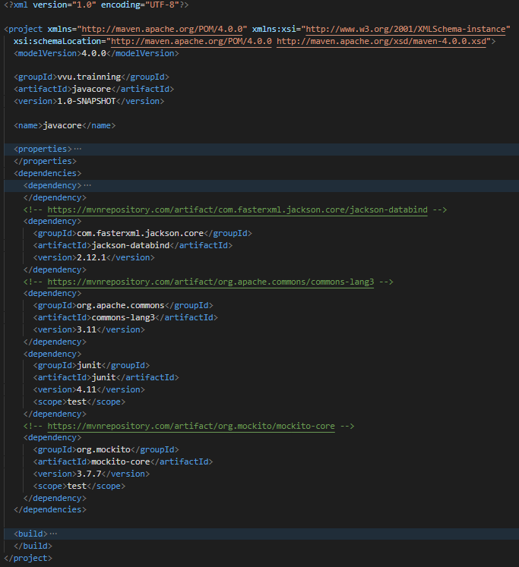
Working with Maven
Example of pom.xml file
Create Project
mvn archetype:generate -DgroupId=vvu.trainning -DartifactId=javacore -DarchetypeArtifactId=maven-archetype-quickstart -DarchetypeVersion=1.4 -DinteractiveMode=false
Build Project
mvn package
Execute Test
mvn -Dtest=vvu.trainning.practice2.notification.NotificationCenterTest#testNotificationCenter_invalidNotifier_NullPointerException test

Slide 12
Unit Testing
Junit and Mockito

Slide 13
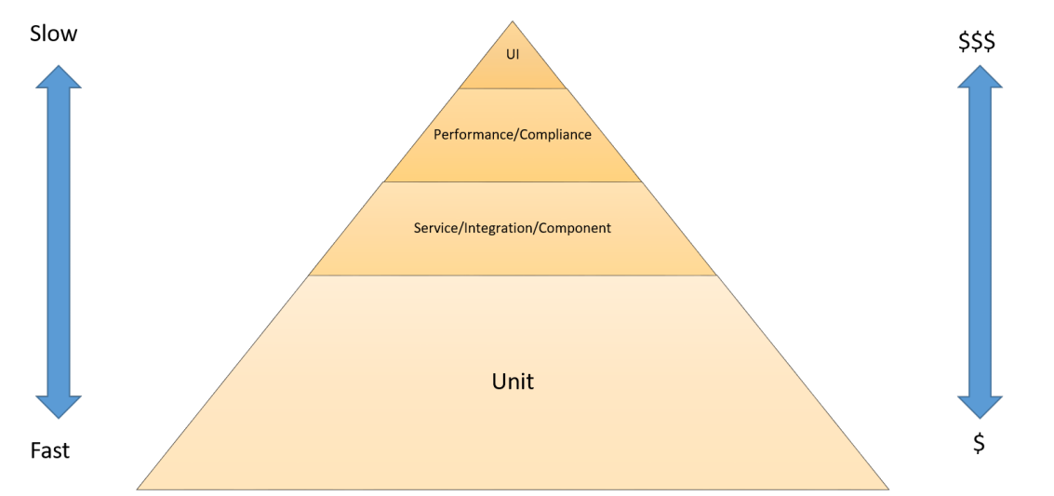
Unit Testing: The Developer Work
Unit Testing: for testing every unit of code
Need to write during coding time
Purpose:
The chance to allow developer review his own code
Developer tests his code himself
Support Automation Testing on CICD: Fastest to run and Least Expensive
Unit tests are on the bottom of the pyramid. They are both the fastest to run and the least expensive.
Therefore, unit tests should make up the bulk of your testing strategy. A good rule of thumb is about 70
percent. Unit tests should have near-complete code coverage because bugs caught in this phase can be
fixed quickly and cheaply

Slide 14
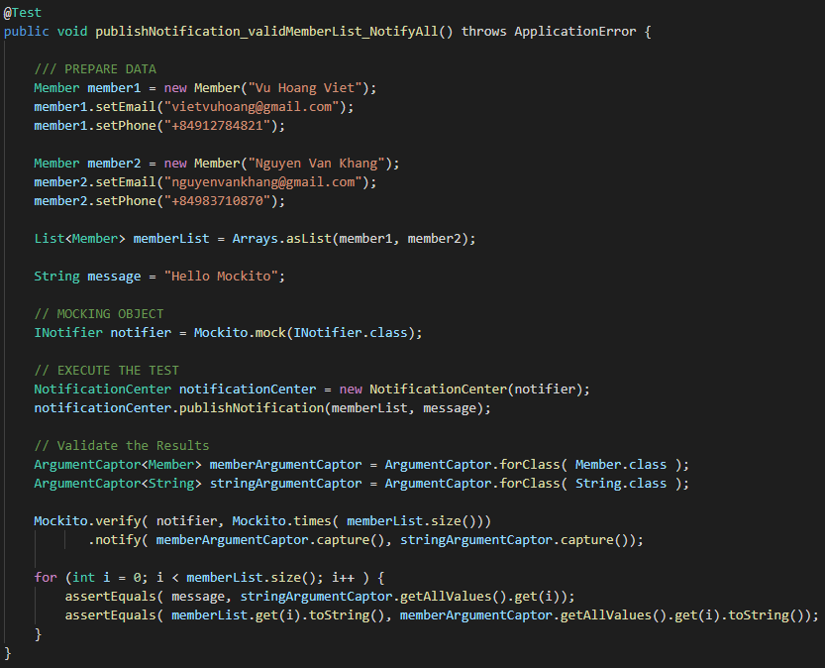
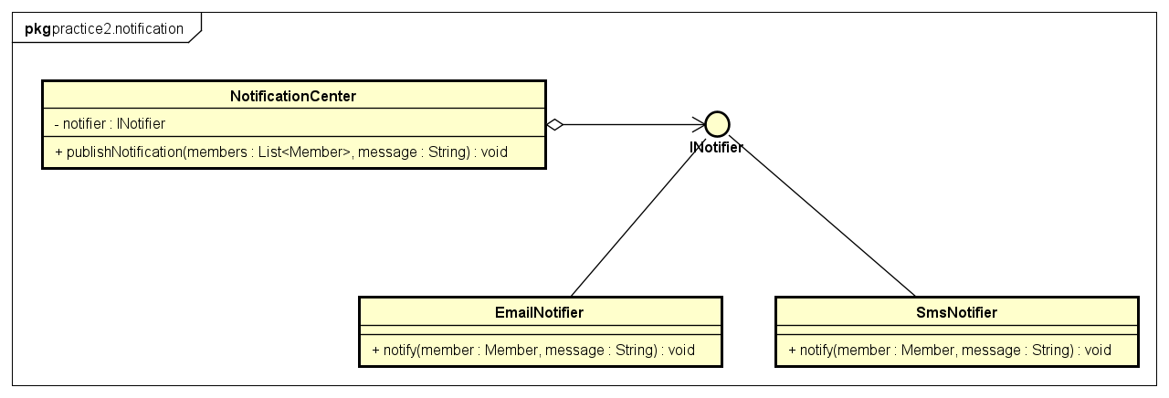
JUnit and Mockito
Java Unit Test Framework: Junit
Mockito: Mocking, Stubbing objects for UT
Example of System Under Test
Example of Testing with Mock

Slide 15

Practices
Homework

Slide 16

Homework
Write a program to do:
Place a piece of chess to the chess board
Determine what position does it cover?
Show of the result to command line

