Slide 1
Learning Kernels to denoise maps
Vignesh Ganapathi-Subramanian, Or Litany and Prof. Leonidas J. Guibas
Wednesday, February 6, 2019

Slide 2
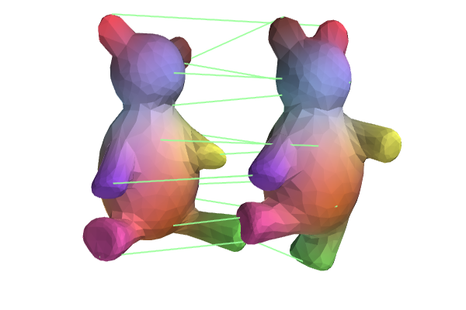
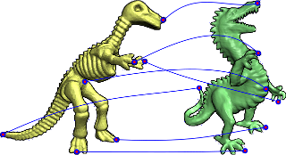
Geometry for Correspondences
Point relationships
Pairwise relationships

Slide 3


Geometry for Correspondences
$$[2.1 3.5 6.2 1.4 0.3]$$
$$[0.2 2.3 3.8 1.5 5.9]$$
Point relationships

Slide 4
Geometry for Correspondences
$$[2.1 3.5 6.2 1.4 0.3]$$
$$[0.2 2.3 3.8 1.5 5.9]$$
Point relationships

Slide 5



Geometry for Correspondences
$$F= [f_{1} f_{2} ⋯ f_{N}]$$
$$GF^{−1}$$
$$G= [g_{1} g_{2} ⋯ g_{N}]$$
Point relationships

Slide 6
Geometry for Correspondences
Point relationships
Pairwise relationships

Slide 7
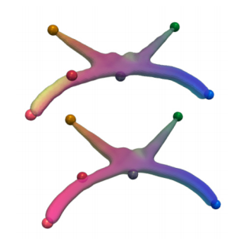
Geometry for Correspondences
Quadratic Assignment
Pairwise relationships

Slide 8
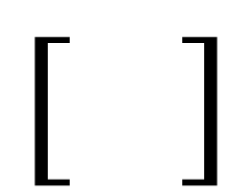
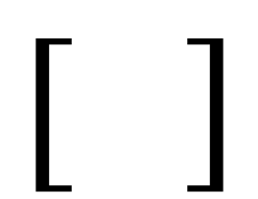
Geometry for Correspondences
$$[ ]$$
$$[ ]$$
Quadratic Assignment
Pairwise relationships

Slide 9
Geometry for Correspondences
$$[ ]$$
$$[ ]$$
Quadratic Assignment
Pairwise relationships

Slide 10


Geometry for Correspondences
Symmetric matrices $D_{X},D_{Y}:N×N$ size
$$\text{argmi}{\text{n}}_{Π}{\left|ΠD_{X}−D_{Y}Π\right|}^{2}$$
Pairwise descriptor matching
Pairwise relationships

Slide 11
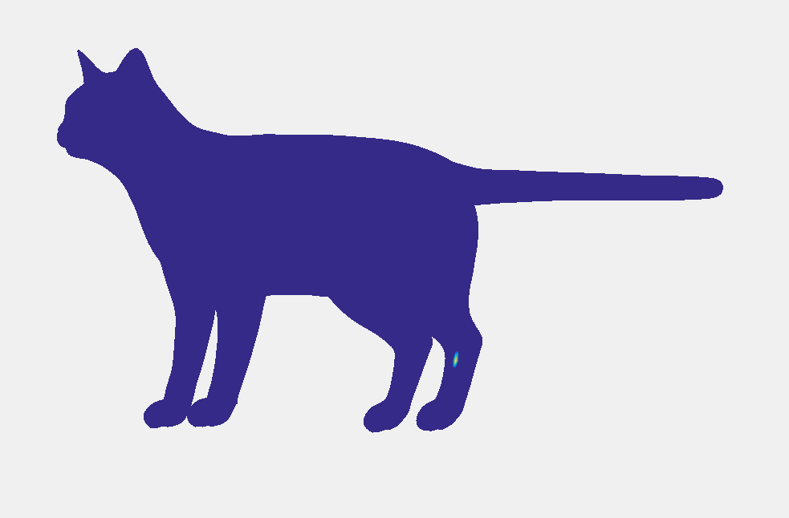
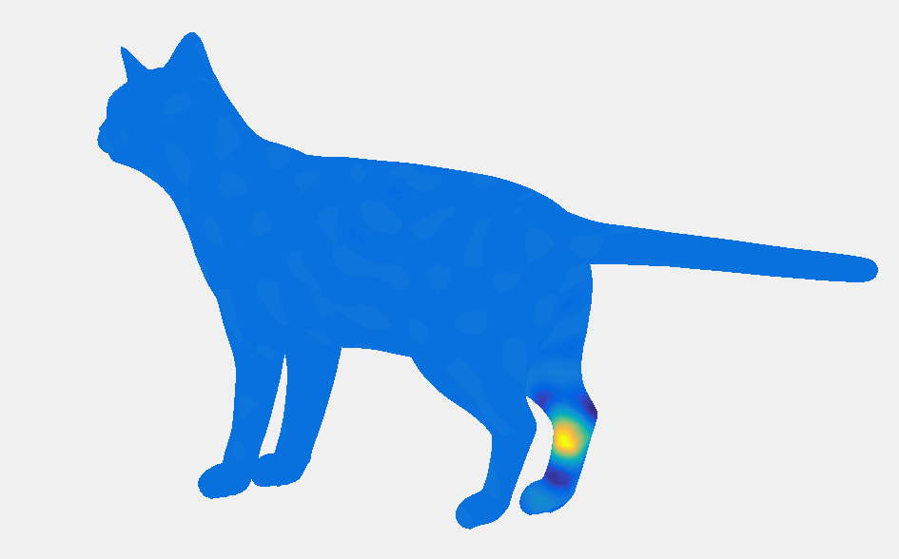

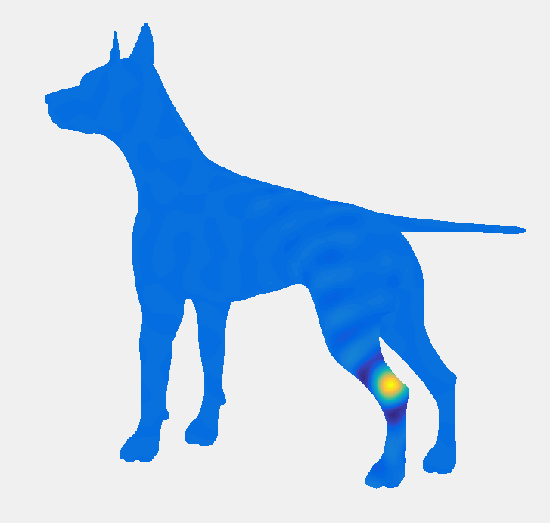




Alternating Diffusion
$$D_{X}$$
$$Π$$
$$Π$$
$$D_{Y}$$

Slide 12
Alternating Diffusion
$$D_{X}$$
$$Π$$
$$Π$$
$$D_{Y}$$
$${argmin}_{Π} {\left|ΠD_{X}−D_{Y}Π\right|}^{2}={argmax}_{Π}⟨Π, D_{Y}ΠD_{X}⟩$$

Slide 13
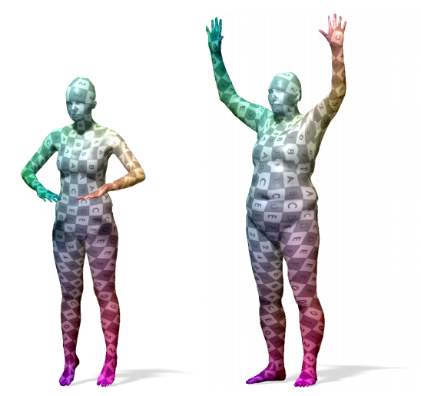
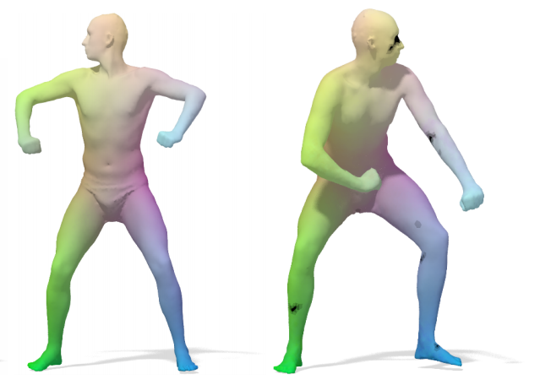

Kernel Matching for Correspondences
Vestner et al., Efficient Deformable Shape Correspondences via Kernel Matching, 2017
$${argmax}_{Π} α\left\langle Π,F_{Y}F_{X}^{T}\right\rangle +⟨Π, D_{Y}ΠD_{X}⟩$$

Slide 14

Kernel Matching for Correspondences
Vestner et al., Efficient Deformable Shape Correspondences via Kernel Matching, 2017
Heat Kernel: $Δ_{X}Φ\left(t\right)=−\frac{dΦ(t)}{dt}$

Slide 15


Kernel Matching for Correspondences
Vestner et al., Efficient Deformable Shape Correspondences via Kernel Matching, 2017
Heat Kernel: $Δ_{X}Φ\left(t\right)=−\frac{dΦ(t)}{dt}$
$$Φ\left(t\right)=e^{−Δ_{X}t}Φ(0)$$
Heat Kernel: ${K_{X}\left(t\right)=e}^{−Δ_{X}t}$

Slide 16

Kernel Matching for Correspondences
Vestner et al., Efficient Deformable Shape Correspondences via Kernel Matching, 2017
Heat Kernel: $Δ_{X}Φ\left(t\right)=−\frac{dΦ(t)}{dt}$
$$Φ\left(t\right)=e^{−Δ_{X}t}Φ(0)$$
Heat Kernel: ${K_{X}\left(t\right)=e}^{−Δ_{X}t}$
For $Δ_{X}=Ψ_{X}Λ_{X}Ψ_{X}^{T}$, $K_{X}(t)=e^{−Δ_{X}t}=Ψ_{X}e^{−Λ_{X}t}Ψ_{X}^{T}$

Slide 17
Kernel Matching for Correspondences
Vestner et al., Efficient Deformable Shape Correspondences via Kernel Matching, 2017
Heat Kernel: $Δ_{X}Φ\left(t\right)=−\frac{dΦ(t)}{dt}$
$$Φ\left(t\right)=e^{−Δ_{X}t}Φ(0)$$
Heat Kernel: ${K_{X}\left(t\right)=e}^{−Δ_{X}t}$
For $Δ_{X}=Ψ_{X}Λ_{X}Ψ_{X}^{T}$, $K_{X}(t)=e^{−Δ_{X}t}=Ψ_{X}e^{−Λ_{X}t}Ψ_{X}^{T}$
$$K_{Y}\left(t\right)ΠK_{X}\left(t\right)=Ψ_{Y}e^{−Λ_{Y}t}Ψ_{Y}^{T}ΠΨ_{X}e^{−Λ_{X}t}Ψ_{X}^{T}$$

Slide 18

Kernel Matching for Correspondences
Vestner et al., Efficient Deformable Shape Correspondences via Kernel Matching, 2017
Heat Kernel: $Δ_{X}Φ\left(t\right)=−\frac{dΦ(t)}{dt}$
$$Φ\left(t\right)=e^{−Δ_{X}t}Φ(0)$$
Heat Kernel: ${K_{X}\left(t\right)=e}^{−Δ_{X}t}$
For $Δ_{X}=Ψ_{X}Λ_{X}Ψ_{X}^{T}$, $K_{X}(t)=e^{−Δ_{X}t}=Ψ_{X}e^{−Λ_{X}t}Ψ_{X}^{T}$
$$K_{Y}\left(t\right)ΠK_{X}\left(t\right)=Ψ_{Y}e^{−Λ_{Y}t}Ψ_{Y}^{T}ΠΨ_{X}e^{−Λ_{X}t}Ψ_{X}^{T}$$
$$C_{XY}$$

Slide 19
Kernel Matching for Correspondences
Vestner et al., Efficient Deformable Shape Correspondences via Kernel Matching, 2017
Heat Kernel: $Δ_{X}Φ\left(t\right)=−\frac{dΦ(t)}{dt}$
$$Φ\left(t\right)=e^{−Δ_{X}t}Φ(0)$$
Heat Kernel: ${K_{X}\left(t\right)=e}^{−Δ_{X}t}$
For $Δ_{X}=Ψ_{X}Λ_{X}Ψ_{X}^{T}$, $K_{X}(t)=e^{−Δ_{X}t}=Ψ_{X}e^{−Λ_{X}t}Ψ_{X}^{T}$
$$K_{Y}\left(t\right)ΠK_{X}\left(t\right)=Ψ_{Y}e^{−Λ_{Y}t}C_{XY}e^{−Λ_{X}t}Ψ_{X}^{T}$$
$${argmax}_{Π}\left\langle Π, D_{Y}ΠD_{X}\right\rangle ={argmax}_{C_{XY}}⟨C_{XY}, e^{−Λ_{Y}t}C_{XY}e^{−Λ_{X}t}⟩$$

Slide 20
Kernel Matching for Correspondences
Vestner et al., Efficient Deformable Shape Correspondences via Kernel Matching, 2017
Heat Kernel: $Δ_{X}Φ\left(t\right)=−\frac{dΦ(t)}{dt}$
$$Φ\left(t\right)=e^{−Δ_{X}t}Φ(0)$$
Heat Kernel: ${K_{X}\left(t\right)=e}^{−Δ_{X}t}$
For $Δ_{X}=Ψ_{X}Λ_{X}Ψ_{X}^{T}$, $K_{X}(t)=e^{−Δ_{X}t}=Ψ_{X}e^{−Λ_{X}t}Ψ_{X}^{T}$
$$K_{Y}\left(t\right)ΠK_{X}\left(t\right)=Ψ_{Y}e^{−Λ_{Y}t}C_{XY}e^{−Λ_{X}t}Ψ_{X}^{T}$$
$${argmax}_{Π}\left\langle Π, D_{Y}ΠD_{X}\right\rangle ={argmax}_{C_{XY}}⟨C_{XY}, e^{−Λ_{Y}t}C_{XY}e^{−Λ_{X}t}⟩$$

Slide 21

Denoising maps using kernels
Attempt denoising of noisy input matching $Π_{in}$
$${argmax}_{Π}\left\langle Π, D_{Y}Π^{k}D_{X}\right\rangle ={argmax}_{C_{XY}}⟨C_{XY}, e^{−Λ_{Y}t}C_{XY}^{k}e^{−Λ_{X}t}⟩$$
iterative process

Slide 22
Denoising maps using kernels
Attempt denoising of noisy input matching $Π_{in}$
$${argmax}_{Π}\left\langle Π, D_{Y}Π_{in}D_{X}\right\rangle ={argmax}_{C_{XY}}⟨C_{XY}, e^{−Λ_{Y}t}C_{XY,in}e^{−Λ_{X}t}⟩$$
denoising process

Slide 23

Denoising maps using kernels
Attempt denoising of noisy input matching $Π_{in}$
$${argmax}_{Π}\left\langle Π, D_{Y}Π_{in}D_{X}\right\rangle ={argmax}_{C_{XY}}⟨C_{XY}, e^{−Λ_{Y}t}C_{XY,in}e^{−Λ_{X}t}⟩$$
denoising process
function of $t$, so one can learn optimal $t$

Slide 24

Denoising maps using kernels
Attempt denoising of noisy input matching $Π_{in}$
${argmax}_{Π}\left\langle Π, D_{Y}Π_{in}D_{X}\right\rangle$ for other kernels?
denoising process

Slide 25
Denoising maps using kernels
Attempt denoising of noisy input matching $Π_{in}$
${argmax}_{Π}\left\langle Π, D_{Y}Π_{in}D_{X}\right\rangle$ for other kernels?
denoising process
${argmax}_{Π}\left\langle Π, D_{Y}Π_{in}D_{X}\right\rangle ={argmax}_{Π}\left\langle Π,Ψ_{Y}f_{θ}\left(Λ_{Y}\right)C_{XY,in}f_{θ}\left(Λ_{X}\right)Ψ_{X}^{T} \right\rangle$ for polynomial $f_{θ}$

Slide 26

Denoising maps using kernels
Attempt denoising of noisy input matching $Π_{in}$
${argmax}_{Π}\left\langle Π, D_{Y}Π_{in}D_{X}\right\rangle$ for other kernels?
denoising process
${argmax}_{Π}\left\langle Π, D_{Y}Π_{in}D_{X}\right\rangle ={argmax}_{Π}\left\langle Π,Ψ_{Y}f_{θ}\left(Λ_{Y}\right)C_{XY,in}f_{θ}\left(Λ_{X}\right)Ψ_{X}^{T} \right\rangle$ for polynomial $f_{θ}$
Can approximate even the heat kernel since
$$e^{−Λt}≈1−Λt+\frac{Λ^{2}}{2}t^{2}−\frac{Λ^{3}}{6}t^{3}+\frac{Λ^{4}}{24}t^{4}−\frac{Λ^{5}}{120}t^{5}$$

Slide 27



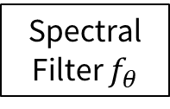




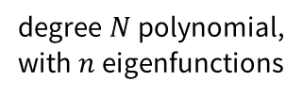





Learning Setup
Attempt denoising of noisy input matching $Π_{in}$
${argmax}_{Π}\left\langle Π, D_{Y}Π_{in}D_{X}\right\rangle$ for other kernels?
denoising process
${argmax}_{Π}\left\langle Π, D_{Y}Π_{in}D_{X}\right\rangle ={argmax}_{Π}\left\langle Π,Ψ_{Y}f_{θ}\left(Λ_{Y}\right)C_{XY,in}f_{θ}\left(Λ_{X}\right)Ψ_{X}^{T} \right\rangle$ for polynomial $f_{θ}$
$$I,Λ,Λ^{2},…,Λ^{N−1}$$
$$Λ_{X}$$
Spectral Filter $f_{θ}$
$$f_{θ}(Λ_{X})$$
Linear ${N×d}_{in}×d_{out}$
RELU
$$x_{i}$$
$$x_{mid}$$
$$x_{i+1}$$
$$Λ_{Y}$$
$$f_{θ}(Λ_{Y})$$
$$n×d_{in}$$
degree $N$polynomial,
with $n$eigenfunctions
$$n×d_{out}$$
$$n×d_{out}$$
One block of the spectral filter

