Slide 1
FIT5147: Data visualization project
5 sheet design methodology
Vignesh Ganesan
30805406

Slide 2
Introduction
Application of the 5SD methodology for the DVP.
Dataset is multi-variate and mix of different types of data.
Primary focus on presenting the distinction between the winners and other teams.

Slide 3
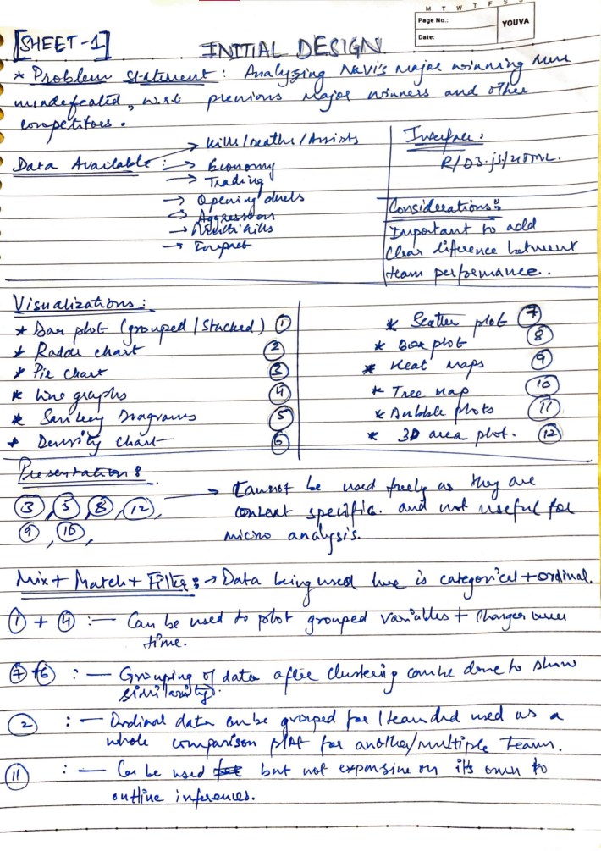

Slide 4
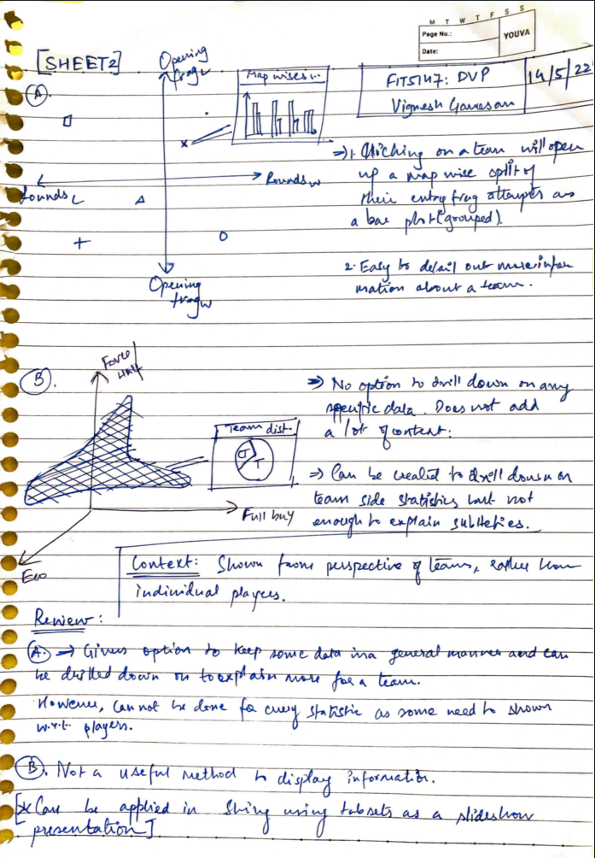

Slide 5
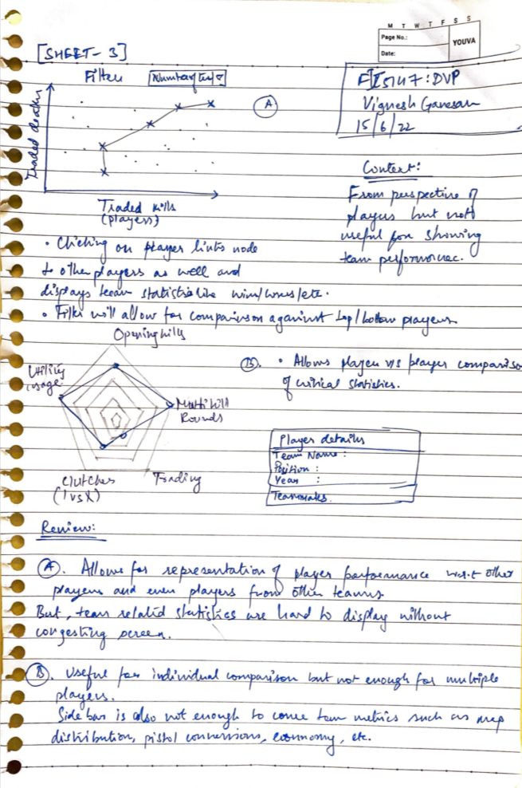

Slide 6
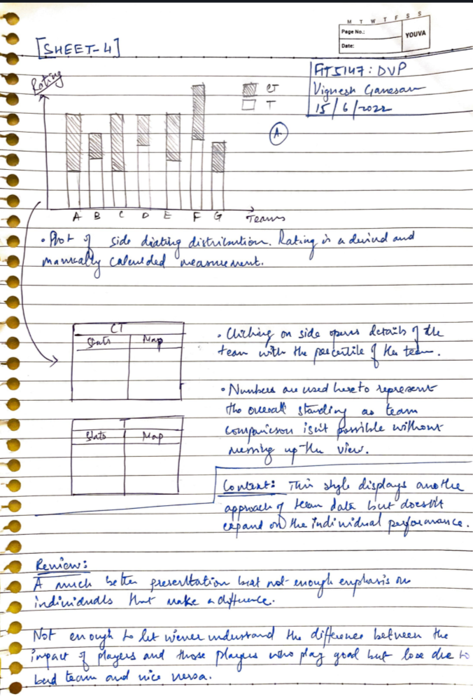

Slide 7
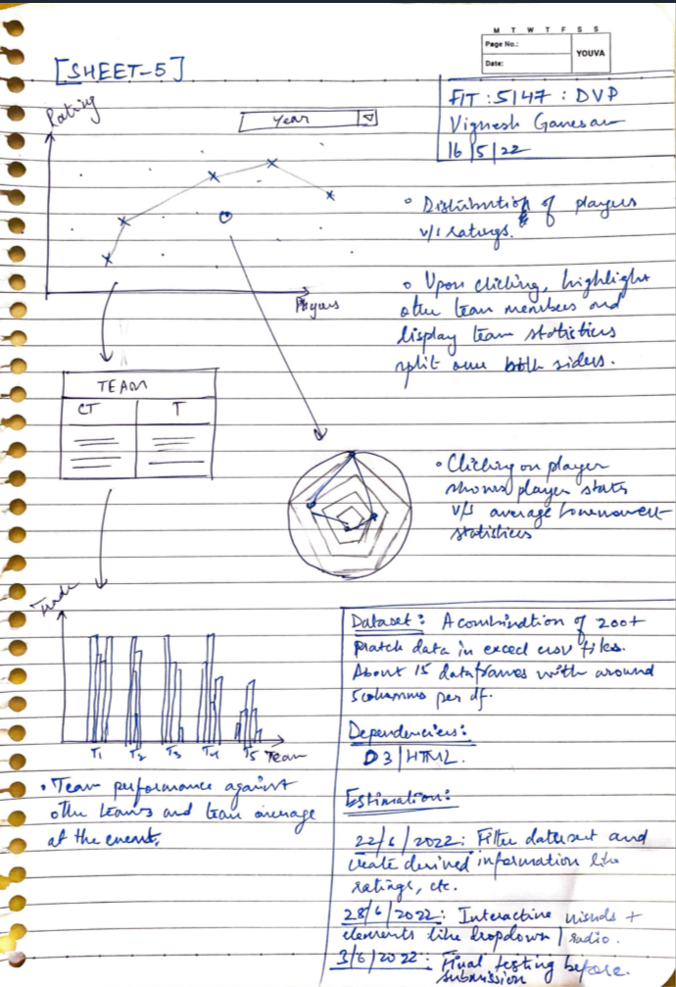

Slide 8
END

