Slide 1
Krafthack 2022
Runner bolts tensional load prediction
Team: Sopra Steria Team 2

Slide 2
Initial Thoughts
Started thinking about data augmentation.
Lack of features in test-dataset.
How to highlight and learn temporal features from dataset.

Slide 3
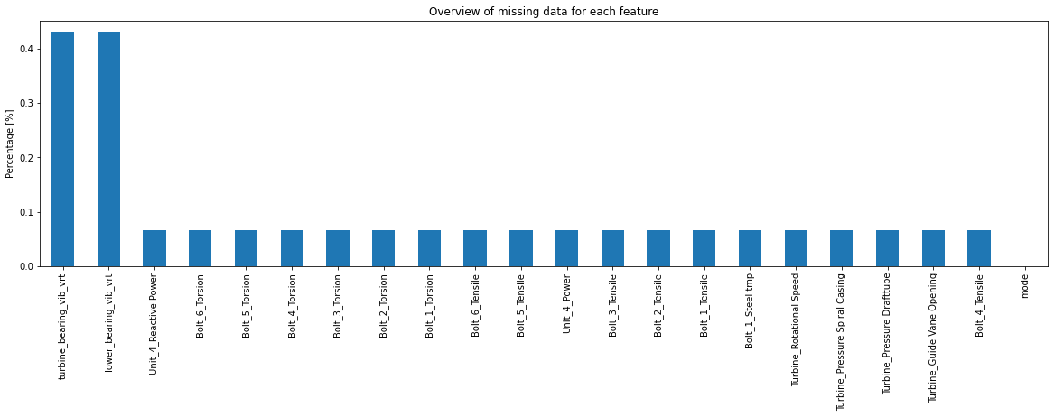
Data processing
Removed all vibration data.
Removed all rows containing nan values.
Translated mode values to 0 and 1’s.
Translated original timestamp to two features.
Day of week and hour of day.
Scaling training and test data, zero mean and 1 std.
Scikit Learn Standardcaler fitted to training data.

Slide 4
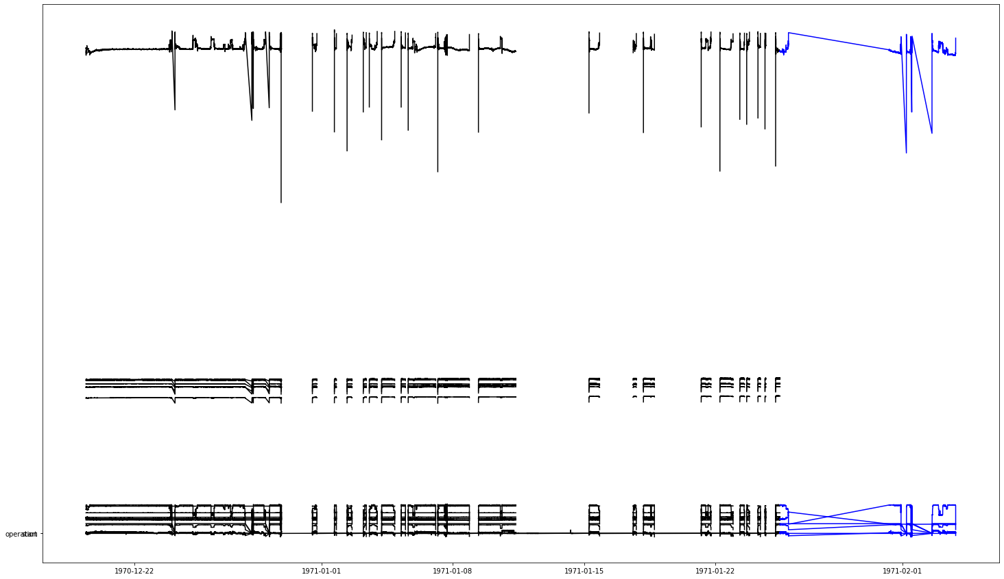
Feature engineering
Augment dataset with data calculable from test-dataset.
Added feature representing current operation duration in seconds.
Bolt tensile tention could potensially rise or decline after turbine startup.
Sliding window feature addition.
Adding previous output as a feature for the next prediction.

Slide 5
Training and validation split
Training dataset split into training and validation data.
70% training data, 30% validation data.
Training and validation data not split randomly.

Slide 6
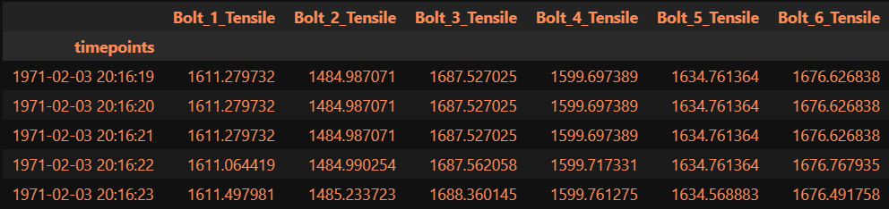
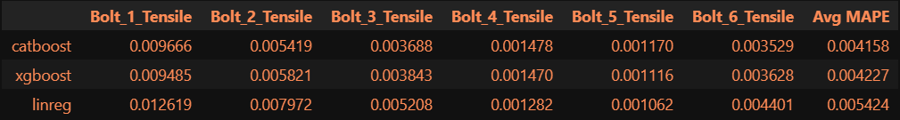
Models and results
Linear Regression, all default values (SkLearn)
XGBoost, XGBRegressor (booster=gbtree, learning_rate=0.2, gamma=0.1, max_depth=6, eval_metric=‘mae’)
Catboost, CatBoostRegressor (iterations=400)

Slide 7
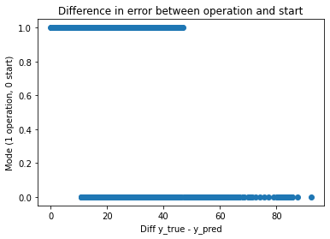
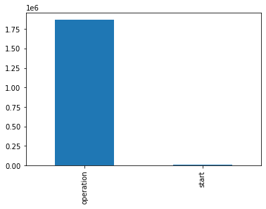
Linear Regression
Simple baseline model
Drawback:
Highly correlated data from data preprocessing
Might lead to overfitting

Slide 8
Results

Slide 9
Discussion
Suggestion for future hackathon:
Use anomaly detection to find optimal guide vane opening for a single turbine/generator regarding tension and torsion in the bolts.
This might expose guide vane value ranges causing higher stress.
Optimize the guide vane openings of all turbines to run at a non-harmful guide vane value, while providing the required reactive power.

