Slide 1
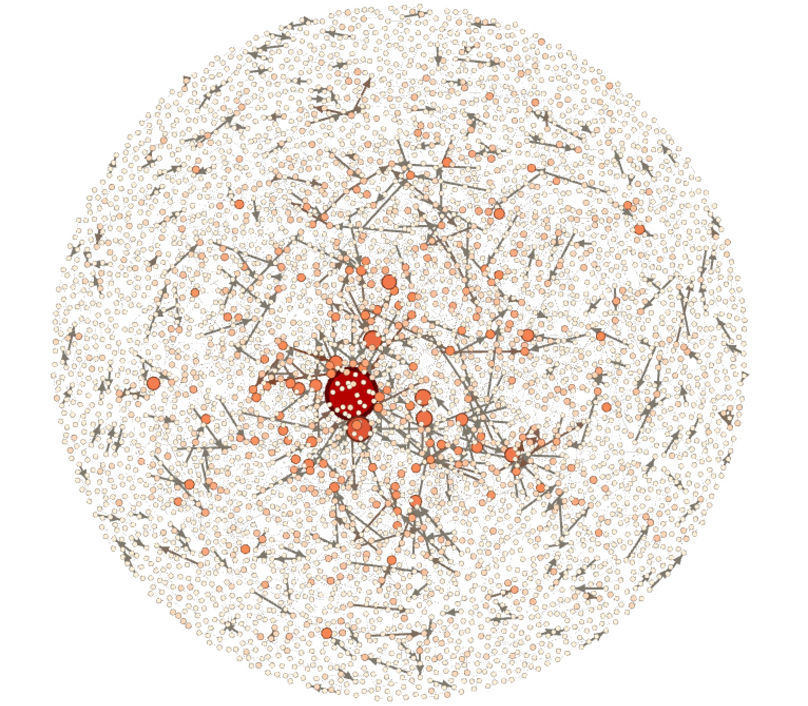
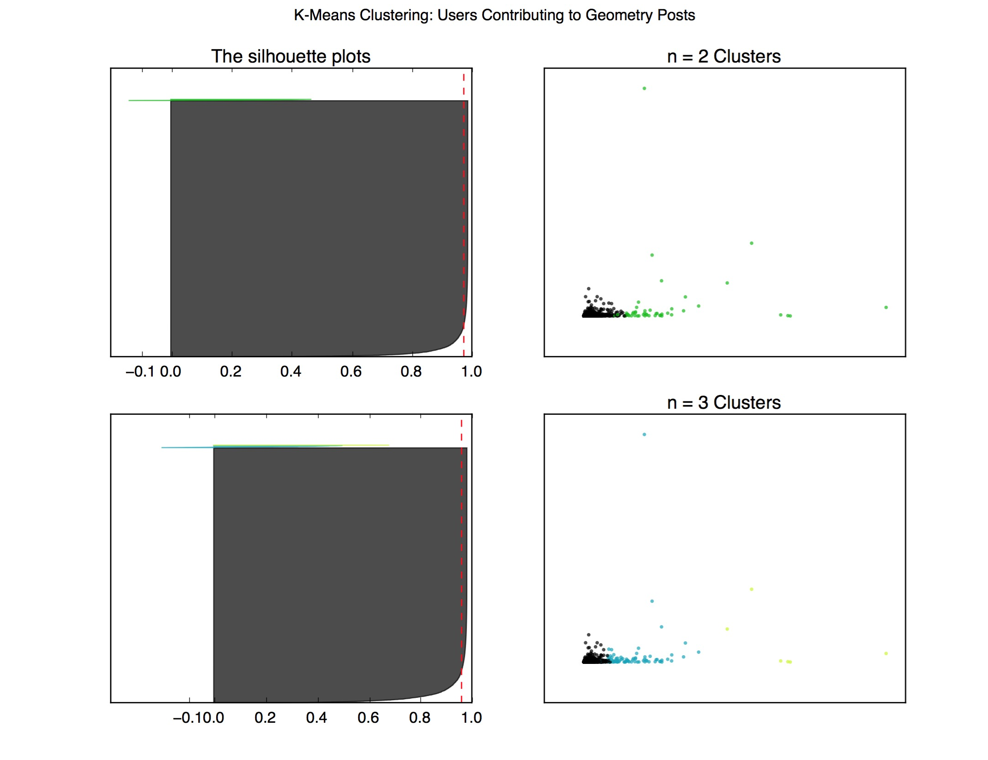
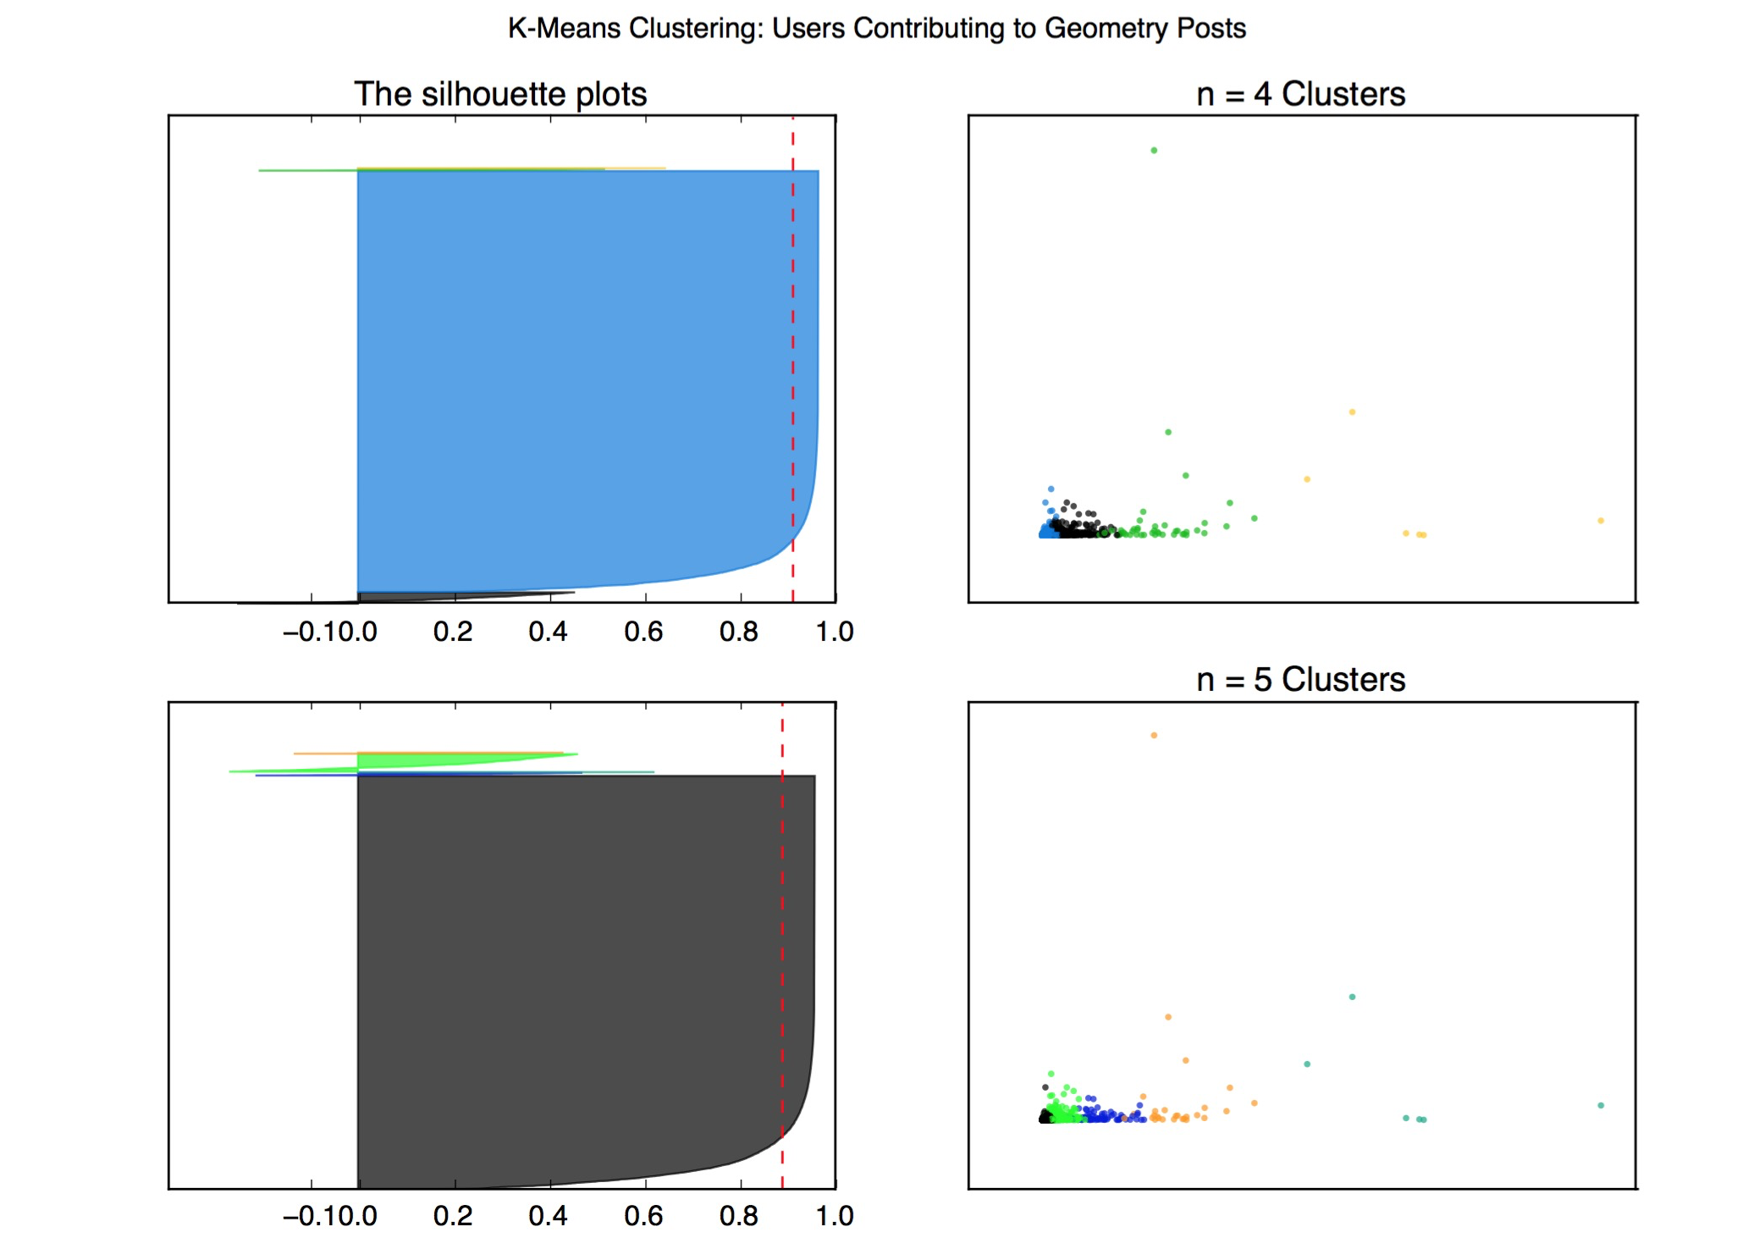
Expertise & Network Properties in StackExchange Sites
Dan Guo (dguo1113), Vani Khosla (vkhosla), Vignesh Venkataraman (viggy)
1. Introduction
We aim to Identify, understand, and designate experts and expertise within StackExchange and StackOverflow data. Because the various subdomains of StackExchange cover a wide range of material, experts can be analyzed both globally and over several different subsets of the data in order to see if there are general patterns or trends that can be extracted. Better defining who experts are and what it means to be an expert, especially in a particularly granular field, would allow knowledge to be managed and distributed more judiciously throughout the community. Rating the reputation of users through the use of network properties would create a credibility system that supersedes the StackExchange sites’ generic user-specific reputation scores.
2. Datasets
The math subdomain of StackExchange, which has 560K Badges, 2M Comments, 1M Posts, 200k Users, 4M votes.
Post Graph: A directed graph where nodes are posts and edges are from a post and the post it is responding to.
User Graph: A directed graph where nodes are users and edges are directed from commenter to original poster.
3. Methods & Models & Findings
3.1. Micro-level Structure
experts are and what it means to be an expert, especially in a particularly granular field, would allow knowledge to be managed and distributed more judiciously throughout the community. Rating the reputation of users through the use of network properties would create a credibility system that supersedes the StackExchange sites’ generic user-specific reputation scores.
3.2. Clustering
In order to identify particular network traits to different personas of people in StackOverflow, k-means clustering was done using the following features: views, down votes, up votes, out degree, in degree, closeness centrality, eigenvector centrality, and PageRank centrality. Given the silhouette values of 0.973 for 2 clusters, 0.959 for 3 cluster, 0.911 for 4 clusters, and 0.887 for 5 clusters, the peak clustering number is at 2 clusters.
3.3. Heuristic Approaches to Ranking
Heuristic functions successfully prioritize domain expertise over total StackExchange reputation.
3.4. Supervised Learning
experts are and what it means to be an expert, especially in a particularly granular field, would allow knowledge to be managed and distributed more judiciously throughout the community. Rating the reputation of users through the use of network properties would create a credibility system that supersedes the StackExchange sites’ generic user-specific reputation scores.
 | 1. Reputation | 2. Degree | 3. Degree*Votes | 4.Betweenness | 5.EigenVector | 6.PageRank
1 | Andre’ Nicolas | MvG | Ross Millikan | MvG | MvG | Henning Makholm
2 | Brian M. Scott | Ross Millikan | Andre/ Nicolas | Ross Millikan | Ross Millikan | Andre’ Nicolas
3 | Asaf Karagila | Andre’ Nicolas | amWhy | Blue | Blue | Ross Millikan
4 | Did | Blue | Michael Hardy | Andre’ Nicolas | Christian Blatter | Hagen von Eitzen
5 | Arturo Magidin | Christian Blatter | Ihf | Christian Blatter | Andre’ Nicolas | robkohn
6 | Qiaochu Yuan | Hagen von Eitzen | Robjohn | Mick | Mick | joriki
7 | Robert Isreal | Jack D’Aurizio | Hagen von Eitzen | Hagen von Eitzen | Jack D’Aurizio | Blue
8 | Robjohn | Joriki | Gerry Myerson | Joseph O’Rourke | Hagen von Eitzen | Jack D’Aurisio
9 | Ross Millikan | Mick | Guess who it is. | Bubba | Bubba | MvG
10 | Bill Dubuque | Lab bhattacharjee | Christian Blatter | Jack D/Aurizio | Harasimham | Robert Isreal

