Slide 1
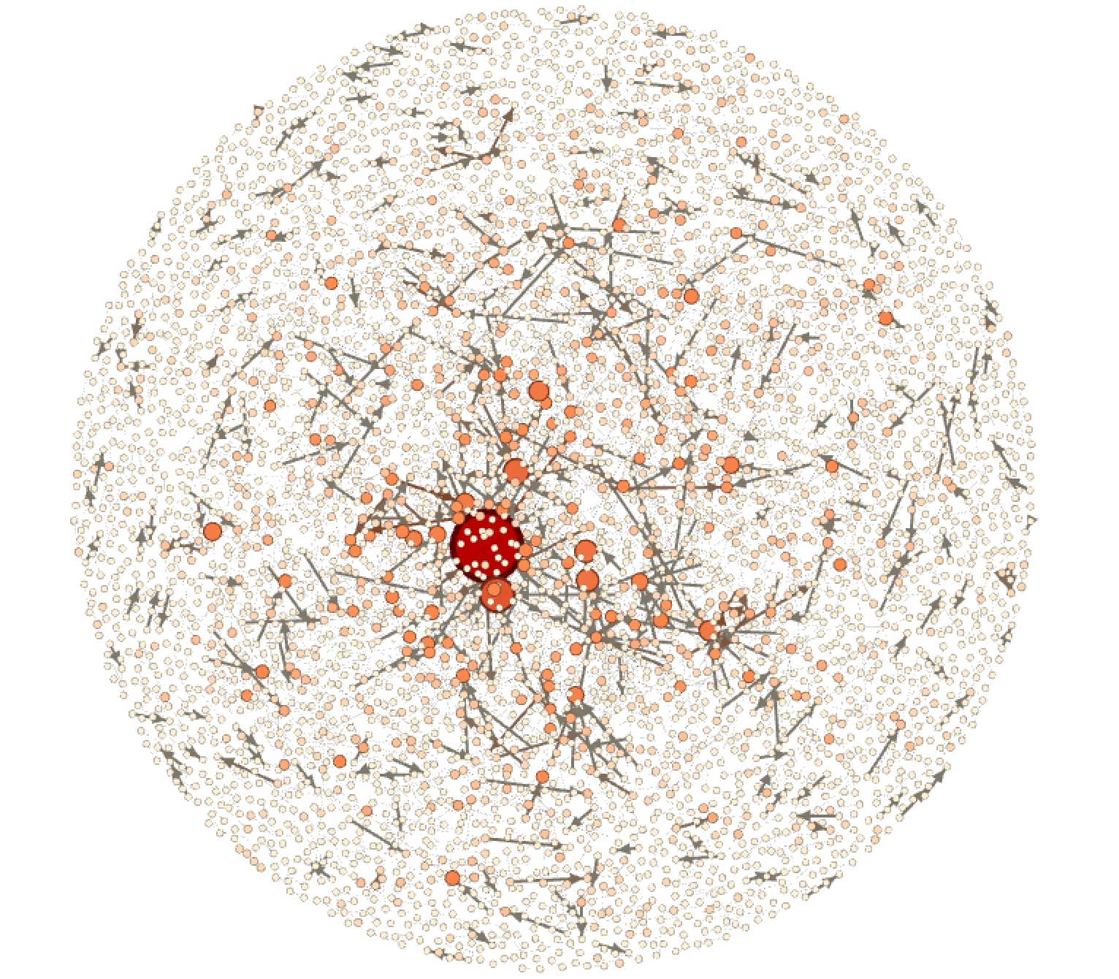
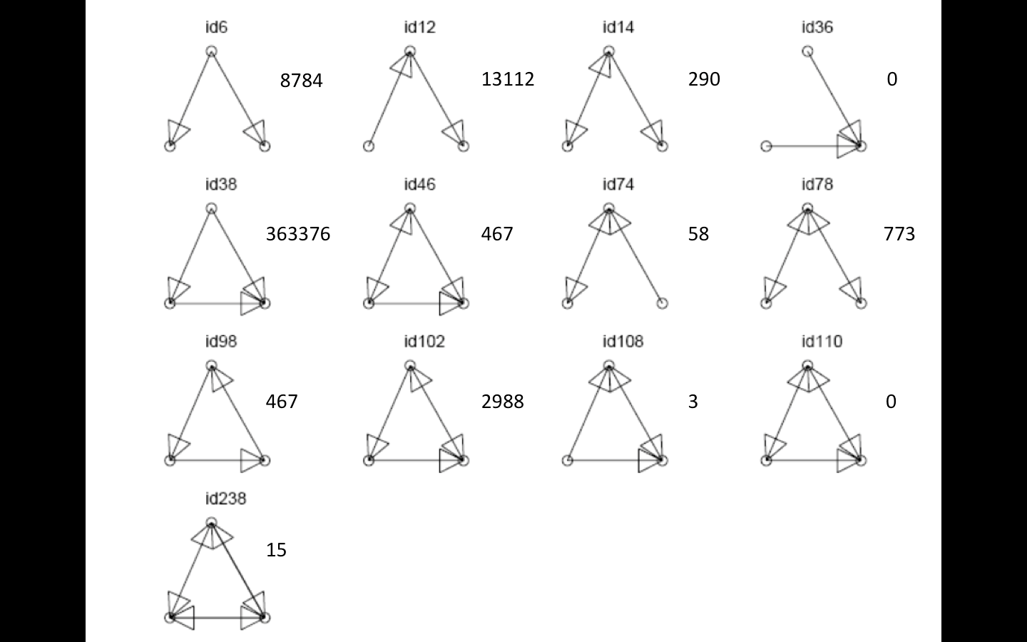
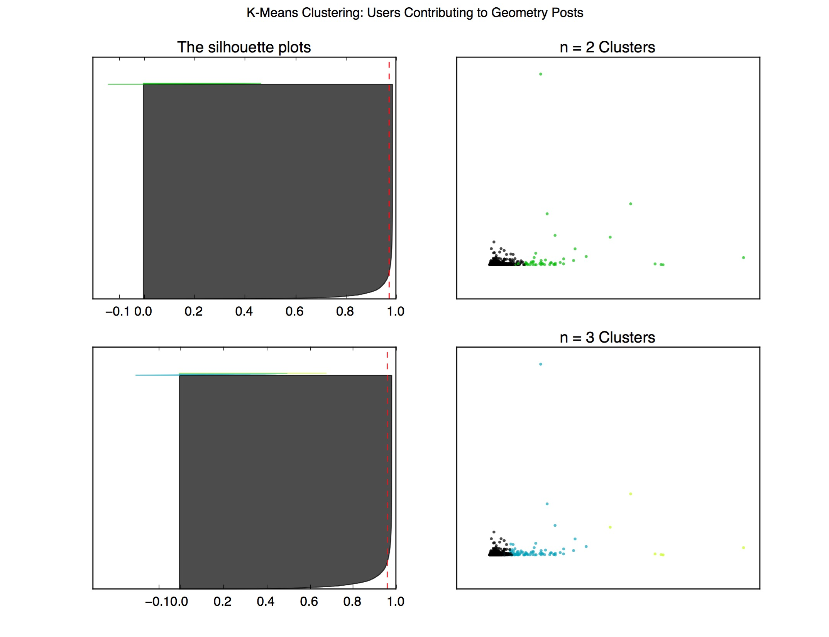
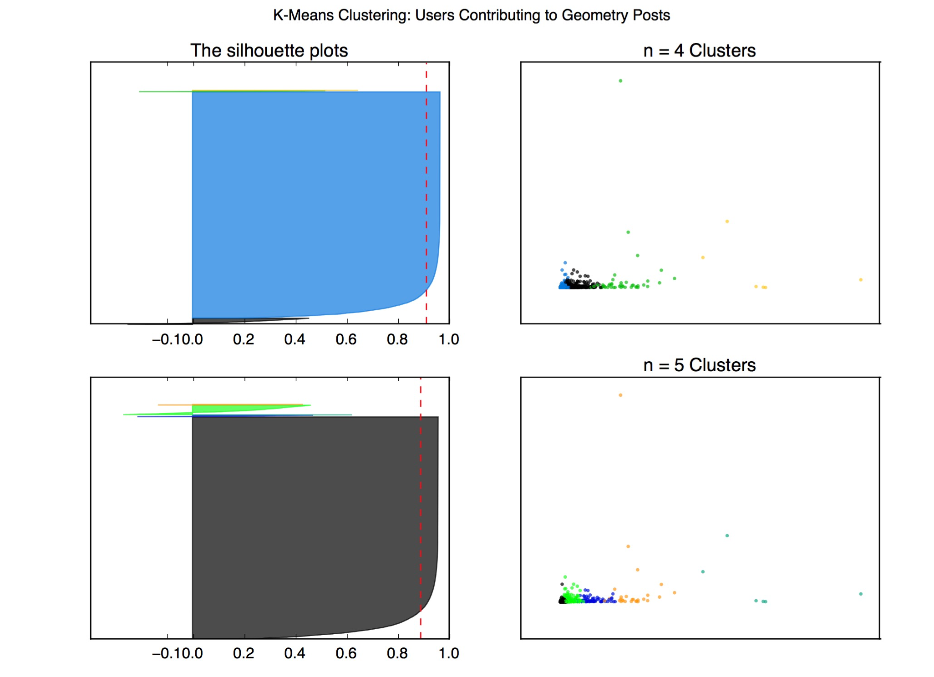
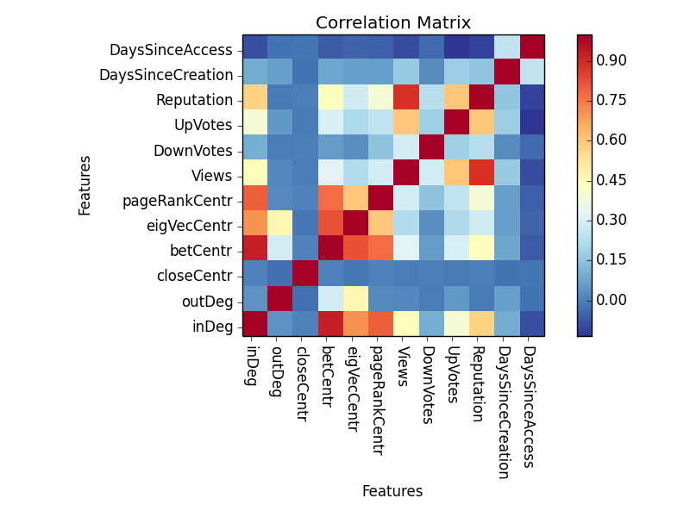
Expertise and Network Properties in StackExchange Sites
Dan Guo (dguo1113), Vani Khosla (vkhosla), Vignesh Venkataraman (viggy)
1. Problem Statement
We aim to identify, understand, and designate experts and expertise within StackExchange. Specifically, our goals:
Better define and identify experts and expertise, particularly in specific domains, such as geometry.
Provide structure for knowledge management within an entire online community.
Create credibility, more granular, scores that supersede StackExchange’s global reputation catch-all.
Prior work in this area include applying network analysis to different question answer forums (Lada), invoking machine learning to predict reputation (Movshovitz), and different perspectives on modeling (Zhang).
2. Datasets
This study looks at the math subdomain of StackExchange, which has 560K Badges, 2M Comments, 1M Posts, 200K Users, and 4M votes. The two main graphs of our study are:
Post Graph: Directed graph where nodes are posts and edges are from response to original post.
User Graph: Directed graph where nodes are users and edges are from commenter to original poster. We use this specific for Geometry tag to focus attention on expertise.
Figure 1. Geometry tagged Post Graph.
3. Methods, Models, Findings
3.1. Micro-level Structure
To gain insight in how users interact in a micro setting, we do a Triad Frequency Analysis. This is performed on the User Graph with Geometry tag. The frequency of all possible Triads are tallied up. Triad id38 is very common and maps usually to a highly reputable user shedding light on to novice users who are discussing.
3.2. Clustering
In order to identify particular network traits to different personas of people, k-means clustering was performed, on the User Graph with Geometry tag, using the following features: views, up/down votes, in/out degree, and closeness/eigenvector/PageRank centrality.
Figure 2. Triads were counted by assign a code each group of linked node sand then mapping those codes to the Triad ids on the left. Note Triad id 38 and id12 occur fairly frequently.
Figure 3. Given the silhouette values of 0.973 for 2 clusters, 0.959 for 3 cluster, 0.911 for 4 clusters, and 0.887 for 5 clusters, the peak clustering number is at 2 clusters.
3.3. Heuristic Approaches to Ranking
A series of increasingly complex heuristic functions successfully prioritize domain expertise over total StackExchange reputation, making these function valid replacements for generic reputation scores.
3.4. Supervised Learning
Ten fold cross validation is our training and testing framework. We minimize RMS error. Ridge Linear Regression performed best in test. Given reputation scores 1-100k+, the regressor performs quite well. We also do correlation analysis to examine the most predictive features.
 | Reputation | Degree | Degree * Votes | Betweenness | Eigenvector | PageRank * Badges
1 | Andre’ Nicolas | MvG | Ross Millikan | MvG | MvG | Henning Makholm
2 | Brian M. Scott | Ross Millikan | Andre/ Nicolas | Ross Millikan | Ross Millikan | Andre’ Nicolas
3 | Asaf Karagila | Andre’ Nicolas | amWhy | Blue | Blue | Ross Millikan
4 | Did | Blue | Michael Hardy | Andre’ Nicolas | Christian Blatter | Hagen von Eitzen
5 | Arturo Magidin | Christian Blatter | Ihf | Christian Blatter | Andre’ Nicolas | robkohn
6 | Qiaochu Yuan | Hagen von Eitzen | Robjohn | Mick | Mick | joriki
7 | Robert Isreal | Jack D’Aurizio | Hagen von Eitzen | Hagen von Eitzen | Jack D’Aurizio | Blue
8 | Robjohn | Joriki | Gerry Myerson | Joseph O’Rourke | Hagen von Eitzen | Jack D’Aurisio
9 | Ross Millikan | Mick | Guess who it is. | Bubba | Bubba | MvG
10 | Bill Dubuque | Lab bhatta… | Christian Blatter | Jack D/Aurizio | Harasimham | Robert Isreal
Figure 4. Correlation matrixamong various network level features, StackExchange constructed features, and the reputation score.
Models | Linear | Ridge Linear | Testing Error
Training Error | 7.20 | 7.21 | 2.25
Testing Error | 8.74 | 8.59 | 9.02
Table 1. These heuristic functions were developed through the User Graph specific to Geometry. This allows us to focus attention on expertise in the Geometry domain. Note these functions had low Spearman Rank correlation to the baseline (0.0545), while they had high Spearman Rank correlation to each other (0.412).
Table 2. Summary of supervised learning models and their respective training and testing set errors, where we train and test with 10k examples through cross validation.
4. Conclusions & Future Work
5. References
Triad Analysis suggests that the question asker usually reads the answer without any further follow up or discussion, evidenced by the most frequent triads having only unidirectional edges.
The results from the k-means clustering indicate that there is a strong contingent of one type of user (the causal question asker/answerer), and a small contingent of the expert users.
Our heuristic analysis shows both feasibility and actual results with regard to the task of predicting and evaluating domain expertise using a data-driven approach that draws from the question-answer graph model.
Supervised learning demonstrates a low correlation between reputation and number of questions asked, but a positive correlation between reputation and number of questions answered, suggesting a “just better” model of people answering questions of those just slightly less informed.
[1] D. Movshovitz-Attias, Y. Movshovitz-Attias, P. Steenkiste, and C. Faloutsos. “Analysis of the Reputation System and User Contributions on a Question Answering Website: StackOverflow.” ASONAM, 2013, pp. 886–893.
[2] Jun Zhang, Mark S. Ackerman, Lada Adamic. “Expertise Networks in Online Communities: Structure and Algorithms.” 16th International Conference on World Wide Web, May 08-12, 2007, Banff, Alberta, Canada.
[3] Lada Adamic, Jun Zhang, Eytan Bakshy, Mark S. Ackerman. “Knowledge Sharing and Yahoo Answers: Everyone Knows Something.” 17th International Conference on World Wide Web, April 21-25, 2008, Beijing, China.
[4] StackExchange Data Dump (Published August 18, 2015). Retrieved 12 October 2015. https://archive.org/details/stackexchange.

