Slide 1
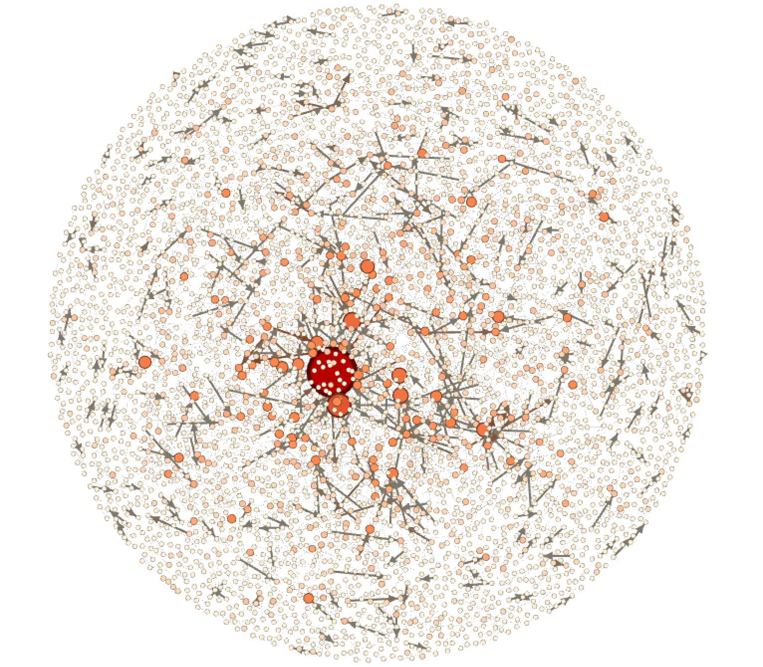
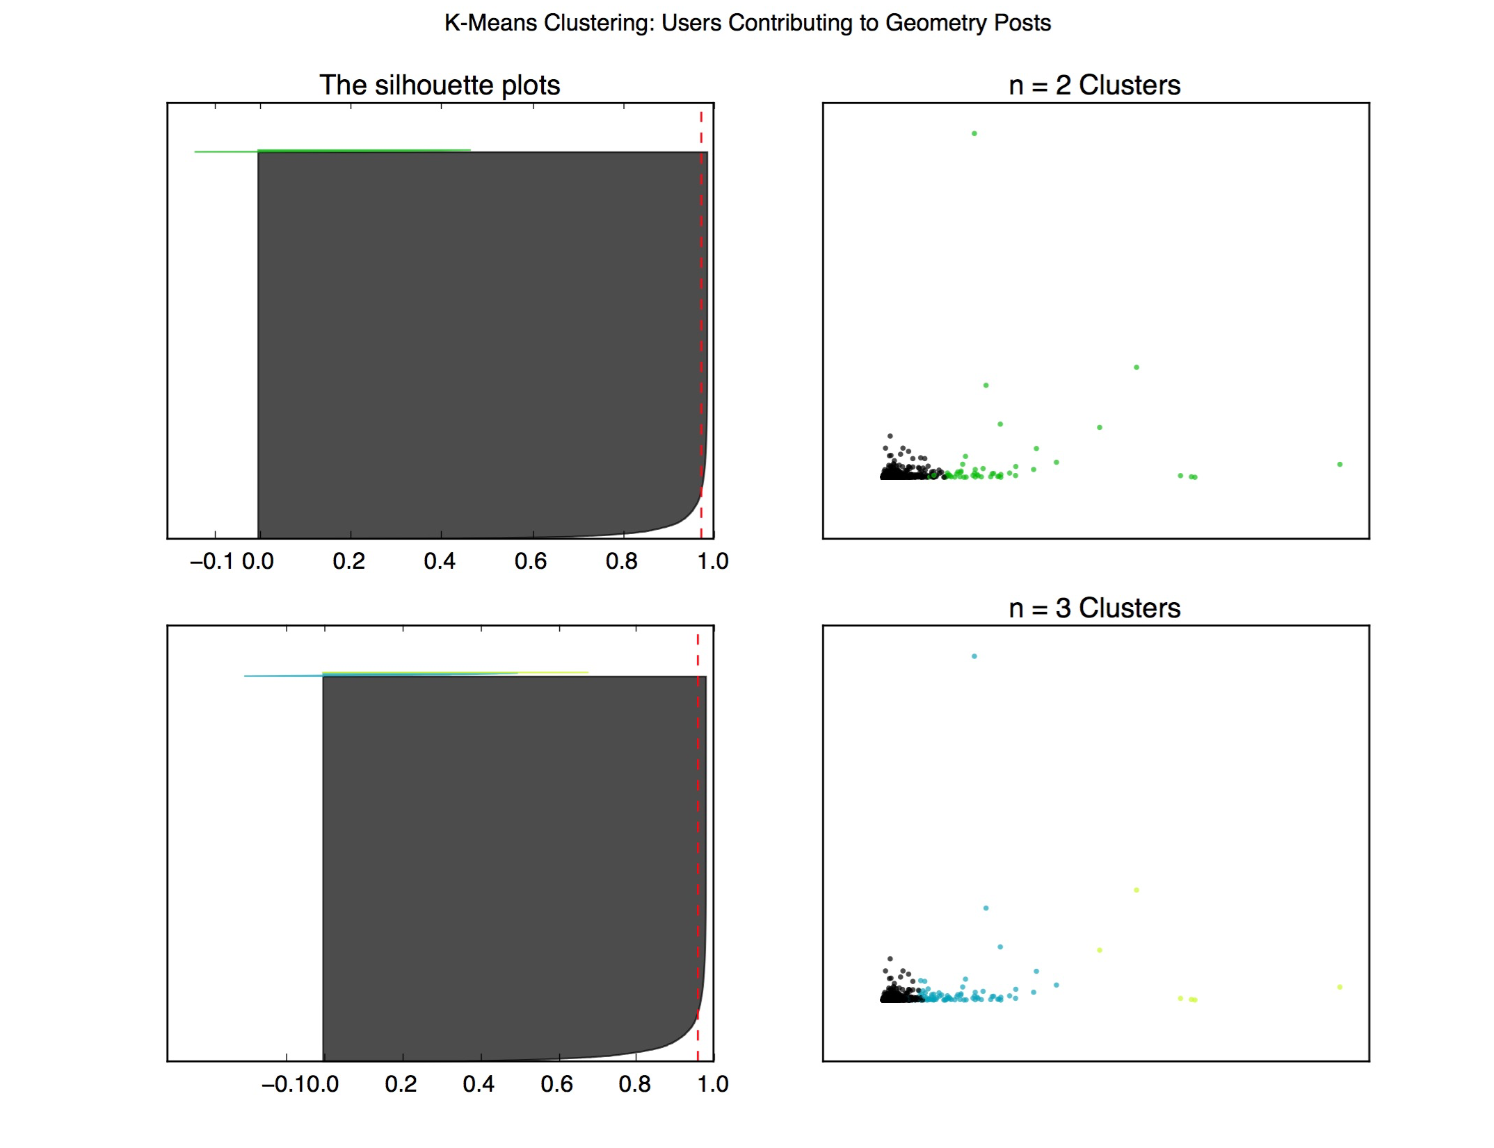
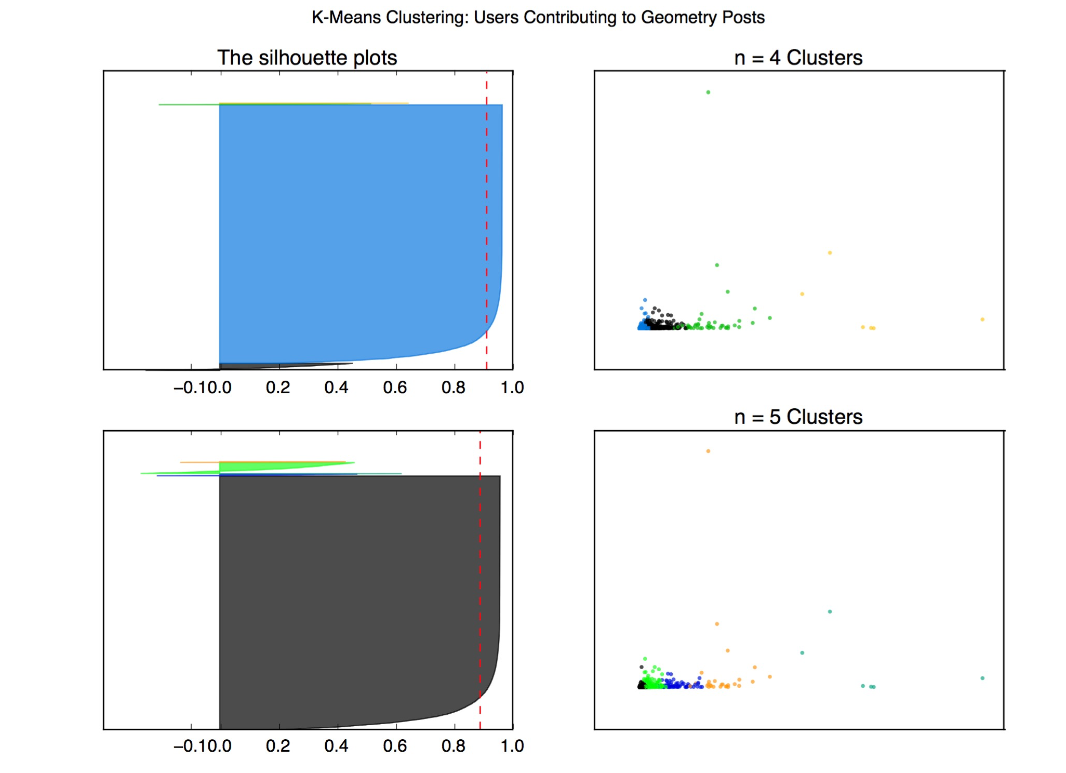
Expertise & Network Properties in StackExchange Sites
Dan Guo (dguo1113), Vani Khosla (vkhosla), Vignesh Venkataraman (viggy)
1. Problem Statement
We aim to identify, understand, and designate experts and expertise within StackExchange data.
Key Goals:
Analyze experts globally and over subsets of data to extract patterns and trends
Better define experts and expertise, particularly in finely granular subdomains
Help distribute and manage knowledge for an entire community
Create credibility scores that supersede StackExchange’s global reputation catch-all
2. Datasets
The math subdomain of StackExchange, which has 560K Badges, 2M Comments, 1M Posts, 200K Users, and 4M votes.
Post Graph: A directed graph where nodes are posts and edges are from a post and the post it is responding to.
User Graph: A directed graph where nodes are users and edges are directed from commenter to original poster.
3. Methods, Models, Findings
3.1. Micro-level Structure
experts are and what it means to be an expert, especially in a particularly granular field, would allow knowledge to be managed and distributed more judiciously throughout the community. Rating the reputation of users through the use of network properties would create a credibility system that supersedes the StackExchange sites’ generic user-specific reputation scores.
3.2. Clustering
In order to identify particular network traits to different personas of people, k-means clustering was done using the following features: views, up/down votes, in/out degree, and closeness/eigenvector/PageRank centrality.
Given the silhouette values of 0.973 for 2 clusters, 0.959 for 3 cluster, 0.911 for 4 clusters, and 0.887 for 5 clusters, the peak clustering number is at 2 clusters.
3.3. Heuristic Approaches to Ranking
A series of increasingly complex heuristic functions successfully prioritized domain expertise over total StackExchange reputation, making these function valid baseline replacements for generic reputation scores.
3.4. Supervised Learning
experts are and what it means to be an expert, especially in a particularly granular field, would allow knowledge to be managed and distributed more judiciously throughout the community. Rating the reputation of users through the use of network properties would create a credibility system that supersedes the StackExchange sites’ generic user-specific reputation scores.
 | Reputation | Degree | Degree * Votes | Betweenness | Eigenvector | PageRank * Badges
1 | Andre’ Nicolas | MvG | Ross Millikan | MvG | MvG | Henning Makholm
2 | Brian M. Scott | Ross Millikan | Andre/ Nicolas | Ross Millikan | Ross Millikan | Andre’ Nicolas
3 | Asaf Karagila | Andre’ Nicolas | amWhy | Blue | Blue | Ross Millikan
4 | Did | Blue | Michael Hardy | Andre’ Nicolas | Christian Blatter | Hagen von Eitzen
5 | Arturo Magidin | Christian Blatter | Ihf | Christian Blatter | Andre’ Nicolas | robkohn
6 | Qiaochu Yuan | Hagen von Eitzen | Robjohn | Mick | Mick | joriki
7 | Robert Isreal | Jack D’Aurizio | Hagen von Eitzen | Hagen von Eitzen | Jack D’Aurizio | Blue
8 | Robjohn | Joriki | Gerry Myerson | Joseph O’Rourke | Hagen von Eitzen | Jack D’Aurisio
9 | Ross Millikan | Mick | Guess who it is. | Bubba | Bubba | MvG
10 | Bill Dubuque | Lab bhatta… | Christian Blatter | Jack D/Aurizio | Harasimham | Robert Isreal
These functions had low Spearman Rank correlation to the baseline (0.0545), while they had high Spearman Rank correlation to each other (0.412).
4. Conclusions & Future Work

