Slide 1


Free Software Discussion
Vignesh Prabhu

Slide 2



Do you recognize them?
www.fsmk.org

Slide 3


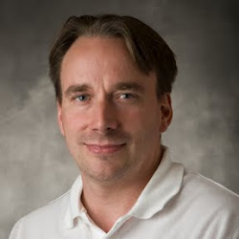

History of Free Software
www.fsmk.org

Slide 4
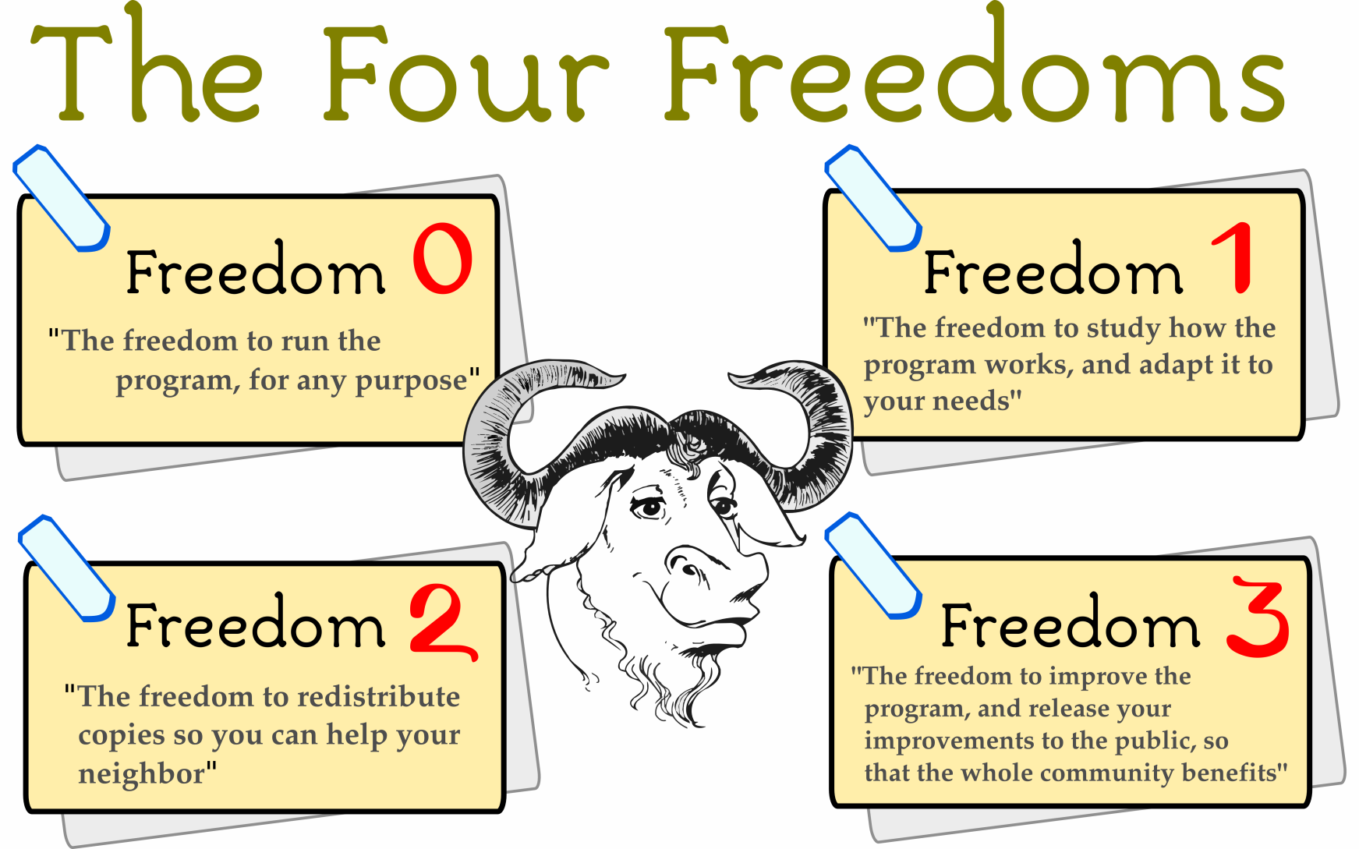
www.fsmk.org

Slide 5
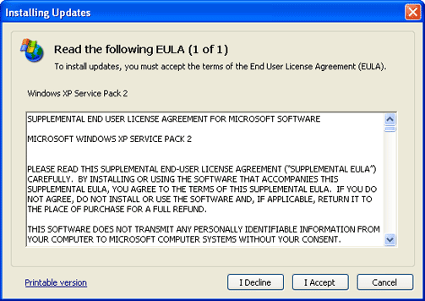


Licenses
www.fsmk.org

Slide 6

We all are pirates?
www.fsmk.org

Slide 7

Patents vs Innovation
www.fsmk.org

Slide 8
Truth Happens
www.fsmk.org

Slide 9
Why free software in India?
Literacy
Specially abled people
Huge domestic market
Special requirements due to scale
Huge economic difference
Need to address digital divide
www.fsmk.org

Slide 10
FSMK
Branch of FSMI
Non Profit Organization
Formed 4 years ago
Software professionals, government officials, college professors, students, etc.
More than 50 active volunteers and around 1000 member base.
www.fsmk.org

Slide 11
Chapters
Students chapter
Academicians chapter
Localization chapter
Community centers chapter
www.fsmk.org

Slide 12
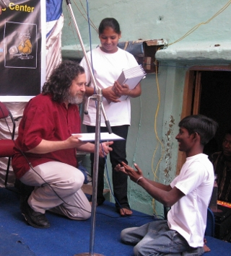
www.fsmk.org

Slide 13
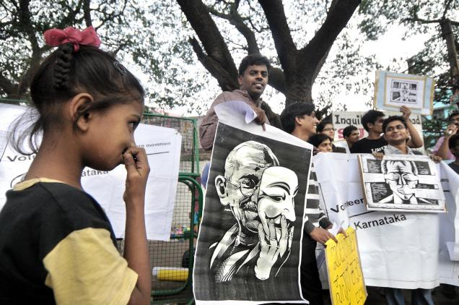
www.fsmk.org

Slide 14
Road Ahead
Formation of GLUG – GNU/Linux User’s Group
Identifying core members
Installation Fest
Study Groups
Weekly GLUG meet
Contributing to FOSS Projects
www.fsmk.org

Slide 15

Thank you
www.fsmk.org

