Slide 1

Bangalore University
University Visvesvaraya College of Engineering
Department of Computer Science and Engineering
Website Fingerprinting Attacks
- A Practical Threat?
Presented by
Vignesh T Prabhu
(14GAMT3018)
Under the guidance
Of
Dr. Thriveni J
Associate Professor

Slide 2
Content
Introduction to TOR Project
Website Fingerprinting Attack
About the paper
Goals
Assumptions
“Classify-Verify” Algorithm
Analysis
Adversary's Cost
Conclusions

Slide 3
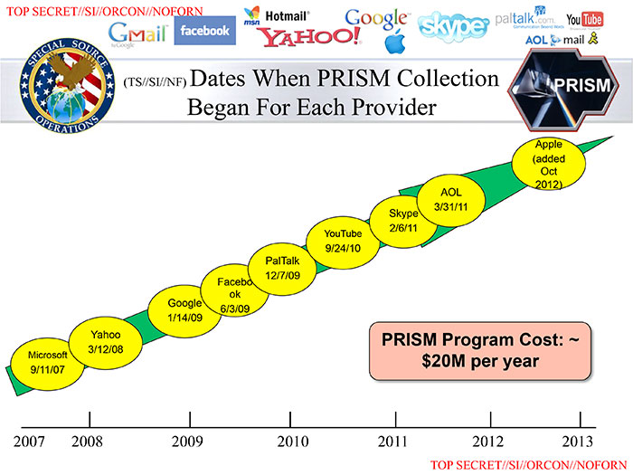
Big Brother is watching you?

Slide 4

TOR Project
TOR – THE ONION ROUTING
Launched on 20th Sept 2002
Most popular distributed anonymous communication systems
More than 3 million daily users
Initially developed by U.S. Naval Research Laboratory
Free Software under BSD License
Available as TOR Browser Bundle

Slide 5
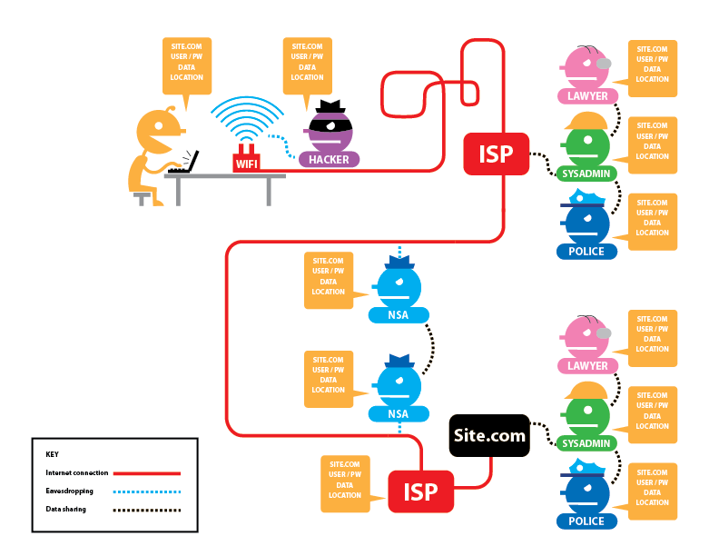
Browsing Without TOR

Slide 6
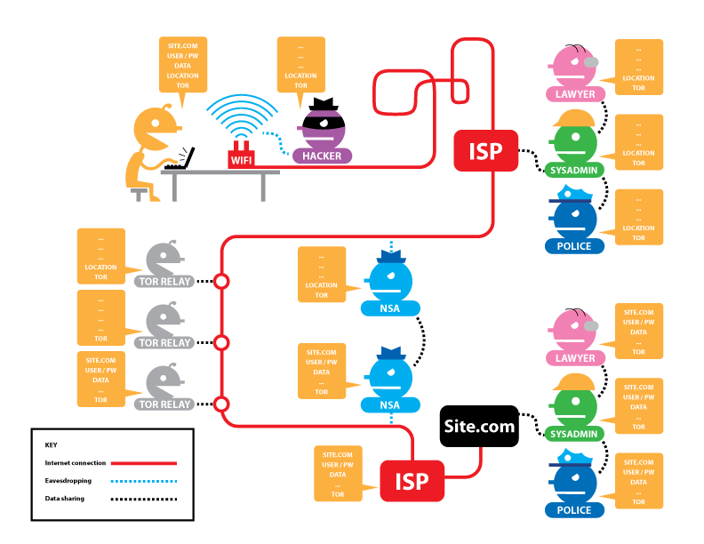
Browsing with TOR

Slide 7
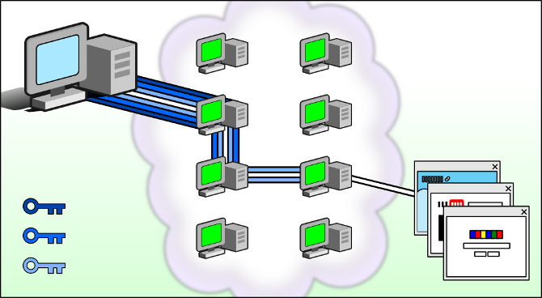
Onion Peeling

Slide 8
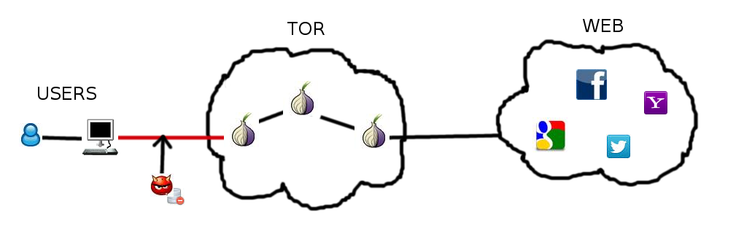
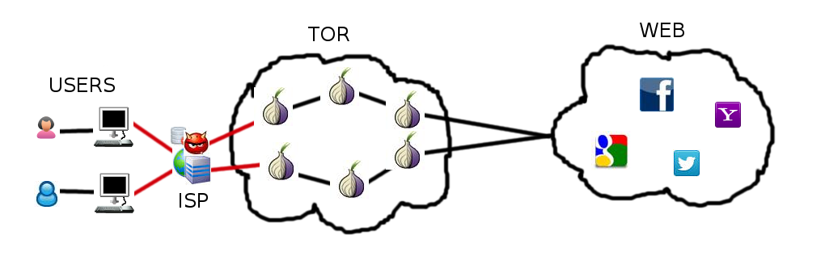
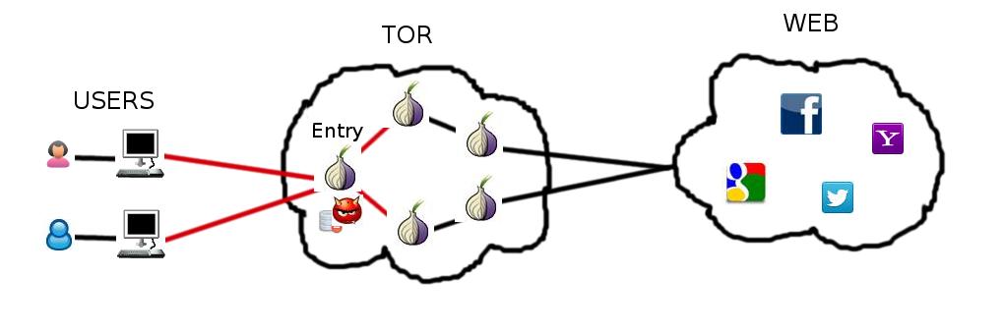
Website Fingerprinting Attack

Slide 9
Website Fingerprinting system
Primary tasks
  Data Collection
  Data Training
  Data Testing
  Updating Data
Misc
  Collecting background information

Slide 10
About the paper
Title: A Critical Evaluation of Website Fingerprinting Attacks
Authors: Marc Juarez, Sadia Afroz, Gunes Acar, Claudia Diaz and Rachel Greenstadt
Presented: 21st ACM Conference on Computer Security held on November 3rd to 7th, 2014 at Scottsdale, Arizona, USA

Slide 11
Goals
A critical evaluation of assumptions made by prior WF studies
An analysis of the variables that affect the accuracy of WF attacks
An approach to reduce false positive rates
A model of the adversary’s cost

Slide 12
Assumptions
Client Settings
  Closed World
  Browsing behaviour
Web
  Template
  No Localized versions
Adversary
  Page Load parsing
  No background traffic
  Replicability

Slide 13
Assumptions
Assumptions | Explicitly made by
Closed-world | [11,26]
Browsing behavior | [11]
Page load parsing | [3, 11, 23, 26, 32]
No background noise | [3, 11, 23, 26, 32]
Replicability | [11, 26]
Template websites | [3]
[3] - X. Cai, X. Zhang, B. Joshi, R. Johnson, “Touching from a Distance: Website Fingerprinting Attacks and Defenses”
[11] - D. Herrmann, R. Wendolsky, H. Federrath, “Website Fingerprinting: Attacking Popular Privacy Enhancing Technologies with the Multinomial Nave-Bayes Classifier”
[23] - A. Panchenko, L. Niessen, A. Zinnen, T. Engel, “Website Fingerprinting in Onion Routing Based Anonymization Networks”
[26] - Y. Shi, K. Matsuura, “Fingerprinting Attack on the Tor Anonymity System”
[32] - T. Wang, I. Goldberg, “Improved Website Fingerprinting on Tor”

Slide 14
Closed World Assumption
Authors | World Size | Success Rate
Herrmann et al. | 775 pages | 3%
Shi and Matsuura | 20 pages | 50%
Panchenko et al. | 775 pages | 54.61%
Wang and Goldberg | 100 pages | 90%

Slide 15
Classifiers
Name | Model | Features
H | Naive Bayes | Packet Lengths
P | SVM(Support Vector Machine) | Packet lengths Order Total bytes
D | N-grams | Total time Up/Downstream bytes Bytes in traffic bursts
W | SVM (Fast-Levenshtein) | Cell traces
T | Decision Tree | Packet lengths Order Total bytes

Slide 16
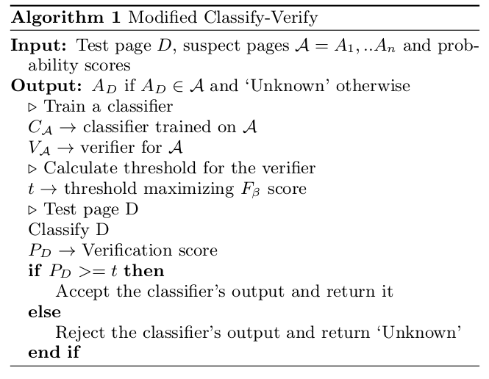
Classify Verify Algorithm*
  *Discussed by Stolerman et al.
  **Led to 63% reduction in False Positive

Slide 17
Experiment
Two steps
  k-fold cross-validation using data of the control crawl
  Evaluate classifier’s accuracy training on the control crawl and testing with data from the test crawl

Slide 18
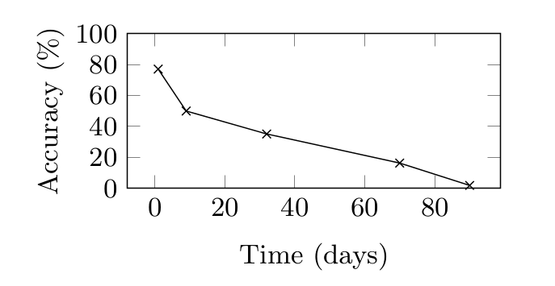
Staleness of data over time

Slide 19
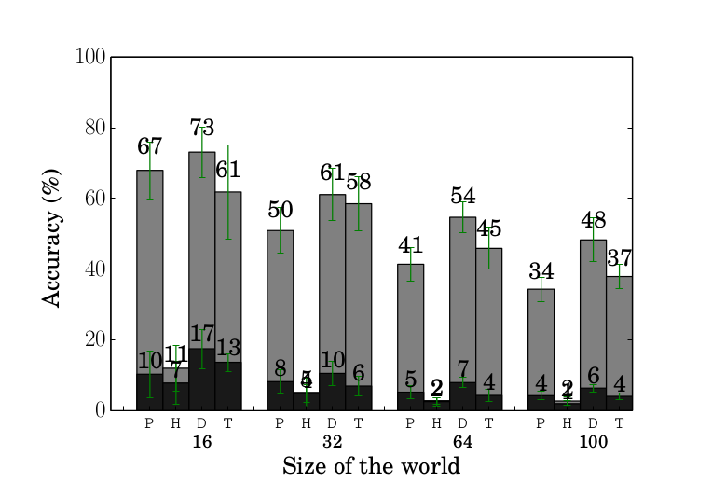
Multitab Browsing Accuracies

Slide 20
Multitab Browsing Accuracies
For Classifier W
Delay | Acc test | Acc control
0.5 sec | 9.8% (±3.1%) | 77.08% (±2.72%)
3 sec | 7.9% (±0.8%) | 77.08% (±2.72%)
5 sec | 8.23%(±2.32%) | 77.08% (±2.72%)

Slide 21
Accuracy for different network locations
Location Trained | Location Tested | Acc test | Acc control
Leuven | New York | 8.83% (±2.87%) | 66.95% (±2.872%)
Leuven | Singapore | 9.93% (±0.98%) | 66.95% (±2.87%)
Singapore | New York | 68.53%(±3.24%) | 76.40% (±5.99%)

Slide 22
Classify-Verify result on ALAD* Users
ALAD User | TP | FP | New TP | New FP
User 3 | 38/260 | 362/400 | 31.2/260 | 107.6/400
User 13 | 56/356 | 344/400 | 26.8/356 | 32/400
User 42 | 3/208 | 397/400 | 1.0/208 | 41.2/400
*ALAD – Active Linguistic Authentication Dataset

Slide 23
Adversary's Cost
Data Collection Cost:
  N training pages, m versions, i instances
Training Cost:
  D total pages, F features, C classifier
Testing Cost:
  T test data(v victims, p visited pages per day), F features, C classifier
Updating Cost:
  d website change frequency
Background Information Cost

Slide 24
Conclusions
Success of WF attacks also depend on
  Temporal proximity of traces
  TBB versions used
  User's Browsing habits
Non-targeted attack seems not feasible due to its sophistication
Targetted attack is also non-trivial
  aspects of their behavior must be observed a priori
Future research on WF attacks should also focus on its practicality and efficacy

Slide 25
Thank You

