Slide 1
Liver Disease Prediction
Group 15
Karthik Macha
Vignesh Sivakumar

Slide 2
Table of contents
01
02
04
05
06
03
Problem Definition
Data Collection
Data Exploration, Visualization and Processing
Dimension Reduction and Variable Selection
Model Exploration and Model Selection
Model Performance Evaluation and Visualization

Slide 3
Introduction
Liver diseases are rapidly becoming one of the most lethal diseases in several countries due to the fact that patients are consuming excessive alcohol, contaminated food, and drugs and inhaling harmful gases.

Slide 4
Problem Definition
The liver damage caused by various diseases is generally irreversible. However, if liver disease is detected early and the underlying cause is treated, further damage can be avoided. In this project, we will identify the best models based on a patient's lifestyle and health conditions to predict liver disease.

Slide 5
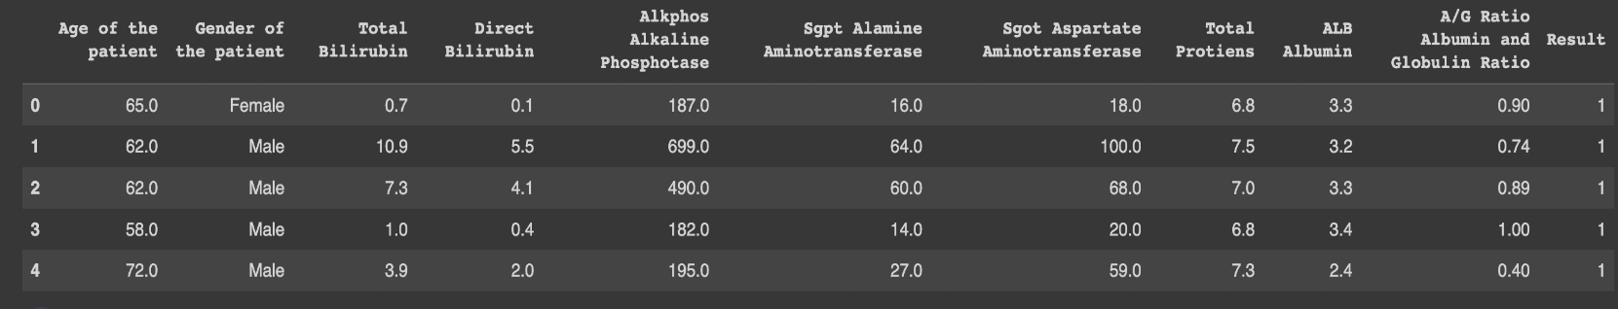
Data Collection
The data for this project is collected from Kaggle. There are 30,691 observations or rows in this data set (Liver Patient Dataset.csv), which has 11 characteristics or columns.
From the 11 variables, 10 are predictor variables and 1 is a response variable Result. There are both integer and categorical variables included in the dataset.

Slide 6
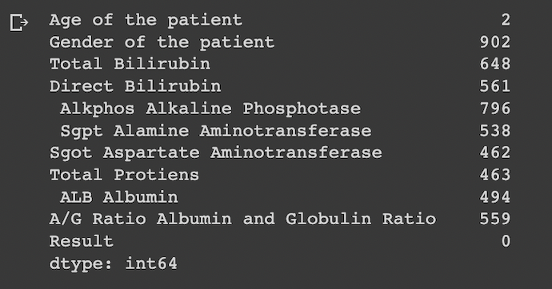
Data Processing
This dataset contains null values that need to be either updated or removed, which is a challenge. Using the mean could lead the data to being skewed, so we calculated the median of the remaining entries in the columns to replace the null values for numerical variables. When dealing with categorical variables, there is only one column, "Gender of the Patient," and any missing values can be filled in by employing mode imputation.

Slide 7
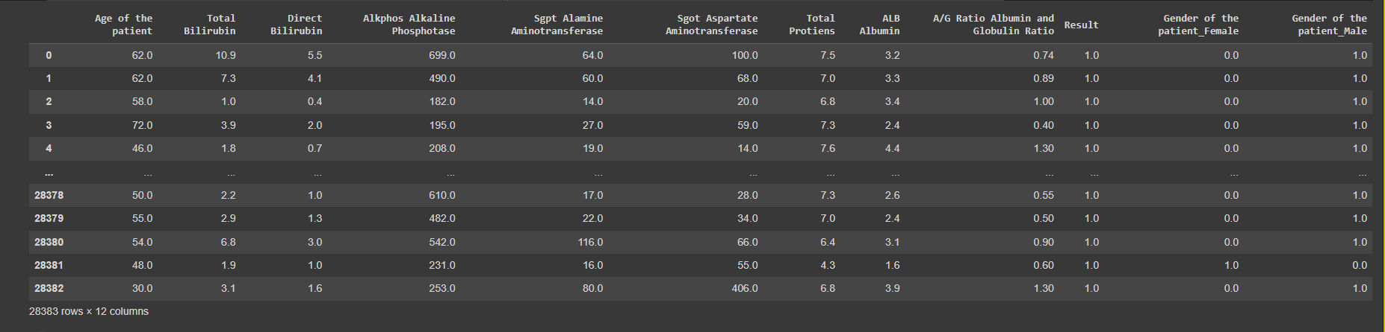
Outlier Detection and Removal
We have removed the outliers by calculating the values of the numeric columns which are 4 standard deviations(cutoff) from the mean. We have then deleted those rows which are having values lower or higher than the cutoff we have defined.

Slide 8
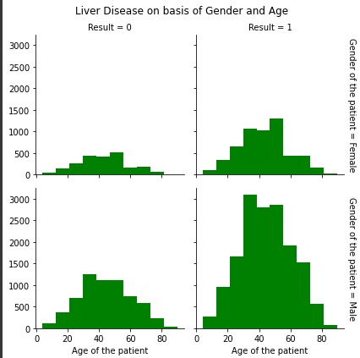
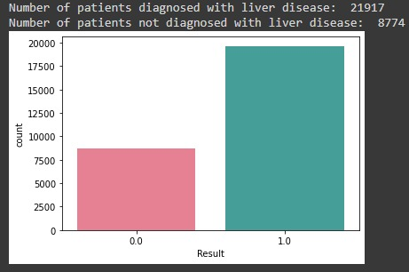
Data visualization and Exploration

Slide 9
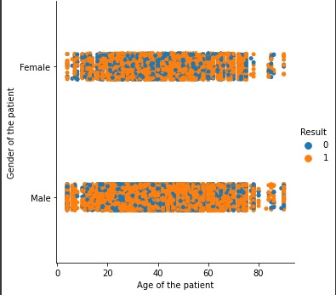
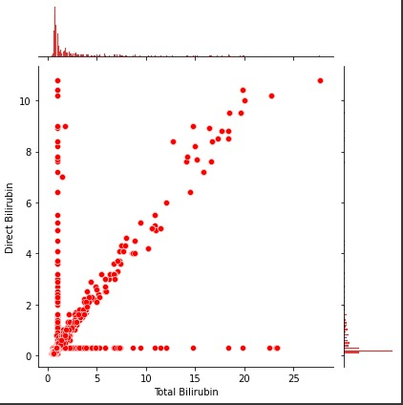
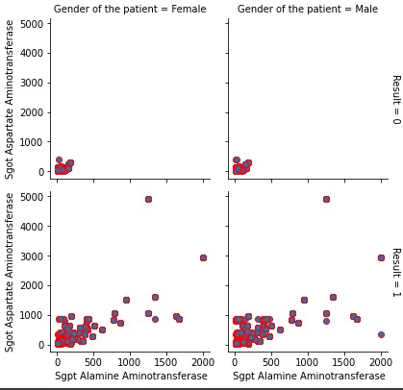
Data visualization and Exploration

Slide 10
Dimension Reduction and Variable Selection
We need to transform data from a high-dimensional space into a low-dimensional space with the intention of keeping the low-dimensional representation as close as possible to the inherent dimension of the original data, this in turn is called as dimension reduction. Working with high-dimensional spaces can be undesirable for different reasons such as the fact that the data analysis is typically computationally uncontrollable, and that the raw data are frequently sparse as a result of the curse of dimensionality.

Slide 11
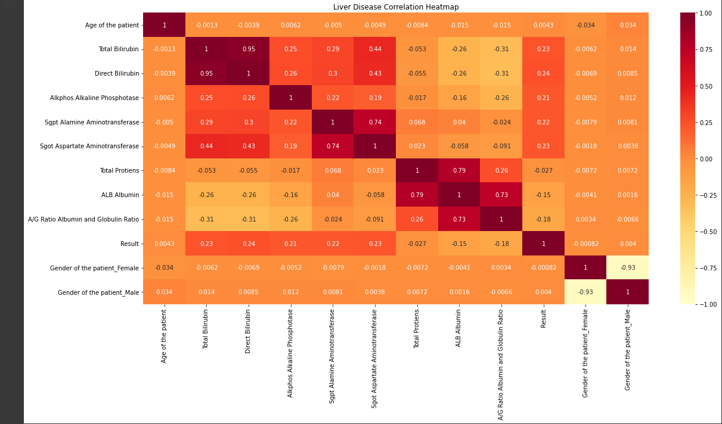
Dimension Reduction and Variable Selection
From the heatmap, we can say that the columns, Direct Bilirubin and Total Bilirubin, Sgpt Alamine Aminotransferase and Sgot Aspartate Aminotransferase, Total Proteins and ALB albumin, Gender of the patient Female, Gender of the patient Male are highly correlated, but we will be dropping ALB Albumin and Gender of the patient Male as it’s not a good correlation with the target variable from the dataset i.e., reducing the dimension of the dataset.

Slide 12
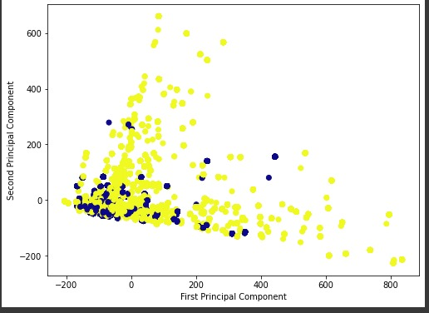
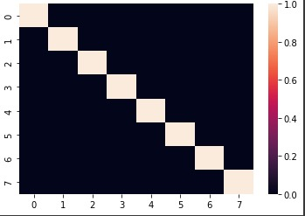
PCA
We will be incorporating an unsupervised learning method for lowering the dimensionality of data using principal component analysis. While minimizing information loss, it simultaneously improves interpretability and makes data easier to plot in 2D and 3D. The large sets of information is retained in a smaller set of dimensions.

Slide 13
Model Exploration and Model Selection
Logistic Regression
Random Forest Classifier
K-NN
Decision Tree Classifier

Slide 14
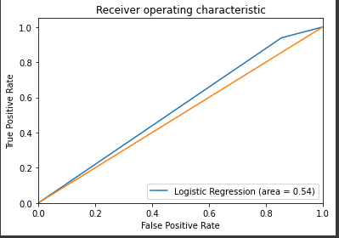
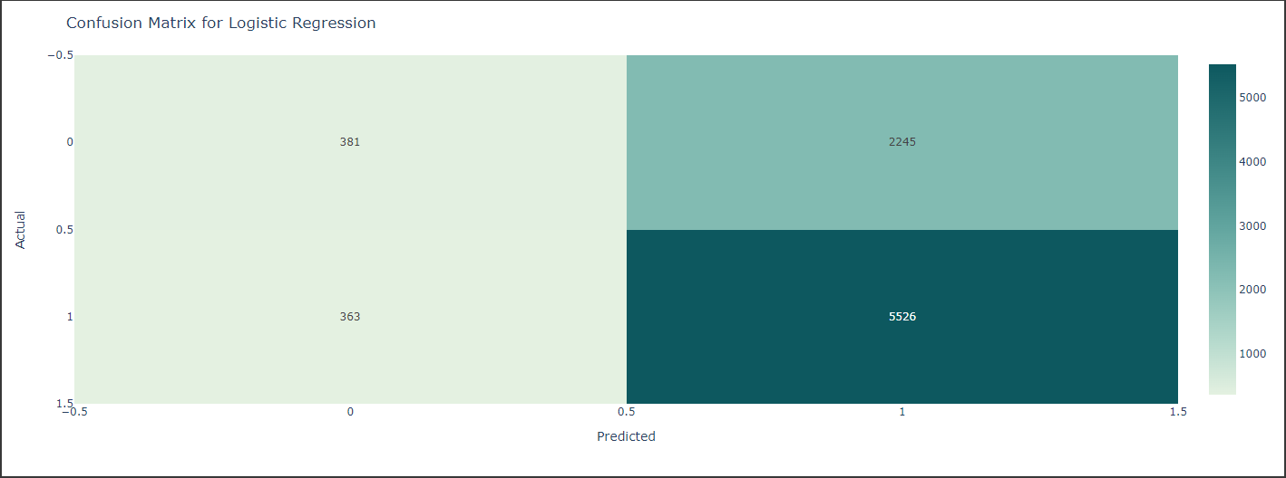
Logistic Regression
The logistic model in statistics is a statistical model that depicts the likelihood that an event will occur by making the event's log-odds a linear combination of one or more independent variables.

Slide 15
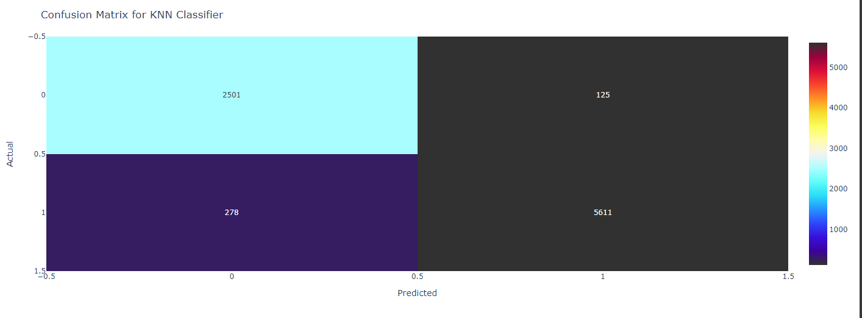
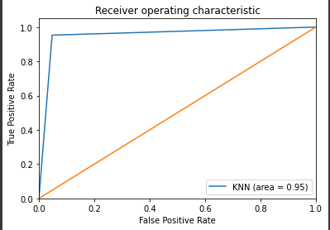
K-NN
The K-nearest neighbors' algorithm, sometimes referred to as KNN or k-NN, is a supervised learning classifier that employs proximity to produce classifications or predictions about the grouping of a single data point.

Slide 16
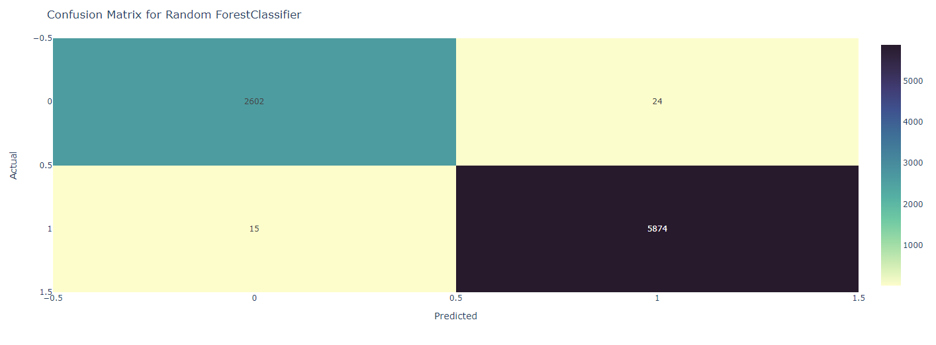
Random Forest Classifier
A classification system made up of several decision trees is called the random forest. The Random Forest Algorithm's ability to handle data sets with both continuous variables, as in regression, and categorical variables, as in classification, is one of its most crucial qualities.

Slide 17
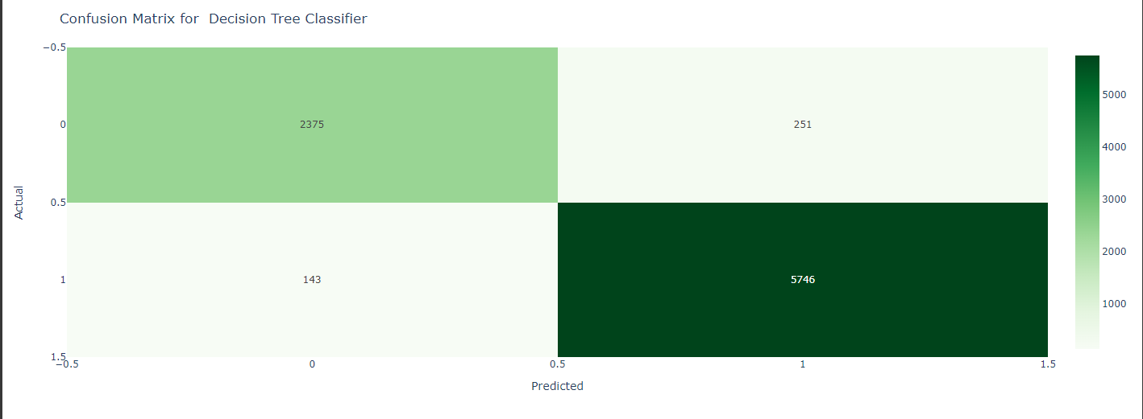
Decision Tree Classifier
A supervised learning method used in statistics, data mining, and machine learning is decision tree. A classification or regression decision tree is employed in this formalization as a prediction model to draw conclusions from a set of observations.

Slide 18
Model Exploration and Model Selection
Models | Accuracy | Precision | Recall | F1 Score
Logistic | 69.37 % | 0.7111 | 0.9383 | 0.8090
KNN | 95.26 % | 0.9782 | 0.9527 | 0.9653
Random Forest | 99.54 % | 0.9959 | 0.9974 | 0.9966
Decision Tree | 95.37 % | 0.9581 | 0.9757 | 0.9668
When compared to the other models we utilized for this project, the random forest classifier has performed exceptionally well as it gives highest accuracy,f1,precision and recall scores.
While the accuracy,f1,precision and recall scores for the logistic regression is the Least.

Slide 19
Conclusion
The ability to forecast liver disease is essential in the medical industry since liver disease is devastating. Our study focuses on predicting liver disease while taking a number of factors into account, such as age, gender, and protein levels. Liver disorders are caused by elevated levels of Sgpt Alamine Aminotransferase and Sgot Aspartate Aminotransferase. Our project will be extremely beneficial to the medical industry because it would reduce the strain on the doctors.

Slide 20
Thank You

