Slide 1
Career Services
ITMD 523: Advance Topics in Data Management
Group No: 83
Presented by: Vighnesh Sawant
Prateek Deshmukh
Siddharth Singh

Slide 2
Career Services
The project is aimed at developing an offline application for Career Services of Illinois Institute of Technology.
This system manages student information with regards to Career Fair held at IIT.
It is a desktop based application which maintains a central repository of all the student information.
It allows the student , faculties and career services to access the recruitment details.
Recruiters can also access student details.

Slide 3
Modules
Administrator module: Add , view and mail to functionality for a faculty.
Career Services module: Registration of Companies , Arrange Job Fair for eligible students , can send mails to eligible candidates ,displaying current Jobs offers.
Student module: View ,update, add photo to a profile, Generate and view CV.
Faculty Module: View the profile, Student list, can view Job Fairs and also can see the eligible candidates list
Admission Module: It consists of registration form containing student information filled by Student itself.
Contact Us Module

Slide 4
Database Selection
The system will involve the use of a lot of information on the basis of the requirements and the most appropriate form of storage of this data is in a database.
We have chosen the MySQL database for storing data because database has proved to deliver high integrity of data storage.
MySQL database has successfully featured the four properties that all database systems must have: atomicity, consistency, isolation and durability.
The MySQL provides a reliable and competent database system.
This database has many features, that give security, protection, maintenance and reliability.

Slide 5
Programming Environment
PHP : PHP is a server side scripting language used for web development.
HTML: HTML is used for creating static web pages
MySQL: MySQL is used as a RDBMS which runs as a server providing access to database.
Wamp Server : Incorporates Apache, PHP and MySQL and easily manages the server by providing web based application on a local host.

Slide 6
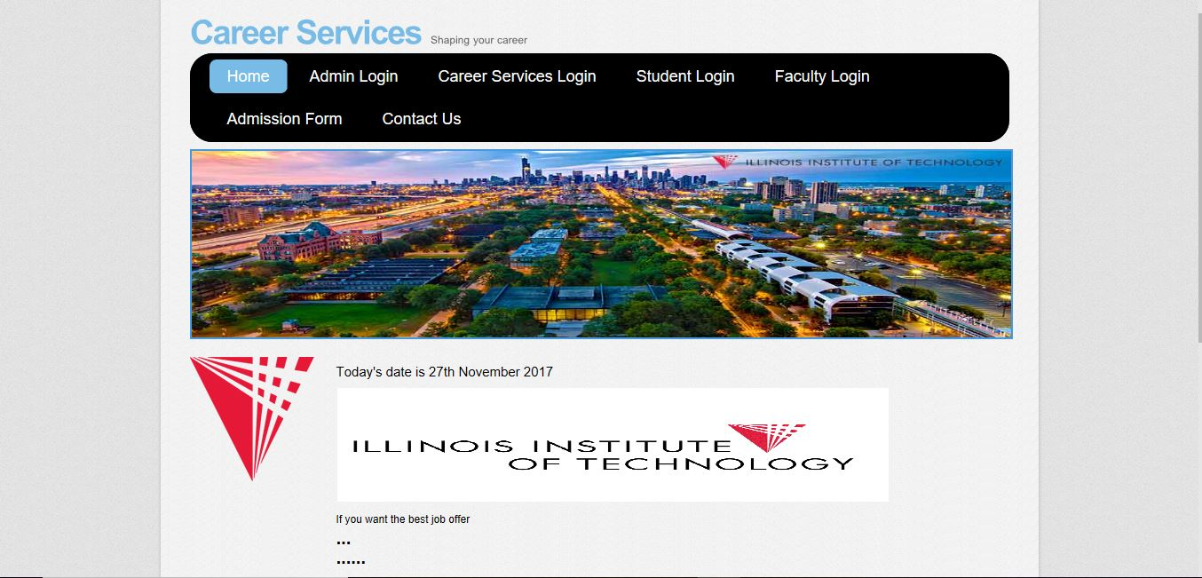
DEMO: Home Page

Slide 7
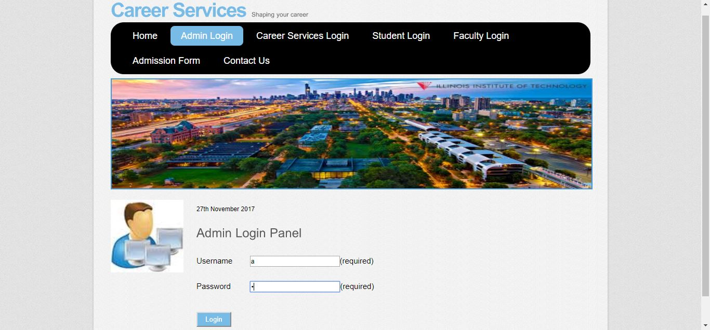
ADMIN login

Slide 8
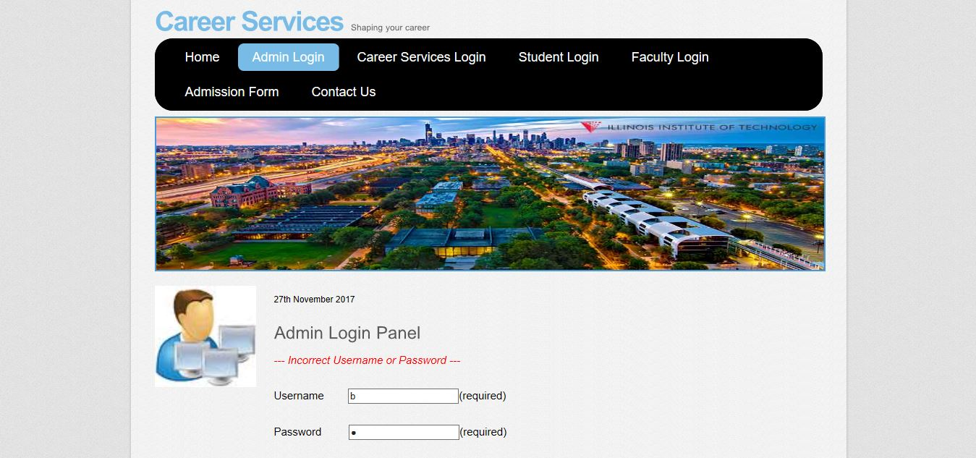
ADMIN login (failure)

Slide 9
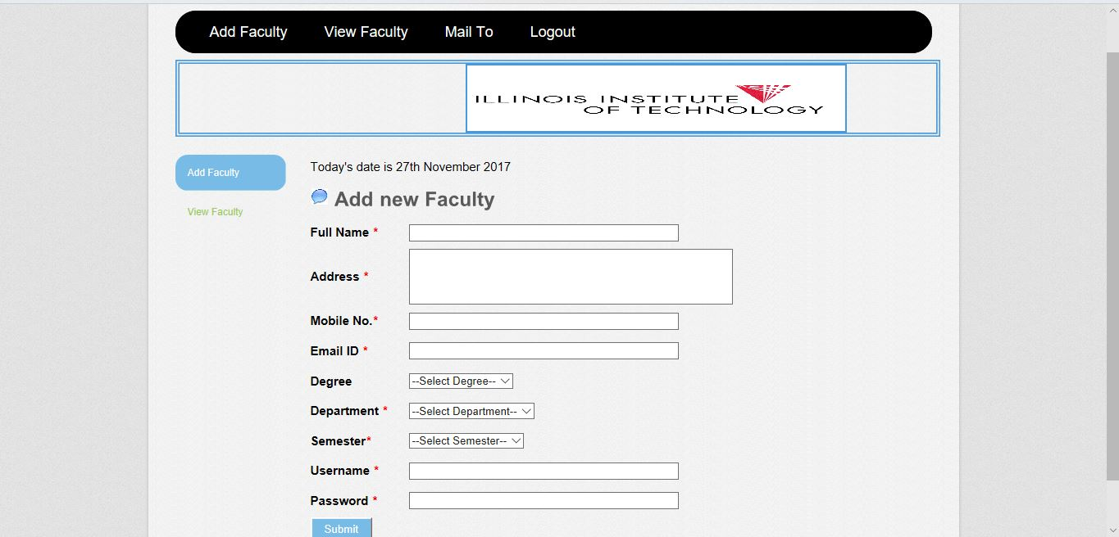
ADD new Faculty

Slide 10
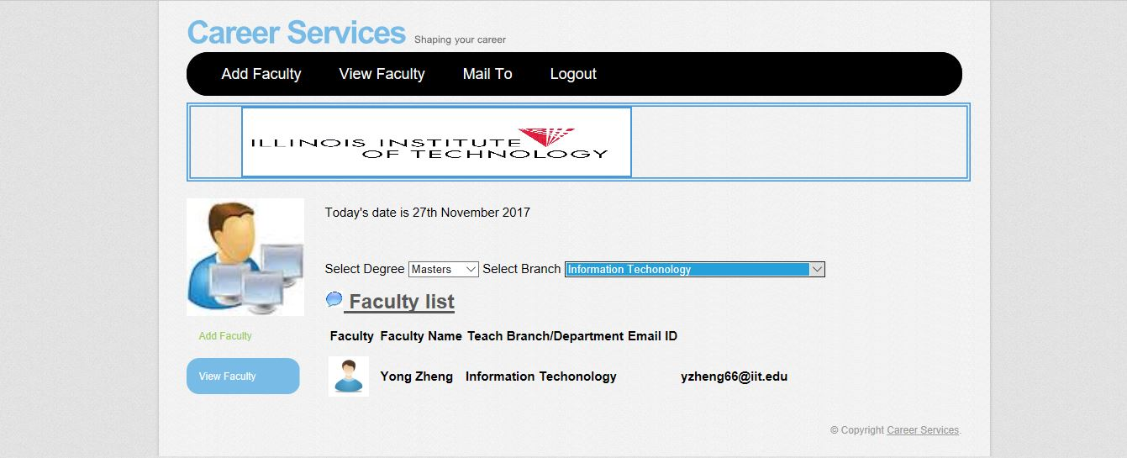
View Faculty

Slide 11
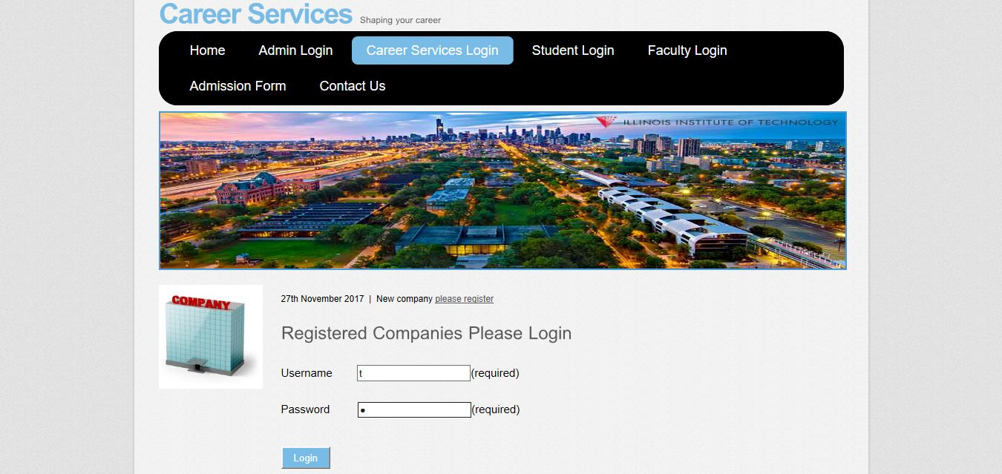
Career Services Login

Slide 12
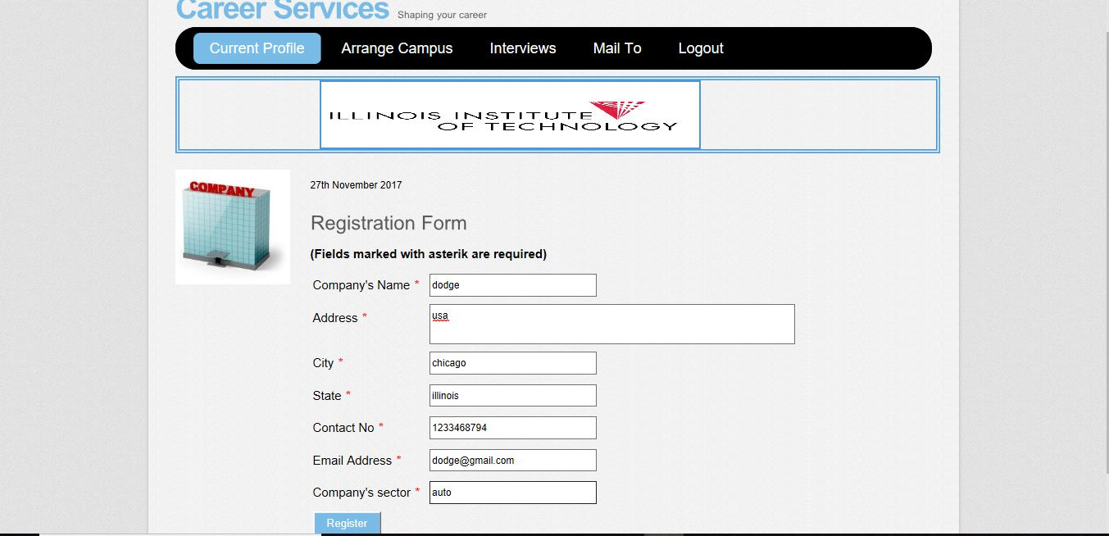
Registration Form for Companies

Slide 13
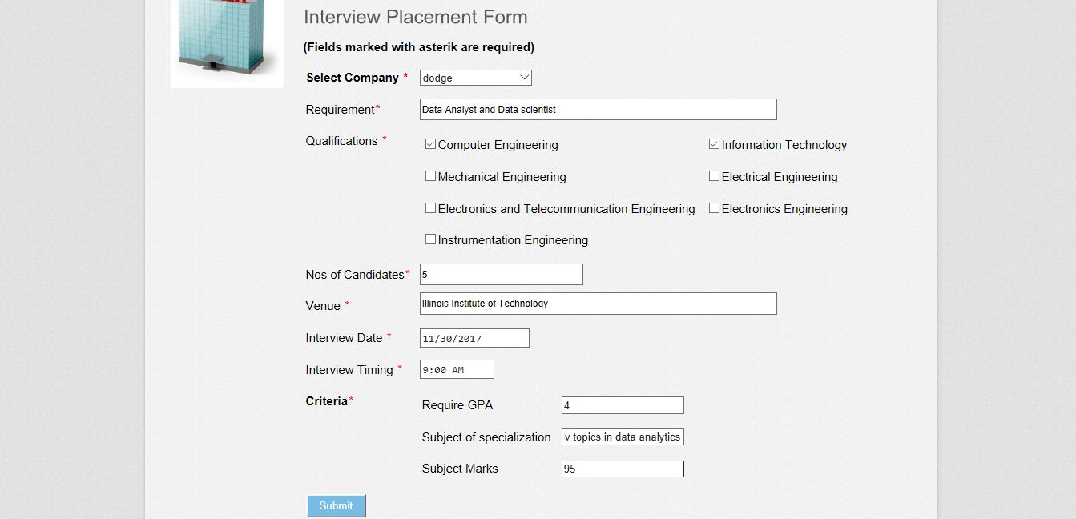
Arrange Campus

Slide 14
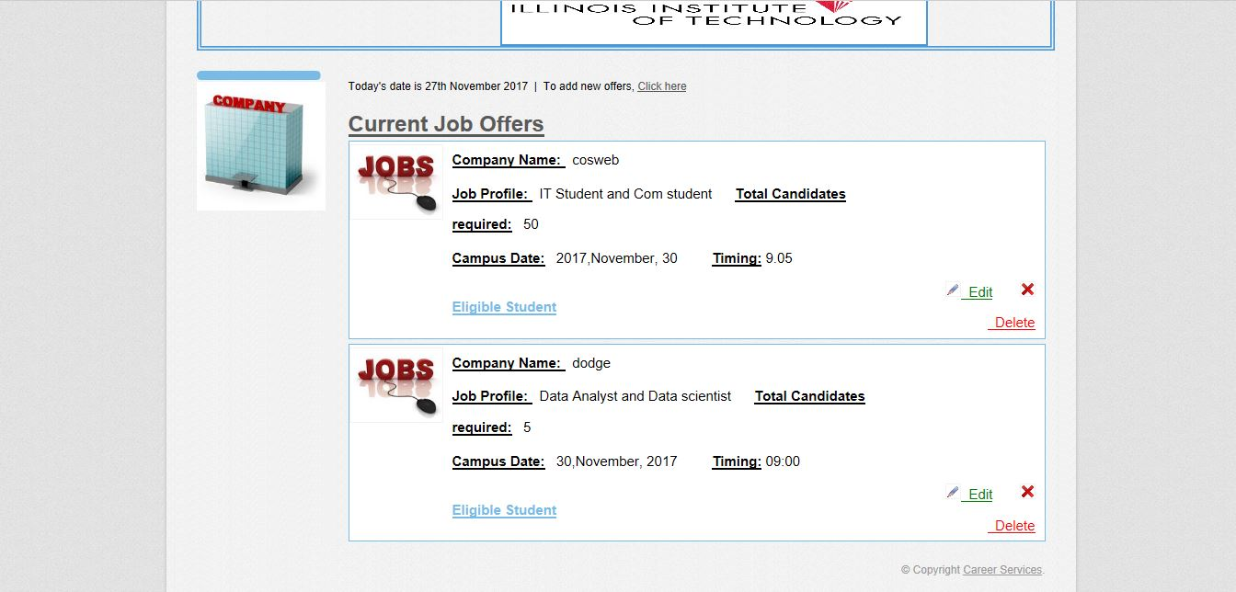
Job Offers

Slide 15
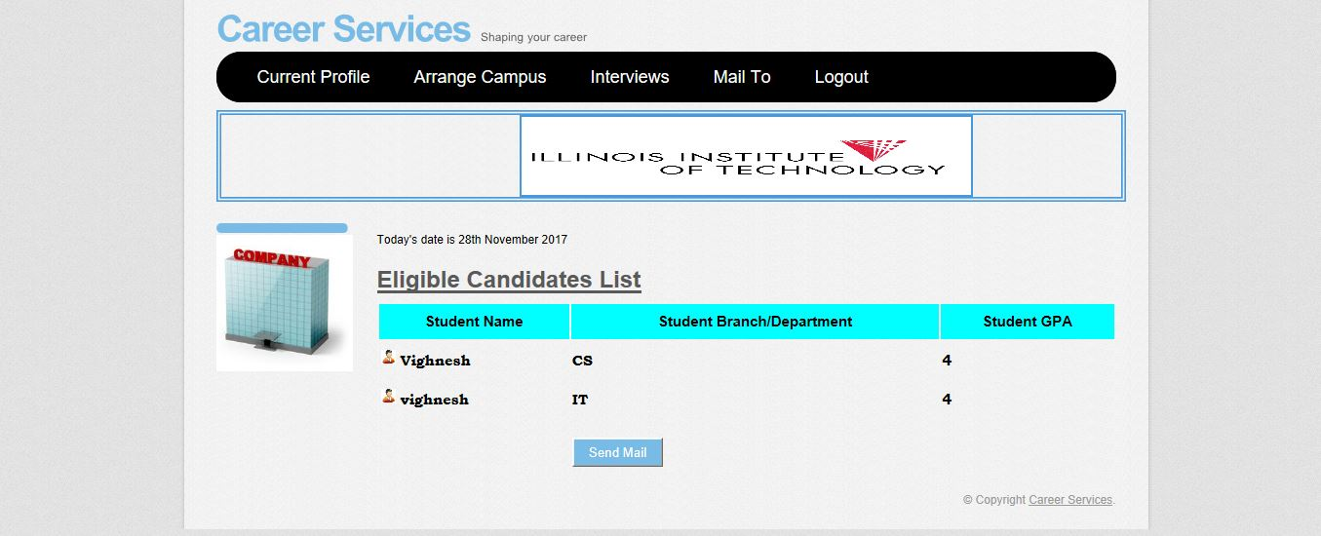
Eligible Student

Slide 16
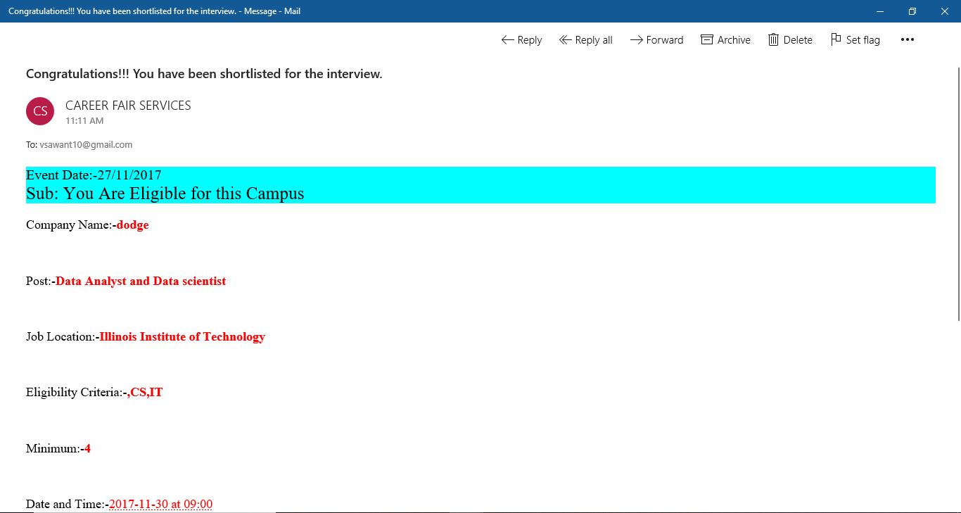
Mail

Slide 17
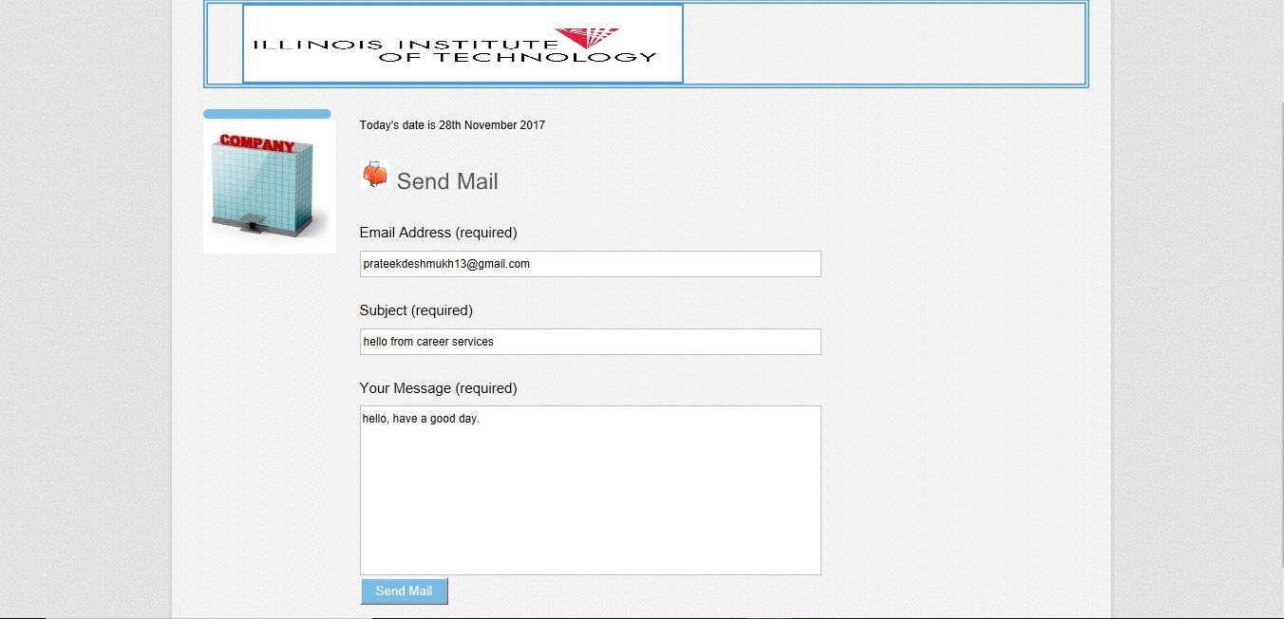
MAIL TO

Slide 18
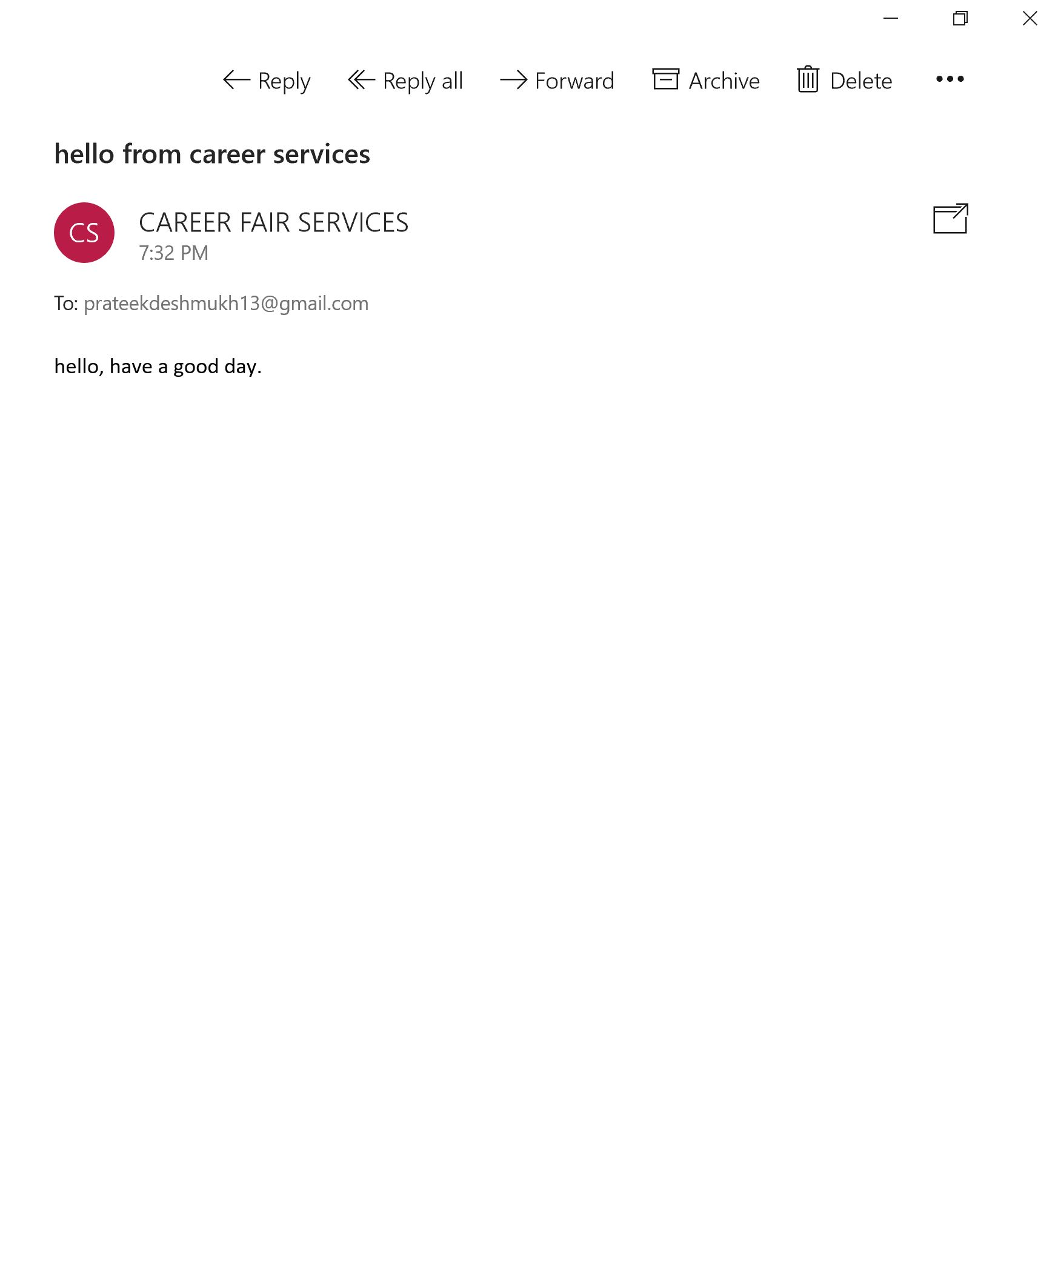
Mail Check

Slide 19
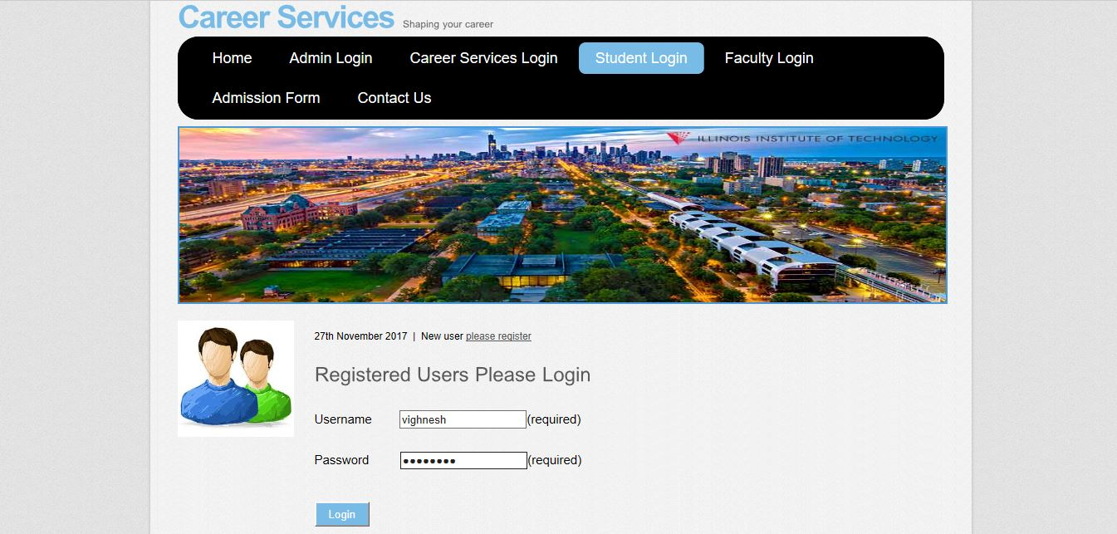
Student Login

Slide 20
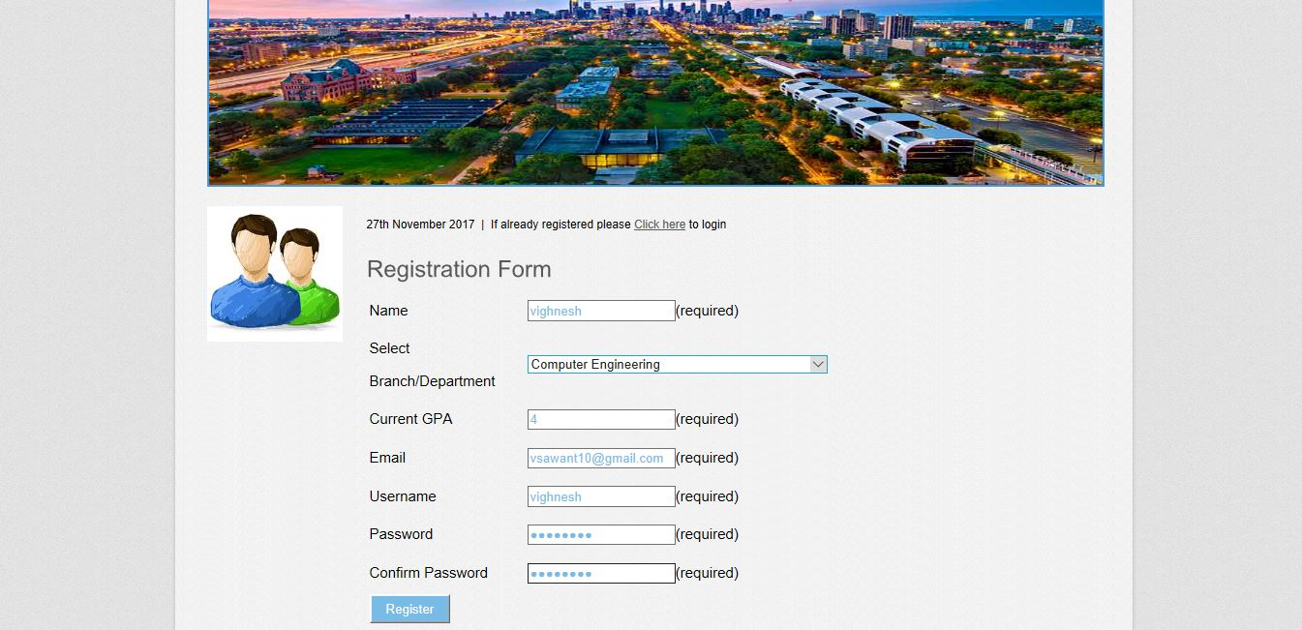
New Student Register

Slide 21
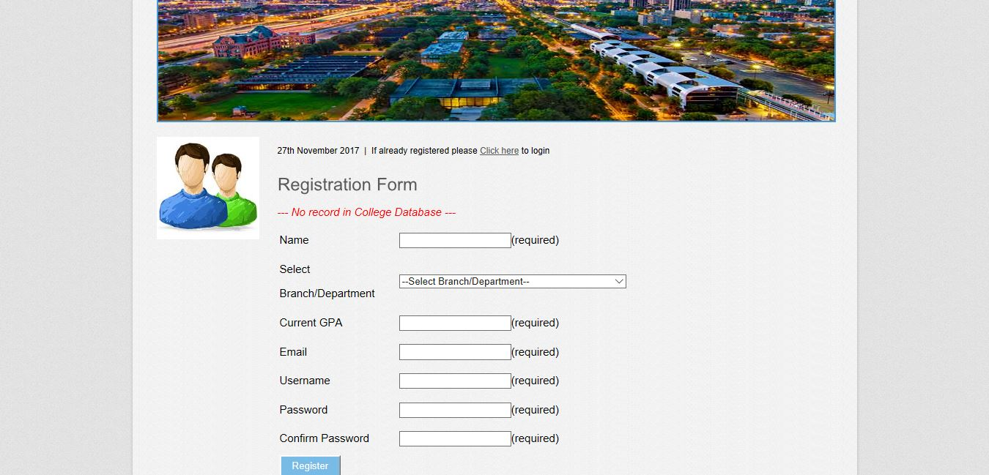
Registration Failed

Slide 22
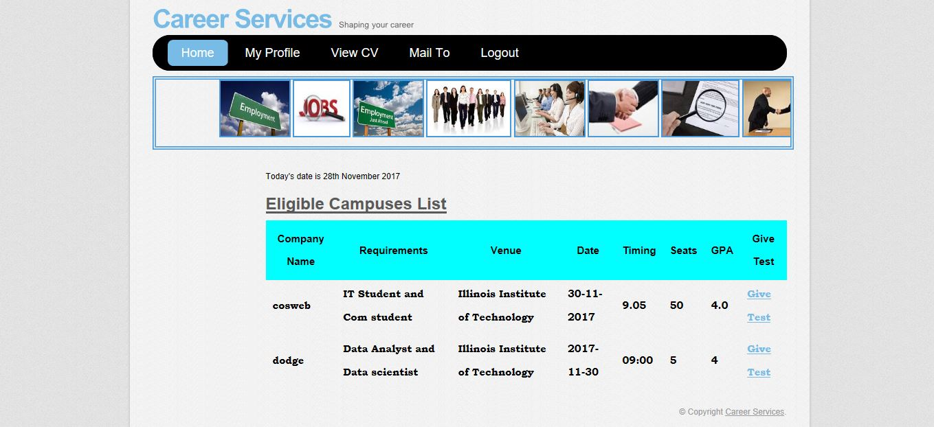
Eligible Campuses

Slide 23
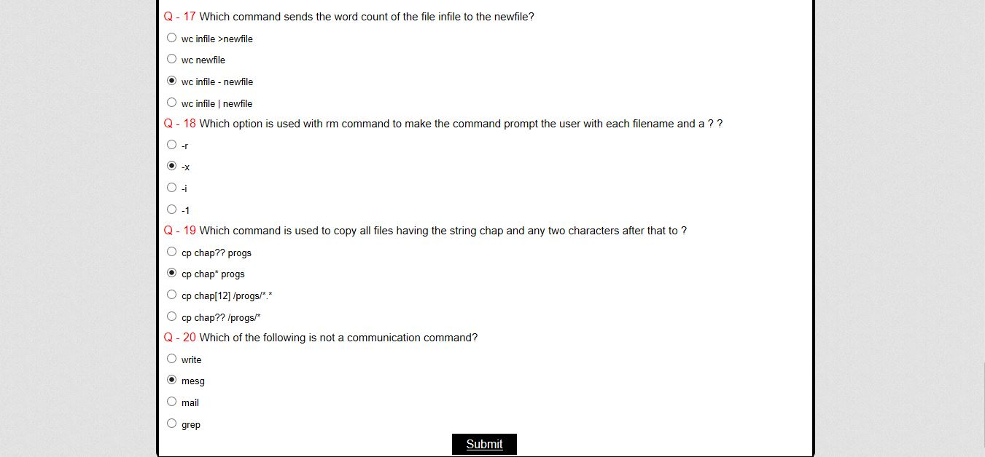
Test

Slide 24
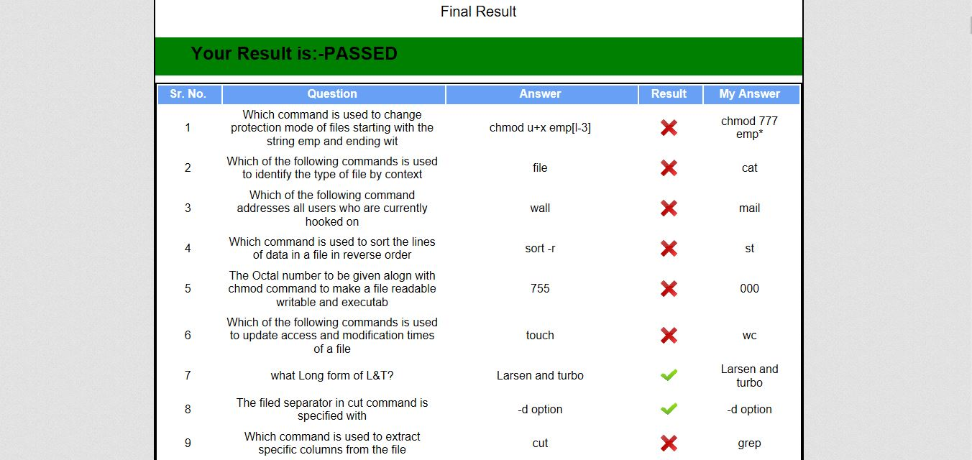
Result

Slide 25
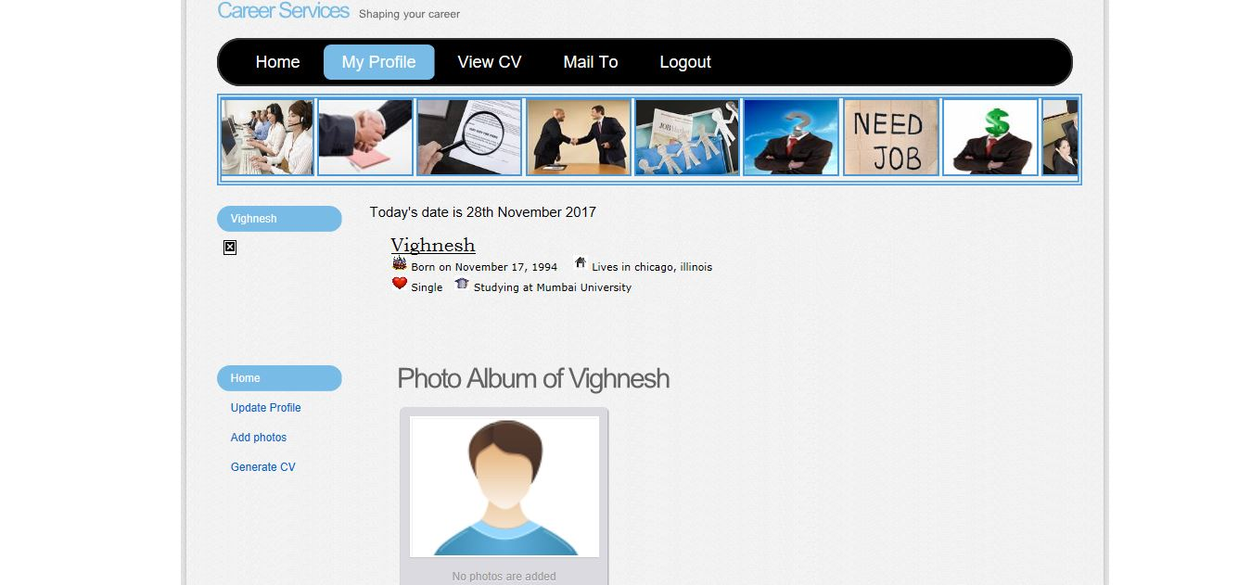
Student Profile

Slide 26
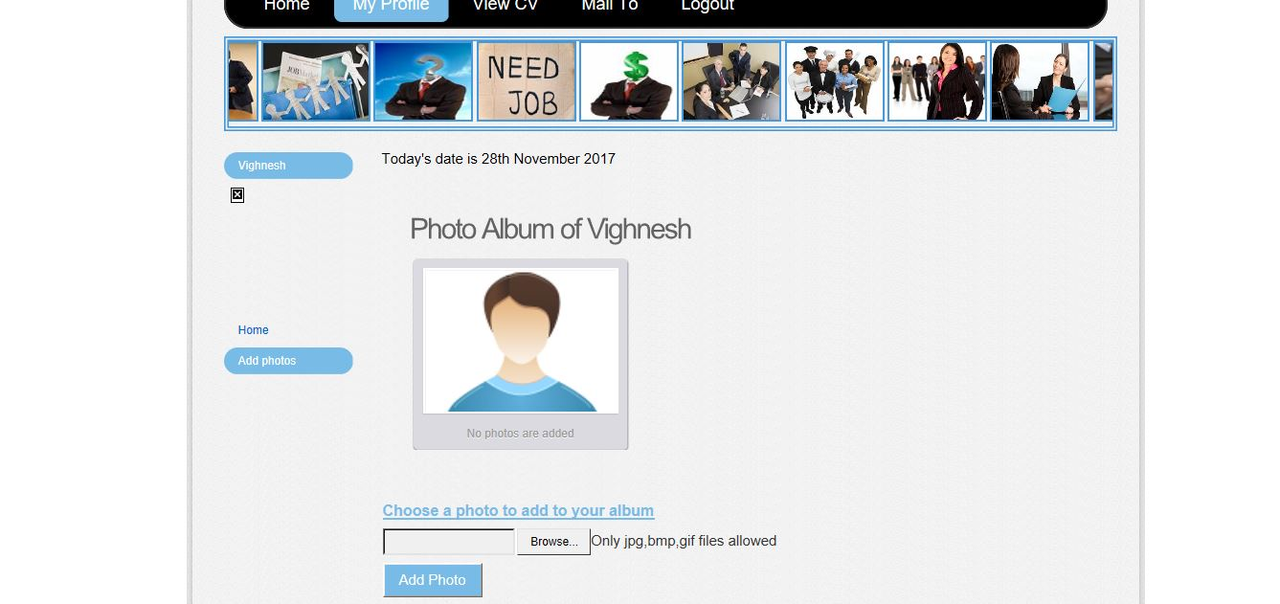
Add Photo

Slide 27
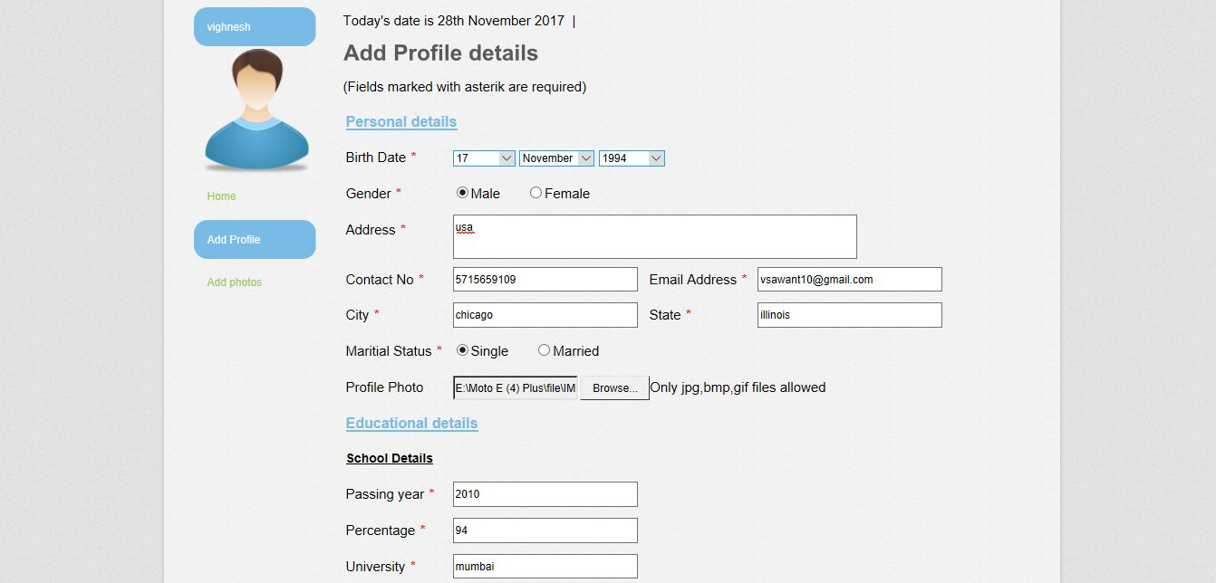
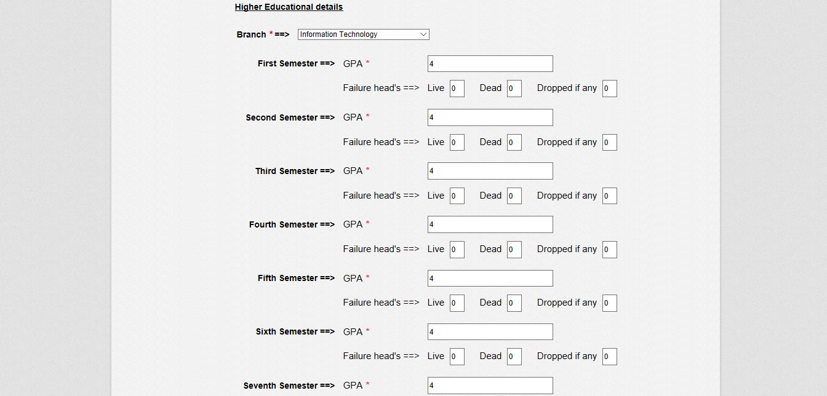
Updating User Profile

Slide 28
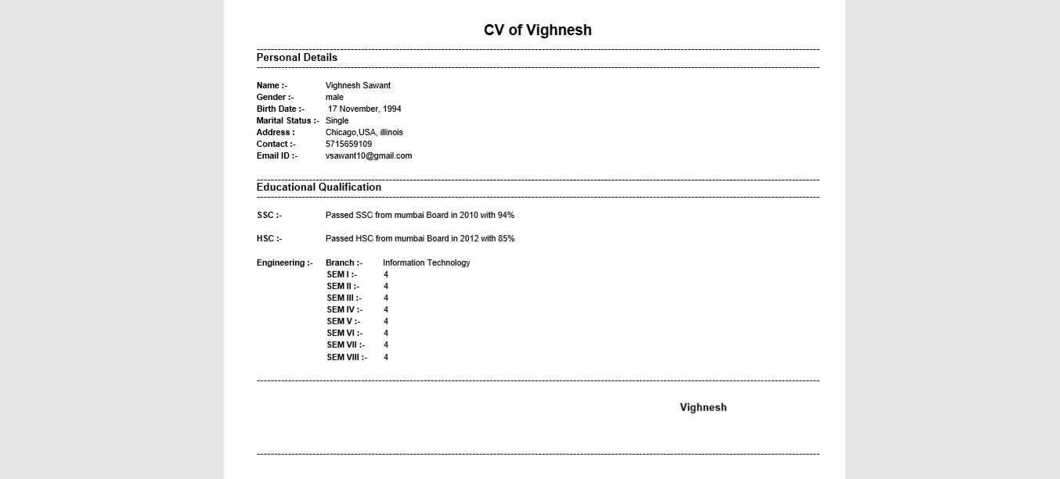
Generate CV

Slide 29
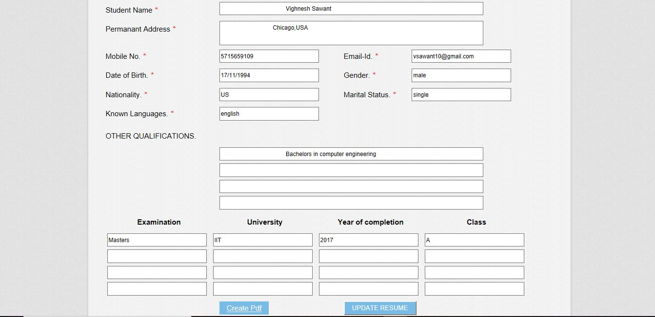
CV

Slide 30
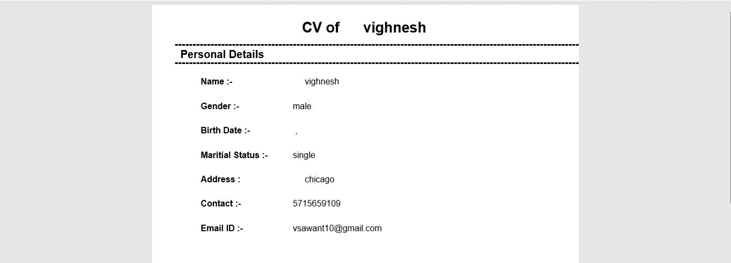
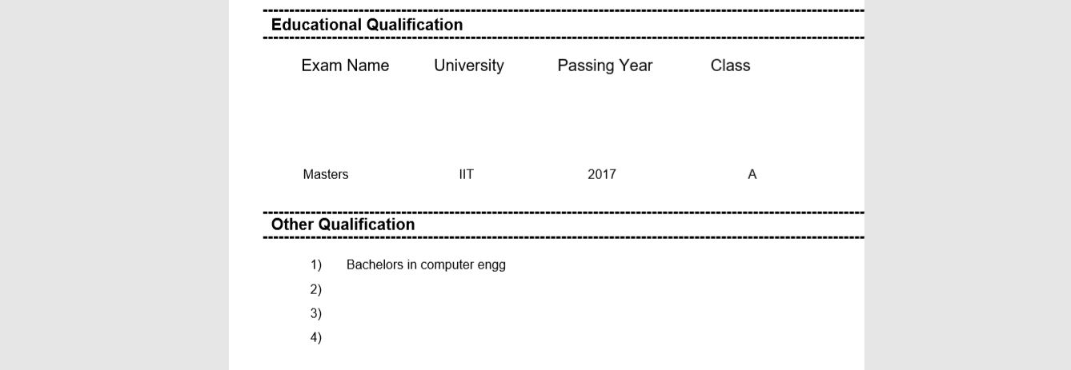
CV

Slide 31
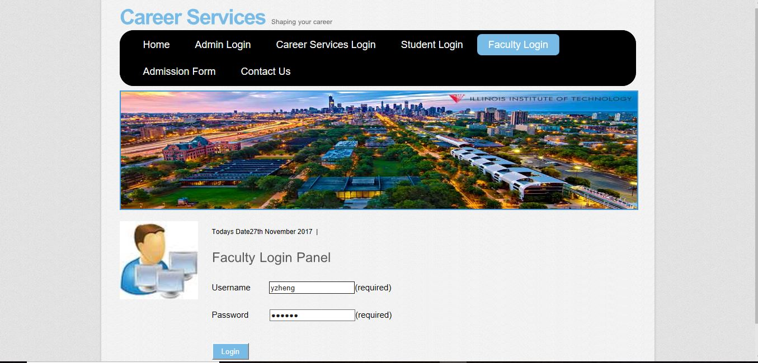
Faculty Login

Slide 32
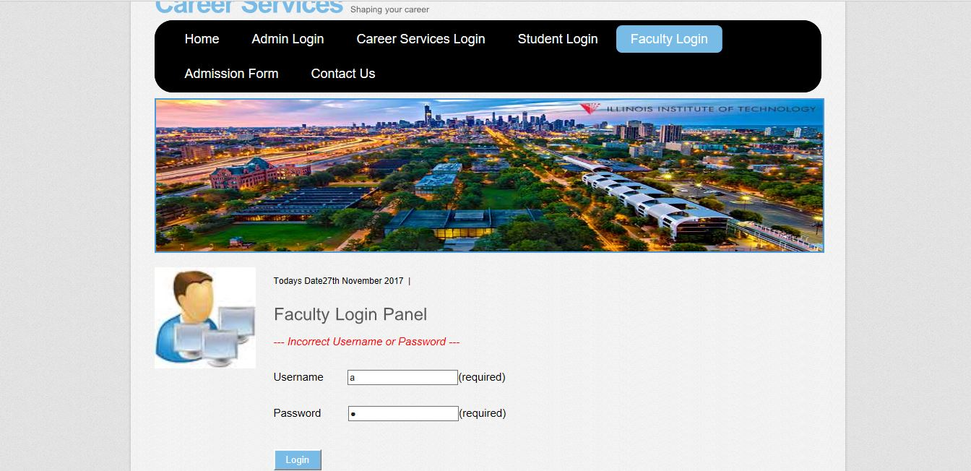
Faculty Login fail

Slide 33
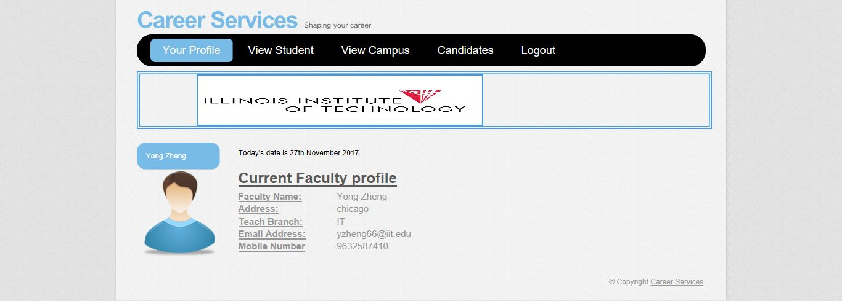
Faculty profile

Slide 34
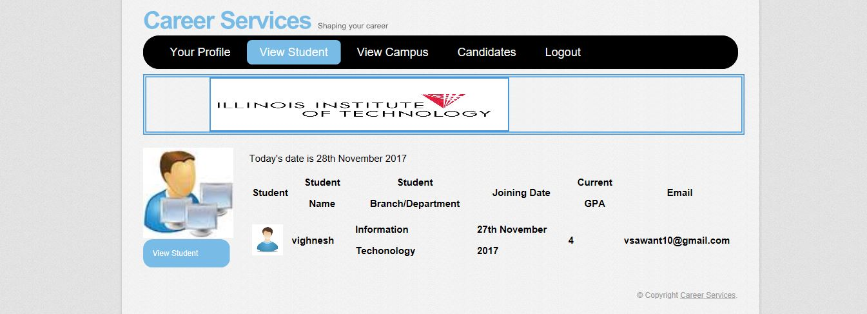
View Student

Slide 35
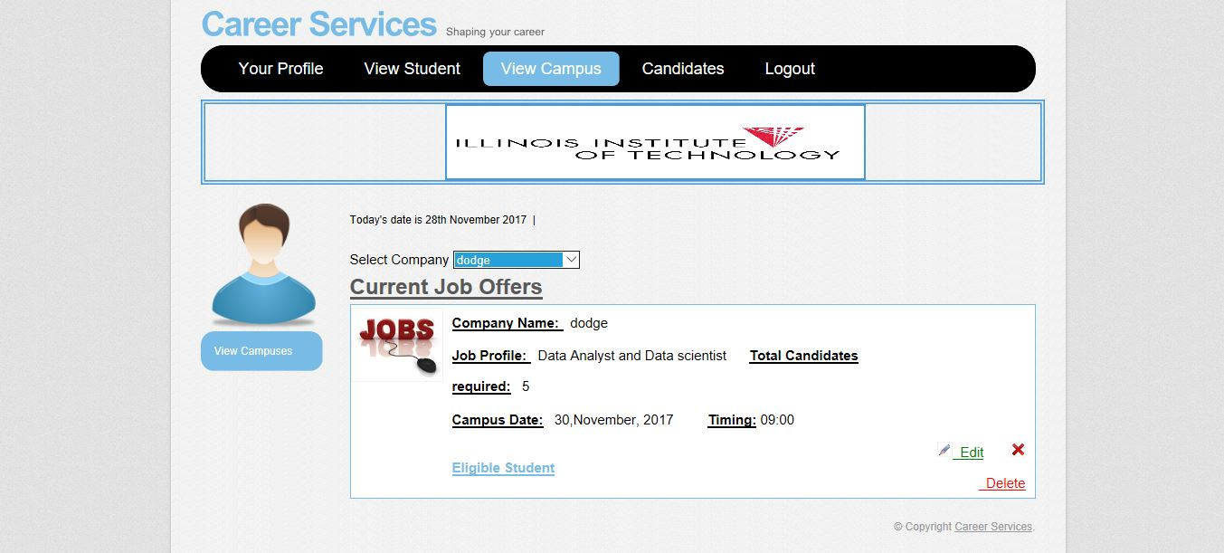
View Campus

Slide 36
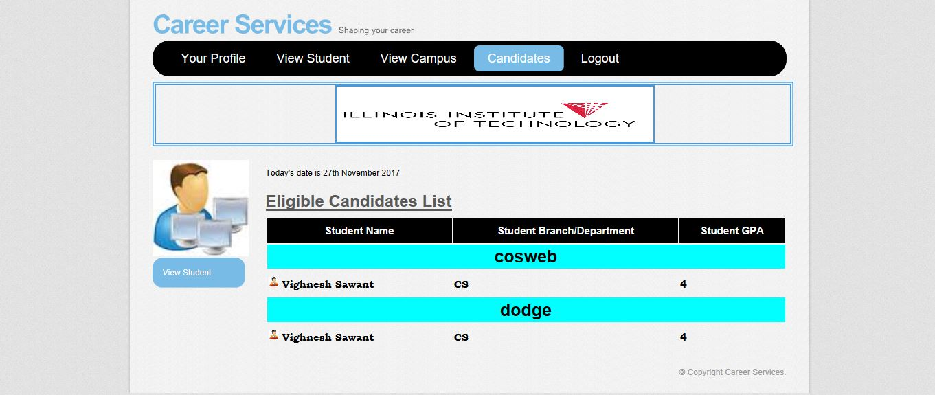
Eligible Students

Slide 37
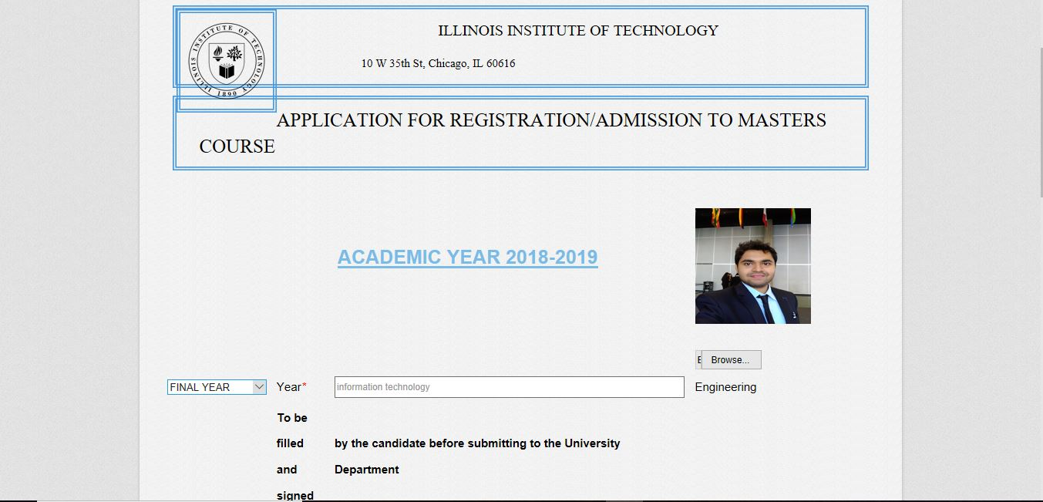
Admission Form

Slide 38
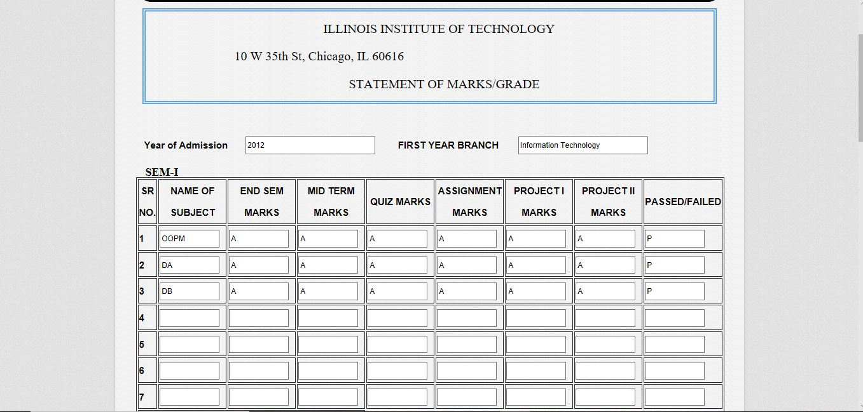
Cont.

Slide 39
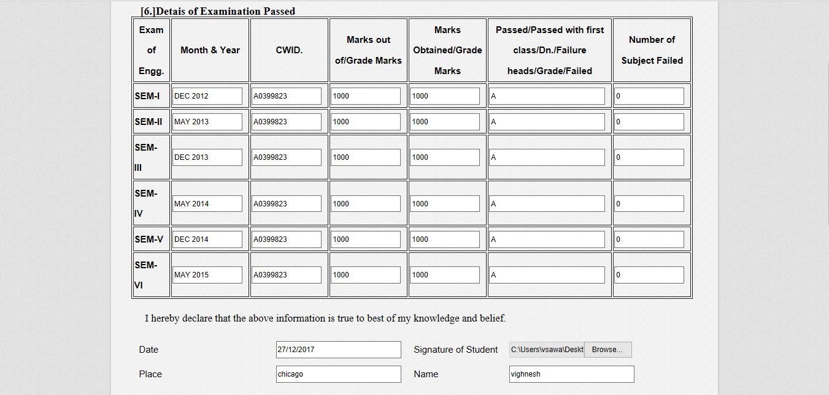
Cont.

Slide 40
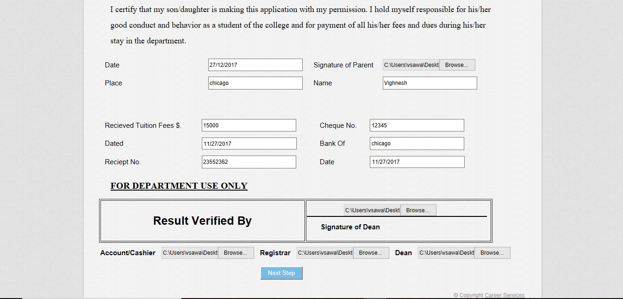
Cont.

Slide 41
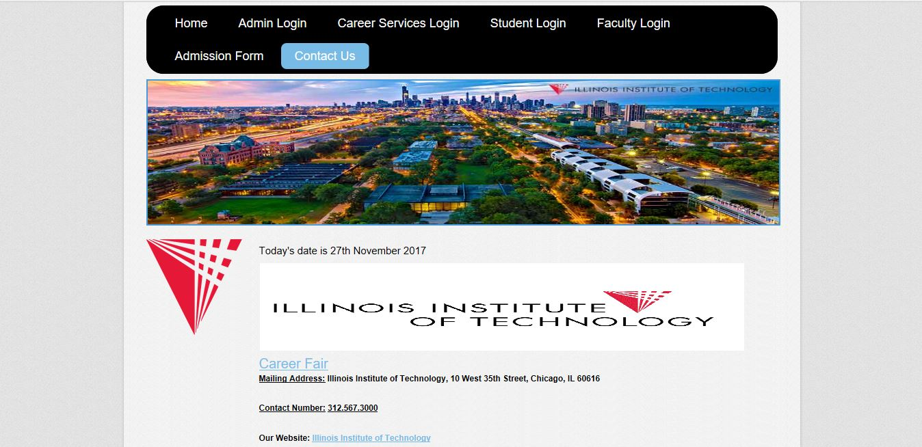
Contact Us

Slide 42
Limitations
Emails have been allowed to only sent to gmail, yahoomail or outlook mails but we cannot send mails to official domain just like xyz@hawk.iit.edu

Slide 43
Future work
SMS integration can be provided, notifications and important notices can be sent via SMS.
we can place the system on cloud so that the maintenance of data is reduced.
Exam section/module can be consolidated with this system so that results will be directly shown to the students

Slide 44
Conclusion
Overall, the entire process of Career services is automated.
We are able to achieve registration of a student, a faculty, personalization of student, communication between career services, student and the faculty
Ease in shortlisting the eligible students for a campus

Slide 45
Thank You
Presented by :
Group id: 83
Members: Vighnesh Sawant
Prateek Deshmukh
Siddharth Singh

