Slide 1

Online File Management System
A Secure and Scalable Cloud Storage Solution
Students: Roll No: 123CS0052, 123CS0058
Guide: Dr. N. Srinivas Naik, Professor & HOD
Department of CSE, IIITDM Kurnool

Slide 2
Abstract
Secure, scalable cloud-based file management system
Three-tier architecture: FastAPI backend, SQLite DB, Next.js frontend
Features: JWT authentication, nested folders, file sharing, activity logs
Innovative hybrid permission model and transactional operations
Optimized for performance and data consistency

Slide 3

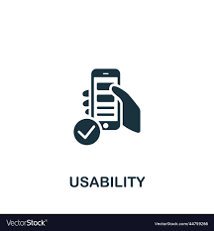

Problem Background
Data explosion demands efficient storage & access solutions
Traditional storage methods are inadequate for remote teams
Existing tools often lack security or usability balance

Slide 4


Problem Definition
Need for secure, intuitive online file storage.
Must support flexible organization, sharing, and permissions.
Ensure reliable file operations and audit logs.

Slide 5
Objectives
Secure user authentication (JWT + bcrypt).
Unlimited folder nesting.
Core file operations: upload, download, rename, move, delete.
Flexible sharing with permission control.
Real-time activity logs & search functionality

Slide 6
Scope
Web-based full-stack system using FastAPI, SQLite, and Next.js.
Includes storage quota management and audit logs.
10GB limit per user.
Excludes versioning and real-time editing (future work)

Slide 7
Literature Survey
Zhang et al. (2023): Hybrid encryption for secure cloud storage.
Kumar & Patel (2024): ACL + RBAC hybrid access control.
Chen et al. (2023): Efficient distributed Meta data management.
Our addition: Simplified architecture with better logging & usability. AI Based summarization for files and code running ability for certain files like c ,c++ ,python.

Slide 8
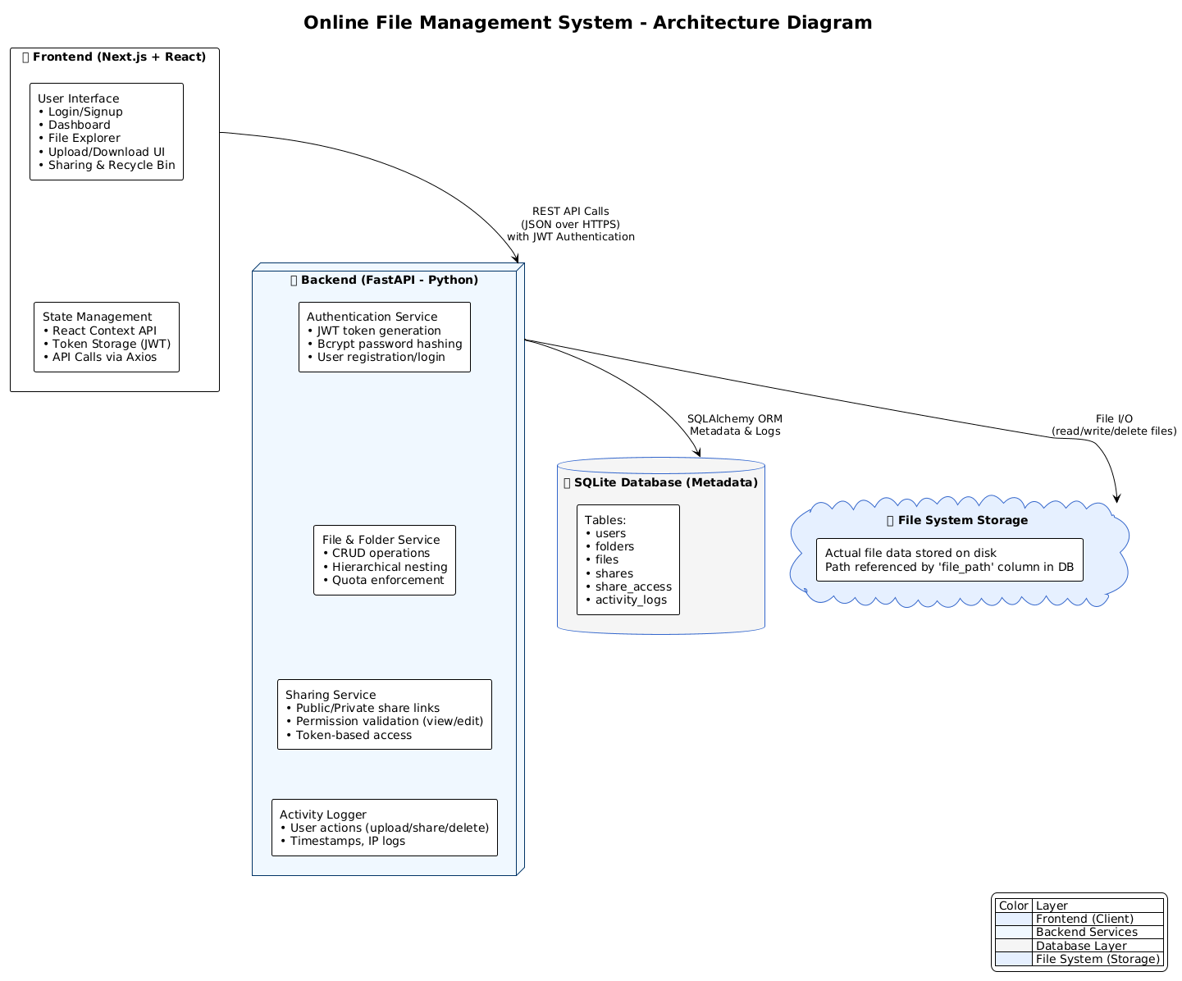
System Architecture
Three-tier structure: frontend, backend, and database.
FastAPI backend exposing REST APIs.
Next.js frontend for dynamic UI.
SQLite for metadata, filesystem for file storage.

Slide 9



Technologies Used
Backend: FastAPI, SQLAlchemy, Pydantic, Passlib, JWT
Backend: FastAPI, SQLAlchemy, Pydantic, Passlib, JWT.
Frontend: Next.js, React, TailwindCSS, Axios.
Database: SQLite.
Security: JWT authentication, bcrypt password hashing

Slide 10
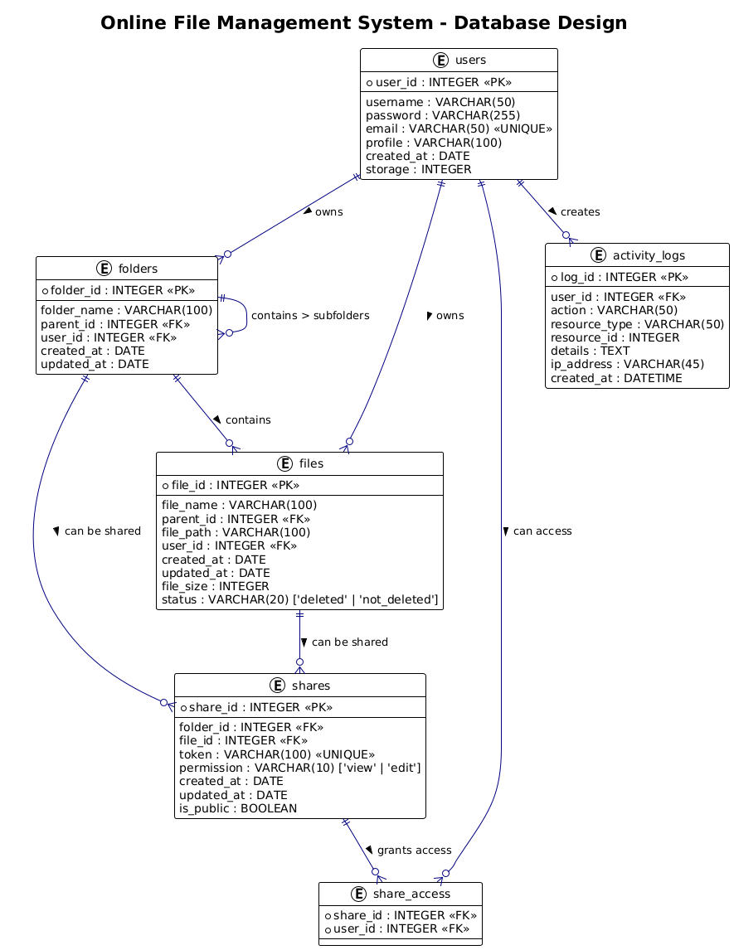
Database Design
Six main tables: Users, Folders, Files, Shares, ShareAccess, ActivityLogs.
Relationships: Users → Folders → Files (hierarchical).
3NF schema for data integrity.

Slide 11
Key Operations
Authentication with bcrypt and JWT.
Transactional file upload ensuring data consistency.
Recursive permission checking (ACL model).
Sharing: public/private with granular access.

Slide 12



Security Features
Encrypted passwords and signed JWT tokens.
Input validation and parameterized SQL queries.
CORS configuration and activity-based logging.
Soft delete + Recycle bin for safe recovery.

Slide 13
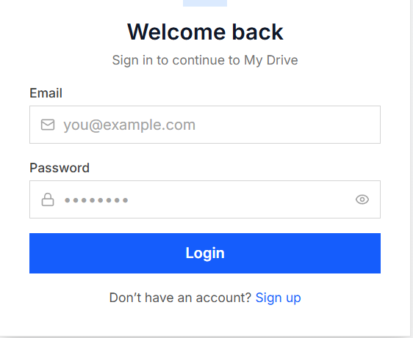
Backend Implementation
Modular FastAPI routes: auth, files, folders, shares.
JWT-based authentication with 24-hour expiry.
File consistency maintained via transactional operations.

Slide 14
Frontend Implementation
Built using Next.js and React.
TailwindCSS for modern, responsive design.
Context API for global state management.
Axios for secure API requests.

Slide 15
Algorithms and Logic
Recursive folder traversal for ZIP downloads.
Owner-attributed logging system.
Recursive SQL checks to prevent circular folder references.
User Interface
Clean, responsive dashboard.
Drag-and-drop upload & share modals.
File preview, recycle bin recovery.

Slide 16
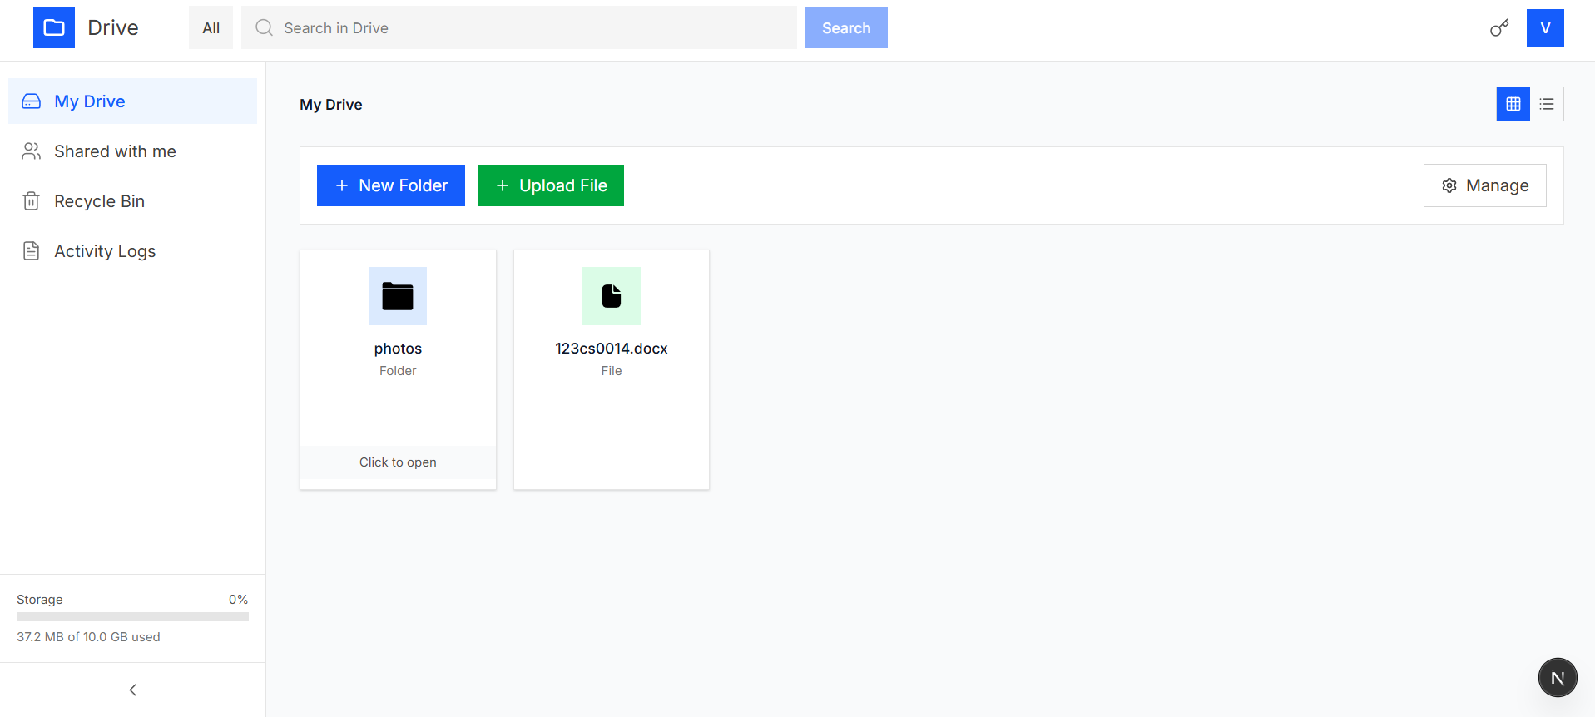
PREVIEW

Slide 17
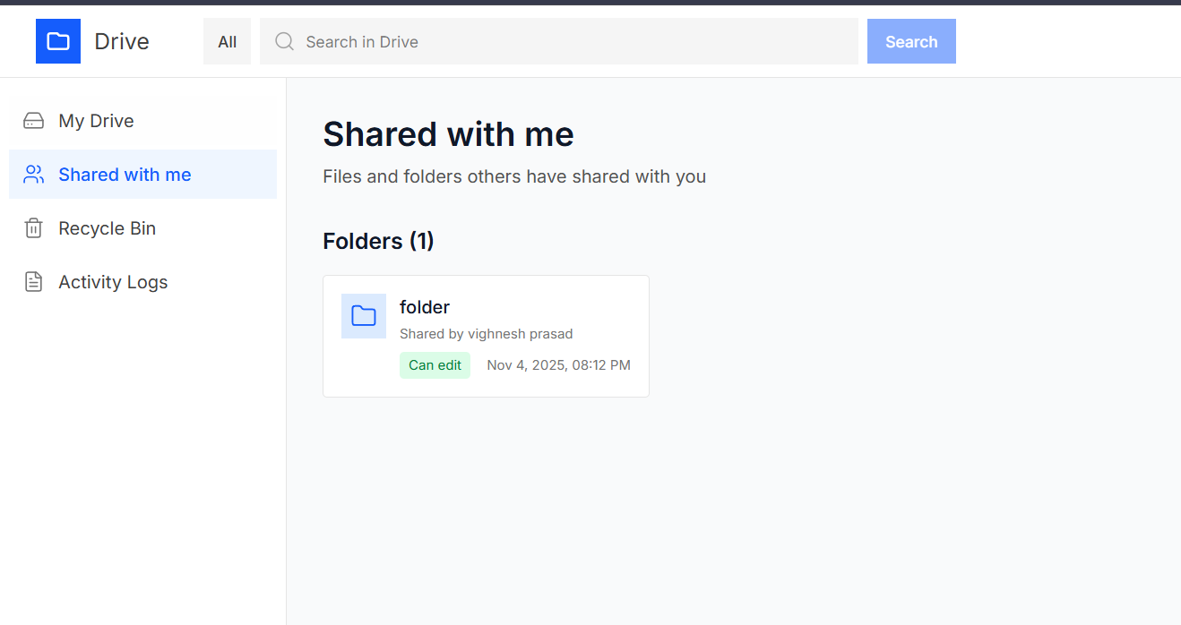
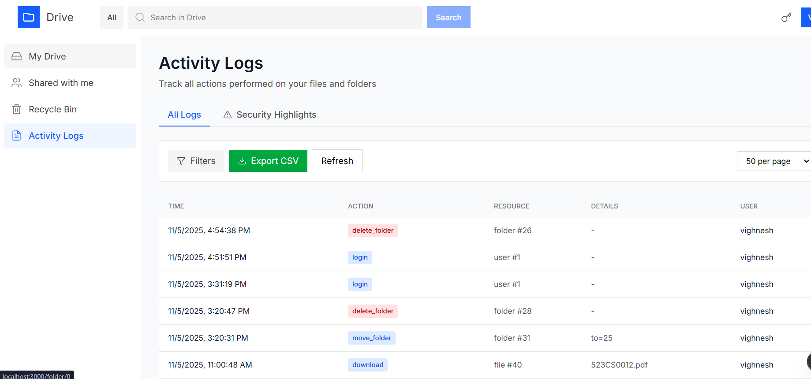
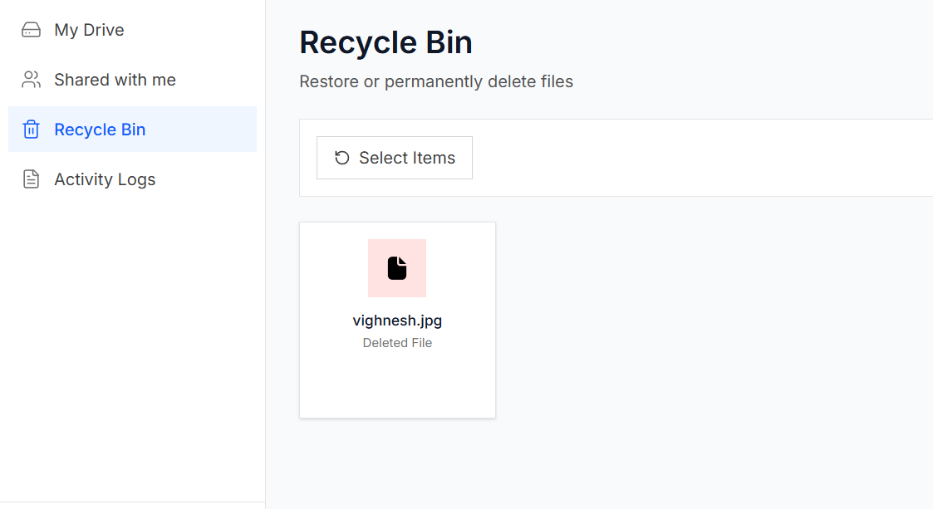
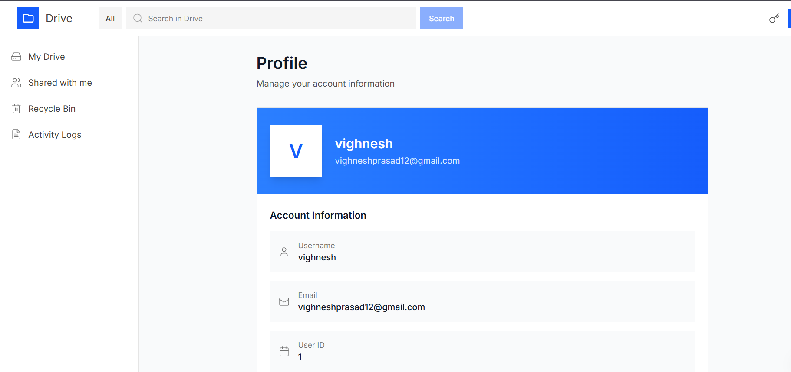

Slide 18
Limitations & Future Work
Limitations:
  10GB limit
  SQLite scalability issues
  No versioning or real-time sync.
Future Enhancements:
  Version control.
  mobile app
  Advanced search & notifications
  PostgreSQL + distributed storageReal-time collaboration & ML-based organization

Slide 19
Conclusion
Built a secure, scalable file management system.
Demonstrated full-stack and security integration.
Extensible, modular, and educational design.
Foundation for future research and enterprise use.

