Slide 1

Churn Analysis for swan telecom customers

Slide 2
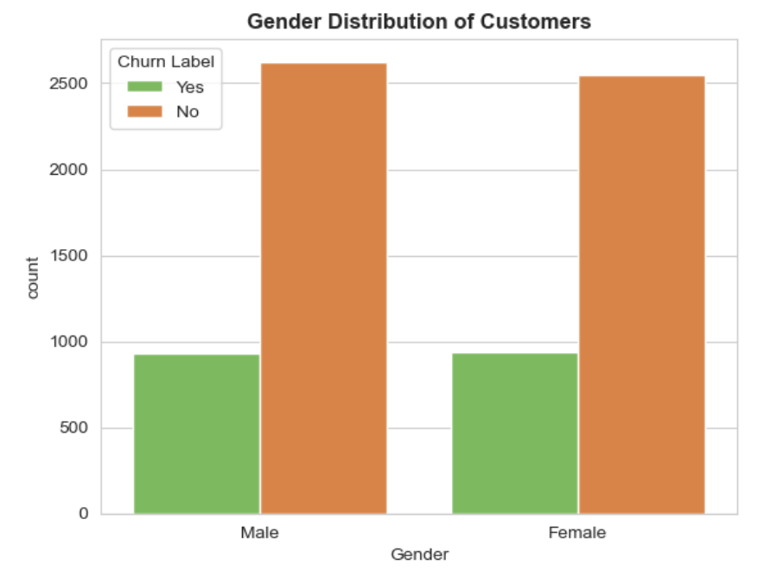
Customer Data review
Gender Wise Split for Customers
Number of male Customers : 3555 Female count: 3488
The number of male customers who churned: 930
The number of female customers who churned:939

Slide 3
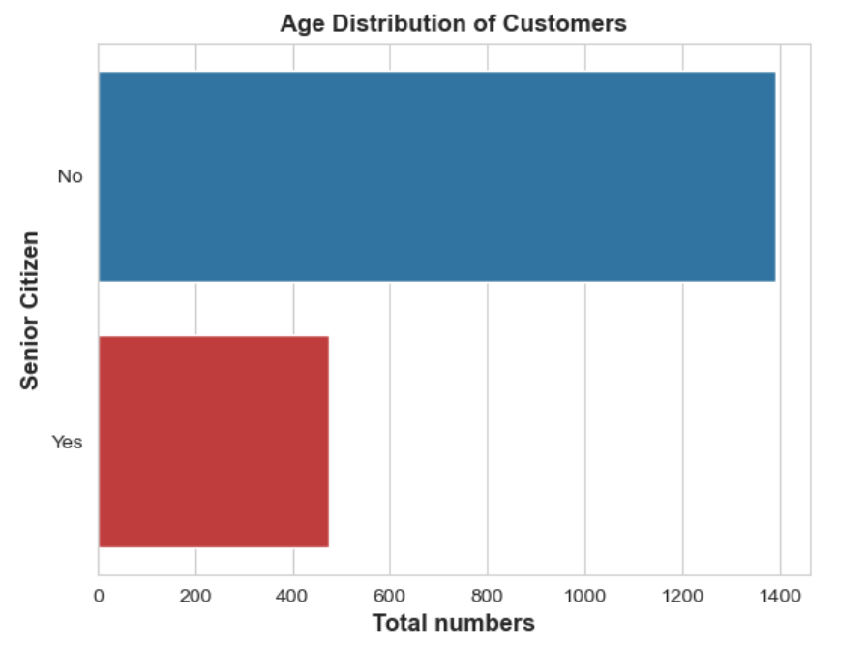
Customer Data review
Age Wise Split for Customers
The number of senior citizens: 1142
The number of non- senior citizens: 5901
The number of senior citizens who churned: 476
The number of non senior citizens who did not churn: 1393

Slide 4

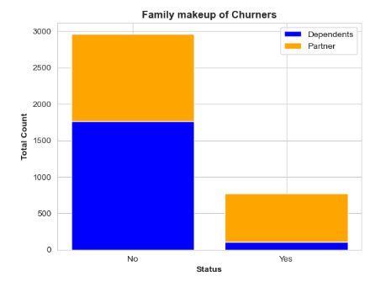
Family makeup of churners
Number of customers with dependents: 1627
Number of customers with no dependents: 5416
Number of churners with dependents: 106
Number of churners with no dependents: 1763
Number of churners with partners: 669
Number of churners with no partners: 1200
Notes:
Number of people with partners
And dependants

Slide 5
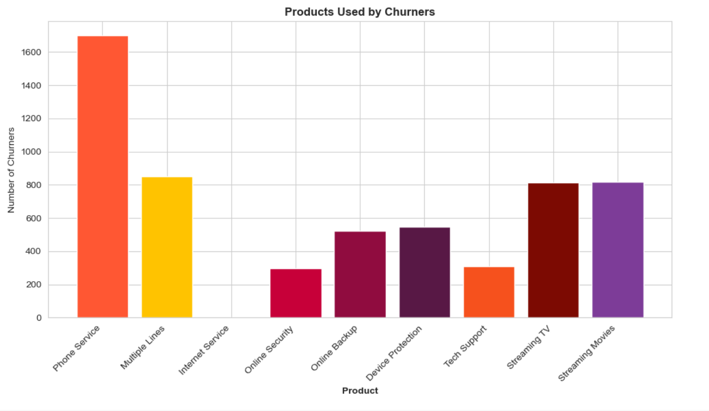
Customer product review
Products Used by Churners
The most churned product: Phone Service
The least churned product: Internet Service
Notes:
Provide caption for each graph

Slide 6
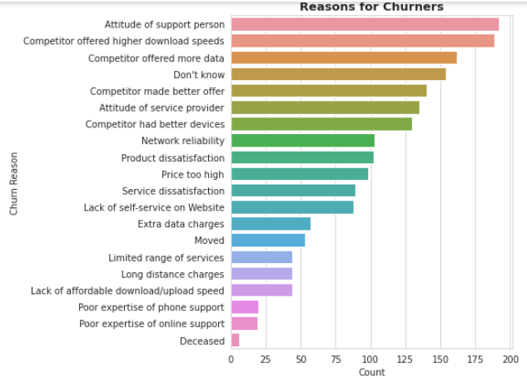
What factors most influence someone churning
Controllable Factors
Attitude of Support Person
Higher download speed by competitors
Un Controllable Factors
1. Customer Demise

Slide 7

Which features most important
Feature (Top 5 features as par the lowest p- values | Feature Description | P- value
Tenure Months | The number of months a customer spends with the provider, contributes to churning. | 1.10369e-154
Churn category | It is a categorical variable that indicates whether a customer lives in a city with a high or low churn rate. | 5.7642e-104
Pay electronic check | It is a binary variable indicating whether a customer pays their bills electronically or not. | 1.94875e-64
Dependants | Whether a customer has dependants or not, contributes to churning | 2.58649e-41
Paperless billing | It is a binary variable indicating whether a customer has opted for electronic bills and statements. | 2.77449e-25

Slide 8
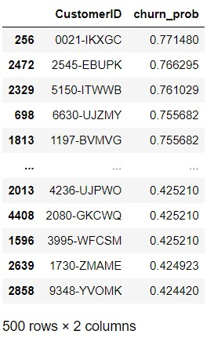
List of Top 500 customers
Identified by applying the predictive model for the top 500 customers who are most likely to churn - They will receive mail.
File is attached

Slide 9
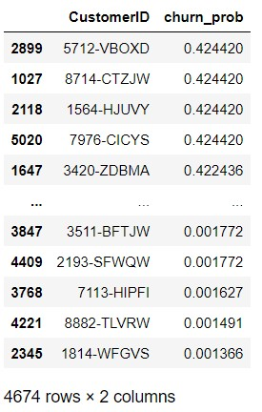
RISK OF REMAINING customers
Attached are the risk of churning in customers that do not fall in the top 500 most likely to churn and their probabilities of churning.
File is attached

Slide 10
DISCUSSING THE MODEL​ for predicting churn
Result for best Logistic Regression Model​ | Training Data (75%)​ | Testing Data (25%)​
Accuracy​ | 0.81 | 0.80
Recall rate​ | ​0.68 | 0.69​
Precision​ | ​0.52 | 0.55
F1-score​ | ​0.59 | 0.61
Data Split in the ratio 0f 75:25
Tested data on a stepwise model, also baseline model and the VIF model was created.
The best performing was the stepwise model so we progressed with that.

Slide 11
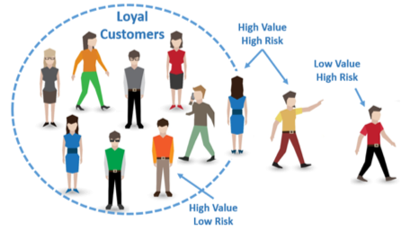
Different factors for churning/ What to INCENTIVISE
Different Factors for churning | What to Incentivise
Poor Phone Service | Reliable phone network
Poor Internet Service | Providing high fibre optic Internet Service
Multiple Phone Service | Long staying customers get bonus

