Slide 1
Implementation of: S3 File Upload Notification System Using SNS

Slide 2
Objective of the Project
The objective of this project is to implement an automated notification system using Amazon S3 and Amazon SNS, where an email alert is sent every time a new file is uploaded to a specified S3 bucket. This setup ensures users are promptly informed about uploads without the need for manual monitoring, enhancing visibility and automation in file handling workflows.

Slide 3
List of AWS Services Used in the Project
01.
Amazon S3 (Simple Storage Service)
Used to store and manage uploaded files.
02.
Amazon SNS (Simple Notification Service)
Used to send email notifications when a new file is uploaded to the S3 bucket.

Slide 4
Scope and Use Case of Services Integrated
01.
Amazon S3 (Simple Storage Service)
A. Scope:
Amazon S3 is used to store and manage files. In this project, it serves as the source of events by detecting file uploads to a specified bucket.
B. Use Case:
Storing user-uploaded files.
Triggering events upon object creation (e.g., file uploads).
Serving as the core input for the notification system.
02.
Amazon SNS (Simple Notification Service)
A. Scope:
SNS is used for sending notifications to users through various protocols like email, SMS, or HTTP. In this project, it was used to send email notifications to subscribed users when a new file is uploaded to S3.
B. Use Case:
Broadcasting system alerts to users.
Sending confirmation messages for actions (e.g., user registration).
Alerting administrators on system events or file uploads.

Slide 5
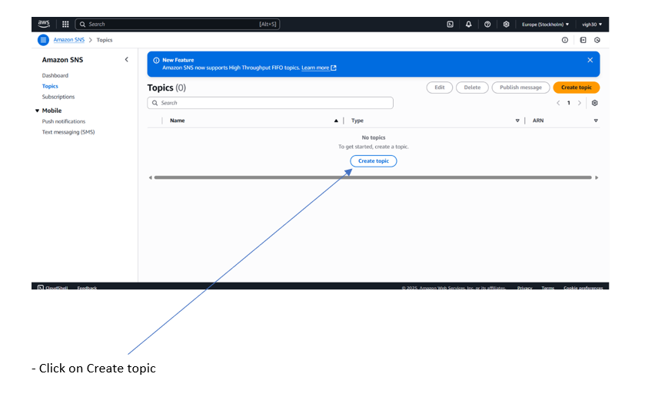
Screenshots of Output – Practical Work

Slide 6
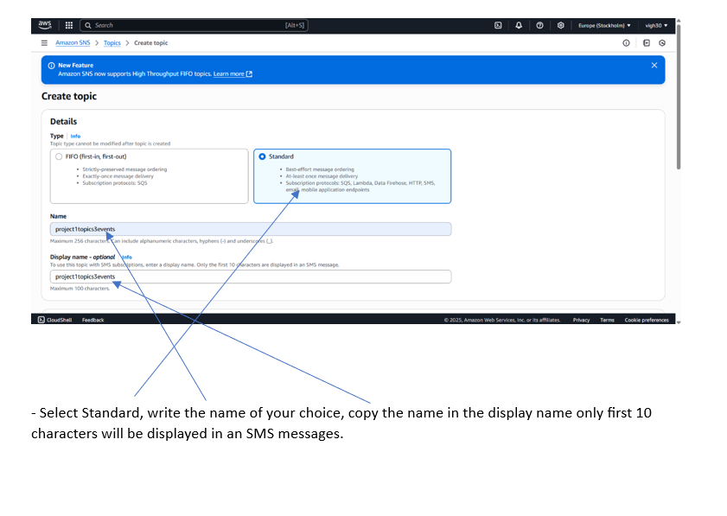
Screenshots of Output – Practical Work

Slide 7
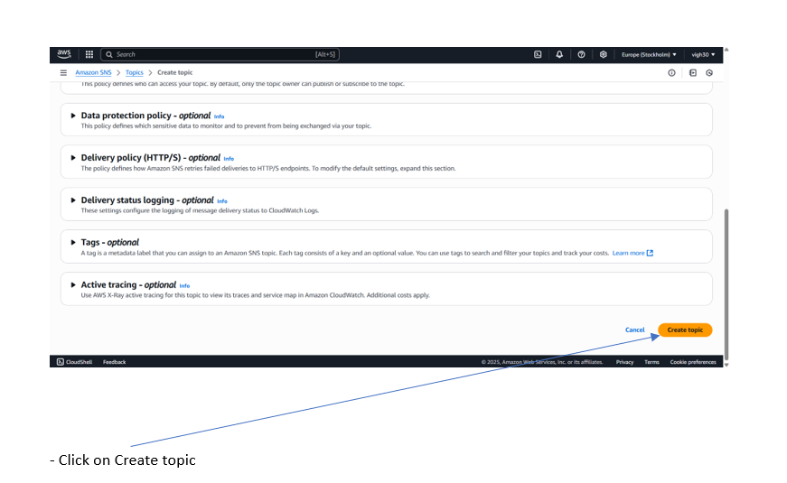
Screenshots of Output – Practical Work

Slide 8
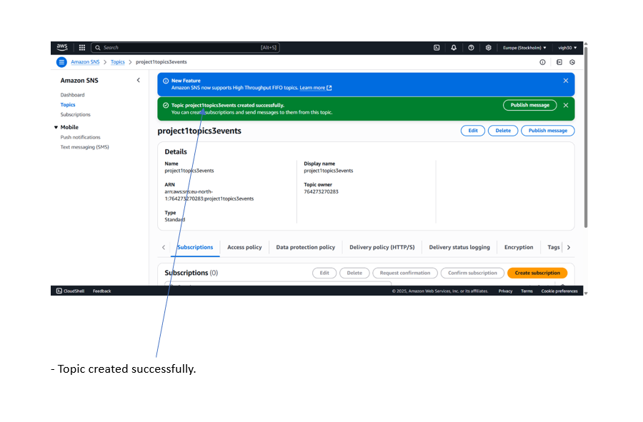
Screenshots of Output – Practical Work

Slide 9
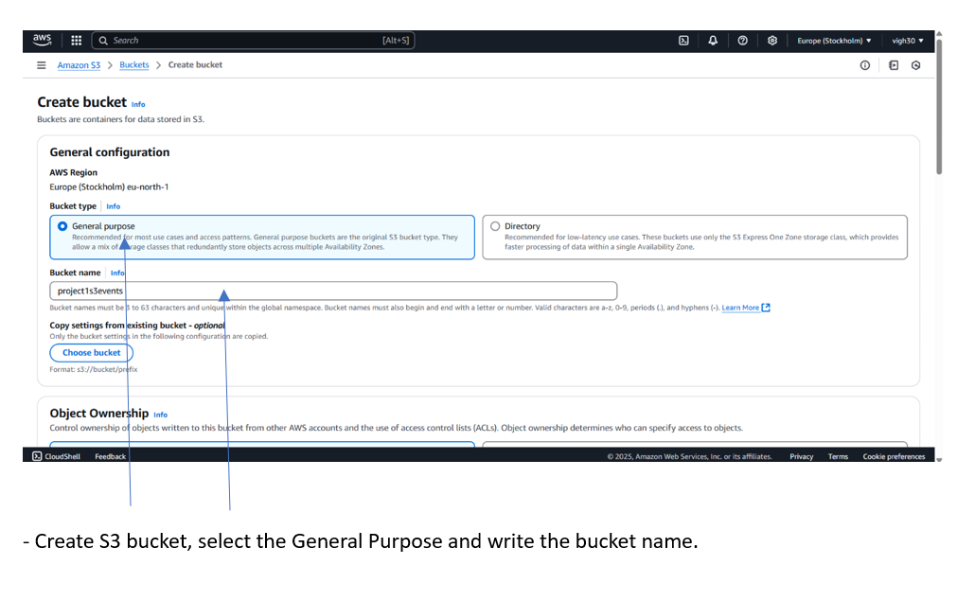
Screenshots of Output – Practical Work

Slide 10
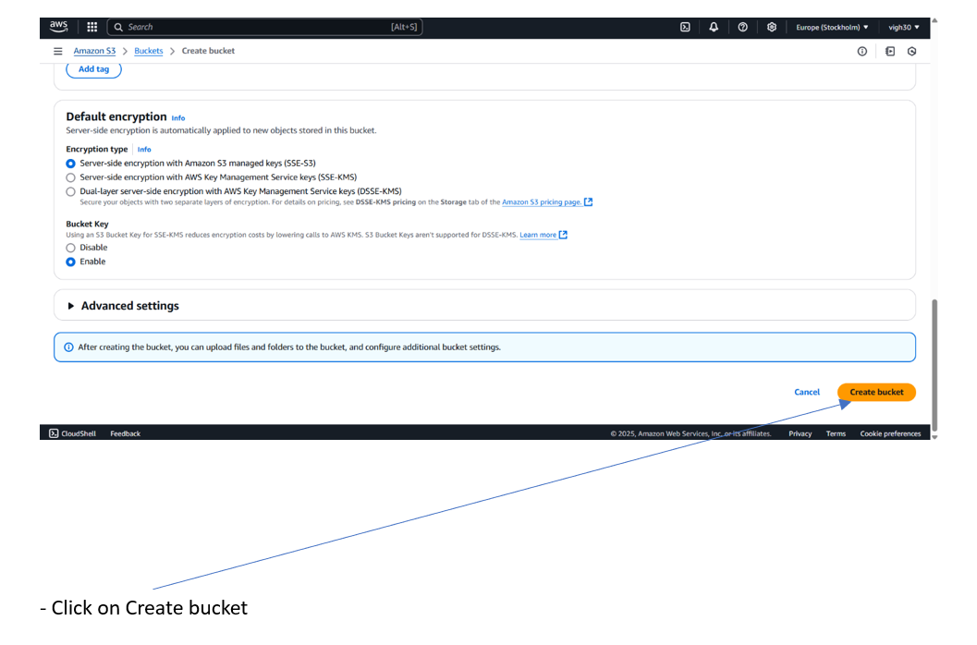
Screenshots of Output – Practical Work

Slide 11
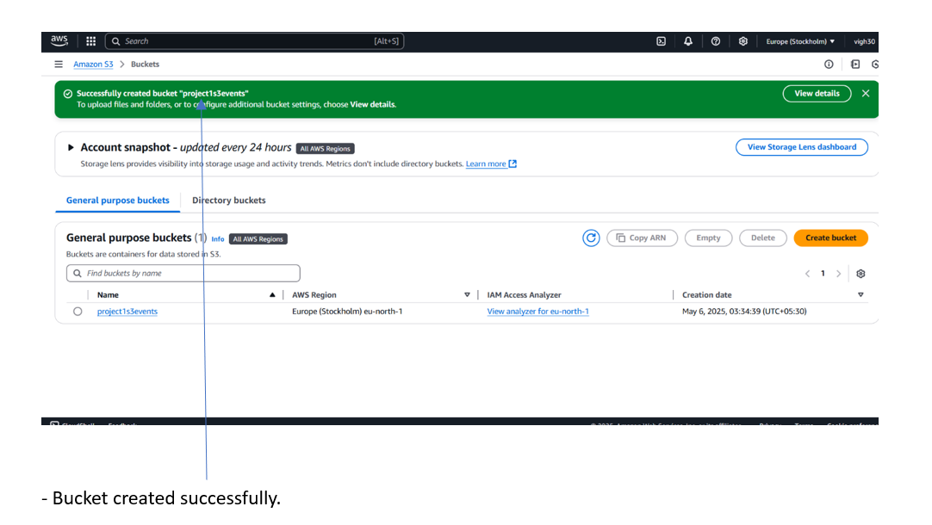
Screenshots of Output – Practical Work

Slide 12
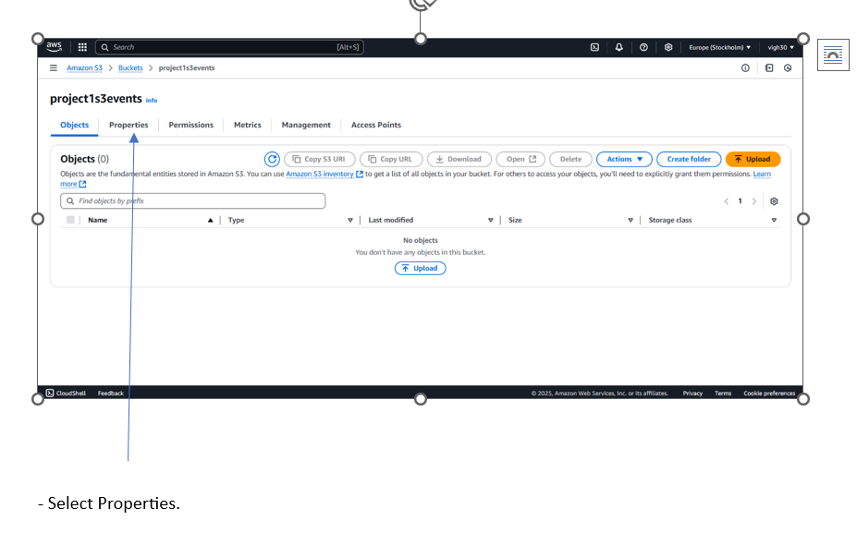
Screenshots of Output – Practical Work

Slide 13
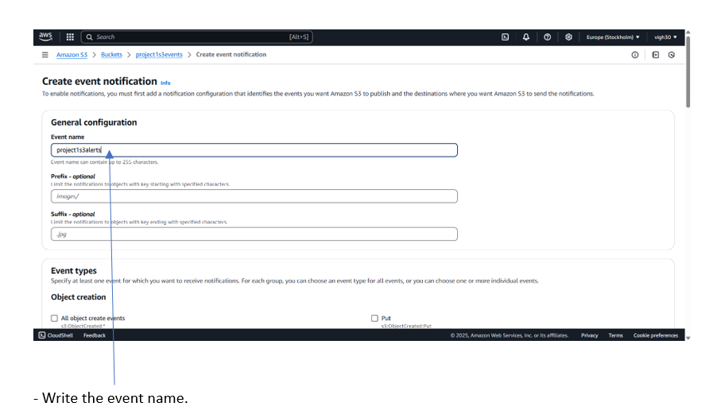
Screenshots of Output – Practical Work

Slide 14
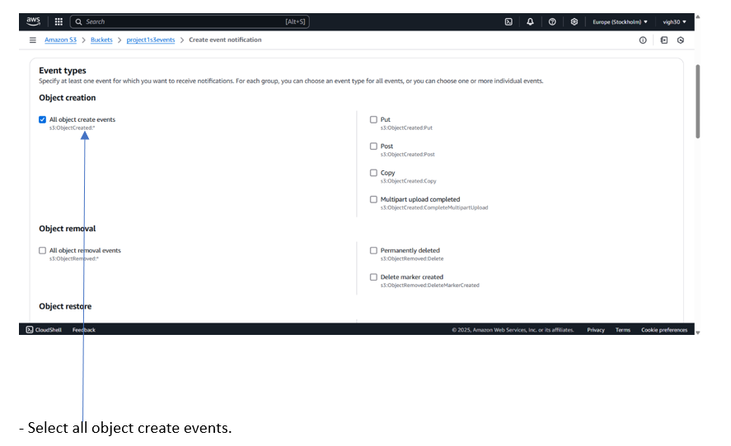
Screenshots of Output – Practical Work

Slide 15
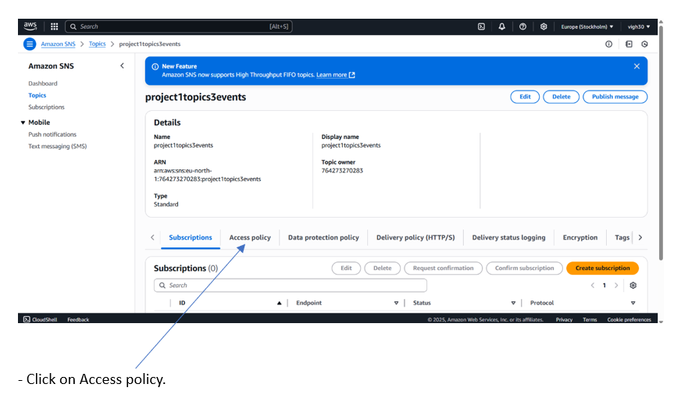
Screenshots of Output – Practical Work

Slide 16
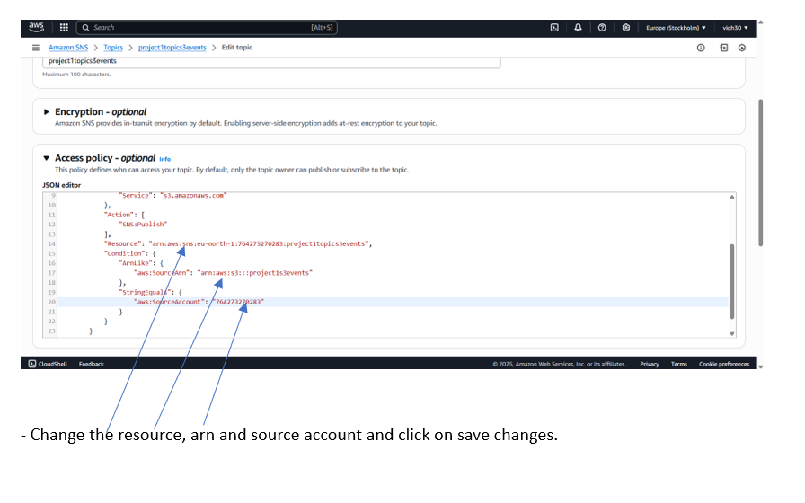
Screenshots of Output – Practical Work

Slide 17
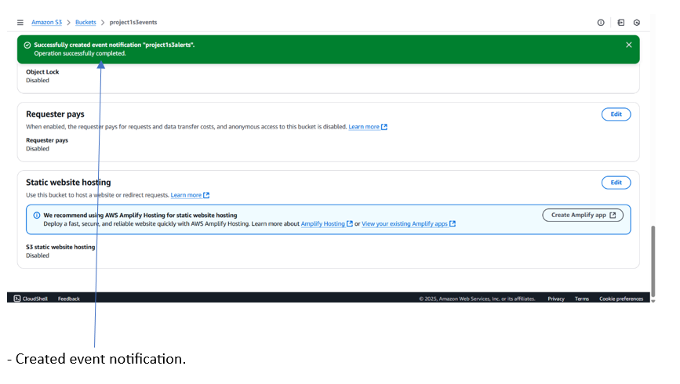
Screenshots of Output – Practical Work

Slide 18
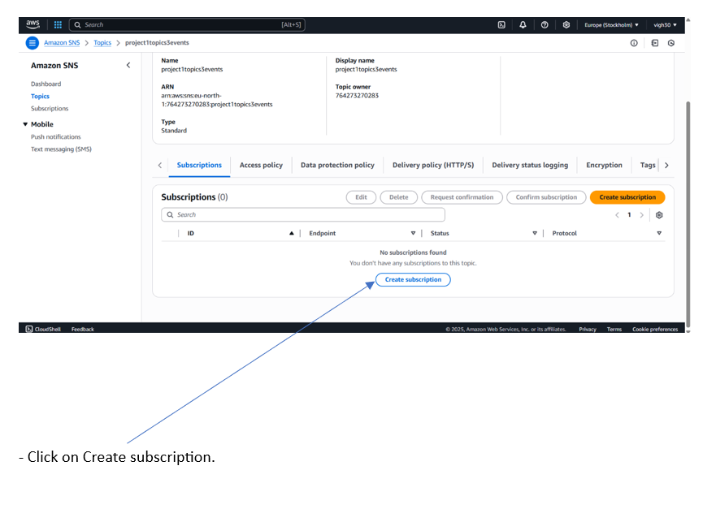
Screenshots of Output – Practical Work

Slide 19
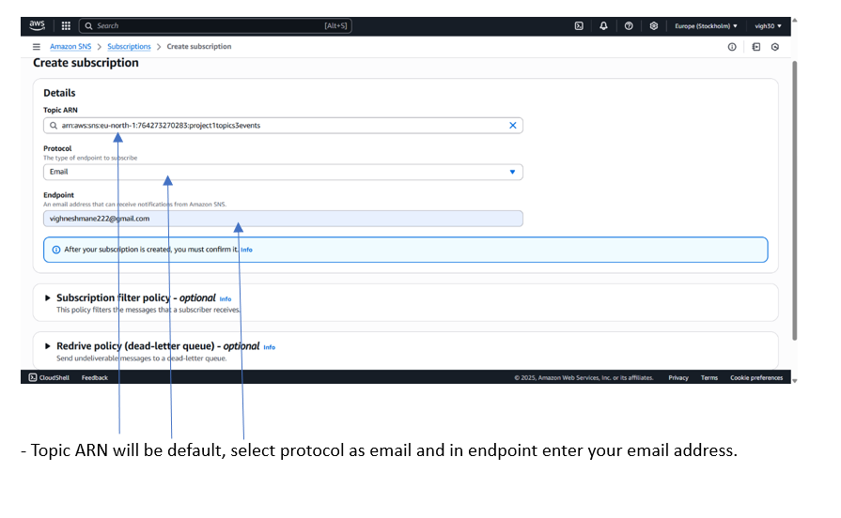
Screenshots of Output – Practical Work

Slide 20
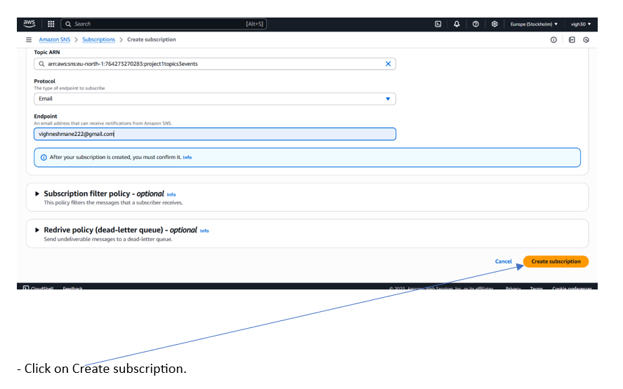
Screenshots of Output – Practical Work

Slide 21
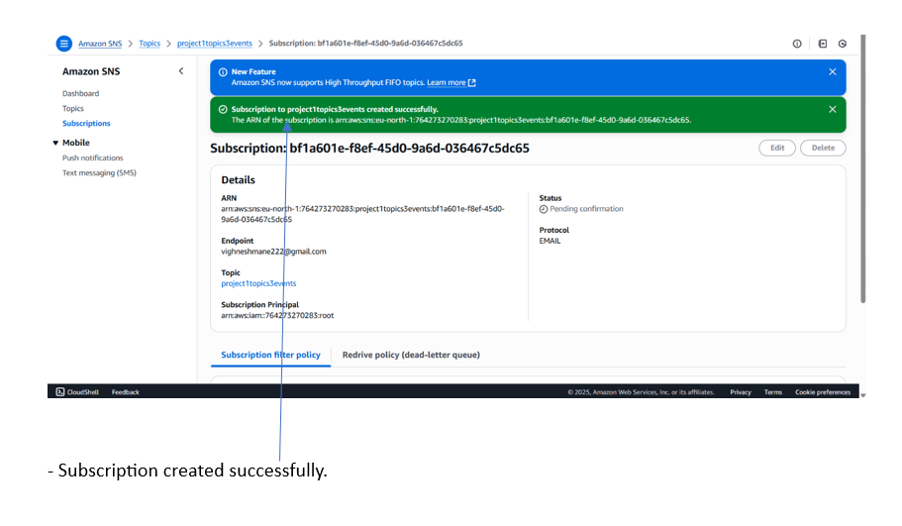
Screenshots of Output – Practical Work

Slide 22
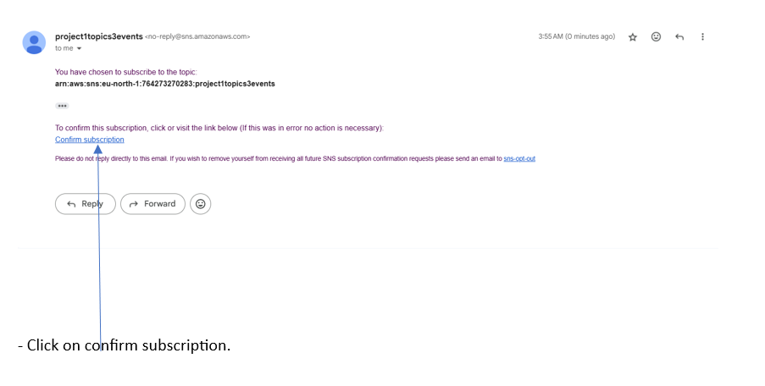
Screenshots of Output – Practical Work

Slide 23
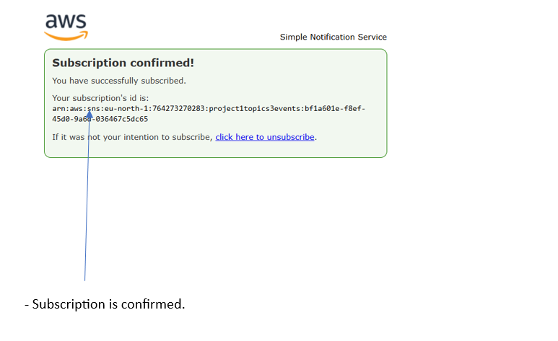
Screenshots of Output – Practical Work

Slide 24
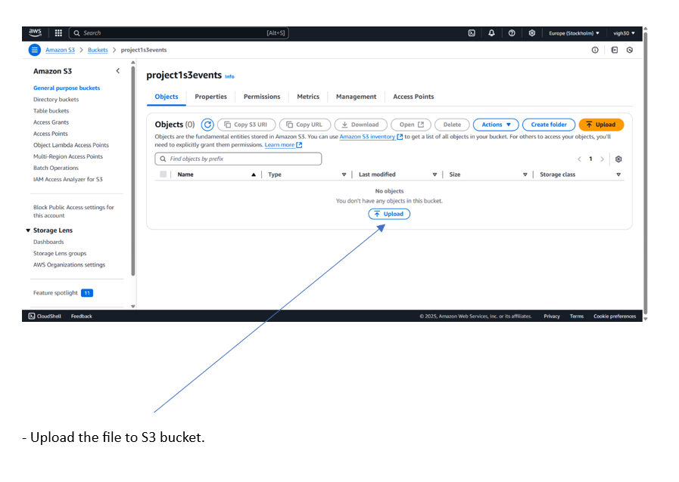
Screenshots of Output – Practical Work

Slide 25
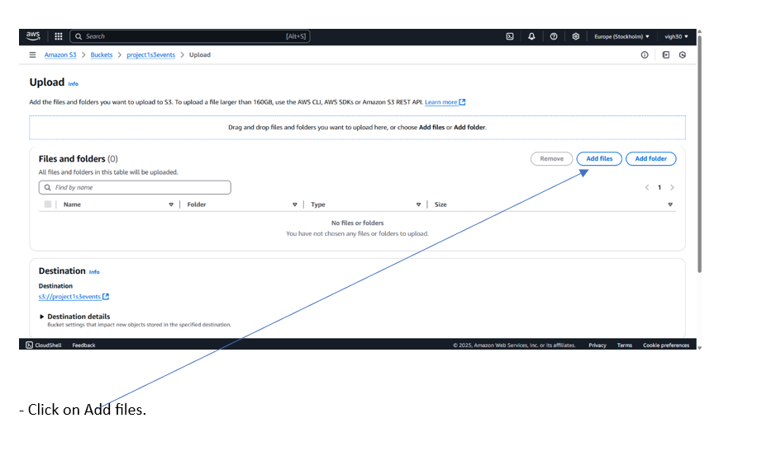
Screenshots of Output – Practical Work

Slide 26
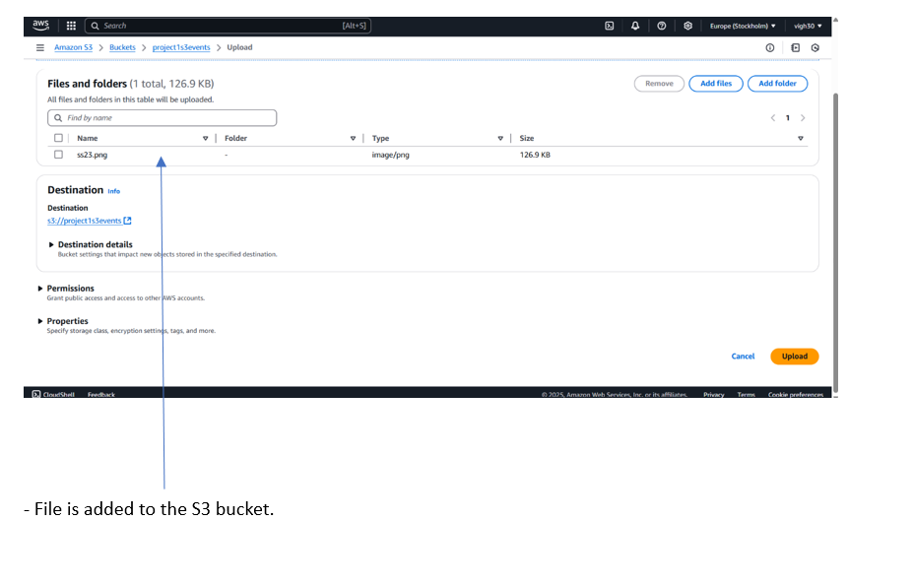
Screenshots of Output – Practical Work

Slide 27
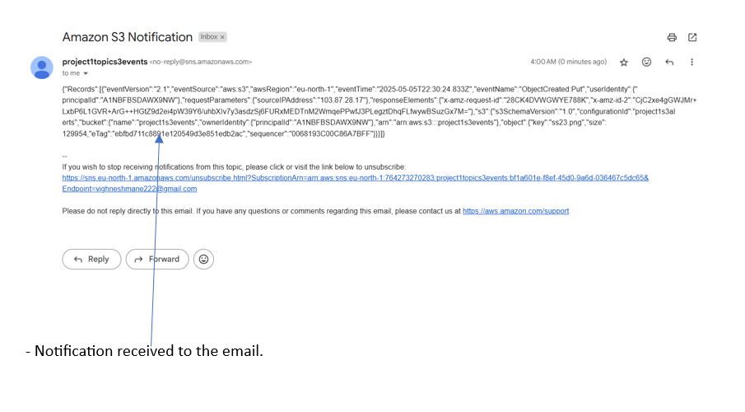
Screenshots of Output – Practical Work

Slide 28
Thank you
Presented By
Vighnesh

