Slide 1
Lab 1 Addendum

Slide 2
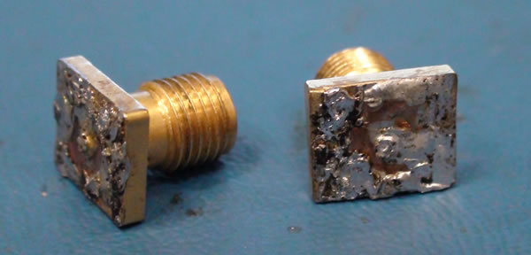
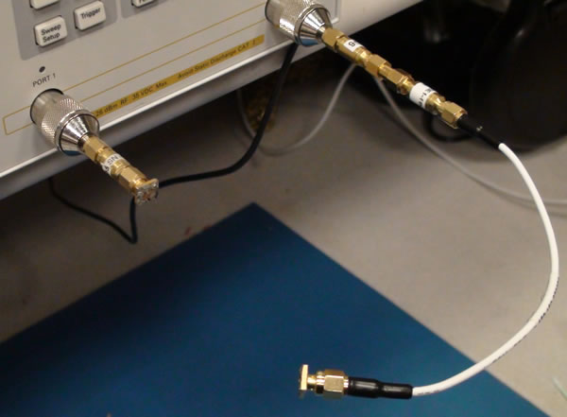
Moving the reference planes:
I’m going to use these shorted SMA connectors, where the center pins have been cut off and then shorted out, to move the reference planes to the location of these shorts. Then subsequent measurements of the Thru board will have the reference planes at the edges of the Thru board:

Slide 3
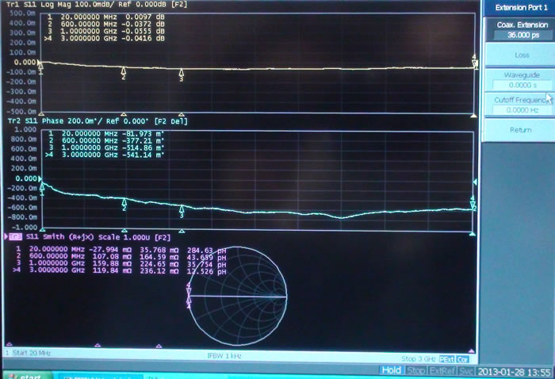
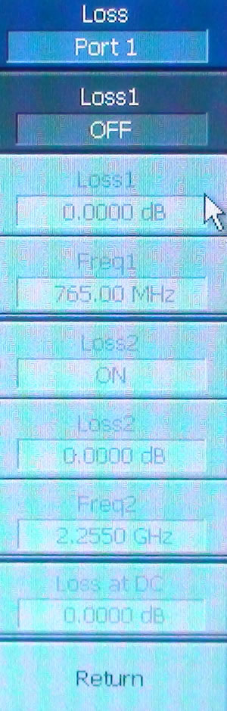
For Port 1 with the shorted SMA connector, found that a manual port extension of 36.0 ps, made all the S11 impedance Smith Chart readings be a dot with a tiny bit of inductance. On the Loss sub-menu, if you turn it on, you can add values that will flatten out the LogMag S11 trace, compensating for any attenuation due to the dummy short.

Slide 4
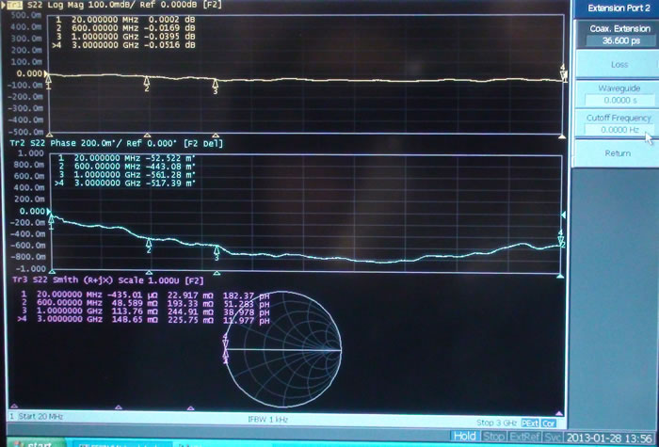
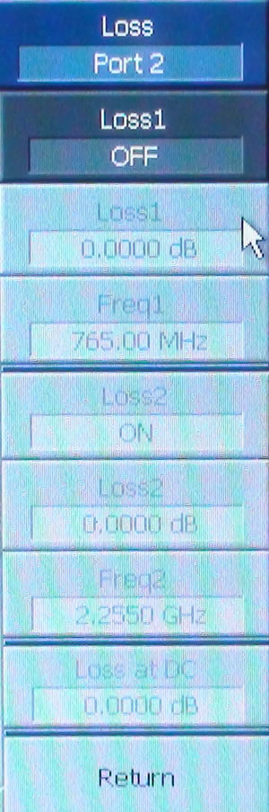
For Port 2 with the shorted SMA connector, found that a manual port extension of 36.6 ps, made all the S11 impedance Smith Chart readings be a dot with a tiny bit of inductance.

Slide 5
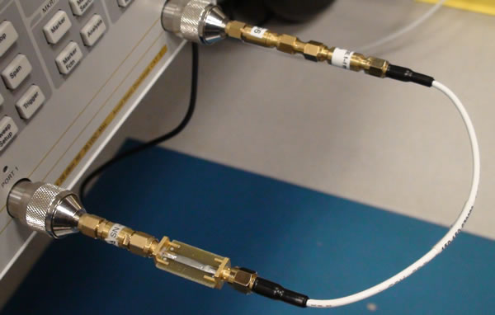
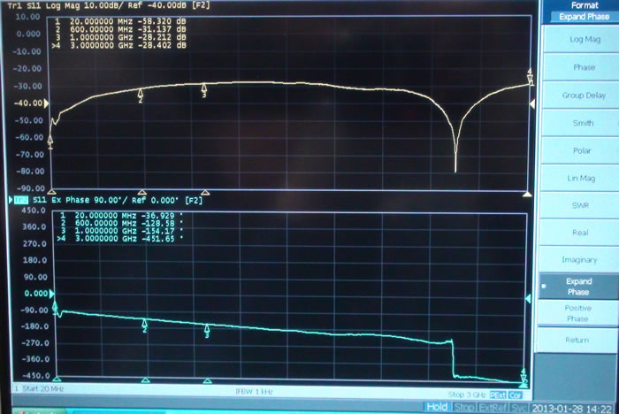
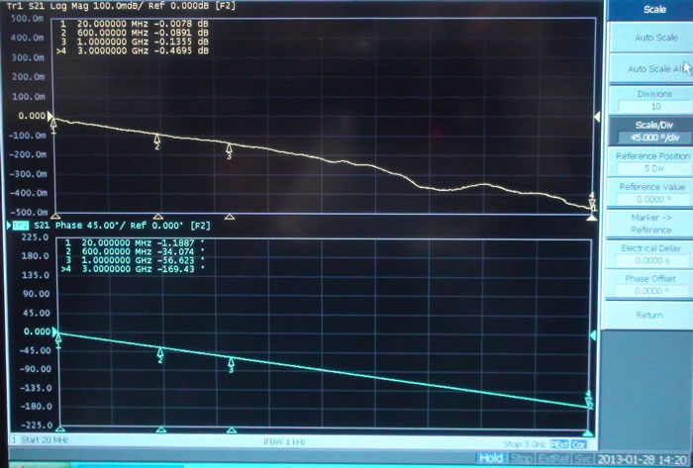
Thru Board
The ref planes are still at the edges of the board (24.69 mm apart).
Thru Board – ref planes are at the edges of the board
Saved in folder:
Sunday130127_aftnn
as Thru_refedges.s2p

Slide 6
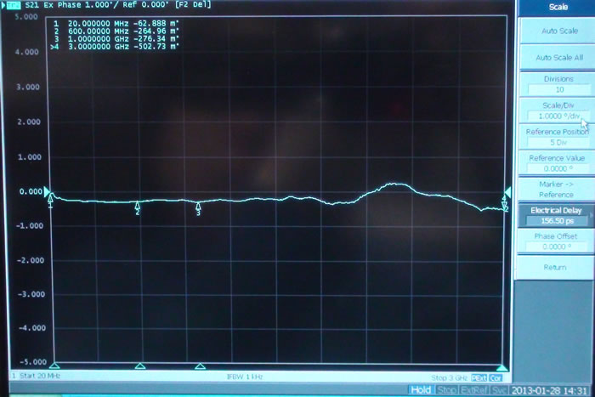
Thru Board
We can measure the electrical length of the Thru board by adding Electrical Delay until the phase is flat at
0 degrees for all freqs. We need 156.6 ps.
Then I set Electrical Delay back to zero.

Slide 7
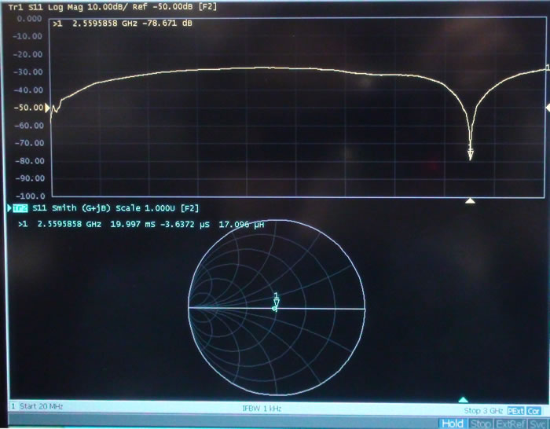
Thru Board

Slide 8
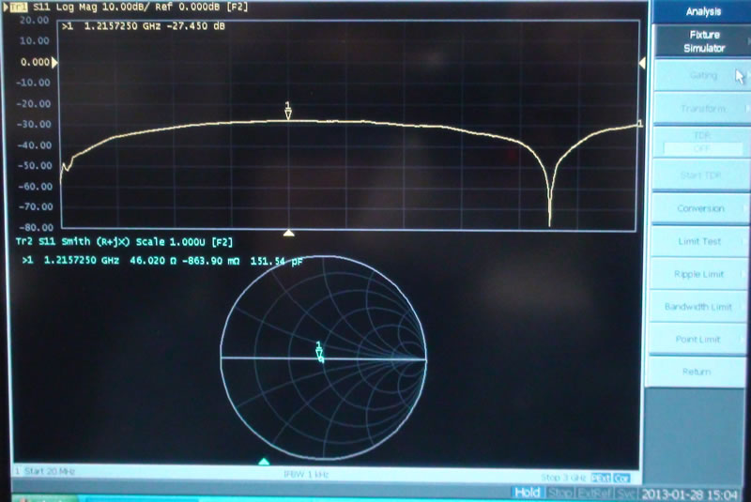
Thru Board
Z_{m} at the λ/4 location is 46 Ω. This means the system impedance of 50 Ω was
transformed to 46 Ω, via whatever the transmission line impedance, Z_{L}, is.
Zm = (ZL^2)/Zo so ZL = sqrt(Zm*Zo) = sqrt(46.02*50) = 47.97
That means if we change the system’s port impedances to 47.97 Ω, then LogMag S11 should go flat (matched).
We can use Fixture Simulator, under the menu for the Analysis hard key, to change port impedances:

Slide 9
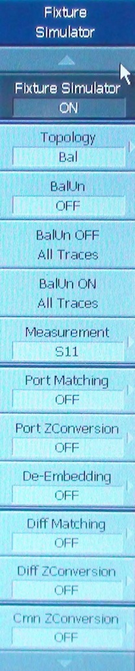
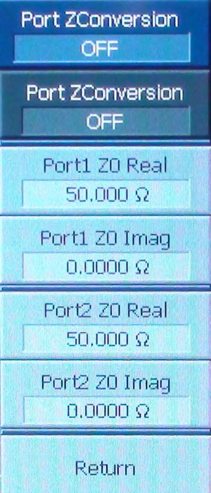
Thru Board
Turn Port ZConversion on.
Set each port’s impedance to 50 Ω real.

Slide 10
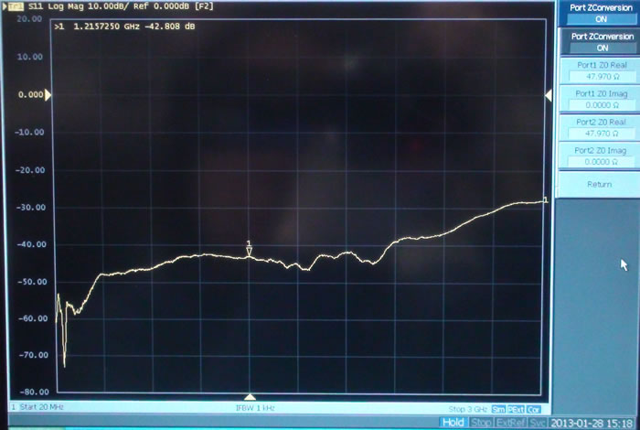
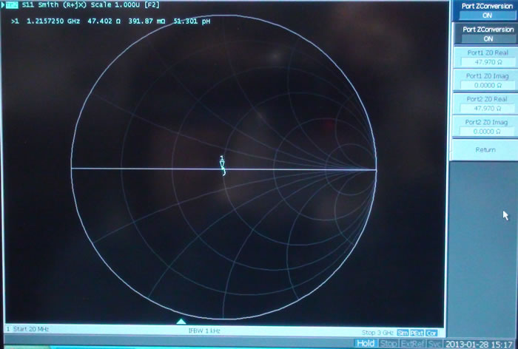
Thru Board
That does make S11 look closer to matched:
So we can characterize Z_{L} of this Thru
board as ~48 Ω. And we’ll assume all
the boards have this same impedance.

Slide 11
Remember to turn off the Fixture Simulator when you’ve finished this measurement. That is,
reset the VNA’s reference impedance back to 50 ohms.

