Slide 1
Discussion 2
Yi-An Li

Slide 2
Outline
Model Card
How setup a bench to get g_{m}, a_{v0}, f_{T}, V*
Diffusion Review

Slide 3
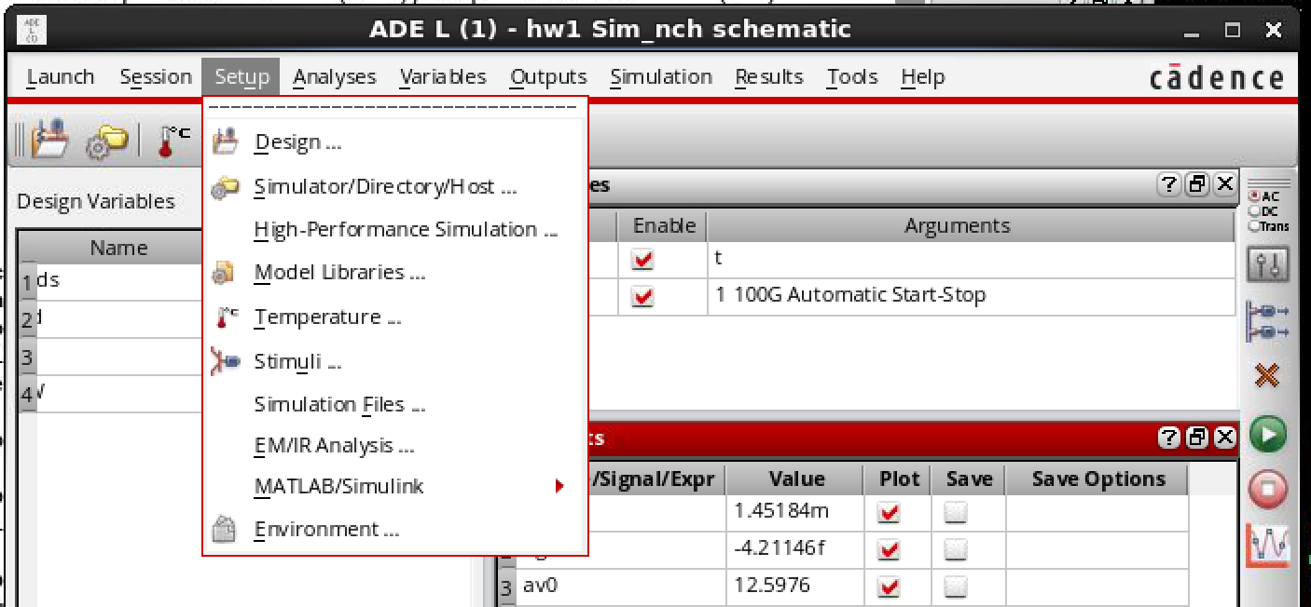
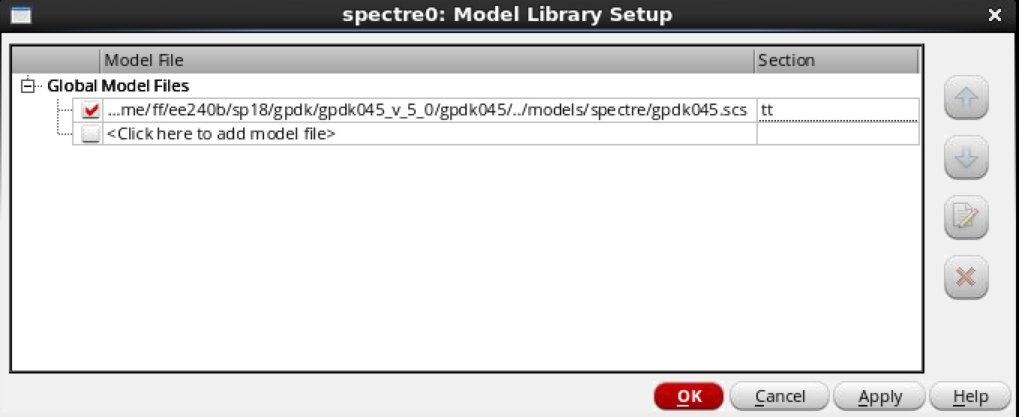
Model Card – Where is it?

Slide 4
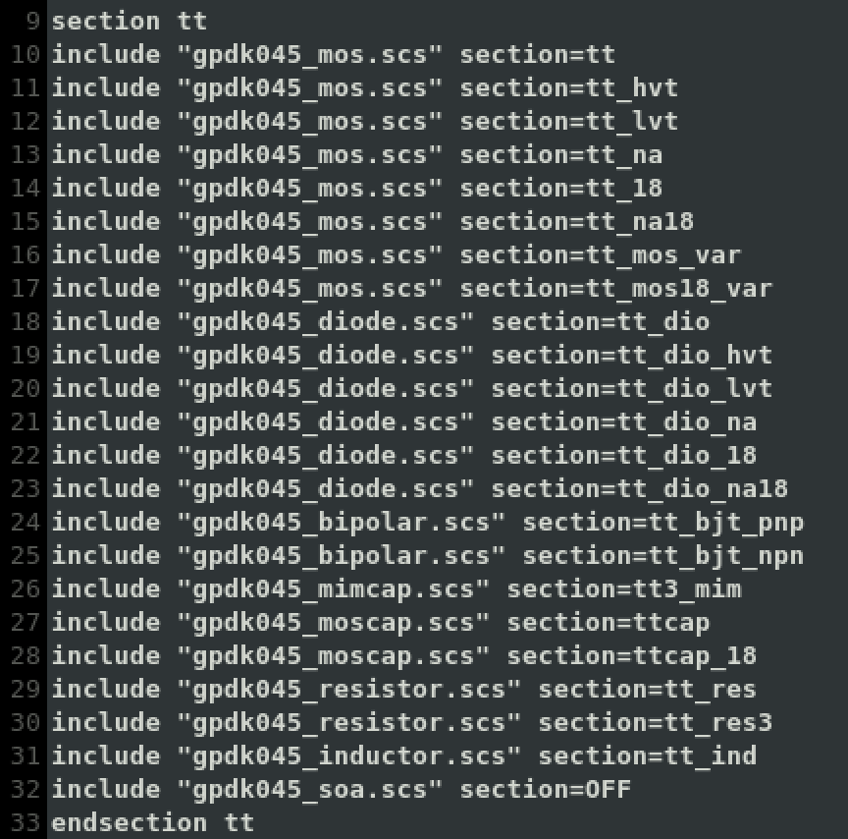
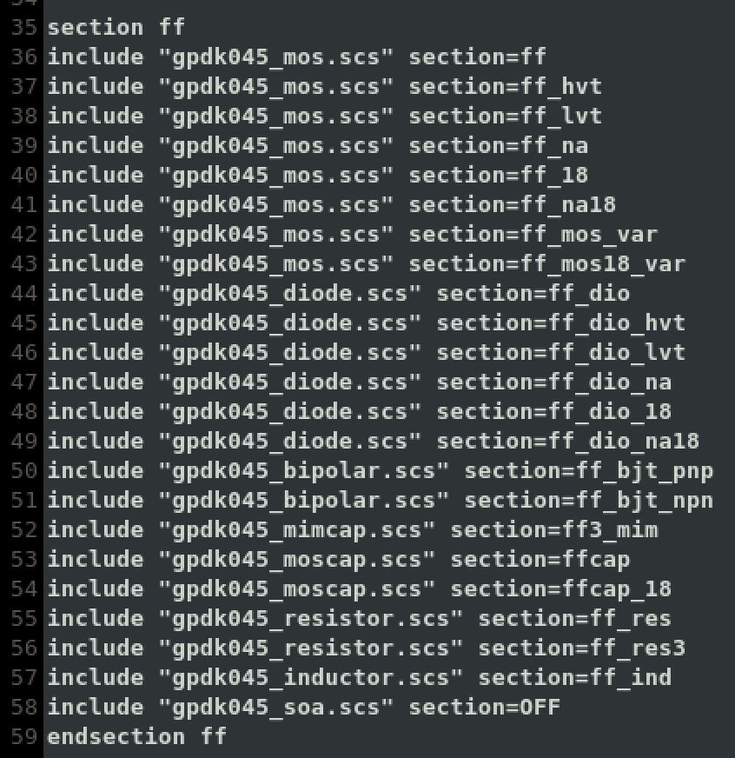
Model Card – What’s inside? _{(gpdk045.scs)}
Sections (corner, MOS type, R, C …)

Slide 5
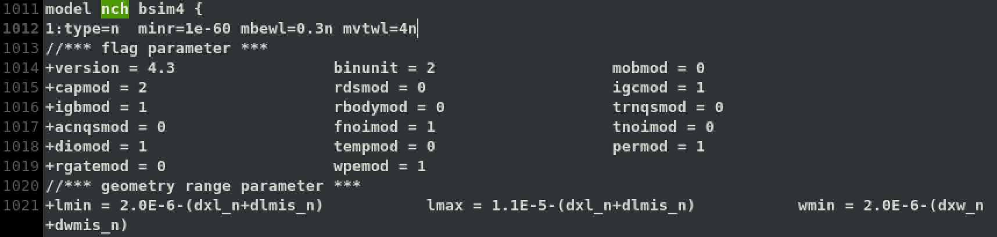
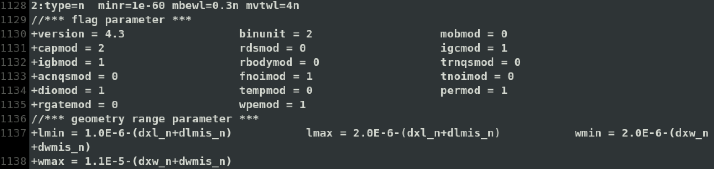
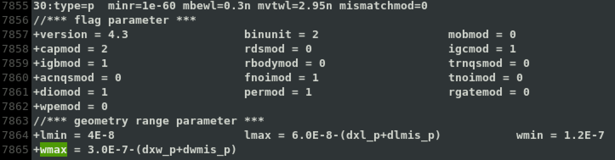
Model Card – What’s inside? _{(gpdk045_mos.scs)}
What’s different between them.

Slide 6
Model Card – What’s inside? _{(gpdk045_mos.scs)}
What’s different between them.
L : 2~11u , W : 2~11u
L : 1~2u , W : 2~11u
…
L : 40n~60n , W : 120n~300n

Slide 7
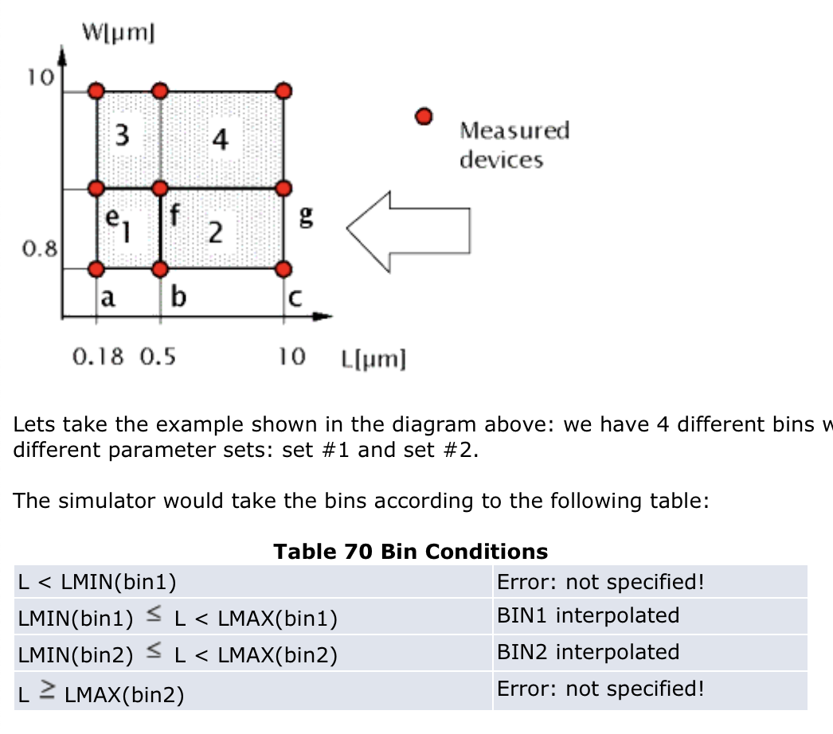
Model Card – What does bin mean?
https://www.ece.ubc.ca/~robertor/Links_files/Files/ICCAP-2008-doc/icmdl/icmdl05a11.html

Slide 8
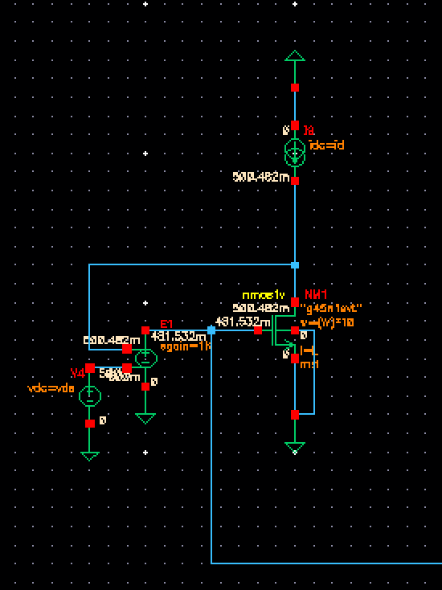
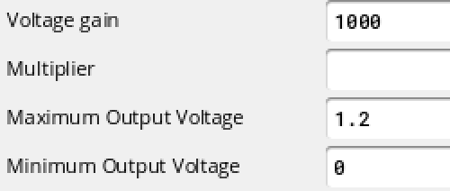
Bench Setup
Use an ideal opamp (VCVS) to fix drain voltage and bias Vgs.
Given Id, the opamp will find a Vgs such that Vds equals desired value.
VCVS

Slide 9
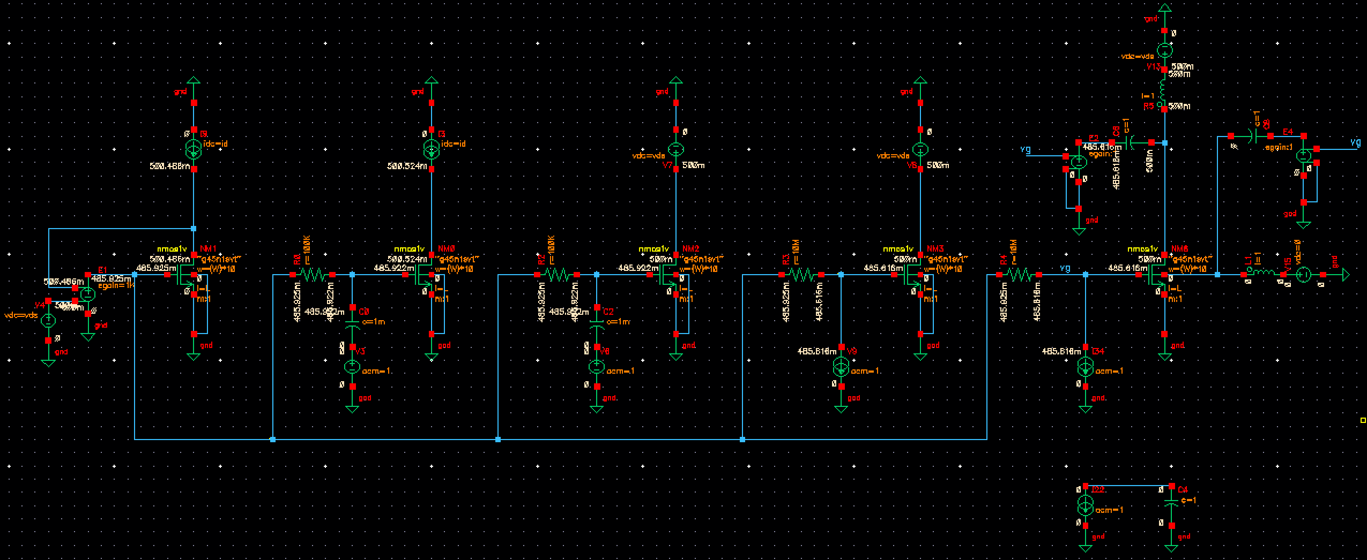
Bench Setup – a_{v0}, g_{m}, f_{T} ,C_{gs}
bias
a_{v0} : Sim v_{d}/v_{g}
g_{m} : Sim i_{d}/v_{g}
f_{T} : Sim i_{d}/i_{g}
C_{gs} : Sim v_{g}/i_{g}

Slide 10
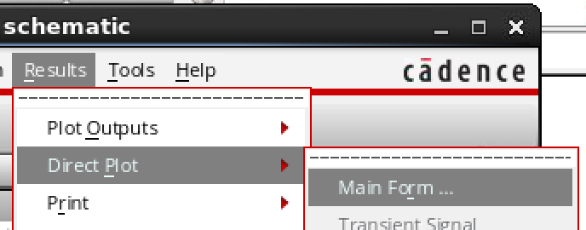
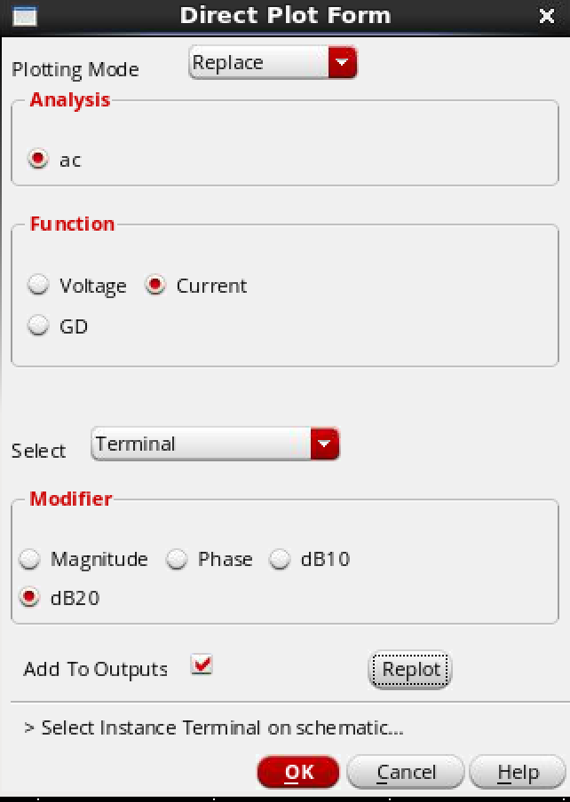
Simulation Tips
V*
Once you have gm & id
Setup in output by equation.
How for find zero crossing freq. ?
Use the function : “cross”
Ex : cross(db(ifreq('ac "/NM3/D")) 0). →. You will get the freq. where gain = 0
How know expressions for simulation results ?
Mark “Add to Outputs”
Expression will show up at output.

Slide 11
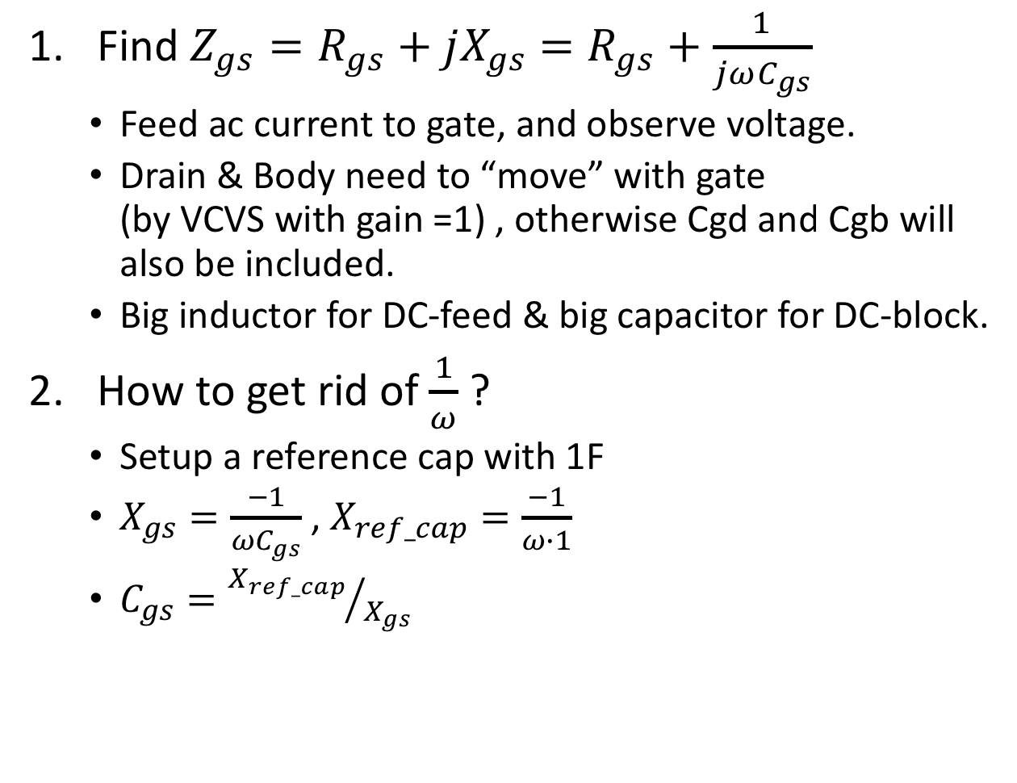
Bench Setup – C_{gs}
Find $Z_{gs}=R_{gs}+jX_{gs}$ $=R_{gs}+\frac{1}{jωC_{gs}}$
Feed ac current to gate, and observe voltage.
Drain & Body need to “move” with gate (by VCVS with gain =1) , otherwise Cgd and Cgb will also be included.
Big inductor for DC-feed & big capacitor for DC-block.
How to get rid of $\frac{1}{ω}$ ?
Setup a reference cap with 1F
$X_{gs}=\frac{−1}{ωC_{gs}}$ , $X_{ref_cap}=\frac{−1}{ω∙1}$
$C_{gs}={X_{ref_cap}}/{X_{gs}}$

Slide 12
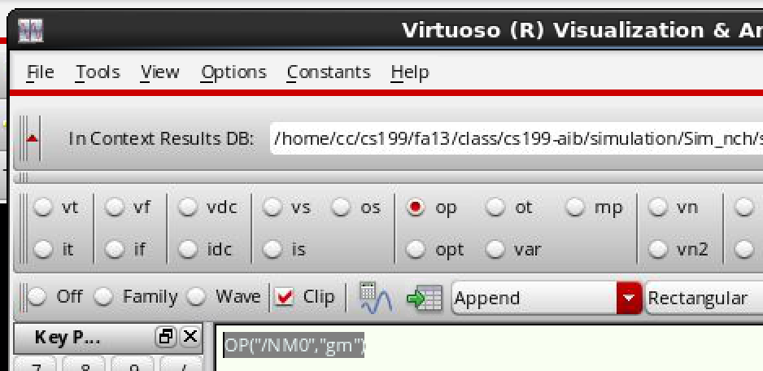
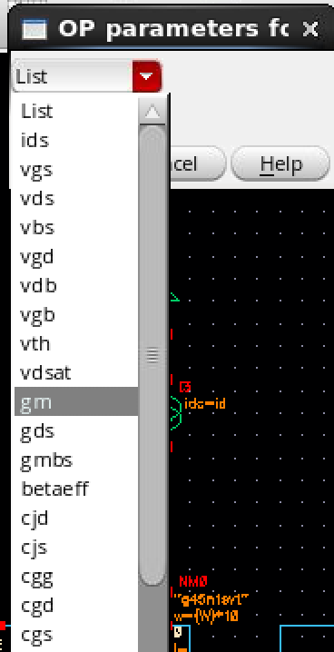
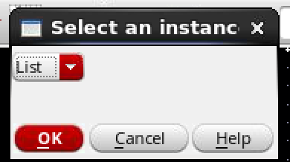
a_{v0}, g_{m}, f_{T} ,C_{gs}
From ac simulation (previous pages)
Or from dc simulation
Open ”Calculator” click “op”
A window will pop up
Click on the device.
Select the parameter.
The expression will shown on calculator ,ex: OP(“NM0”,”gm”)
Use as a reference to verify your result from ac sim.

Slide 13

Diffusion Review
Diffusion
$J_{n}={qD}_{n}\frac{dn}{dx}$ $=D_{n}\frac{dQ_{D}}{dx}$
n : electron concentration ( # of free elections/cm³)
$D_{n}$ $=μ_{n}V_{T}$
Hw1
Step1 : Find Q in a unit volume.

