Slide 1
Discussion 4
Yi-An Li
20180227

Slide 2
Outline
More on noise .
Clarify on one side or two side , integral over ds or df
Decompose current noise source
Cascode
TIA noise example

Slide 3
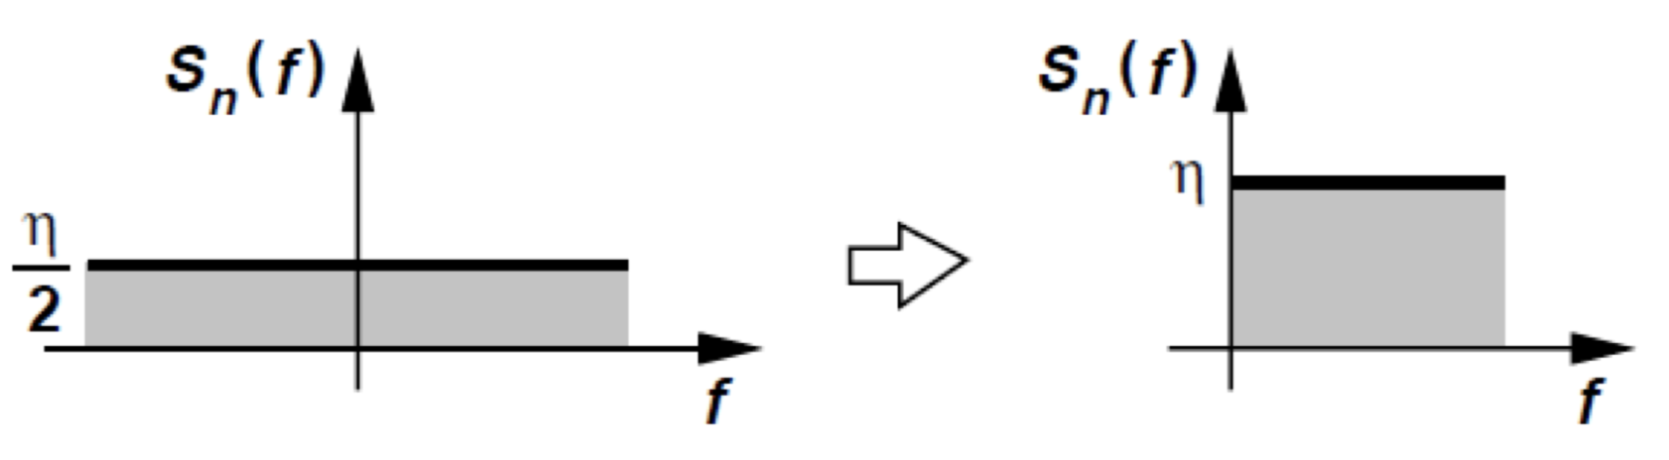

Noise density
One side or two side
$\int_{−∞}^{∞}{2kT(…)df}=\int_{0}^{∞}{4kT(…)df}$

Slide 4
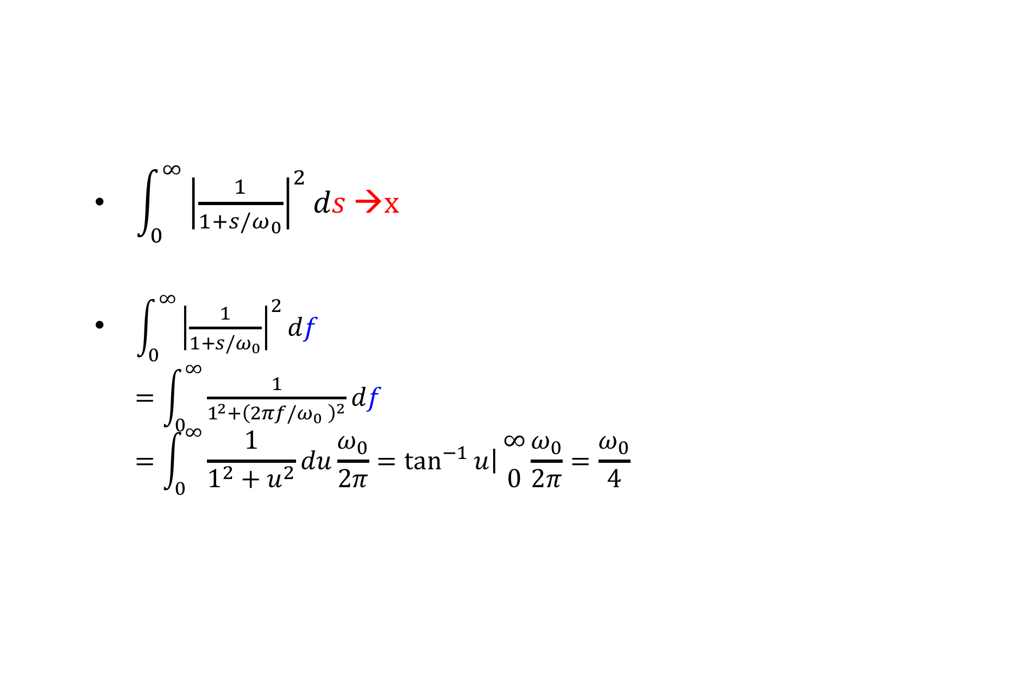
Noise Integration
$\int_{0}^{∞}{{\left|\frac{1}{1+s/ω_{0}}\right|}^{2}ds}$ →x
$\int_{0}^{∞}{{\left|\frac{1}{1+s/ω_{0}}\right|}^{2}df}$
$=\int_{0}^{∞}{\frac{1}{1^{2}+{\left(2πf/ω_{0} \right)}^{2}}df}$ $$=\int_{0}^{∞}{\frac{1}{1^{2}+u^{2}}du}\frac{ω_{0}}{2π}=\left.\tan^{−1}{u}\right|{∞ \atop 0}\frac{ω_{0}}{2π}=\frac{ω_{0}}{4}$$

Slide 5
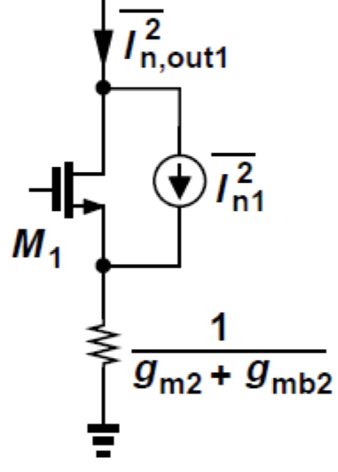
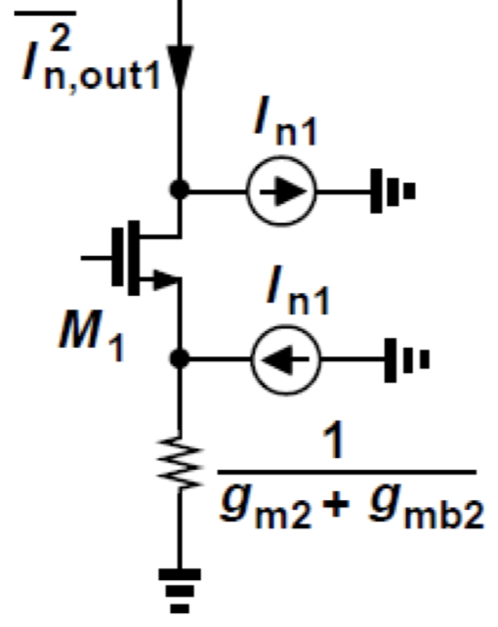
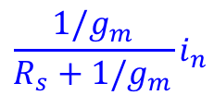
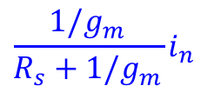
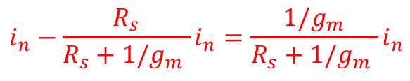
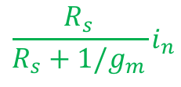

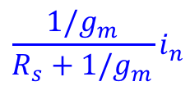
Noise with degeneration (I)
$$i_{n}−{\frac{R_{s}}{R_{s}+1/g_{m} }i}_{n}={\frac{1/g_{m}}{R_{s}+1/g_{m} }i}_{n}$$
$${\frac{1/g_{m}}{R_{s}+1/g_{m}}i}_{n}$$
$$i_{n}$$
$${\frac{R_{s}}{R_{s}+1/g_{m}}i}_{n}$$
R_{S}
$${\frac{1/g_{m}}{R_{s}+1/g_{m}}i}_{n}$$
$${\frac{1/g_{m}}{R_{s}+1/g_{m}}i}_{n}$$

Slide 6
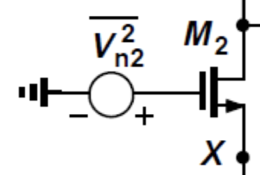
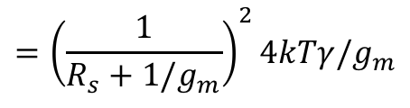
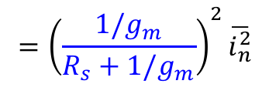
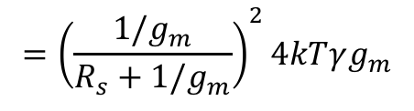
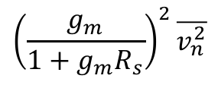
Noise with degeneration (II)
$${\left(\frac{g_{m}}{1+g_{m}R_{s}}\right)}^{2}\overline{v_{n}^{2}}$$
$$={\left(\frac{1}{R_{s}+1/g_{m}}\right)}^{2}4kTγ/g_{m}$$
$$={\left(\frac{1/g_{m}}{R_{s}+1/g_{m}}\right)}^{2}4kTγg_{m}$$
R_{S}
$$={\left(\frac{1/g_{m}}{R_{s}+1/g_{m}}\right)}^{2}\overline{i_{n}^{2}}$$

Slide 7
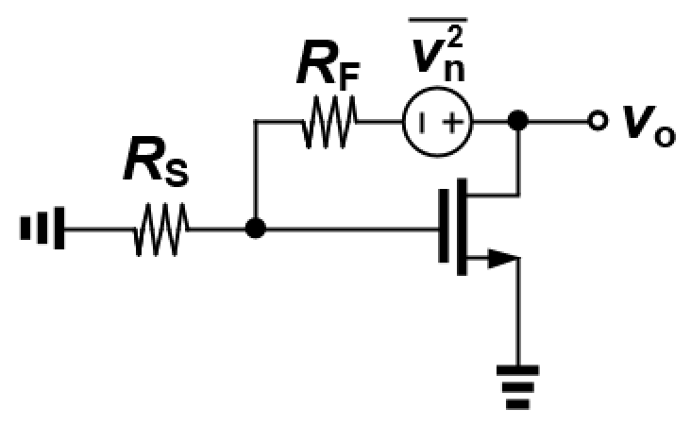
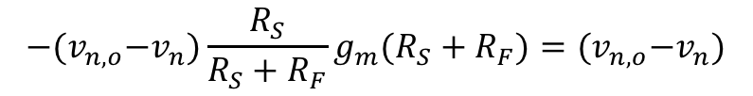

Noise of R_{F}
$$−{(v}_{n,o}−v_{n})\frac{R_{S}}{R_{S}+R_{F}}g_{m}(R_{S}+R_{F})={(v}_{n,o}−v_{n})$$
$$(1+g_{m}R_{S})v_{n,o}=(1+g_{m}R_{S})v_{n}$$
$$v_{n,o}=v_{n}$$

Slide 8
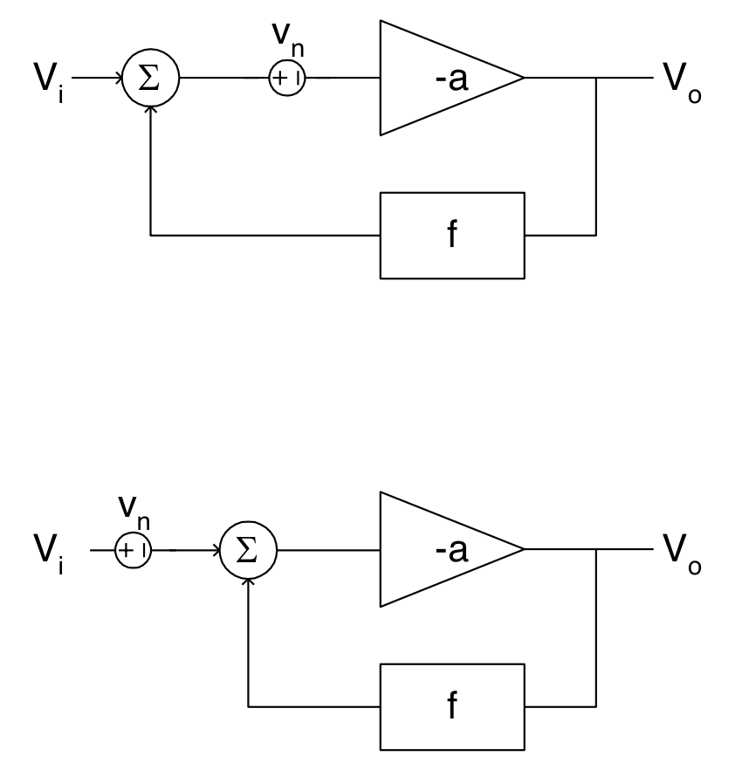


FB Noise
$${(V}_{i}−fV_{o}−v_{n})(−a)=V_{o}$$
$$V_{o}=(V_{i}−v_{n})\frac{−a}{1−af}$$
Input referred noise open loop = closed loop

Slide 9
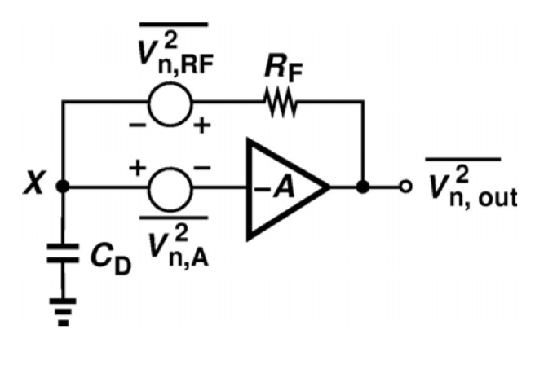
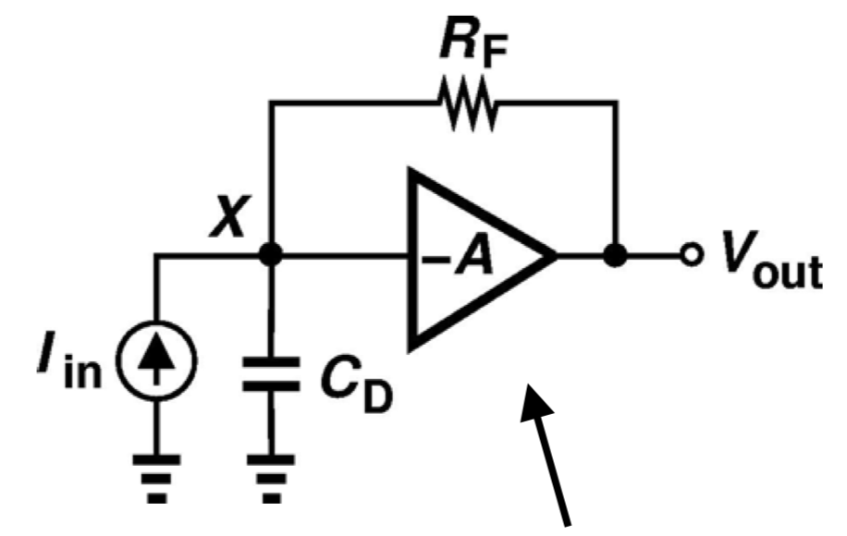
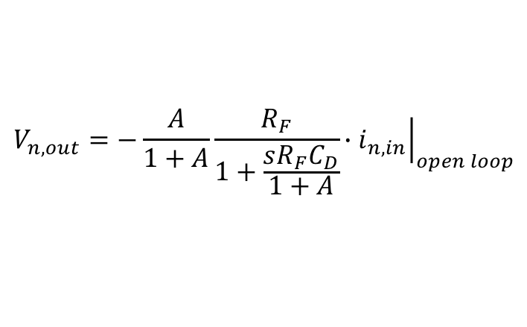
FB Noise
Output noise of TIA
Ideal opamp
$$V_{n,out}=−\frac{A}{1+A}\frac{R_{F}}{1+\frac{sR_{F}C_{D}}{1+A}}{\left.{∙i}_{n,in}\right|}_{open loop}$$

Slide 10
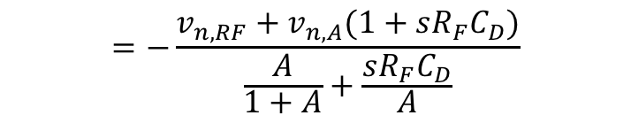
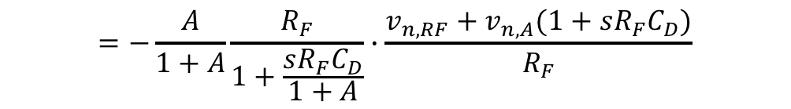
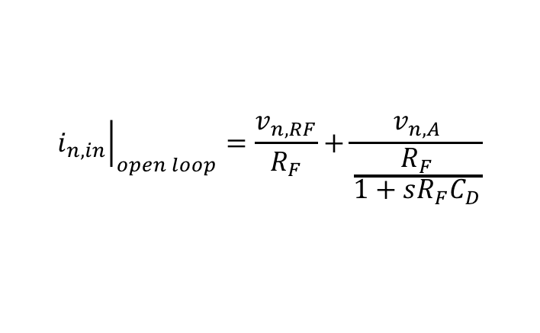
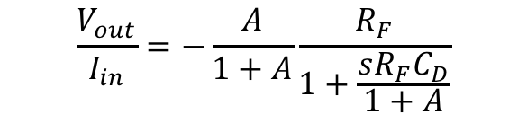
FB Noise
Output noise of TIA
Ideal opamp
$$V_{n,out}=−\frac{A}{1+A}\frac{R_{F}}{1+\frac{sR_{F}C_{D}}{1+A}}{\left.{∙i}_{n,in}\right|}_{open loop}$$
$$\frac{V_{out}}{I_{in}}=−\frac{A}{1+A}\frac{R_{F}}{1+\frac{sR_{F}C_{D}}{1+A}}$$
$$=−\frac{A}{1+A}\frac{R_{F}}{1+\frac{sR_{F}C_{D}}{1+A}}∙\frac{v_{n,RF}+v_{n,A}(1+sR_{F}C_{D})}{R_{F}}$$
$${\left.i_{n,in}\right|}_{open loop}=\frac{v_{n,RF}}{R_{F}}+\frac{v_{n,A}}{\frac{R_{F}}{1+sR_{F}C_{D}}}$$
$$=−\frac{v_{n,RF}+v_{n,A}(1+sR_{F}C_{D})}{\frac{A}{1+A}+\frac{sR_{F}C_{D}}{A}}$$

