Slide 1
EE 241B: Variability Simulation Tips

Slide 2
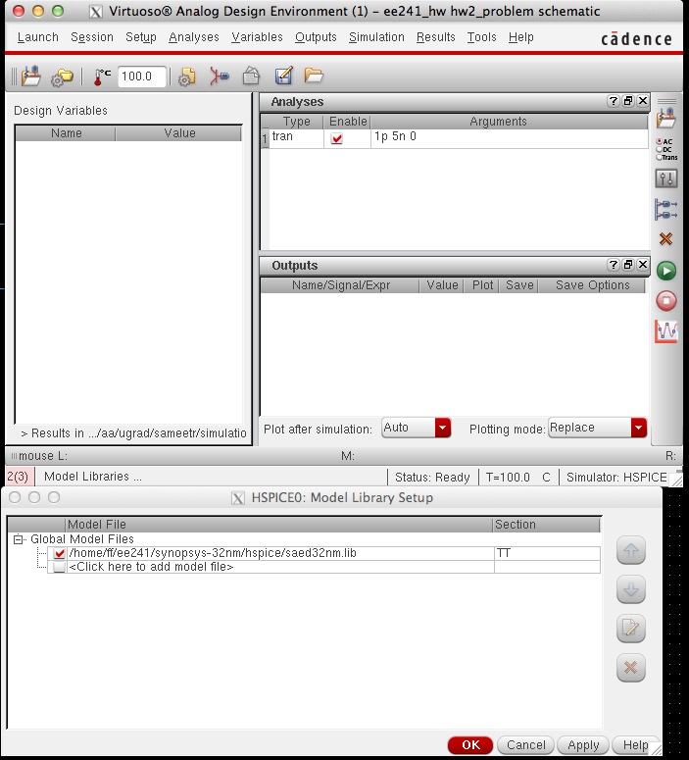
To Simulate over corners, go to Setup->Model Libraries in ADE, and change Section from TT to the relevant corner

Slide 3
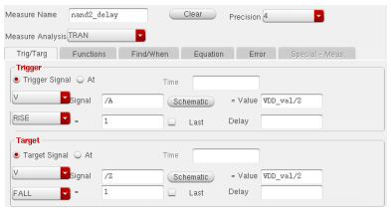
To run Monte Carlo, in your open ADE L window, go to Tools -> HSPICE Statistical. Under “Number of runs” enter 300, and check the box next to “Enabled”. Under the outputs tab in the Measurements section, click on “Open.” Enter the settings shown below, (modifying your signal names and Voltage values as needed), and click “Add”, then “Close”. Now insize the HSPICE Monte Carlo Analysis window, under the “Simulation” section, click “Netlist-Run”.
For any measurement, statistics are automatically calculated in the Measurement Variation Statistics section. Here you can get mean and sigma information. To view the distribution, click “Get Variation Statistics”, then click “Plotting as.”

Slide 4
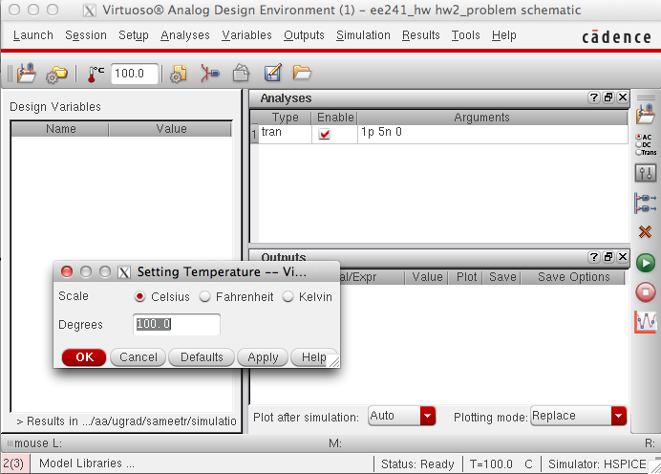
To Simulate over Temperature, go to Setup->Temperature, and change Degrees

