Slide 2
A.scala
B.scala
Builder.scala
A.scala
B.scala
Builder.scala
A.class
B.class
Builder.class
A.scala
B.scala
Builder.scala
A.sv
B.sv
A.class
B.class
Builder.class
A1.scala
B.scala
Builder.scala
A1.scala
B.scala
Builder.scala
A1.class
B.class
Builder.class
A1.class
B.class
Builder.class
A1.sv
B.sv
A.sv
B.sv

Slide 3
CalyxSumMMIOWrapper
CalyxSumBlackBox
SystemVerilog

Slide 4
Digital SoC Architecture
RocketTile
Rocket
Core
PTW
We just created a port here!
L1I$
L1D$
Tile Bus
System Bus
Periphery Bus
Front Bus
Control Bus
L2 Bank
L2 Bank
UART
GPIOs
BootROM
Serdes
PLIC
Memory Bus
CLINT
Debug
DRAM Chan.
DRAM Chan.

Slide 5
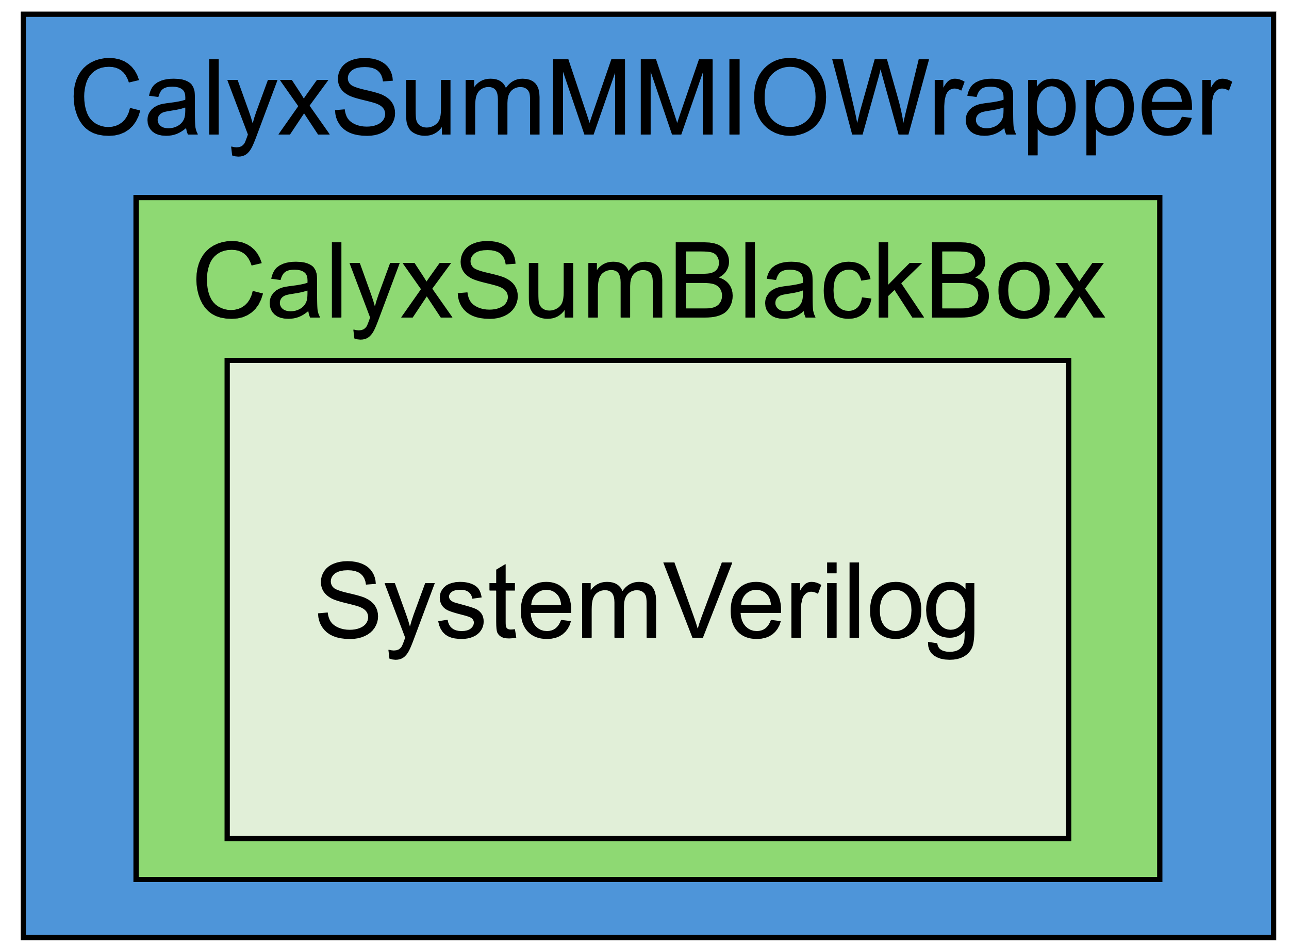
Digital SoC Architecture
RocketTile
Rocket
Core
PTW
L1I$
L1D$
Tile Bus
System Bus
Periphery Bus
Front Bus
Control Bus
L2 Bank
L2 Bank
UART
GPIOs
BootROM
Serdes
PLIC
Memory Bus
CLINT
Debug
DRAM Chan.
DRAM Chan.

Slide 6
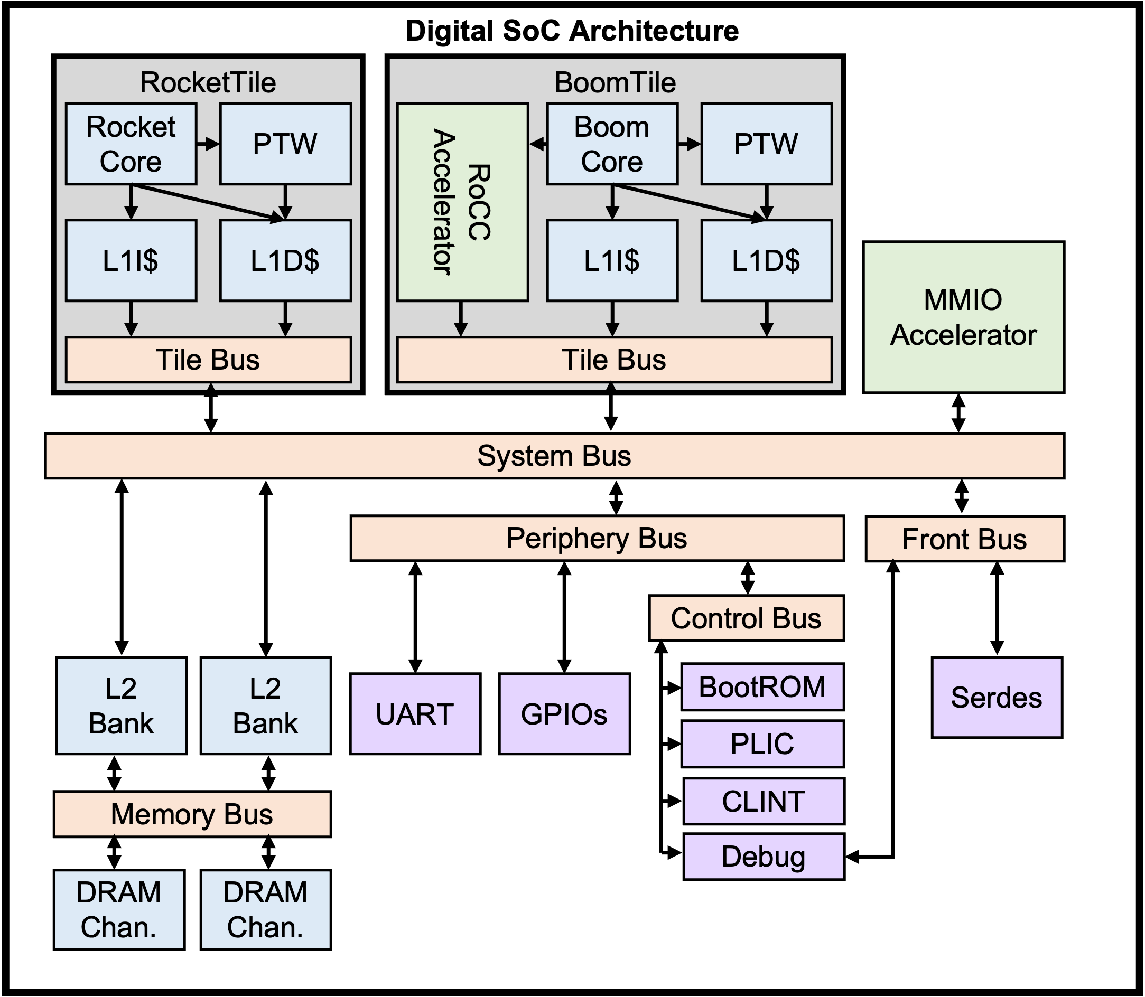
FPGA
Simulator shim
FPGA

Slide 7
HLS
Calyx Frontends
RTL
HLS Compiler
Custom Compiler
RTL Compiler
??????
Verilator
FPGA
ASIC

Slide 8
HLS
Calyx Frontends
RTL
HLS Compiler
Custom Compiler
RTL Compiler
Calyx
Interface
Generation
RTL IR
Discrete
Event Model
Verilator

Slide 9
Behavioral
Model
Calyx
RTL IR
Various peek poke
Function Calls
Latency
Insensitive
Wire
Valid
Rdy/Val
Common Transaction Scheme
Discrete Event
Scheduler

Slide 10
HLS
Calyx Frontends
RTL
HLS Compiler
Custom Compiler
RTL Compiler
Calyx
RTL IR
FPGA flow
VLSI flow
FPGA
ASIC

Slide 11
HLS
Calyx Frontends
RTL
HLS Compiler
Custom Compiler
RTL Compiler
Calyx
RTL IR
Discrete
Event Model
FPGA flow
VLSI flow
Verilator
FPGA
ASIC

Slide 12
HLS
Calyx Frontends
RTL
HLS Compiler
Custom Compiler
RTL Compiler
Calyx
RTL IR
Discrete
Event Model
FPGA flow
VLSI flow
Verilator
FPGA
ASIC

Slide 13







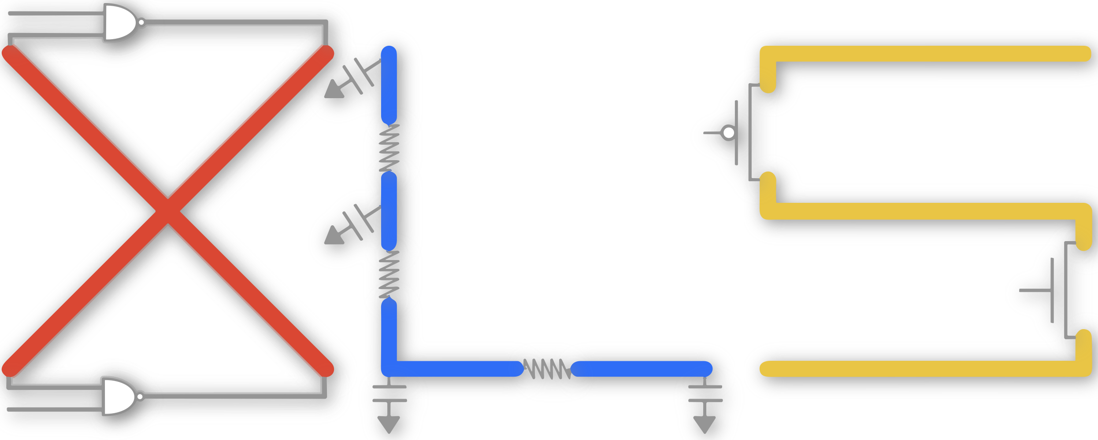

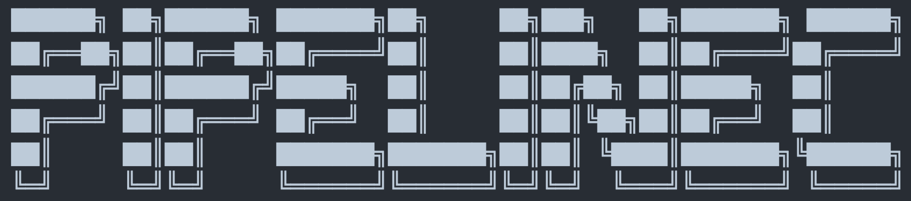





RTL
Data Flow
Ctrl Flow
Accel DSL
HLS
③
RTL
①
②
Simulation
FPGA Flow
VLSI Flow

Slide 14
RTL
Data Flow
Ctrl Flow
Accel DSL
HLS
Elaboration Interop
Common IR
②
③
①
Runtime Interop
Simulation
FPGA Flow
VLSI Flow

Slide 15
RTL
Data Flow
Ctrl Flow
Accel DSL
HLS
Elaboration Interop
Common IR
②
③
①
Runtime Interop
Simulation
FPGA Flow
VLSI Flow

Slide 16
RTL
Data Flow
Ctrl Flow
Accel DSL
HLS
Elaboration Interop
Common IR
②
③
①
Runtime Interop
Simulation
FPGA Flow
VLSI Flow

Slide 17
RTL
HLS
Edge
Accel DSL

Slide 18
0
0
2
0
RTL
HLS
RTL
HLS
Req
1
0
3
3
RTL
HLS
RTL
HLS
Resp

Slide 19


Spade
Shakeflow
RTL

Slide 20
Spade
Shakeflow
~ minutes
RTL
Oops!
~ hours

Slide 21
RTL
Spade
Shakeflow

Slide 22
RTL
Ctrl/Data synth
HLS
Elaboration Scheme
Runtime Scheme
SW
RTL sim
FPGA/ASIC

