Slide 2
A.scala
B.scala
Builder.scala
A.scala
B.scala
Builder.scala
A.class
B.class
Builder.class
A.scala
B.scala
Builder.scala
A.sv
B.sv
A.class
B.class
Builder.class
A1.scala
B.scala
Builder.scala
A1.scala
B.scala
Builder.scala
A1.class
B.class
Builder.class
A1.class
B.class
Builder.class
A1.sv
B.sv
A.sv
B.sv

Slide 3
FireSim has been used* in published work from authors at over 20 academic and industrial institutions
*actually used, not only cited

Slide 4
A.java
B.java
A.java
B.java
Frontend
Frontend
A.ir
B.ir
A.ir
B.ir
IR
IR
A.syn
B.syn
A.syn
B.syn
Backend
Backend
A.pnr
B.pnr
A.pnr
B.pnr

Slide 5
A.java
Frontend
Design
A.ir
IR
A.syn
Backend
Module
A.pnr
Module Deps.

Slide 6
A.java
Frontend
Design
a
A.ir
IR
A.syn
Backend
Module
A.pnr
Module Deps.

Slide 7
A.java
Frontend
Design
a
A.ir
IR
b
A.syn
Backend
Module
A.pnr
Module Deps.

Slide 8
A.java
Frontend
Design
a
A.ir
IR
b
A.syn
c
Backend
Module
A.pnr
Module Deps.

Slide 9
A.java
Frontend
Design
a
A.ir
IR
b
d
A.syn
c
Backend
Module
A.pnr
Module Deps.

Slide 10
Digital SoC Architecture
RocketTile
Dataflow Accelerator
Systolic Array Based
Accelerator
Rocket
Core
PTW
L1I$
L1D$
Tile Bus
System Bus
Periphery Bus
Front Bus
Control Bus
L2 Bank
L2 Bank
UART
GPIOs
BootROM
Serdes
PLIC
Memory Bus
CLINT
Debug
DRAM Chan.
DRAM Chan.

Slide 11
Digital SoC Architecture
RocketTile
Dataflow Accelerator
Systolic Array Based
Accelerator
Rocket
Core
PTW
L1I$
L1D$
Tile Bus
System Bus
Periphery Bus
Front Bus
Control Bus
L2 Bank
L2 Bank
UART
GPIOs
BootROM
Serdes
PLIC
Memory Bus
CLINT
Debug
DRAM Chan.
DRAM Chan.

Slide 12
Digital SoC Architecture
RocketTile
Dataflow Accelerator
Systolic Array Based
Accelerator
Rocket
Core
PTW
L1I$
L1D$
Tile Bus
System Bus
Periphery Bus
Front Bus
Control Bus
L2 Bank
L2 Bank
UART
GPIOs
BootROM
Serdes
PLIC
Memory Bus
CLINT
Debug
DRAM Chan.
DRAM Chan.

Slide 13
Digital SoC Architecture
RocketTile
Dataflow Accelerator
Systolic Array Based
Accelerator
Rocket
Core
PTW
L1I$
L1D$
Tile Bus
System Bus
Periphery Bus
Front Bus
Control Bus
L2 Bank
L2 Bank
UART
GPIOs
BootROM
Serdes
PLIC
Memory Bus
CLINT
Debug
DRAM Chan.
DRAM Chan.

Slide 14
Digital SoC Architecture
RocketTile
Dataflow Accelerator
Systolic Array Based
Accelerator
Rocket
Core
PTW
L1I$
L1D$
Tile Bus
System Bus
Periphery Bus
Front Bus
Control Bus
L2 Bank
L2 Bank
UART
GPIOs
BootROM
Serdes
PLIC
Memory Bus
CLINT
Debug
DRAM Chan.
DRAM Chan.

Slide 15
Digital SoC Architecture
RocketTile
Dataflow Accelerator
Systolic Array Based
Accelerator
Rocket
Core
PTW
L1I$
L1D$
Tile Bus
System Bus
Periphery Bus
Front Bus
Control Bus
L2 Bank
L2 Bank
UART
GPIOs
BootROM
Serdes
PLIC
Memory Bus
CLINT
Debug
DRAM Chan.
DRAM Chan.

Slide 16
CalyxSumMMIOWrapper
CalyxSumBlackBox
SystemVerilog

Slide 17
Digital SoC Architecture
RocketTile
Rocket
Core
PTW
We just created a port here!
L1I$
L1D$
Tile Bus
System Bus
Periphery Bus
Front Bus
Control Bus
L2 Bank
L2 Bank
UART
GPIOs
BootROM
Serdes
PLIC
Memory Bus
CLINT
Debug
DRAM Chan.
DRAM Chan.

Slide 18
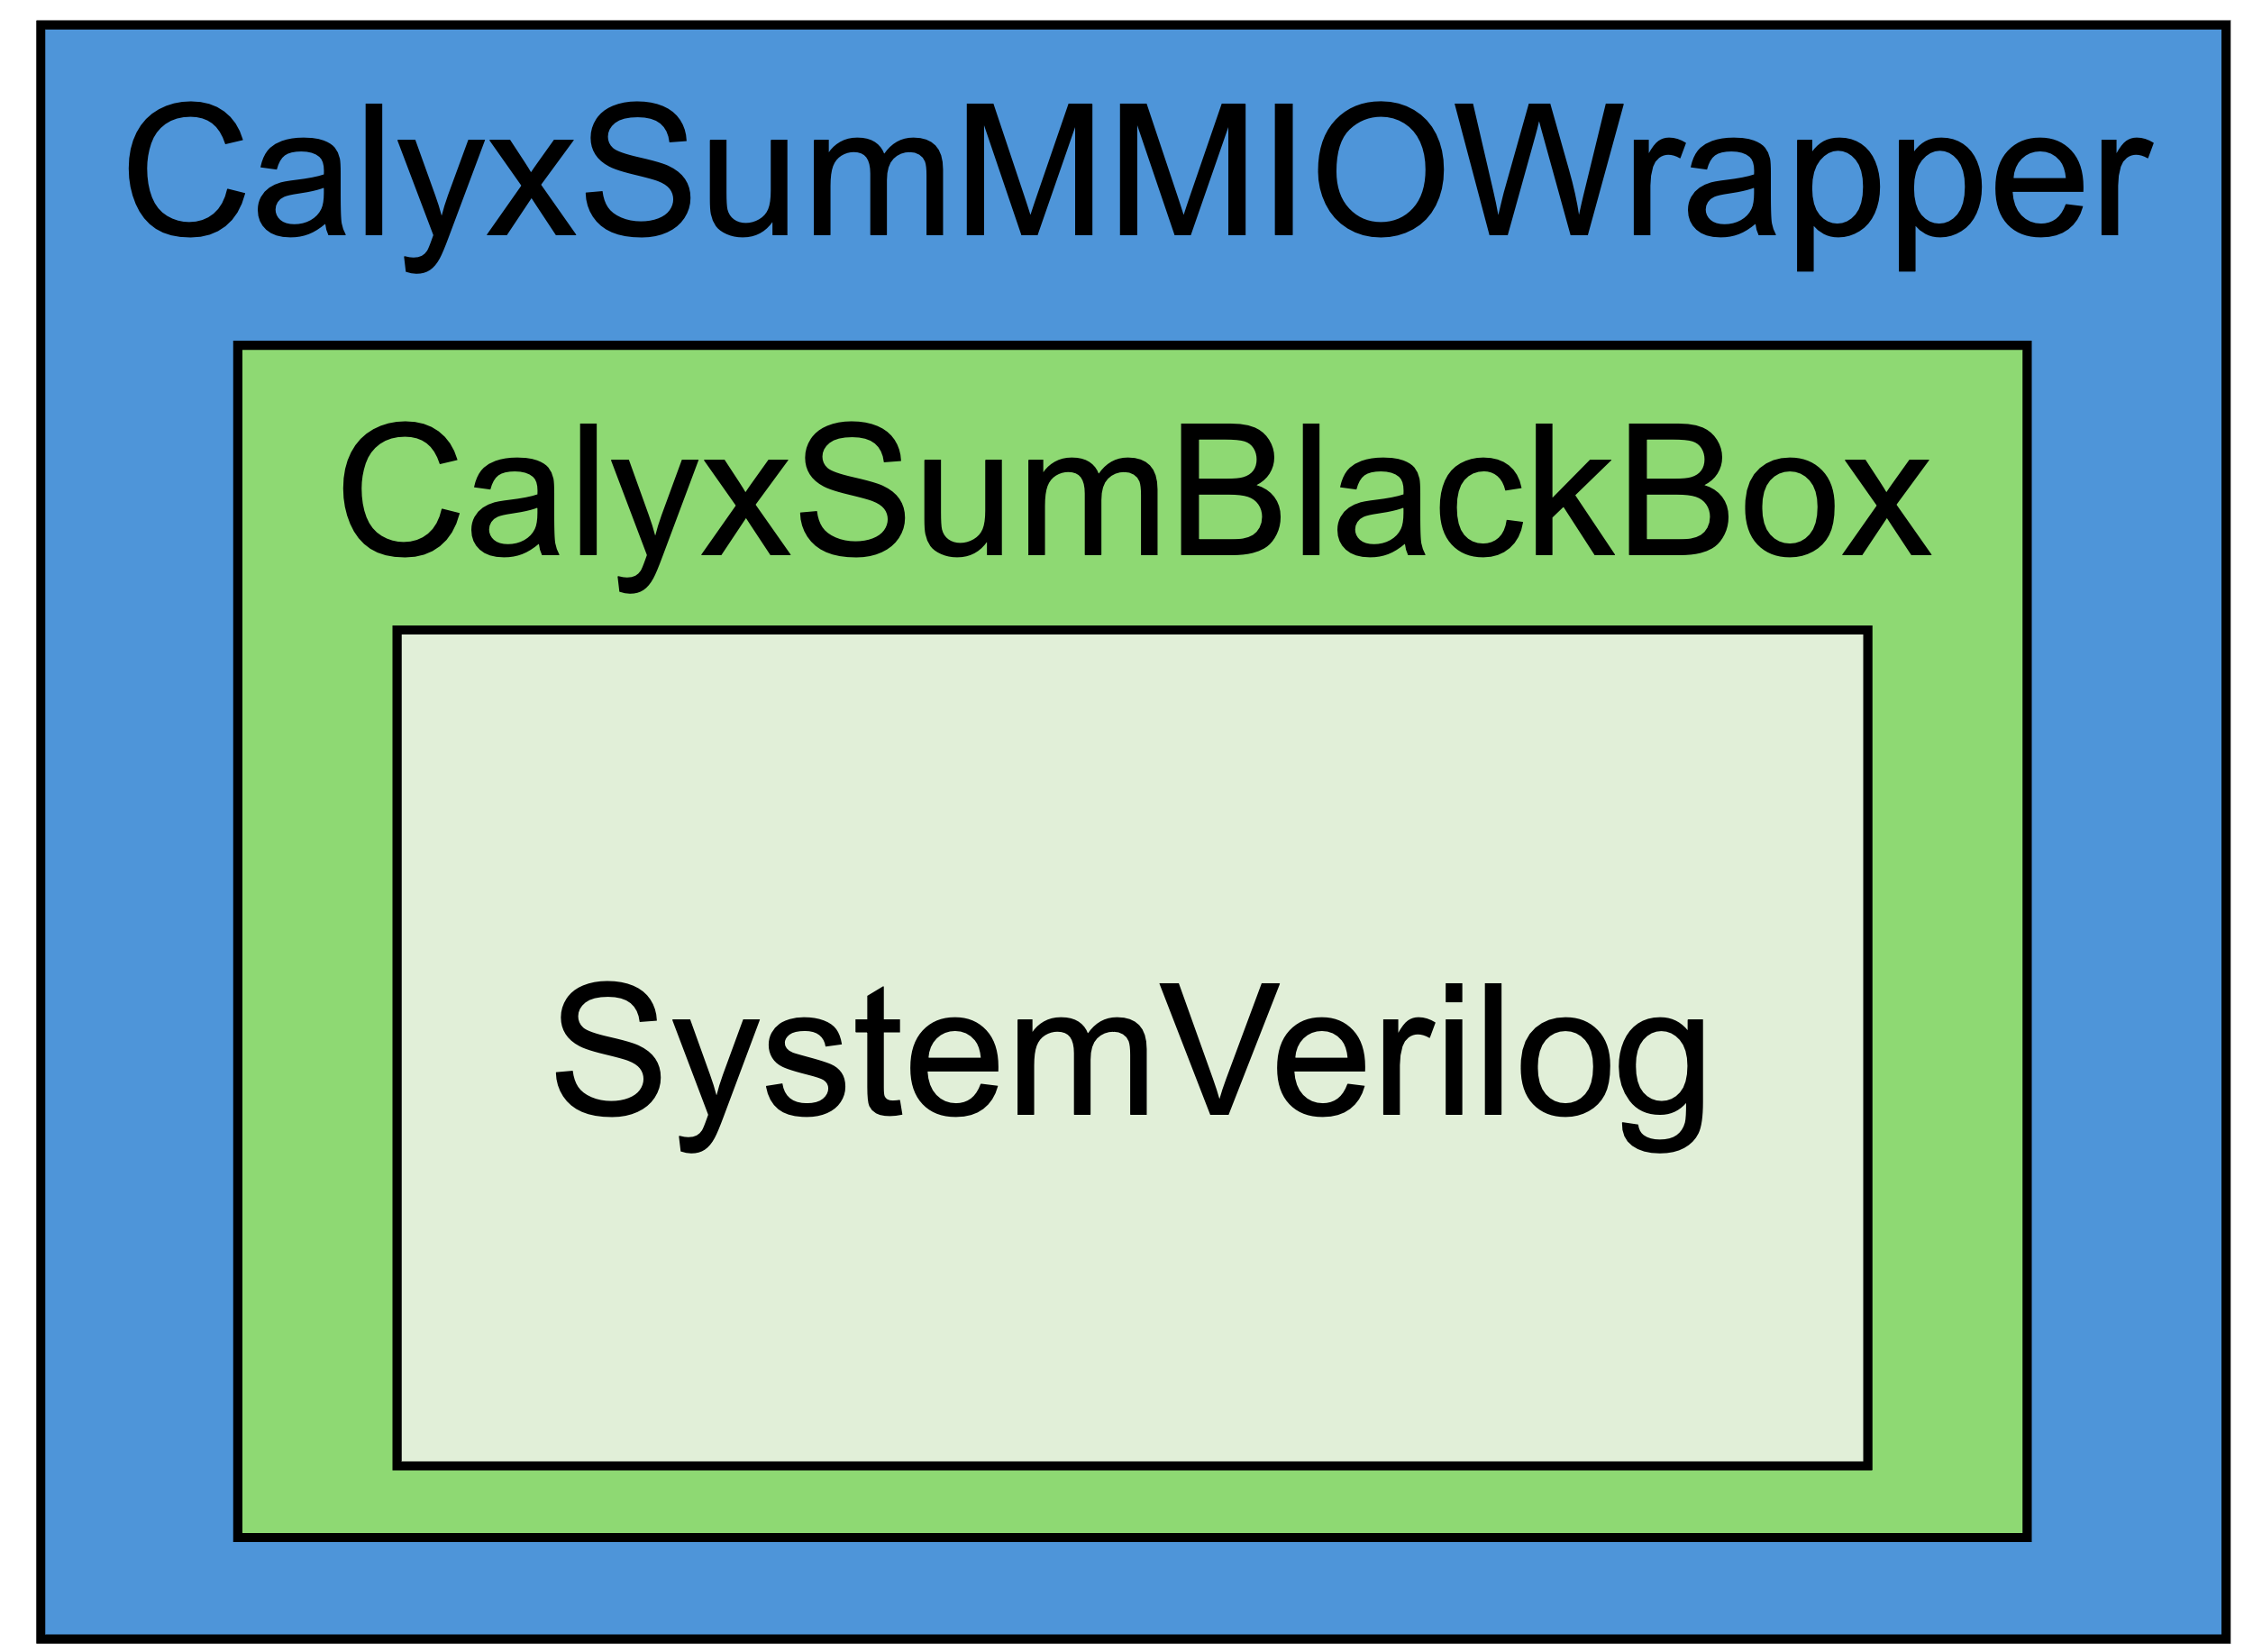
Digital SoC Architecture
RocketTile
Rocket
Core
PTW
L1I$
L1D$
Tile Bus
System Bus
Periphery Bus
Front Bus
Control Bus
L2 Bank
L2 Bank
UART
GPIOs
BootROM
Serdes
PLIC
Memory Bus
CLINT
Debug
DRAM Chan.
DRAM Chan.

Slide 19
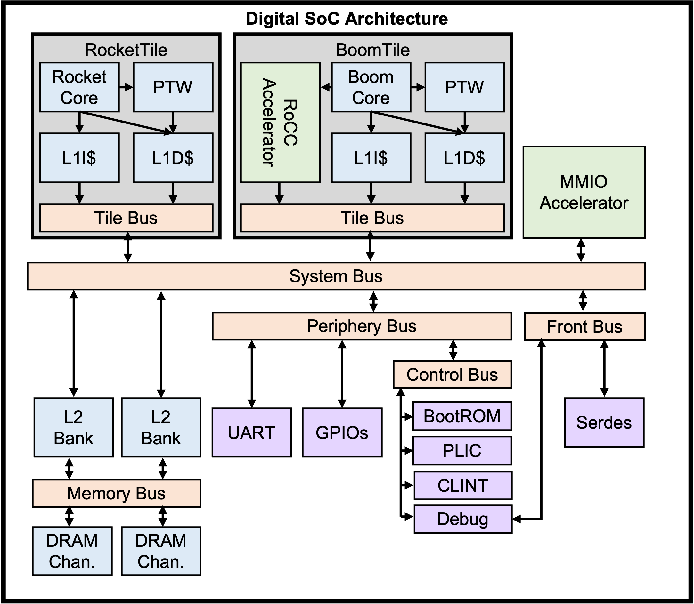
FPGA
Simulator shim
FPGA

Slide 20
Digital SoC Architecture
Digital SoC Architecture
RocketTile
BoomTile
RocketTile
BoomTile
Rocket
Core
PTW
Boom
Core
PTW
Rocket
Core
PTW
Boom
Core
PTW
RoCC
Accelerator
RoCC
Accelerator
L1I$
L1D$
L1I$
L1D$
MMIO Accelerator
L1I$
L1D$
L1I$
L1D$
MMIO Accelerator
Tile Bus
Tile Bus
Tile Bus
Tile Bus
System Bus
System Bus
Periphery Bus
Front Bus
Periphery Bus
Front Bus
Control Bus
Control Bus
L2 Bank
L2 Bank
UART
GPIOs
BootROM
Serdes
L2 Bank
L2 Bank
UART
GPIOs
BootROM
Serdes
PLIC
PLIC
Memory Bus
CLINT
Memory Bus
CLINT
Debug
Debug
DRAM Chan.
DRAM Chan.
DRAM Chan.
DRAM Chan.

Slide 21
Digital SoC Architecture
Digital SoC Architecture
RocketTile
BoomTile
RocketTile
BoomTile
Rocket
Core
PTW
Boom
Core
PTW
Rocket
Core
PTW
Boom
Core
PTW
RoCC
Accelerator
RoCC
Accelerator
L1I$
L1D$
L1I$
L1D$
MMIO Accelerator
L1I$
L1D$
L1I$
L1D$
MMIO Accelerator
Tile Bus
Tile Bus
Tile Bus
Tile Bus
System Bus
System Bus
Periphery Bus
Front Bus
Periphery Bus
Front Bus
Control Bus
Control Bus
L2 Bank
L2 Bank
UART
GPIOs
BootROM
Serdes
L2 Bank
L2 Bank
UART
GPIOs
BootROM
Serdes
PLIC
PLIC
Memory Bus
CLINT
Memory Bus
CLINT
Debug
Debug
DRAM Chan.
DRAM Chan.
DRAM Chan.
DRAM Chan.

Slide 22
Digital SoC Architecture
Digital SoC Architecture
RocketTile
BoomTile
RocketTile
BoomTile
Rocket
Core
PTW
Boom
Core
PTW
Rocket
Core
PTW
Boom
Core
PTW
RoCC
Accelerator
RoCC
Accelerator
L1I$
L1D$
L1I$
L1D$
MMIO Accelerator
L1I$
L1D$
L1I$
L1D$
MMIO Accelerator
Tile Bus
Tile Bus
Tile Bus
Tile Bus
System Bus
System Bus
Periphery Bus
Front Bus
Periphery Bus
Front Bus
Control Bus
Control Bus
L2 Bank
L2 Bank
UART
GPIOs
BootROM
Serdes
L2 Bank
L2 Bank
UART
GPIOs
BootROM
Serdes
PLIC
PLIC
Memory Bus
CLINT
Memory Bus
CLINT
Debug
Debug
DRAM Chan.
DRAM Chan.
DRAM Chan.
DRAM Chan.

Slide 23
HLS
Calyx Frontends
RTL
HLS Compiler
Custom Compiler
RTL Compiler
??????
Verilator
FPGA
ASIC

Slide 24
HLS
Calyx Frontends
RTL
HLS Compiler
Custom Compiler
RTL Compiler
Calyx
Interface
Generation
RTL IR
Discrete
Event Model
Verilator

Slide 25
Behavioral
Model
Calyx
RTL IR
Various peek poke
Function Calls
Latency
Insensitive
Wire
Valid
Rdy/Val
Common Transaction Scheme
Discrete Event
Scheduler

Slide 26
HLS
Calyx Frontends
RTL
HLS Compiler
Custom Compiler
RTL Compiler
Calyx
RTL IR
FPGA flow
VLSI flow
FPGA
ASIC

Slide 27
HLS
Calyx Frontends
RTL
HLS Compiler
Custom Compiler
RTL Compiler
Calyx
RTL IR
Discrete
Event Model
FPGA flow
VLSI flow
Verilator
FPGA
ASIC

Slide 28
HLS
Calyx Frontends
RTL
HLS Compiler
Custom Compiler
RTL Compiler
Calyx
RTL IR
Discrete
Event Model
FPGA flow
VLSI flow
Verilator
FPGA
ASIC

Slide 29




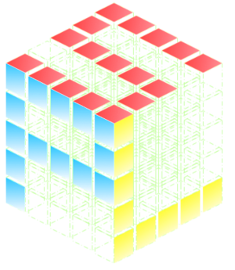


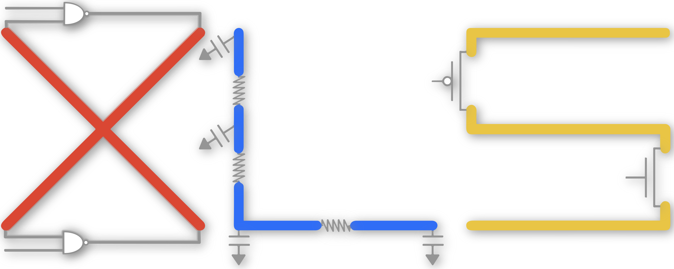

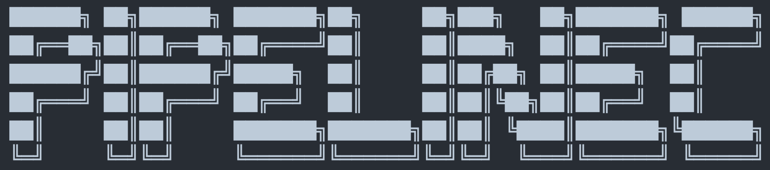





RTL
Data Flow
Ctrl Flow
Accel DSL
HLS
③
RTL
①
②
Simulation
FPGA Flow
VLSI Flow

Slide 30
RTL
Data Flow
Ctrl Flow
Accel DSL
HLS
Elaboration Interop
Common IR
②
③
①
Runtime Interop
Simulation
FPGA Flow
VLSI Flow

Slide 31
RTL
Data Flow
Ctrl Flow
Accel DSL
HLS
Elaboration Interop
Common IR
②
③
①
Runtime Interop
Simulation
FPGA Flow
VLSI Flow

Slide 32
RTL
Data Flow
Ctrl Flow
Accel DSL
HLS
Elaboration Interop
Common IR
②
③
①
Runtime Interop
Simulation
FPGA Flow
VLSI Flow

Slide 33
RTL
HLS
Edge
Accel DSL

Slide 34
RTL
HLS
Edge
2
0
RTL
HLS
0
0
RTL
HLS
Req
1
0
3
3
RTL
HLS
RTL
HLS
Resp

Slide 35


Spade
Shakeflow
RTL

Slide 36
Spade
Shakeflow
~ minutes
RTL
Oops!
~ hours

Slide 37
RTL
Spade
Shakeflow

Slide 38
RTL
Ctrl/Data synth
HLS
Elaboration Scheme
Runtime Scheme
SW
RTL sim
FPGA/ASIC

