Slide 1
DRILLS: Debugging RTL Intelligently with Localization from Long Simulation
Specification mining using trace dumps derived from long-running FPGA emulation to localize bugs in complex digital designs
Donggyu Kim & Vighnesh Iyer

Slide 2
Plan
Problem: given many error-free traces and one error trace, localize the likely bug location by module or line of RTL and find the fine-grained mined properties which were violated.
Specification mining [Li ‘10] is a technique to extract fine-grained (Σ = 2,3) LTL properties (based on a set of templates) from execution traces
  We will add additional LTL templates, and will apply this technique to large designs
Error-free Waveforms
From FPGA Emulation
Buggy RTL
(Hopefully) Early
Fine-Grained Property Failures
LTL → FSM
Assertion Synthesis
DESSERT
Spec Mining Engine
Failure Ranking +
SAT Localization
Fine-Grained
LTL Properties
FPGA Emulator
Replay buggy test
Bug Location

Slide 3
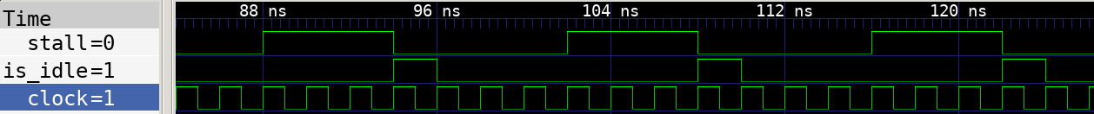
Current Status + TODO
Working VCD parser and LTL property miner (for 2 property templates)
  Alternating: Δa A Δb
  Until: G(Δa → X (a U Δb))
  Next: G(Δa → X Δb)
  Eventual: G(Δa → X F Δb)
Capable of mining properties from chisel-examples and riscv-mini
  Next: [['TOP.Tile.core.dpath.csr_io_stall', 'TOP.Tile.core.dpath.stall', 'TOP.Tile.core.dpath.csr.io_stall'], ['TOP.Tile.icache.is_idle']]

Slide 4
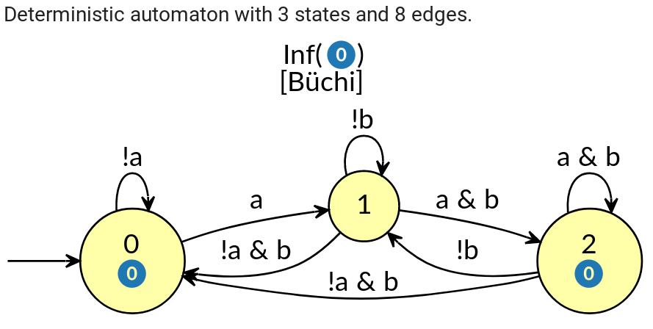
Questions
Is there a systematic way to go from LTL property to ‘monitor automaton’?
  Right now, the mining functions are very explicit and need hand-constructed automaton
  Spot can emit automata for an LTL property, but it needs to be modified for finite-length traces
Example for G(a → XF b)
State-based acceptance only works for infinite-length traces that visit accepting states infinitely often
We need to augment the automata with a ‘num_patterns_seen` var
Q: how to prune mined LTL properties?

