Slide 1
The Baker Challenge Provider Call Prediction - Long Duration
Team Databots

Slide 2
Agenda
Team Introduction
Data source / lineage and description
Context/Background
Business problem and question
Value proposition
Hypothesis
Exploratory data analysis (EDA)
Model Specifications and Variable Selection
Model Evaluation
Conclusion
Ethical considerations

Slide 3
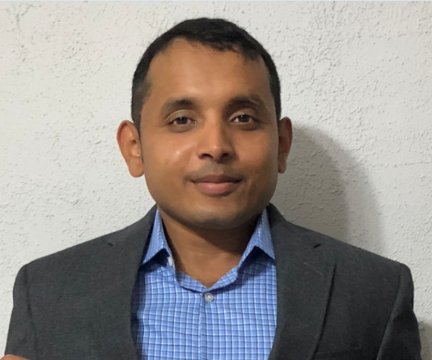
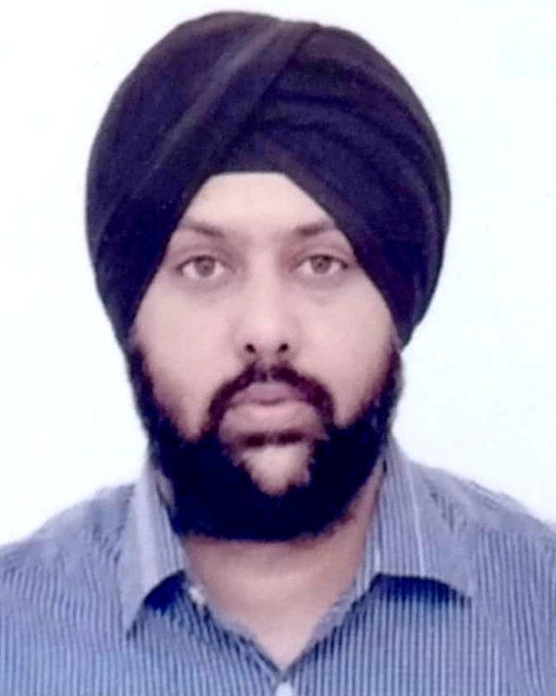


Team DataBots
Ameya Thakur
Lead Software Engineer
(OptumHealth Technology – Schaumburg)
Amandeep Bhatia
Scrum Master – Agile Coach
(OGS – Hyderabad)
Abhishek Chowdhury
Mgr. Software Engineering
(OGS – Hyderabad)
Vighnesh Kumar
Sr. Software Engineer I
(OGS – Hyderabad)

Slide 4
Data source / lineage and description
Data Source/Lineage
Methods of Data Collection
Data systematically collected for UHCInsight providers’ claims - provided by the DataViz Admin Team which includes
Claim-Call : This dataset is claim level, containing UHCInsight providers’ claims
Provider Profile :This data set contains the provider related details to augment the claim-call dataset if/as needed
Claim call (key claim & call attributes(for claims that have had a call))
All data were de-identified before being provided to the DataViz Teams.
Claim line (key claim line attributes for the claims in the “Claim-Call”)
Provider profile data
The data received is UHCInsight providers’ claims and represents call data for the year 2017
Claim Line : This dataset includes claim attribute for the claims in “Claim-Call”

Slide 5
Context/Background
Context
Need
Vision
Enable preventive action by creating a hypothesis/model for predicting long duration calls
Outcome
Provide preventive quality care in order to avoid long duration calls and associated costs by early detection
Analyze Co-relation between call time duration vs dependent attributes (Fiduciary Code, Claim Place of Service, etc.)
36 Million claim calls in 2017 out of which 7.6 Million were transferred with projected cost > $35 Million
Involving 6000+ Call Advocates and 100+ Operations/Applications
Long duration claim calls associate with significant costs and is a high-priority healthcare measure for cost reduction
Predict why and when someone is calling our help center on a provider’s behalf

Slide 6
Business Problem and Question
Question
Does the change in call duration have an impact on claim calls prediction?
Call Prediction – Long Duration
Despite broad interest in improving the provider experience, relatively little research has been focused on reaching out to providers before they call, identify education for them and as a differentiator enhance our technology and tools. The burden of long duration calls, however is substantial, growing, and costly. With Longer calls, agent’s operational efficiency reduces and probability of call transfer increases.
Reducing long duration calls by predicting why and when someone is calling on a provider’s behalf has the potential to greatly reduce health care costs while simultaneously improving care. If we can predict for a given claim and its attributes , next call will be long duration call , we can analyze the probable reasons and collect data beforehand thus saving substantial dollars.

Slide 7
Value Proposition
Basis exploration & analysis of the data sets, documents. Supported by existing Domain knowledge
36M
~$15/hr
~98630
Long Duration Calls (Percentage) | ~ Long Duration Calls/Day | ~ Long Durations Call/Day Cost | ~ Savings /Year
0.5% | 493 | $14,794 | 5.4M
1% | 986 | $29,589 | 10.8M
1.5% | 1479 | $44,383 | 16.2M
Calls in 2017
Billing Rate
Calls per day (Approx..)
6000 +
2 hours
~16
Call Advocates
Long Call Duration/day (Approx..)
Calls per advocate per day (Approx..)
This project appears to be of high value but low feasibility (Imbalanced Data)
HIGH VALUE
LOW
FEASIBILITY
MORE
QUANTIFIABLE DATA NEEDED
followed with
MORE RESEARCH

Slide 8
Hypothesis
H0 (Null Hypothesis)
Change in the Fiduciary Code, Claim Place of Service does not impact call duration
H1 (Alternate Hypothesis)
Change in the Fiduciary Code, Claim Place of Service has impact on call duration
Used Pearson’s chi-squared statistical hypothesis to calculate the p-value

Slide 9
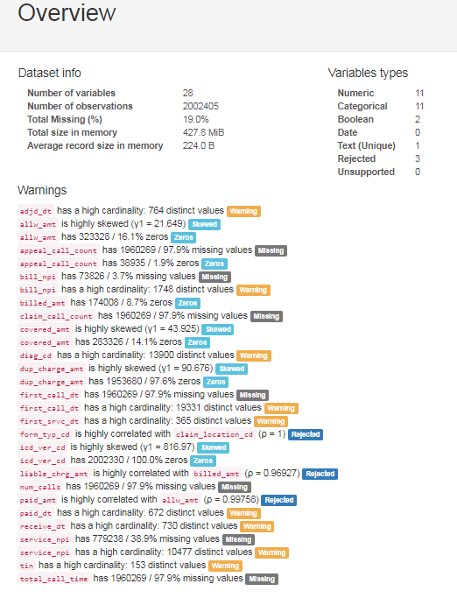
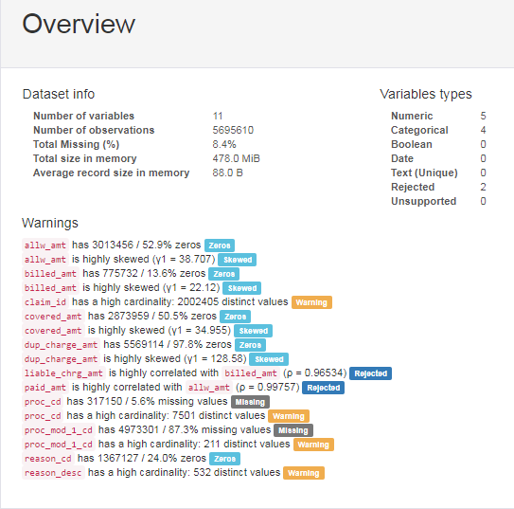
Data Profiling Summary (prior to data cleansing)
CALL CLAIM
CALL LINE

Slide 10
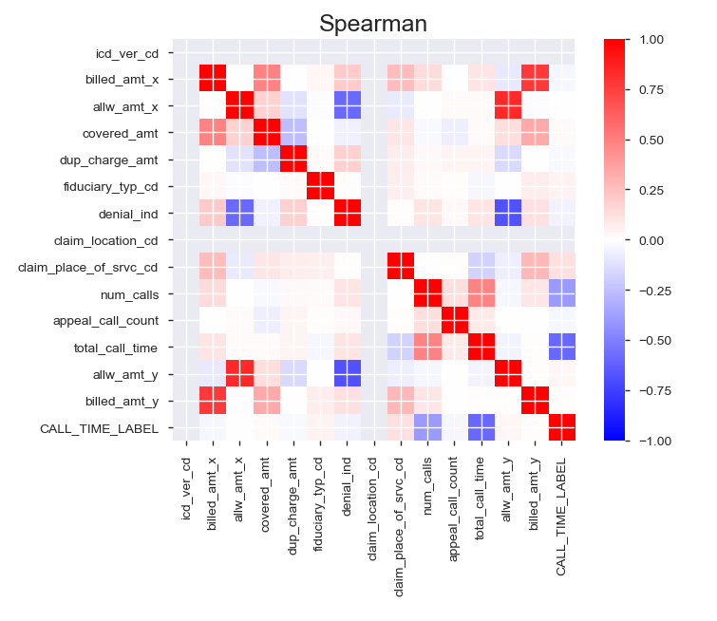
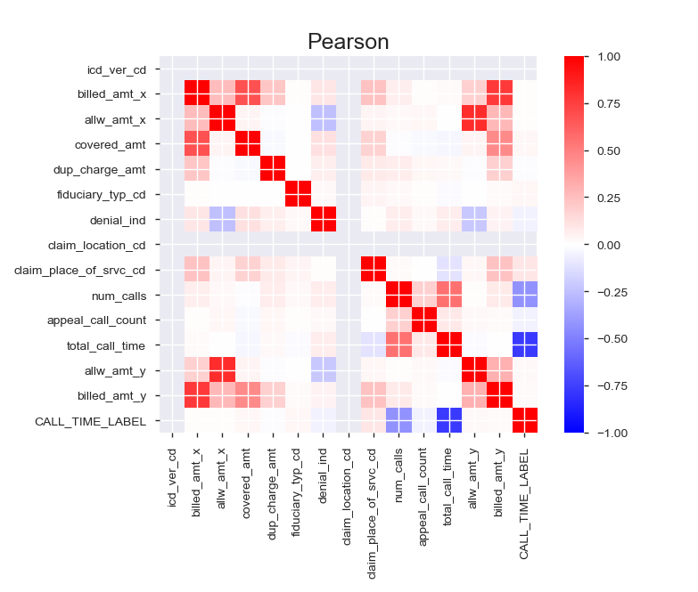
Exploratory Data Analysis – Multivariate Analysis (post data cleansing)
Correlational Matrix [merged (call claim & call line)]

Slide 11
Model Specifications and Variable Selection
12587 encounters
Patients with readmission encounter event or non event.
Event : Encounter with Call Duration > 14400 seconds (4 hours)
Non Event : Encounter with Call Duration < 14400 seconds (4 hours)
During univariate and multivariate exploratory data analysis, we found strong relationship between the CALL_TIME_LABEL dependent - Boolean variable (value = 1(total_call_time < 4 hours) else 0) and the below independent variables
billed_amt
allw_amt
covered_amt
dup_charge_amt
fiduciary_typ_cd
denial_ind
claim_location_cd
claim_place_of_srvc_cd
num_calls
appeal_call_count
Built sets of categorical, numerical features and used one hot encoding as needed for model analysis and evaluation
Baseline
Denominator
Feature Engineering/ Variable Selection
Reference: https://towardsdatascience.com/

Slide 12
Data Sampling and Transformation
Diving data into 3 samples
Training – To train the model – 70%
Validation – To validate and improve the model – 15%
Test – To measure generalized performance of the model – 15%
Shuffle the samples
Check prevalence of the 3 samples (call duration <4 hours)
Training Sample – 0.869 → 86.9%
Validation Sample – 0.870→87%
Test Sample – 0.854→ 85.4%
This is an imbalanced dataset
Create balanced training data set with 50% events and 50% non events (Sub Sampling), Randomized Search, SMOTE
Used scaler to fit and transform
Set threshold = 0.5
Random Sampling - To measure model performance on unseen data
Reference: https://towardsdatascience.com/

Slide 13
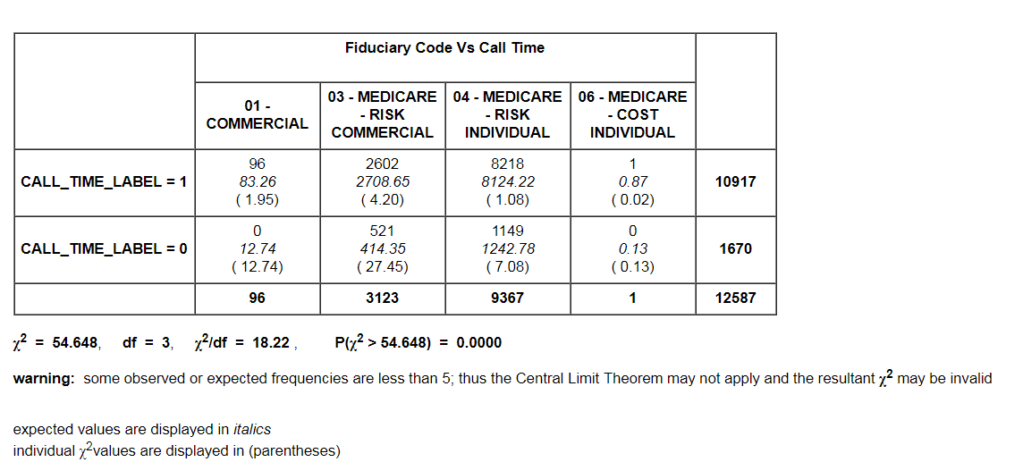

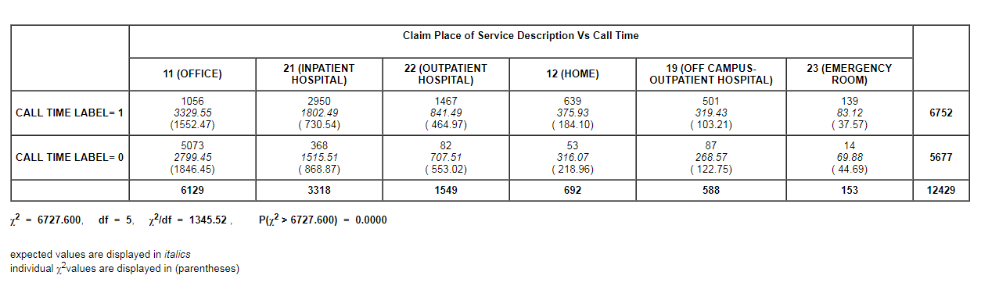
Pearson’s chi-squared statistical hypothesis
fiduciary_typ_cd vs Dependent Boolean Variable (CALL_TIME_LABEL) → p-value = 0.0000 (post data cleaning)
claim_place_of_srvc_cd vs Dependent Boolean Variable (CALL_TIME_LABEL) → p-value = 0.0000 (post data cleaning)
Call Prediction – Long Duration
Reference: http://turner.faculty.swau.edu/mathematics/math241/materials/contablecalc/calculate.php

Slide 14
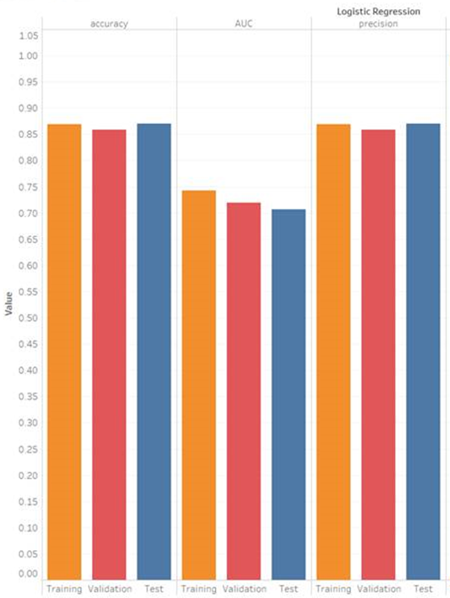


Model Analysis
Linear Regression
Traditional Machine Learning Model
Fits linear decision boundary between positive and negative samples
Interpretable (feature importance for predictive positive or negative)
Sensitive to scaling of features
Reference: https://towardsdatascience.com/

Slide 15
Ethical Considerations
Dataset used is de-identified and did not contain any PHI , PII information.
Due to the de-identified nature of the dataset obtained, this study can not be considered human subjects research
Study used the data for UHCInsight providers’ claims provided by the DataViz Admin Team

Slide 16
Conclusion
Hypothesis Verification Tools
Excel
Online Chi Square Calculator
Python
Results
Able to reject the null hypothesis (fiduciary_cd & claim_place_of_srvc_cd doesn't have impact on the call duration for claims)
since p-value = 0.0000 (p-value<=0.05)
Hence fiduciary_cd & claim_place_of_srvc_cd have a significant impact on the call duration.
Machine Learning Model
Able to predict 70% of long duration calls with Linear Regression Model
Exploration
UHG should take proactive and timely measures to avoid long duration calls.
Provide preventive quality care in turn reducing the turn-around time and associated costs by early detection of long duration calls.
Reference: http://turner.faculty.swau.edu/mathematics/math241/materials/contablecalc/calculate.php

Slide 17
Thank you
17

Slide 18
Appendix
18

Slide 19
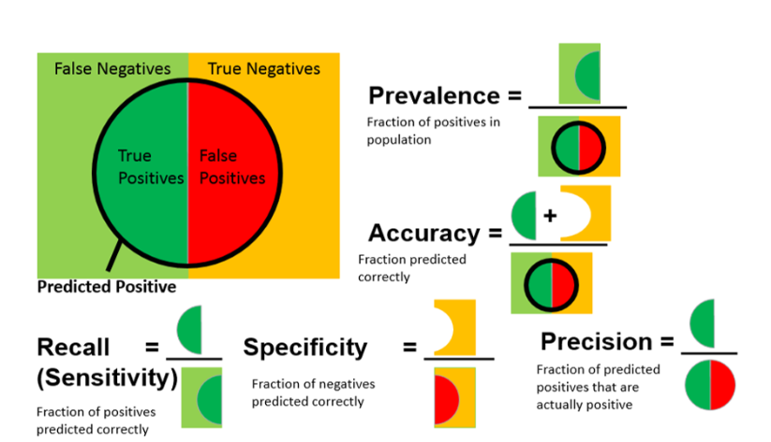

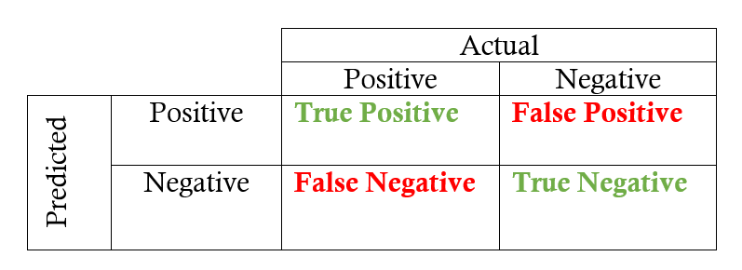
Data Science Performance Metrics
Reference: https://towardsdatascience.com/
https://www.dataschool.io/simple-guide-to-confusion-matrix-terminology/

