Slide 1






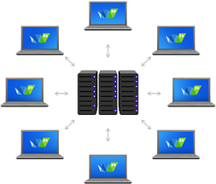
Jabber Smart Bot
Action/Get info
SSMO
Chat/Alert with email
Get Credential
SA
Action/ Response
Leaders
Action/Response with email
Action/Get info
Key Feature of this JSB (Jabber Smart Bot):
SA = system admin
SSMO =
JSB will alert to SSMO team if any RPA bot is not running on production.
Those who have the System Admin role they can give the action to stop and start the RPA bot.
Leaders can ask to JSB about daily monthly kind of reports.

Slide 2
Creating jabber chatbot to provide the current status of production running BOT. I have more than 200 BOT which is running on VDI currently we can't login on all VDI to see the status is running or not. avoid any delay in process the cases jabber chatbot will ping the message to direct SSMO team who will directly login on that VDI. Opportunity I need to create jabber chatbot to provide the current status of production running BOT.

