Slide 1
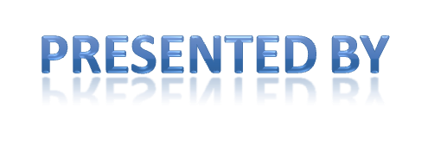

Slide 2
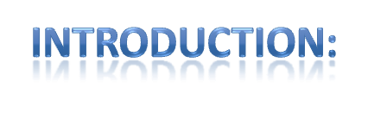
Cloud computing has been envisioned as the next-generation architecture of IT enterprise. In contrast to traditional solutions, where the IT services are under proper physical, logical and personnel controls, cloud computing moves the application software and databases to the large data centers, where the management of the data and services may not be fully trustworthy. This unique attribute, however, poses many new security challenges which have not been well understood. In this article, we focus on cloud data storage security, which has always been an important aspect of quality of service. To ensure the correctness of users' data in the cloud, we propose an effective and flexible distributed scheme with two salient features, opposing to its predecessors. By utilizing the homomorphic token with distributed verification of erasure-coded data, our scheme achieves the integration of storage correctness insurance and data error localization, i.e., the identification of misbehaving server (s). Unlike most prior works, the new scheme further supports secure and efficient dynamic operations on data blocks, including: data update, delete and append. Extensive security and performance analysis shows that the proposed scheme is highly efficient and resilient against Byzantine failure, malicious data modification attack, and even server colluding attacks.

Slide 3
What is cloud Computing?
key to the defination of cloud computing is the “cloud” itself. here cloud is the group of large group of interconnected computers
these computers can be personal or network servers.
the cloud of computers extend beyond a single company or entity. the application and data served by cloud are available to broader group of users, cross enterprise,and cross platform.
access is via internet. any authorized user can access these documents, application from any computer over the internet.

Slide 4
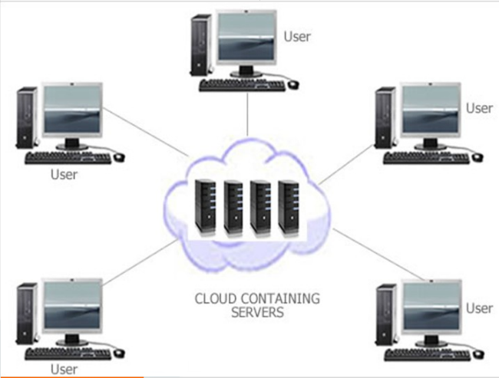

Slide 5
Key properties to cloud Computing
user centric:- once user connected with cloud, user can access images data messages applications, whatever- becomes authorized to the user access.
task centric:- instead of focusing on the application ,here the focus is on what one need to be done and the application customized for us.
powerful:- connecting hundreds odf thousands of computers together in a cloud creates a wealth of computing power which is impossible for single desktop pc.
accessible:- because data is stored in cloud user can retrieve more information from multiple repositories

Slide 6
intelligent:- with all the data stored in computers of cloud, data mining and analysis are necessary to access that information in an intelligent manner.
programmable:- many of the task necessary with the cloud must be automated. for eg data to protect the integrity of data information stored on single computer must be replicable on other computers in cloud. If one computer goes offline cloud’s programming automatically redistributes the data to other computers.

Slide 7
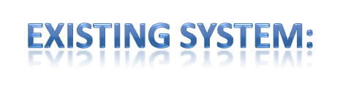

From the perspective of data security, which has always been an important aspect of quality of service, Cloud Computing inevitably poses new challenging security threats for number of reasons.
Firstly, traditional cryptographic primitives for the purpose of data security protection can not be directly adopted due to the users’ loss control of data under Cloud Computing.
2. Secondly, Cloud Computing is not just a third party data warehouse. The data stored in the cloud may be frequently updated by the users, including insertion, deletion, modification, appending, reordering, etc.

Slide 8
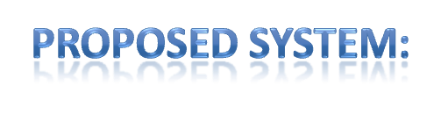
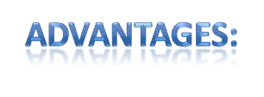
In this paper, we propose an effective and flexible distributed scheme with explicit dynamic data support to ensure the correctness of users’ data in the cloud. We rely on erasure correcting code in the file distribution preparation to provide redundancies and guarantee the data dependability. This construction drastically reduces the communication and storage overhead as compared to the traditional replication-based file distribution techniques.
Compared to many of its predecessors, which only provide binary results about the storage state across the distributed servers, the challenge-response protocol in our work further provides the localization of data error.
Unlike most prior works for ensuring remote data integrity, the new scheme supports secure and efficient dynamic operations on data blocks, including: update, delete and append.
Extensive security and performance analysis shows that the proposed scheme is highly efficient and resilient against Byzantine failure, malicious data modification attack, and even server colluding attacks.

Slide 9
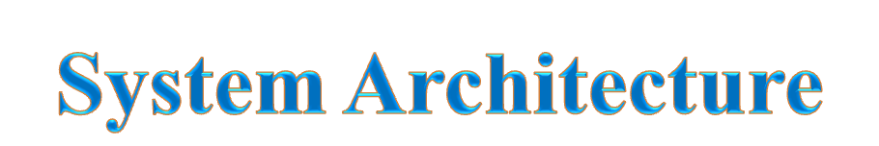

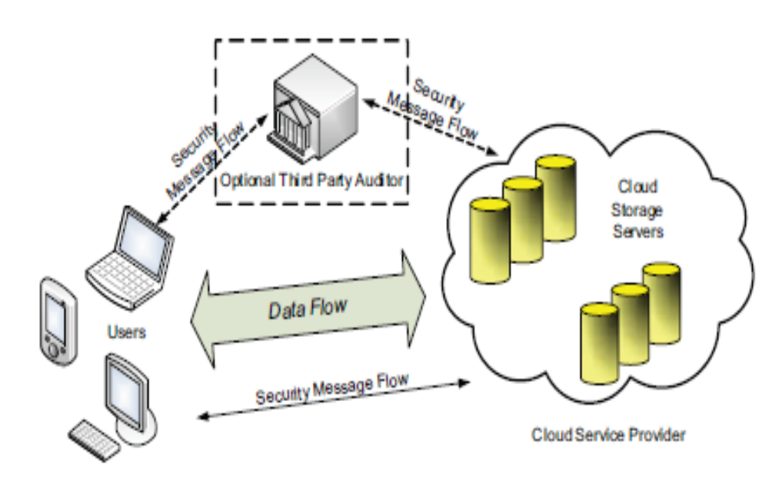

Slide 10
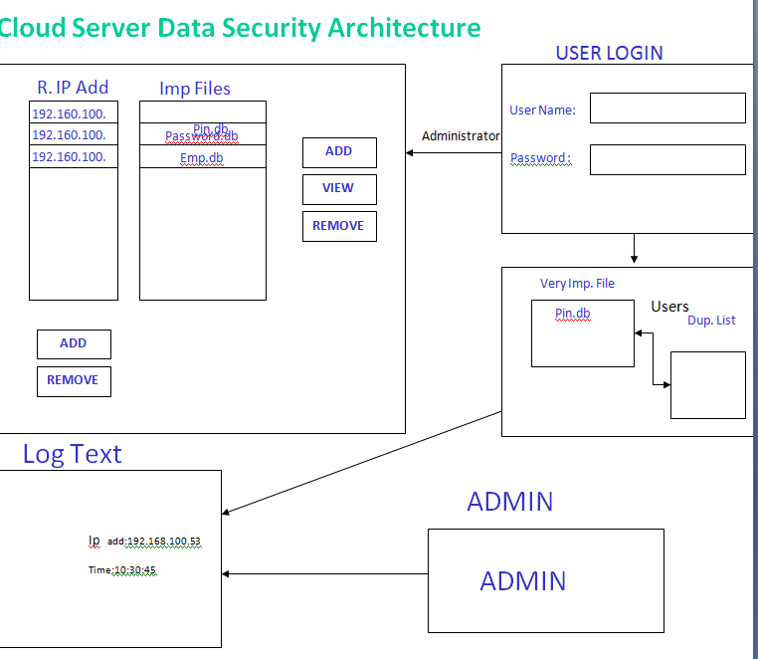

Slide 11
modules
1. Client Module:
In this module, the client sends the query to the server. Based on the query the server sends the corresponding file to the client.
2. System Module:
• User:
Users, who have data to be stored in the cloud and rely on the cloud for data computation, consist of both individual consumers and organizations.
• Cloud Service Provider (CSP):
A CSP, who has significant resources and expertise in building and managing distributed cloud storage servers, owns and operates live Cloud Computing systems,.
• Third Party Auditor (TPA):
An optional TPA, who has expertise and capabilities that users may not have, is Trusted to assess and expose risk of cloud storage services on behalf of the users upon request.

Slide 12
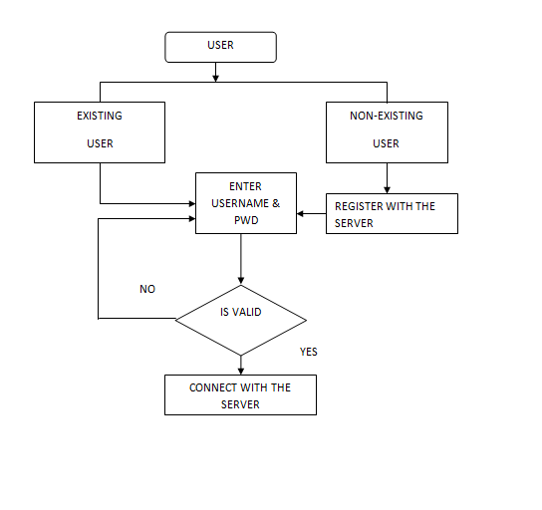
CLIENT

Slide 13
3. Cloud data storage Module:
Cloud data storage, a user stores his data through a CSP into a set of cloud servers, which are running in a simultaneous, the user interacts with the cloud servers via CSP to access or retrieve his data.
4. Cloud Authentication Server:
The Authentication Server (AS) functions as any AS would with a few additional behaviors added to the typical client-authentication protocol. The first addition is the sending of the client authentication information to the masquerading router.
The other optional function that should be supported by the AS is the updating of client lists.
5. Unauthorized data modification and corruption module:
One of the key issues is to effectively detect any unauthorized data modification and corruption, possibly due to server compromise and/or random Byzantine failures.

Slide 14
6. Adversary Module:
Weak Adversary: The adversary is interested in corrupting the user’s data files stored on individual servers. Once a server is comprised, an adversary can pollute the original data files by modifying or introducing its own fraudulent data to prevent the original data from being retrieved by the user.
Strong Adversary: This is the worst case scenario, in which we assume that the adversary can compromise all the storage servers so that he can intentionally modify the data files as long as they are internally consistent. In fact, this is equivalent to the case where all servers are colluding together to hide a data loss or corruption incident.

Slide 15
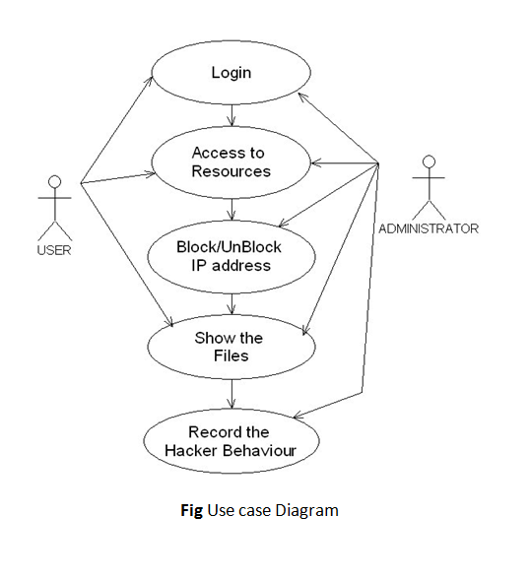
Use case diagram
uml diagrams

Slide 16
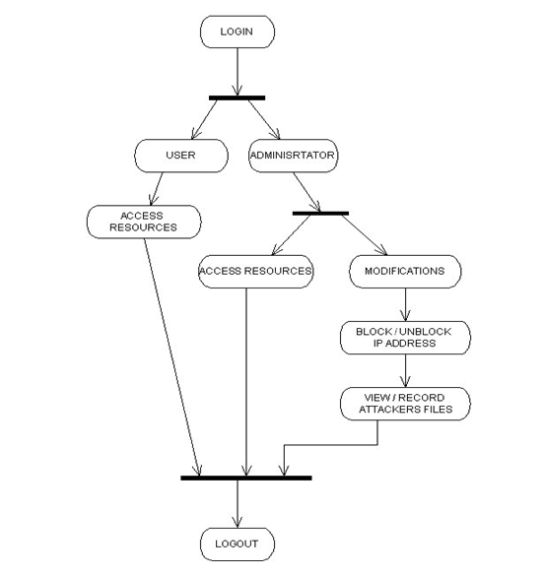
Activity diagram

Slide 17
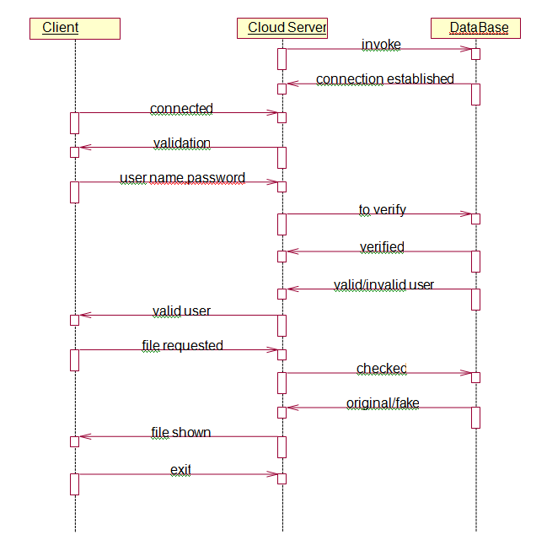
SEQUENCE DIAGRAM

Slide 18
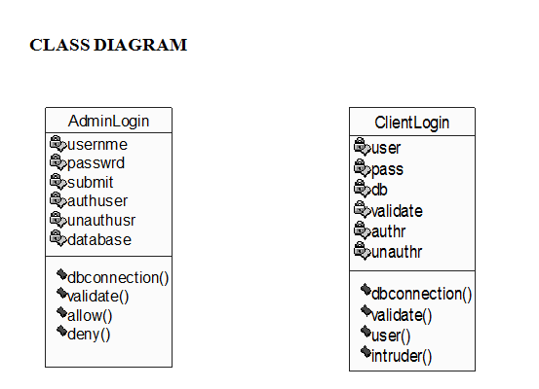

Slide 19
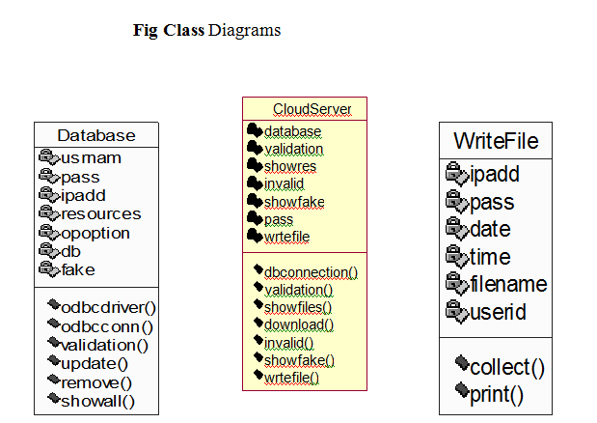

Slide 20
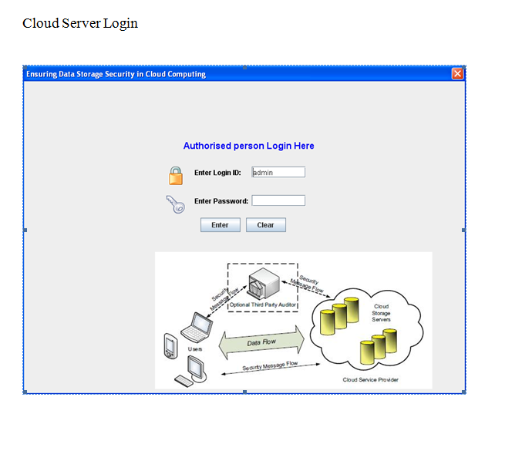
screen shots

Slide 21
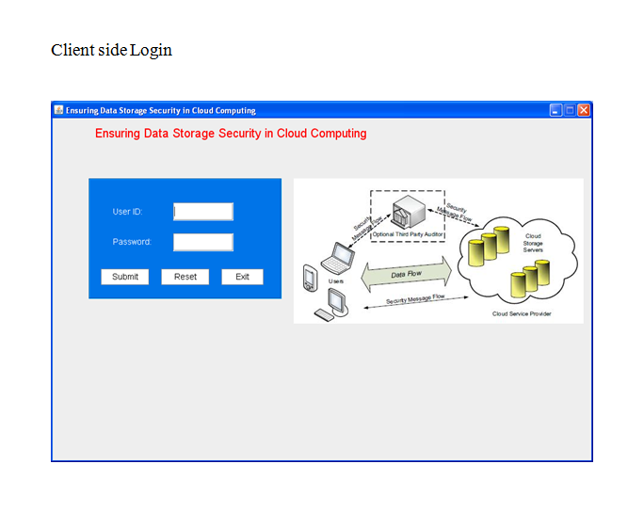

Slide 22
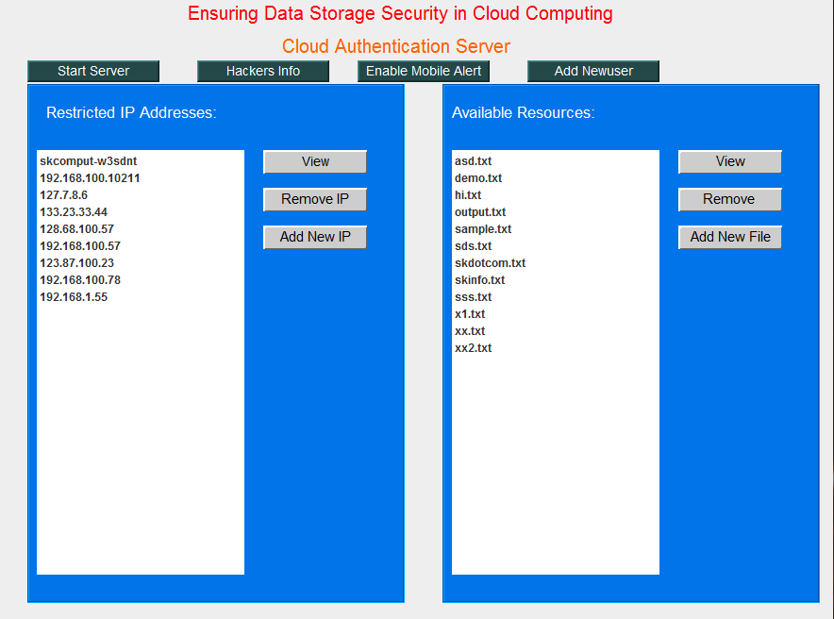

Slide 23
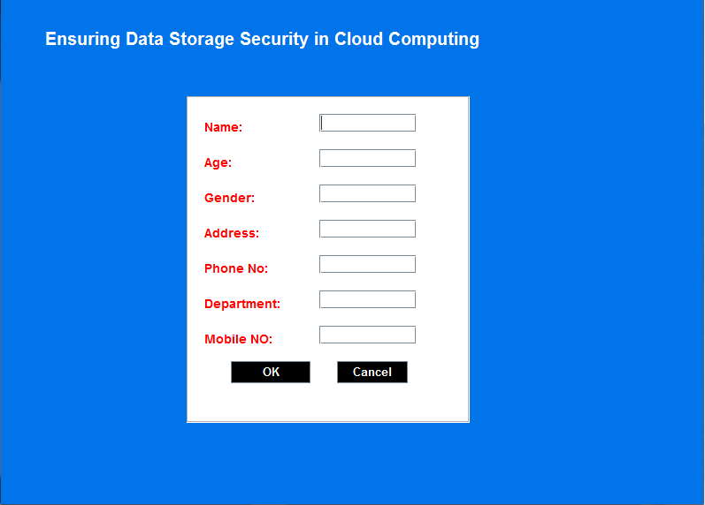

Slide 24
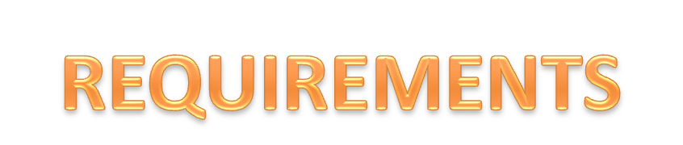
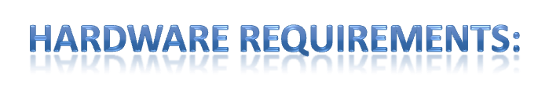
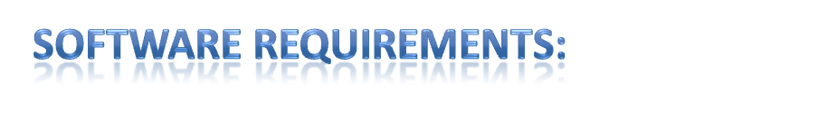
256 MB RAM.
40 MB Hard Disk Space
Ethernet card with an Internet or Internet zero.
Operating system : Windows XP.
Coding Language : JAVA,Swing,RMI,J2me(WirelessToolkit)

Slide 25
Conclusion
cloud computing provides a supercomputing power.the cloud of computers extend beyond a single company or enterprise.
. To ensure the correctness of users’ data in cloud data storage, we proposed an effective and flexible distributed scheme with explicit dynamic data support, including block update, delete, and append.
We believe that data storage security in Cloud Computing, an area full of challenges and of paramount importance, is still in its infancy now, and many research problems are yet to be identified

Slide 26
