Slide 1
WebApi
A Gentle Introduction
Vighnesh PP
Notes:
This is the cover slide only, do not use for internal pages. Presenter email, Twitter handle or other info can be added beneath the name if desired.

Slide 2
Agenda
What are WebApis?
Various other alternatives
Basics of WebApi
WebApi 2.0
KID Project Run through to show WebApi actual implementation.

Slide 3
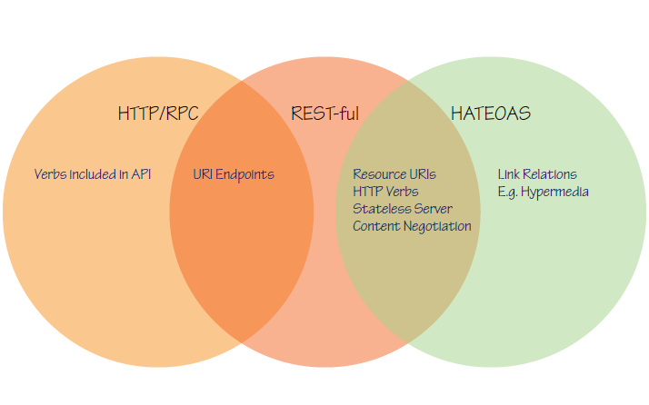
What are WebApis

Slide 4
What it offers?
Structure and Organise your UI Code
Addresses Seperation Of Concerns
Decouples DOM Manipulation from application Logic
Modularity to the application
Parallel development
Declarative UI

Slide 5
Ways to implement Web Services
ASMX Web Services
WCF Web Services
WCF Rest
WCF Data and OData Client
MVC3
MVC4
WebApi (1.0 and 2.0)

Slide 6
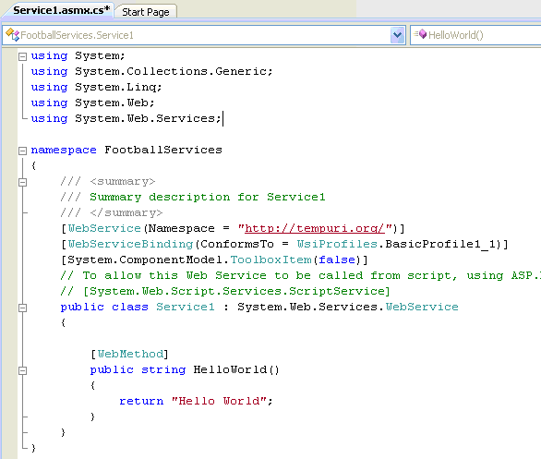
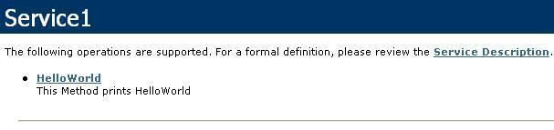
AsMx Web Service
One of the first ways to b uild a web service in .net
SOAP based with HTTP Post
ASMX is depreciated!

Slide 7
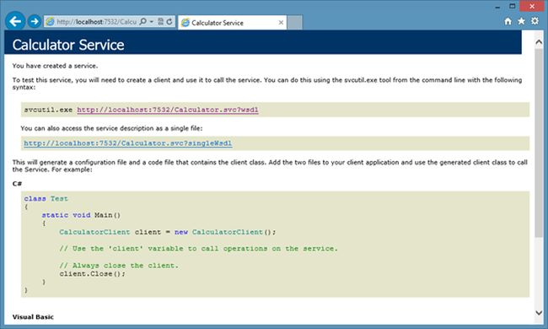
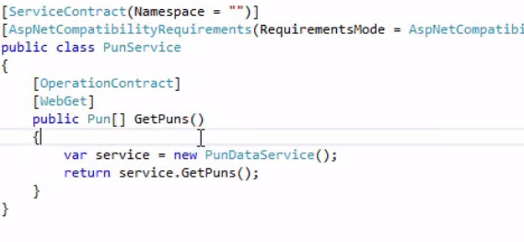
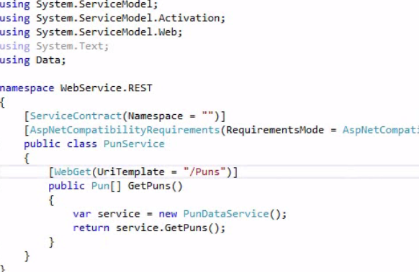
WCF Web Services

Slide 8
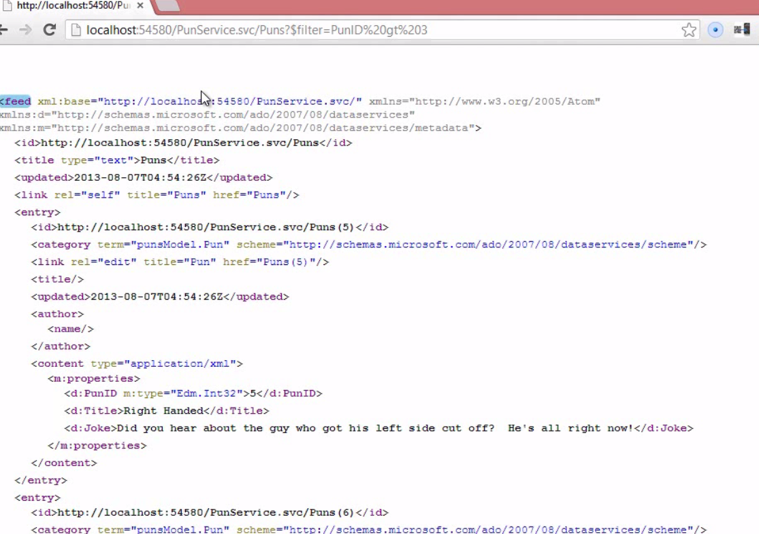
WCF Odata Service

Slide 9
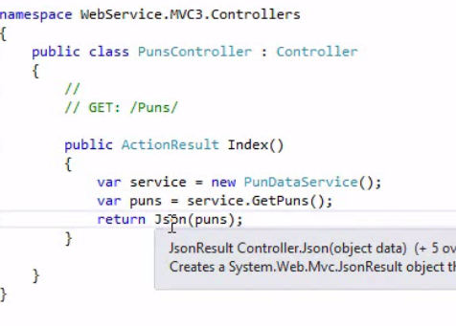
MVC3
Model, View and the Controller
Routes : maps b/w request and appropriate controller/action.
Uses URI templates /{controller}/{action}/{param}

Slide 10
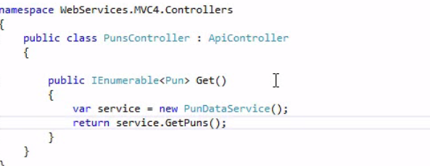
MVC4
Same as MVC3
+ApiController
Automatic content negotiations with Accept Types etc

Slide 11
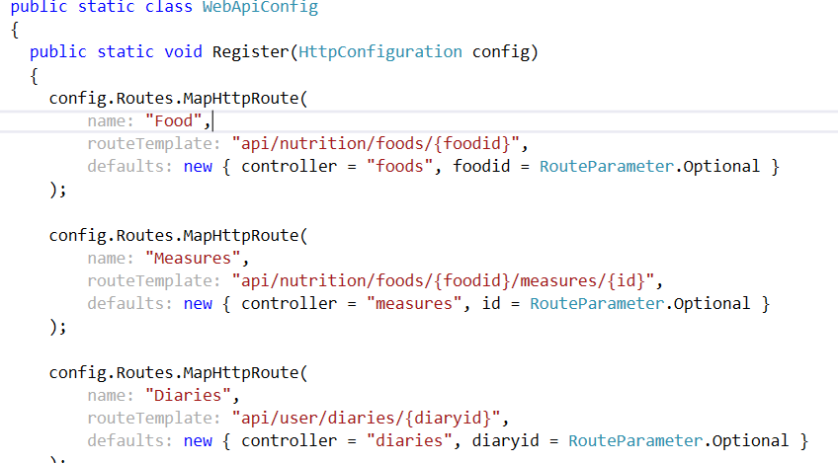
WebApi 1.0

Slide 12
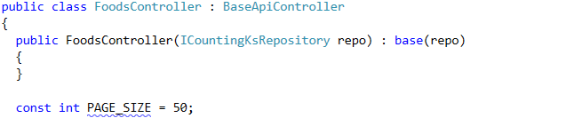

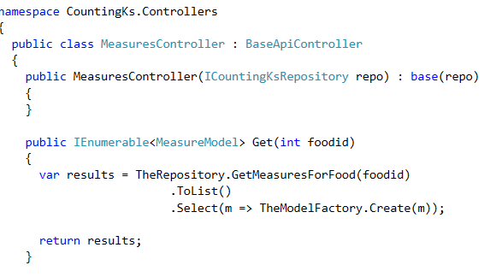
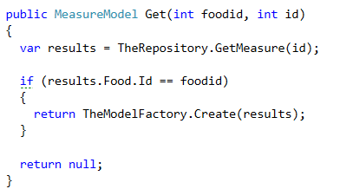
WeBAPI1.0 contd.

Slide 13
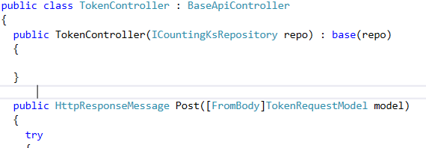
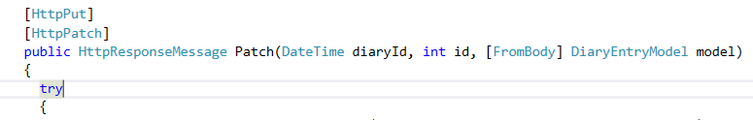
WebApi 1.0 Contd.

Slide 14
WebApi 2.0
Maturation of existing webapi stack
Requires 4.5
Attributed routing
CORS Support
IHTTPActionResult interface
OAuth support
OWIN for self hosting
OData support

Slide 15
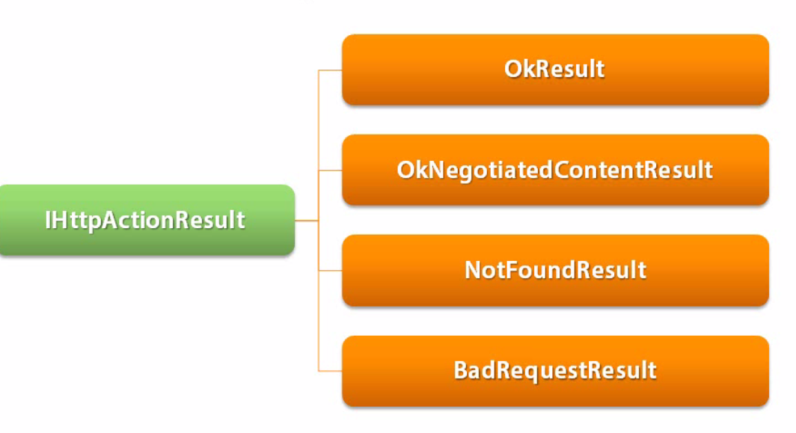
IHttpActionResult
Standard way of Constructing Common Results
Replacement for HttpResponseMessage
Can create custom action Result too

Slide 16
KID DEMO

