Slide 1
Arithmetic Logic Unit
Chen-Kang (Angus) Tsai
Email: angus@cereal.cse.nsysu.edu.tw
Date: 2020/11/18

Slide 2
ALU
Arithmetic logic unit (ALU) is used to perform performs arithmetic and bitwise operations.
A and B are operated according to “Opcode”
The Zero equal to 1 when the result equal to zero
Opcode
A
Zero
ALU
Result
B
Overflow

Slide 3
ALU
The operation result is according to Opcode
There are six modes of operation
AND (bitwise)
OR (bitwise)
Addition
Subtraction
Set-on-less-than
NOR(bitwise)
ALUop
3
A
16
Zero
ALU
Result
16
B
Overflow
16
ALUop
function
000
001
010
011
100
101
AND
OR
Add
Sub
Set-on-less-than
nor

Slide 4
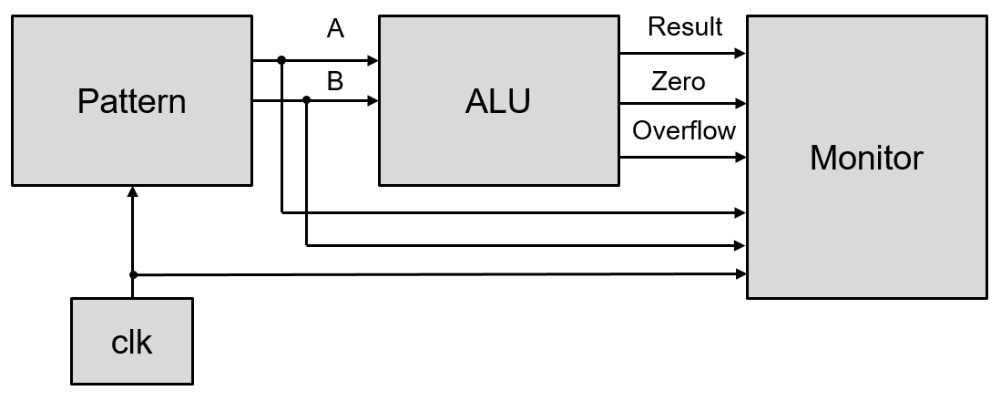
Lab2
Design a 16-bits ALU
System block
clk
Pattern
ALU
Monitor

Slide 5
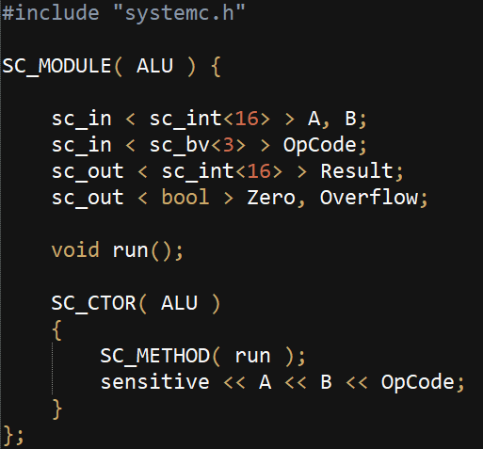
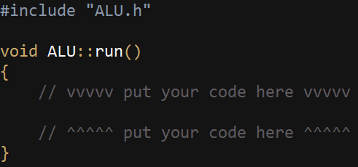
Lab2
ALU
ALU.cpp
ALU.h

Slide 6
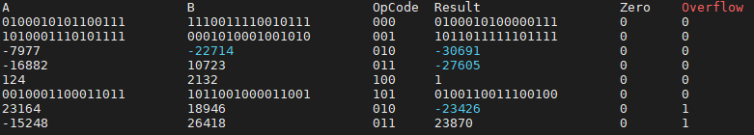
Lab2
Execution result
When ALU perform bitwise operation, show the A, B and result with binary

Slide 7
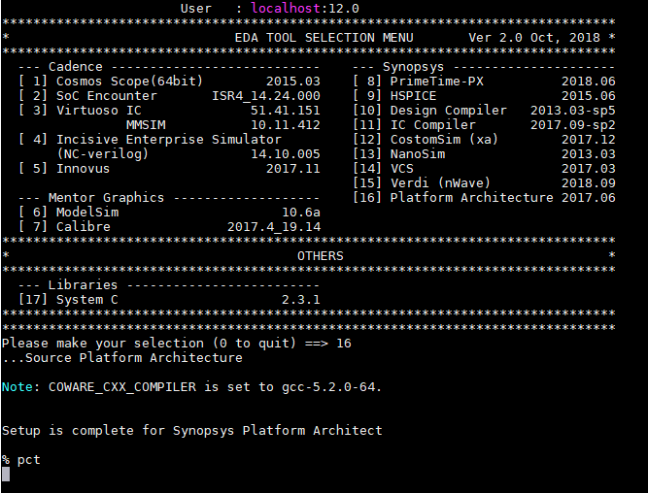
Platform Architect
tool -> enter -> 16 -> enter -> 0 -> enter -> pct -> enter
Choose 16

Slide 8
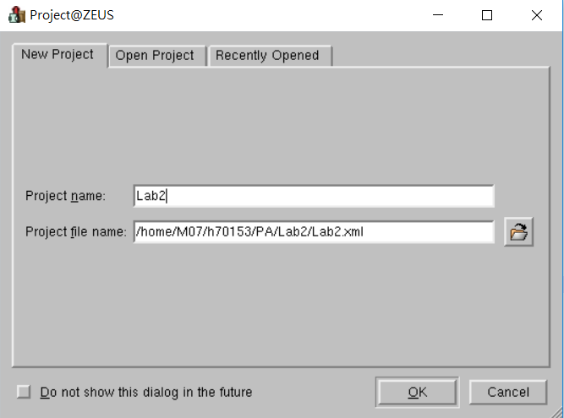
Platform Architect
Create project -> Project name -> Project file name -> OK

Slide 9
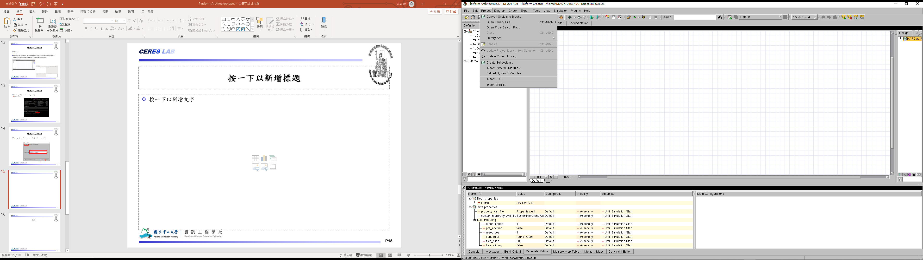
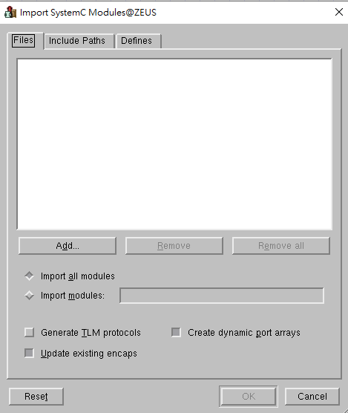
Platform Architect
Import SystemC Modules -> Add -> Choose all the source file

Slide 10
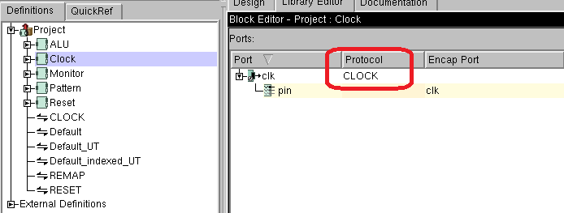
Platform Architect
Change protocol of clock port
Double click Clock -> Click Default -> Choose CLOCK

Slide 11
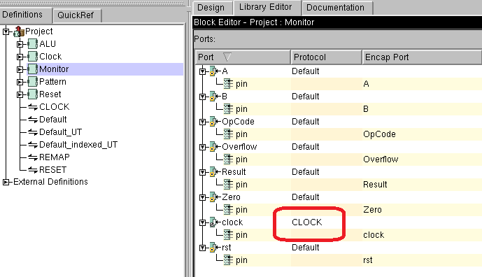
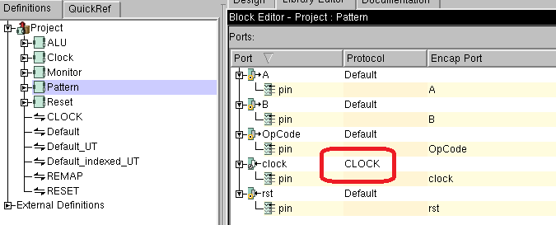
Platform Architect
Repeat the same action to change the clock protocol of Monitor block and Pattern block.

Slide 12
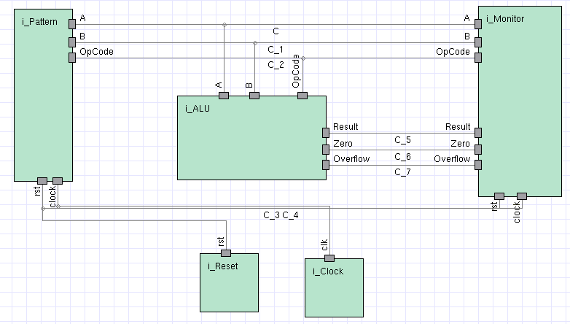
Platform Architect
Create the block diagram

Slide 13
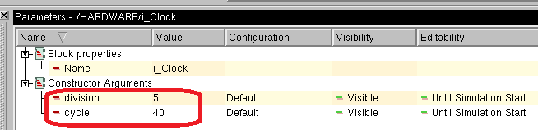
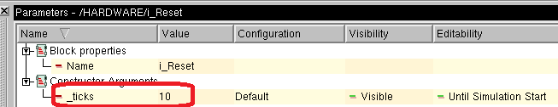
Platform Architect
Click clock block -> Set clock period
division -> 5
cycle -> 40
Click Reset block -> Set reset period
_ticks -> 10

Slide 14
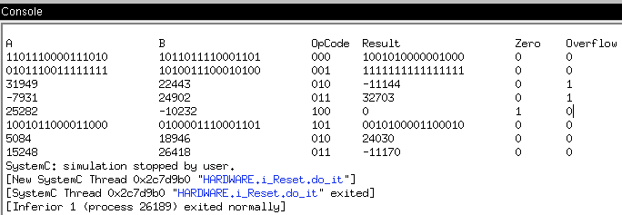
Platform Architect
Simulation result

Slide 15
Requirement
Due in one week (11/25)
Complete 16-bits ALU.
Use Platform Architecture to simulate output result.
Source code ( all of your file, include PA project file, source code…. ).

