Slide 1

TimeSwap – A Student Time & Skill Barter Platform
G. Narayanamma Institute of Technology & Science
(Autonomous) (For Women)
Department of CSE(Data Science)
BATCH:D06
B. Laxmi Vigna 22251A6706
G. Sahithi 22251A6715
D. Sujitha 22251A6740
Y. Sreeja 22251A6763
Guide: Mrs. Y.Rajyalaxmi
Assistant Professor

Slide 2
TABLE OF CONTENTS:
1.Introduction
2.Existing System
3.Literature survey
4.Challenges
5.Proposed System
6.Objectives
7.Methodology
8.Modules
9. Hardware and Software Requirements
10.Implementation
11.Results
12.Conclusion
13.References

Slide 3
Introduction
TimeSwap taps into the hidden talents of student communities by turning peer skills into a powerful support system. Instead of money, students exchange time—offering what they know in return for what they need. It’s a smart, collaborative way to learn, grow, and thrive together.

Slide 4
Existing system
LinkedInConnects professionals and endorsements
No direct skill barter system
FiverrFreelance projects and services
Paid transactions only; no peer-to-peer barter
Upwork / InternshalaInternship & freelance work opportunities
Focus on career work; barter not possible
Meetup / Facebook Groups
Skill-based groups and offline meetups
No structured request/accept system or ratings

Slide 5
LITERATURE SURVEY
S.no | Journal | Year | Author | Model | Metrics | Disadvantages
1 | arXiv: Digital Skills Formation in Gendered Peer Networks | 2025 | Research team (EduTech study) | Network analysis of peer skill-sharing | Peer interactions, gender influence | Focused only on school students, not general users
2 | Frontiers in Human Dynamics – KIDS4ALLL Project | 2025 | Multinational EU researchers | Buddy-pair learning model in digital platform | Peer engagement, inclusivity | Limited to non-formal education context
3 | International Journal of Scientific Research in Engineering and Management – P2P Skill Exchange | 2024 | Various authors (India) | Prototype platform with profiles, assessments | Skill self-assessment, knowledge sharing | Still conceptual; lacks database & live deployment
4 | ResearchGate – Exploring Commitment in Timebanks (Scoping Review) | 2024 | Multiple reviewers | Literature review of timebanking systems | Motivators: altruism, interaction | No technical platform studied, only behavioral aspects

Slide 6
Challenges
Efficient skill matching & recommendations
Scalability with growing users
Real-time notifications
Data management & storage optimization
User engagement & trust

Slide 7
Proposed system
End-to-End Skill Barter:
Users list skills, desired skills, qualifications, and certifications
Direct requests to trade skills with others
Privacy & Controlled Access:
Mobile numbers visible only after request acceptance
Search & Filter Options:
Dedicated pages for skills and locations
Search by skills or location for quick matching
Notifications & Request Tracking:
Real-time notifications for sent and received requests
Dedicated sent request and received request pages
Ratings & Reviews:
Users can rate others, helping build trust
User Verification & Security:
Only approved users appear on the dashboard
Optional certificate uploads for authenticity
Dashboard:
View other users, their skills, location, and ratings at a glance

Slide 8
OBJECTIVES
To provide a non-monetary, student-focused skill exchange platform.
To ensure trust, accountability, and transparency.
To promote peer-to-peer learning and networking.
To implement structured matching & scheduling tools.
To design a scalable, cloud-ready platform for future expansion.

Slide 9
METHODOLOGY:
Requirements
UI/UX Design
Frontend
Backend
Deployment
Testing
Database

Slide 10
MODULES:
UI Development Module
Backend Integration Module
Database Management Module
Skill Matching and Exchange Module
Feedback and Analytics Module

Slide 11
Hardware and Software Requirements
Hardware Requirements
Processor: Intel i3 / Ryzen 3 or above
RAM: 8 GB (4 GB may slow down development)
Storage: SSD with 50–100 GB free
Internet: Minimum 2 Mbps, stable connection
Software Requirements
OS: Windows 10/11, Ubuntu, or macOS Backend: Python 3.10+, Django 4.x, DRF, SimpleJWT, SQLite Frontend: Node.js, React.js, React Router DOM, React Hooks, TailwindCSS/Bootstrap Tools: VS Code, Postman, Git & GitHub, Chrome/Firefox

Slide 12
IMPLEMENTATION:
1. UI Development Module
React + Tailwind
Home, Skills, Locations
Login/Signup (UI)
About page
Responsive design
2. Backend Integration Module
Django + DRF APIs
JWT authentication
Skills & Locations data
API endpoints

Slide 13
IMPLEMENTATION:
3. Database Management Module
User Registration
FriendSessions
Users table
Skills table
Barter history
Search & filter

Slide 14
IMPLEMENTATION:
4. Skill Matching and Exchange Module
Matching logic
Skill request/offers
Peer connection
5. Feedback and Analytics Module
User ratings
Session feedback
Participation tracking
Admin insights/dashboard

Slide 15
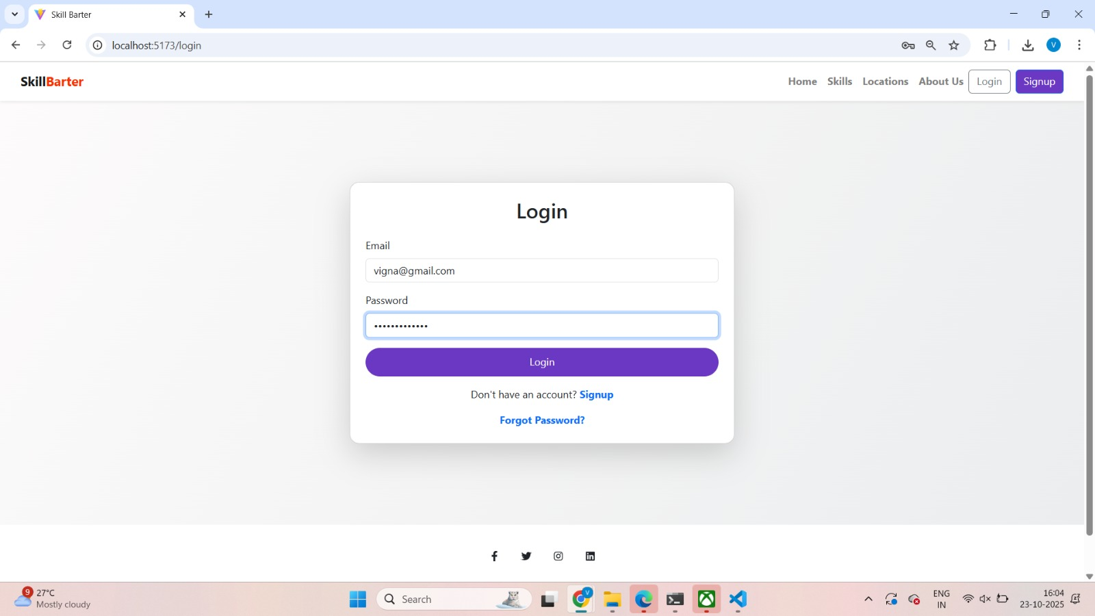
Results

Slide 16
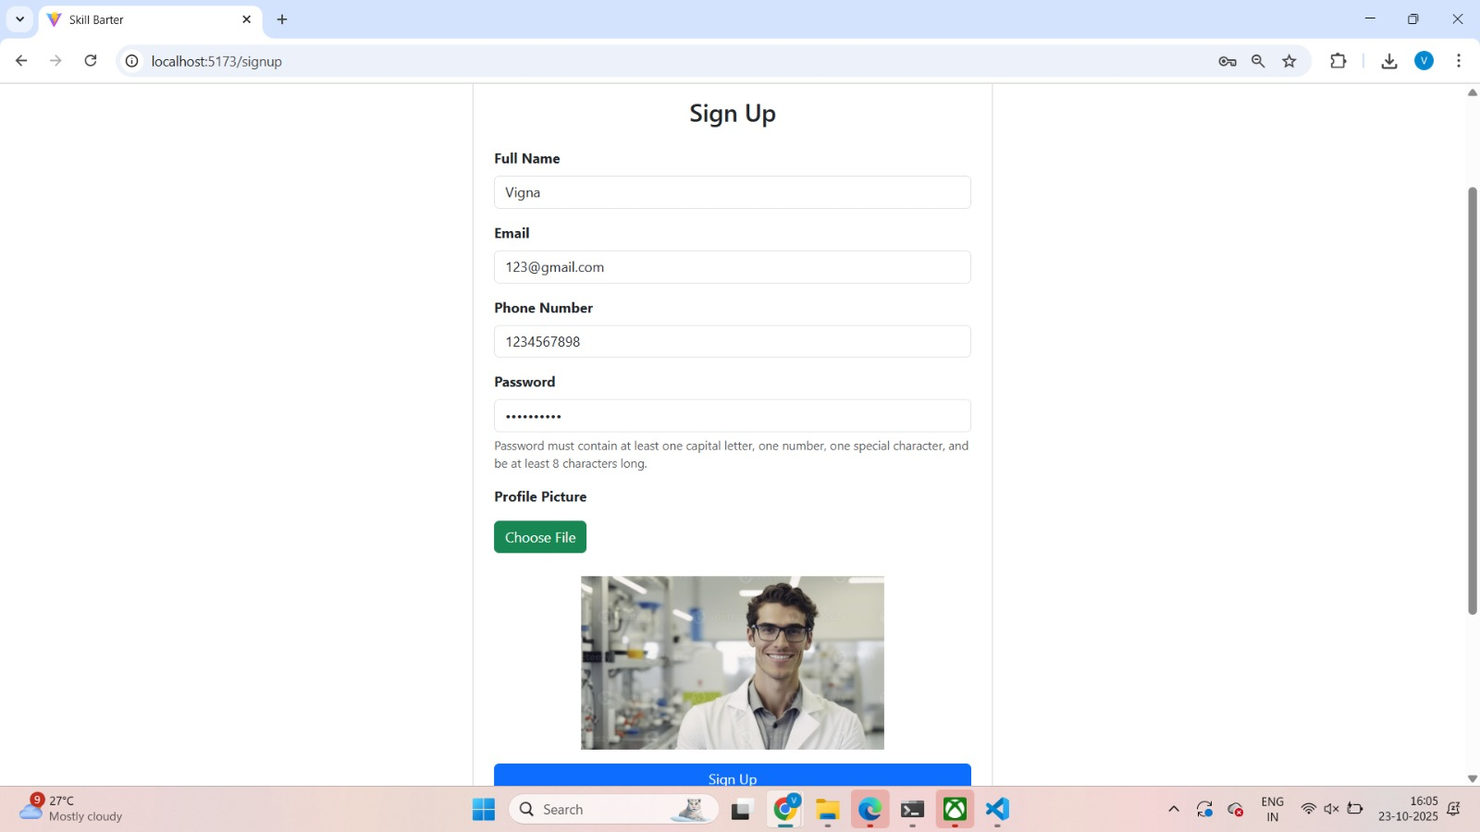

Slide 17
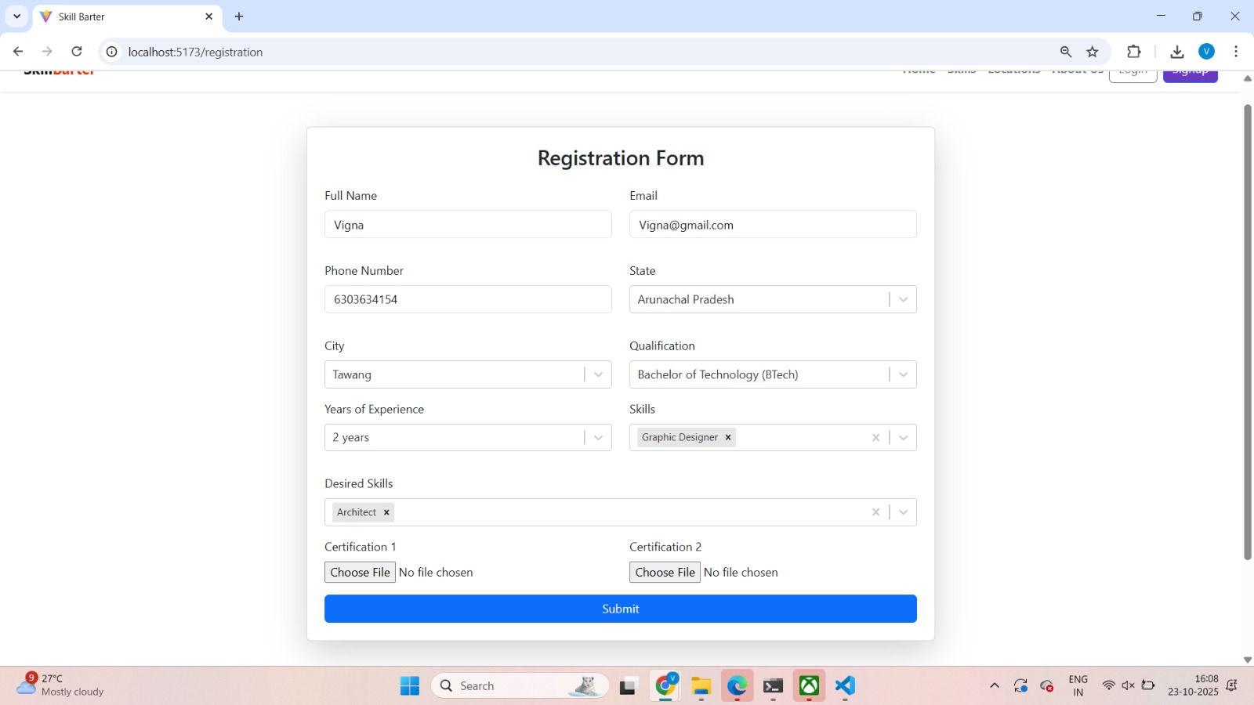

Slide 18
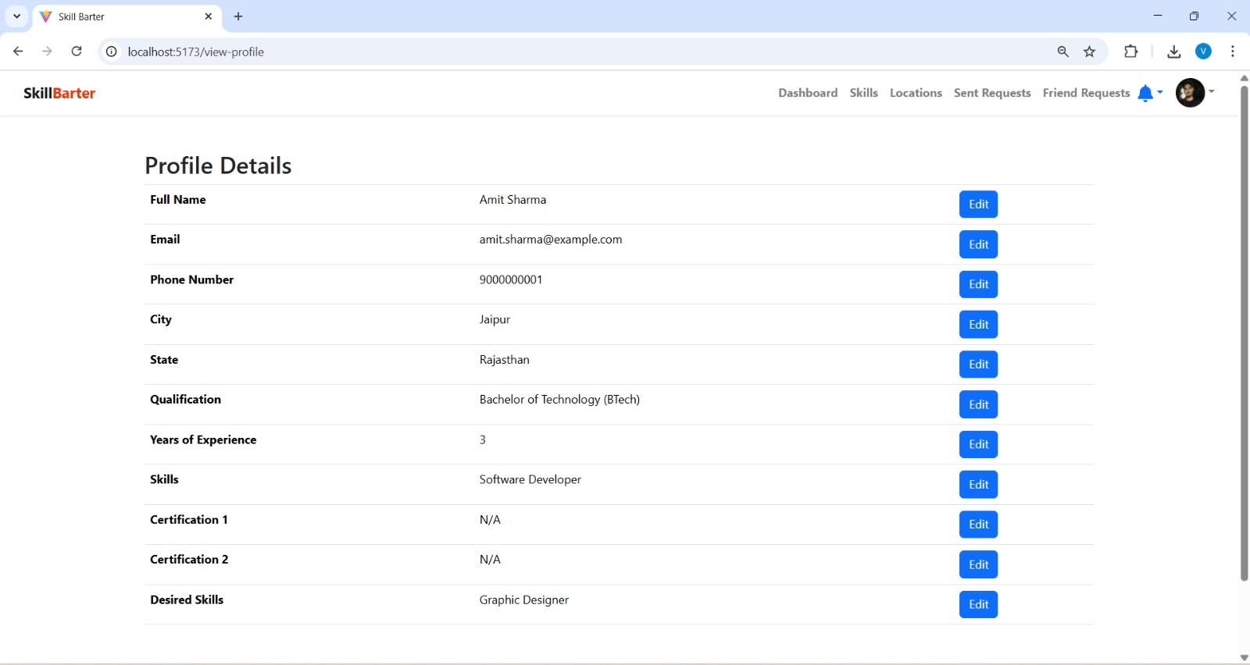

Slide 19
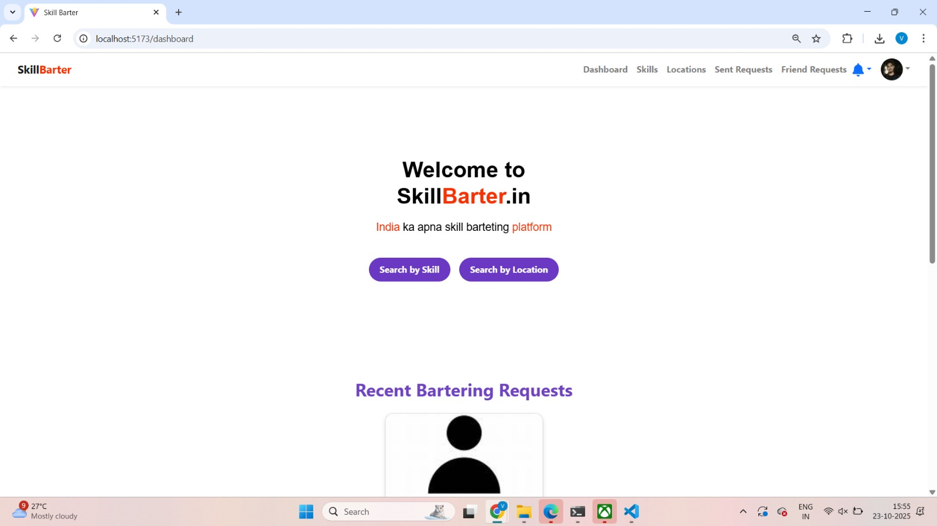

Slide 20
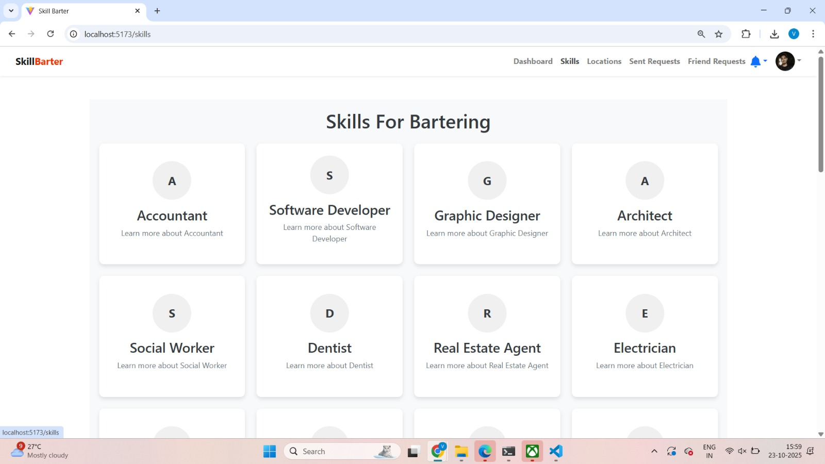

Slide 21
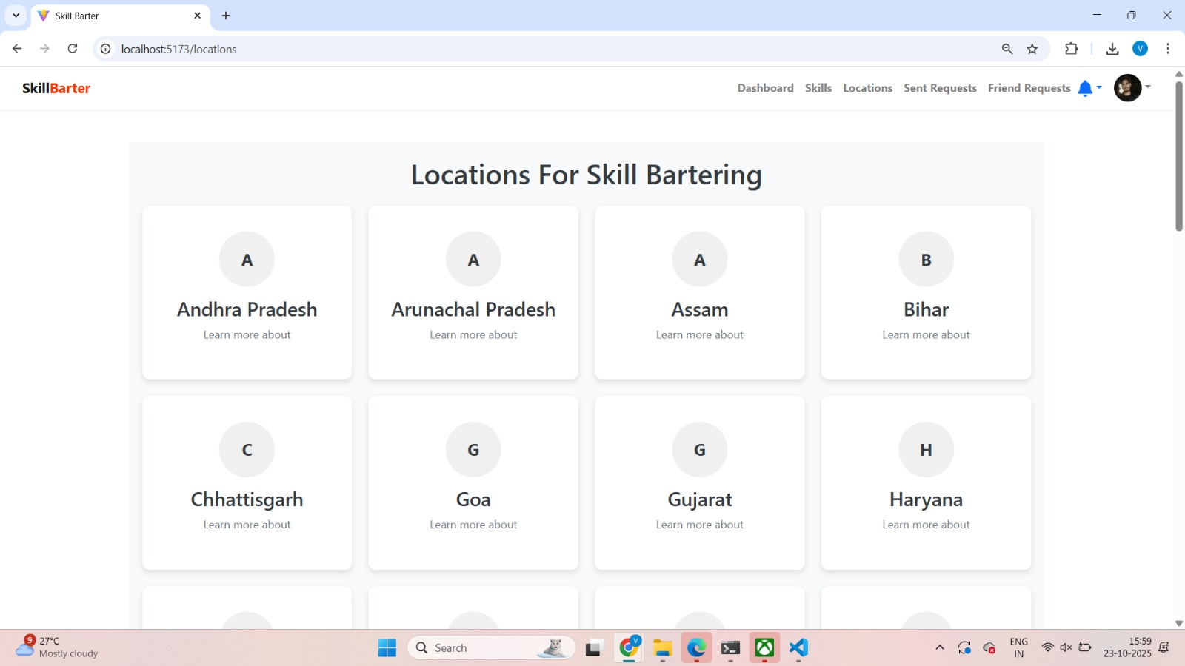

Slide 22
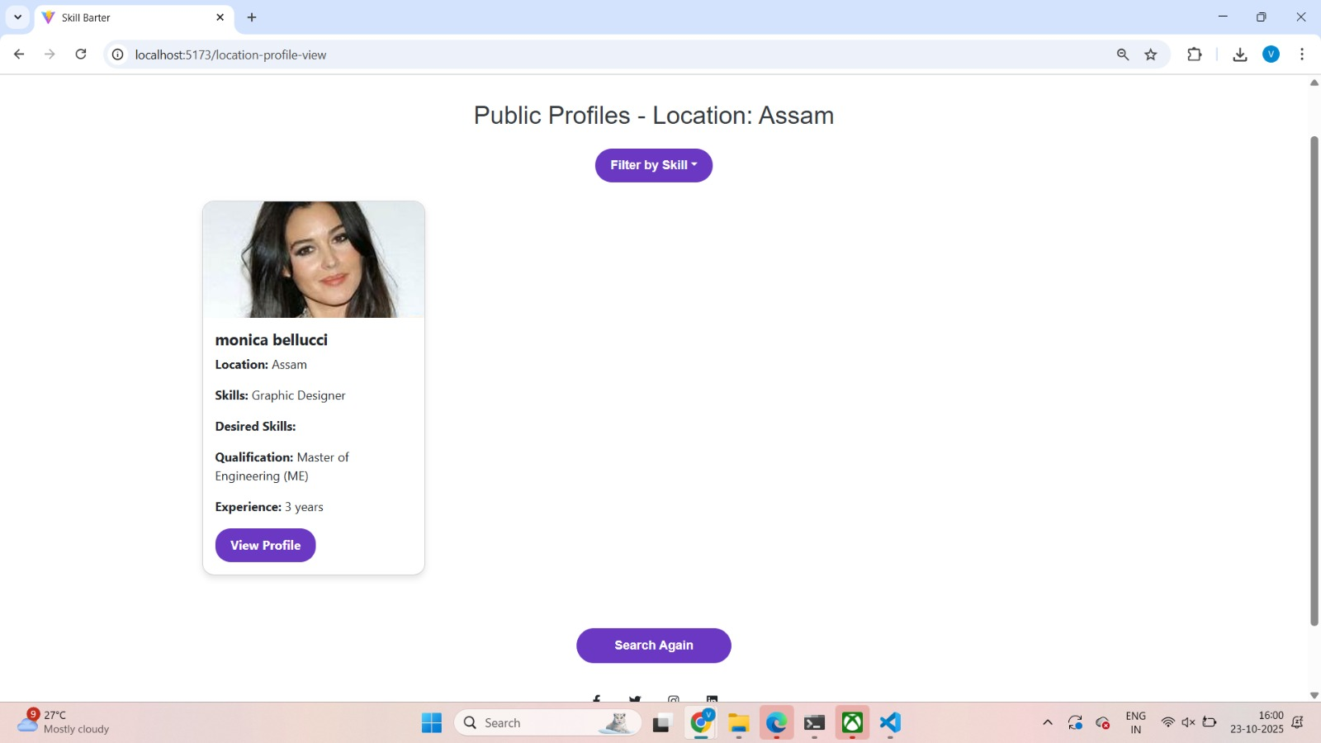

Slide 23
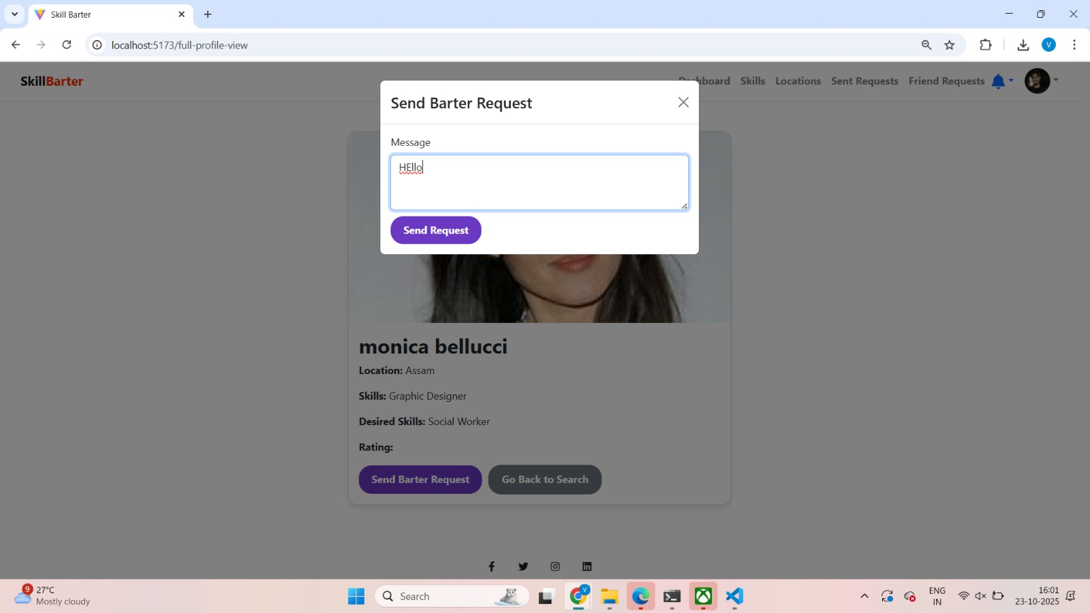

Slide 24
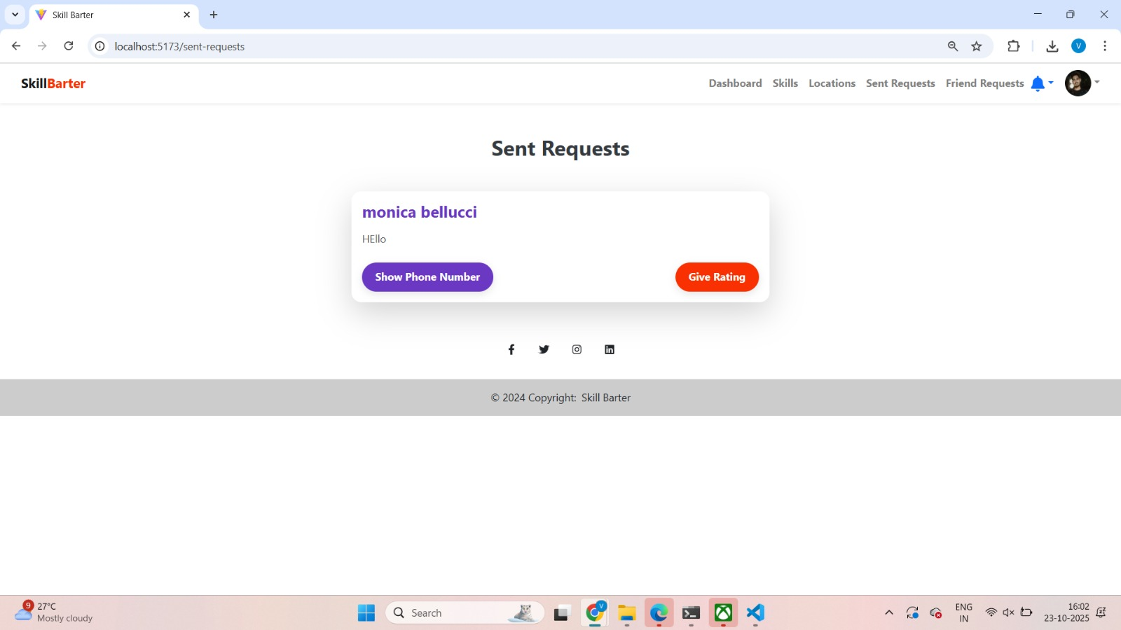

Slide 25
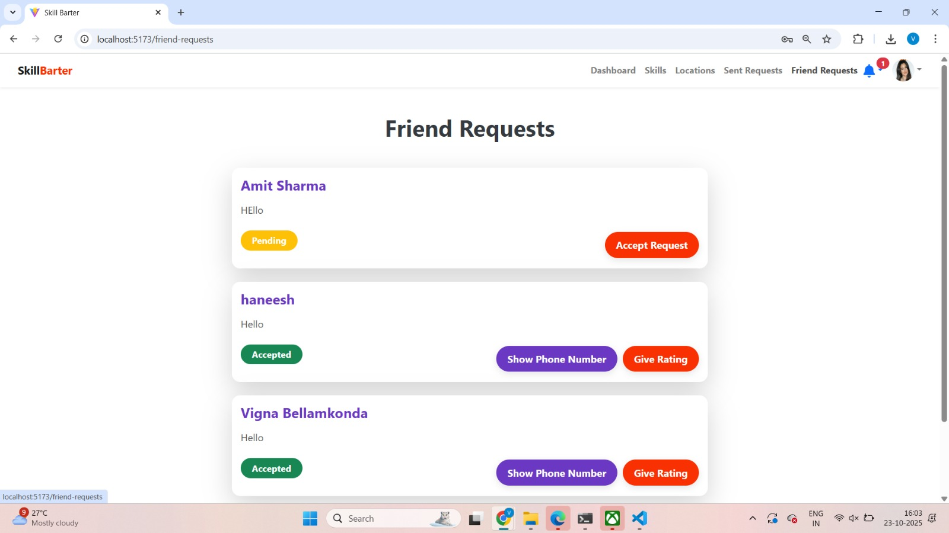

Slide 26
CONCLUSION:
The Skill Barter Platform makes learning easier and more accessible by connecting people who want to exchange their skills instead of paying for courses. It helps users find others with matching interests, build real connections, and grow together through mutual learning.
By using React.js and Django REST Framework with secure JWT authentication, the platform offers a smooth and safe experience for users across India. Whether someone is a Software Developer, Chef, Designer, or Teacher, our website provides a space to learn new skills, share knowledge, and support each other’s growth.

Slide 27
References
1. Meena Sri et al. (2025) – Peer-to-peer skill exchange platform for students using profile-based matching. 2. Chiang et al. (2018) – Peer coaching model to support skill growth in online communities. 3. Seyfang & Longhurst (2016) – Study on time banking systems for fair, non-monetary service exchange.

Slide 28
THANK YOU

