Slide 1
ReconX
Enterprise Trade Reconciliation Platform
Avani · Vigna · Nandini · Shubhang · Gaurav
TDI 2026 Advanced Track — Deutsche Bank

Slide 2
The Problem
Ops teams reconcile thousands of trades a day against custodian and counterparty feeds — largely by hand
Mismatches surface late, after settlement risk has already built up, and cost real money to unwind
ReconX auto-detects breaks in near-real-time so Ops resolves them, not discovers them
Why it matters
A single undetected break can sit unresolved for a full settlement cycle. Automated, streaming reconciliation turns a next-day discovery into a same-minute alert.
ReconX · 2/10

Slide 3
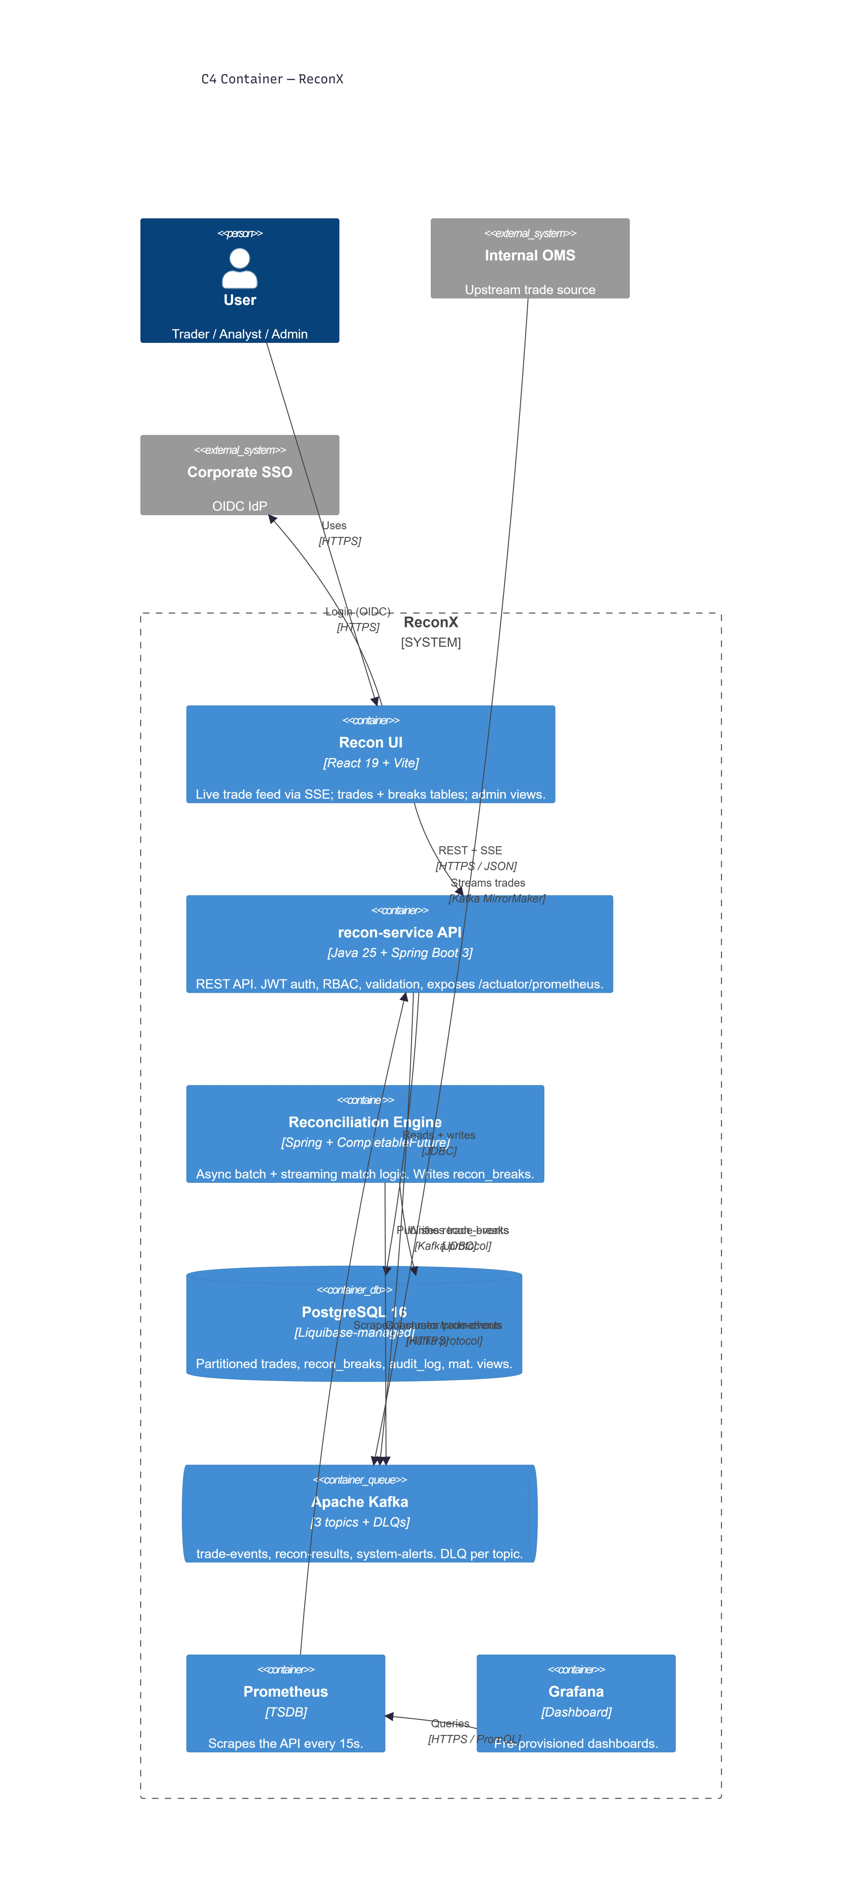
Architecture — C4 Container View
Recon UI
React 19 + Vite, live SSE feed
recon-service API
Java 25 + Spring Boot 3, JWT + RBAC
Reconciliation Engine
Async match + break detection
PostgreSQL 16
Liquibase-managed schema
Apache Kafka
3 topics + DLQ per topic
Prometheus + Grafana
Scrapes /actuator/prometheus
ReconX · 3/10

Slide 4
Tech Stack — by Layer
Data
PostgreSQL 16 · Liquibase migrations
Application
Java 25 · Spring Boot 3 · Spring Security (JWT/RBAC)
Messaging
Apache Kafka · 3 topics · DLQ per topic
UI
React 19 · Vite · Server-Sent Events
Observability
Prometheus · Grafana
ReconX · 4/10

Slide 5
Live Demo — Login & Post a Trade
Log in as trader@db.com — JWT issued, role-checked
Submit a new trade from the Recon UI
Request validated, persisted, and published to Kafka
Fallback
Screen recording from rehearsal, pending capture (ADV163).
ReconX · 5/10

Slide 6
Live Demo — Kafka & Auto-Reconciliation
Trade lands on the trade-events topic (Kafdrop)
Reconciliation engine consumes it and runs match logic
Grafana's request-rate panel ticks up in real time
Fallback
Kafdrop + Grafana screenshot, pending capture (ADV159).
ReconX · 6/10

Slide 7
CI/CD Pipeline
85% JaCoCo coverage gate
Liquibase validate · Docker build · GHCR push on green main · tag-triggered v1.0.0 rebuild
ReconX · 7/10

Slide 8
Monitoring
Prometheus scrapes /actuator/prometheus every 15s
Grafana dashboards pre-provisioned (request rate, latency, break count)
Screenshots skipped for this cohort per instructor guidance
Scope note
Grafana screenshots (ADV159) were explicitly marked optional/skip by the instructor for this cohort — not an open item.
ReconX · 8/10

Slide 9
Learnings
Avani
Lead
— one-sentence takeaway (spoken live)
Vigna
Backend — API
— one-sentence takeaway (spoken live)
Nandini
Backend — Kafka
— one-sentence takeaway (spoken live)
Shubhang
Frontend
— one-sentence takeaway (spoken live)
Gaurav
DevOps / CI
— one-sentence takeaway (spoken live)
ReconX · 9/10

Slide 10
Questions?
github.com/<org>/reconx
Avani routes questions — "we didn't get to that" is a valid answer.

