Slide 1
CUFFLESS BLOOD PRESSURE ESTIMATION
From Physiological Signals Using
Feature Engineering and Deep Learning
Vignan Kamarthi & Ariv Ahuja
DS 4400: Machine Learning | Prof. Silvio Amir | Spring 2026
github.com/vignankamarthi/Blood-Pressure-Inference-with-BVP

Slide 2
The Clinical Challenge
140/90 mmHg
PulseDB v2.0
MIMIC + VitalDB
• Hypertension threshold: leading cause of cardiovascular death
• Cuff-based measurement: infrequent, clinic-only, reactive
• PPG from wearables: continuous, passive, preventive
• 5.2M segments, 5,361 subjects
• 3 signals: PPG, ECG, ABP
• 125 Hz, 10-second windows
• CalFree protocol: train/test by subject
Two-track experiment: handcrafted features vs. learned representations
DS 4400 | Spring 2026 | Northeastern University
2 / 5

Slide 3
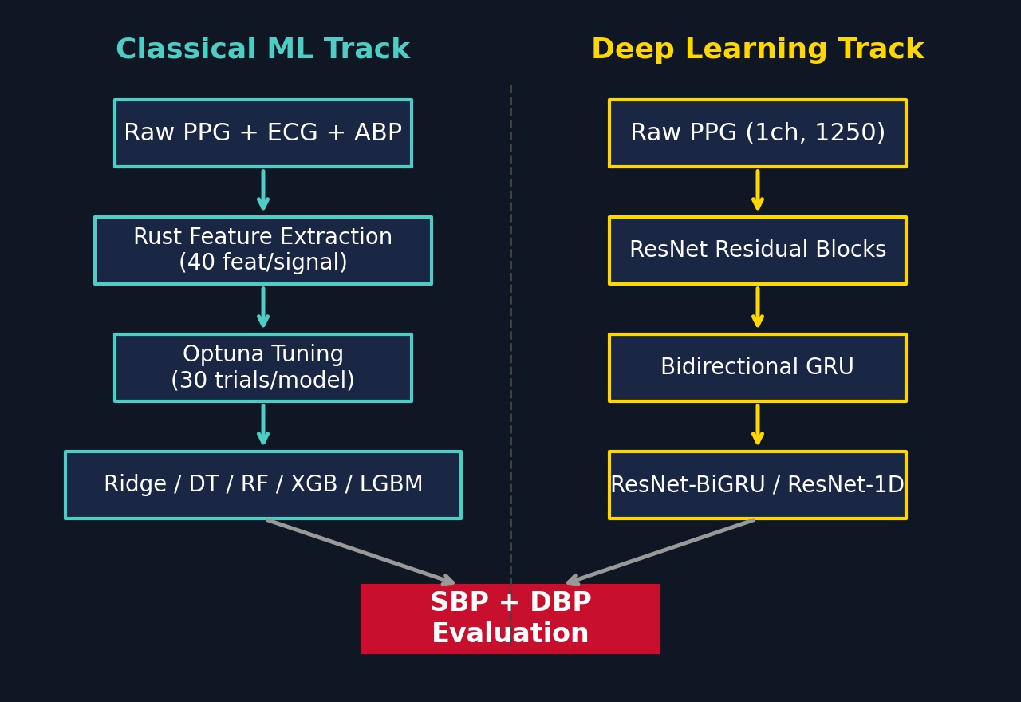
Two-Track Pipeline
Feature Engineering
• Catch22 (22) + Entropy (10) + Stats (8)
• Rust extraction: 40 features per signal
• Optuna tuning: 30 trials per model
Deep Learning
• ResNet-BiGRU: residual blocks + bidirectional GRU
• ResNet-1D baseline for comparison
• GradientSHAP temporal attribution
DS 4400 | Spring 2026 | Northeastern University
3 / 5

Slide 4
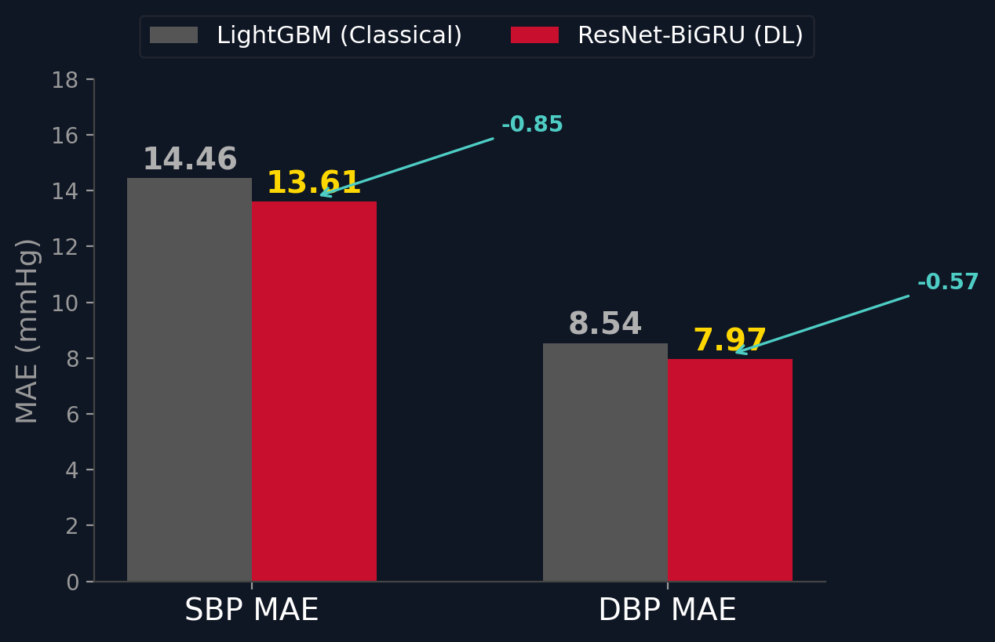
Key Results (CalFree Test Set)
13.61
SBP MAE (mmHg)
BHS Grade C
for DBP (best model)
• ECG adds only 0.03 mmHg improvement over PPG alone
• All models fail AAMI standard (SD > 8 mmHg)
• Consistent with PulseDB benchmark results
DS 4400 | Spring 2026 | Northeastern University
4 / 5

Slide 5
What We Learned
• PPG alone is sufficient for wearable BP monitoring
• Deep learning outperforms feature engineering by 0.85 mmHg
• AAMI compliance remains an open challenge for the field
Thank you
kamarthi.v@northeastern.edu | ahuja.ar@northeastern.edu
DS 4400 | Spring 2026 | Northeastern University
5 / 5

