Slide 1
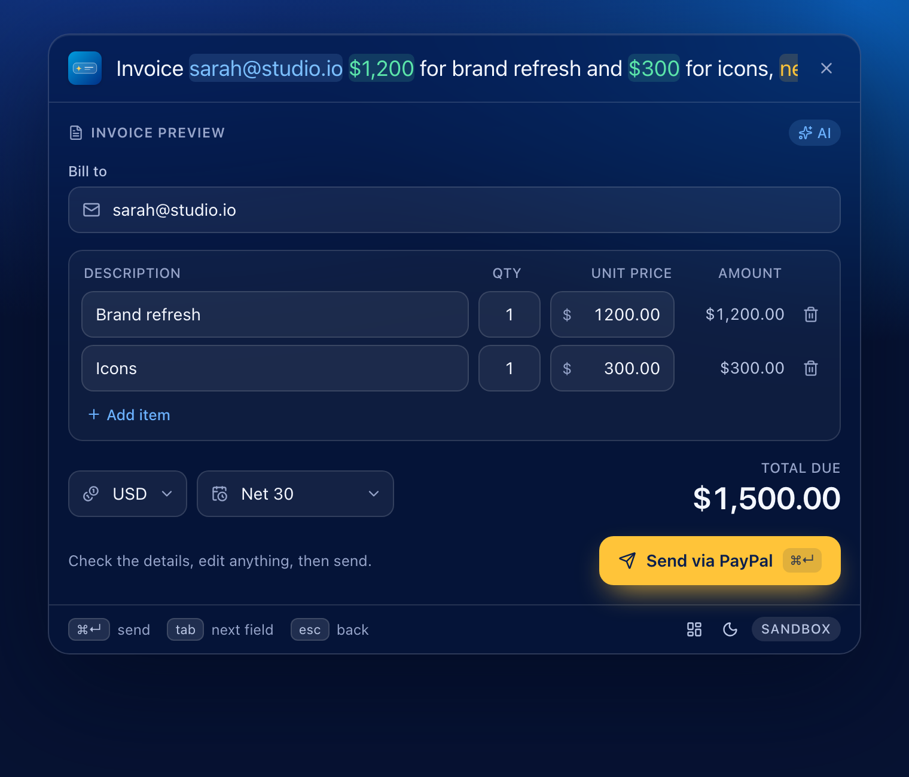

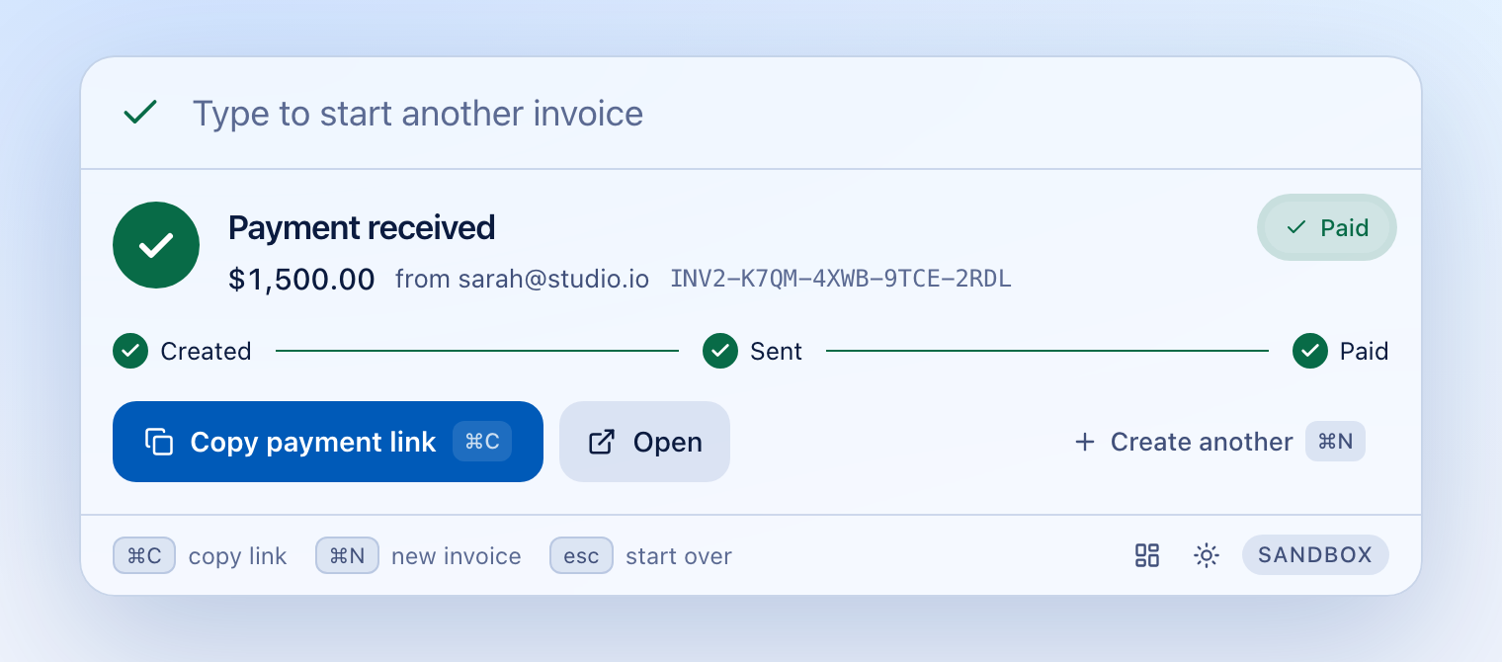
Mercury Cmd
User guide, guidelines and FAQ
Say it in plain English. Get paid with PayPal.
Built for the PayPal AI Hackathon · PayPal sandbox only

Slide 2
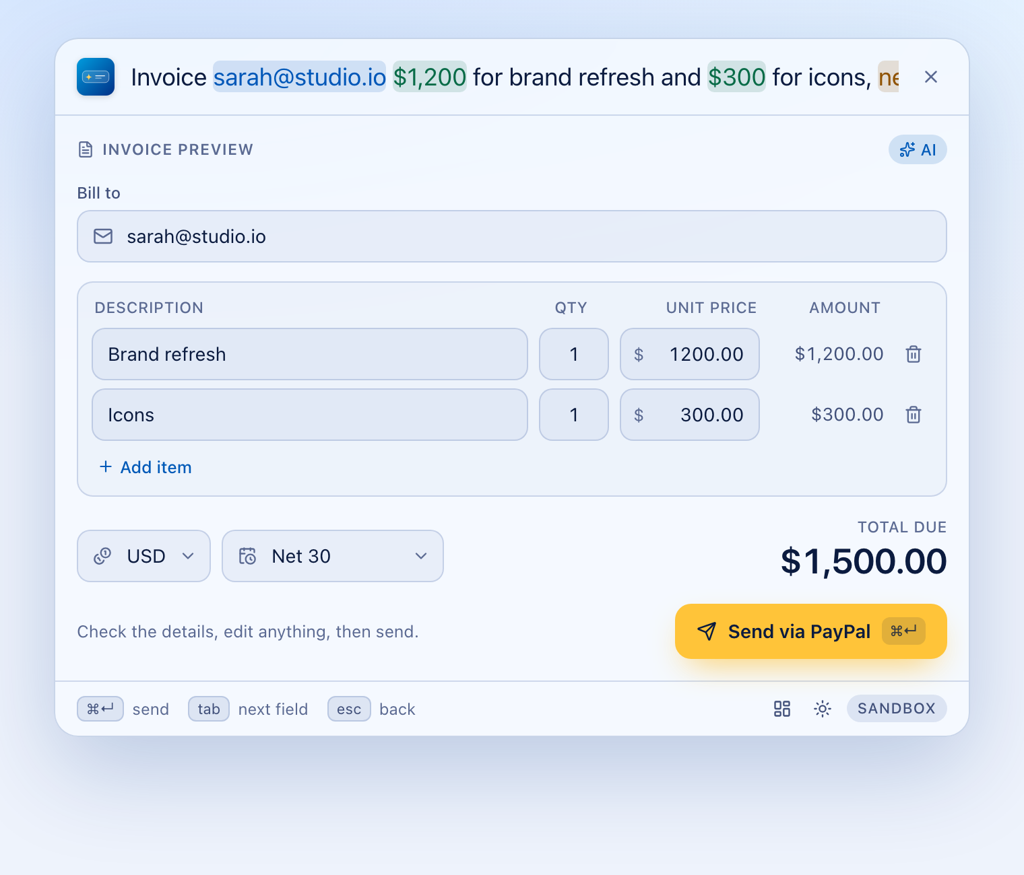




What Mercury Cmd is for
Invoice without leaving your work
A global hotkey opens the palette over any app. No tabs, no forms.
Say it, don't fill it in
One sentence replaces the email, items, amounts, currency and terms.
AI you can trust with money
Every value is checked against your own words before anything is sent.
Know when you're paid
A live Created, Sent, Paid timeline, plus your recent invoices.

Slide 3


Who it's for, and where it fits
A good fit
Not a fit (yet)
Freelancers, contractors and small agencies who invoice a few clients
Anyone already billing through PayPal who wants fewer clicks
Demos and learning: AI plus a real payments API, safely in the sandbox
People who want AI that is checked before it acts
Moving real money. Mercury Cmd is sandbox-only by design
Accounting, tax or recurring subscriptions
Windows or Linux desktop (browser mode works anywhere)
Several invoices in one sentence (one invoice per request)

Slide 4
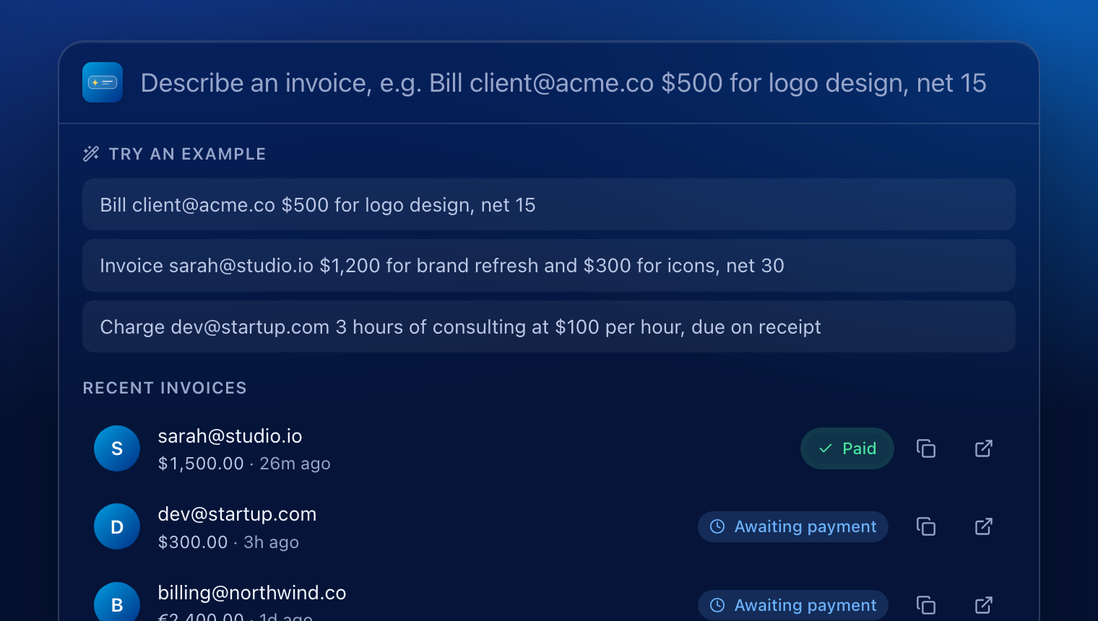
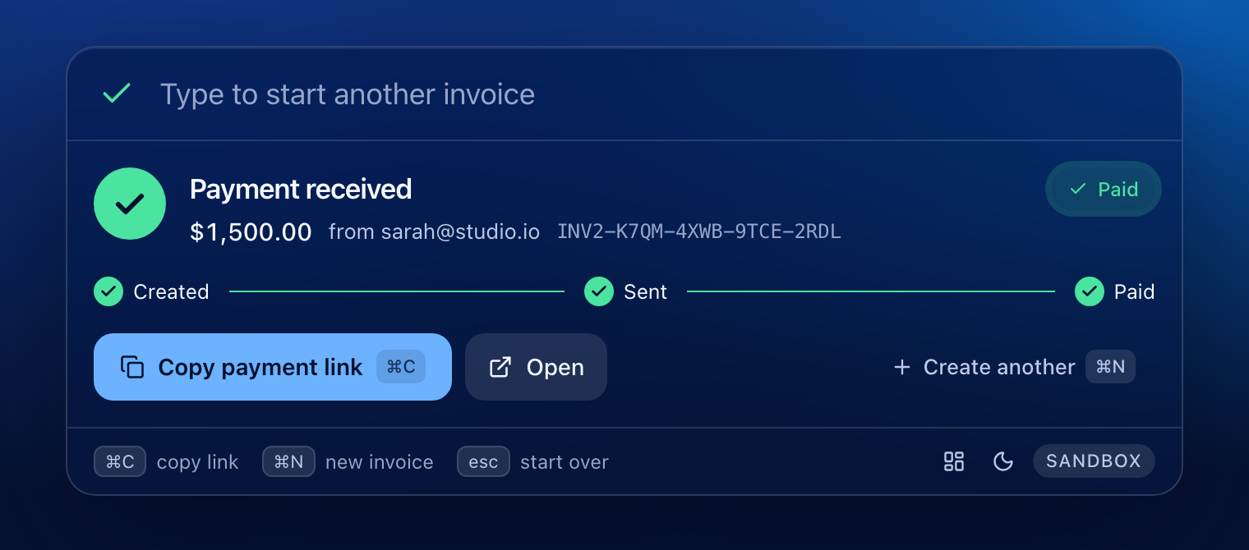
How it works: describe, review, track
1
Describe
2
Review
3
Track
Press the hotkey and type one sentence. The email, amounts and terms light up as you type.
The AI fills an editable invoice and checks every value against your words. Fix anything.
Send with ⌘↵, share the link, and watch Created, Sent, Paid update live.

Slide 5

Quick start
1
Install everything
make setup
Two ways to run
Creates the virtualenv, installs dependencies and writes both .env files.
2
Add your PayPal sandbox keys
Browser mode
make dev-web. No Rust needed. Open localhost:1420. ⌘K focuses the input.
Desktop app
make dev. Needs Rust. Press ⌘⇧Space from any app, or use the menu-bar icon.
Needs macOS, Node 20+ and Python 3.12+. About two minutes once you have sandbox keys.
backend/.env
Client ID, secret and the Business account email (next slide).
3
Optional: set up the AI model
ollama pull gemma4:e2b-it-qat
Needs Ollama (ollama.com/download). Skip it for Basic mode.
4
Run it
make dev-web or make dev
Browser at localhost:1420, or the desktop app with the global hotkey.

Slide 6

PayPal sandbox setup checklist
Two sandbox accounts, both in the United States
A Business account (the merchant) and a Personal account (the buyer). India-based sandbox accounts cannot send invoices.
Why these matter
Enable Invoicing before the first use
Real errors, and what causes them
403 NOT_AUTHORIZED: Invoicing was enabled after the first token.
“Unable to send invoices to customers within India”: accounts created in India.
HTTP 301 from PayPal: the website address used as the API host.
Create a Merchant app on the Business account, tick Invoicing, click Save, and only then copy the keys.
Use the REST API host
PAYPAL_API_BASE=https://api-m.sandbox.paypal.com. Not the website address https://sandbox.paypal.com.
Invoice the buyer, not yourself
PAYPAL_MERCHANT_EMAIL is the Business email. The recipient in your sentence is the Personal account's email.

Slide 7
Keyboard shortcuts
Key | What it does | Where
⌘⇧Space | Open or hide the palette from any app | Desktop
Enter | Read the sentence right now (it also reads after a short pause) | Input
⌘↵ | Send the invoice | Preview
Esc | Step back: preview, then input, then clear. After a send it starts over. On an empty input it hides | Anywhere
⌘N | Start a new invoice from any state | Anywhere
⌘, | Open the Dashboard | Anywhere
⌘C | Copy the payment link | After sending
↓ ↑ | Move through examples and recent invoices | Empty state
Tab | Move to the next field | Preview
Prefer the mouse? Everything is clickable, and the menu-bar icon opens the palette too. In browser mode ⌘K focuses the input. Change the hotkey with MERCURY_HOTKEY (for example Alt+Space).

Slide 8
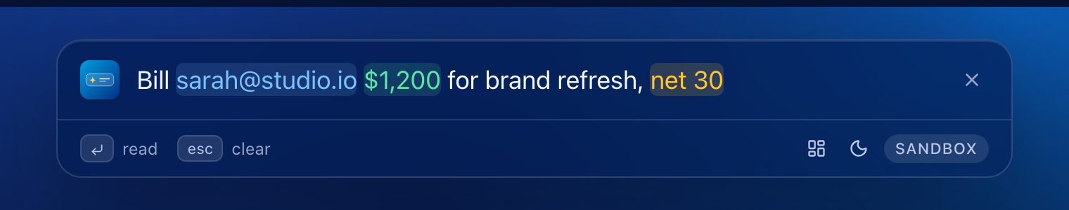
Write a request the AI can read
Email
Who to bill
Amount
What it costs
Terms
When it's due
sarah@acme.co. It must appear in your text; it is never guessed.
$1,200 · 1.5k · €500 · 450 USD · 3 hours at $100
net 30 · due on receipt · due in 2 weeks
Tips: one sentence is enough. Include an email and an amount. Use “and” or commas for several items. Press Enter to read it straight away.

Slide 9
What it understands
Element | Say it like | Notes
Client email | sarah@acme.co | Must appear in your text
Amounts | $1,200 · $99.99 · 1.5k · €500 · 450 USD | Up to 1,000,000 per item
Several items | $1,200 for brand refresh and $300 for icons | Up to 10 items with the AI model
Quantities | 3 hours of consulting at $100 per hour | Quantity 3, unit price $100
Payment terms | net 30 · net30 · due on receipt · due in 2 weeks | Sent to PayPal as invoice terms
Currency | $ € £ or USD, EUR, GBP, CAD, AUD | Defaults to USD
Without Ollama, Basic mode reads one item per invoice: the email, the first amount, the terms and a short description.

Slide 10
Review before you send
1
AI or Basic mode
AI means the local model read it and every value was checked. Basic mode means the rule-based parser answered.
2
Missing: email
An amber badge jumps the cursor to the field you still need to fill.
3
Amber warnings
A value was dropped because it was not in your text. Check it and type it in.
4
Everything is editable
Description, quantity, price, currency and terms. The total updates as you type.
5
Send via PayPal
The gold button, or ⌘↵. Nothing is ever sent before this.

Slide 11
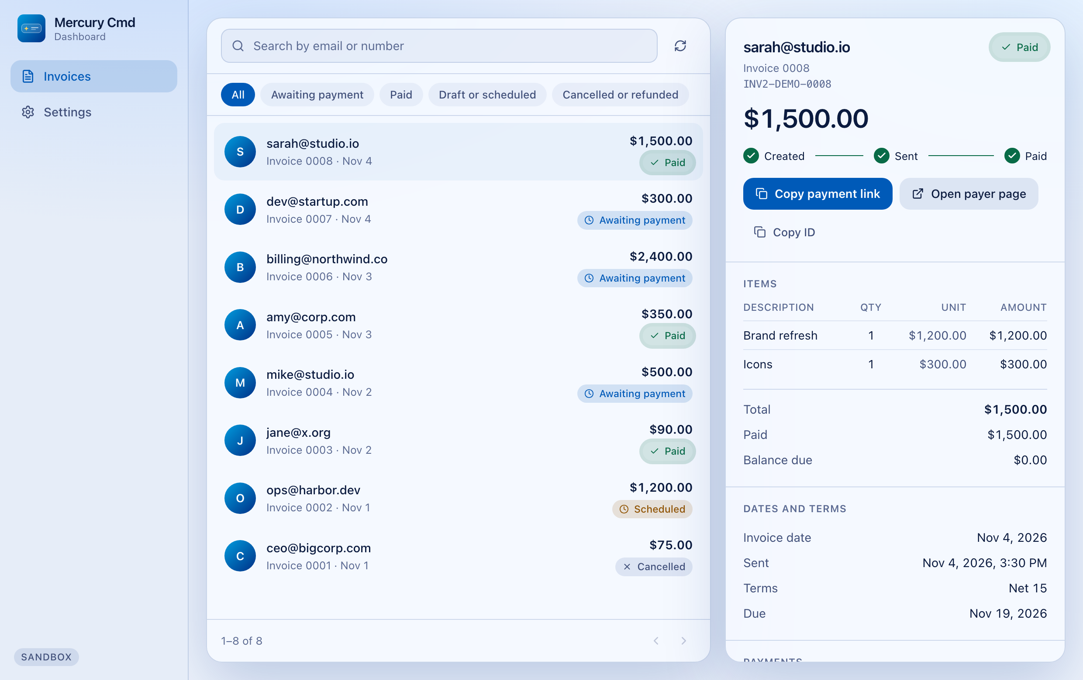




The Dashboard: history and detail
A real window
Title bar with close, minimize and zoom, resizable. Open it with ⌘, the footer icon, or the menu-bar icon.
Every invoice, from PayPal
Newest first, with status filters and search by email or number. Not limited to this device.
Full detail
Items, totals, paid and balance, dates, terms and each payment with its transaction ID.
Share again
Copy the payment link, open the payer page or copy the invoice ID at any time.

Slide 12
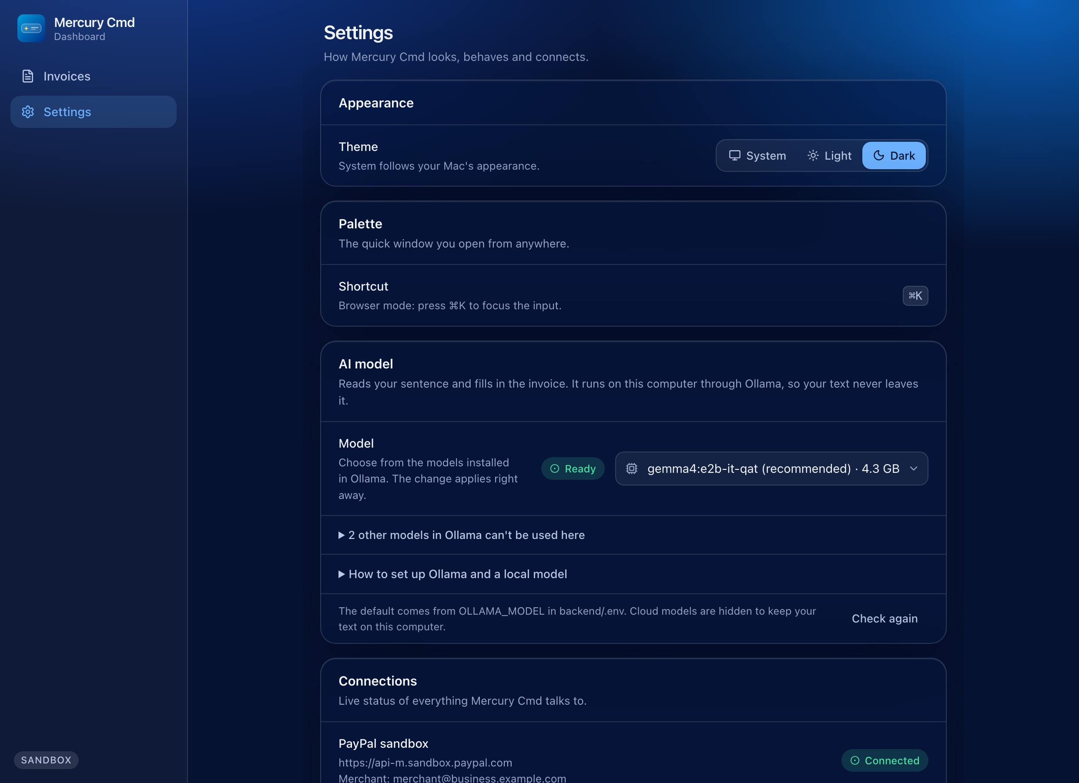




Settings and live health
Theme
System, Light or Dark. The whole app follows it and remembers it.
Shortcut and pin
See the active hotkey and whether another app is using it. Pin the palette so it stays open.
Live connections
PayPal sandbox and the backend with a Check again button, plus an AI model picker and an Ollama setup guide.
Your data
Clear the short recent-invoices list stored on this device. Your history always lives in PayPal.

Slide 13



Safety built in
AI that must show its work
Sandbox only
Any email, amount, quantity or term the AI returns must appear in your text. Anything else is dropped with a warning.
The backend refuses to start against a live PayPal host, and the footer always says SANDBOX. No real money moves.
You approve every invoice
No duplicates, no self-invoicing
Nothing is sent until you press Send on a visible, editable preview.
Repeating a send returns the same invoice. Invoicing your own merchant account is blocked before PayPal is called.

Slide 14
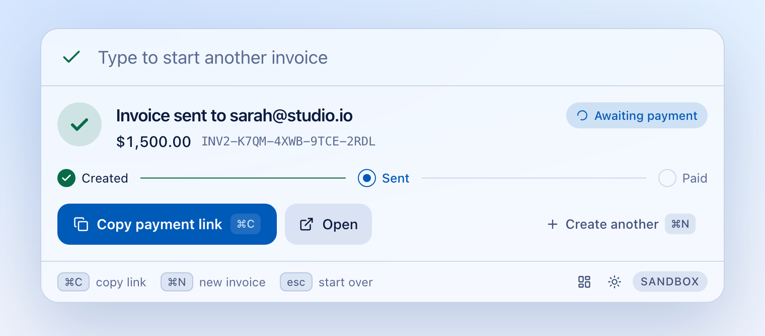
Invoice status, explained
Pill | Meaning
Awaiting payment | Sent. The client has it and has not paid yet.
Viewed | The client opened the invoice.
Payment pending | A payment has started but has not settled.
Partially paid | Part of the total has been paid.
Paid | Done. The timeline completes and the card says “Payment received”.
Scheduled | PayPal will send it on the invoice date.
Cancelled, Refunded | Closed. No payment is expected.
After sending: Awaiting payment
After the buyer pays: Paid

Slide 15


Themes, accessibility and desktop tips
Dark and light
Accessible
Desktop tips
Follows your system appearance
Switch with the sun, moon or monitor icon in the footer
The window's blur follows the theme
PayPal-inspired blues with a gold Send button
Fully usable by keyboard
Labelled controls and a main landmark
WCAG AA contrast, checked by tests
Respects the reduced-motion setting
Menu-bar icon: Open, Dashboard and Quit
Pin it to keep it open; drag the top edge to move it
Opens on the screen your mouse is on
Change the hotkey with MERCURY_HOTKEY

Slide 16
Guidelines: do and don't
Do
Don't
Invoice a sandbox Personal account email
Put an email and an amount in every sentence
Read the preview, especially amber warnings
Keep secrets in backend/.env only
Warm up the model before a demo: the first parse can take about 10 seconds
Rotate your secret after sharing credentials
Use real customer emails or live credentials. The backend refuses live hosts
Paste secrets into chats, issues or commits
Invoice your own merchant account
Enable Invoicing after the first token. Create a new app instead
Promise instant parsing: 2 to 3 seconds is typical
Edit a draft after “Retry send” appears. The draft is already saved

Slide 17

FAQ: setup and access
Do I need a PayPal business account?
Is real money ever moved?
No. A free PayPal developer account is enough. The sandbox gives you fake Business and Personal accounts, with no real money or documents.
Never. The backend refuses to start unless PAYPAL_API_BASE is a sandbox REST host, and the footer always shows SANDBOX.
Do I need Ollama?
Does it run on Windows or Linux?
No. Without it, Mercury Cmd uses a rule-based parser (one item, Basic mode). With Ollama you also get several items, quantities and looser phrasing.
The desktop app targets macOS. Browser mode (make dev-web) runs anywhere Node and Python run, with ⌘K to focus the input.

Slide 18
FAQ: AI and parsing
Where does my text go?
Why was my amount or email ignored?
Parsing runs locally in Ollama. PayPal only receives the invoice fields you approve on the preview.
Grounding: a value must appear in your text. If the AI returns one that does not, it is dropped with an amber warning. Retype it or fix it in the preview.
Why does it say Basic mode?
Can I use a different model?
Ollama was offline, took longer than 8 seconds, or returned nothing usable. Start Ollama and read the sentence again.
Yes. Pick any installed local model in Settings, AI model; it applies at once. Only the default, gemma4:e2b-it-qat, is tested (33 of 33 sentences), so check the preview with others.

Slide 19
FAQ: the Dashboard and the window
Where do I see all my invoices?
Why no minimize or maximize on the palette?
Open the Dashboard with ⌘, the footer icon, or the menu-bar icon. It lists every invoice on your PayPal sandbox account, newest first, with filters and search.
The palette is a quick window and hides when you click away. For a normal window with close, minimize and zoom, open the Dashboard. Pin keeps the palette open.
How do I start another invoice?
Can I move the palette?
Just start typing, or press ⌘N, or press Esc once. The box clears itself after a send, so you never have to close the palette first.
Yes. Drag its top edge or footer. It opens near the top of the screen your mouse is on, and a pinned palette stays where you leave it.

Slide 20
FAQ: sending and payments
How does the client pay?
How do I know it was paid?
PayPal emails them the invoice. Copy payment link or Open gives the payer page. In the sandbox, pay as the Personal account.
Keep the success card open: it checks every 4 seconds, then every 15 seconds for up to an hour, and again the moment you return to the window. Recent invoices refresh when you reopen the palette.
What if I press send twice?
Send failed after the draft. Now what?
You still get one invoice. Each preview carries a unique request ID, so a repeat returns the same invoice.
The draft is kept and the card shows Retry send. It only retries the send and never creates a second invoice.

Slide 21
Troubleshooting: message, cause, fix
You see | Likely cause | Fix
Mercury's backend isn't running | Backend not started | make dev-web, or make backend
PayPal rejected the sandbox credentials | Wrong ID or secret | Recheck backend/.env
Denied: insufficient permissions (403) | Invoicing enabled after first use | Create a new app, enable Invoicing first
Unable to send to customers within India | Sandbox accounts created in India | Create US Business and Personal accounts
That is your own business account | Recipient is the merchant email | Invoice the Personal account's email
Status says Scheduled | Older build sent a local date | Update; the app no longer sends one
Hotkey does nothing | Another app uses ⌘⇧Space | Set MERCURY_HOTKEY=Alt+Space and restart

Slide 22


Known limits and what could come next
Known limits
Ideas to explore next
Desktop app is macOS only; browser mode runs anywhere
Basic mode handles one item per invoice
Five currencies: USD, EUR, GBP, CAD, AUD
Live status runs for an hour while the success card is open
Cancel and remind are not in the app yet
PayPal sandbox only
A saved address book: “bill Acme again”
Cancel and remind from the Dashboard
Recurring invoices
More currencies and tax lines
Windows and Linux desktop builds
Hotkey and theme settings in the app

Slide 23
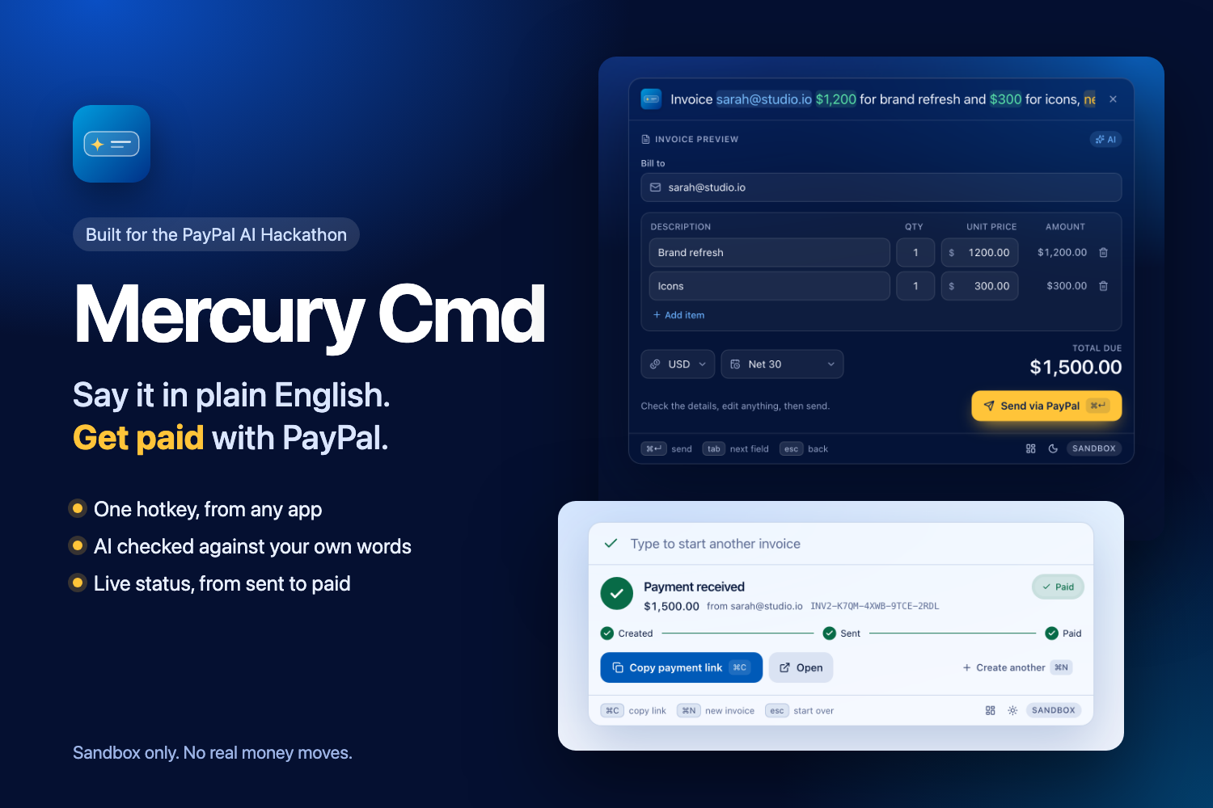
Try it today
make setup, add your sandbox keys, make dev-web
README.md: setup and usage
docs/TESTING.md: what is tested and verified
mercury_cmd_execution_spec.md: design and API
MIT licensed. Sandbox only. No real money moves.

