Slide 1


PANIMALAR ENGINEERING COLLEGE
Department of Computer Science and Engineering
CS8811 PROJECT WORK
DECENTRALIZED REAL ESTATE USING BLOCKCHAIN
Mr.M.MAHENDRAN,B.E.,M.Tech.,(Ph.D.), SUPERVISOR ASSISTANT PROFESSOR GRADE I
VIGNASH M [211419104300] VIJAY M P [211419104301] SUNDARAPANDIYAN G [211419104273]
Batch Number: C14

Slide 2
INTRODUCTION
Decentralized Real Estate using blockchain is a revolutionary approach that aims to transform the traditional real estate industry by leveraging the benefits of blockchain technology. Blockchain-based real estate systems are characterized by enhanced transparency, immutability, and security, which is expected to mitigate many of the challenges currently faced by the real estate industry, such as fraud, inefficiency, and lack of transparency. The use of smart contracts, which are self-executing and self-enforcing, enables the automation of various real estate processes, including property listings, purchase agreements, and title transfers. Moreover, the decentralized nature of blockchain eliminates the need for intermediaries, such as banks, lawyers, and brokers, thus reducing transaction costs and increasing accessibility to the market. The integration of blockchain in the real estate industry is expected to enable faster, more secure, and more transparent transactions, leading to increased efficiency and trust in the market. In this paper, we provide an overview of the current state of decentralized real estate using blockchain, as well as its potential benefits and challenges. We also explore various use cases and discuss future developments in this rapidly evolving field.

Slide 3
LITERATURE SURVEY
TITLE | DESCRIPTION | AUTHOR1 | YEAR
1. Business Process Models of Blockchain and South African Real Estate Transactions | This research looks at two approaches to real estate transaction execution: the South African case and an international blockchain technology use case. | Jack Laurie Tilbury, Ed de la Rey, Karl van der Schyff | 2019
2. Blockchain-Based Real Estate Market: One Method for Applying Blockchain Technology in Commaercial Real Estate Market | Global real estate (RE) investments exceed the size of the stock market. Despite this, the number of RE investors is much lower due to liquidity and global access. The current system is barely satisfactory for tenants, owners, and investors | Sobhan Latifi, Yunpeng Zhang, Liang-Chieh Cheng | 2020
3. Land Registry Using Blockchain - A Survey of existing systems and proposing a feasible solution | When a person purchases land under this system, the government authority will provide the person with a hard copy of the property papers, and the system will store the documents in the Inter Planetary File System (IPFS), a decentralized database. | Disha Shinde, Snehal Padekar, Siddharth Raut, Abdul Wasay, S. S. Sambhare | 2020
4. A Transparent and Trusted Property Registration System on Permissioned Blockchain | In this proposal, lands are registered on the Blockchain network using a smart contract. The proposed study can provide several benefits to stakeholders, such as efficiency, transparency, trustworthiness, and integrity for various entities and processes involved in buying and selling real estate. | Toqeer Ali, Adnan Nadeem, Ali Alzahrani, Salman Jan | 2020
5. Real Estate Management System based on Blockchain | This paper describes a real estate management system powered by blockchain technology that will provide a transparent, secure, and efficient real estate management system. | Ankit Mittal, Bhavyansh Sharma, Pinku Ranjan | 2021

Slide 4
PROBLEM STATEMENT
Global real estate (RE) investments account more than twice the size of the stock market. A real estate crisis often affect and creates financial crises which in turn could lead to economic meltdowns both on a micro- but also on a macrolevel. There are inefficiencies within the real estate market that might cause the crises, such as problems with transparency and illiquidity, high transaction costs, personal biases and slow transaction processes.The proposed system is a practical solution for the current problems faced in the real estate management.

Slide 5
EXISTING SYSTEM
Customer walks into the developers office asks Developer for required property.Developer searches for named properties/location/flats among cluster/group of books.After finding out it serves to the customer.If customer is interested in buying that flats, Developer sales the property/flat bycompleting all formalities, and makes entry into the Customer Details Registermanually.All the permanent data of the order such as the name of the property / flat,Estate ID, as well as name of buyer/customer, Member_ID and so on aremaintained in a master file for future reference.The customer has the option of paying by cash or check or credit card.At the time customer pays the price he is issued a receipt acknowledging thesame.After carefully studying requirements and working of the organization it has beendecided to develop an Online Real Estate Website.

Slide 6
PROPOSED SYSTEM
The Proposed system is built in a secured by storing all the data in a blockchain so there won’t be any frauds and scams can possibly happen. In the proposed system, fractional ownership feature is also added so if many users can have a small fraction of ownership in a big land Also the proposed system will allocate NFT (Non – fungible token ) to all the buyers who are buying , so there avoid online and fake document scams.
Smart contracts could allow for lower-cost real estate transactions because there’s not as much work involved. If you don’t have to go through the effort to get a property on blockchain as an agent and then taking it down, that’s a significant time savings. Additionally, title work won’t be as hard if there’s a clear ownership history on the blockchain. This is going to translate into lower costs for everyone involved.

Slide 7
TECHNOLOGY STACK
MINIMUM HARDWARE REQUIREMENTS
Processor : Pentium Dual Core 2.00GHZ
Hard disk : 120 GB
RAM : 2GB (minimum)
Keyboard : 110 keys enhanced
SOFTWARE REQUIREMENTS
Operating system : Windows 7 ,8,9,10,11
Language : Solidity

Slide 8
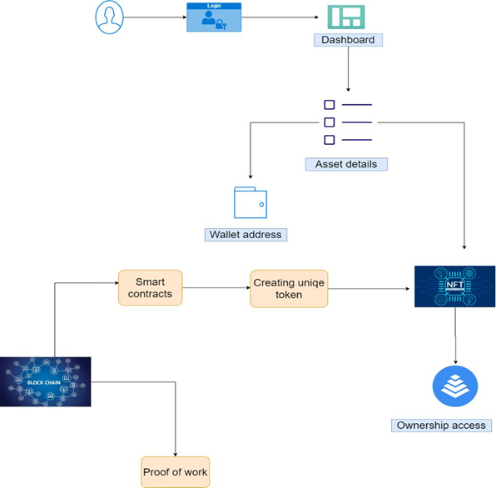
SYSTEM ARCHITECTURE
This graphic provides a concise and understandable description of all the entities currently integrated into the system. The diagram shows how the many actions and choices are linked together. You might say that the whole process and how it was carried out is a picture. The figure below shows the functional connections between various entities.

Slide 9
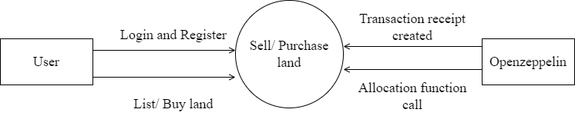
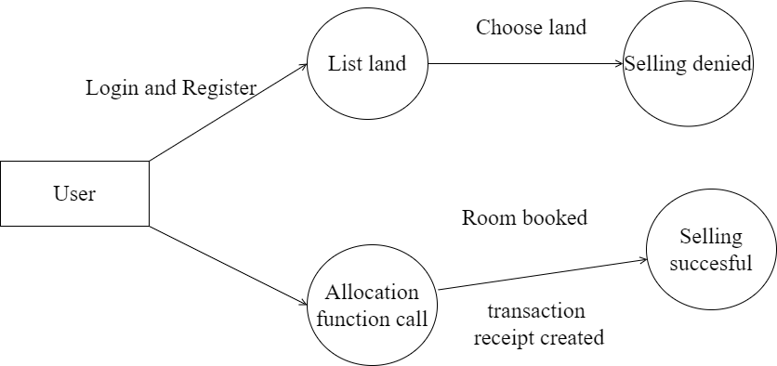
SYSTEM DESIGN
DATAFLOW DIAGRAM
( LEVEL 0 )
(LEVEL 1)

Slide 10
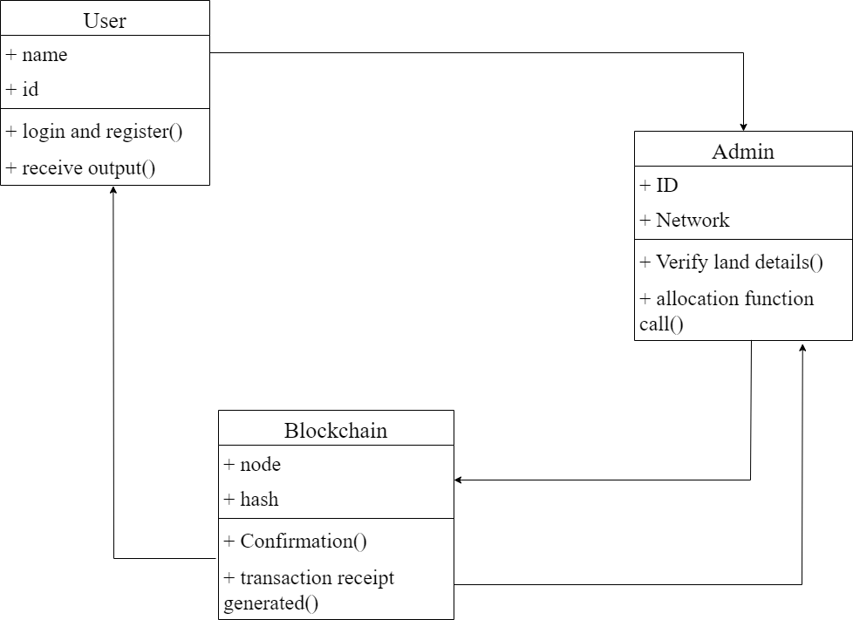
CLASS DIAGRAM

Slide 11
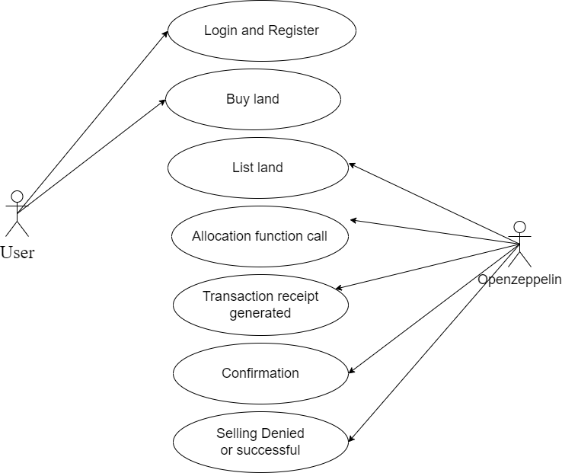
USECASE DIAGRAM

Slide 12
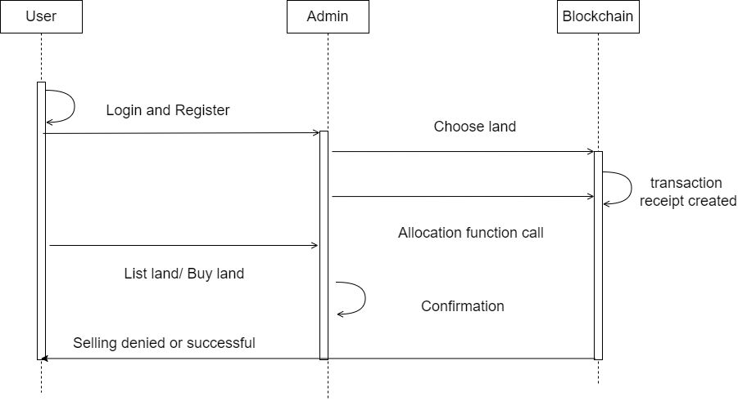
SEQUENCE DIAGRAM

Slide 13
MODULE DESCRIPTION
Decentralized real estate using blockchain is a module that aims to enable the secure and efficient transfer of ownership and management of real estate properties through a decentralized network powered by blockchain technology.The module would leverage the immutable and transparent nature of blockchain to create a secure and reliable database of real estate ownership records, as well as facilitate the execution of smart contracts that would automate processes such as property transfers, rental agreements, and maintenance.
Module Names
MODULE 1: RealEstate.sol Contract
MODULE 2: Front-end

Slide 14
Module 1
The RealEstate.sol contract is used to handle all the user storing & land registration logic.
Modifiers-
onlyAdmin()
It restricts function call to only Admin.The transaction will get reverted when if someone else tries to call the function.
onlyRegistrar()
It restricts the function call to only the Registrar.The transaction will get reverted if someone other than the registrar tries to call the function

Slide 15
Module 2
The ABI & address of the deployed contract is used along with the help of web3.js library to connect the frontend with the smart-contract. The whole code for the front-end part is contained in App.js file.At first it is checked if Metamask wallet is exists in the user’s browser or not.
If Metamask does not exist in the user’s wallet , then the
User is prompted to install a Wallet
Then the user is asked to connect to the wallet.
After the user signs the transaction the landing page is shown,where the user can fill the form to register their property and save the data on the tamper-proof, immutable Blockchain.

Slide 16
TESTS AND REPORTS
Test case 1: Unit Testing:
\
Test case 2: Security Testing:
Test Case ID | Test Case Description | Input Data | Expected Output | Actual Output | Pass/Fail | Remarks
T1 | Test the creation of a new property listing | Property information | Property information is stored on the blockchain | To show valid information stored | Pass | Efficient
T2 | Test the retrieval of property listings | Property ID | Transacton details | List of all transactions associated with the property | Pass | Efficient
Test Case ID | Test Case Description | Input Data | Expected Output | Actual Output | Pass/Fail | Remarks
T1 | SQL injection attack | Malicious code entered into a text field | Display an error message | System should reject the input and display an error message. | Pass | Efficient
T2 | Cross-site scripting attack | Multiple incorrect login attempts | To prevent unauthorized access. | System should block the user after a certain number of attempts to prevent unauthorized access. | Pass | Efficient

Slide 17
Test case 3: Functional Testing:
Test case 4: Compatibility Testing:
Test Case ID | Test Case Description | Input Data | Expected Output | Actual Output | Pass/Fail | Remarks
T1 | Smart contract and blockchain integration test | Property information | Property can be retrieved from the blockchain using its unique ID | Property Retrieved using Unique id | Pass | Efficient
T2 | Front-end and back-end integration test: | Frontend & Backend Connectivity | To ensure that the front-end and back-end of the application are integrated | Integrated the application | Pass | Efficient
Test Case ID | Test Case Description | Input Data | Expected Output | Actual Output | Pass/Fail | Remarks
T1 | Compatibility with different browsers. | Accessing the platform on different browsers | The platform should work smoothly on all the tested browsers | The platform should work smoothly on all the tested browsers | Pass | Efficient
T2 | Compatibility with different devices | Accessing the platform on different devices | Accessing the platform on different devices such as desktop, laptop | Accessing the platform on different devices such as desktop, laptop | Pass | Efficient

Slide 18
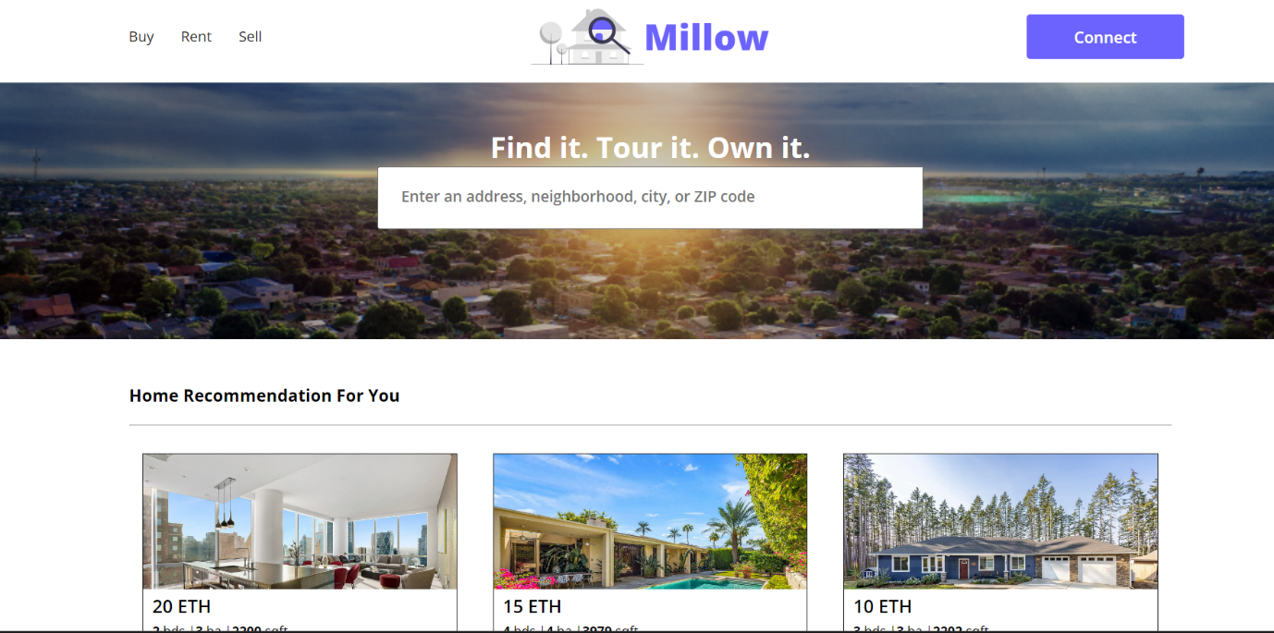
SCREENSHOTS :
Front end

Slide 19
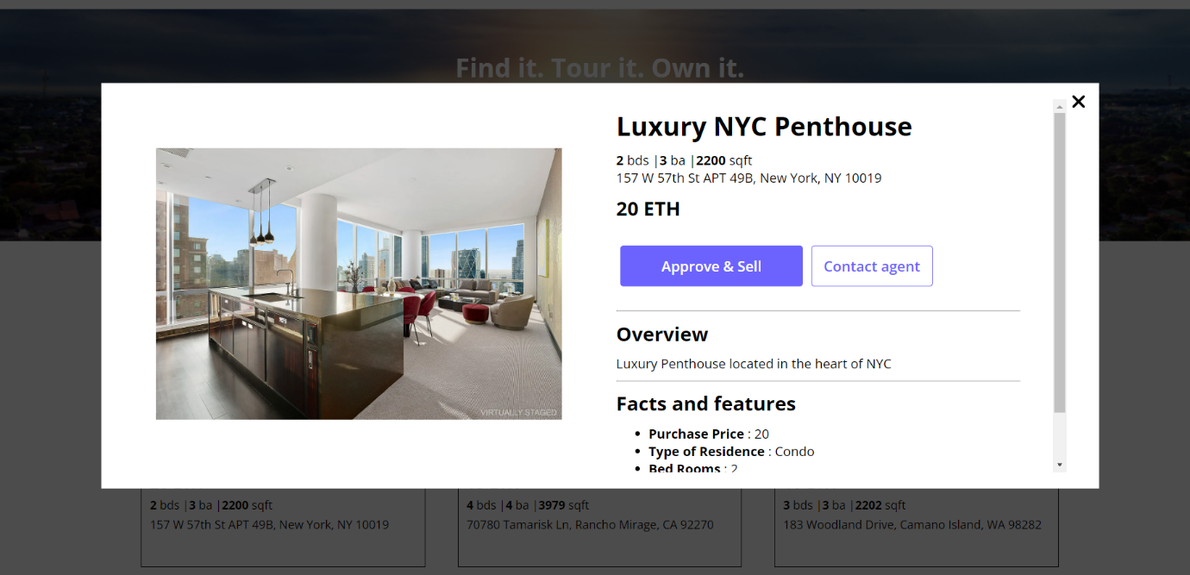
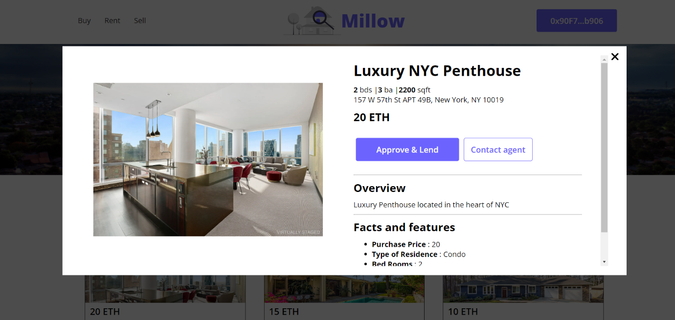

Slide 20
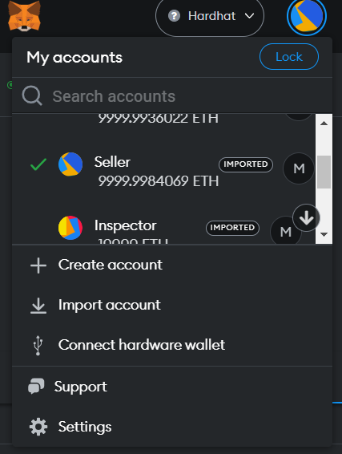
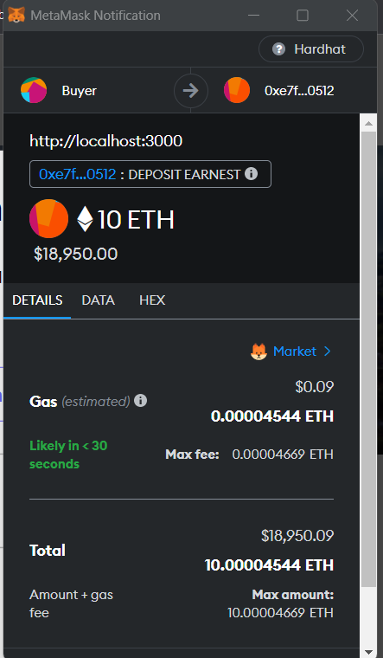
Metamask

Slide 21
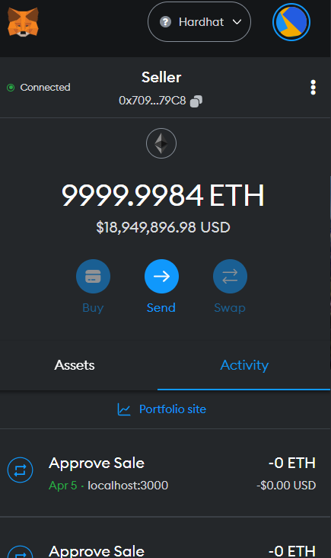
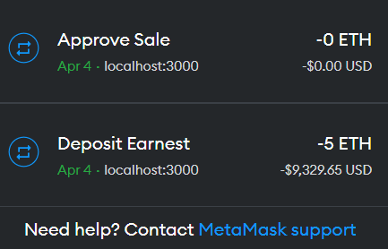

Slide 22
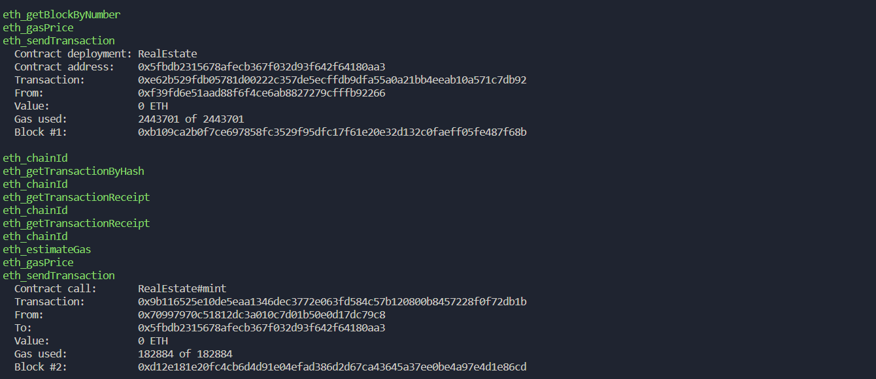
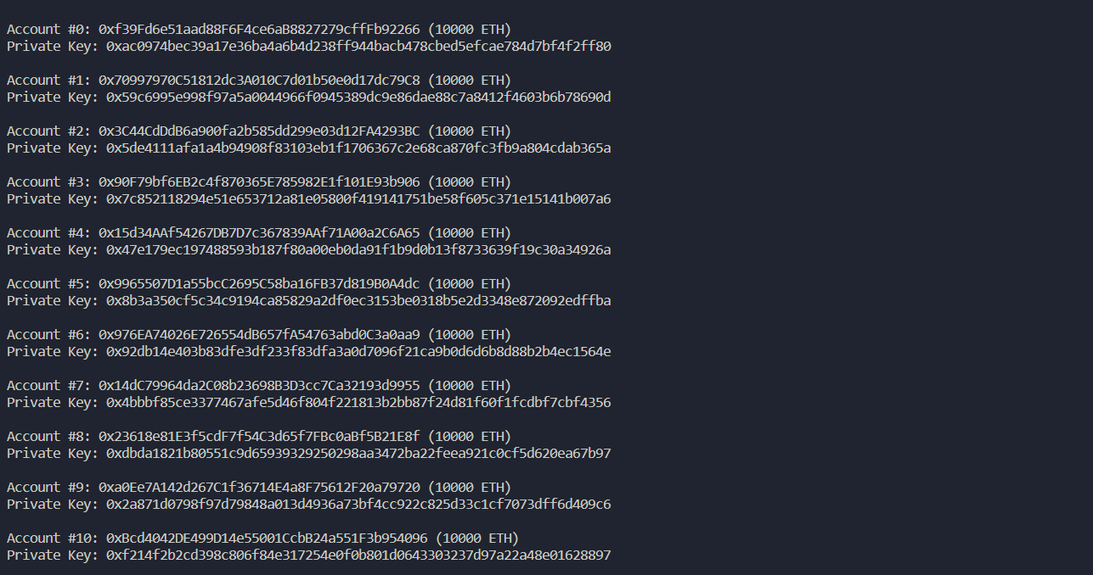
Hardhat

Slide 23
CONCLUSION
In conclusion, the implementation of a decentralized real estate system using blockchain technology has the potential to revolutionize the real estate industry by providing a secure, transparent, and efficient method of recording and transferring property ownership. The use of smart contracts enables automated and immutable transactions that remove the need for intermediaries, reducing costs and streamlining the buying and selling process. Additionally, blockchain's tamper-proof nature ensures that all information recorded on the ledger is accurate and trustworthy, mitigating the risk of fraud and improving the overall integrity of the system. Despite the promising potential of blockchain technology in the real estate industry, there are still some challenges that need to be addressed, such as regulatory and legal hurdles, standardization of data, and adoption by industry stakeholders. Moreover, the implementation of a decentralized system requires a significant investment of resources and infrastructure, which may deter some companies from adopting the technology. However, as the benefits of blockchain become more apparent and the technology becomes more widely adopted, it is likely that we will see an increase in decentralized real estate systems. The potential for increased transparency, reduced costs, and improved efficiency will drive the industry towards this new way of conducting real estate transactions. Ultimately, the successful implementation of a decentralized real estate system using blockchain technology could transform the industry, making it more accessible, efficient, and secure for all stakeholders involved.

Slide 24
REFERENCES
[1] Sobhan Latifi, Yunpeng Zhang, Liang-Chieh Cheng, “Blockchain-Based Real Estate Market: One Method for Applying Blockchain Technology in Commercial Real Estate Market”, IEEE International Conference on Blockchain (Blockchain), 2020
[2] Jack Laurie Tilbury, Ed de la Rey, Karl van der Schyff, “Business Process Models of Blockchain and South African Real Estate Transactions”, International Conference on Advances in Big Data, Computing and Data Communication Systems (icABCD), 2019
[3] Disha Shinde, Snehal Padekar, Siddharth Raut, Abdul Wasay, S. S. Sambhare, “Land Registry Using Blockchain - A Survey of existing systems and proposing a feasible solution”, 5th International Conference On Computing, Communication, Control And Automation (ICCUBEA), 2020
[4] Toqeer Ali, Adnan Nadeem, Ali Alzahrani, Salman Jan, “A Transparent and Trusted Property Registration System on Permissioned Blockchain”, International Conference on Advances in the Emerging Computing Technologies (AECT), 2020
[5] Ankit Mittal, Bhavyansh Sharma, Pinku Ranjan, “Real Estate Management System based on Blockchain”, IEEE 7th Uttar Pradesh Section International Conference on Electrical, Electronics and Computer Engineering (UPCON), 2021
[6] VO Khoa Tan, Thu Nguyen, “The Real Estate Transaction Trace System Model Based on Ethereum Blockchain Platform”, 14th International Conference on Computer and Automation Engineering (ICCAE), 2022
[7] Andrey Averin, Pavel Rukhlov, Elnur Musaev, “Review of Existing Solutions in the Field of Real Estate and Cadastral Accounting Based on Blockchain Technology”, International Conference on Quality Management, Transport and Information Security, Information Technologies (IT&QM&IS), 2021
[8] Ishan Yapa, Samitha Heanthenna, Nadun Bandara, Isuru Prasad, Yashas Mallawarachchi, “Decentralized Ledger for Land and Property Transactions in Sri Lanka Acresense”, IEEE Region 10 Humanitarian Technology Conference (R10-HTC), 2019
[9] P. Shamili, B. Muruganantham, “Blockchain based Application: Decentralized Financial Technologies for Exchanging Crypto Currency”, International Conference on Advances in Computing, Communication and Applied Informatics (ACCAI), 2022
[10] Dipika Bhanushali, Akshara Koul, Sainiranjan Sharma, Bushra Shaikh, “BlockChain to Prevent Fraudulent Activities: Buying and Selling Property Using BlockChain”, International Conference on Inventive Computation Technologies (ICICT), 2020

