Slide 1
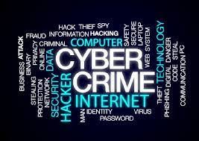
CYBER CRIME

Slide 2

Crime committed using a computer and the internet to steal data or information.
Example: Stealing credit card information
Breaking into government website

Slide 3
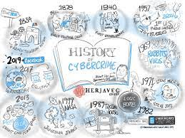
HISTORY OF CYBER CRIME
THE FIRST RECORDED CYBER CRIME IN THE 1820.
In 1820, Joseph-Marie, a manufacturer in France produced the loom.
Repetition of a series of steps in the weaving of special fabrics.
They committed acts of sabotage to discourage Joseph from further use of the new technology.

Slide 4
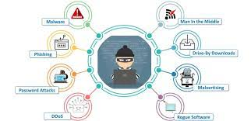
Types of Cyber Crime
➤Hacking
➤ Credit Card Fraud
➤Phishing
➤ Cyber Terrorism
➤Computer Vandalism
➤Software Piracy
➤ Spoofing
➤Spam

Slide 5

Hacking
Hacking is a source of threat to security in computer. It is defined as unauthorized access to the computer system by a hacker.
Types Of Hackers:
i. White Hat Hackers
ii. Black Hat Hackers
iii. Gray Hat Hackers

Slide 6


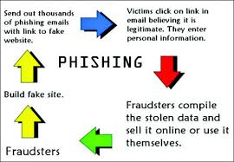
DENIAL OF SERVICE ATTACKS:
An act by the criminals who fill victims E-mail box
with spam mail
CYBERSTALKING:
Frequent revisit of a webpage.
CYBER PHISHING:
Attempt to steal money or identity.

Slide 7

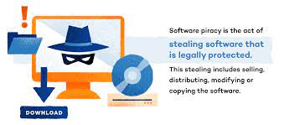
CYBER VANDALISM:
Program that attach themselves to a file and then circulate.
CYBER TERRORISM:
Planned activity in cyberspace via internet to create terror
SOFTWARE PIRACY:
Theft of software through the illegal copying of genuine programs

Slide 8
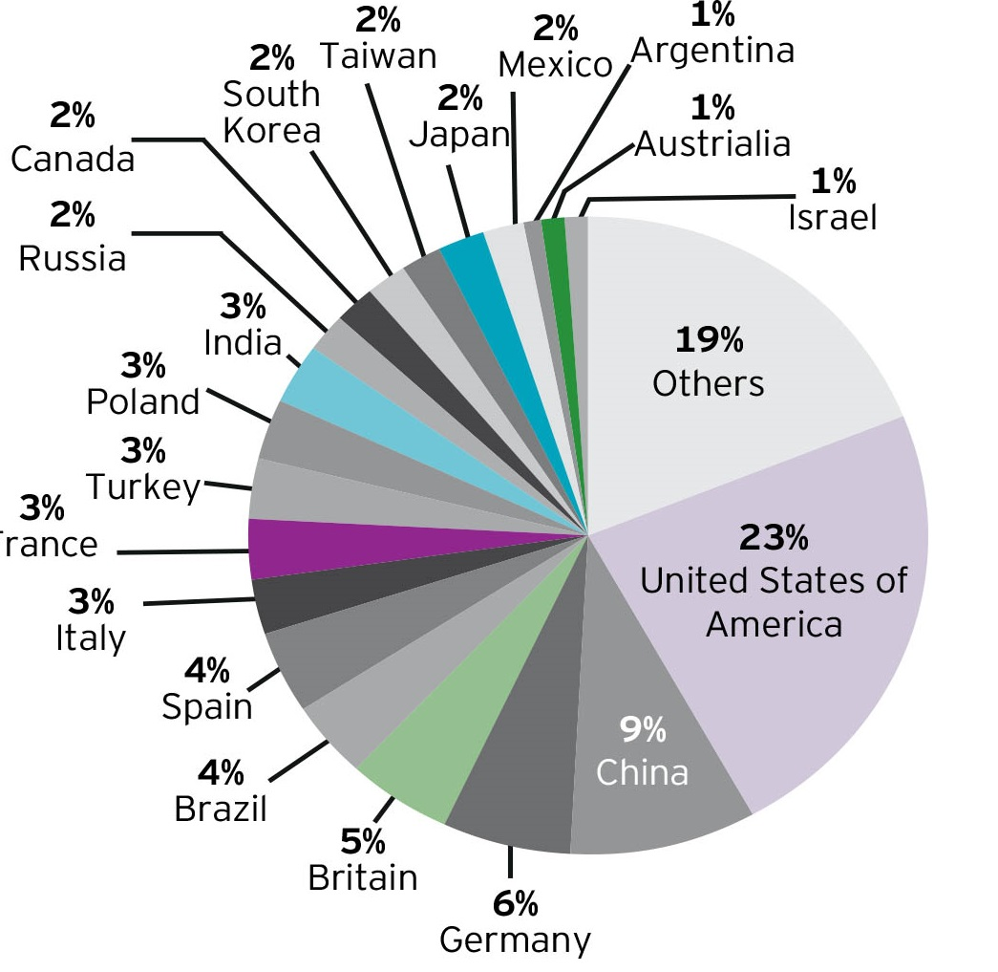
Frequently Used Cyber Crimes
➤Unauthorized access to computer systems or networks.
➤Theft of information contained in electronic form.
➤Email bombing.
➤ Salami attacks.
➤Denial of Service attack.

