Slide 1
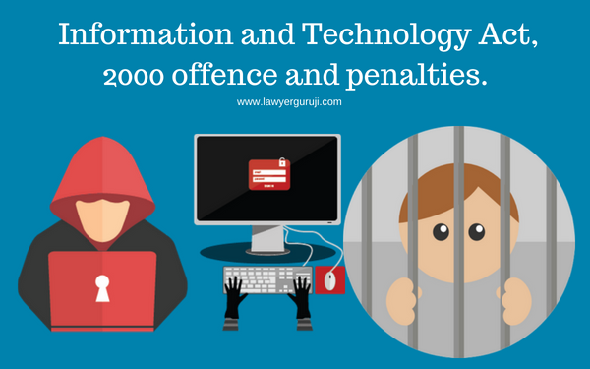
For every lock there is someone out there trying to break in.
IT ACT(Information Technology Act)
Pramod Mahajan – October 2000
Legalize e-commerce(digital governance,e-mail)
Prevent cybercrime
94 sections ->13 chapters

Slide 2
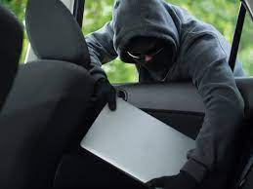


2008 - Updated→IT(Amendment) Act [ITAA]
Section 66A:
Cyber Stalking - Offensive messages
Imprisonment upto 3 years and a huge fine
Section 66B:
Receiving stolen computer/device dishonestly
Imprisonment upto 3 years or 1 lakh fine
Section 66C:
Identity theft - passwords
3 years of imprisonment along with fine
Section 66D:
Internet Fraud - deception, wrong information into trap victims for money(misusing computer resources)
Imprisonment for 3 years or fine of 1 lakh

Slide 3

Section 66E:
Violation of privacy of an individual
Imprisonment for 3 years and fine upto 1 lakh
Section 66F:
Act of cyber terrorism
Imprisonment upto life
Section 67B:
Child pornography
Imprisonment upto 5 years with 10 lakhs fine
Section 67A:
Publishining / transmitting sexually explicit contents in electronic form
Imprisonment upto 5 years with 10 lakhs fine
Section 72:
Breach of confidentiality and privacy
Imprisonment upto 2 years and 1 lakh fine
Section 73:
Publishes/Spreads digital signature certificate for fraudulent purposes
Imprisonment 2 years or 1 lakh fine

Slide 4
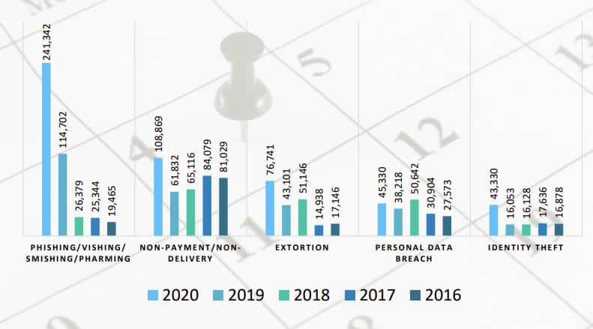

Slide 5
